Slide 1
Algorithms
Lecture #23
Dr.Sohail Aslam

Slide 2
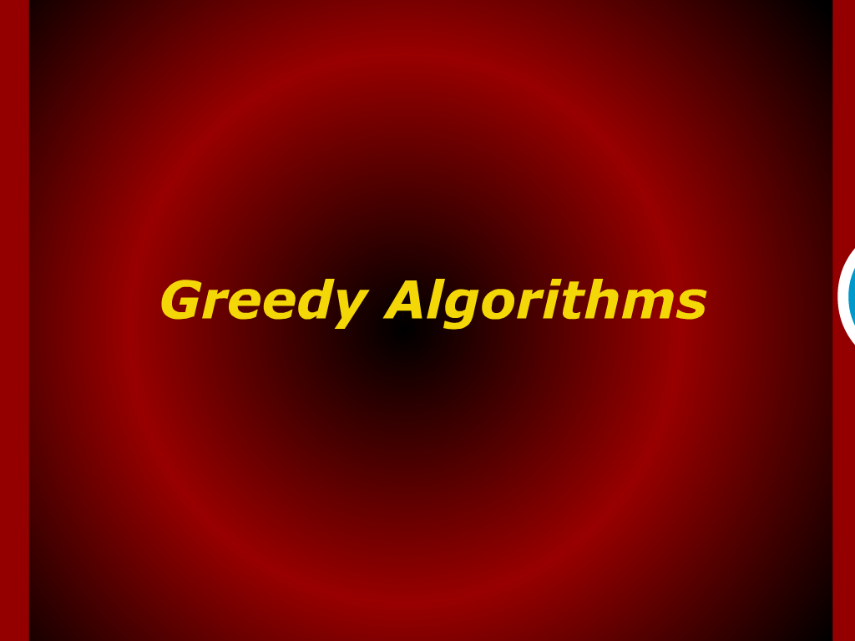
Greedy Algorithm

Slide 3
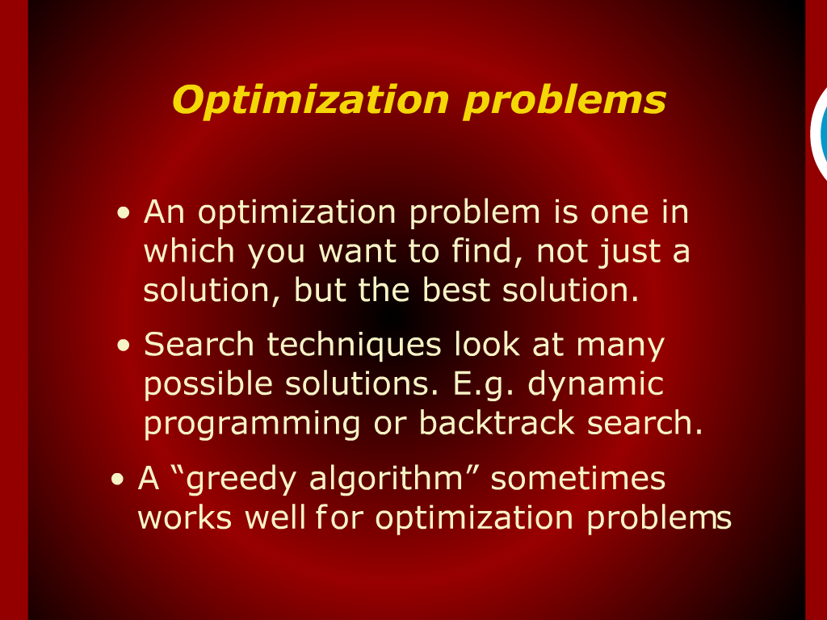
Optimization Problems

Slide 4
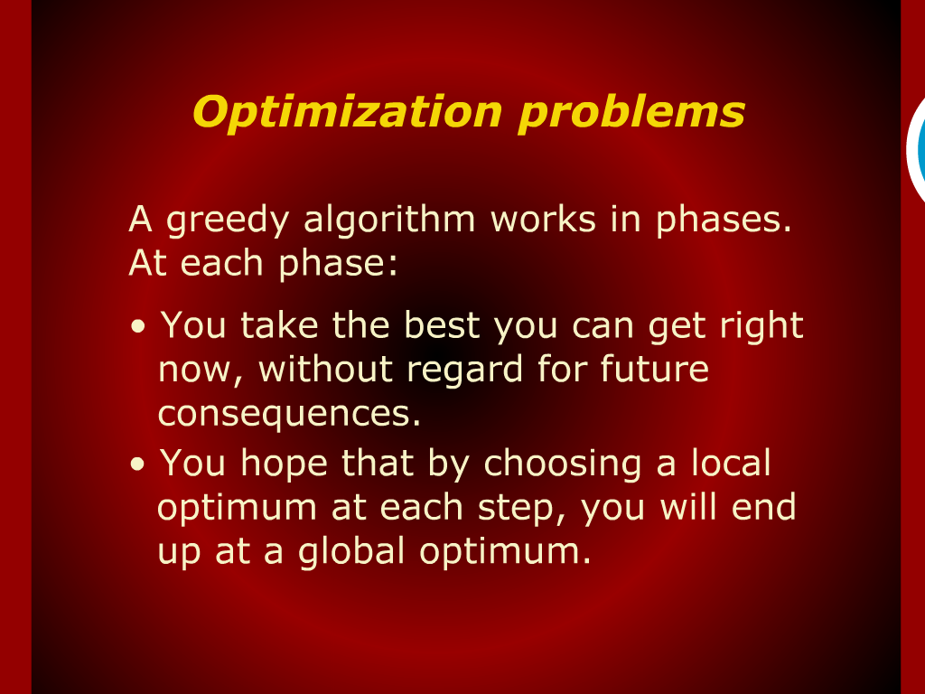
Optimization Problems

Slide 5
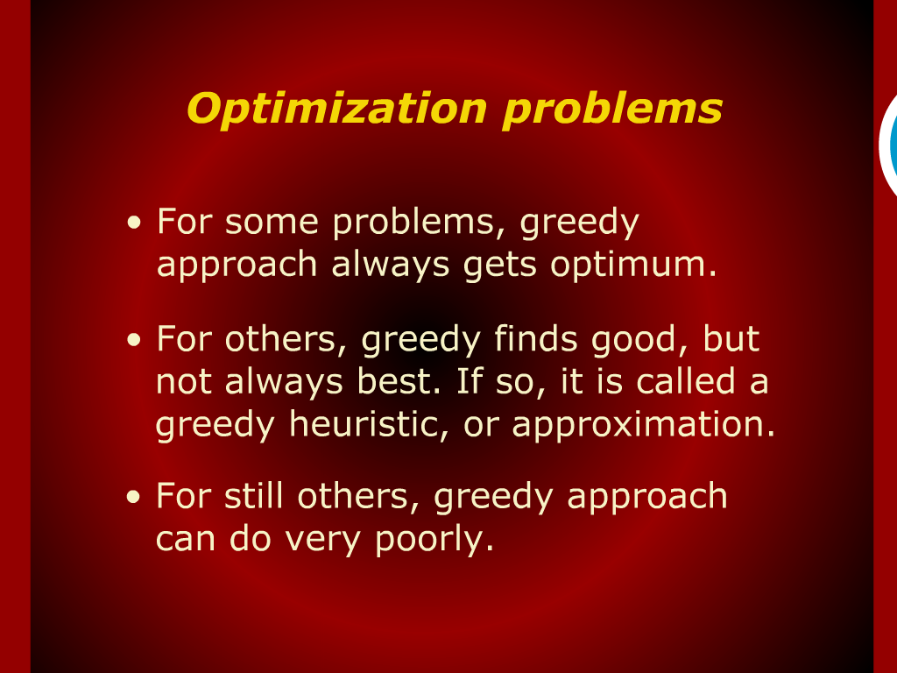
Optimization Problems

Slide 6
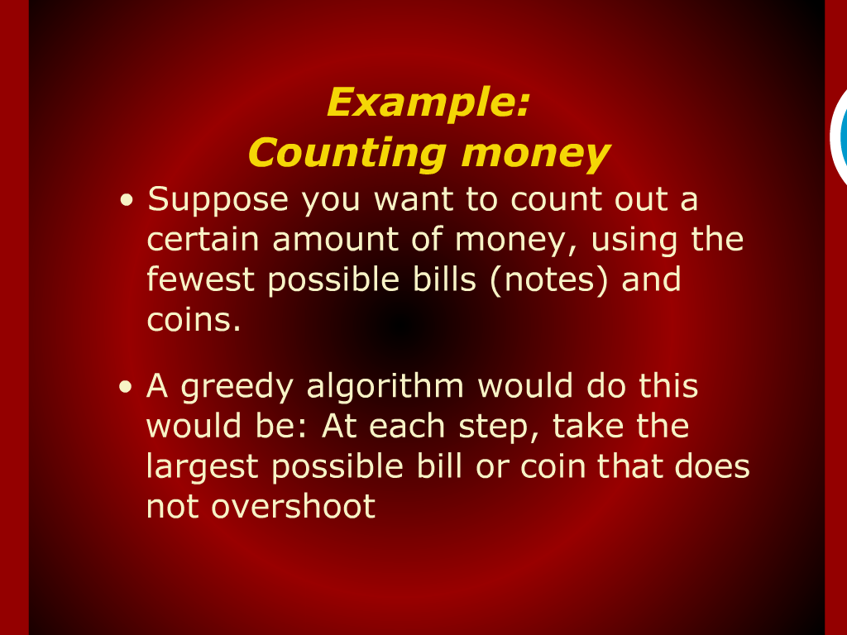
Example: Counting Money

Slide 7
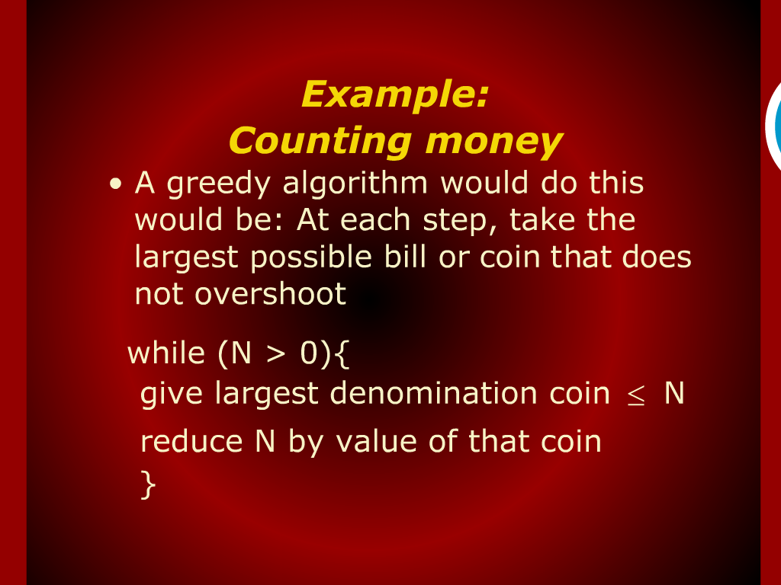
Example: Counting Money

Slide 8
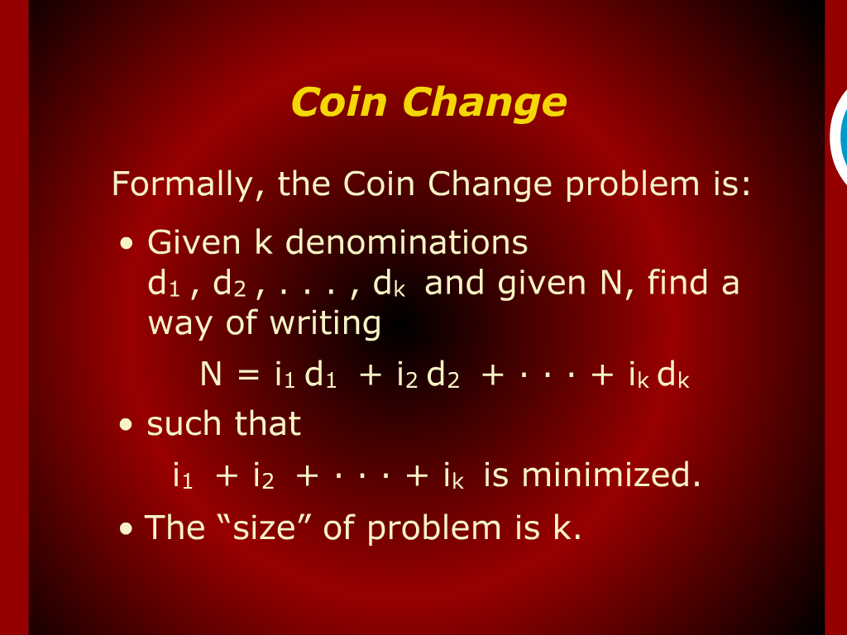
Coin Change

Slide 9
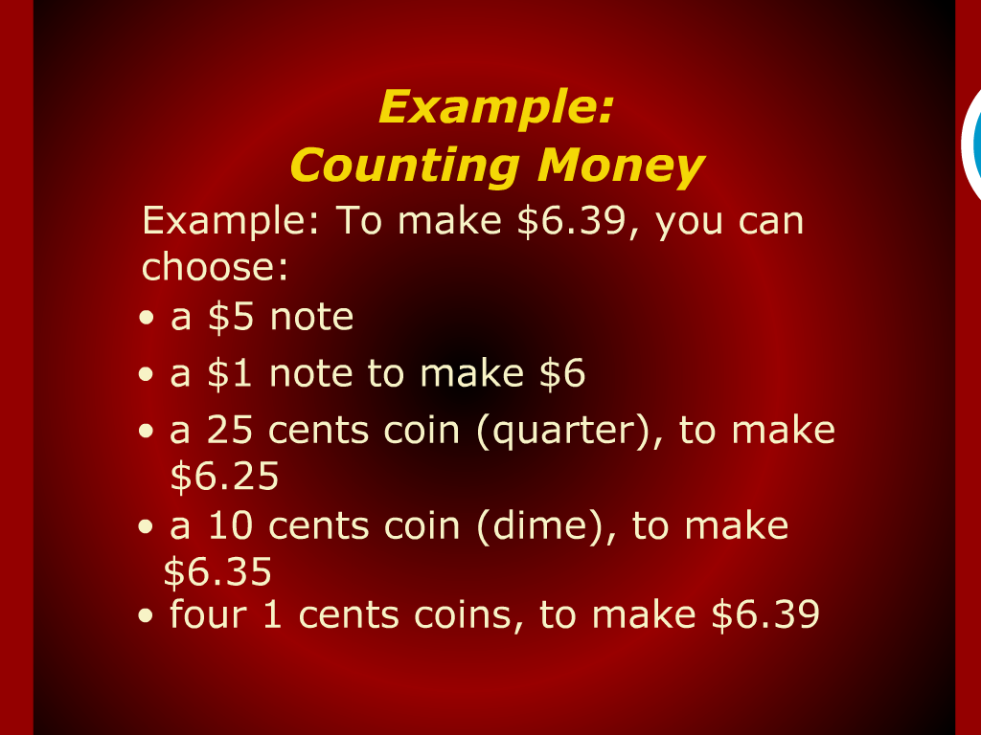
Example: Counting Money

Slide 10
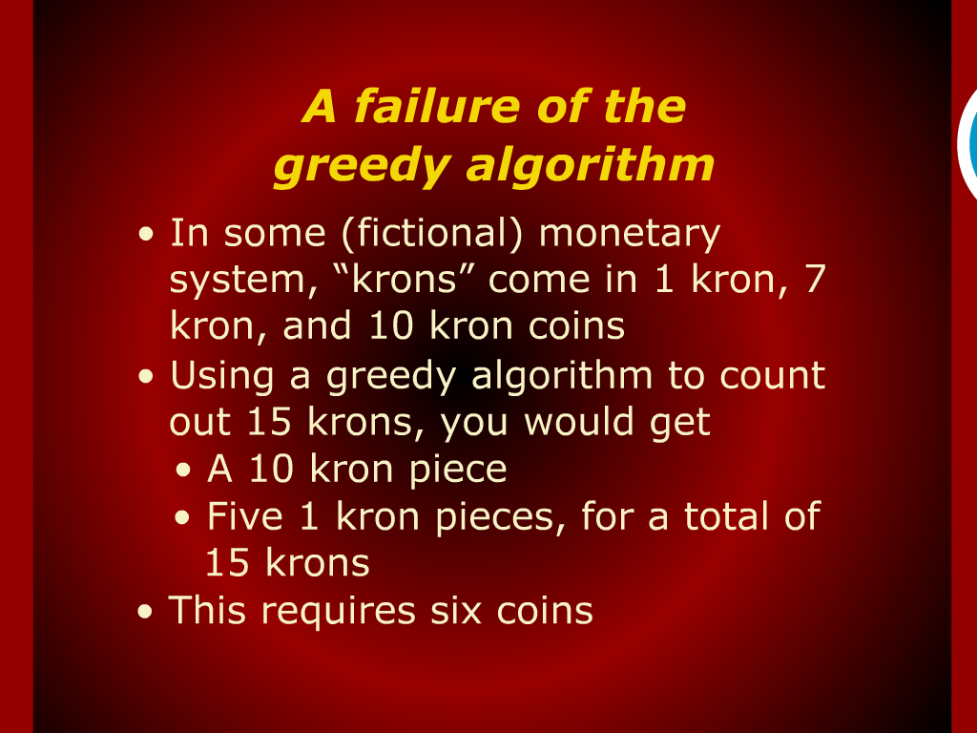
A failure of the Greedy Algorithm

Slide 11
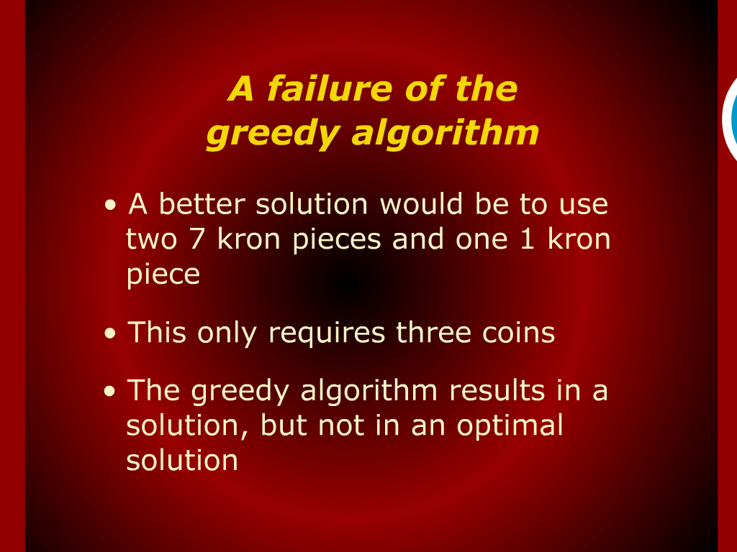
A failure of the Greedy Algorithm

Slide 12
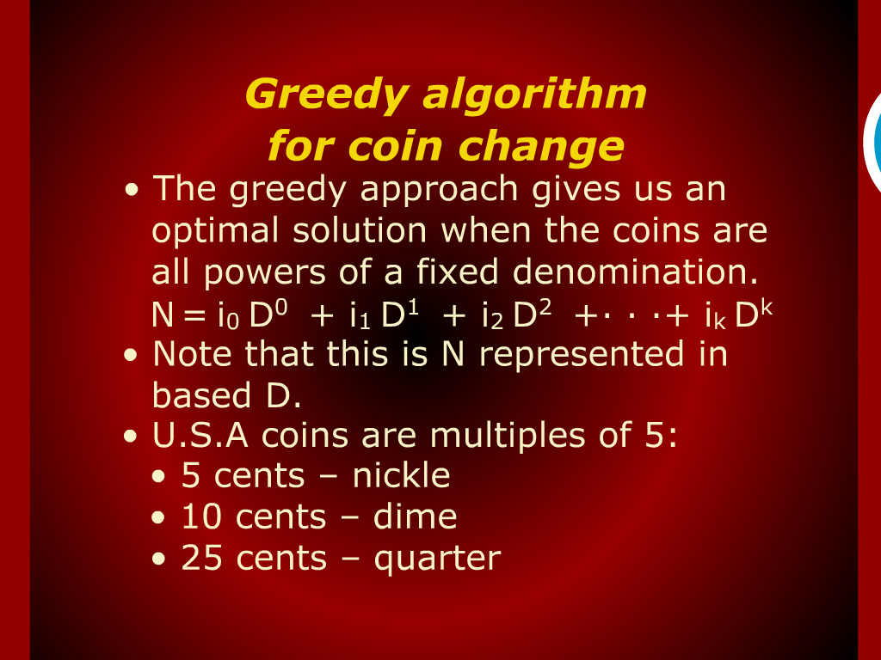
Greedy Algorithm for Coin Change

Slide 13
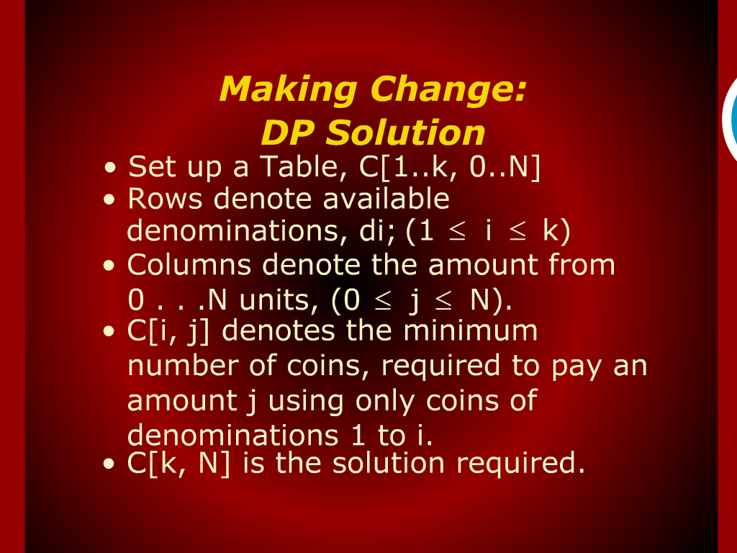
Making Change DP Solution

Slide 14
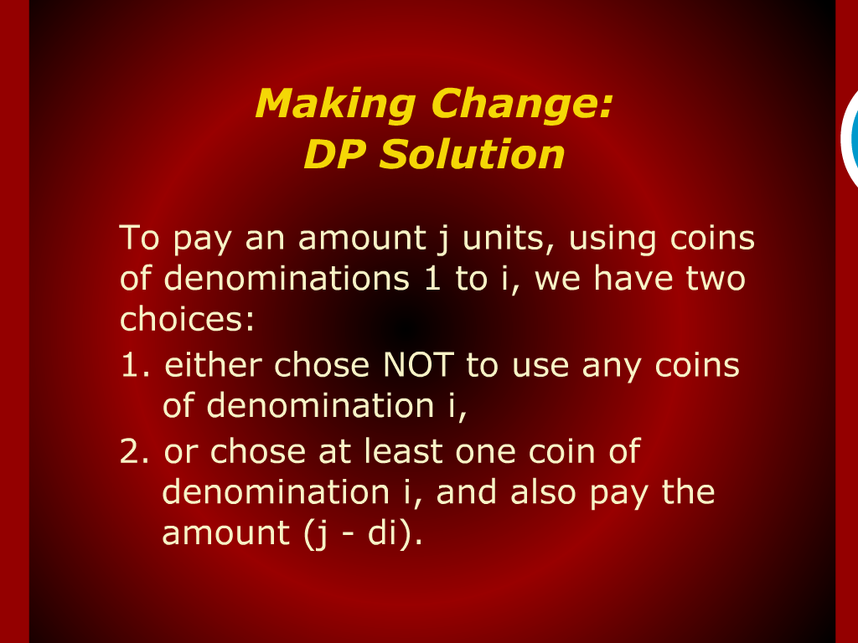
Making Change DP Solution

Slide 15
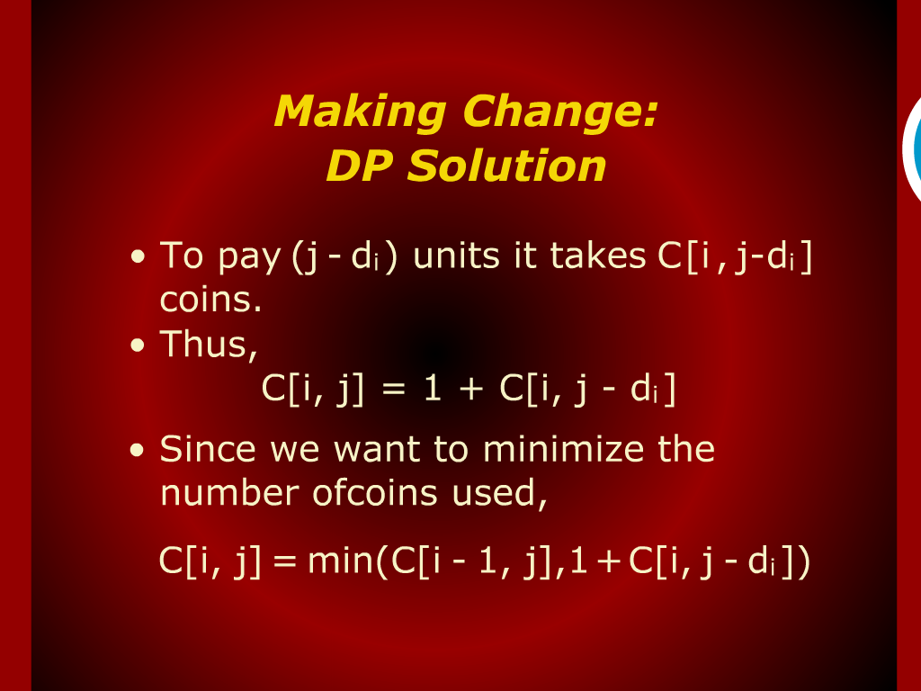
Making Change DP Solution

Slide 16
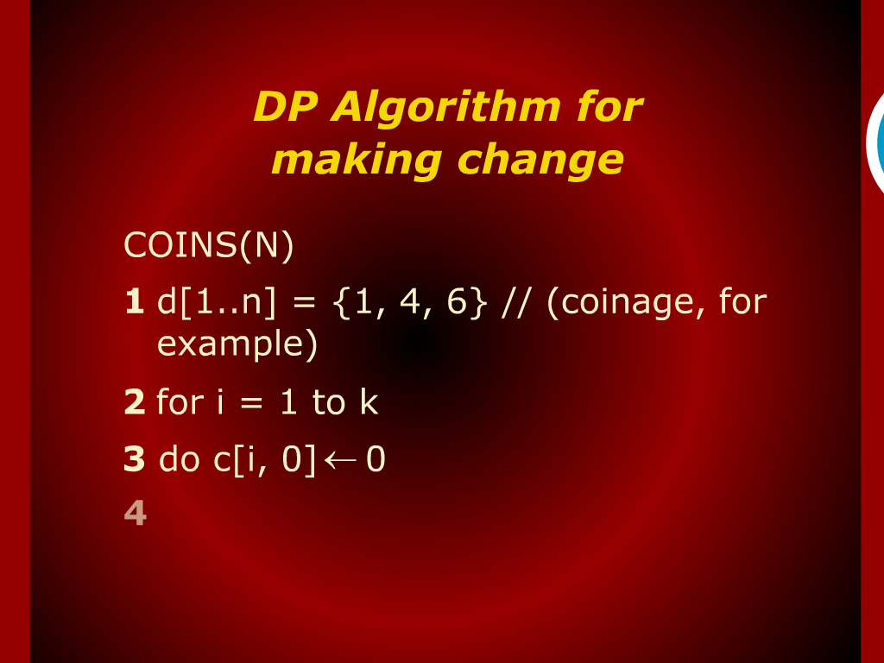
DP Algorithm for Making Change

Slide 17
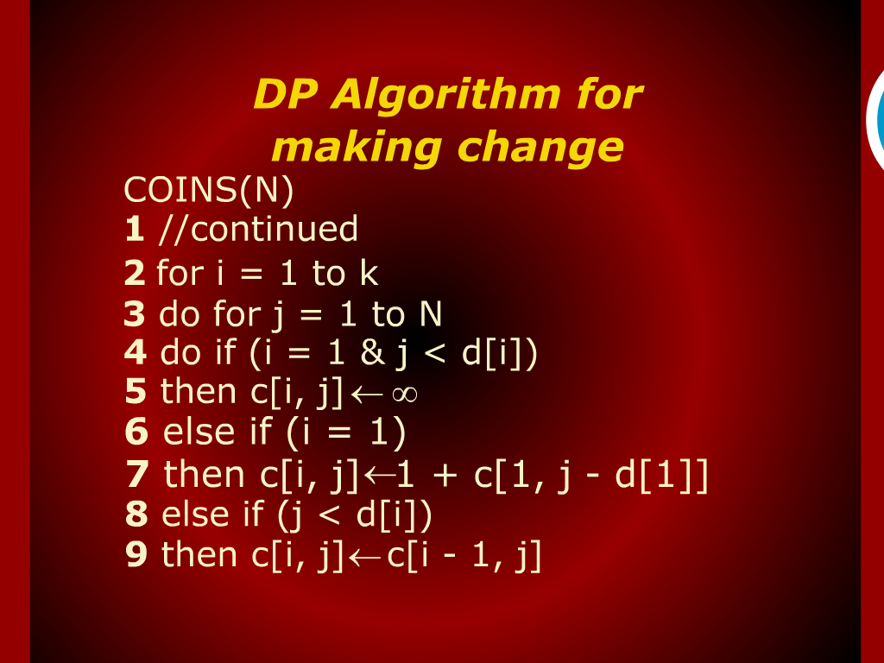
DP Algorithm for Making Change

Slide 18
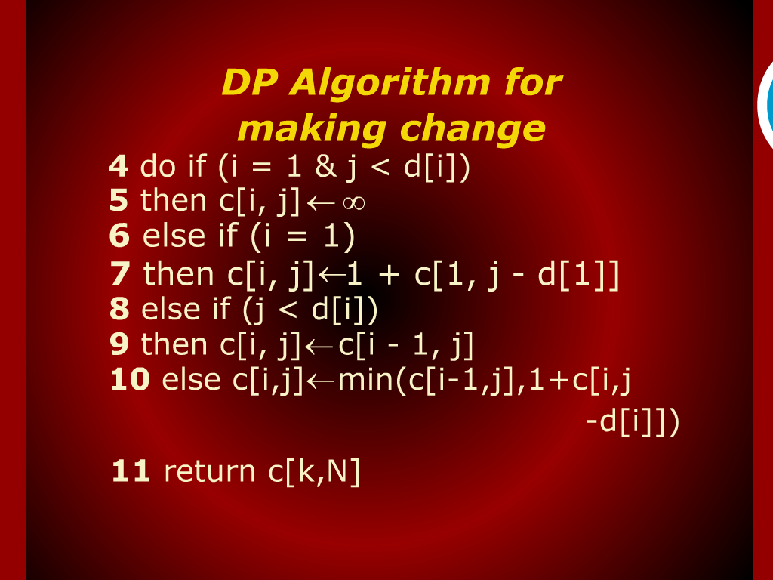
DP Algorithm for Making Change

Slide 19
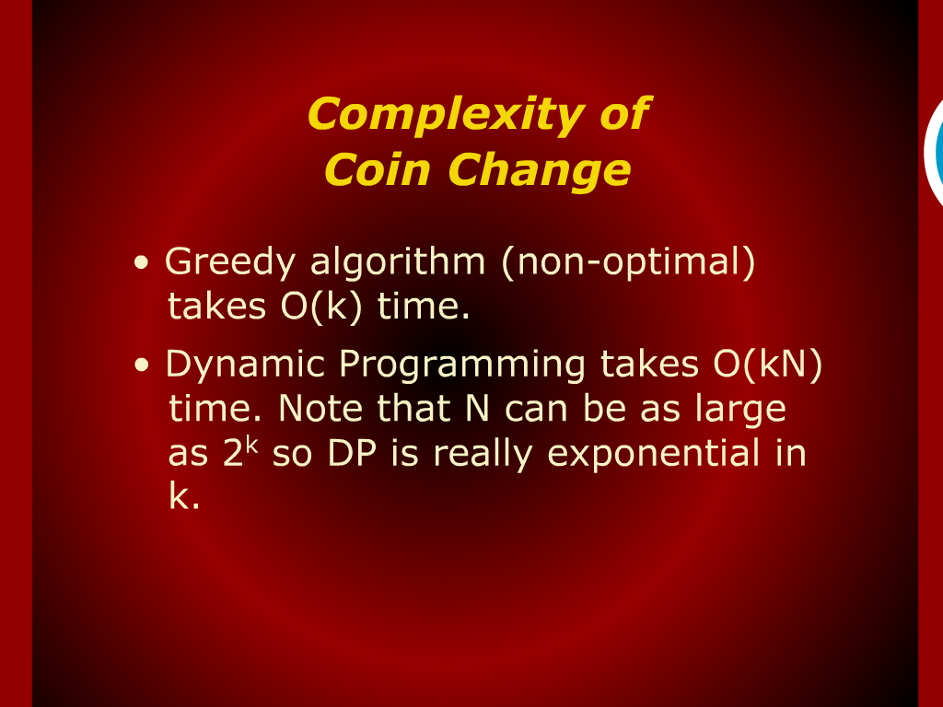
Complexity of Coin Change

Slide 20
Coin Change

Slide 21
Design and Analysis
of
Algorithms

