Slide 1
Algorithms
Lecture #24
Dr.Sohail Aslam

Slide 2
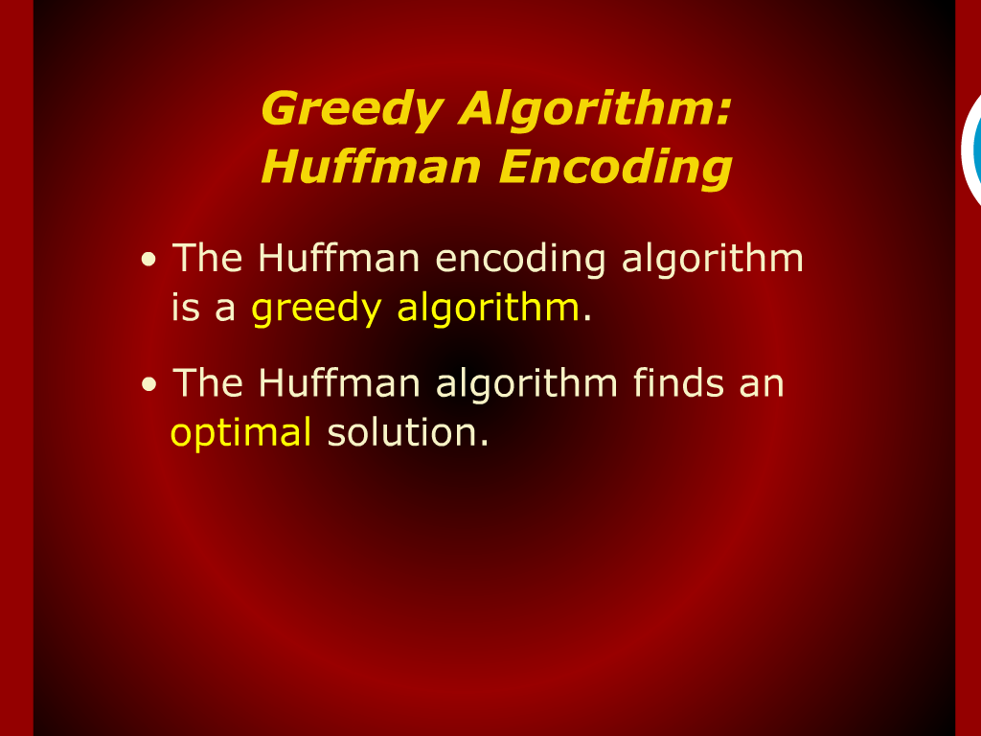
Greedy Algorithm: Huffman Encoding

Slide 3
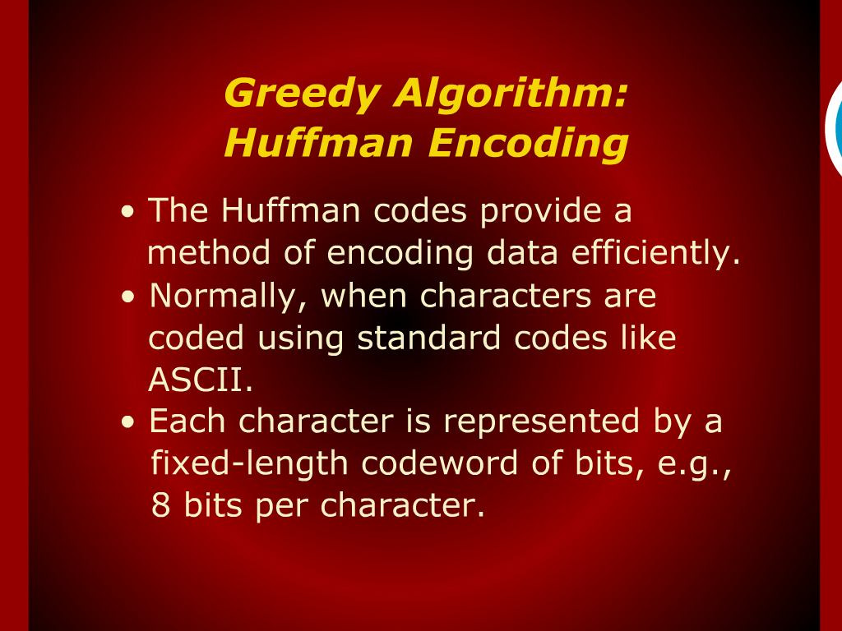
Greedy Algorithm: Huffman Encoding

Slide 4
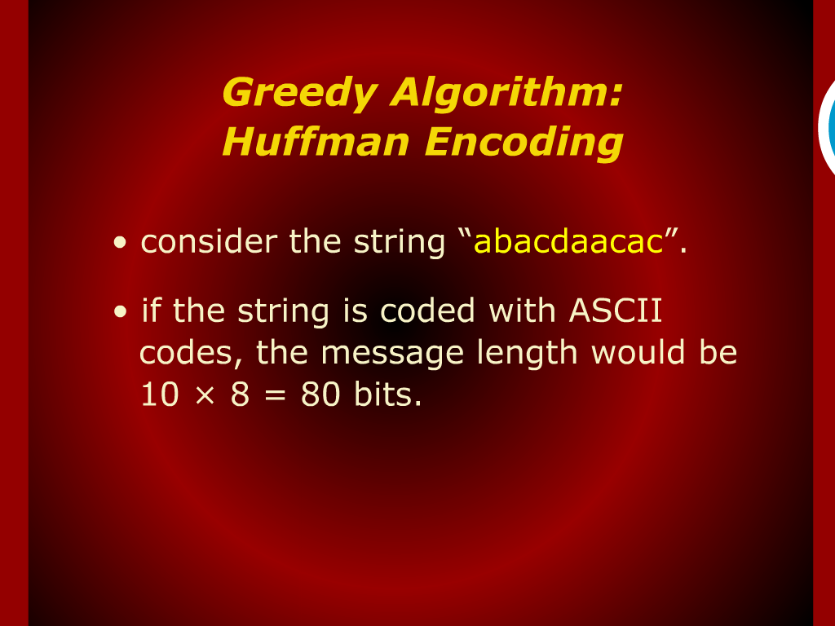
Greedy Algorithm: Huffman Encoding

Slide 5
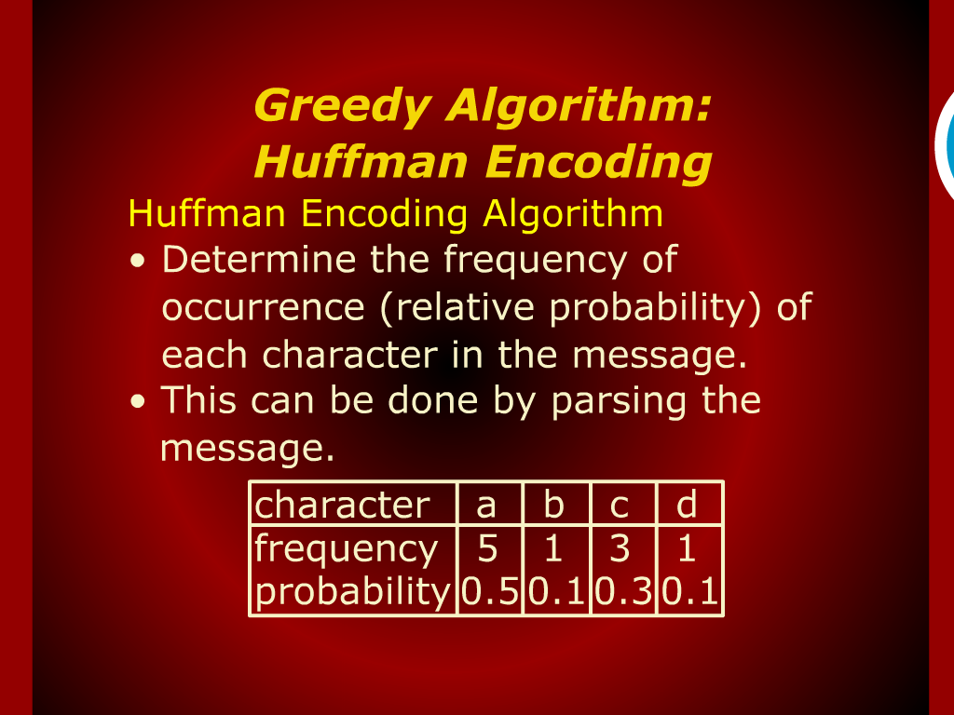
Greedy Algorithm: Huffman Encoding

Slide 6
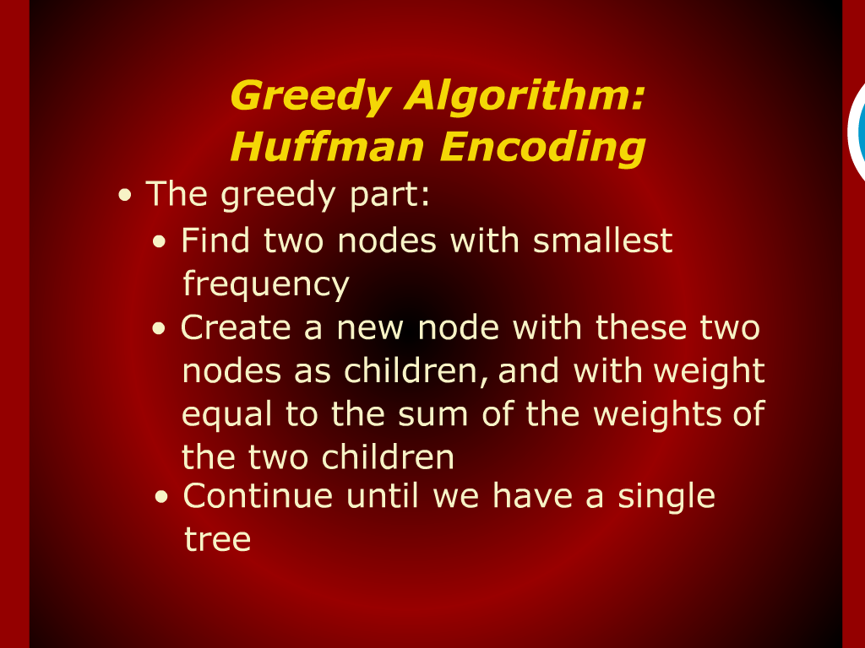
Greedy Algorithm: Huffman Encoding

Slide 7
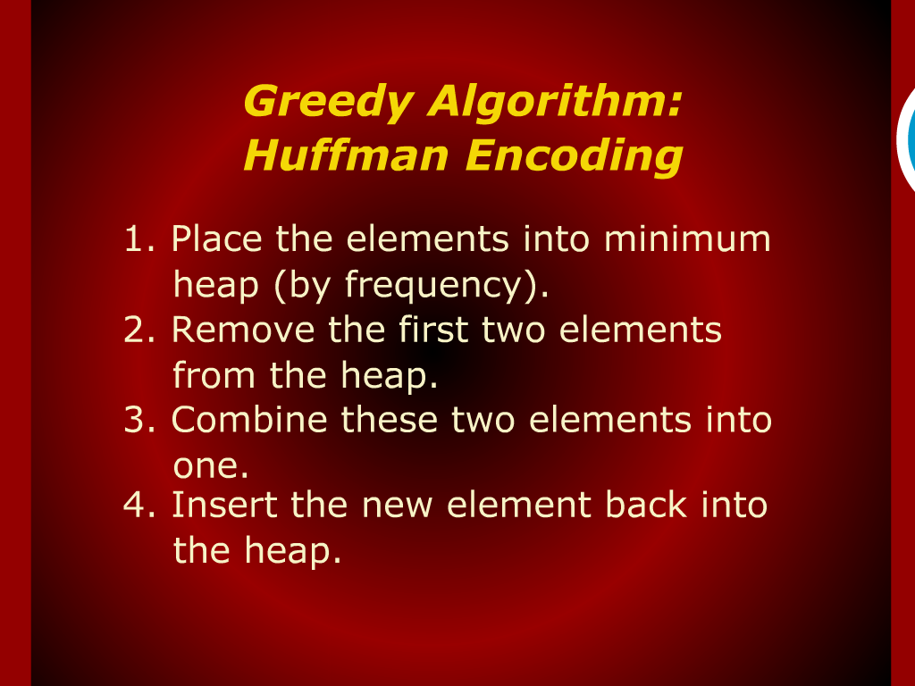
Greedy Algorithm: Huffman Encoding

Slide 8
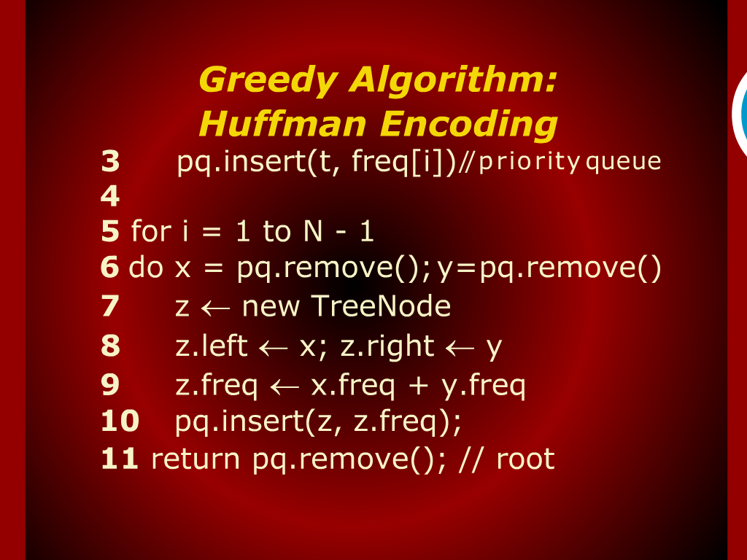
Greedy Algorithm: Huffman Encoding

Slide 9
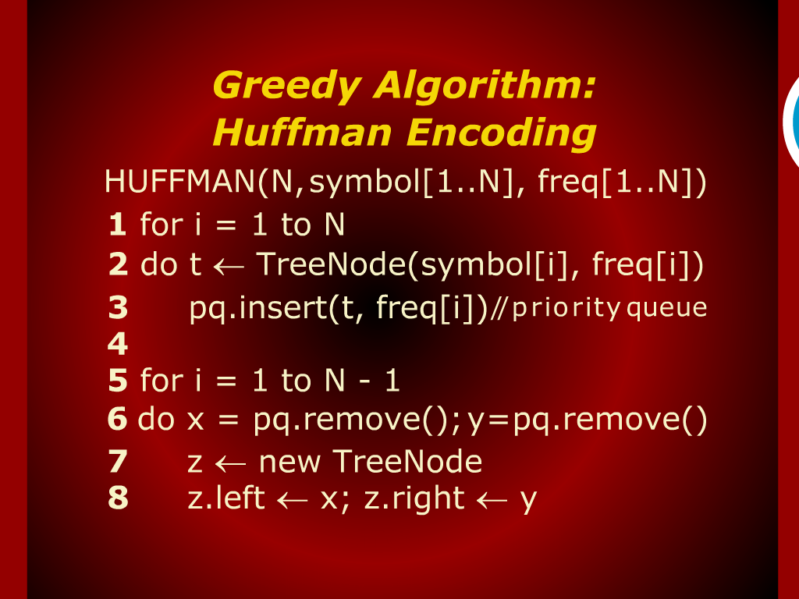
Greedy Algorithm: Huffman Encoding

Slide 10
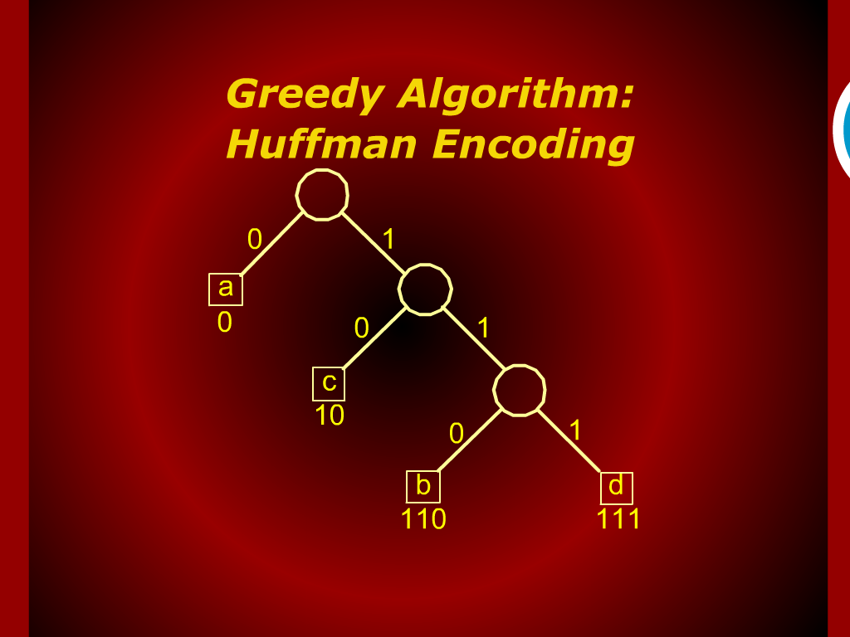
Greedy Algorithm: Huffman Encoding

Slide 11
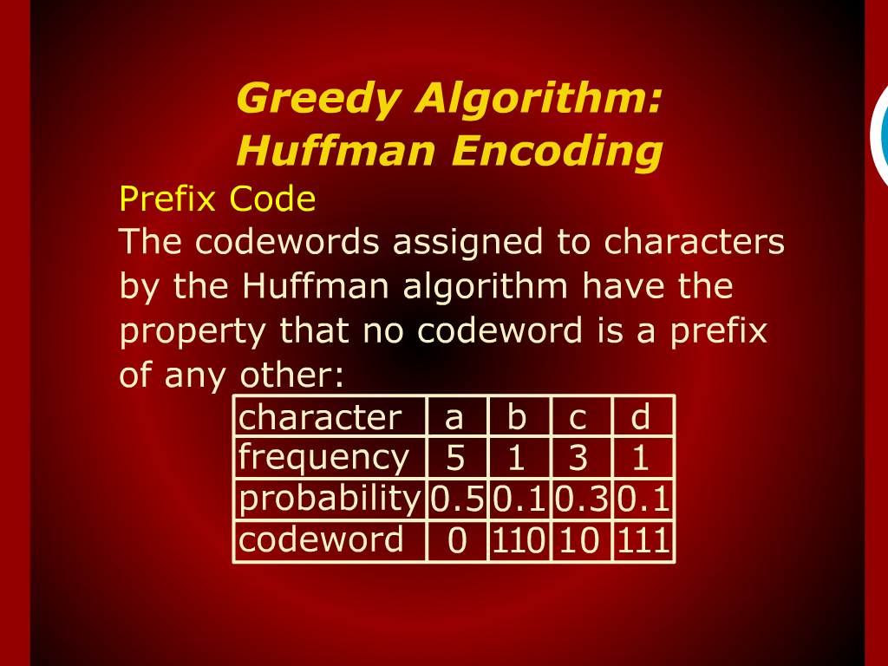
Greedy Algorithm: Huffman Encoding

Slide 12
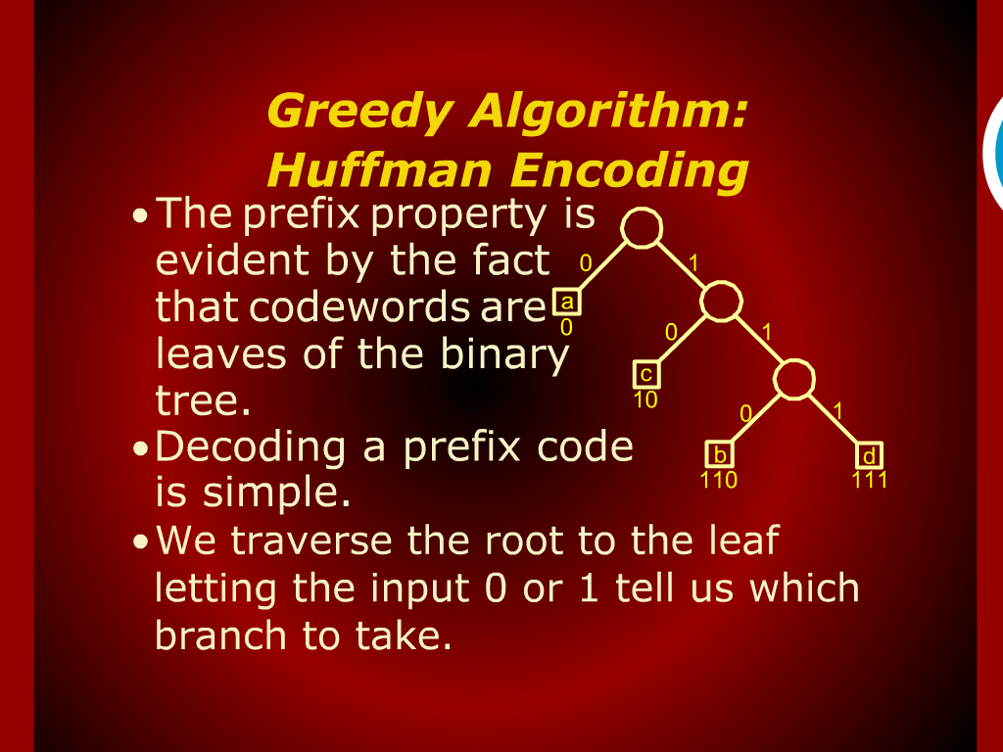
Greedy Algorithm: Huffman Encoding

Slide 13
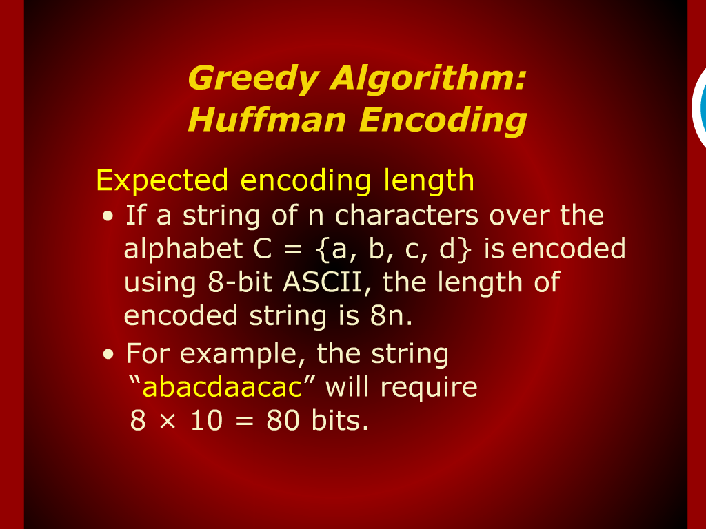
Greedy Algorithm: Huffman Encoding

Slide 14
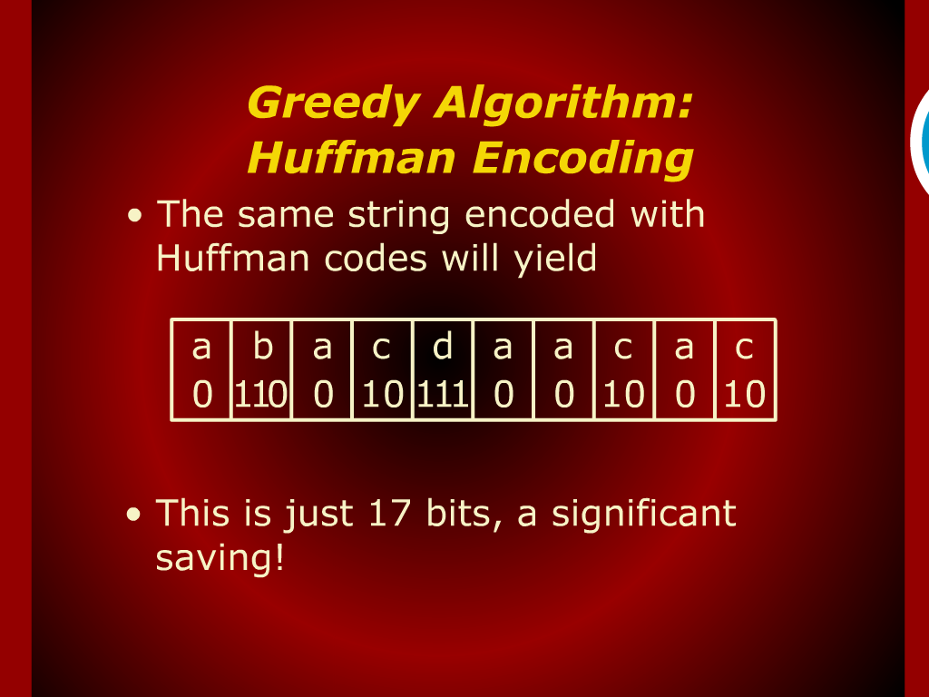
Greedy Algorithm: Huffman Encoding

Slide 15
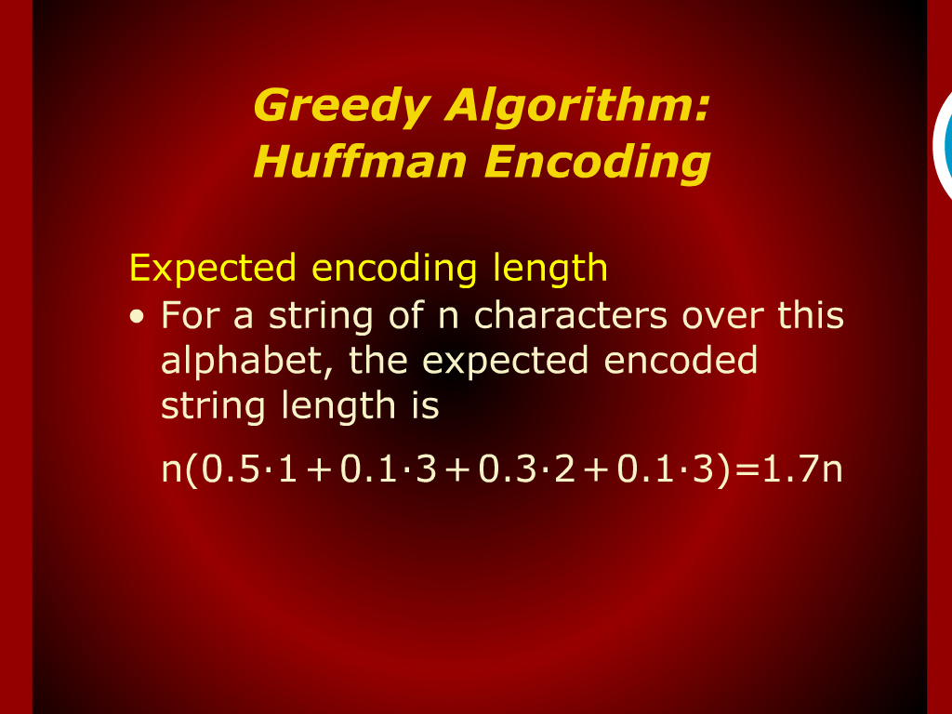
Greedy Algorithm: Huffman Encoding

Slide 16
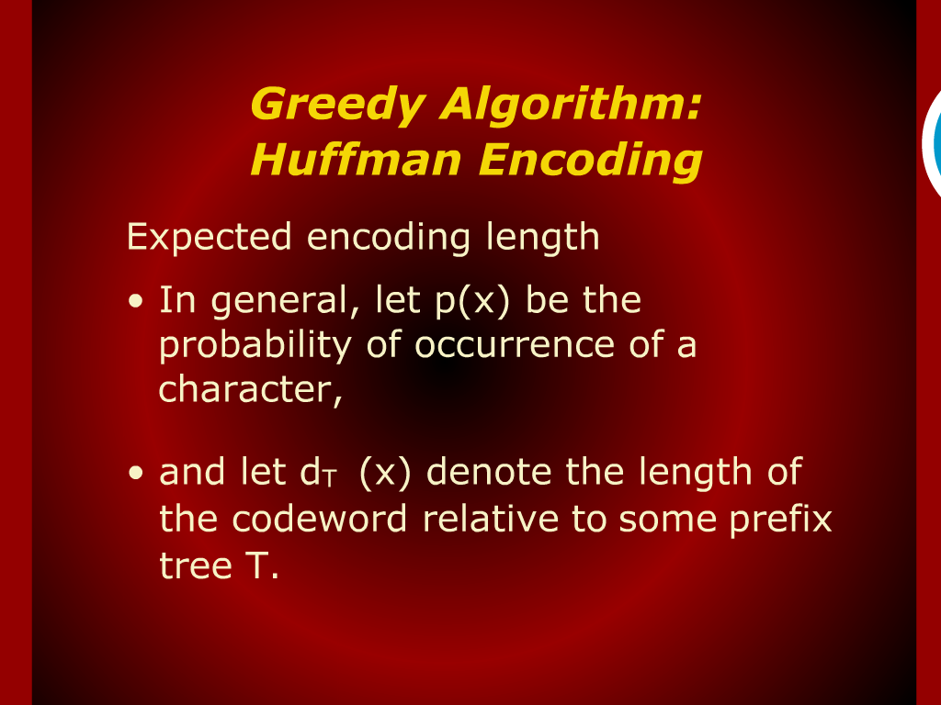
Greedy Algorithm: Huffman Encoding

Slide 17
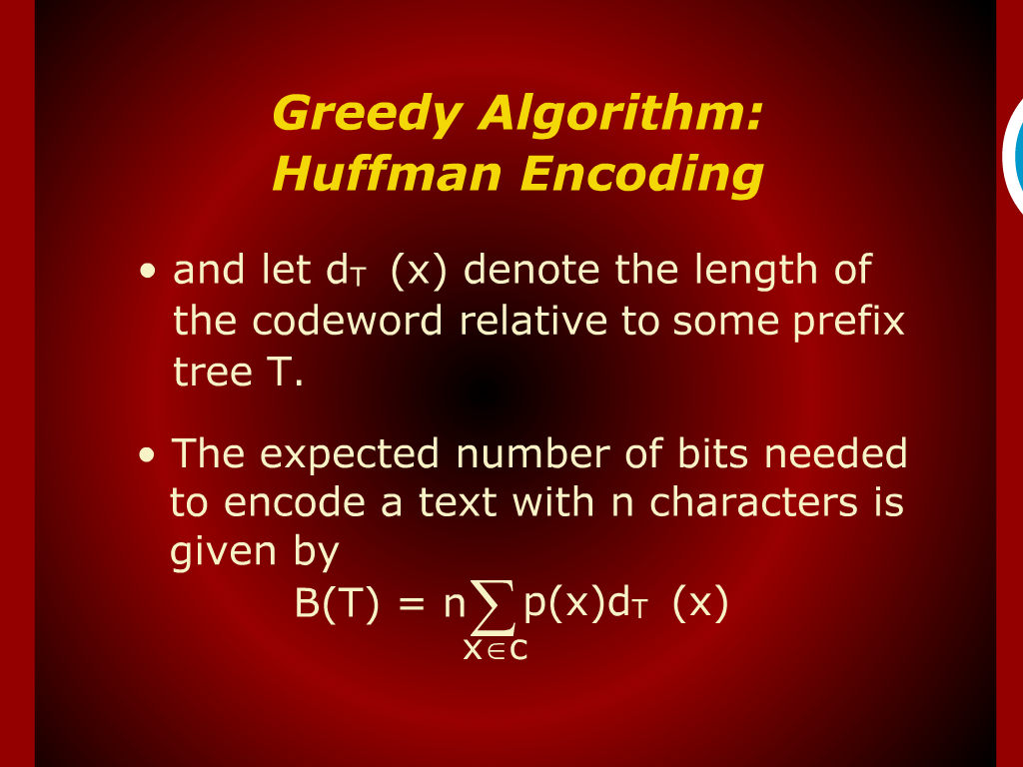
Greedy Algorithm: Huffman Encoding

Slide 18
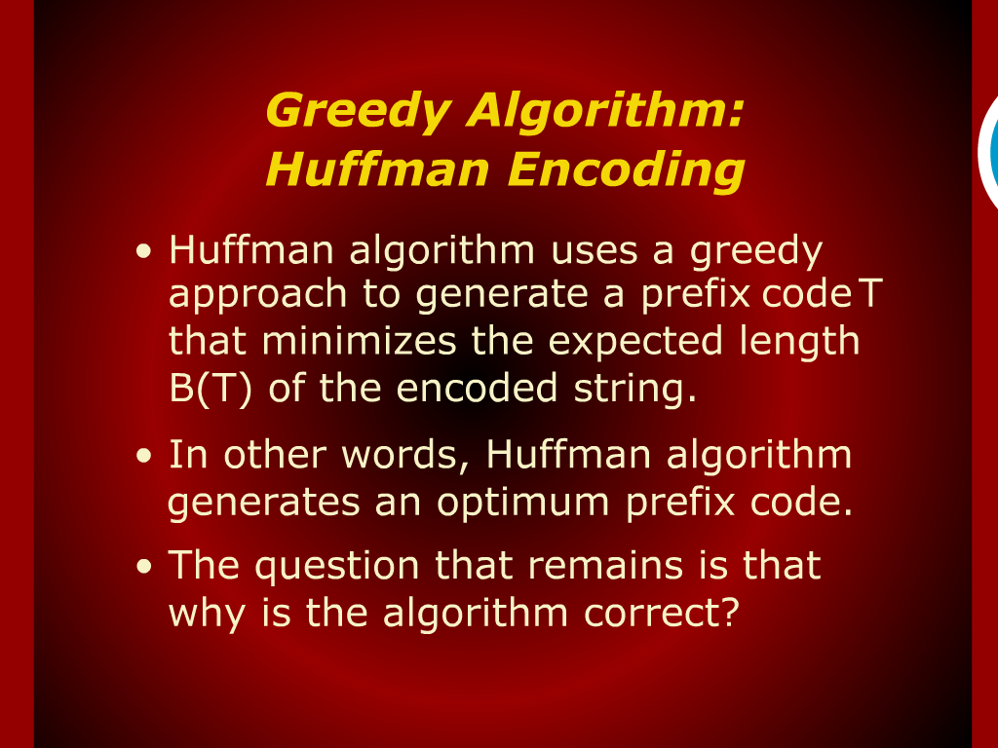
Greedy Algorithm: Huffman Encoding

Slide 19
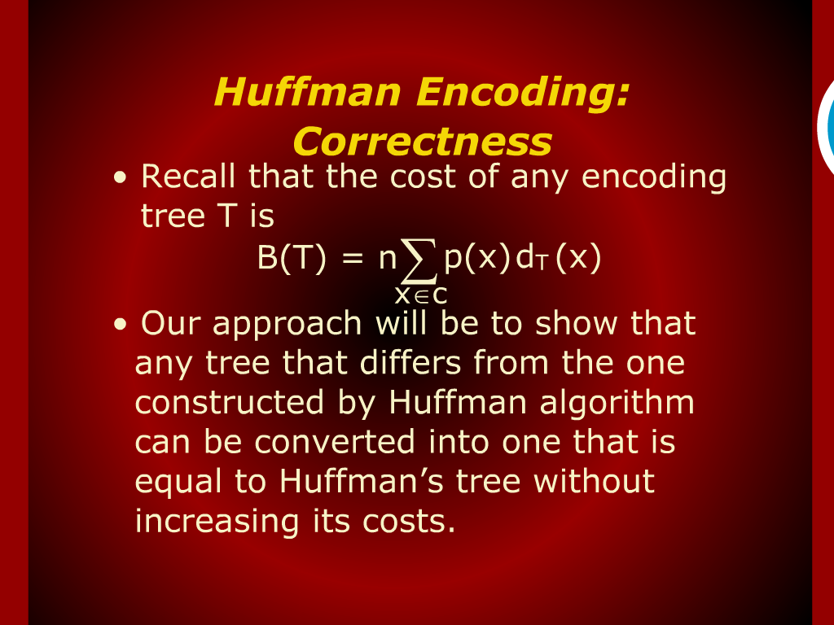
Huffman Encoding: Correctness

