Slide 1
Algorithms
Lecture # 25
Dr. Sohail Aslam

Slide 2
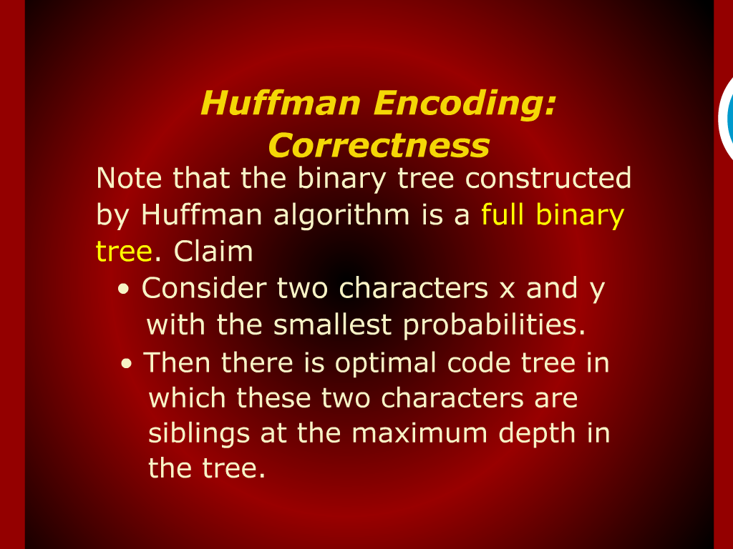
Huffman Encoding: Correctness

Slide 3
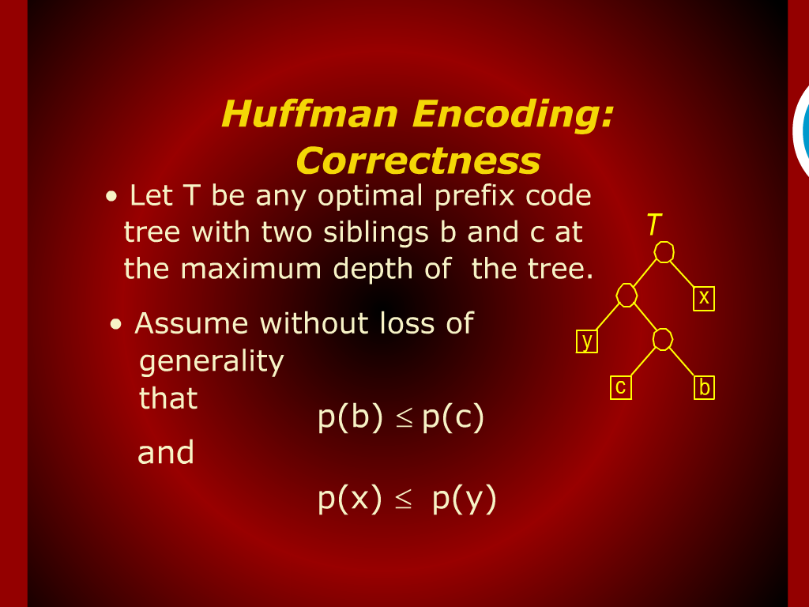
Huffman Encoding: Correctness

Slide 4
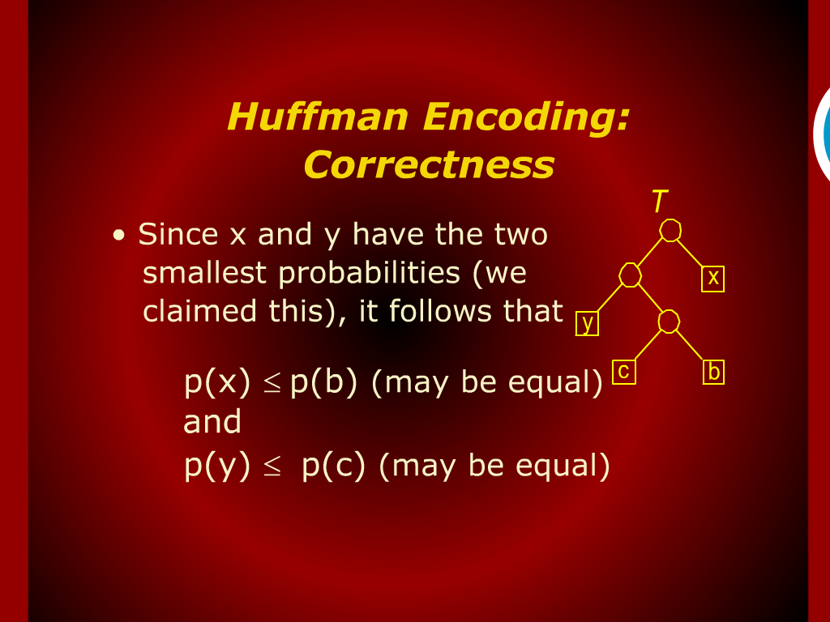
Huffman Encoding: Correctness

Slide 5
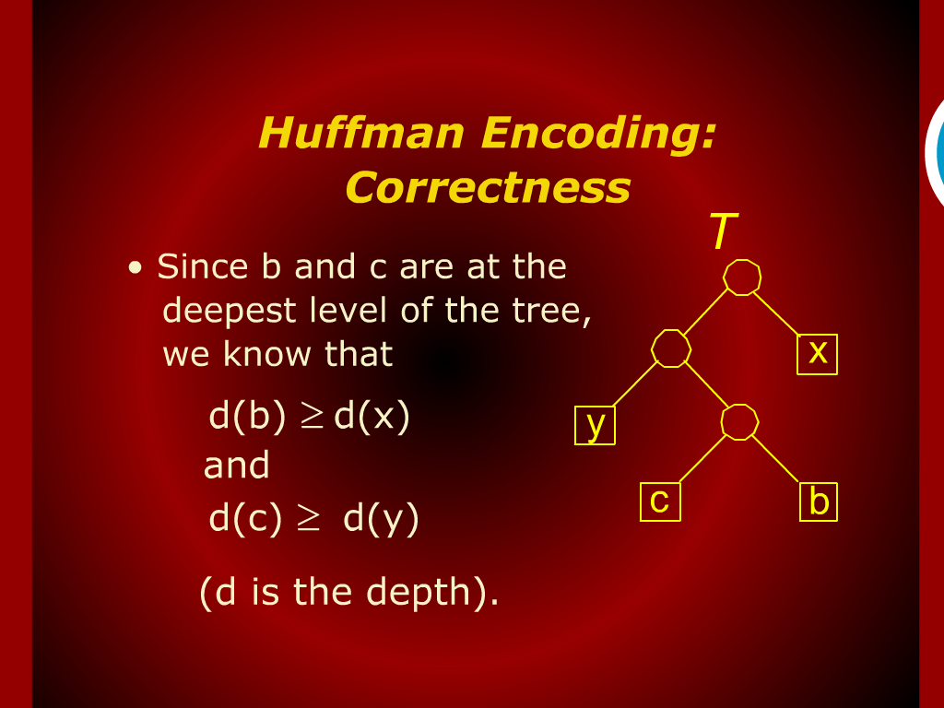
Huffman Encoding: Correctness

Slide 6
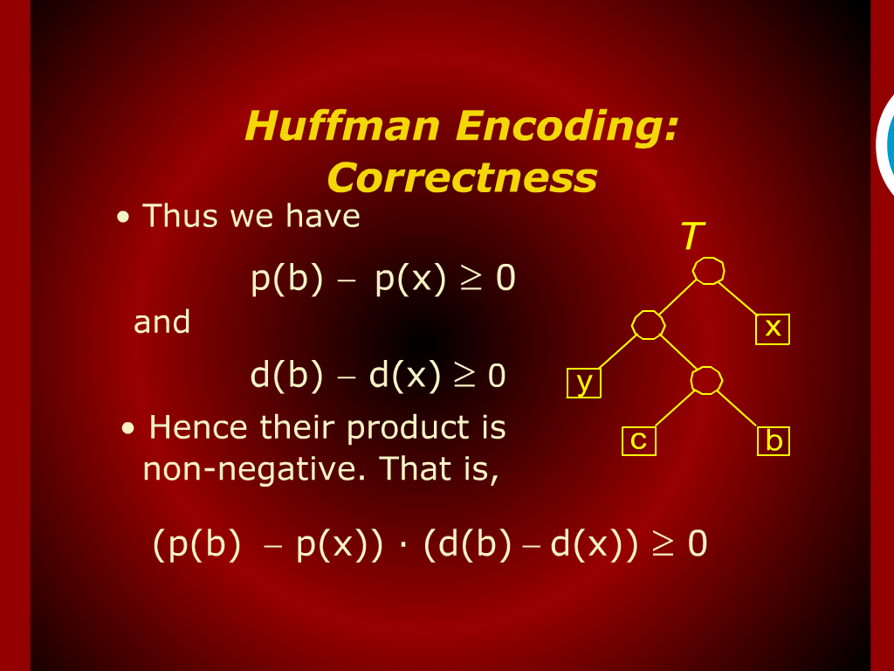
Huffman Encoding: Correctness

Slide 7
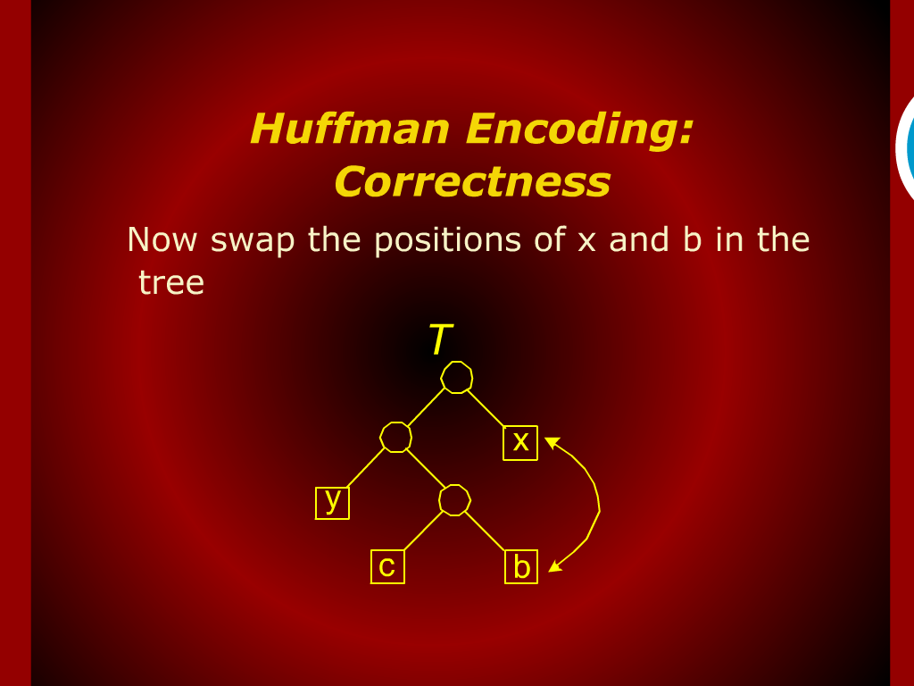
Huffman Encoding: Correctness

Slide 8
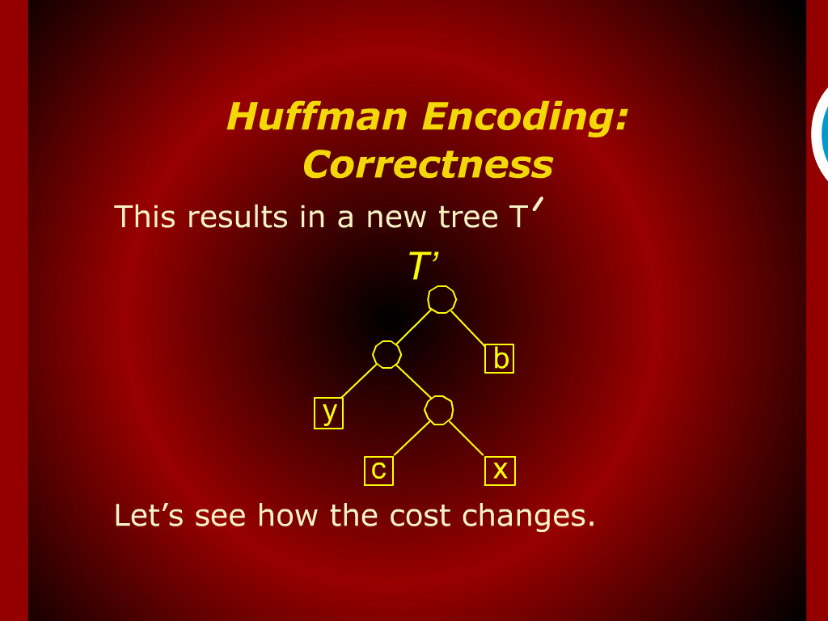
Huffman Encoding: Correctness

Slide 9
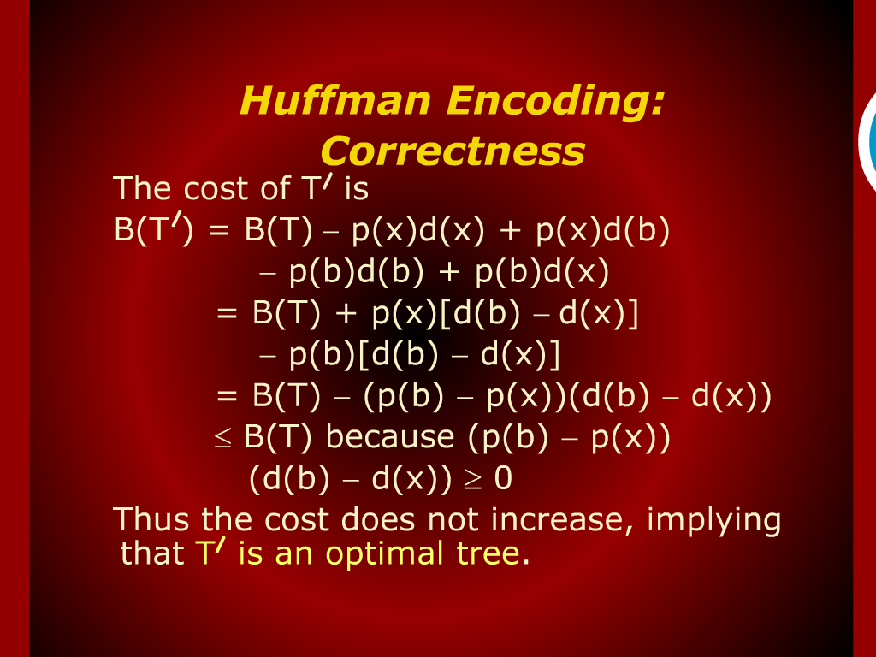
Huffman Encoding: Correctness

Slide 10
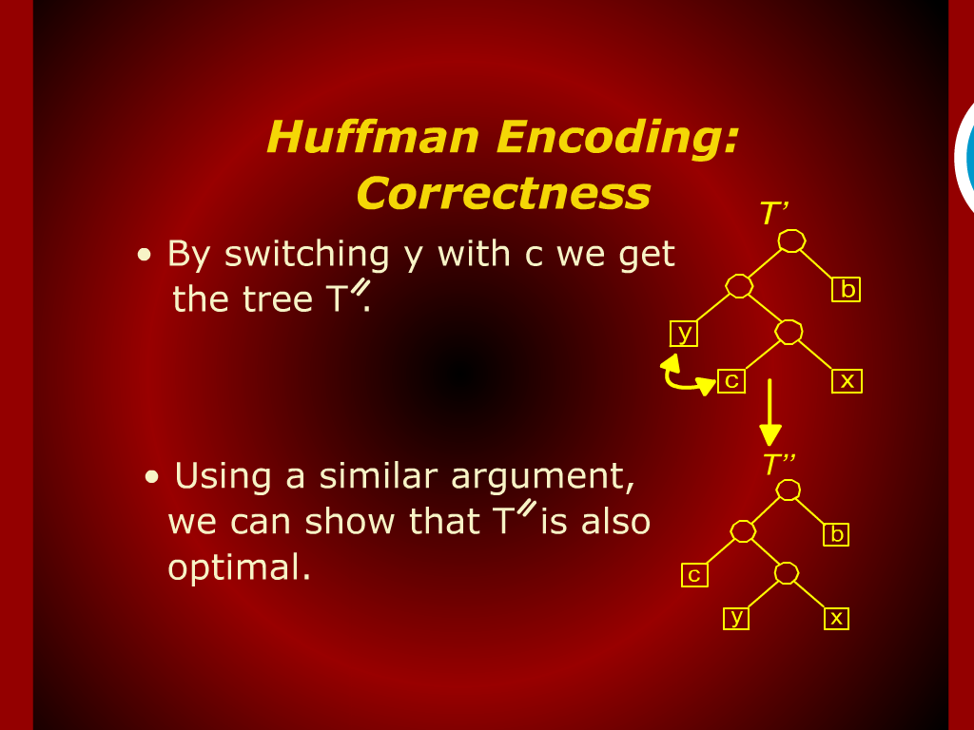
Huffman Encoding: Correctness

Slide 11
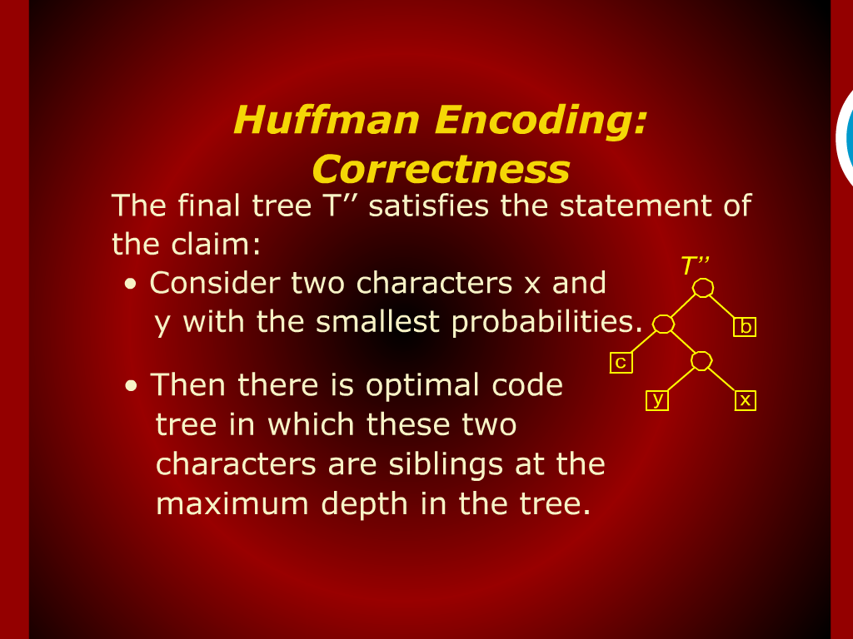
Huffman Encoding: Correctness

Slide 12
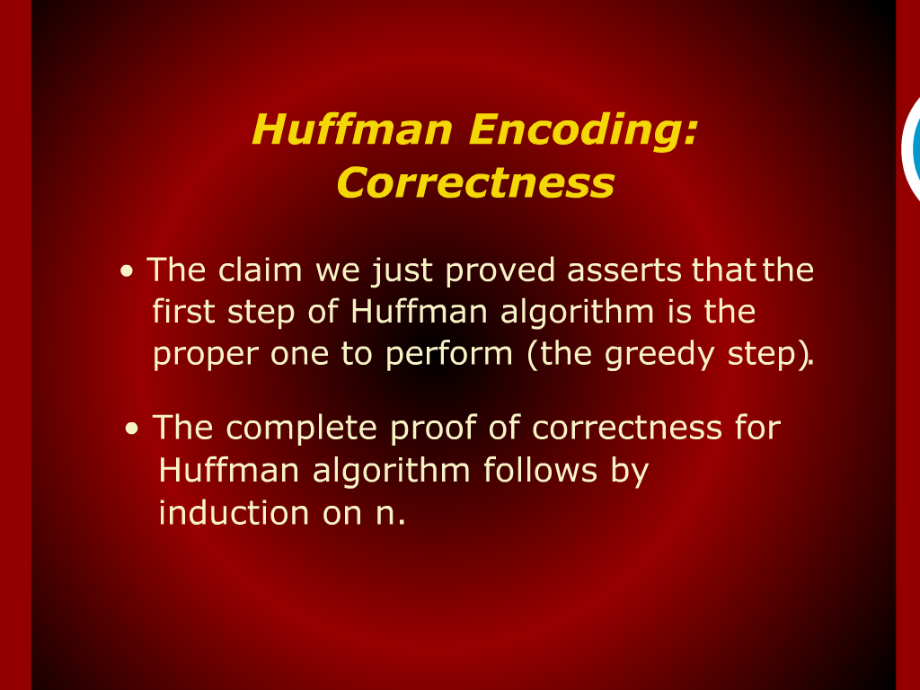
Huffman Encoding: Correctness

Slide 13
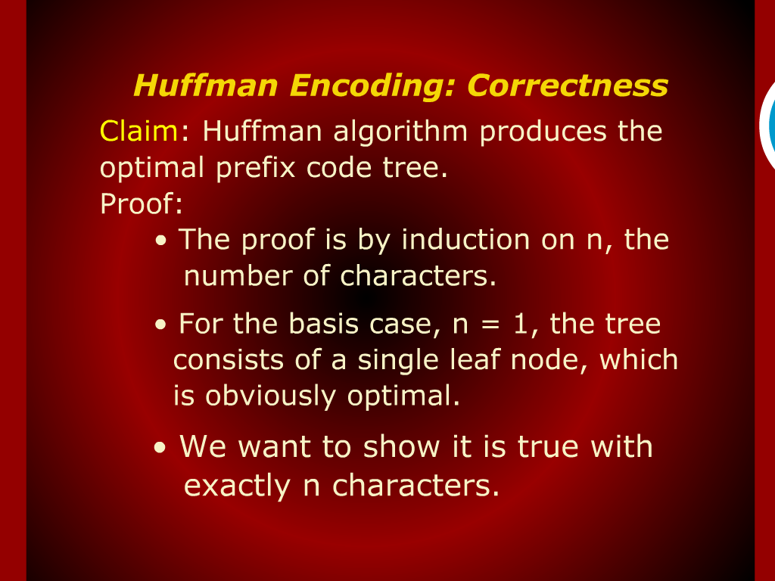
Huffman Encoding: Correctness

Slide 14
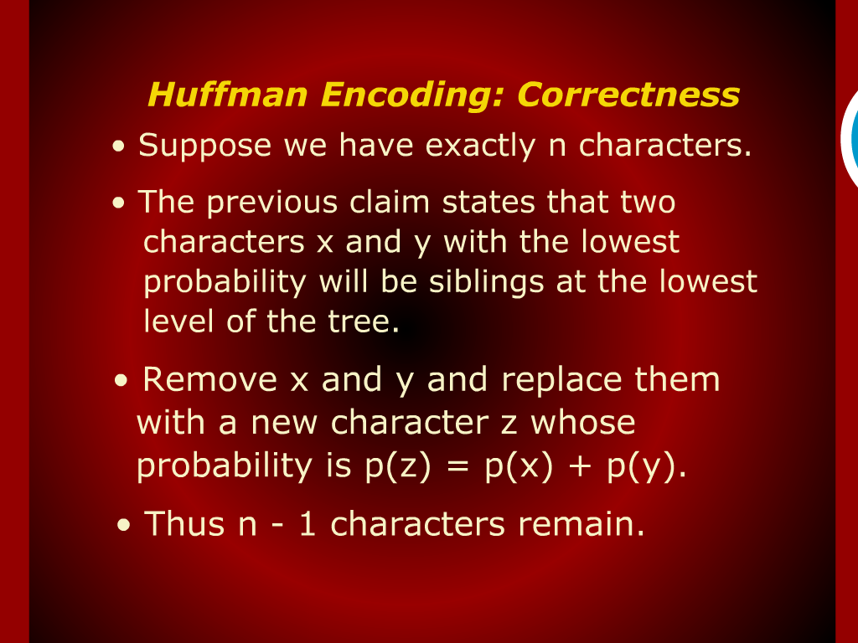
Huffman Encoding: Correctness

Slide 15
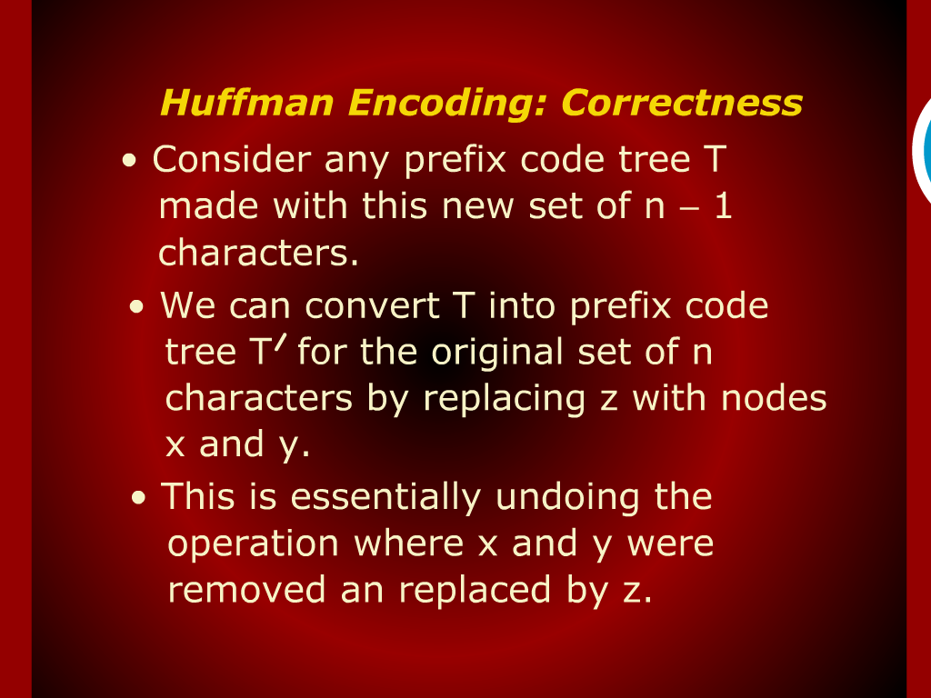
Huffman Encoding: Correctness

Slide 16
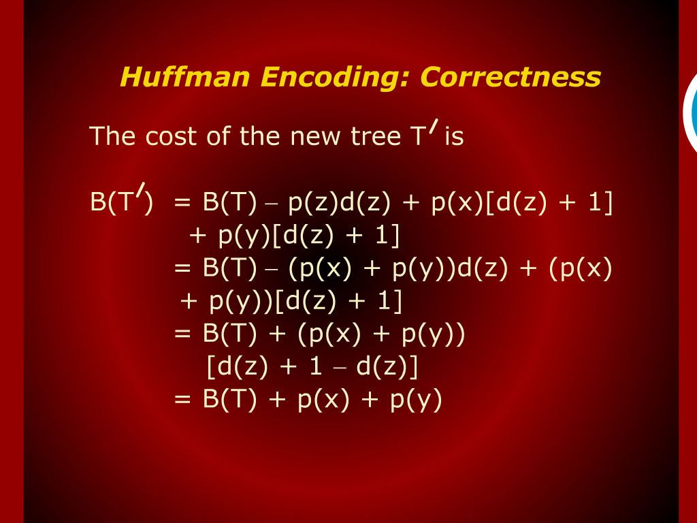
Huffman Encoding: Correctness

Slide 17
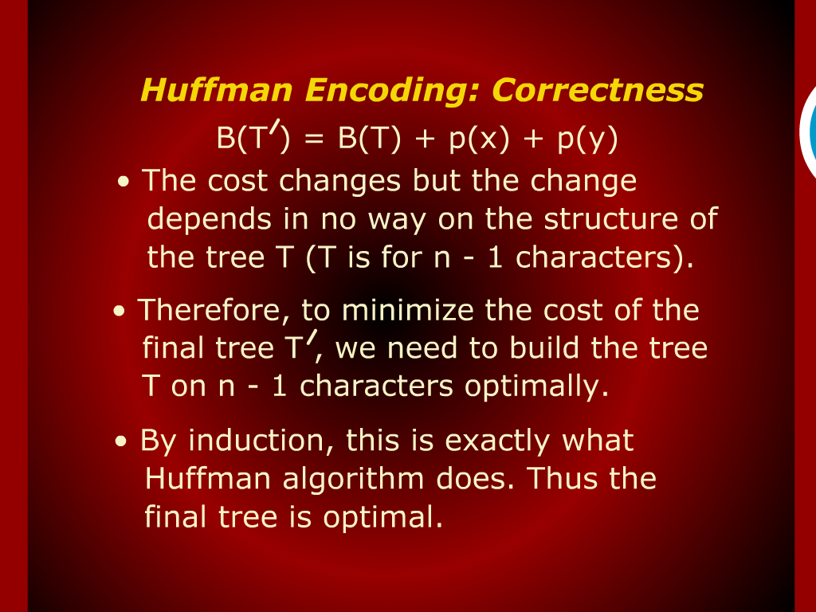
Huffman Encoding: Correctness

Slide 18
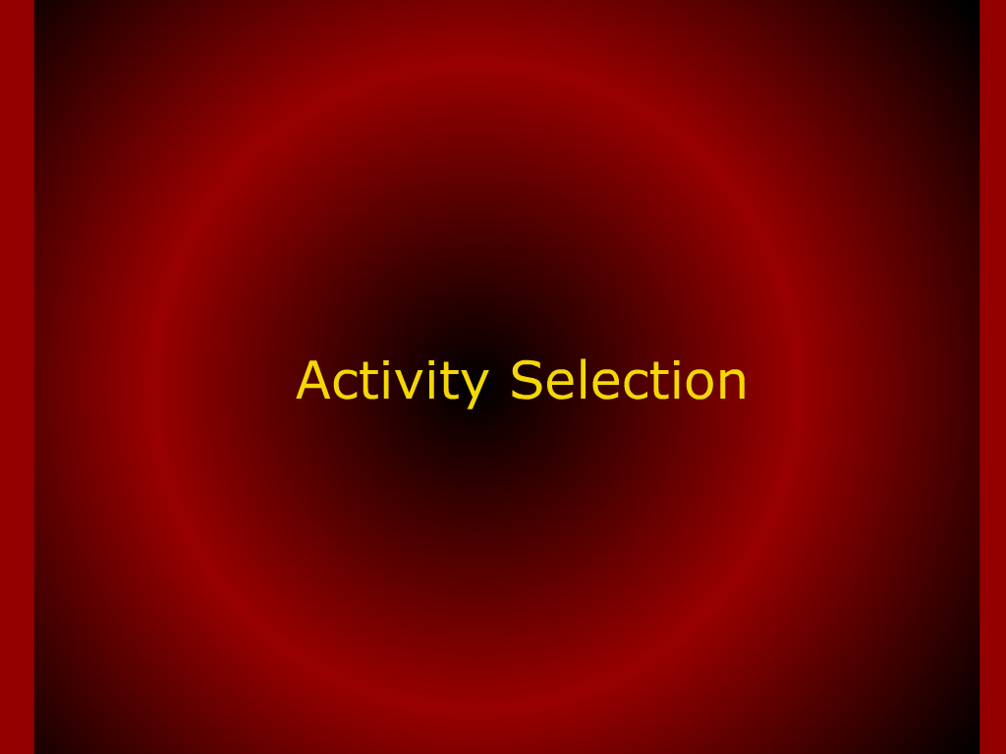
Activity Selection

Slide 19
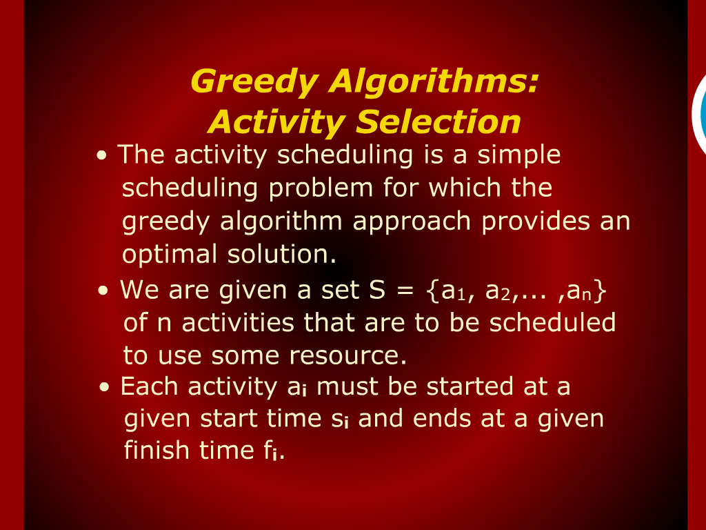
Greedy Algorithms:
Activity Selection

Slide 20
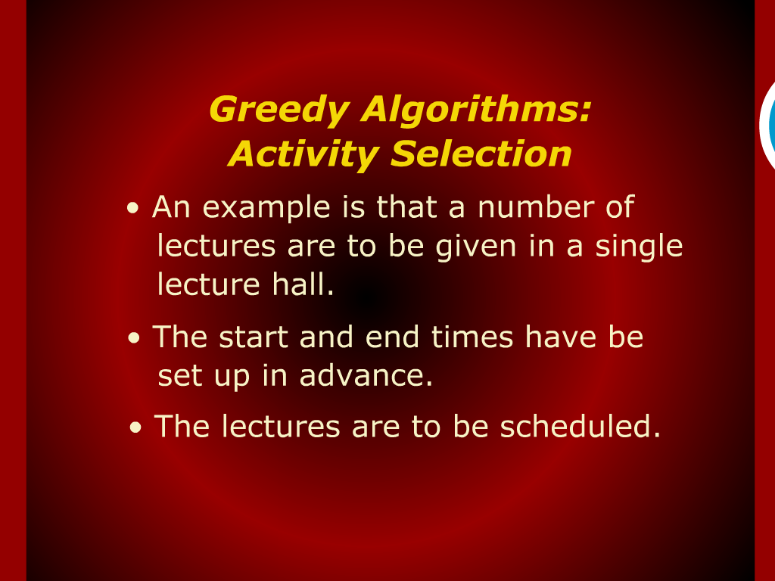
Greedy Algorithms:
Activity Selection

Slide 21
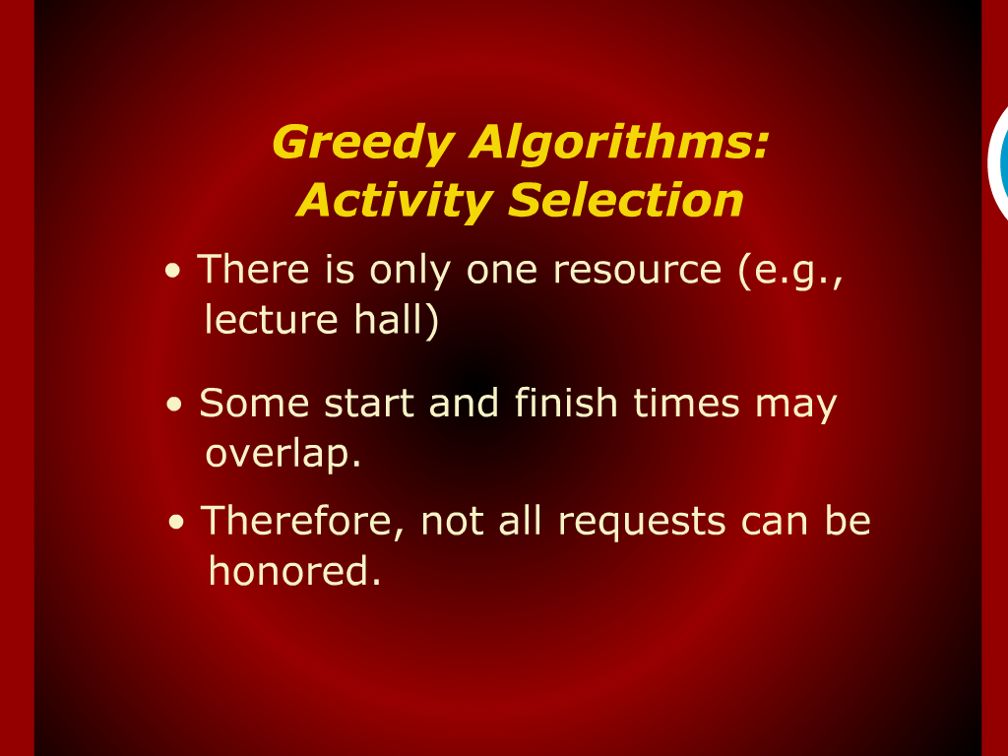
Greedy Algorithms:
Activity Selection

Slide 22
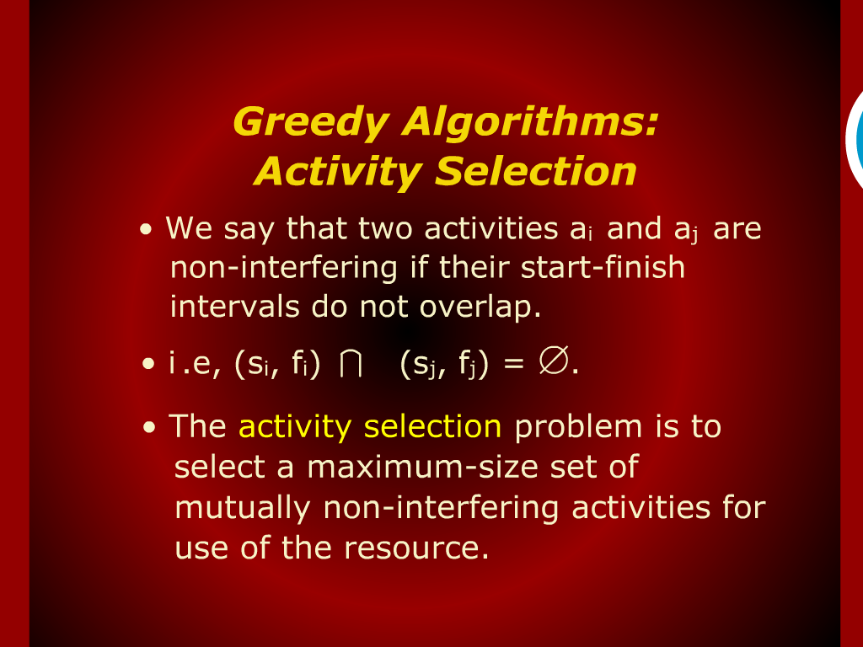
Greedy Algorithms:
Activity Selection

Slide 23
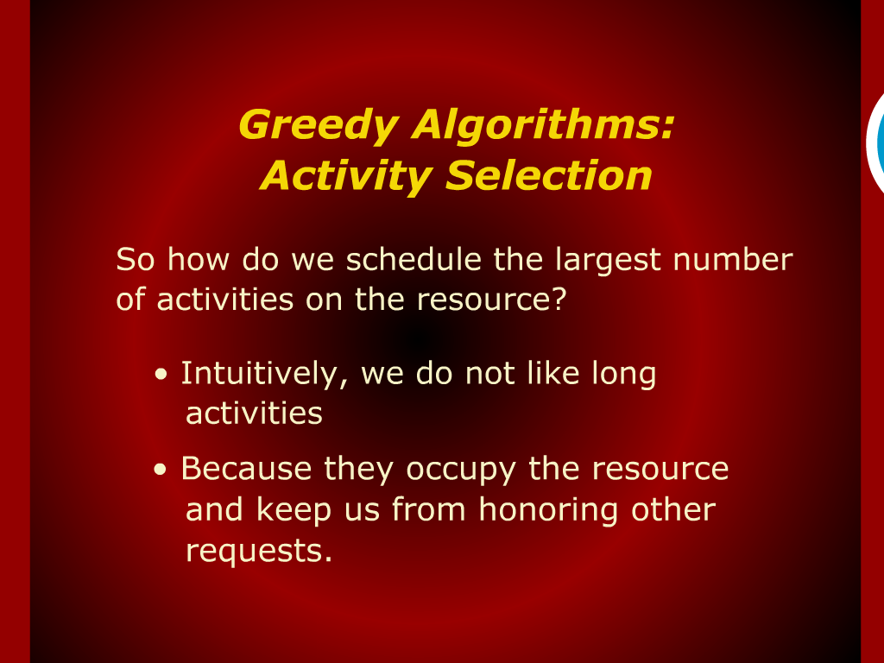
Greedy Algorithms:
Activity Selection

Slide 24
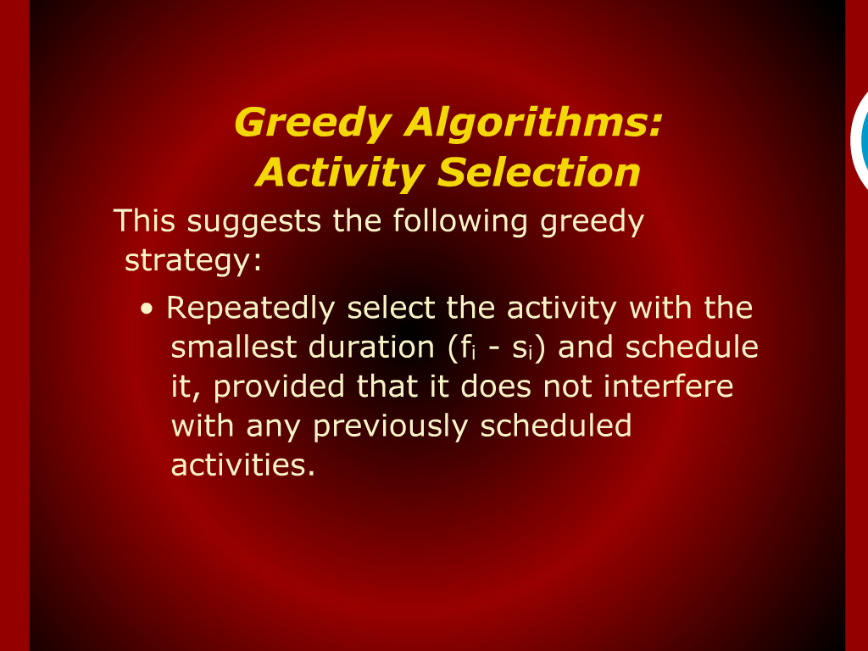
Greedy Algorithms:
Activity Selection

Slide 25
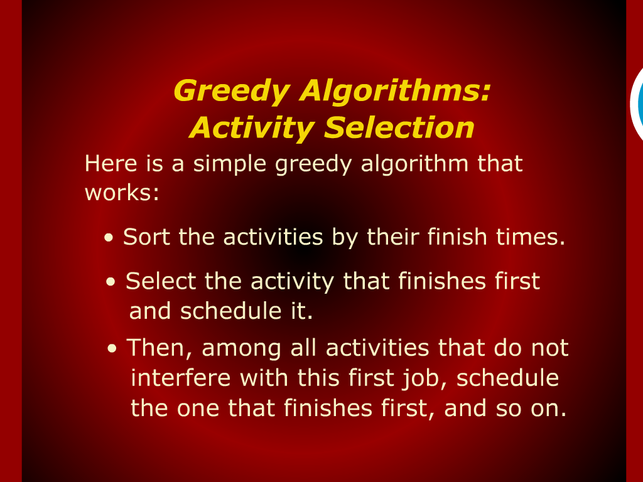
Greedy Algorithms:
Activity Selection

Slide 26
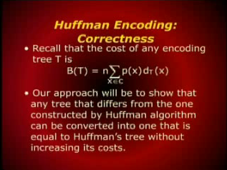
Huffman Encoding: Correctness

Slide 27
Huffman Encoding

Slide 28
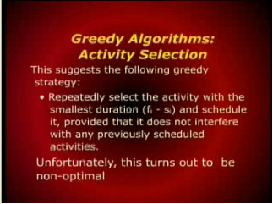
Greedy Algorithms:
Activity Selection

Slide 29
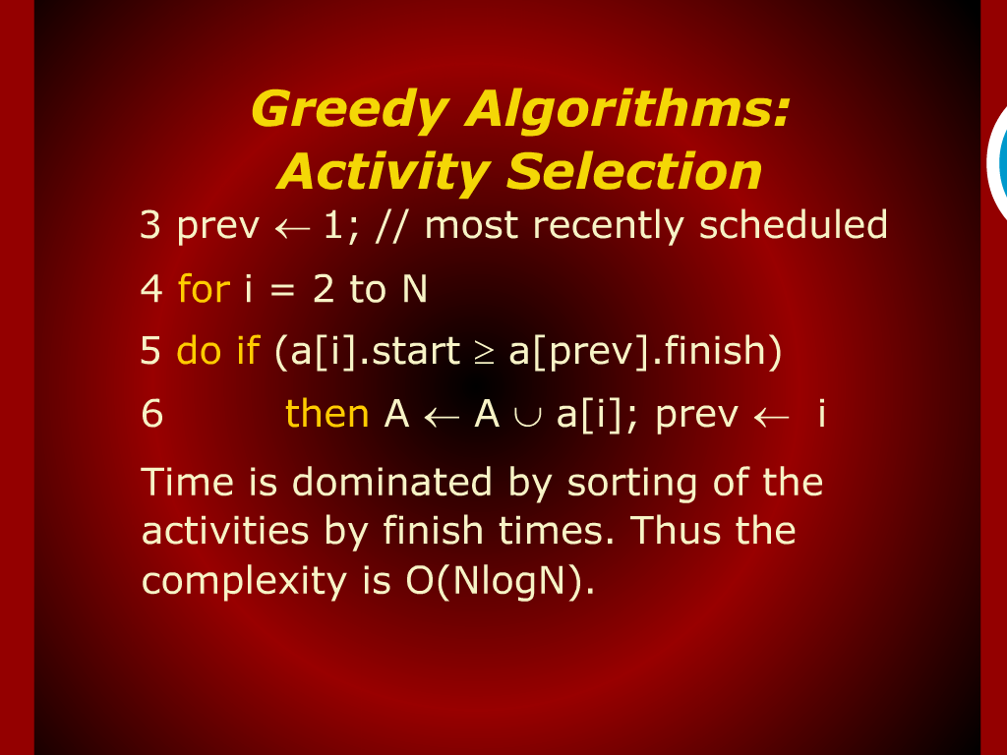
Greedy Algorithms:
Activity Selection

Slide 30
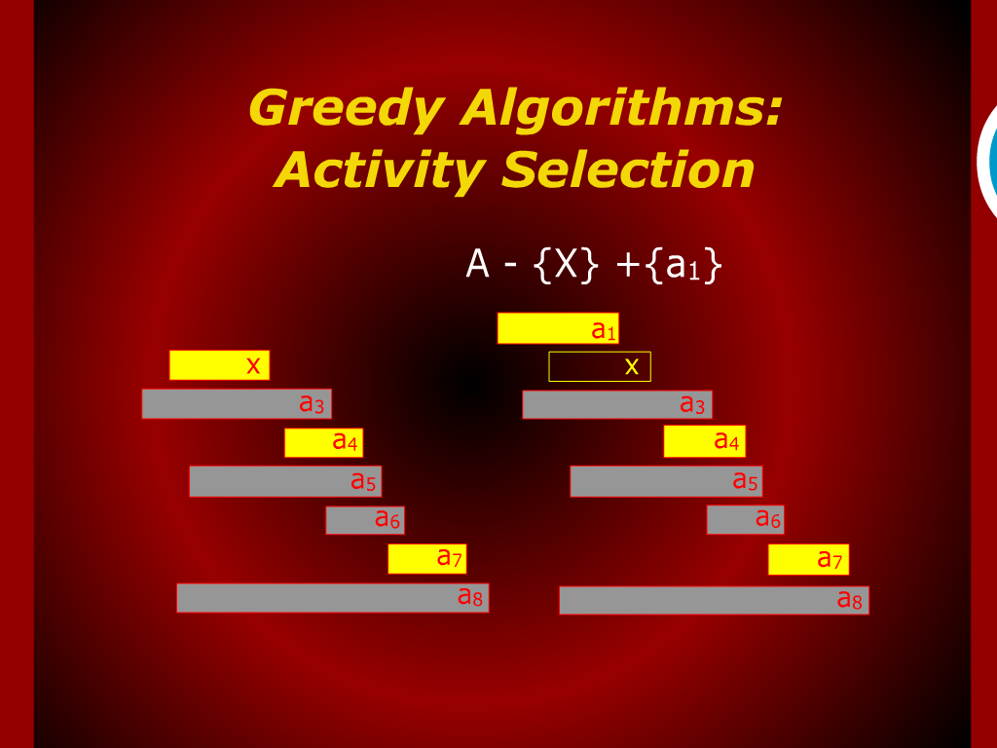
Greedy Algorithms:
Activity Selection

