Slide 1
Algorithms
Lecture # 26
Dr. Sohail Aslam

Slide 2
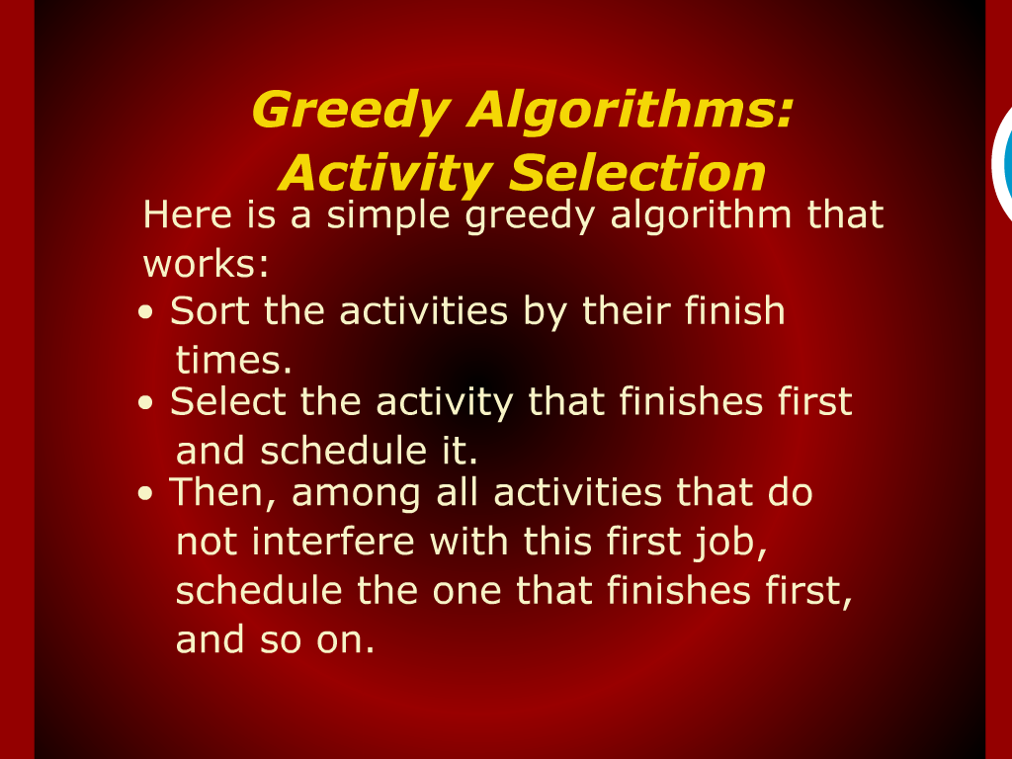
Greedy Algorithms: Activity Selection

Slide 3
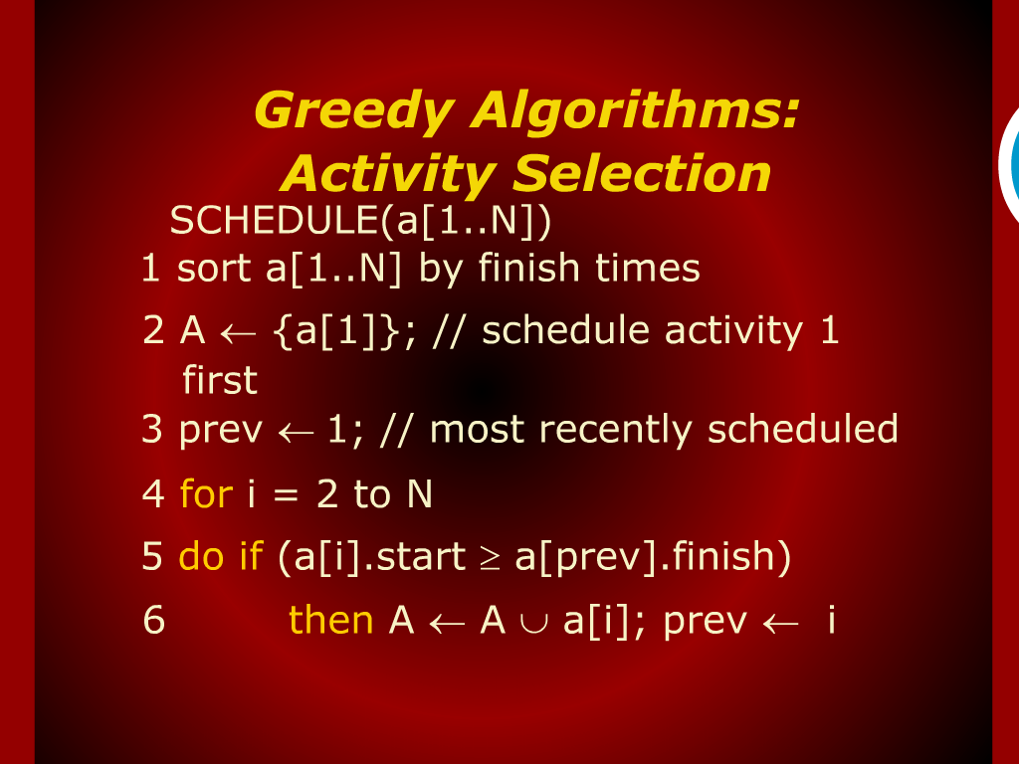
Greedy Algorithms: Activity Selection

Slide 4
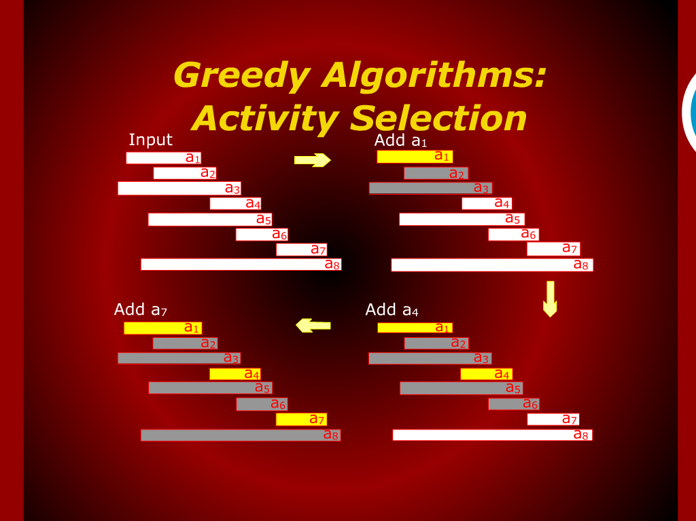
Greedy Algorithms: Activity Selection

Slide 5
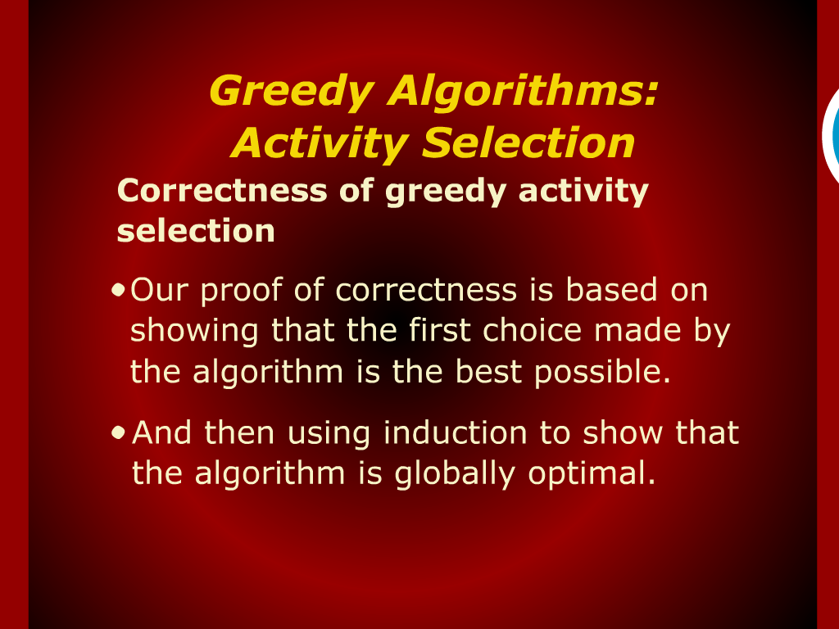
Greedy Algorithms: Activity Selection

Slide 6
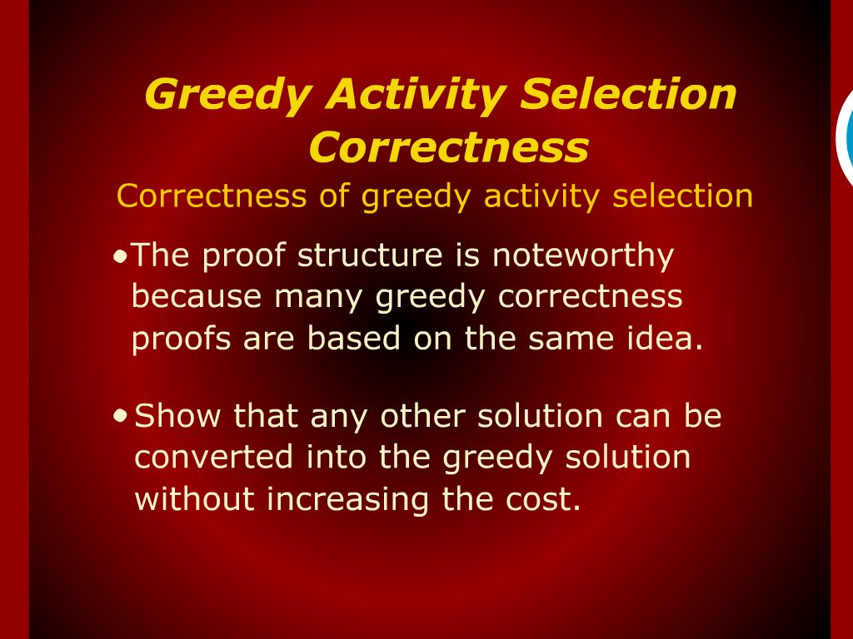
Greedy Activity Selection Correctness

Slide 7
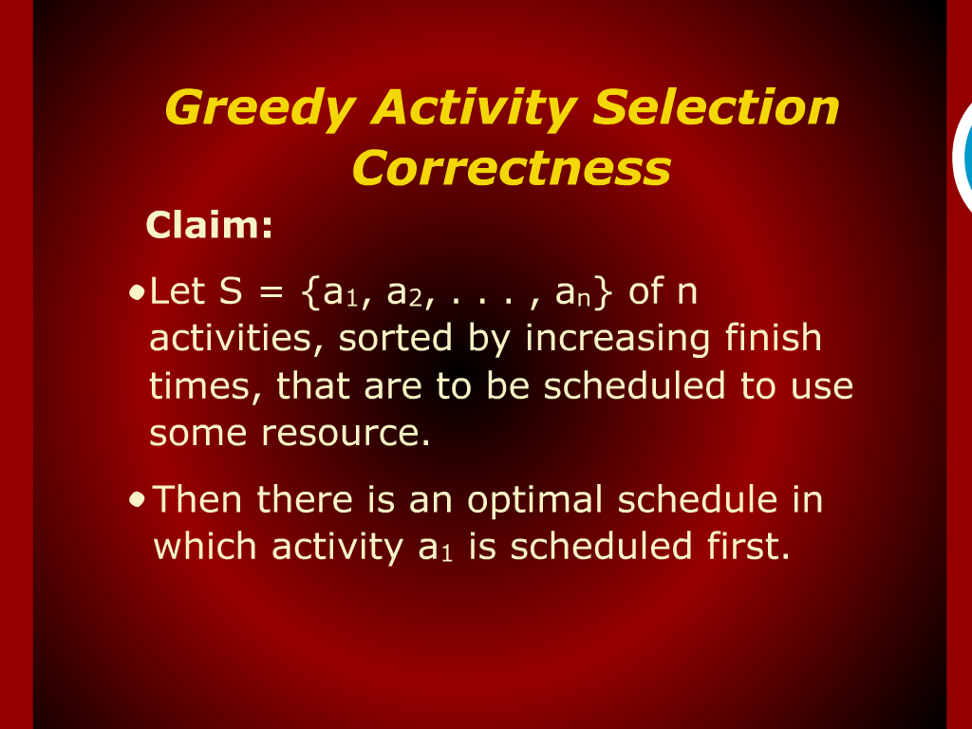
Greedy Activity Selection Correctness

Slide 8
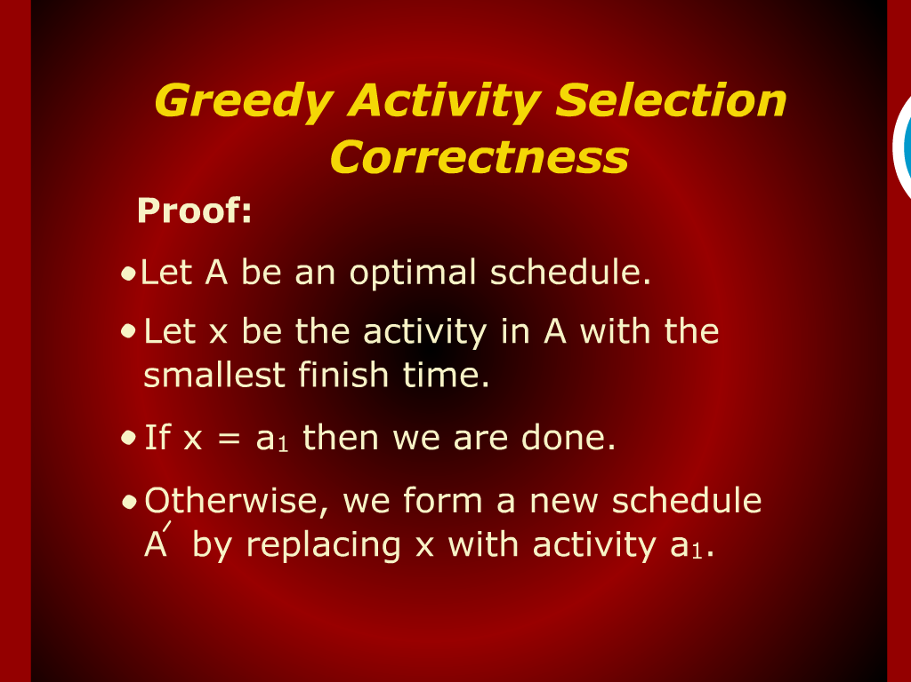
Greedy Activity Selection Correctness

Slide 9
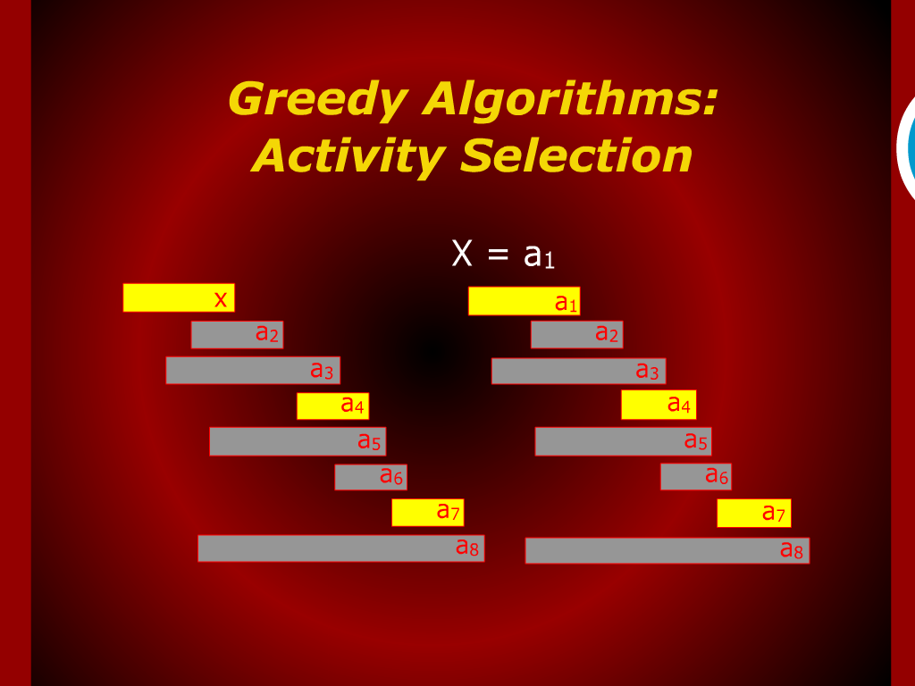
Greedy Algorithms: Activity Selection

Slide 10
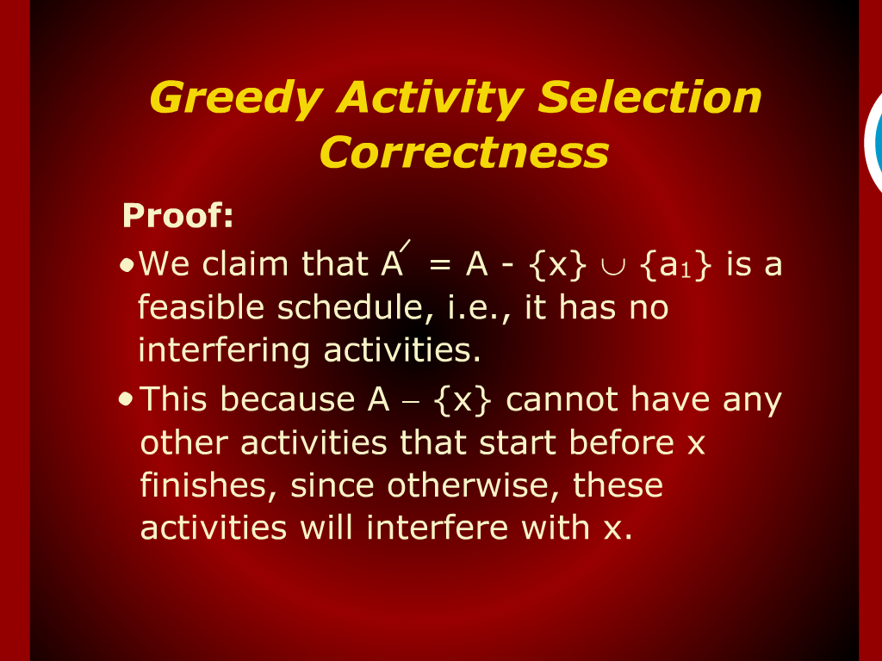
Greedy Activity Selection Correctness

Slide 11
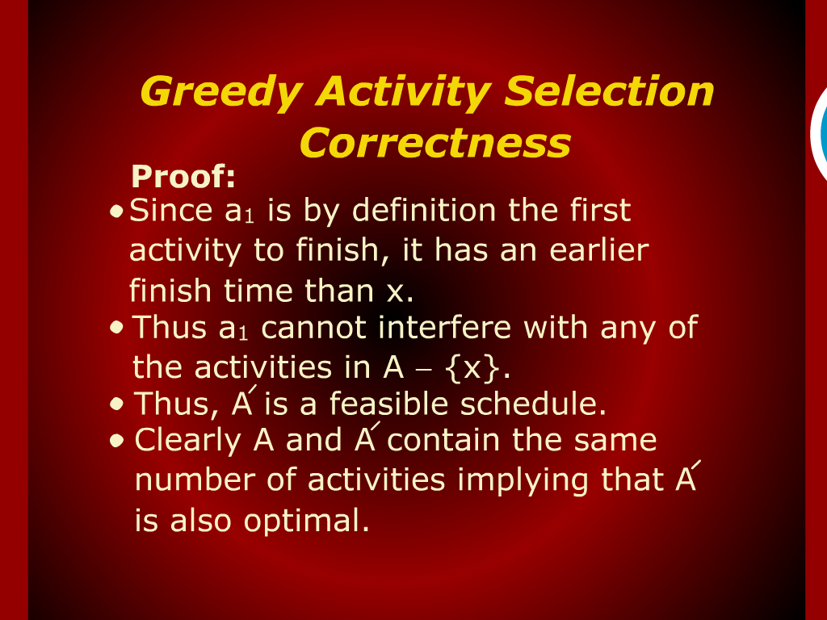
Greedy Activity Selection Correctness

Slide 12
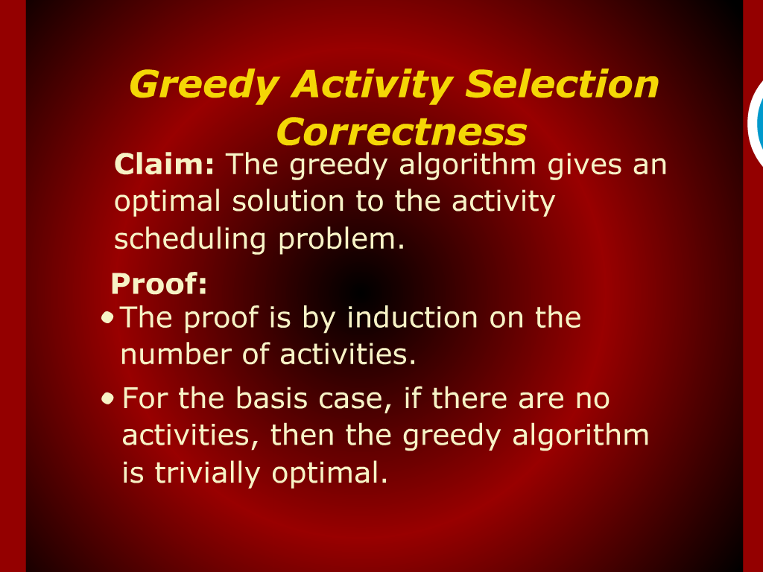
Greedy Activity Selection Correctness

Slide 13
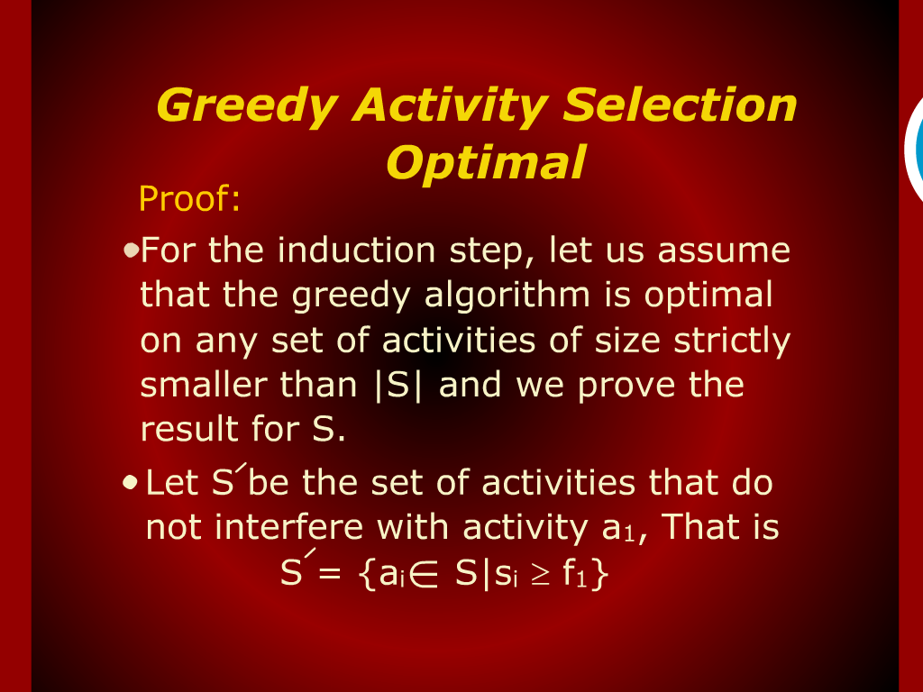
Greedy Activity Selection Optimal

Slide 14
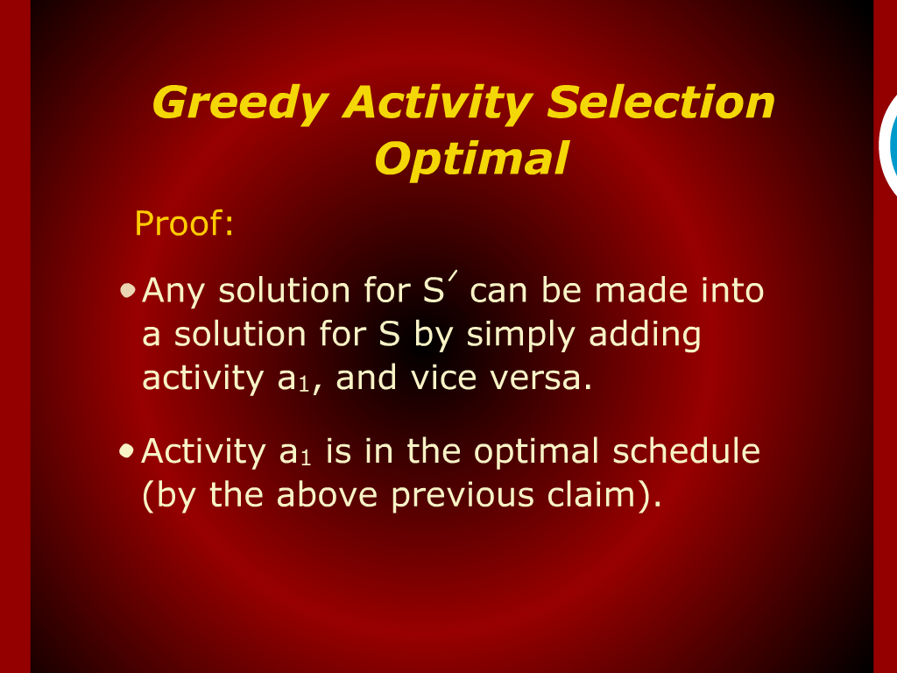
Greedy Activity Selection Optimal

Slide 15
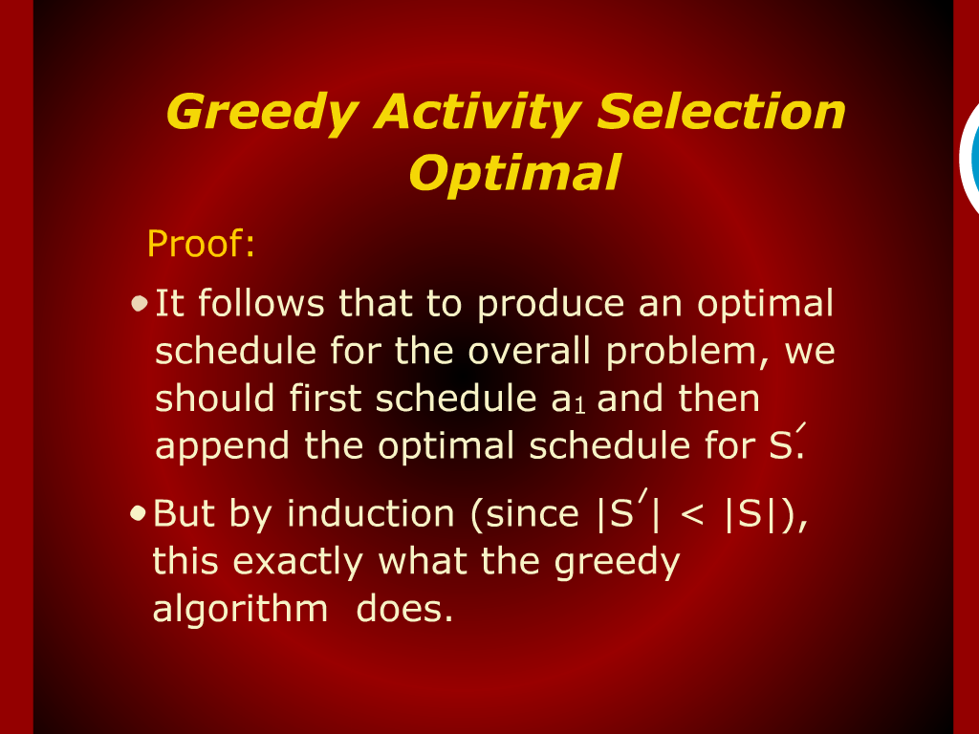
Greedy Activity Selection Optimal

Slide 16
Activity Selection

Slide 17
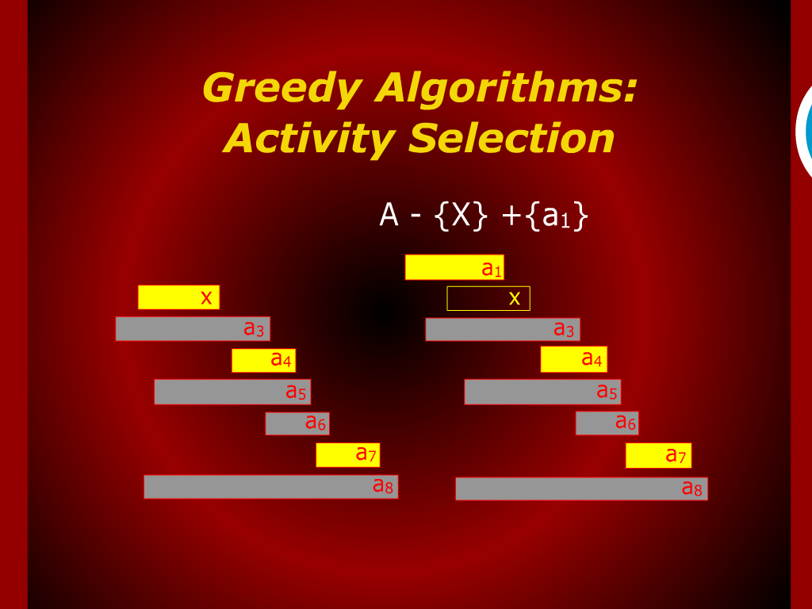
Greedy Algorithms:
Activity Selection

Slide 18
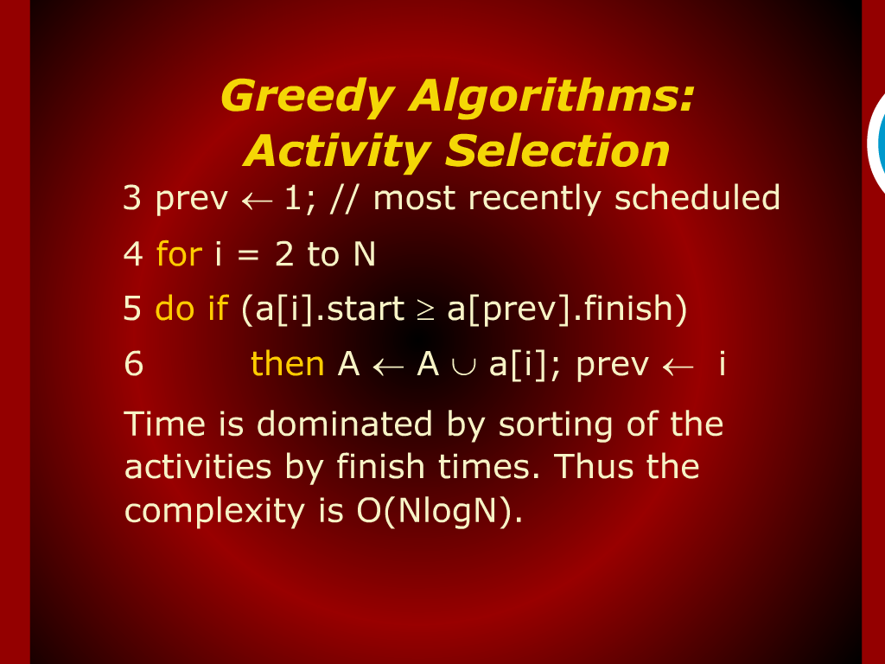
Greedy Algorithms:
Activity Selection

Slide 19
Random Access Machine

