Slide 1
Algorithms
Lecture # 27
Dr. Sohail Aslam

Slide 2
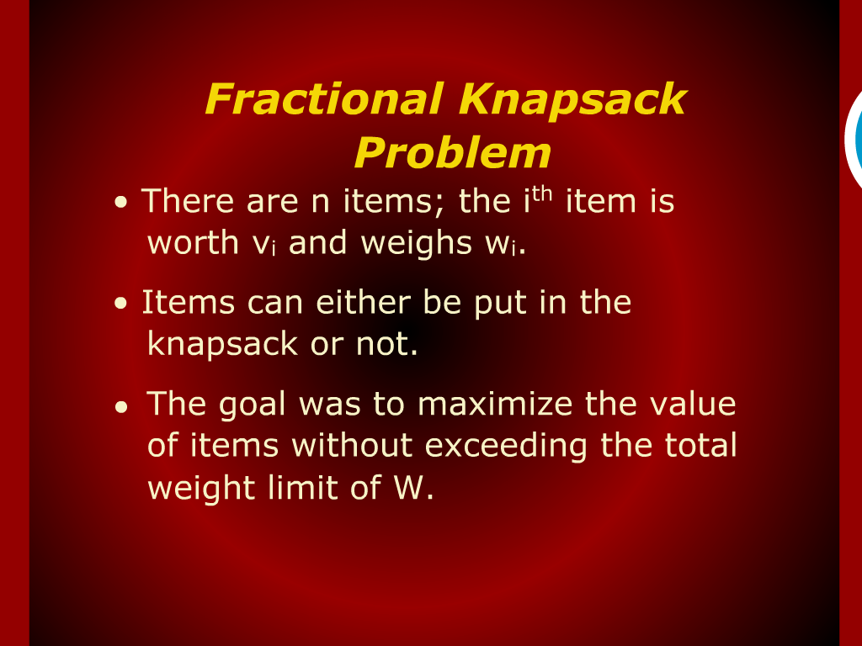
Fractional Knapsack Problem

Slide 3
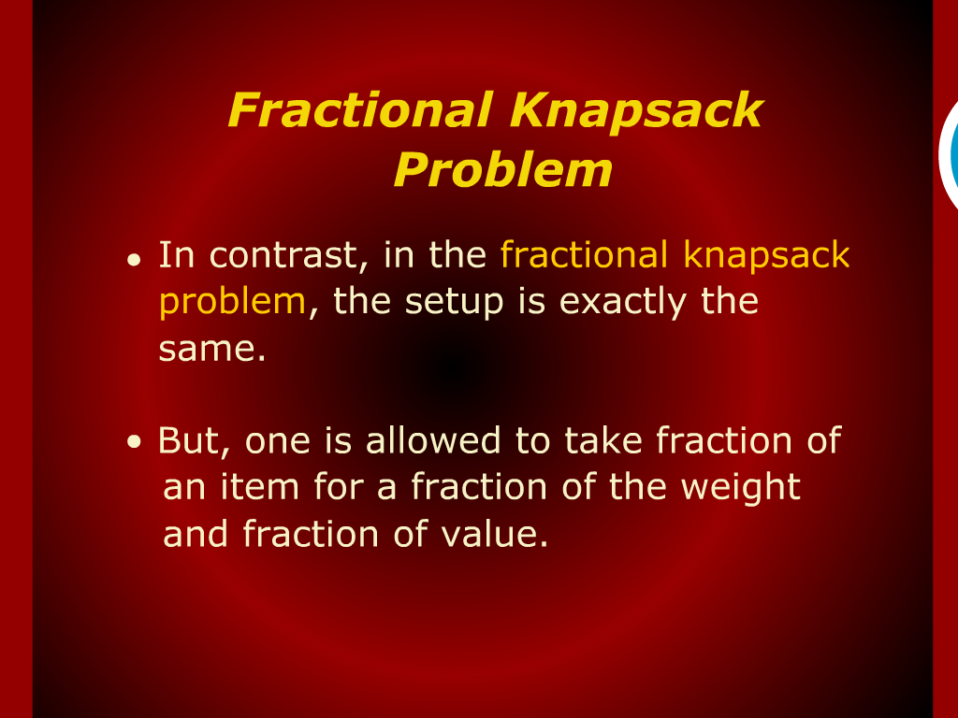
Fractional Knapsack Problem

Slide 4
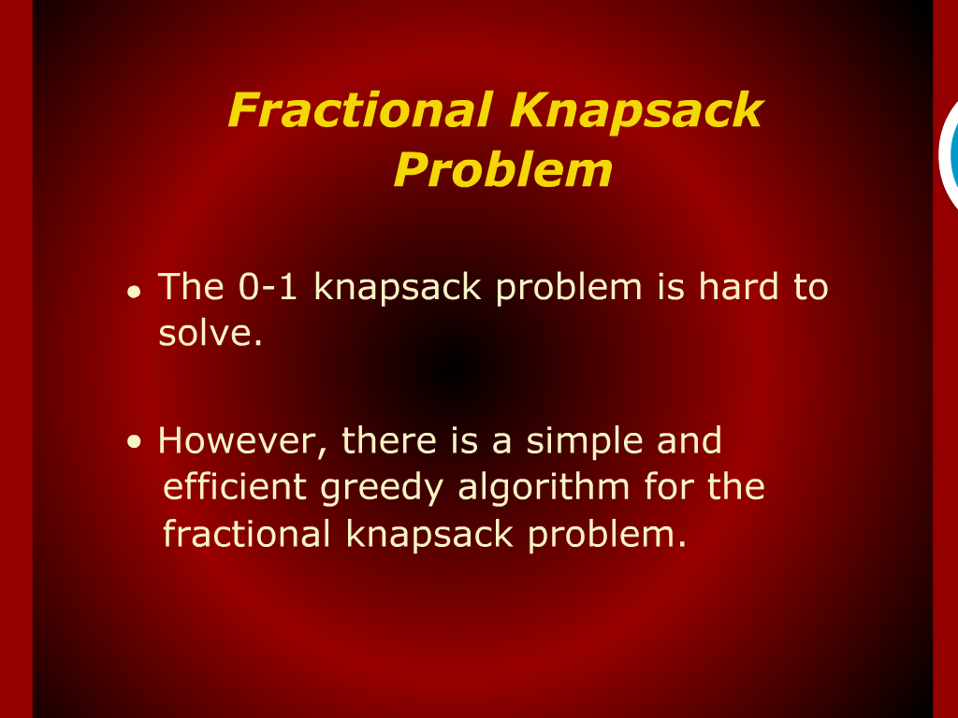
Fractional Knapsack Problem

Slide 5
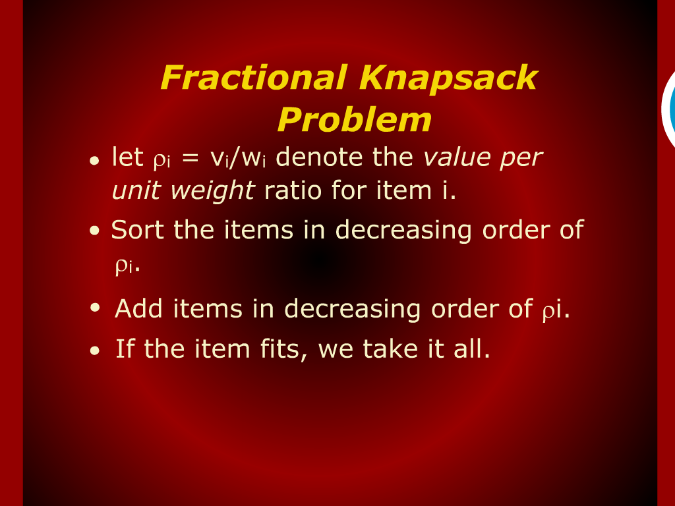
Fractional Knapsack Problem

Slide 6
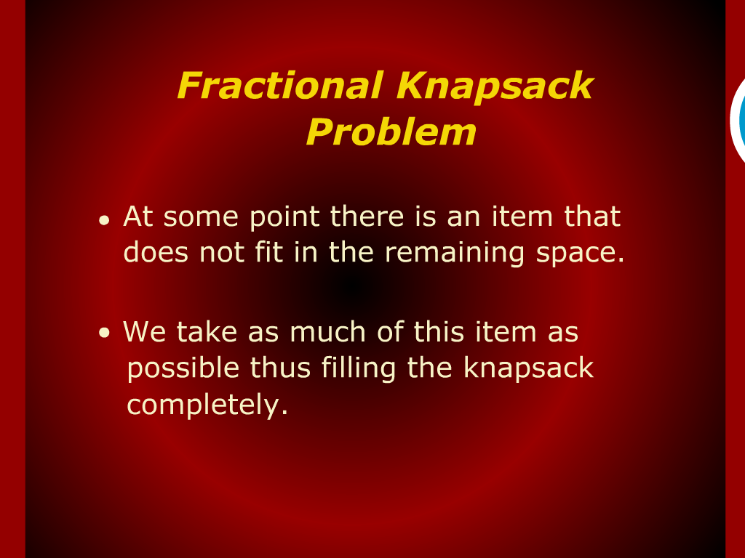
Fractional Knapsack Problem

Slide 7
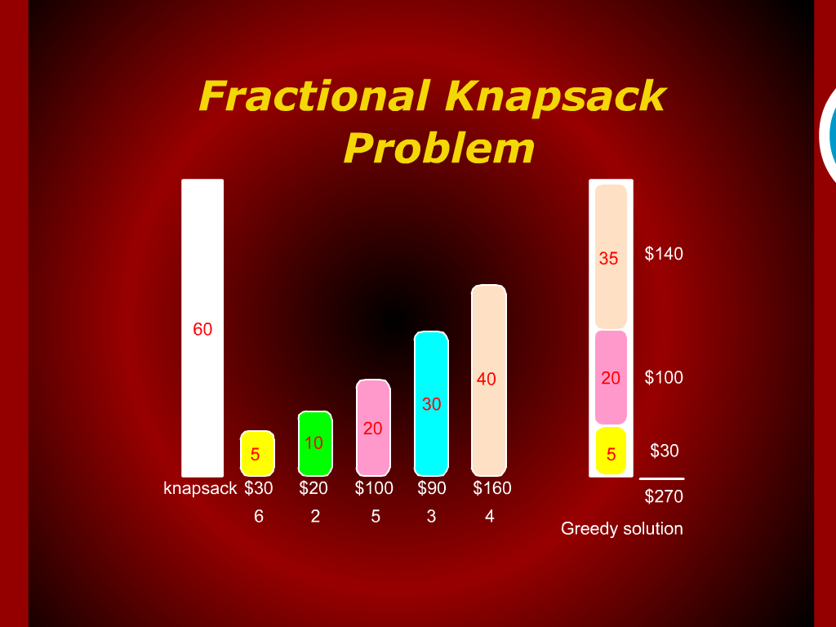
Fractional Knapsack Problem

Slide 8
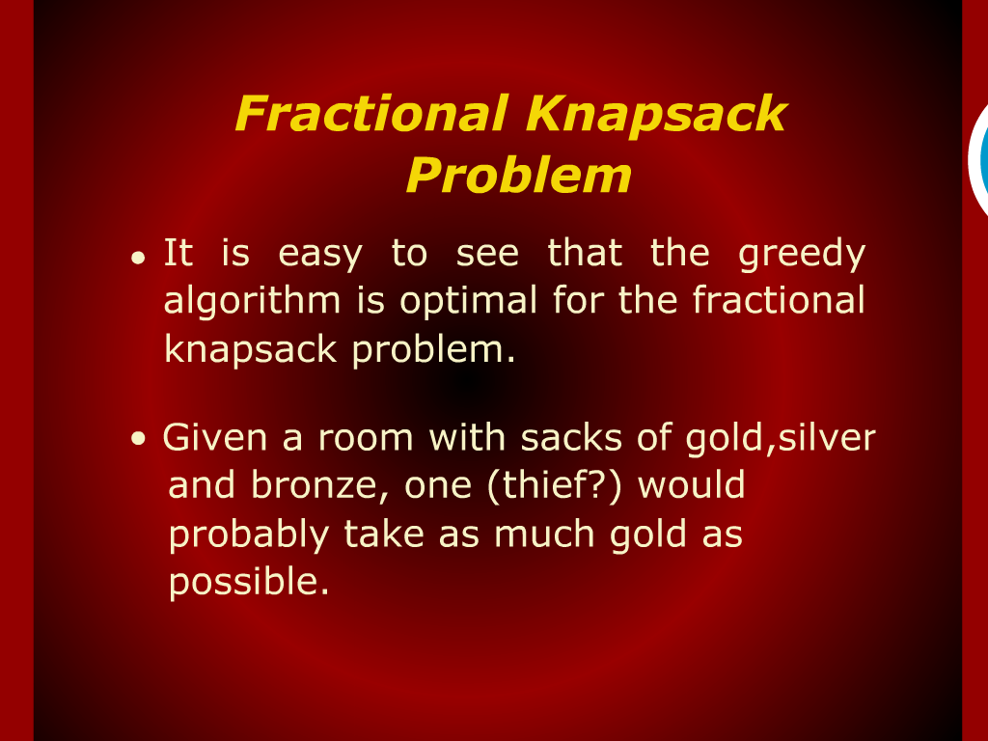
Fractional Knapsack Problem

Slide 9
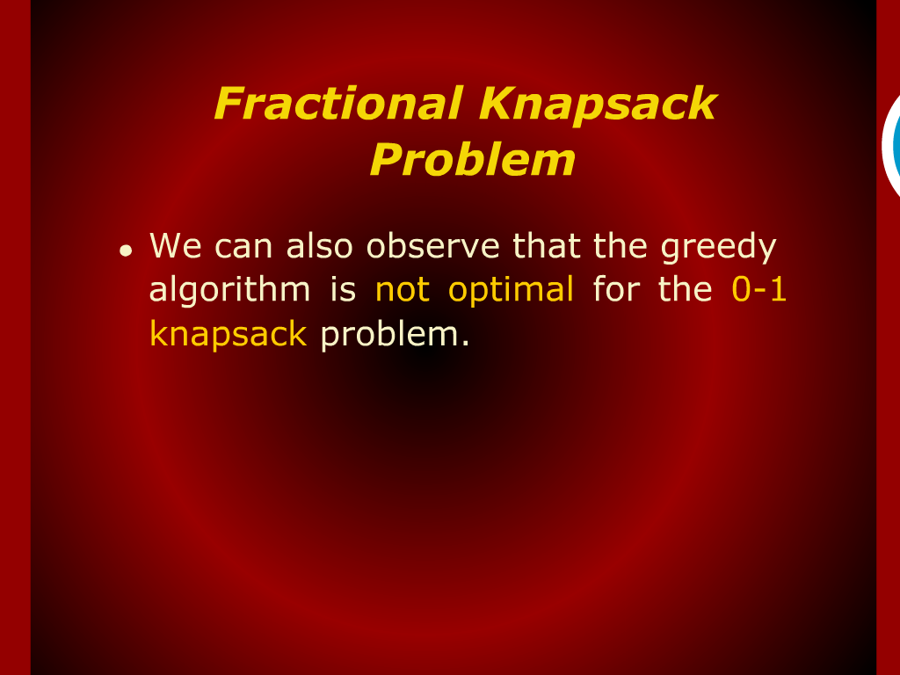
Fractional Knapsack Problem

Slide 10
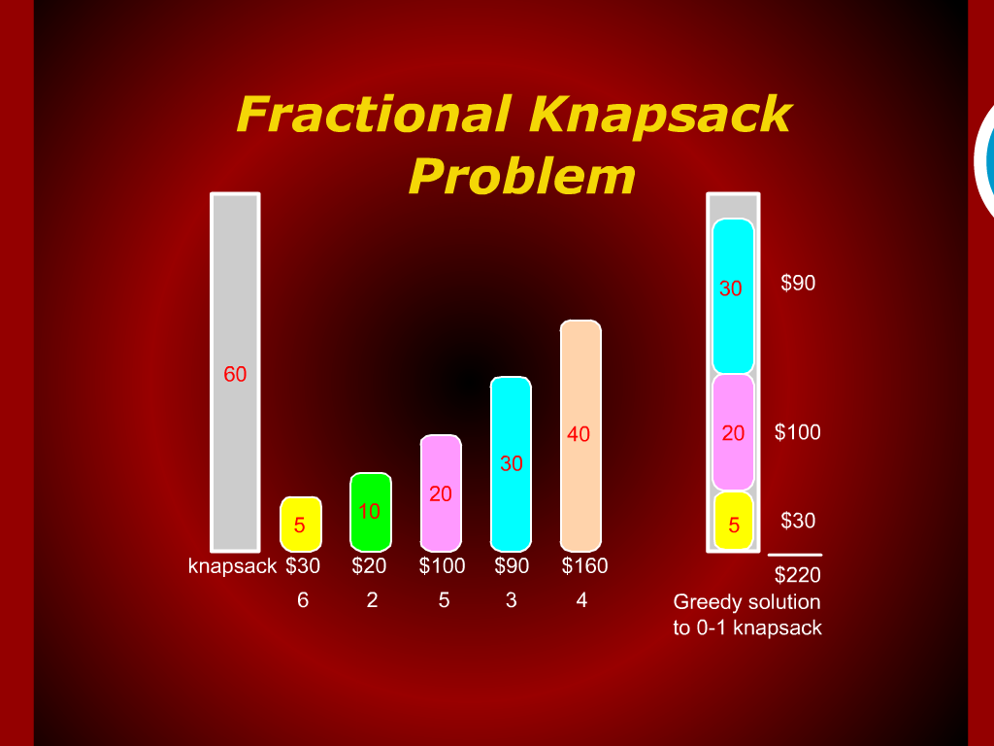
Fractional Knapsack Problem

Slide 11
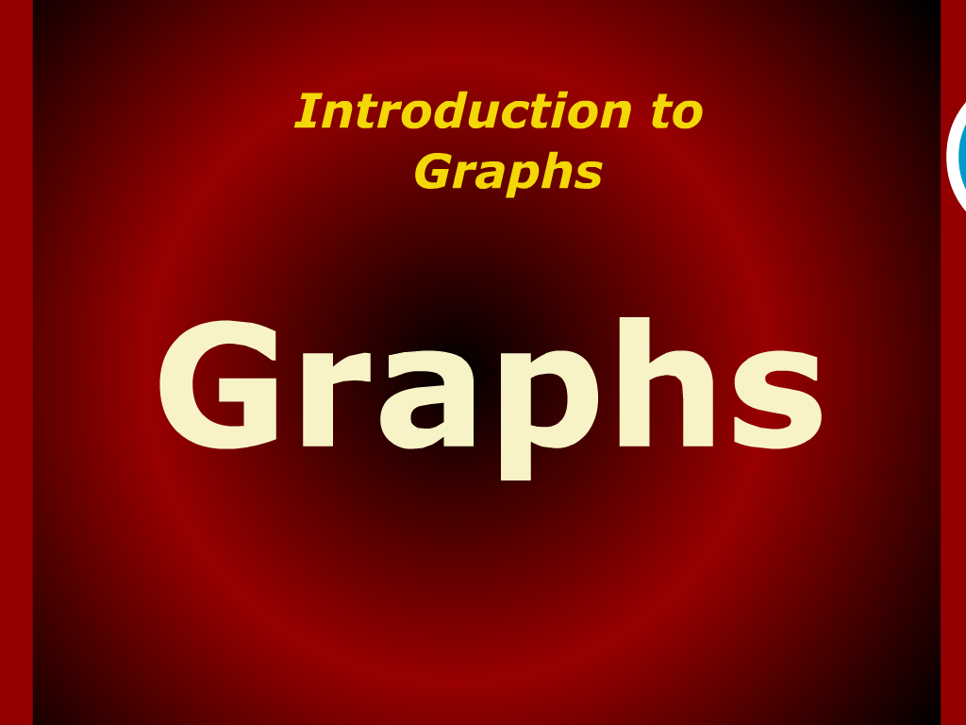
Introduction to Graphs

Slide 12
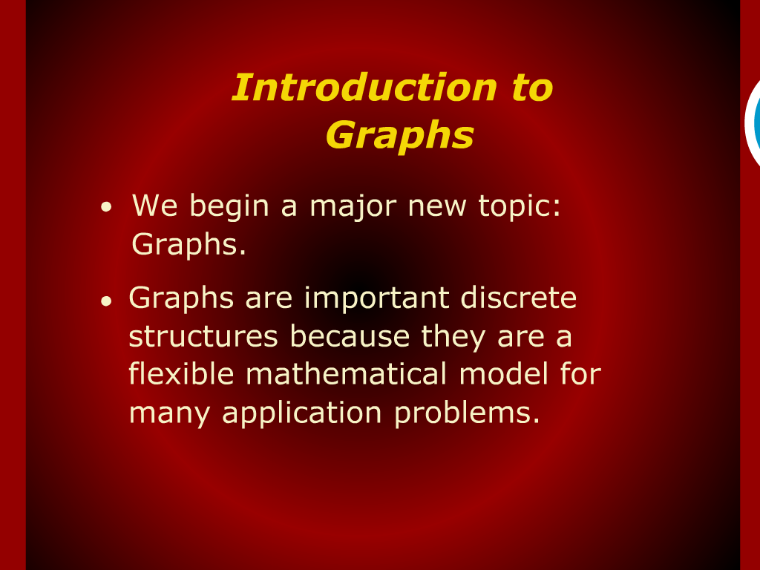
Introduction to Graphs

Slide 13
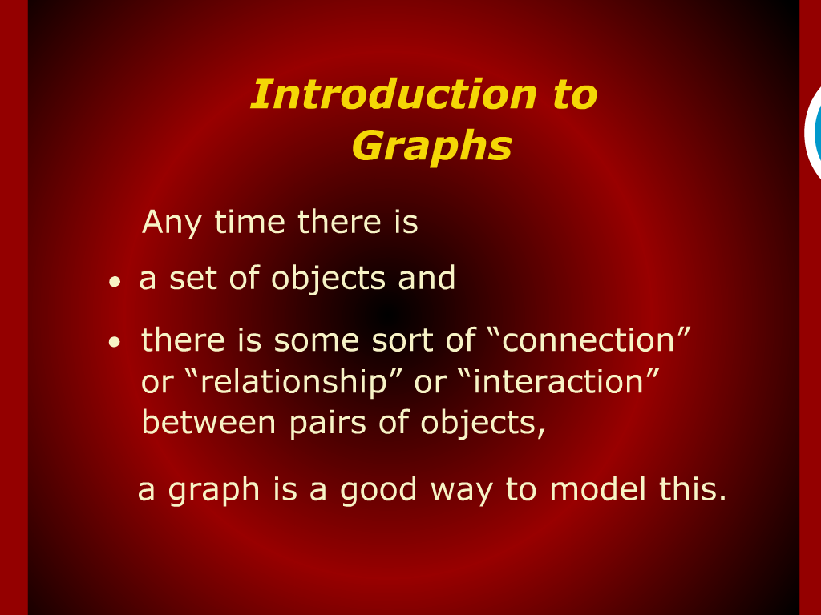
Introduction to Graphs

Slide 14
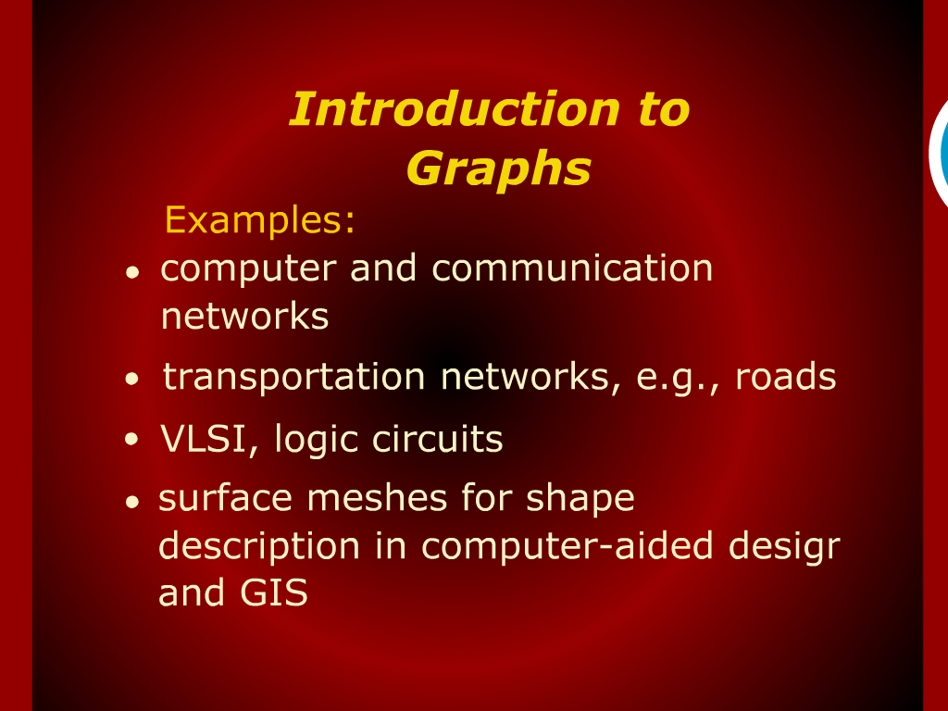
Introduction to Graphs

Slide 15
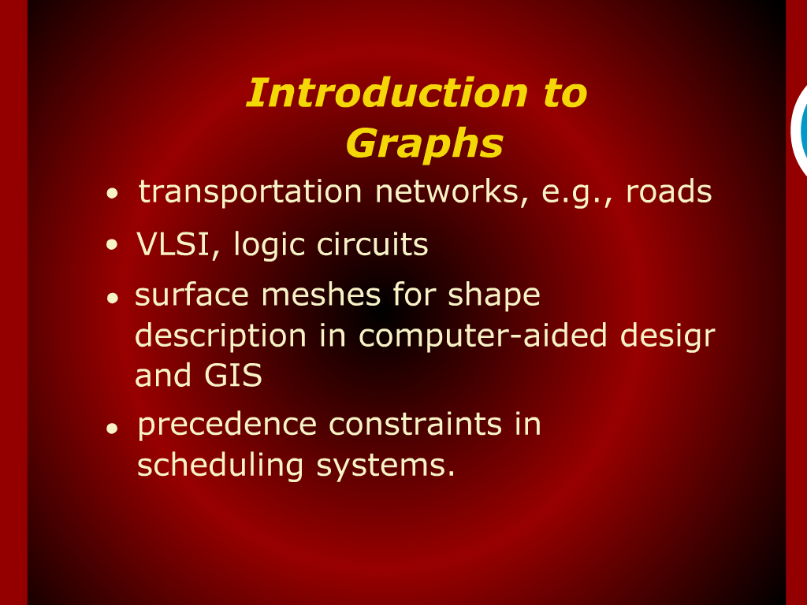
Introduction to Graphs

Slide 16
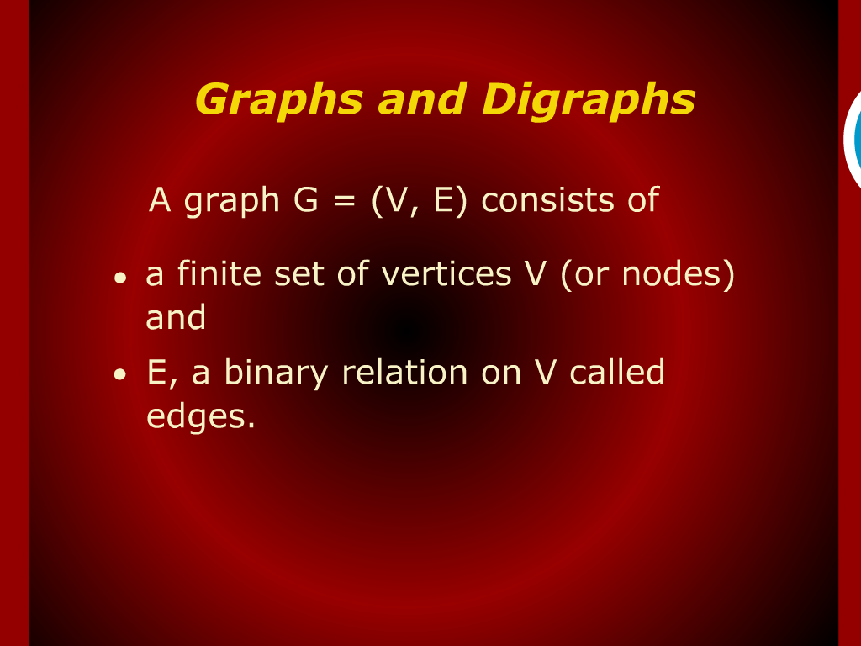
Graphs and Digraphs

Slide 17
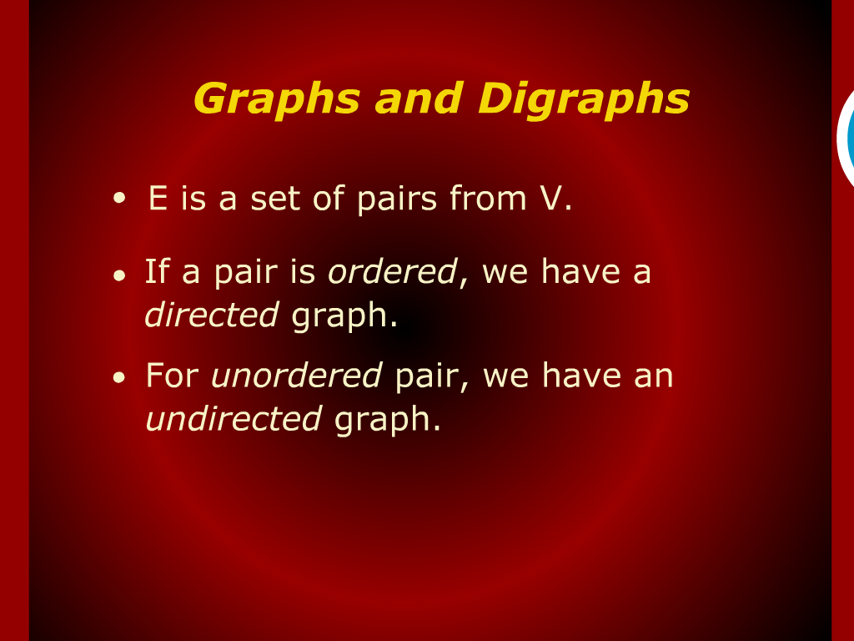
Graphs and Digraphs

Slide 18
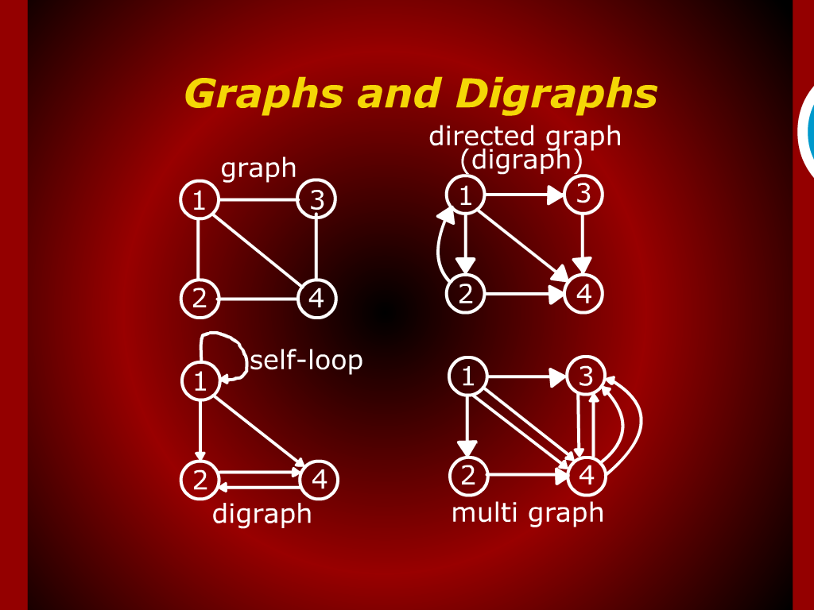
Graphs and Digraphs

Slide 19
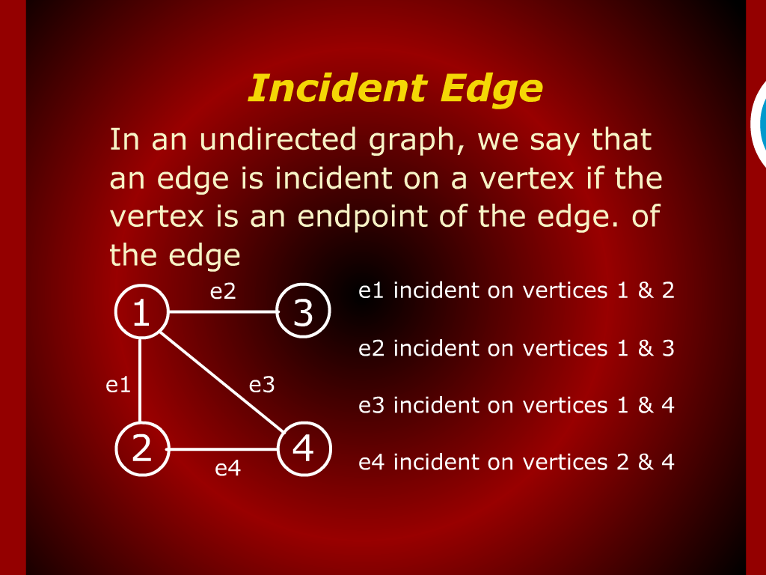
Incident Edge

Slide 20
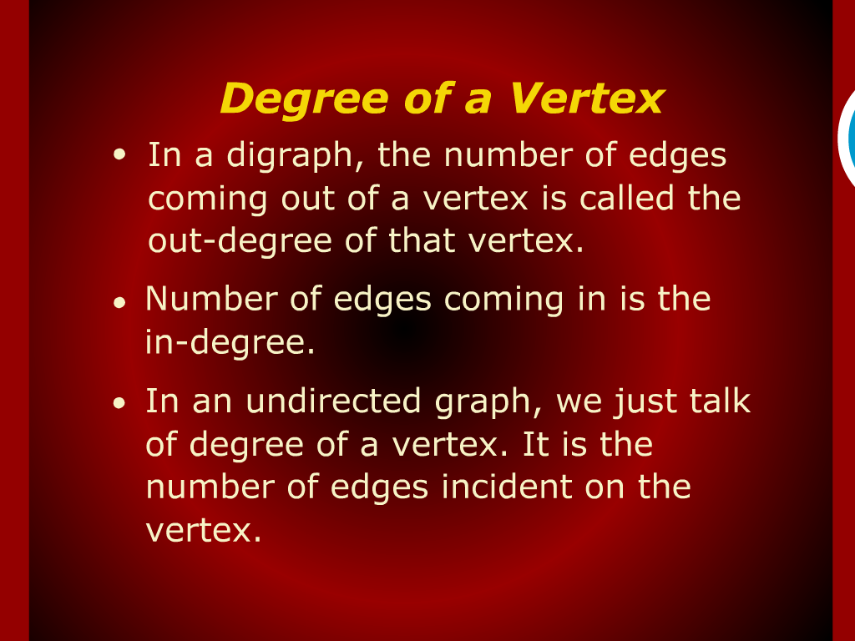
Degree of a Vertex

Slide 21
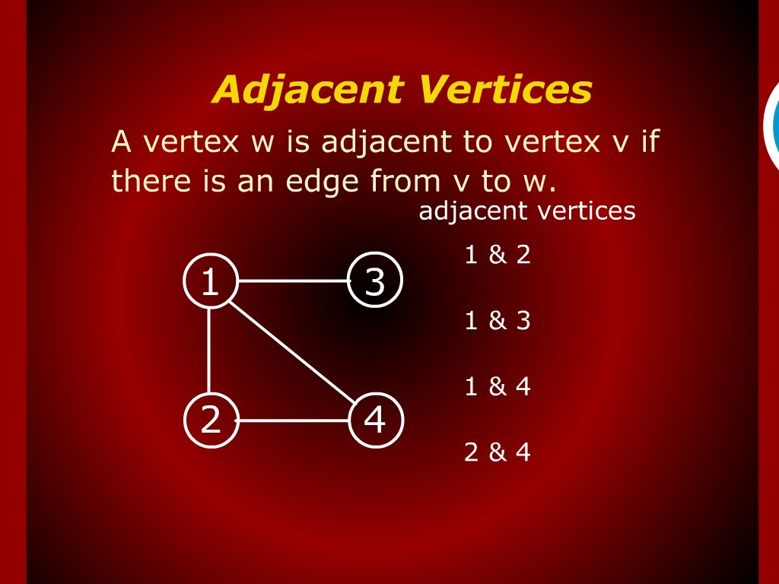
Adjacent Vertices

Slide 22
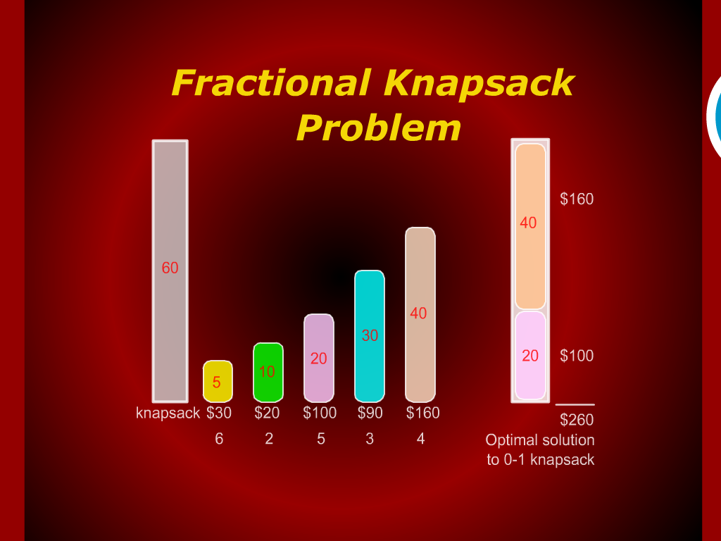
Fractional Knapsack Problem

Slide 23
Fractional Knapsack

Slide 24
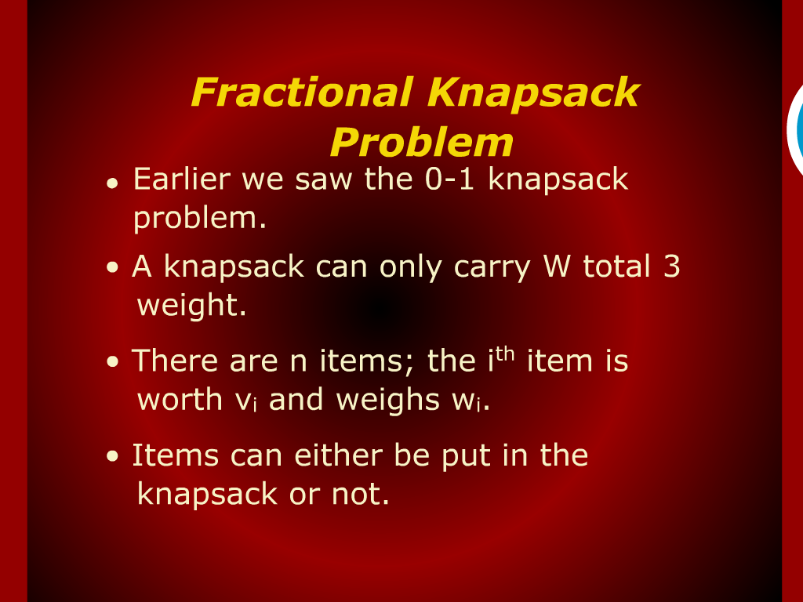
Fractional Knapsack Problem

Slide 25
Course outline

Slide 26
Criteria for analyzing Algorithms

Slide 27
Criteria for analyzing Algorithms

Slide 28
Model of Computation

Slide 29
Model of Computation

Slide 30
Model of Computation

Slide 31
Random Access Machine

