Slide 1
Algorithms
Lecture # 28
Dr. Sohail Aslam

Slide 2
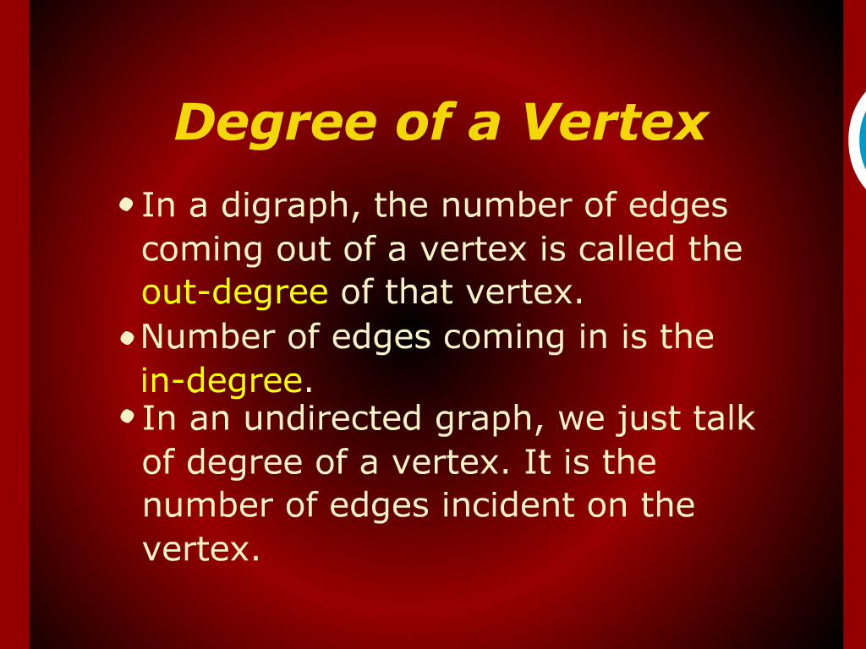
Degree of a Vertex

Slide 3
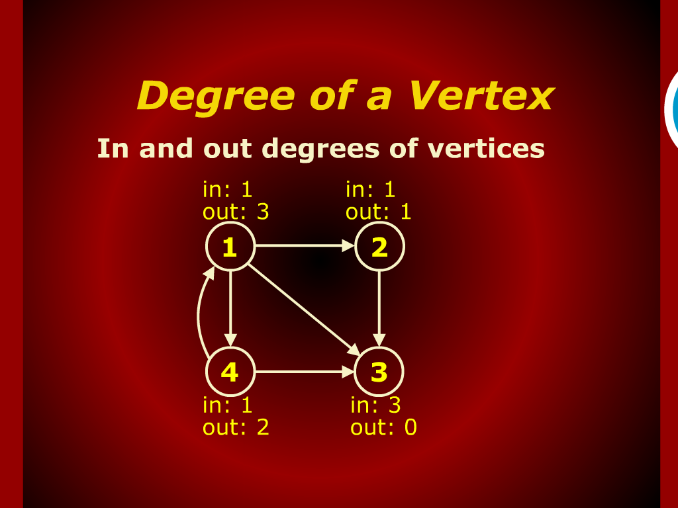
Degree of a Vertex

Slide 4
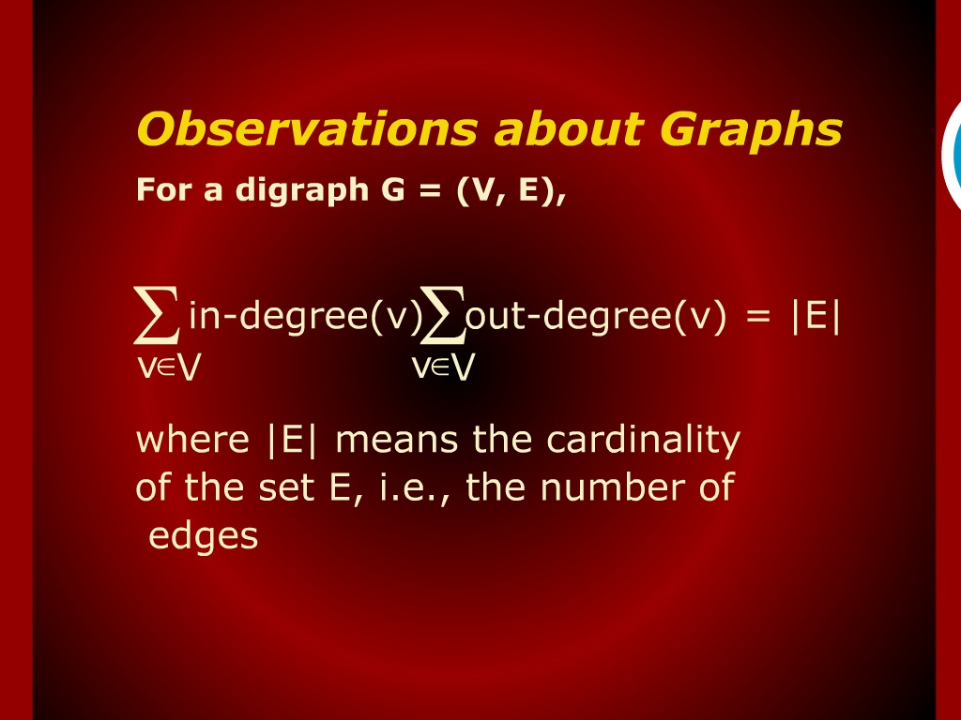
Observations about Graphs

Slide 5
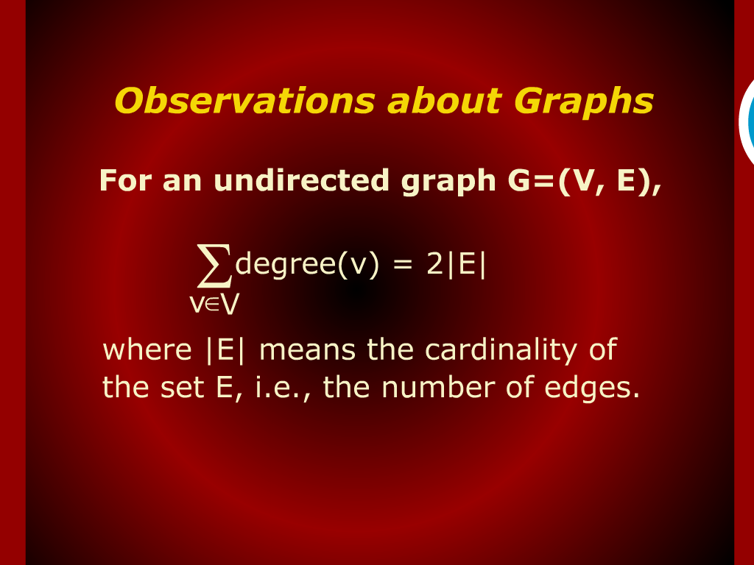
Observations about Graphs

Slide 6
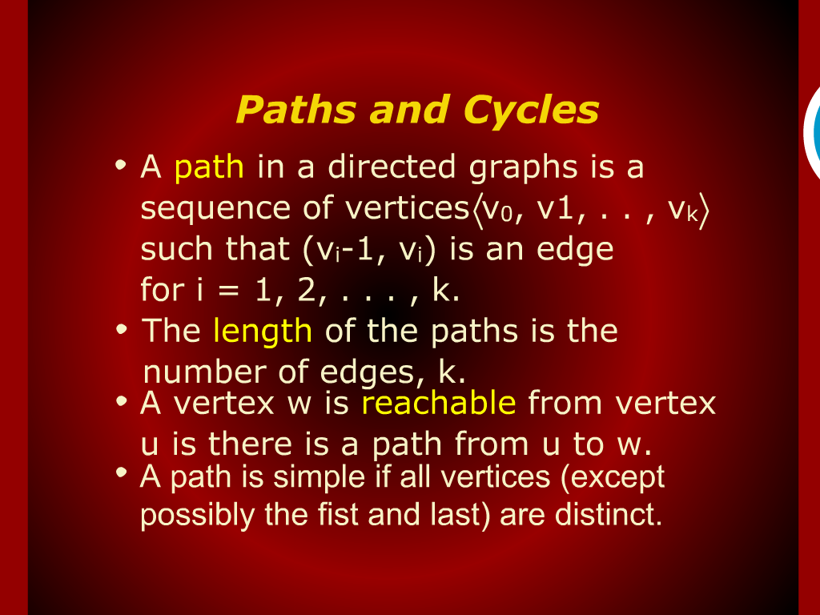
Paths and cycles

Slide 7
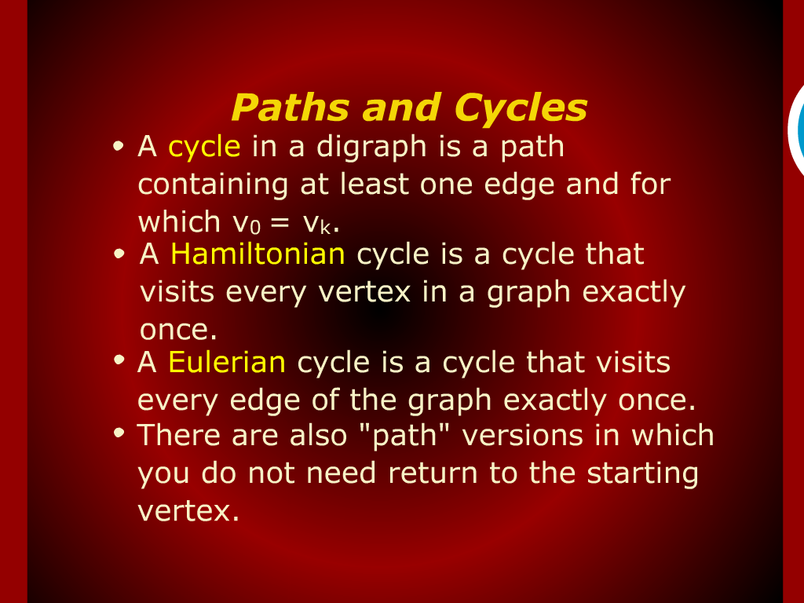
Paths and cycles

Slide 8
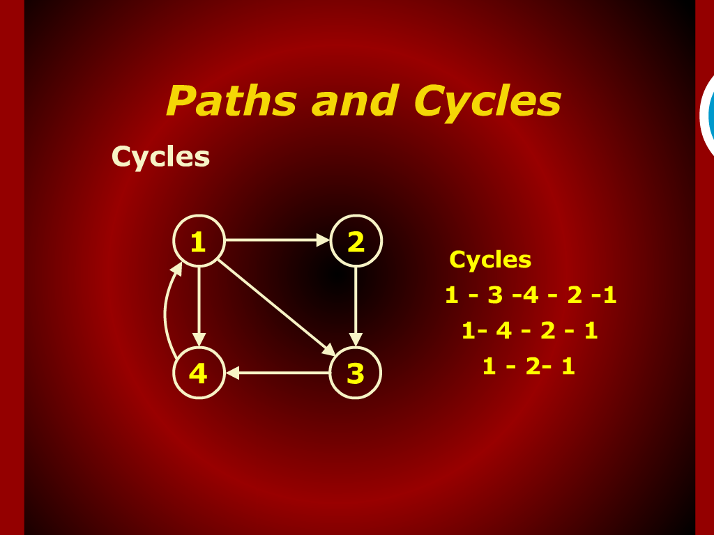
Paths and cycles

Slide 9
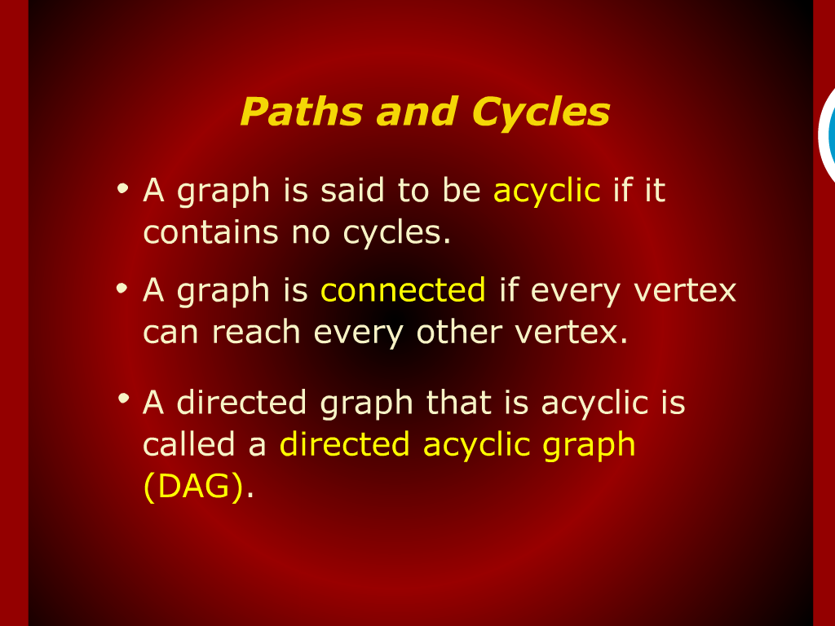
Paths and cycles

Slide 10
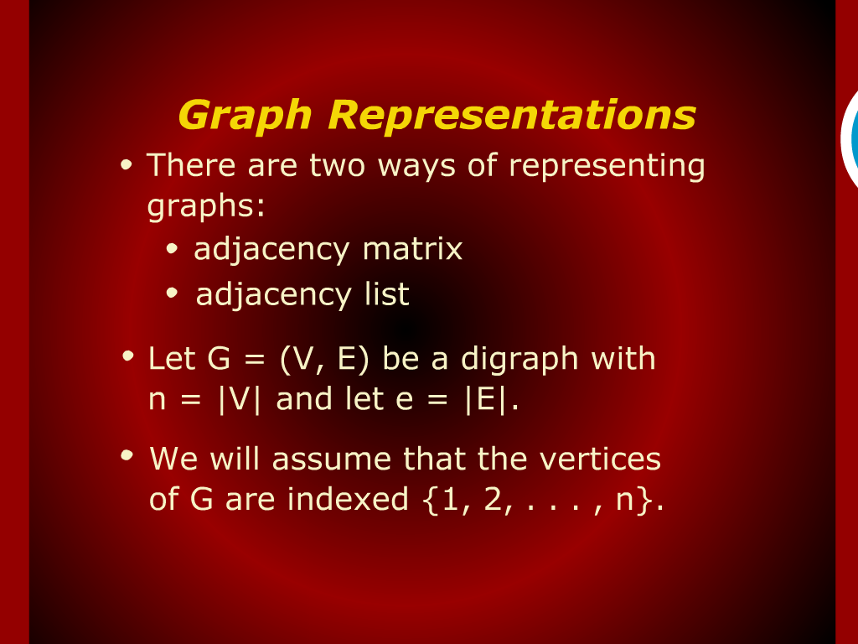
Graph Representations

Slide 11
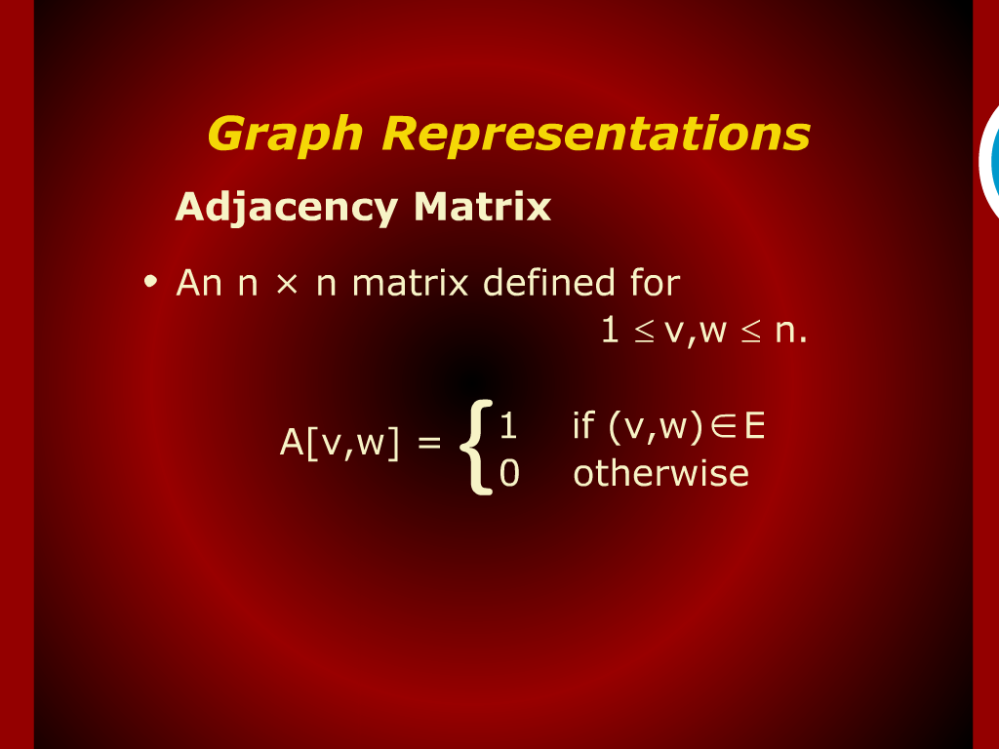
Graph Representations

Slide 12
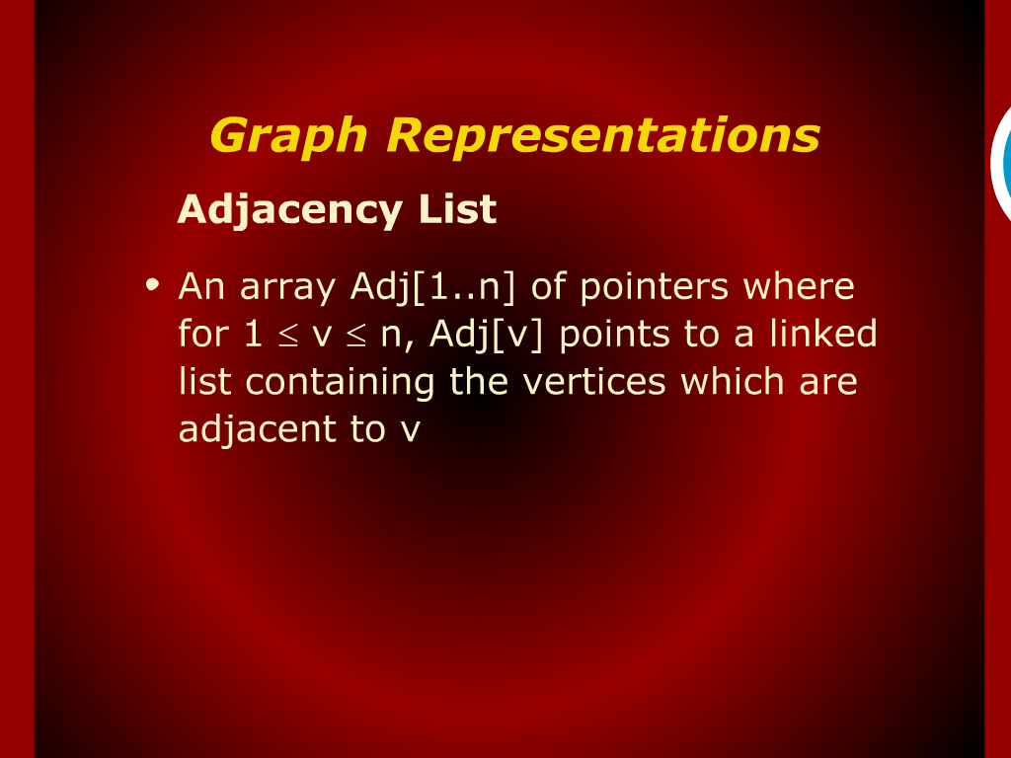
Graph Representations

Slide 13
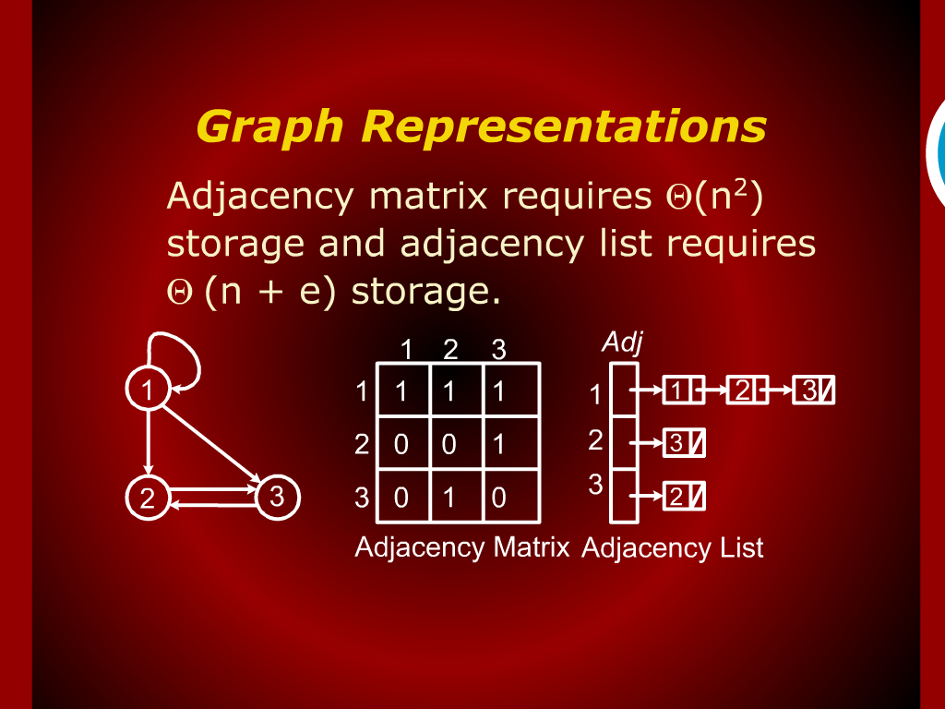
Graph Representations

Slide 14
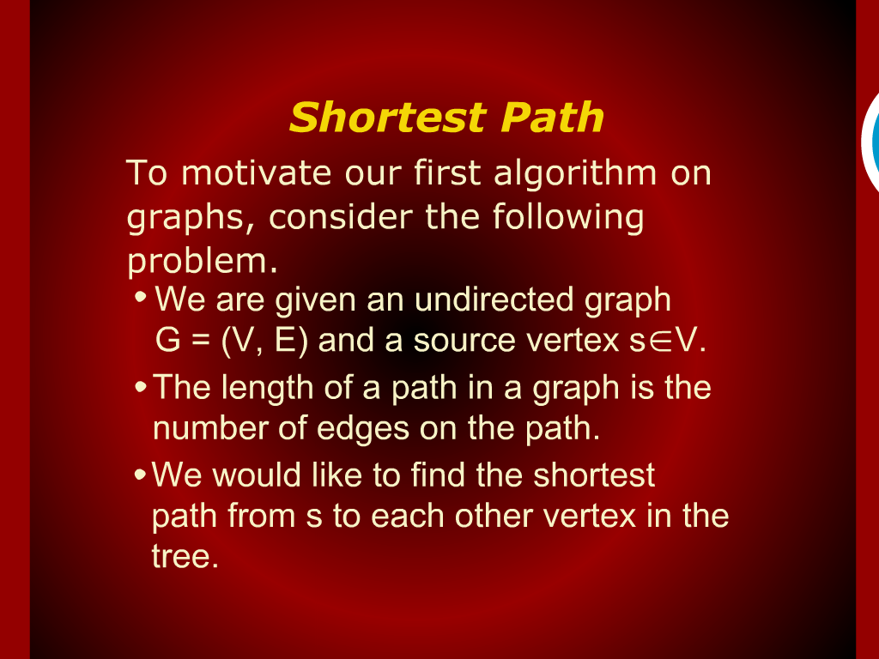
Shortest Path

Slide 15
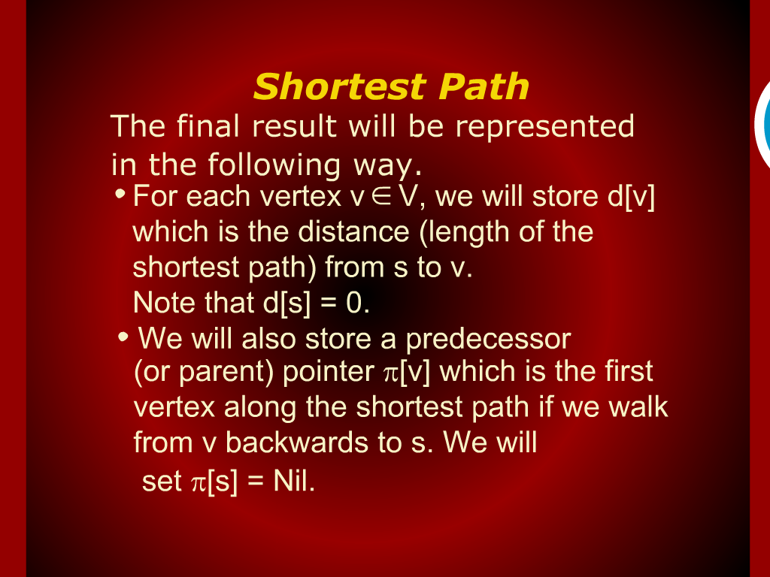
Shortest Path

Slide 16
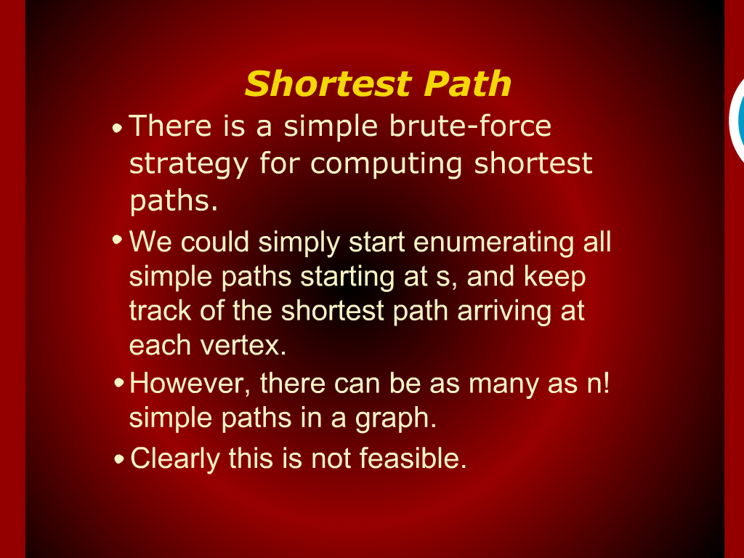
Shortest Path

Slide 17
Design and Analysis
Of
Algorithms

Slide 18
GRAPHS

