Slide 1
Algorithms
Lecture # 29
Dr. Sohail Aslam

Slide 2
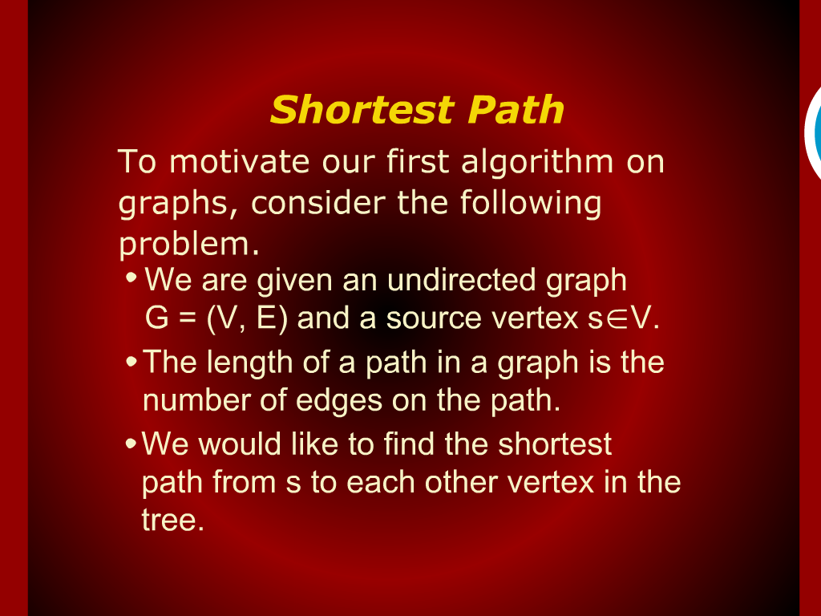
Shortest Path

Slide 3
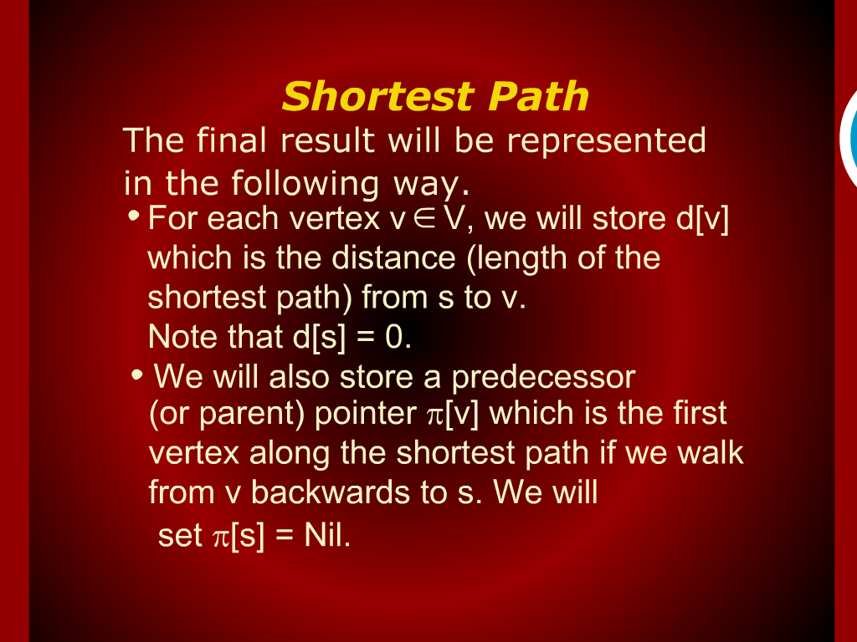
Shortest Path

Slide 4
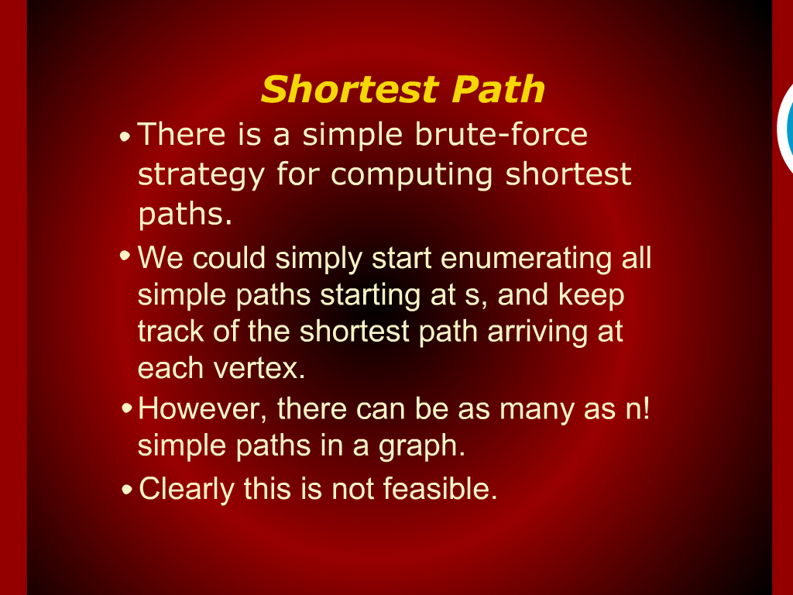
Shortest Path

Slide 5
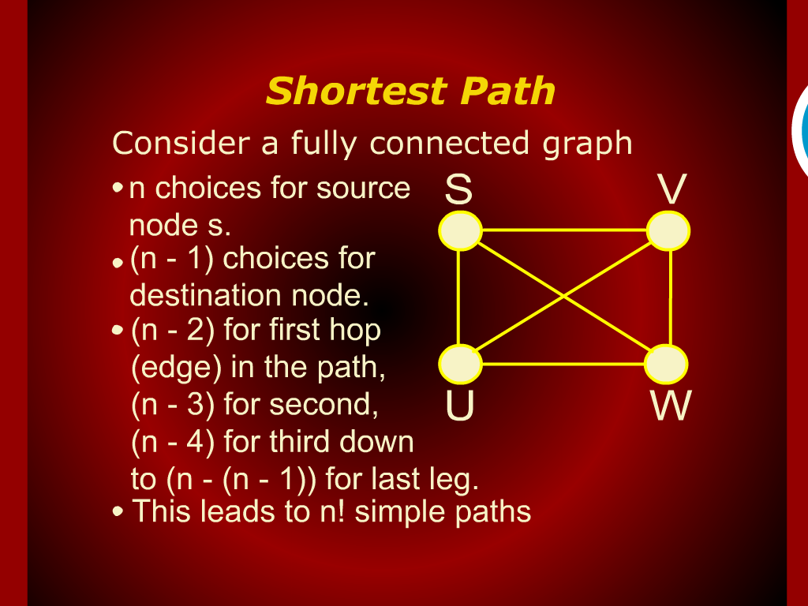
Shortest Path

Slide 6
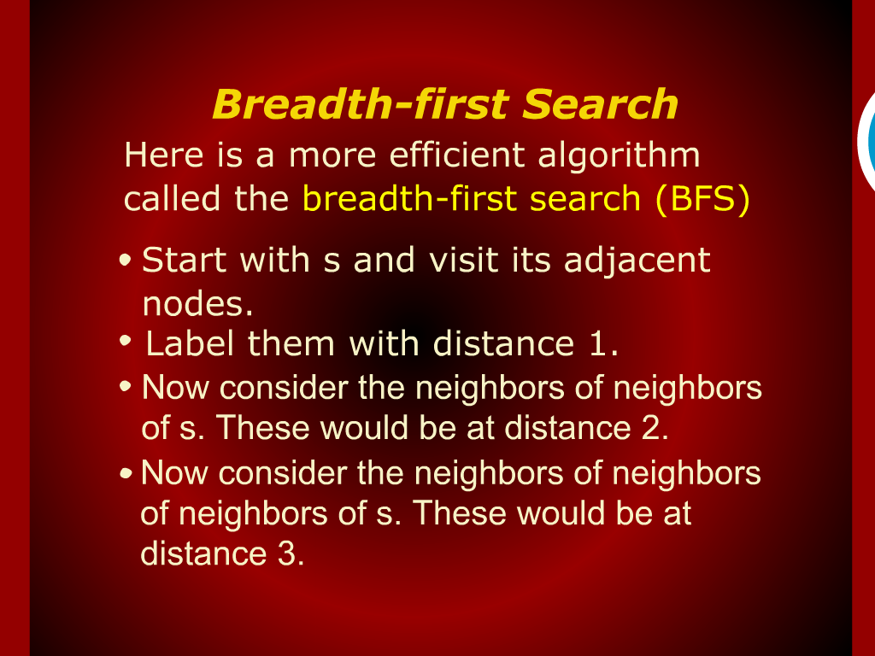
Breadth-first Search

Slide 7
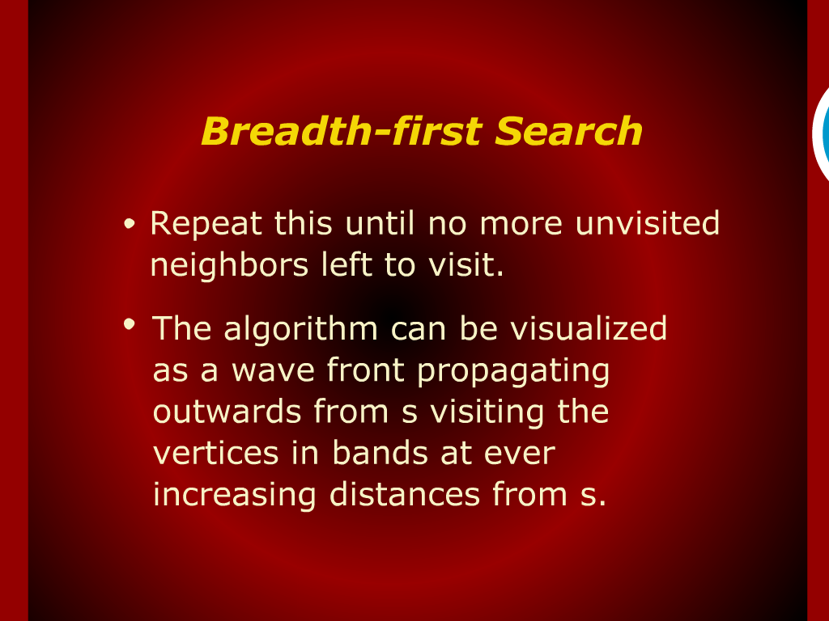
Breadth-first Search

Slide 8
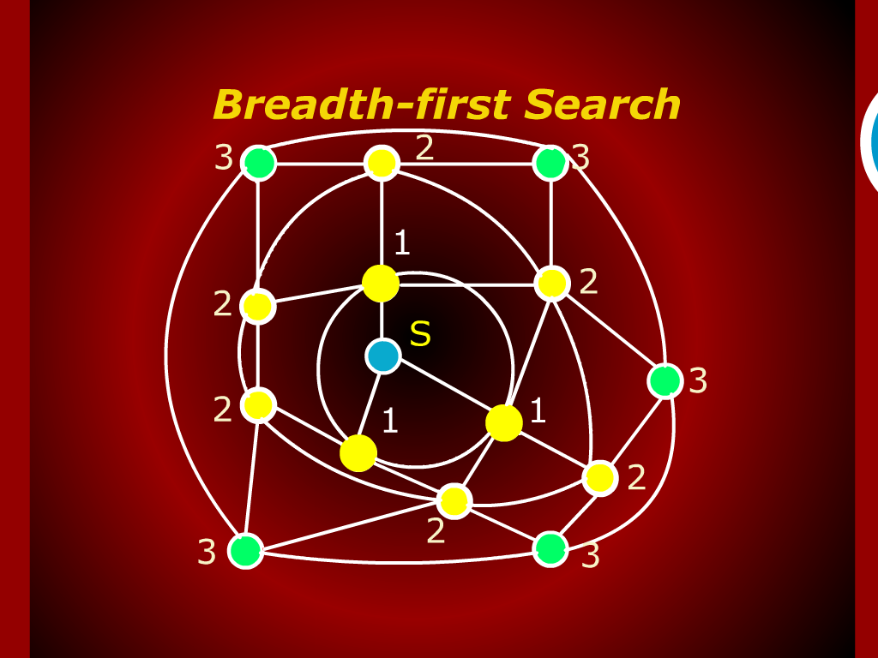
Breadth-first Search

Slide 9
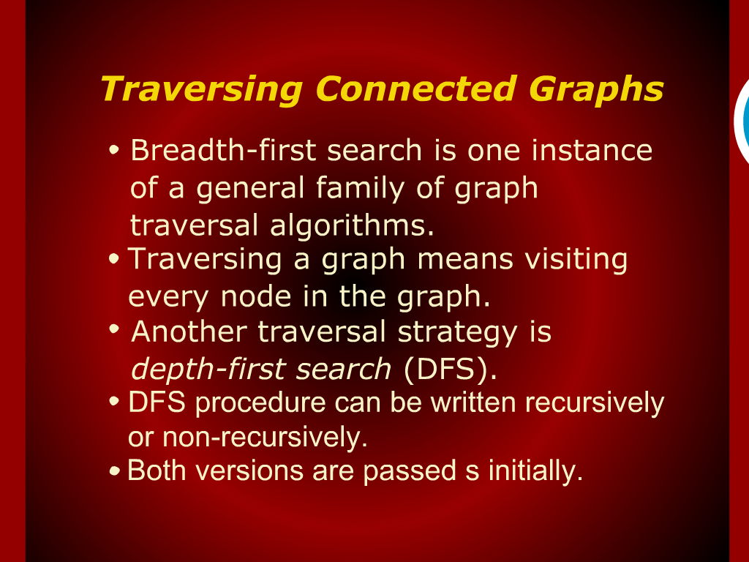
Traversing Connected Graphs

Slide 10
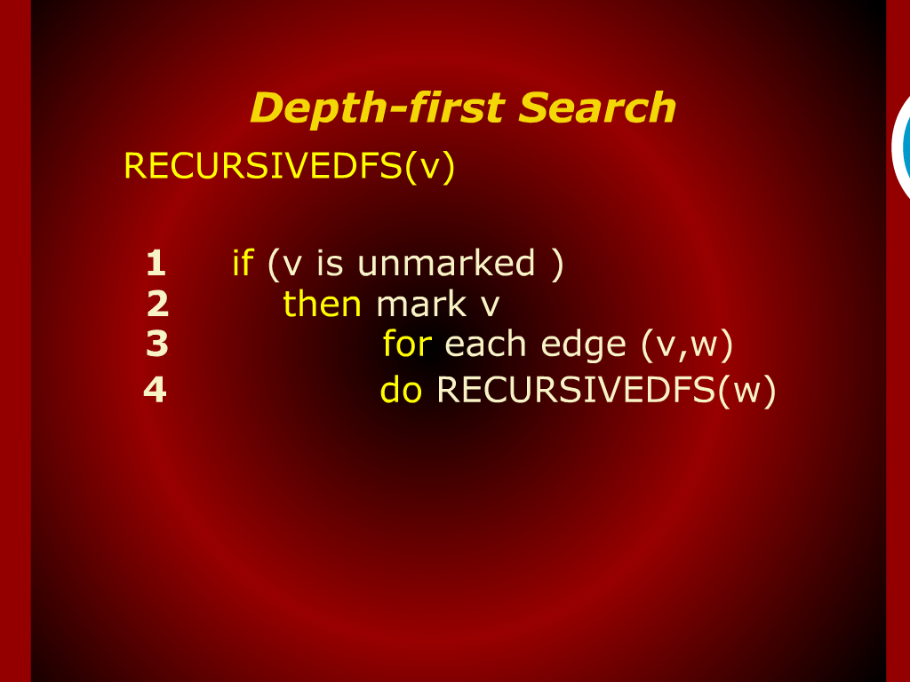
Depth-first Search

Slide 11
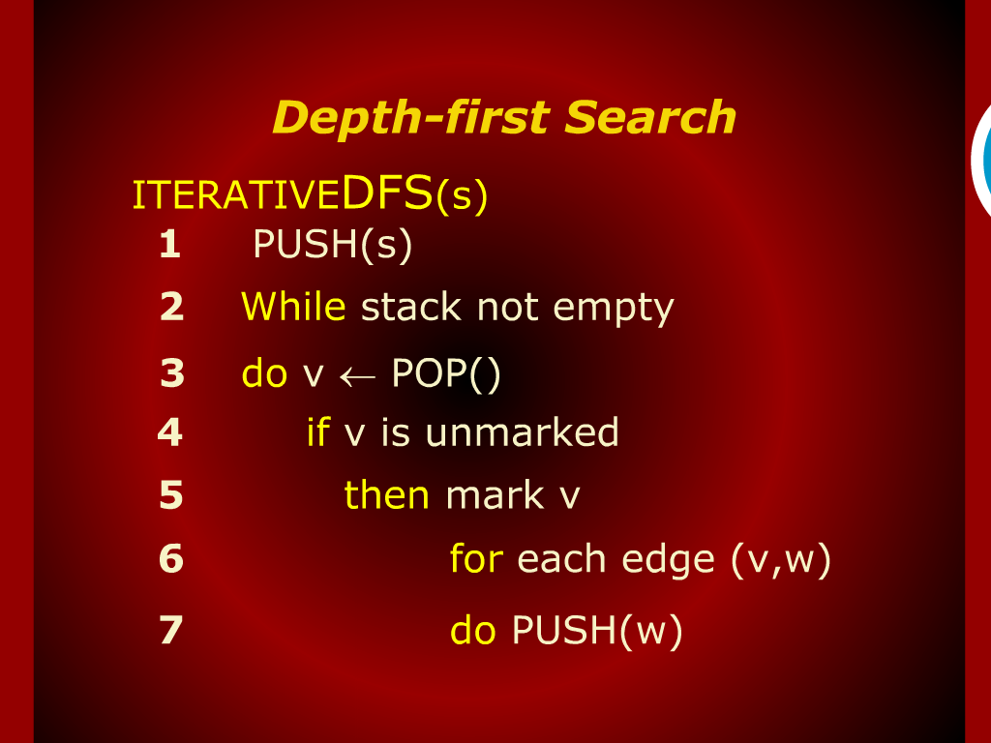
Depth-first Search

Slide 12
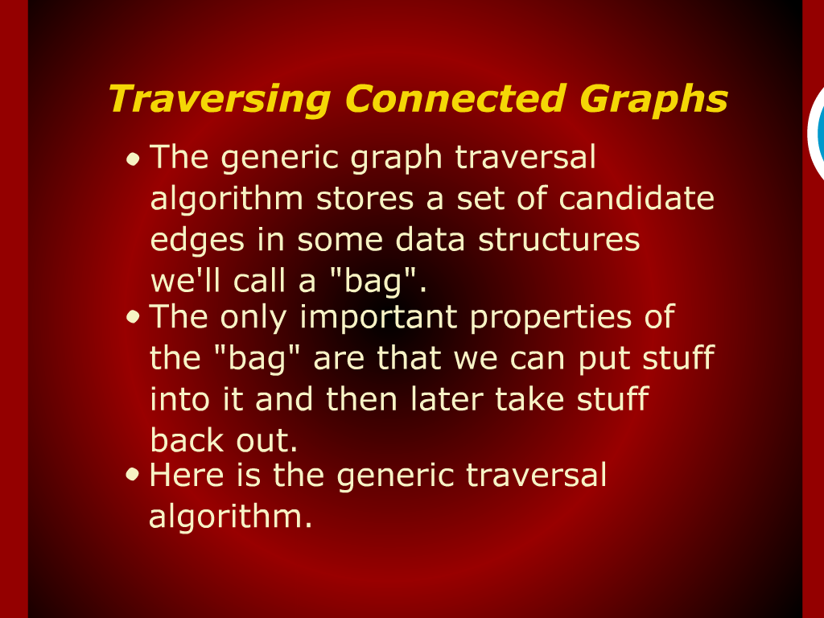
Traversing Connected Graphs

Slide 13
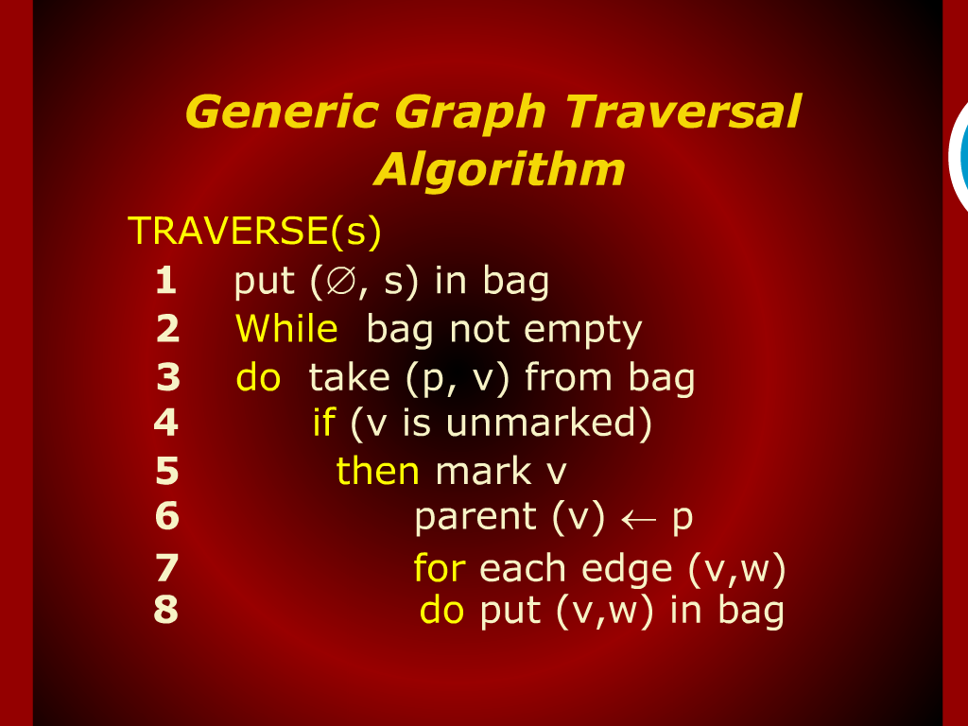
Generic Graph Traversal Algorithm

Slide 14
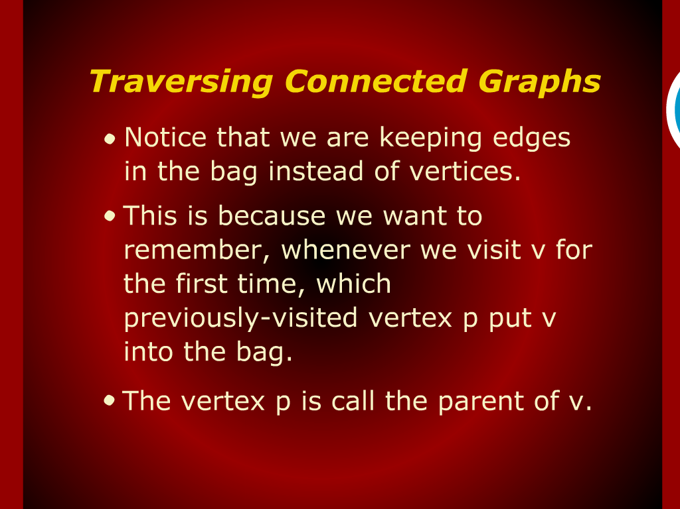
Traversing Connected Graphs

Slide 15
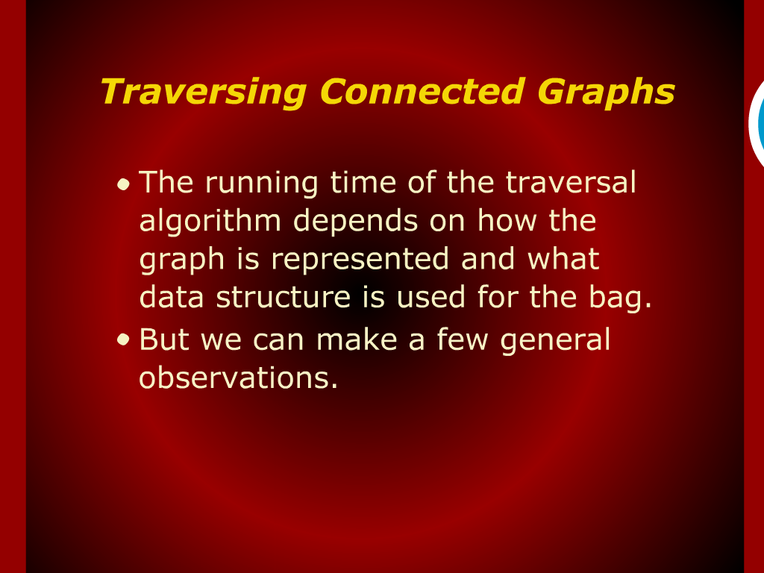
Traversing Connected Graphs

Slide 16
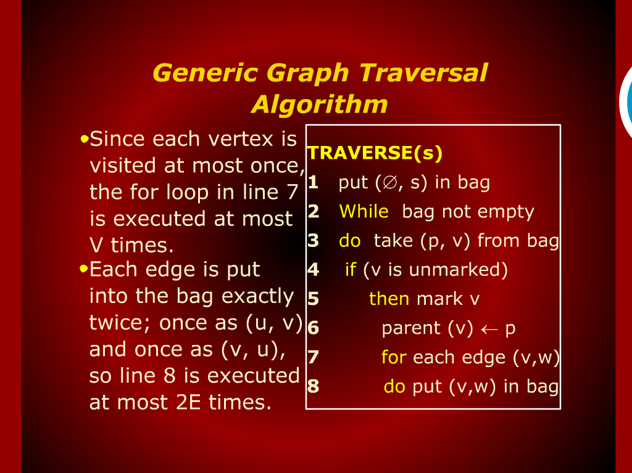
Generic Graph Traversal Algorithm

Slide 17
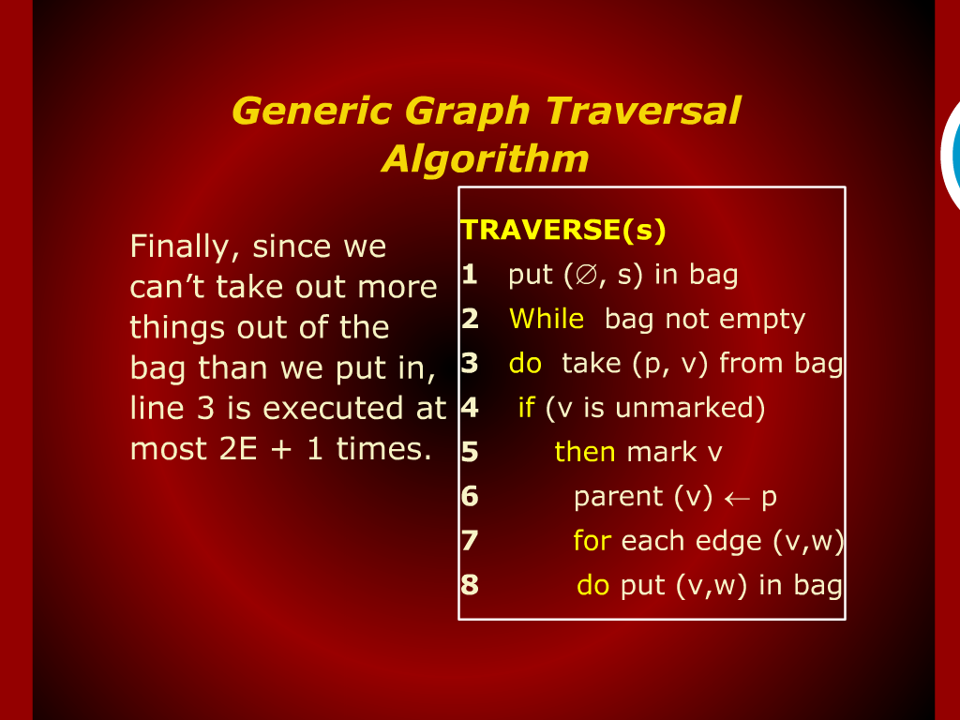
Generic Graph Traversal Algorithm

Slide 18
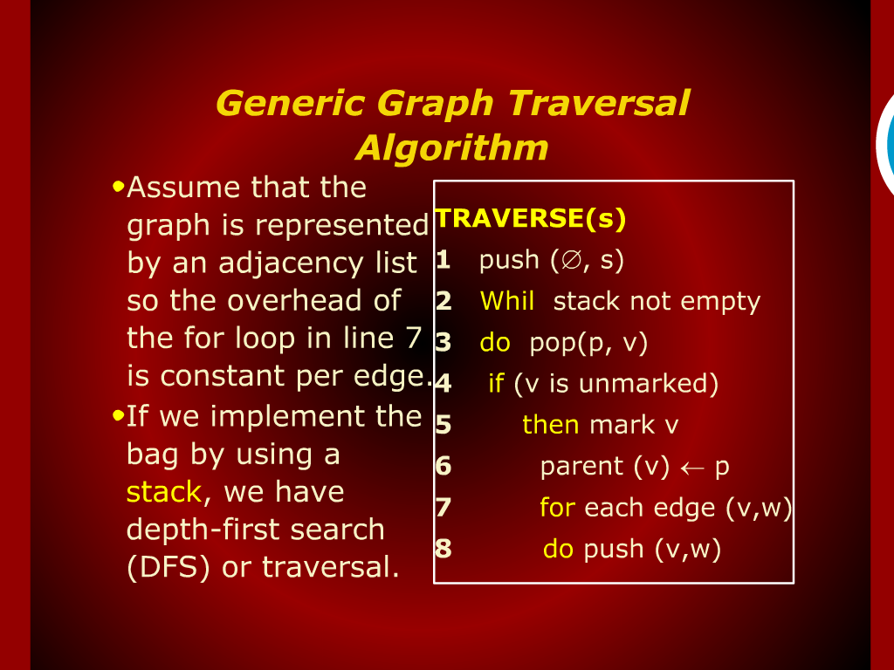
Generic Graph Traversal Algorithm

Slide 19
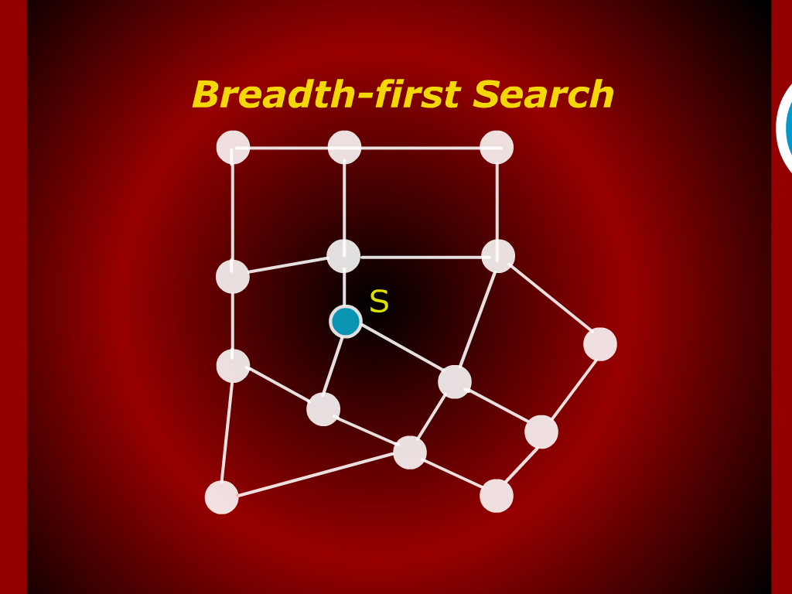
Breadth-first Search

Slide 20
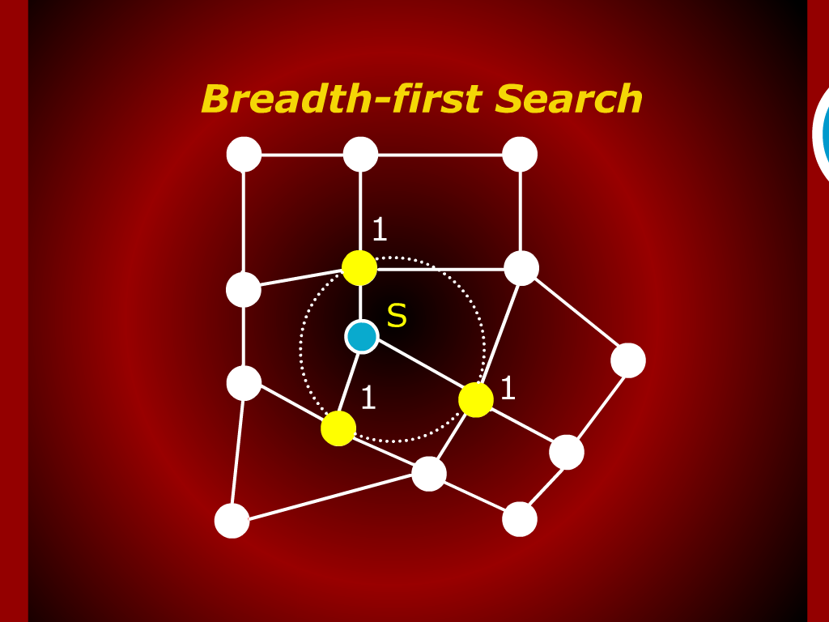
Breadth-first Search

Slide 21
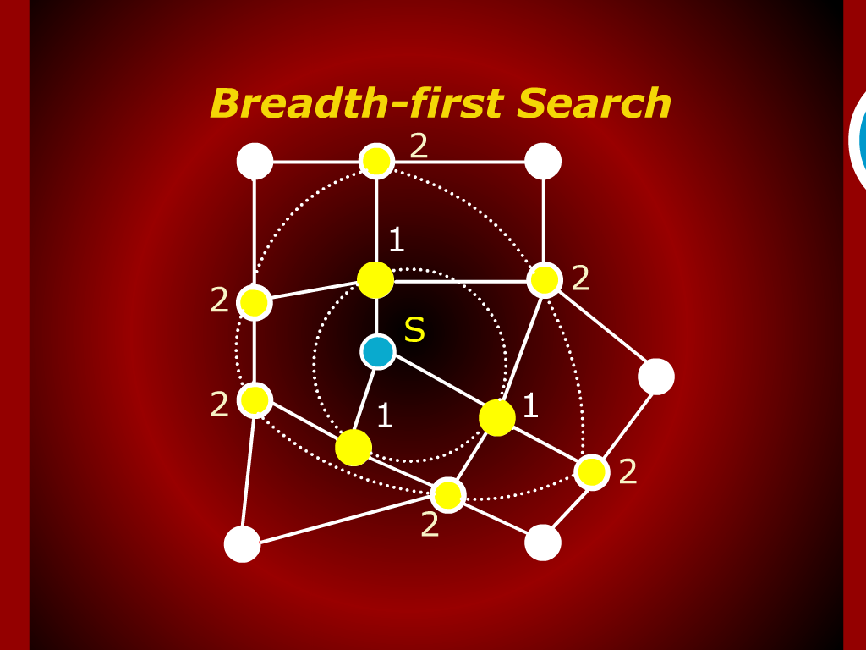
Breadth-first Search

Slide 22

Breadth-first Search

Slide 23
GRAPHS

Slide 24
Depth-first Search

Slide 25
Breadth-first Search

