Slide 1
Algorithms
Lecture # 30
Dr. Sohail Aslam

Slide 2
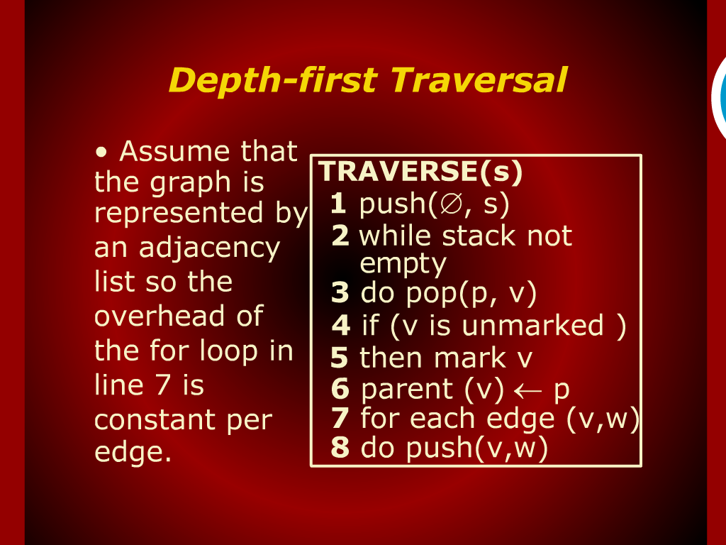
Depth-first Traversal

Slide 3
Depth-first Traversal

Slide 4
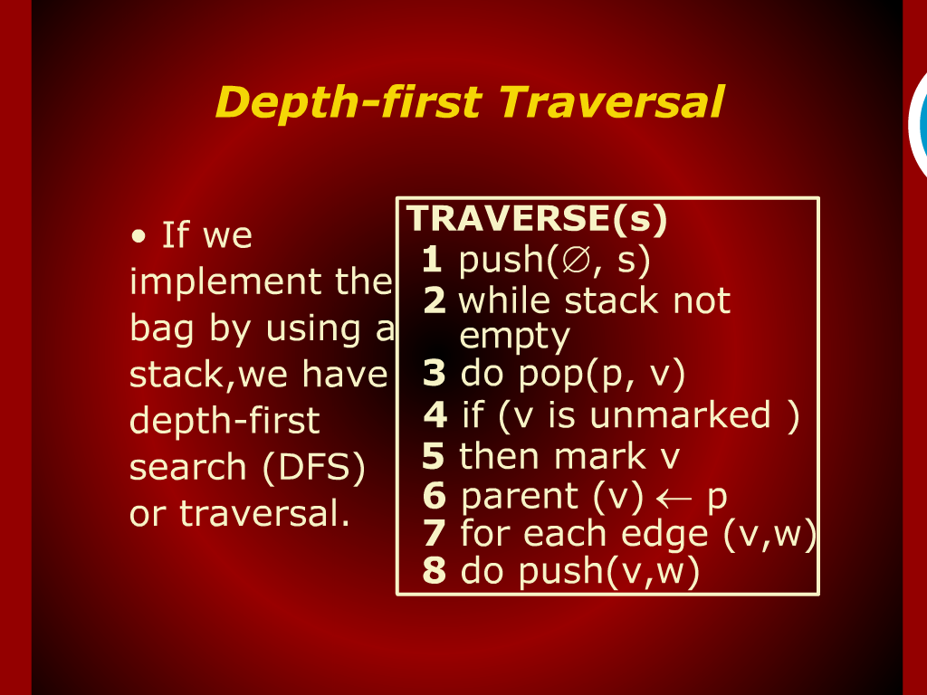
Model of Computation

Slide 5
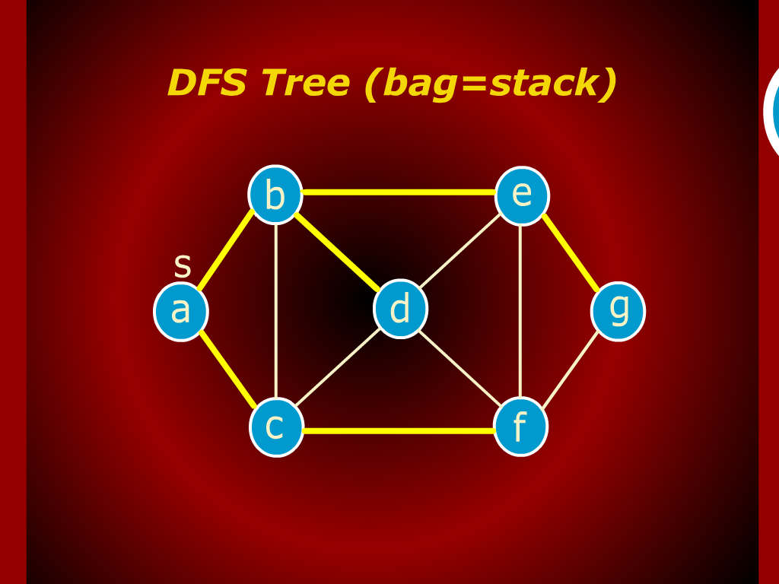
DFS Tree (bag=stack)

Slide 6
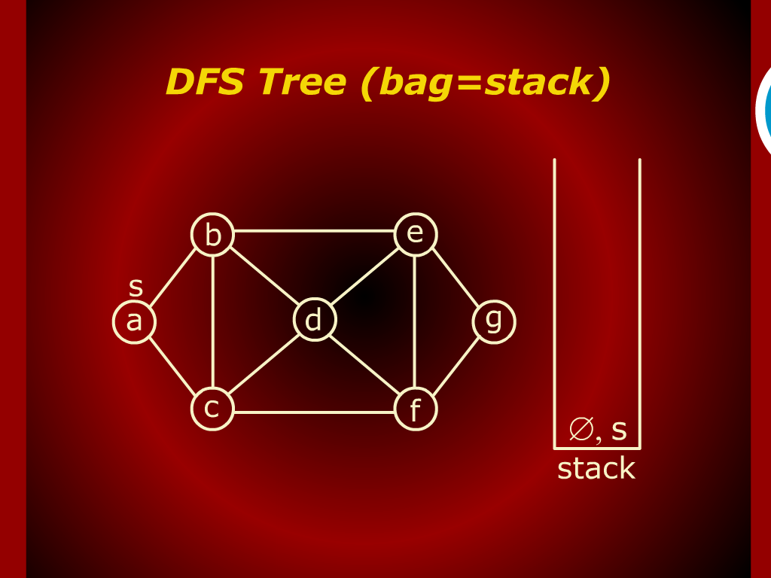
DFS Tree (bag=stack)

Slide 7
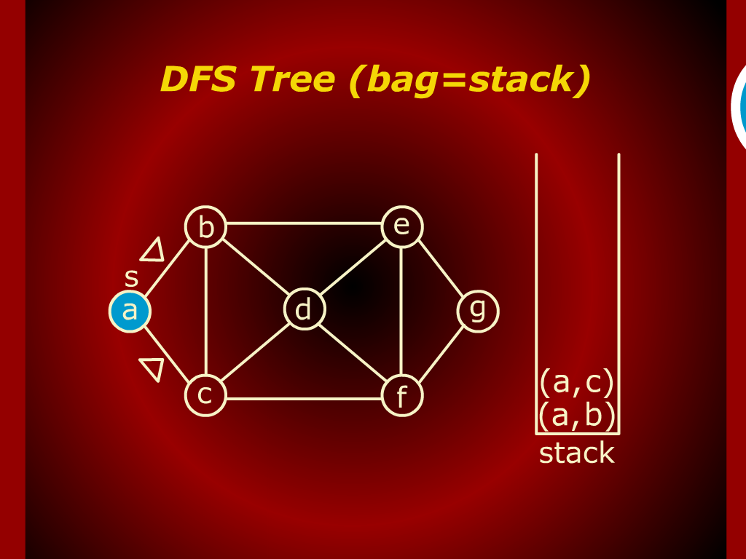
DFS Tree (bag=stack)

Slide 8
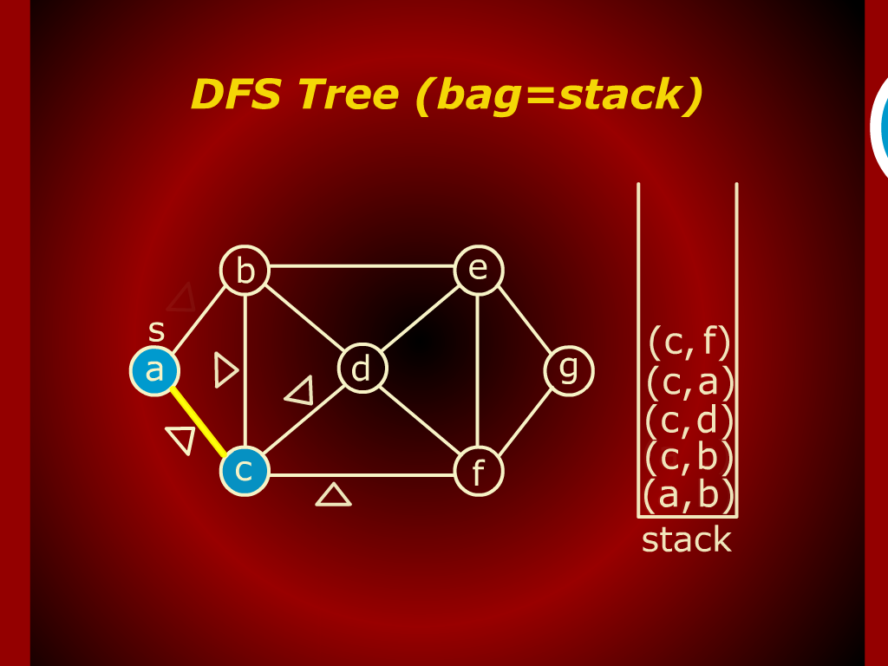
DFS Tree (bag=stack)

Slide 9
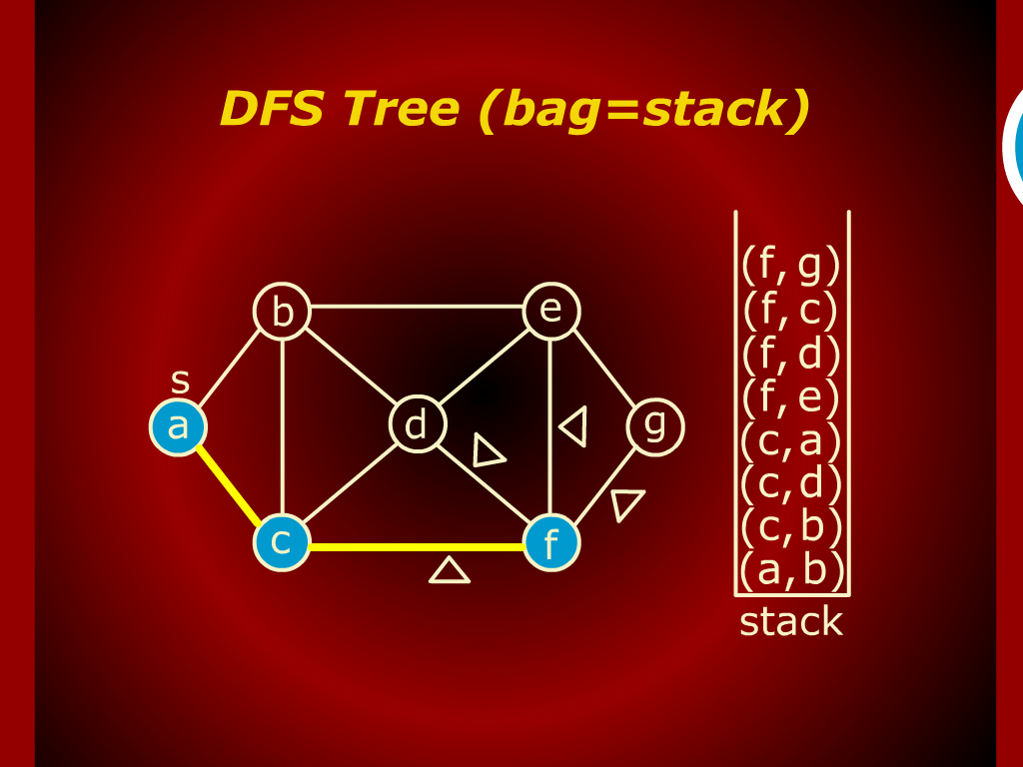
DFS Tree (bag=stack)

Slide 10
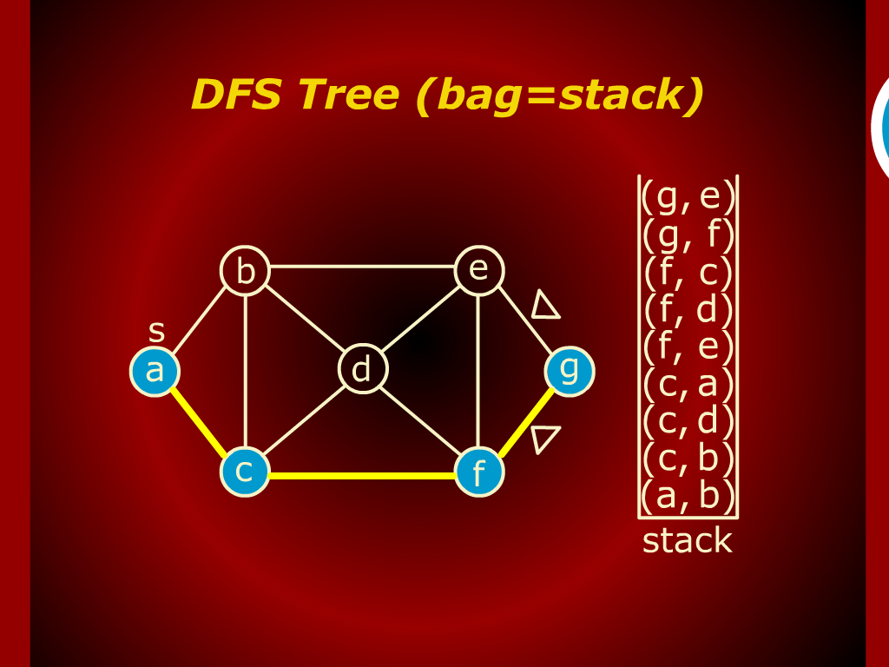
DFS Tree (bag=stack)

Slide 11
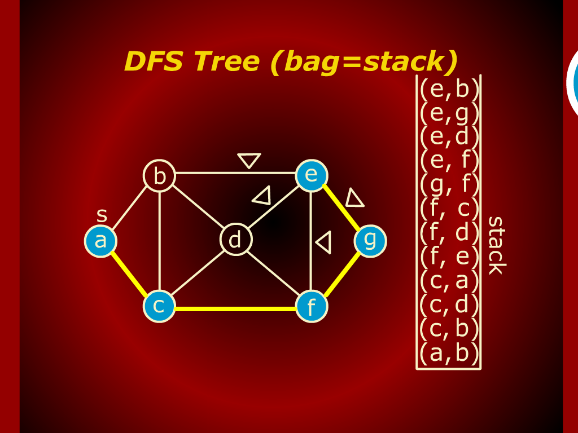
DFS Tree (bag=stack)

Slide 12
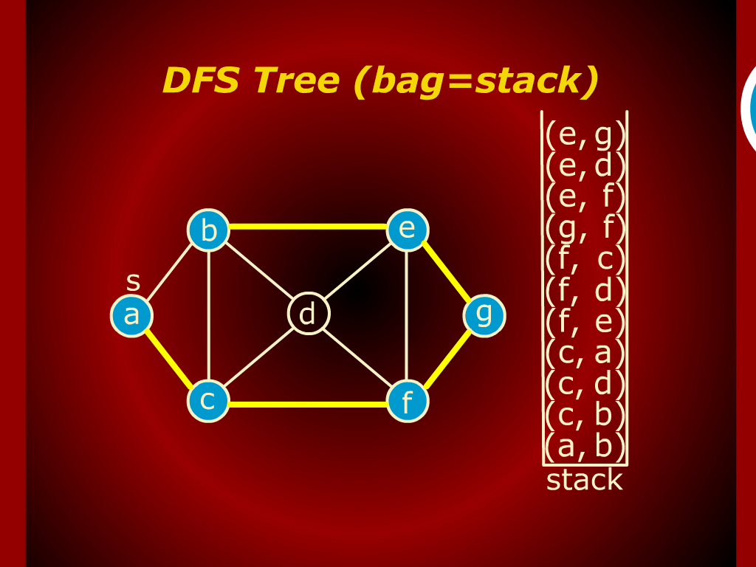
DFS Tree (bag=stack)

Slide 13
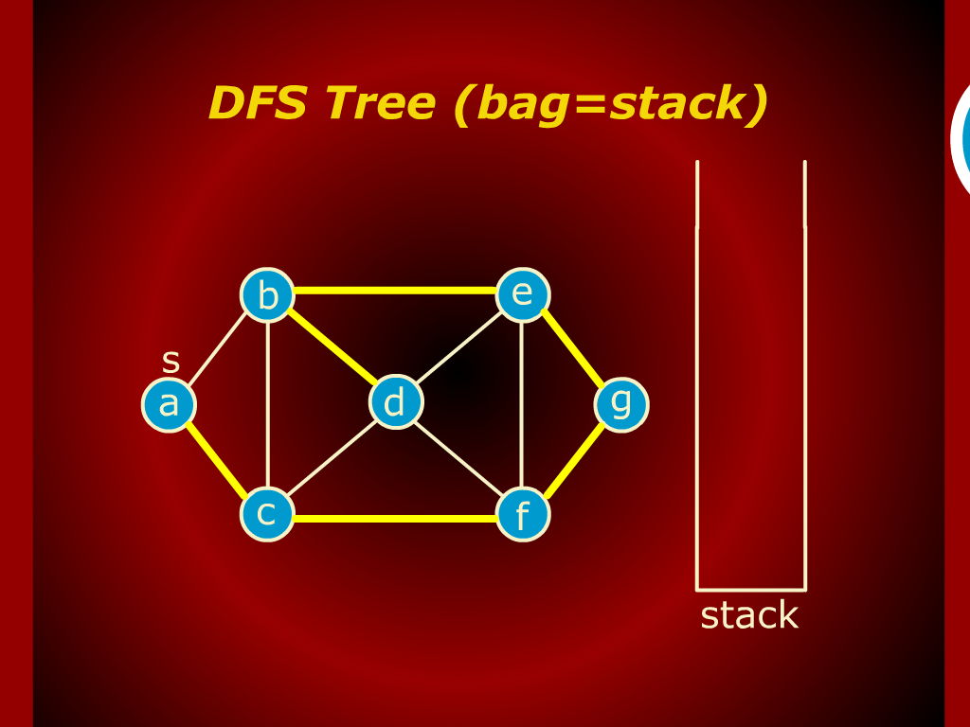
DFS Tree (bag=stack)

Slide 14
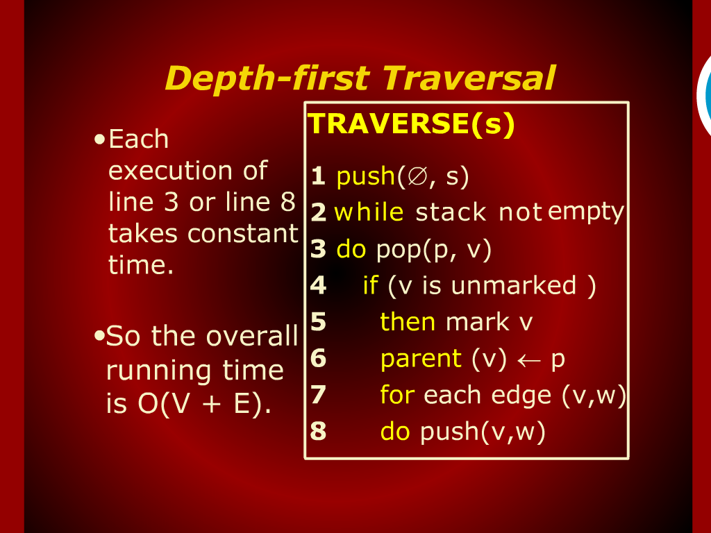
Depth-first Traversal

Slide 15
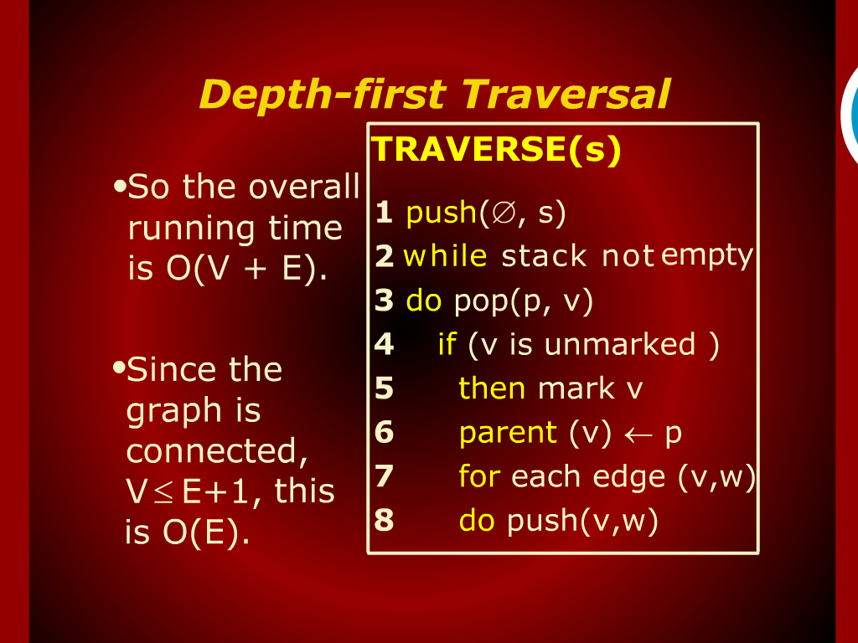
Depth-first Traversal

Slide 16
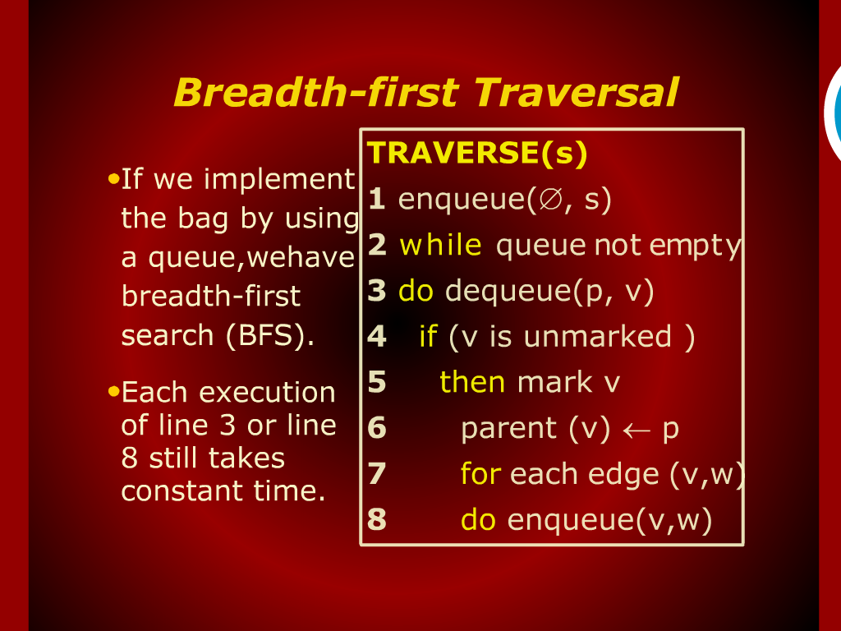
Breadth-first Traversal

Slide 17
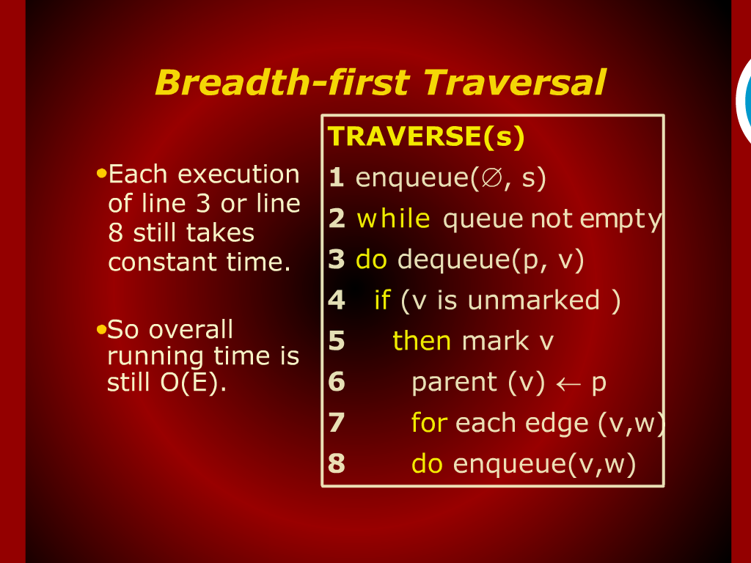
Breadth-first Traversal

Slide 18
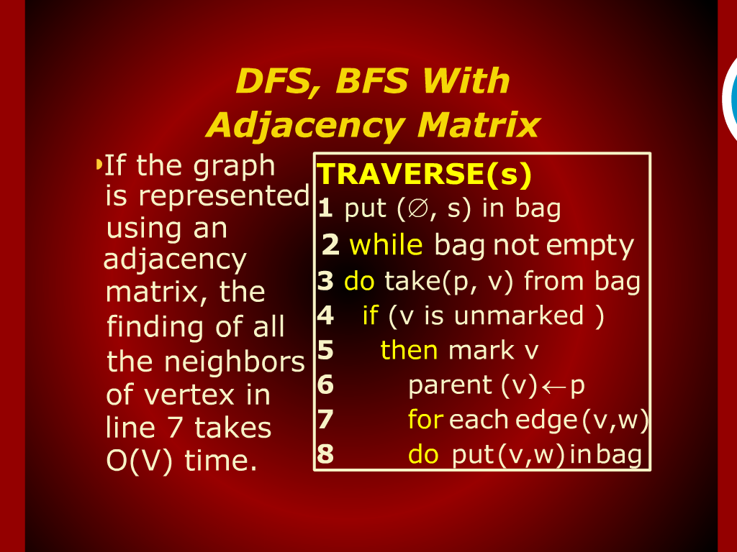
DFS,BFS with Adjacency Matrix

Slide 19
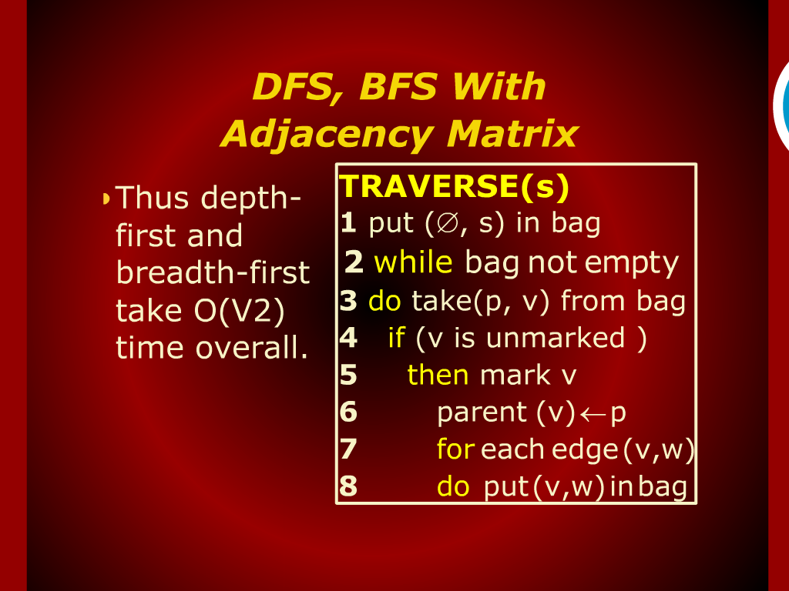
DFS,BFS with Adjacency Matrix

Slide 20
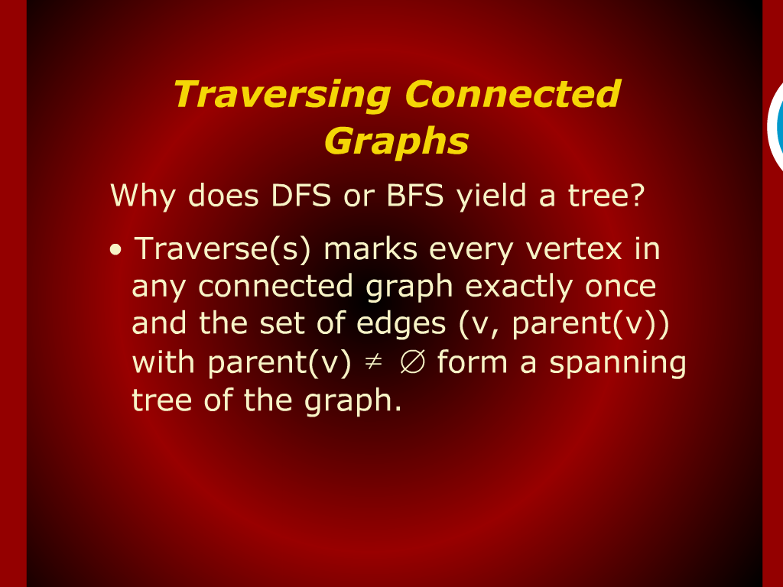
Traversing Connected Graphs

Slide 21
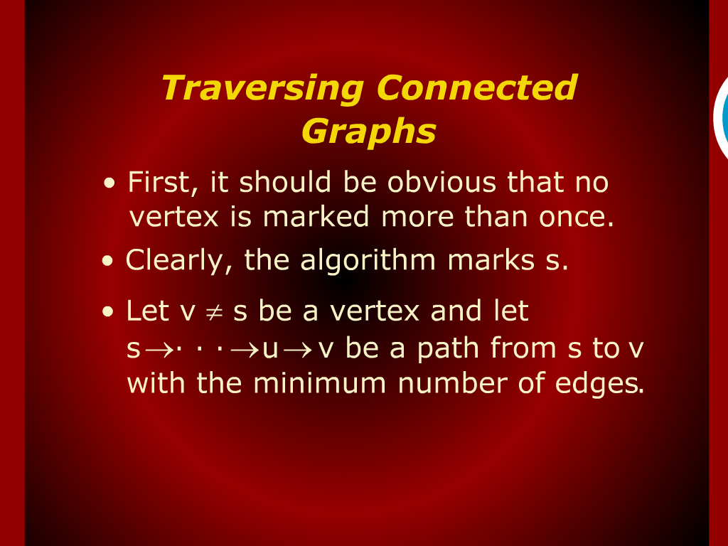
Traversing Connected Graphs

Slide 22
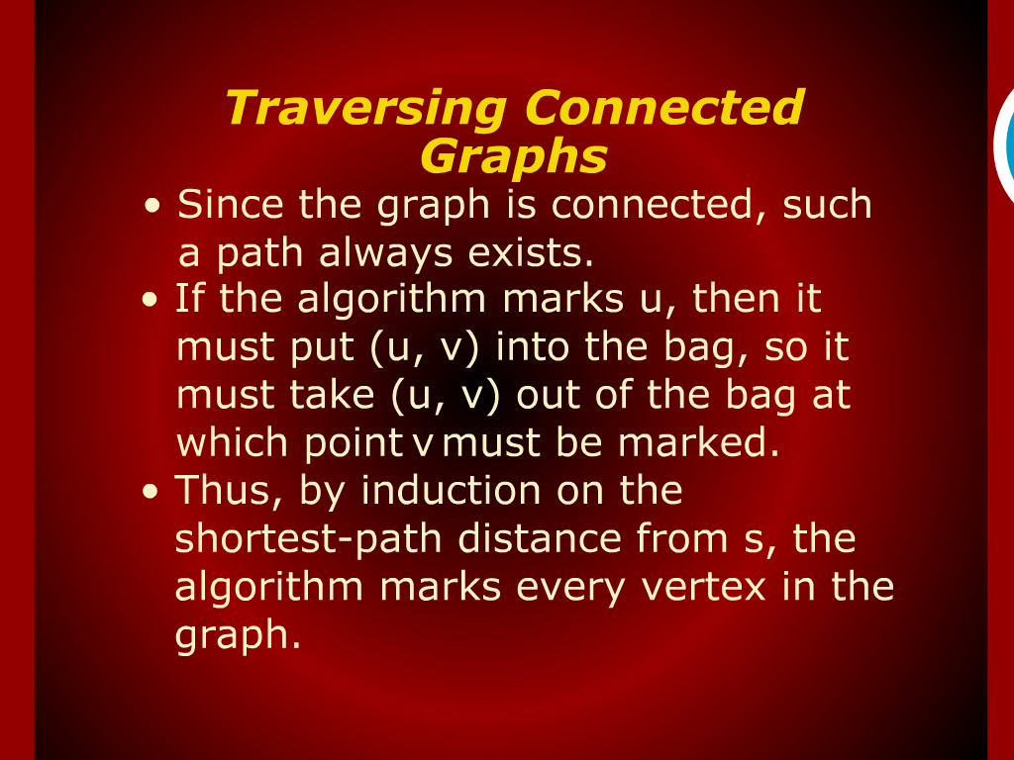
Traversing Connected Graphs

Slide 23
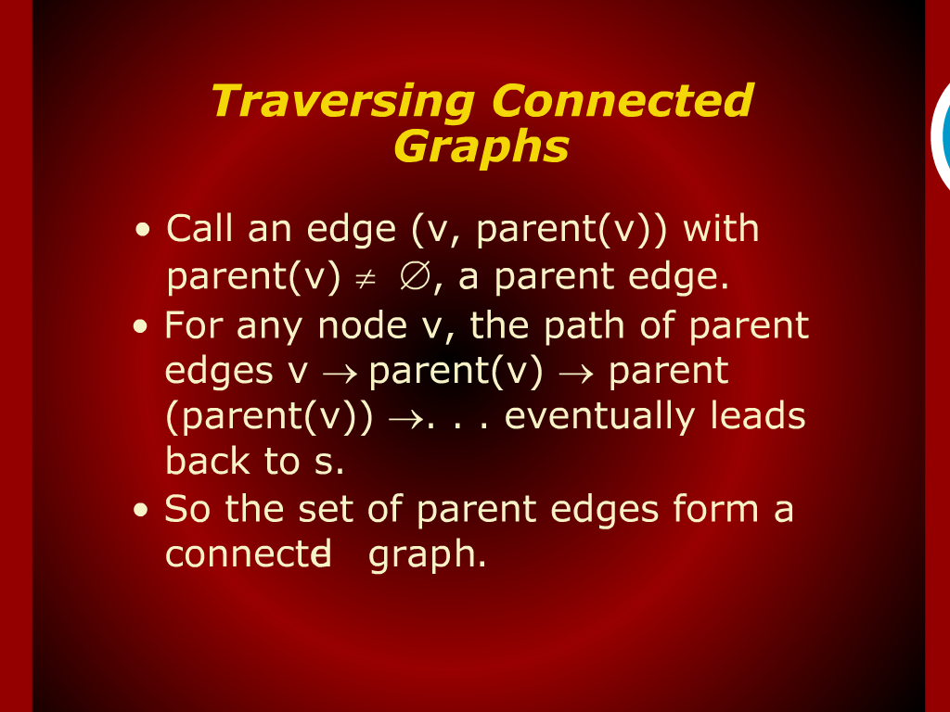
Traversing Connected Graphs

Slide 24
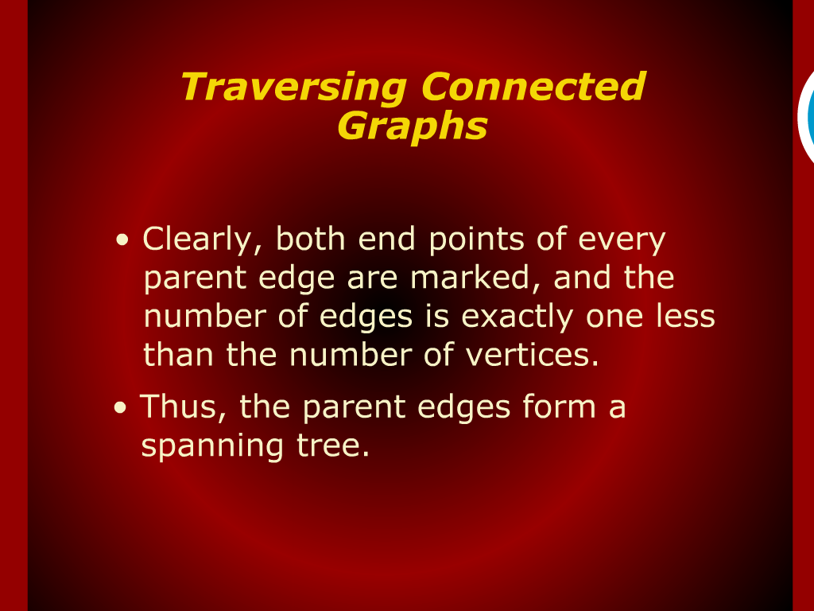
Traversing Connected Graphs

Slide 25
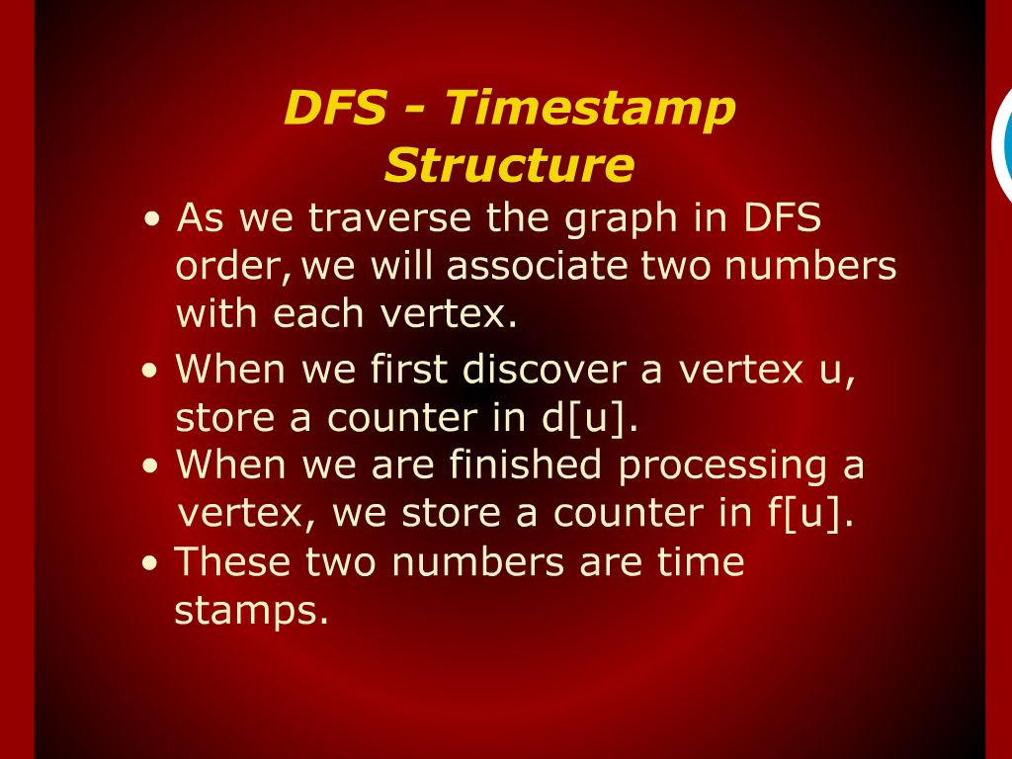
DFS – Timestamp Structure

Slide 26
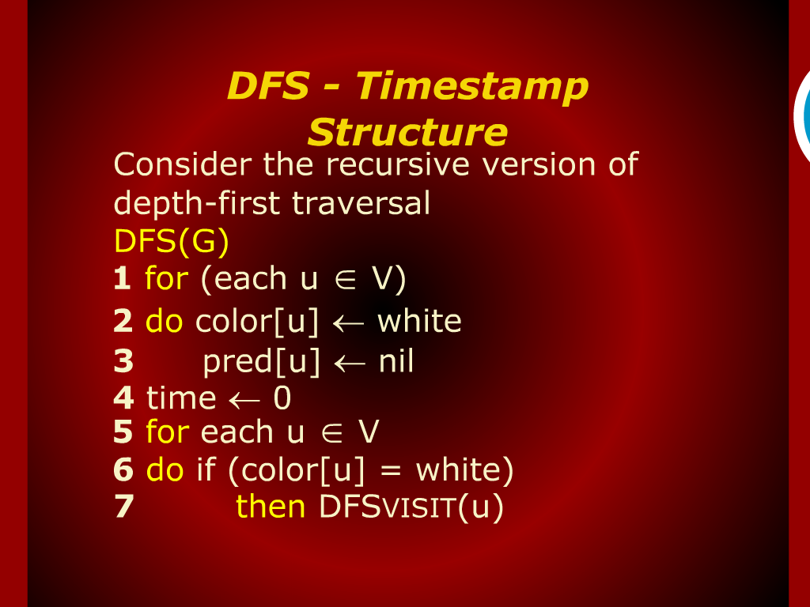
DFS – Timestamp Structure

Slide 27
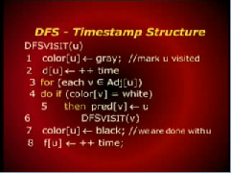
DFS – Timestamp Structure

Slide 28
Model of Computation

Slide 29
Depth-first Search

