Slide 1
Algorithms
Lecture # 31
Dr. Sohail Aslam

Slide 2
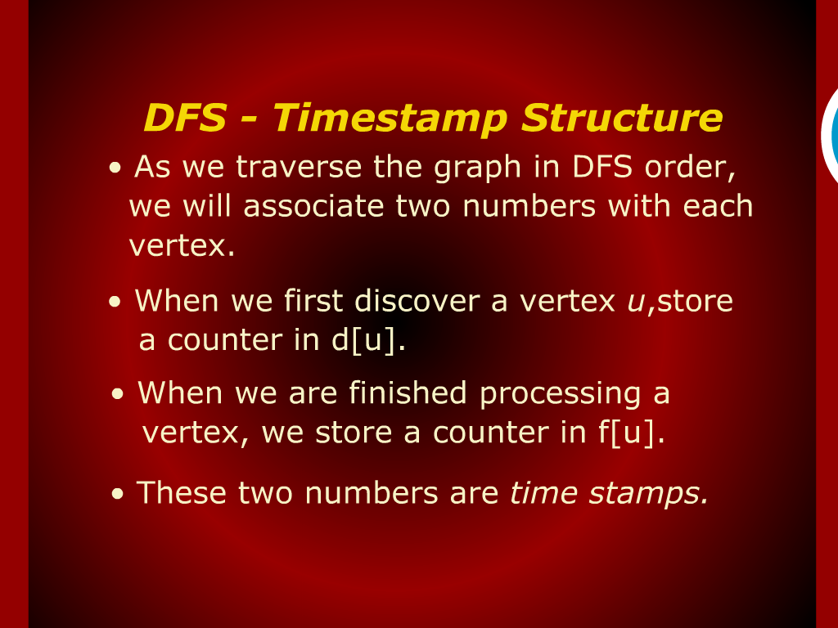
DFS-Time Stamp Structure

Slide 3
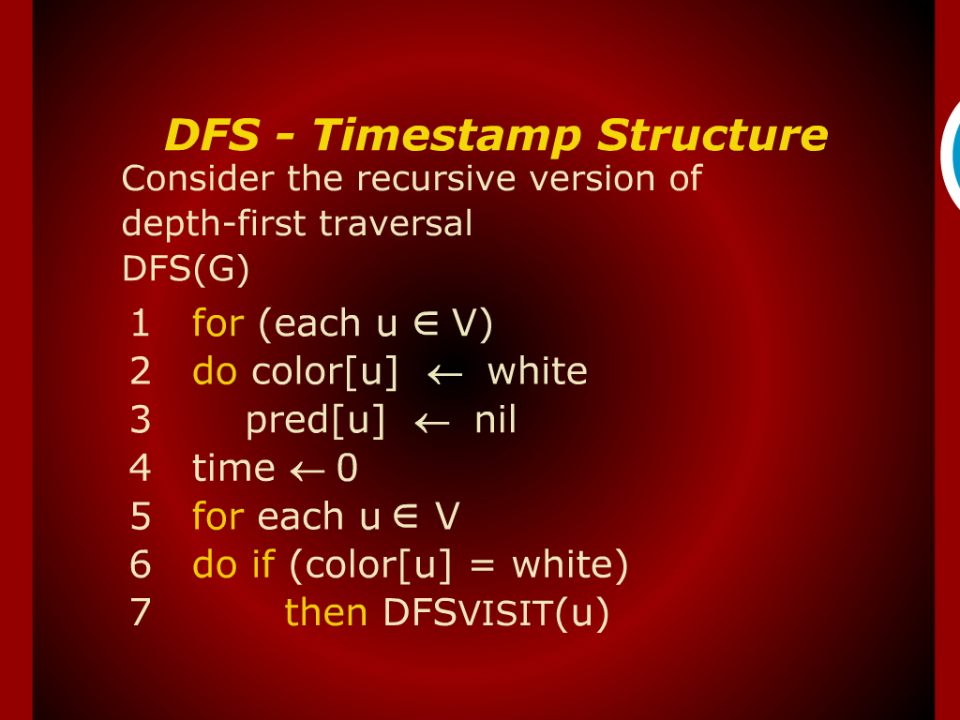
DFS-Time Stamp Structure

Slide 4
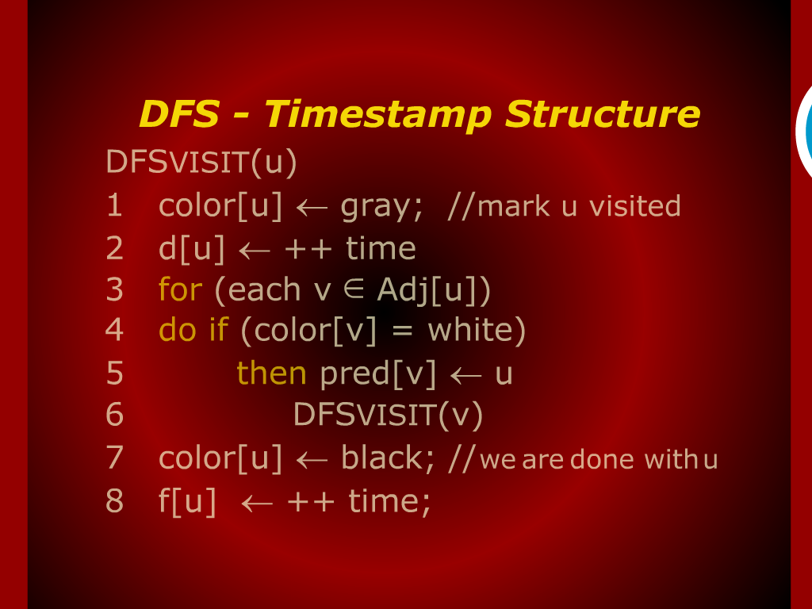
DFS-Time Stamp Structure

Slide 5
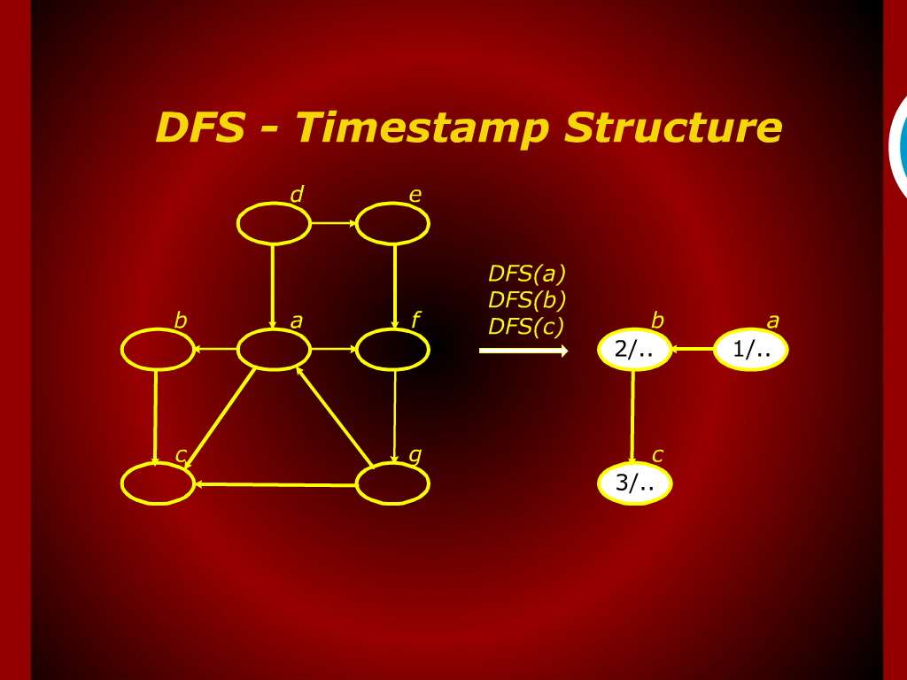
DFS-Time Stamp Structure

Slide 6
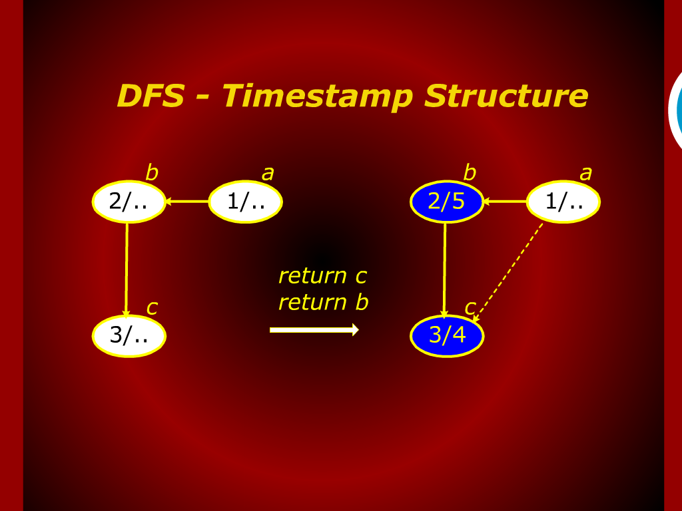
DFS-Time Stamp Structure

Slide 7
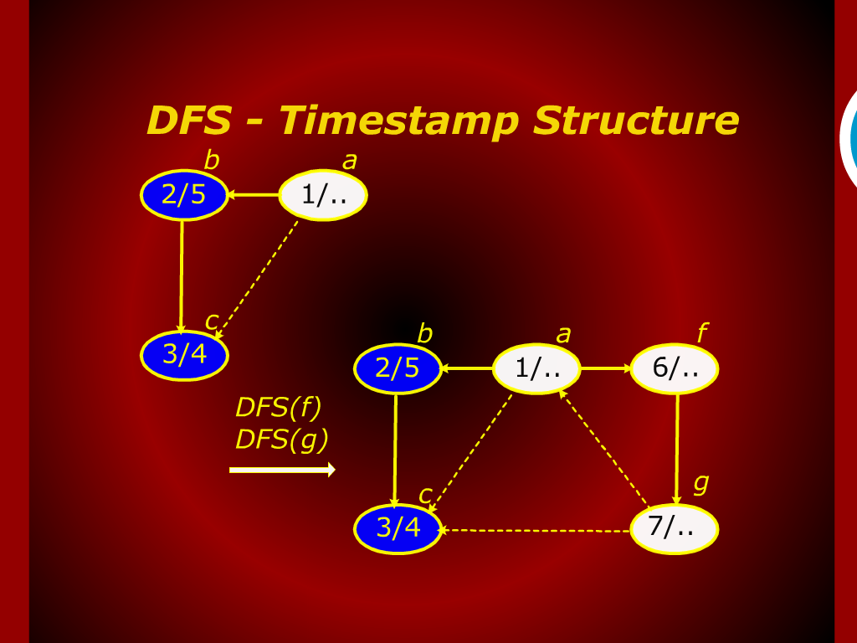
DFS-Time Stamp Structure

Slide 8
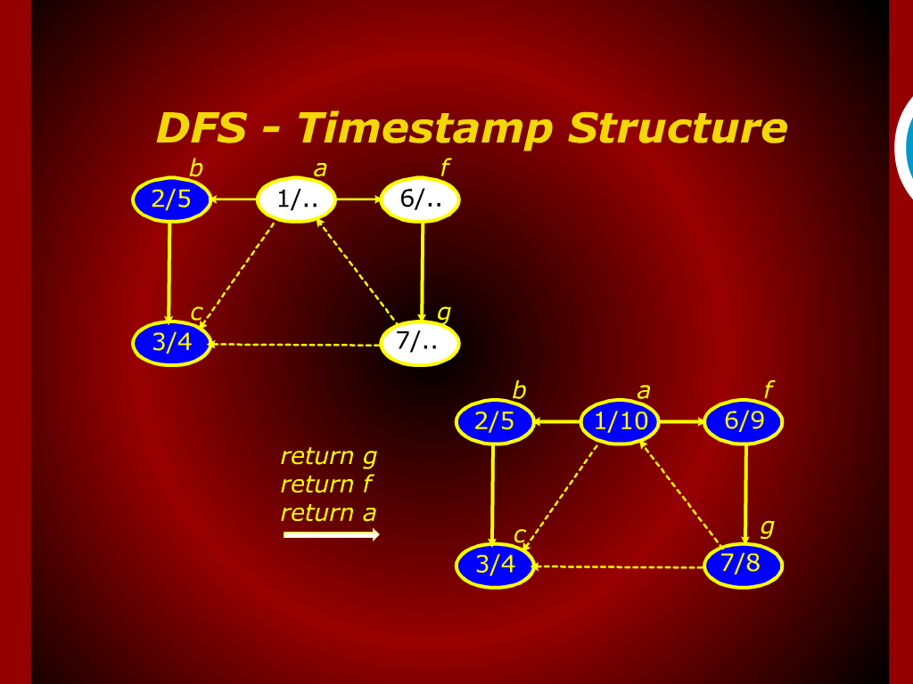
DFS-Time Stamp Structure

Slide 9
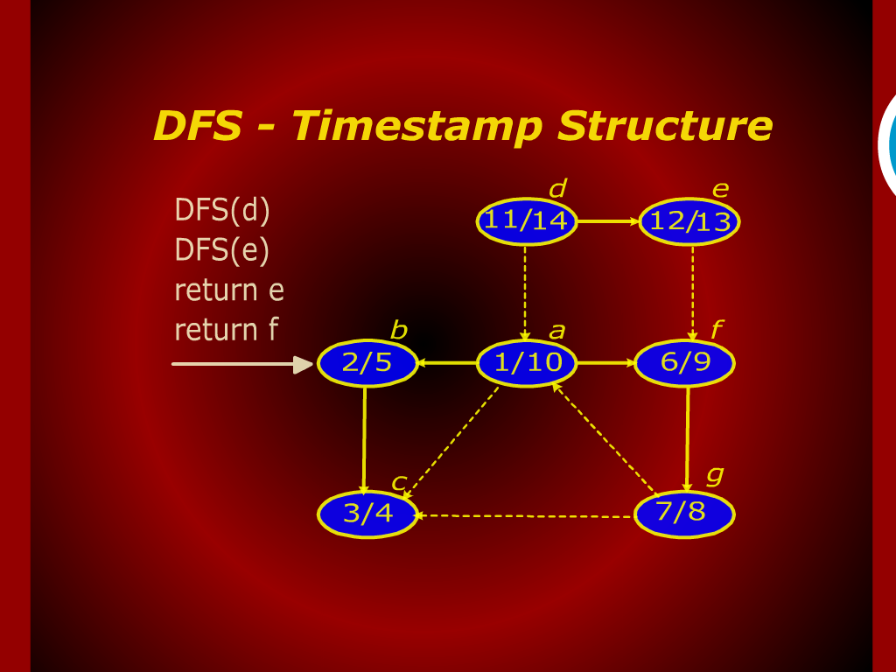
DFS-Time Stamp Structure

Slide 10
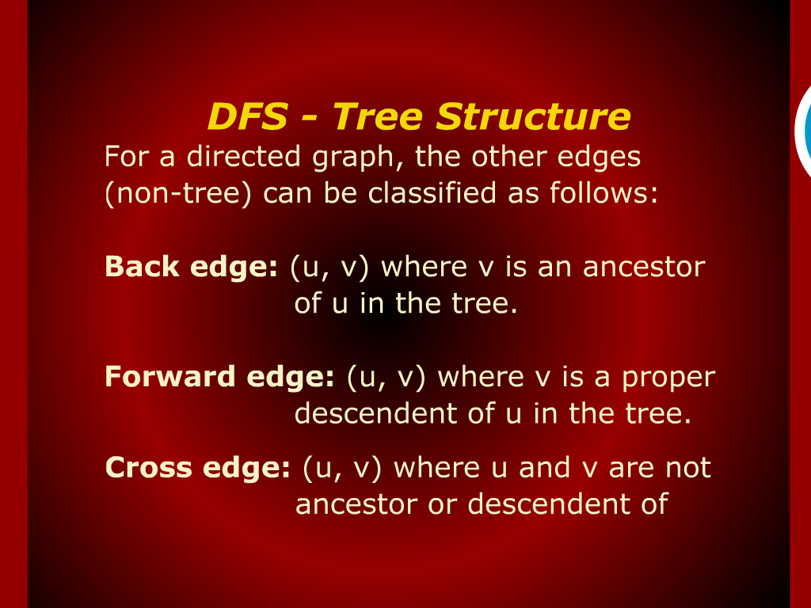
DFS-Tree Structure

Slide 11
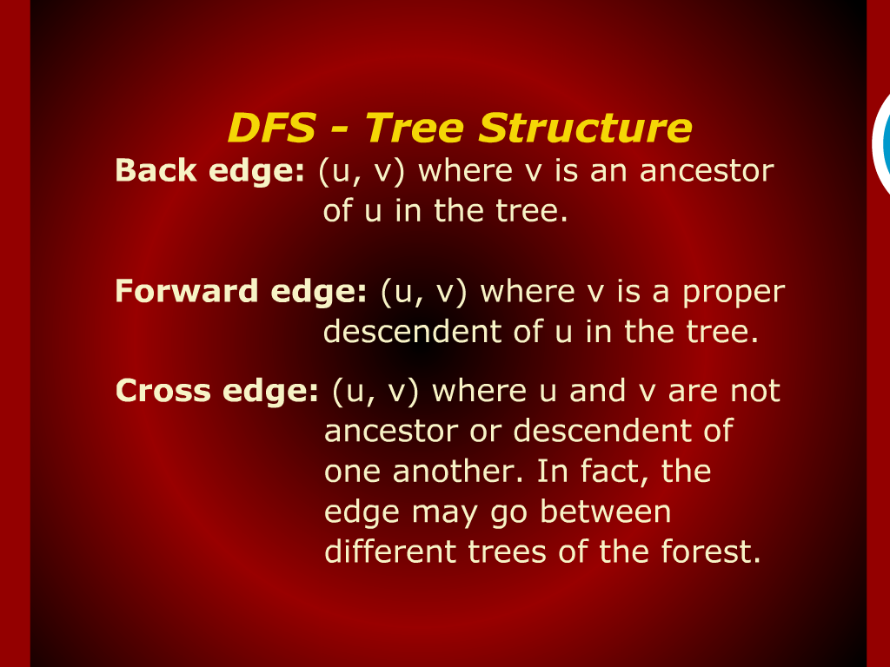
DFS-Tree Structure

Slide 12
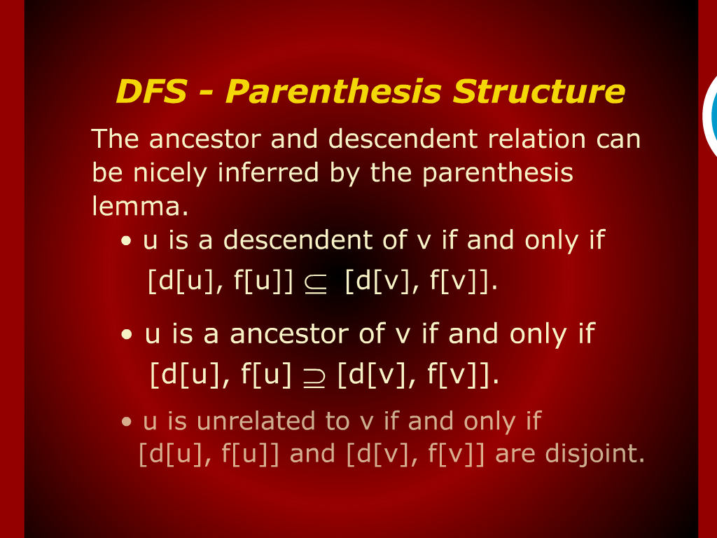
DFS-Parenthesis Structure

Slide 13
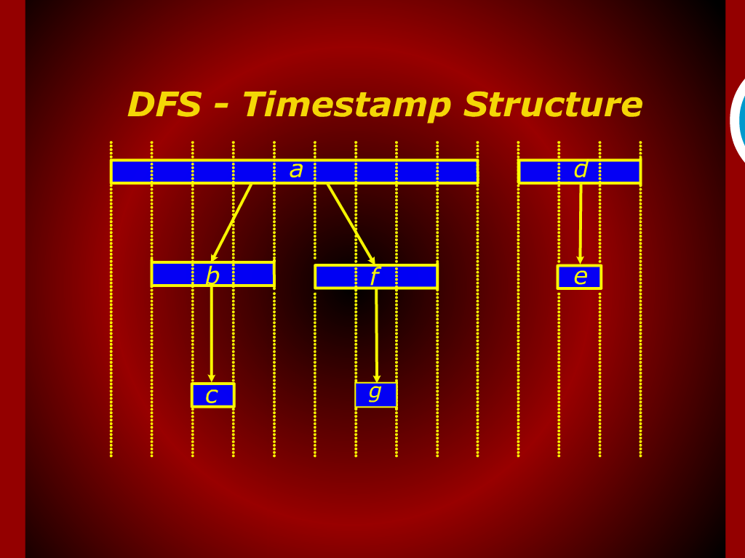
DFS-Time Stamp Structure

Slide 14
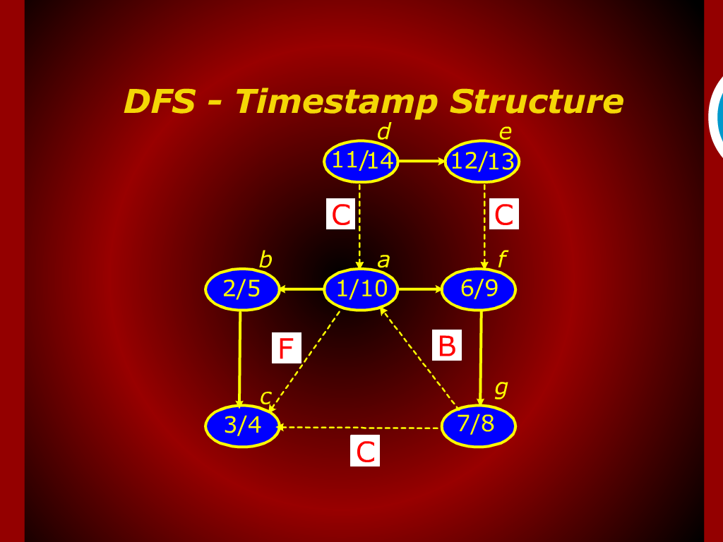
DFS-Time Stamp Structure

Slide 15
DFS
Time Stamp
Structure

