Slide 1
Algorithms
Lecture #32
Dr. Sohail Aslam

Slide 2
Design & Analysis of Algorithms

Slide 3
DFS
Cycles

Slide 4
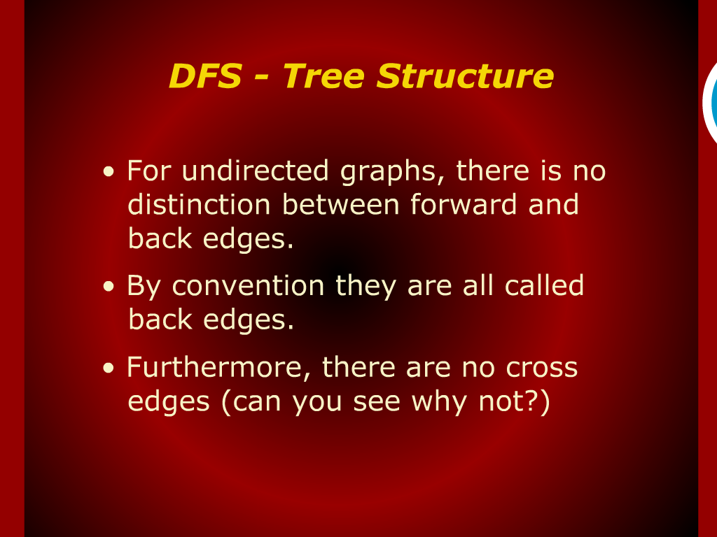
DFS-Tree Structures

Slide 5
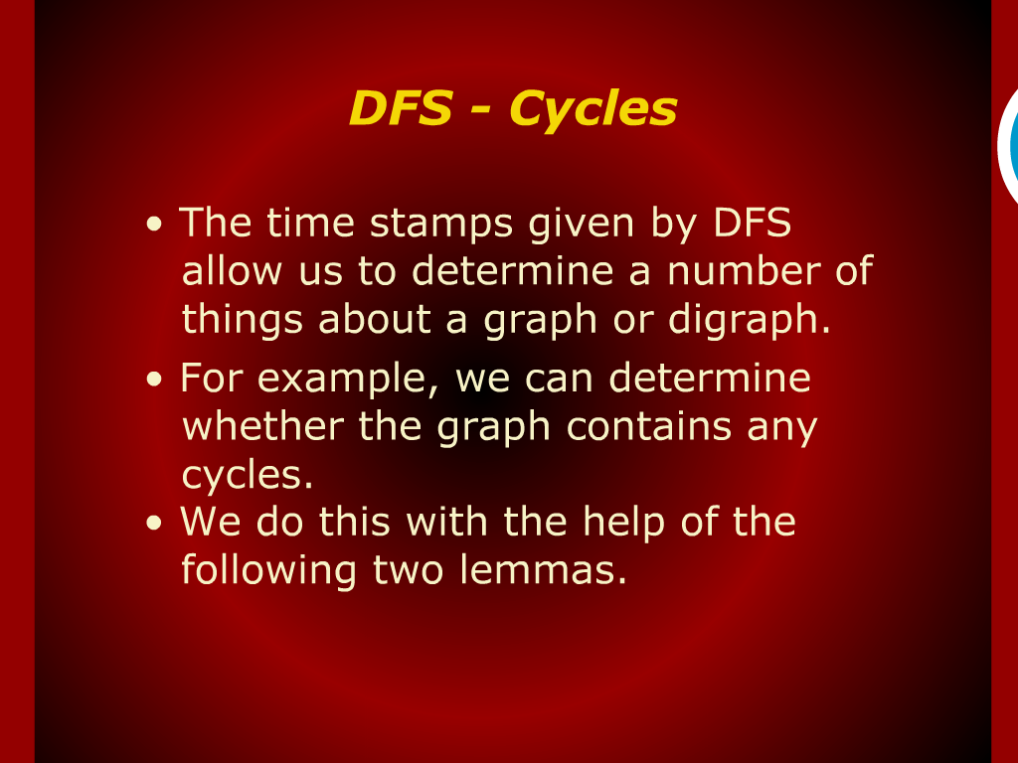
DFS-Cycles

Slide 6
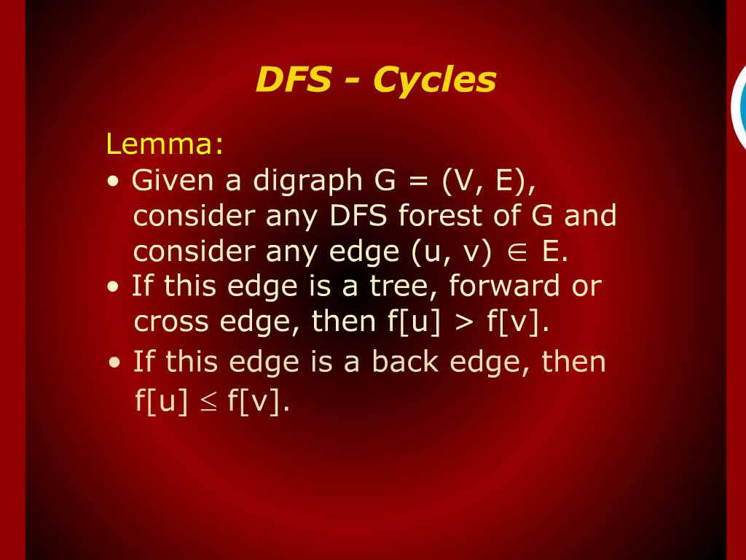
DFS-Cycles

Slide 7
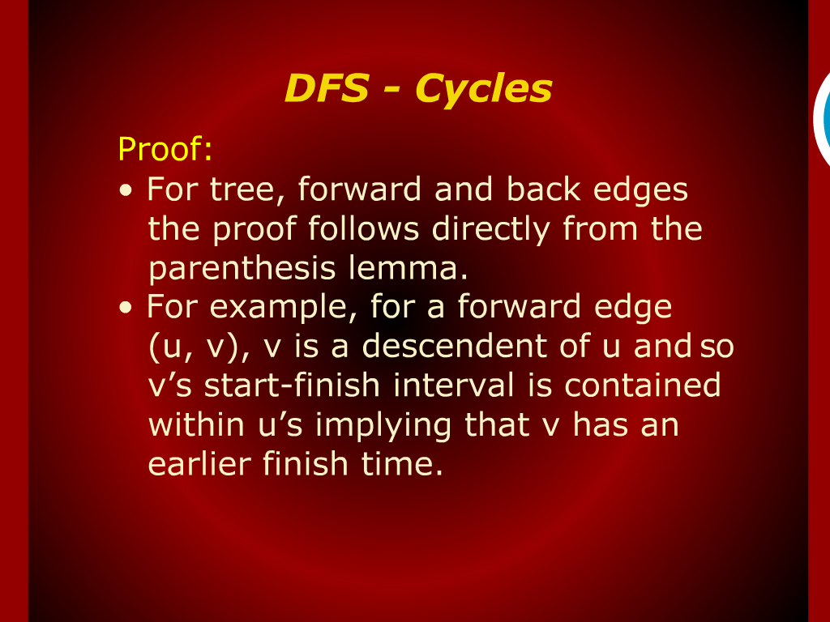
DFS-Cycles

Slide 8
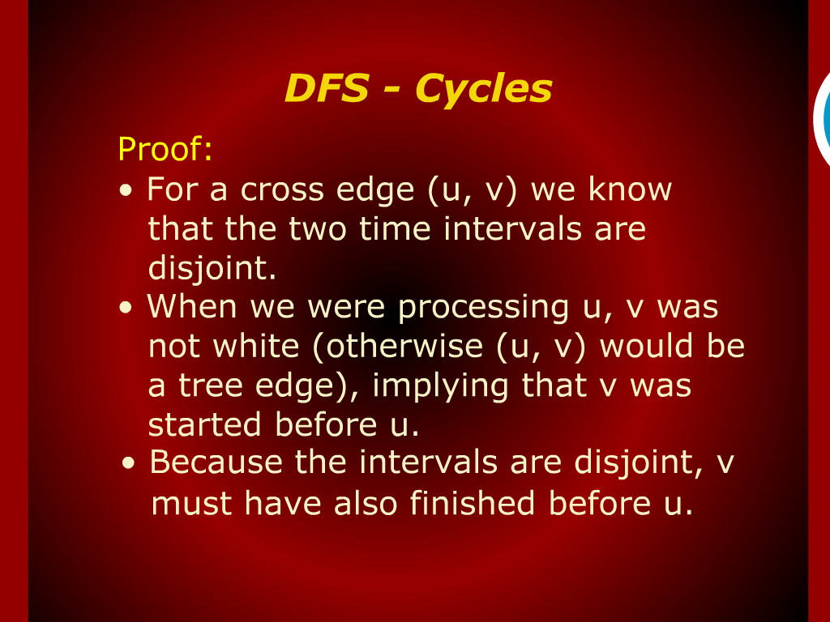
DFS-Cycles

Slide 9
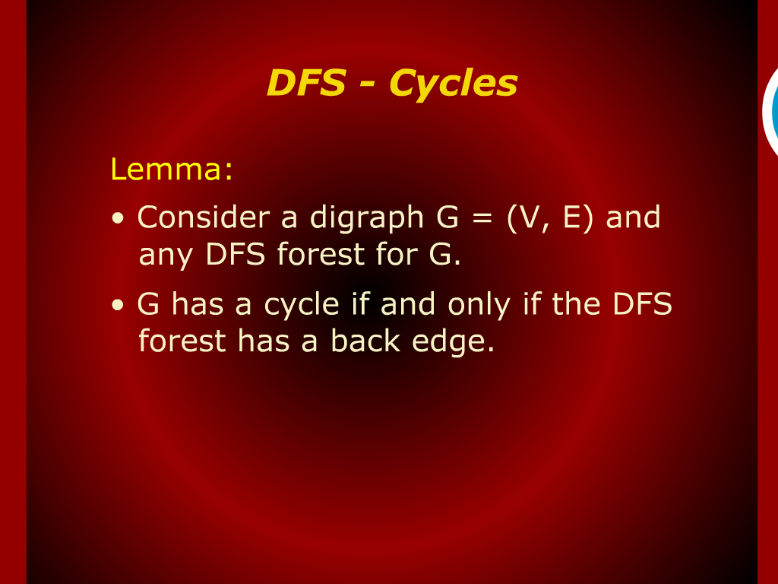
DFS-Cycles

Slide 10
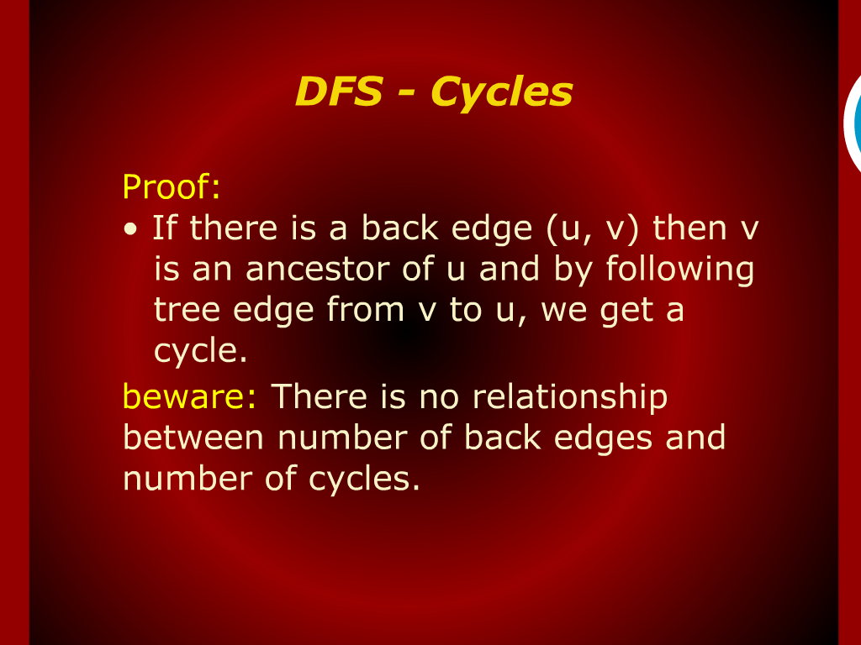
DFS-Cycles

Slide 11
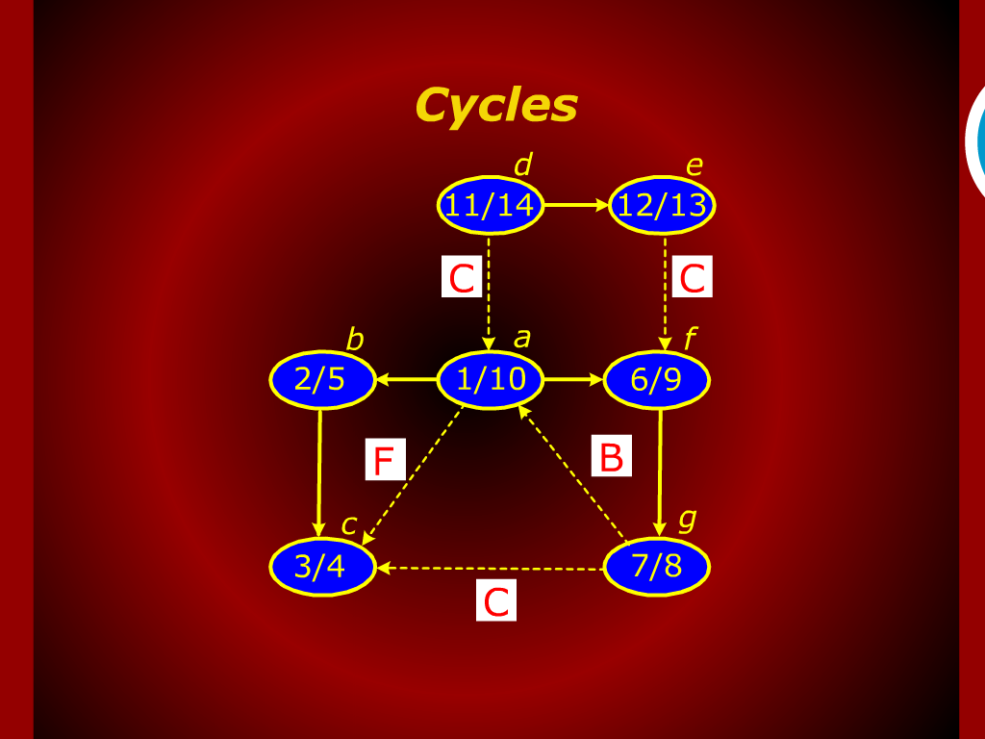
Cycles

Slide 12
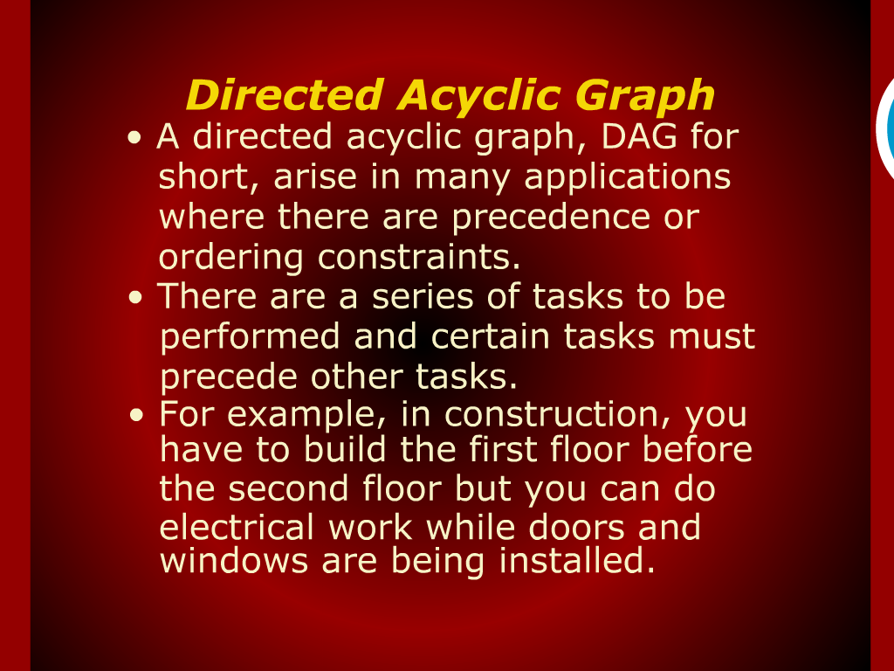
Direct Acyclic Graph

Slide 13
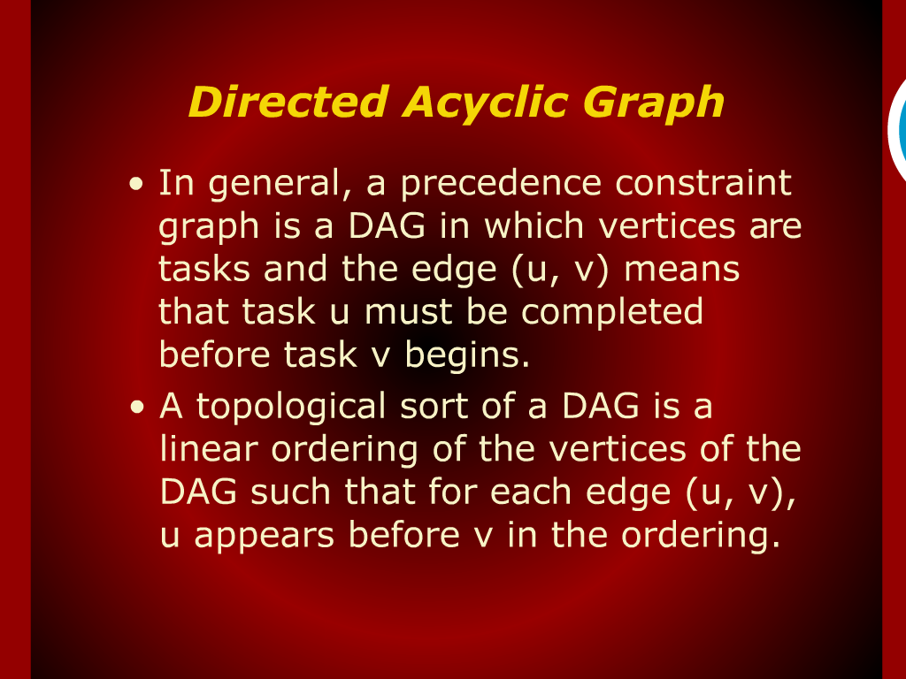
Direct Acyclic Graph

Slide 14
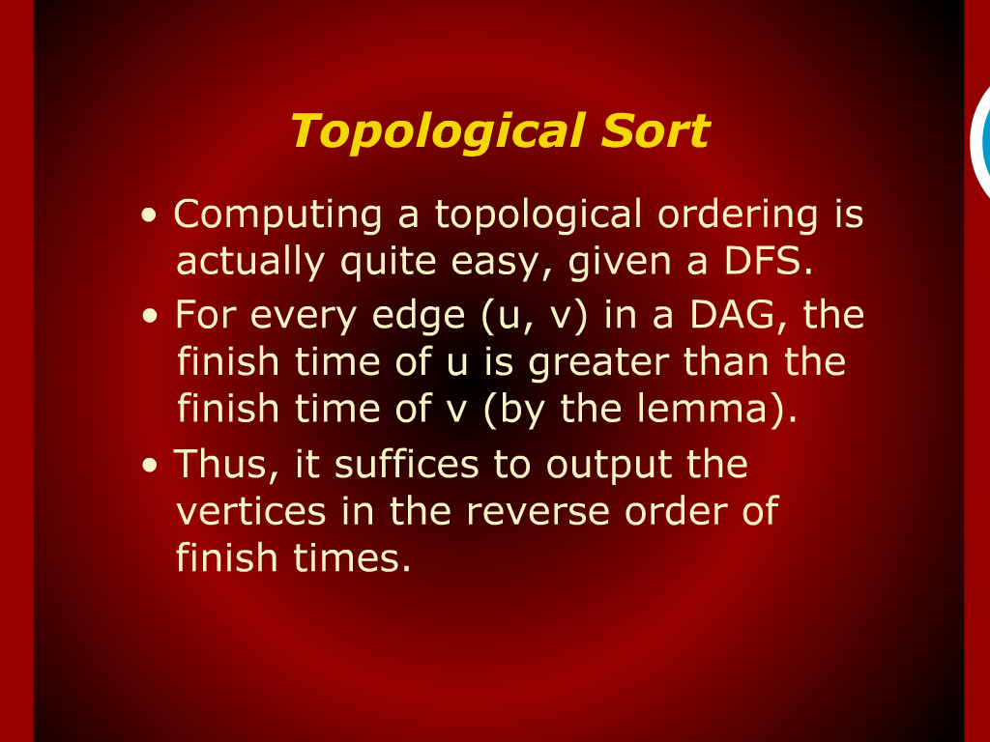
Topological Sort

Slide 15
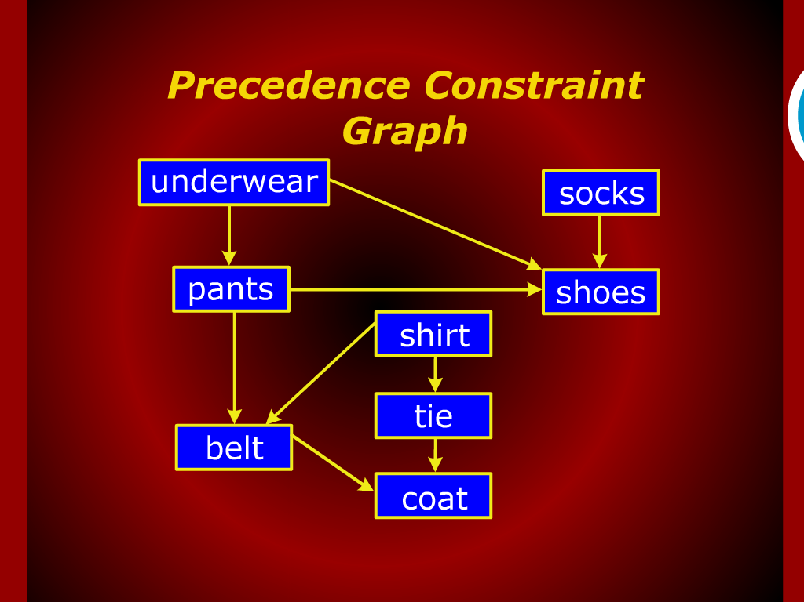
Precedence Constraint Graph

Slide 16
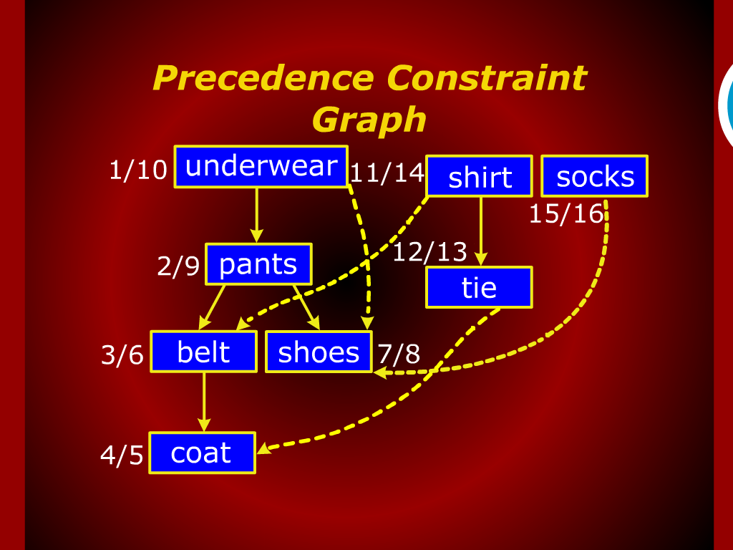
Precedence Constraint Graph

Slide 17
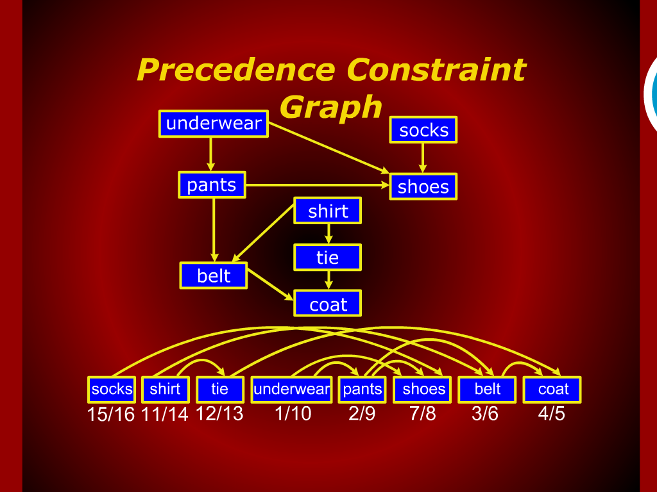
Precedence Constraint Graph

Slide 18
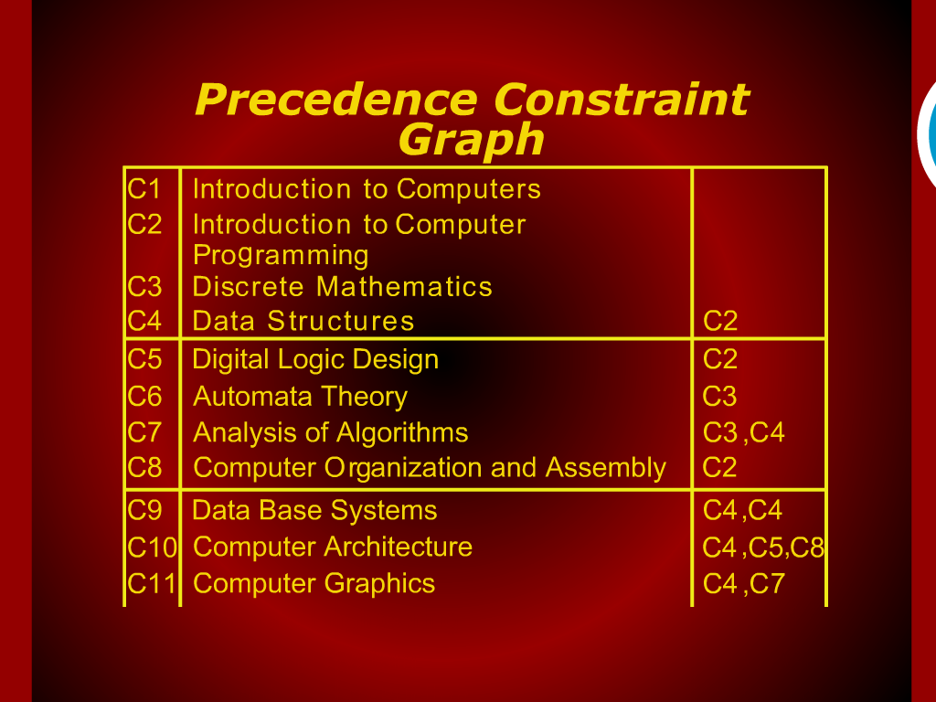
Precedence Constraint Graph

Slide 19
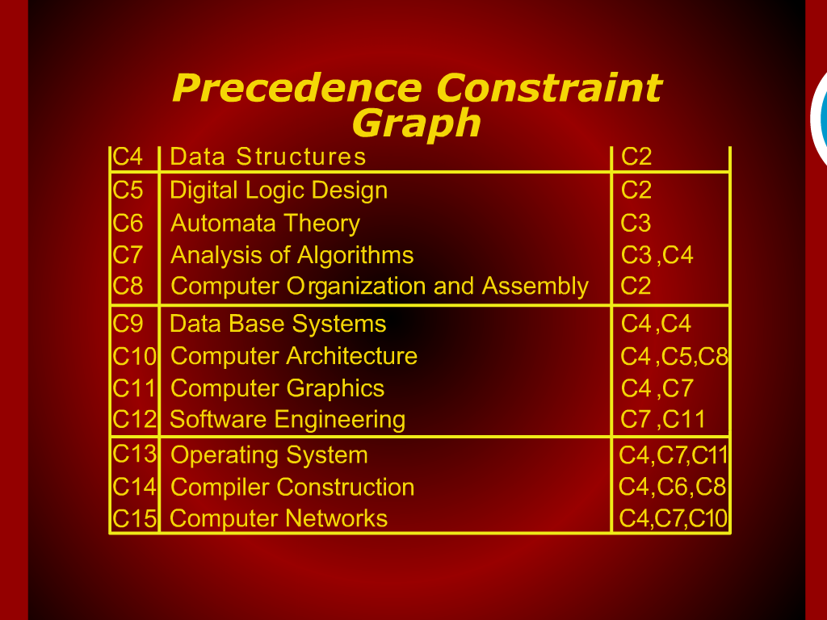
Precedence Constraint Graph

Slide 20
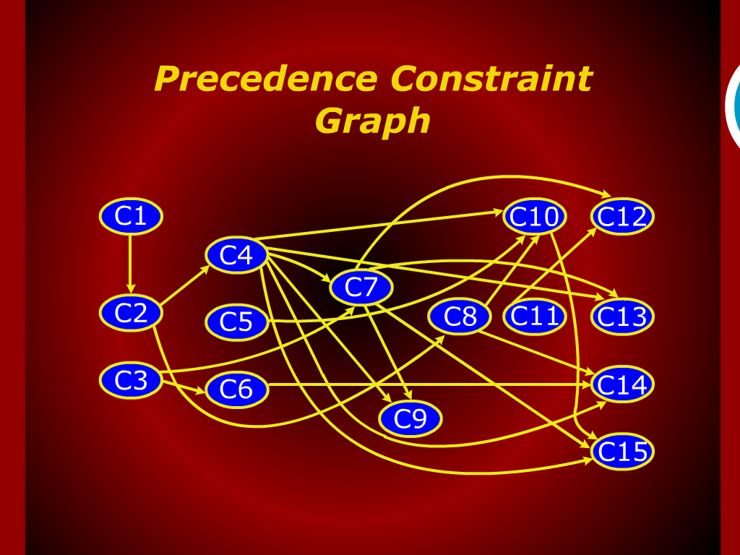
Precedence Constraint Graph

Slide 21
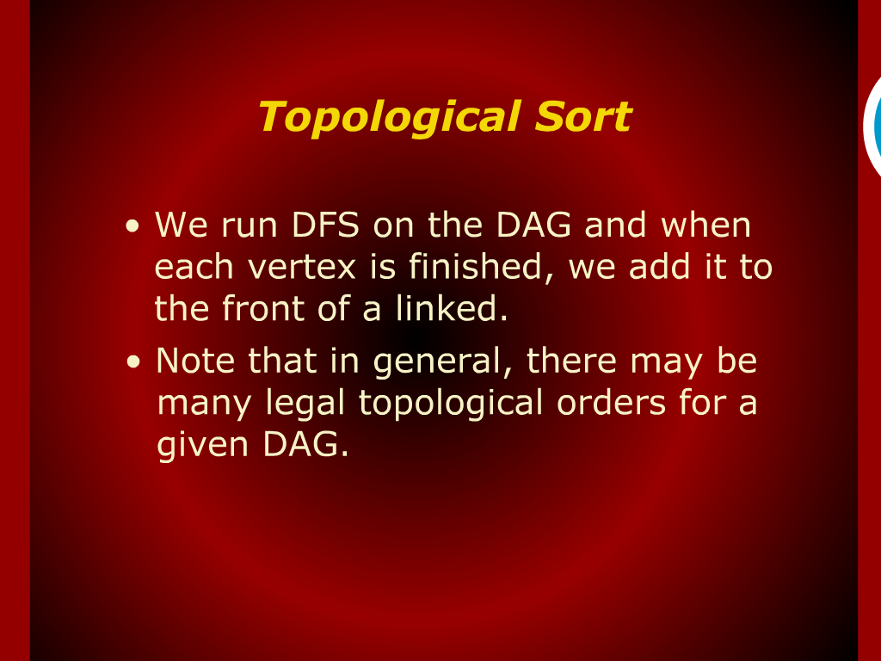
Topological Sort

Slide 22
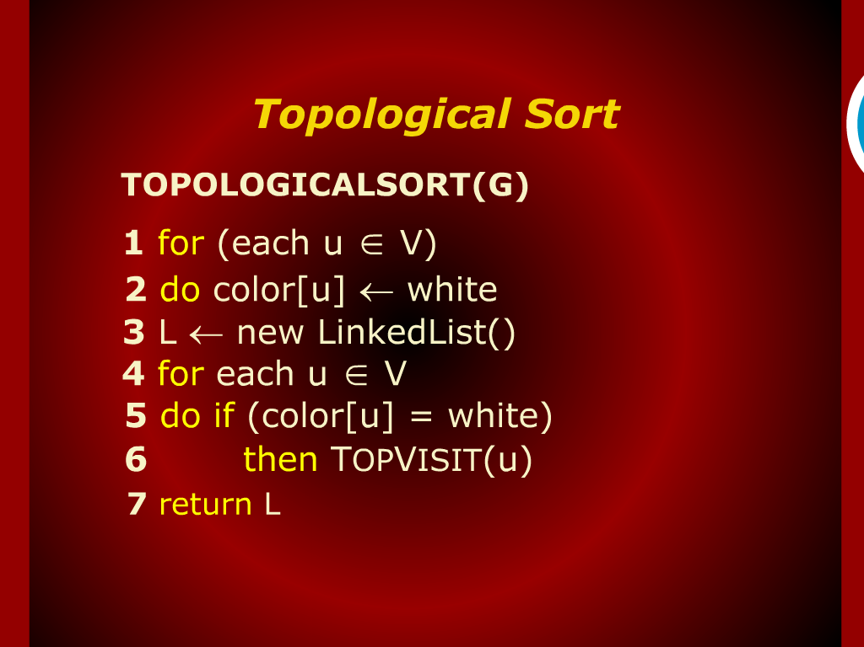
Topological Sort

Slide 23
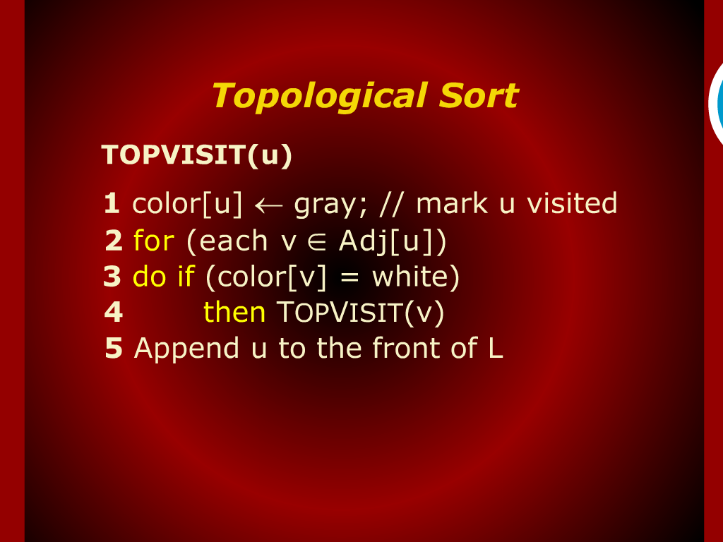
Topological Sort

Slide 24
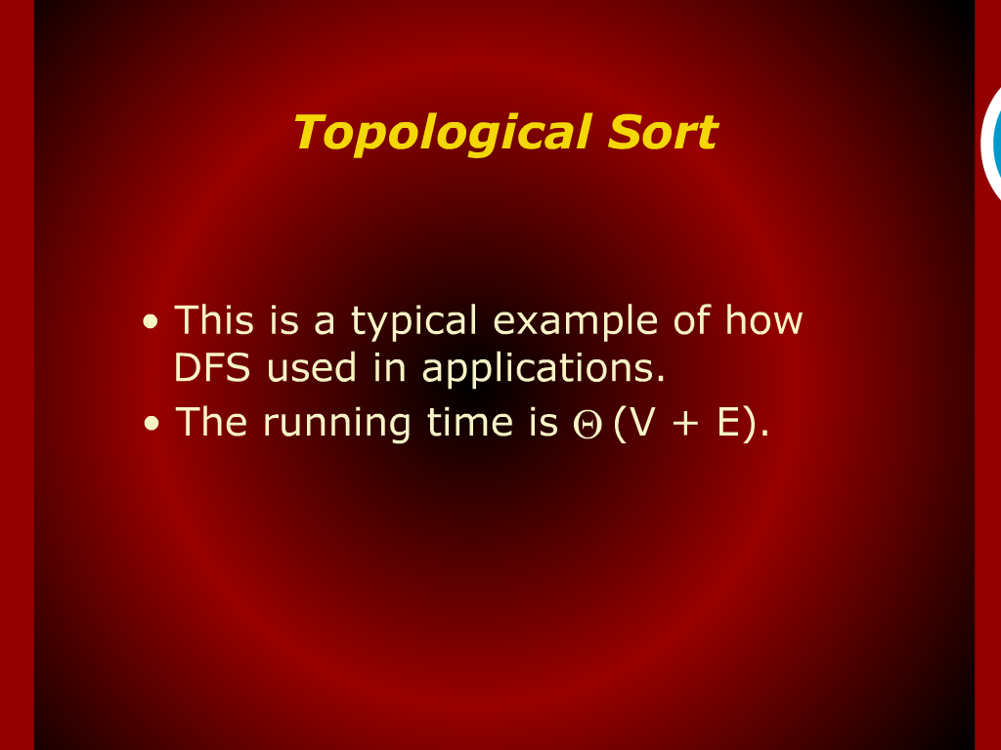
Topological Sort

Slide 25

Strong Components

