Slide 1
Algorithms
Lecture # 33
Dr. Sohail Aslam

Slide 2
Strong Components

Slide 3
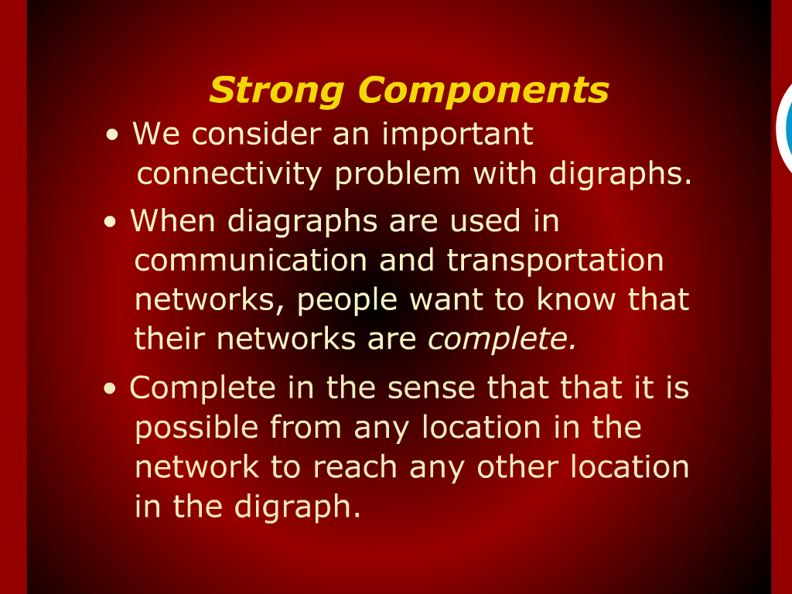
Strong Components

Slide 4
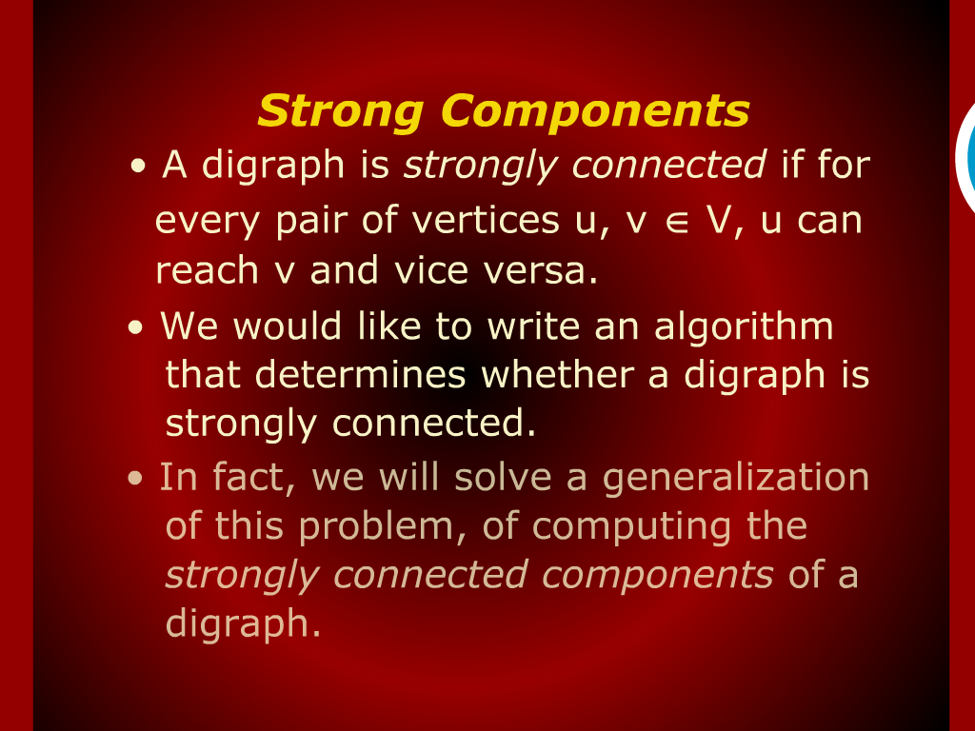
Strong Components

Slide 5
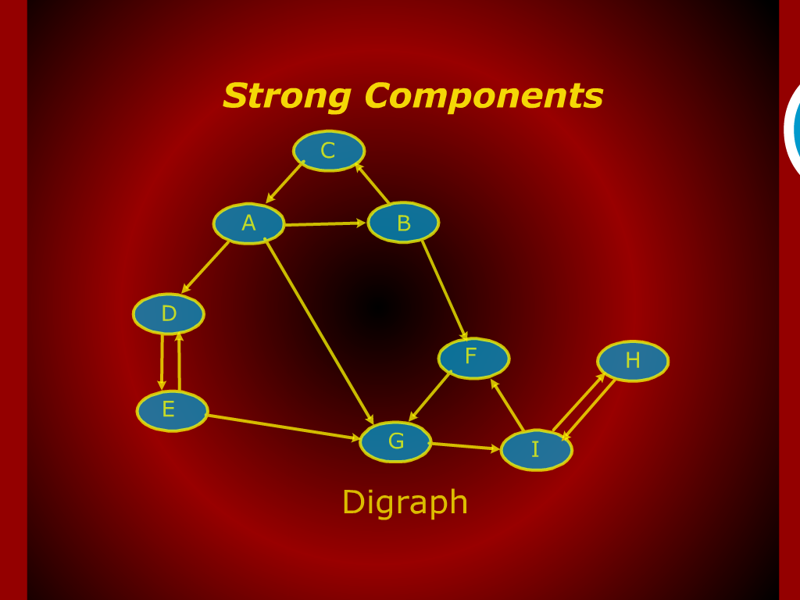
Strong Components

Slide 6
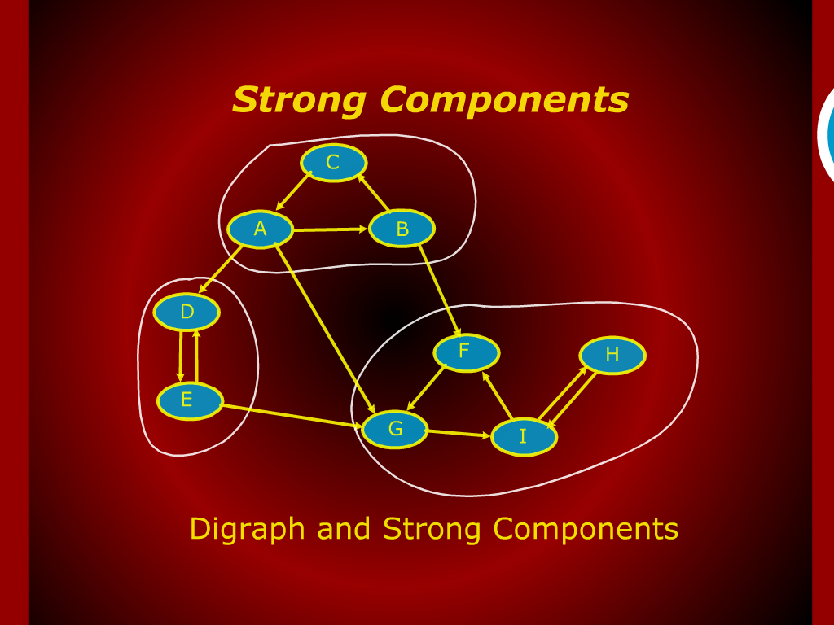
Strong Components

Slide 7
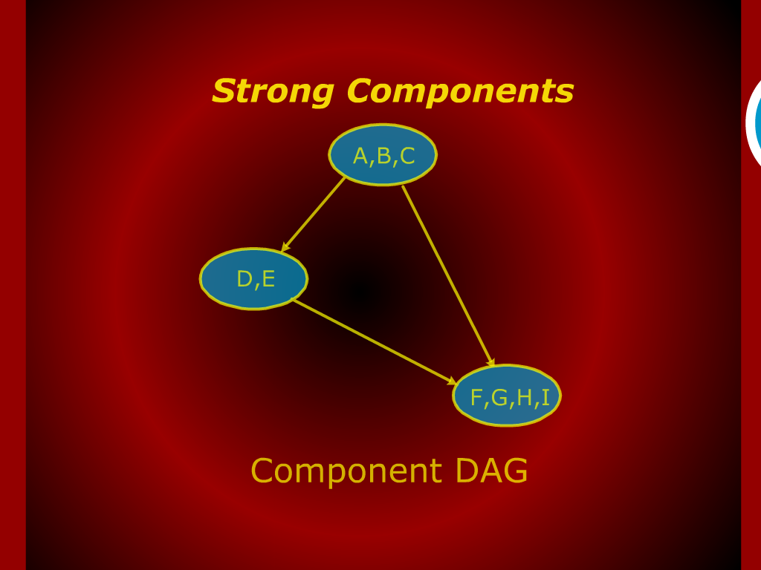
Strong Components

Slide 8
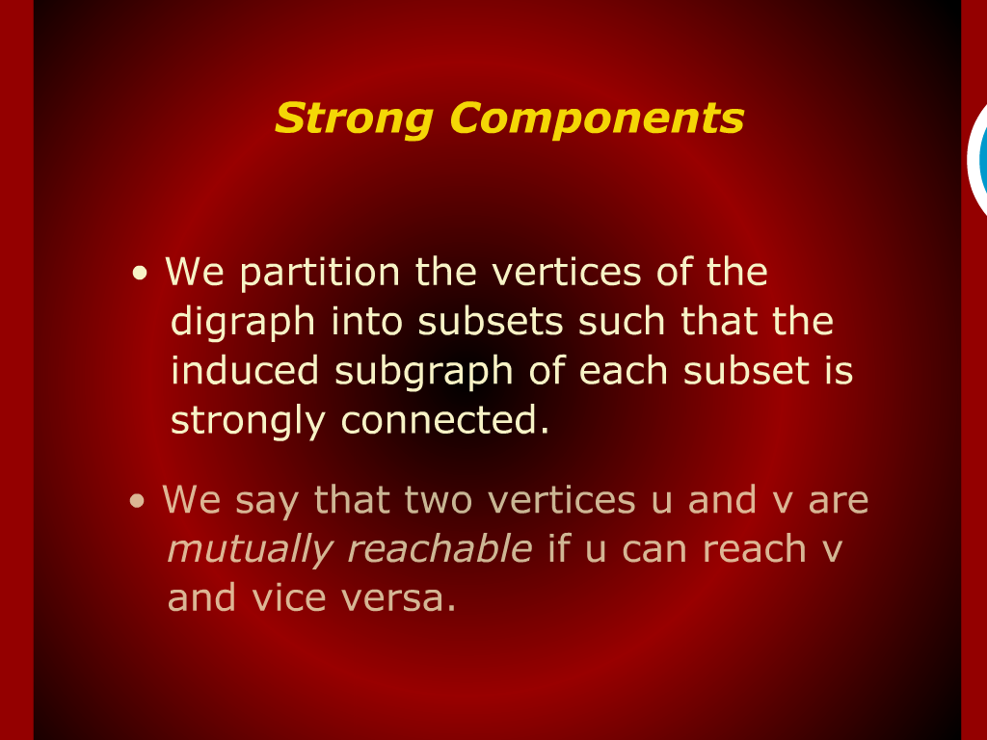
Strong Components

Slide 9
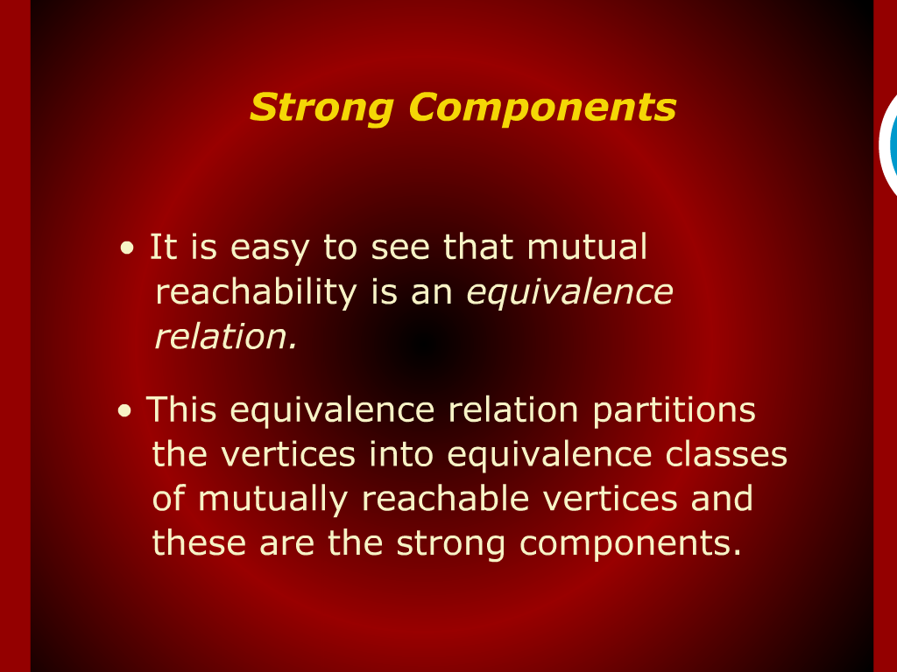
Strong Components

Slide 10
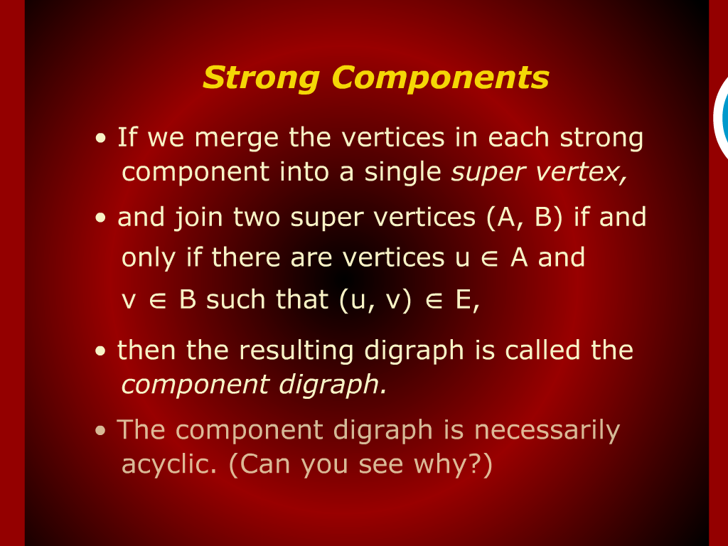
Strong Components

Slide 11
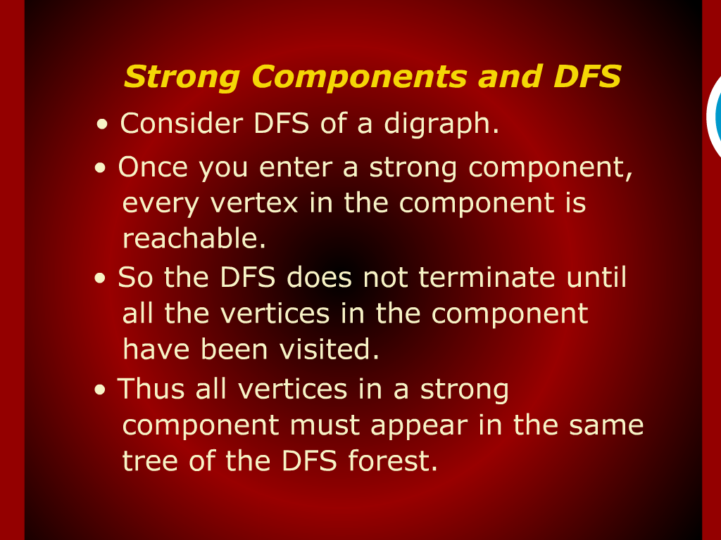
Strong Components and DFS

Slide 12
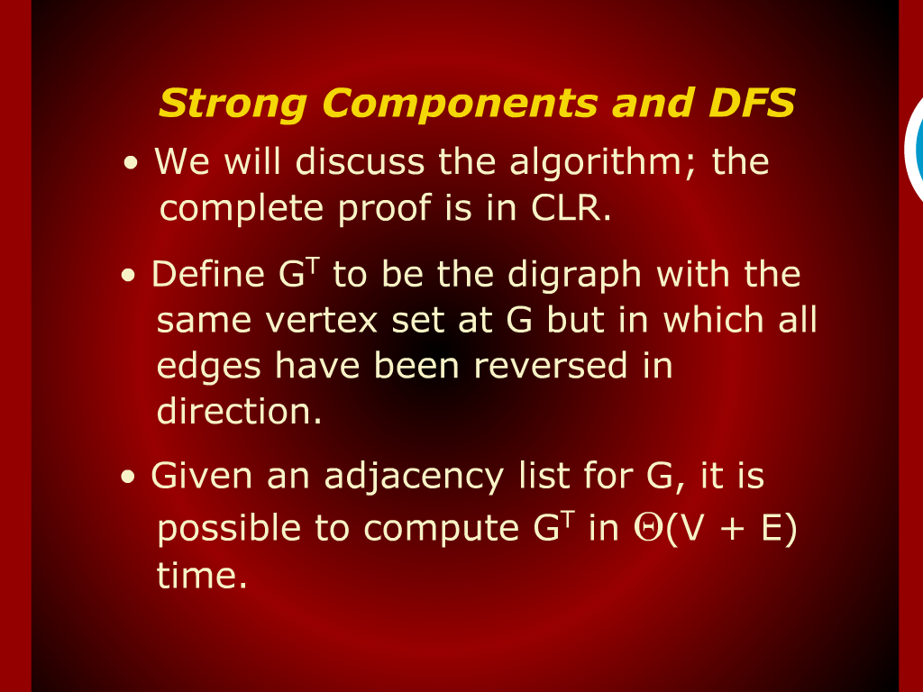
Strong Components and DFS

Slide 13
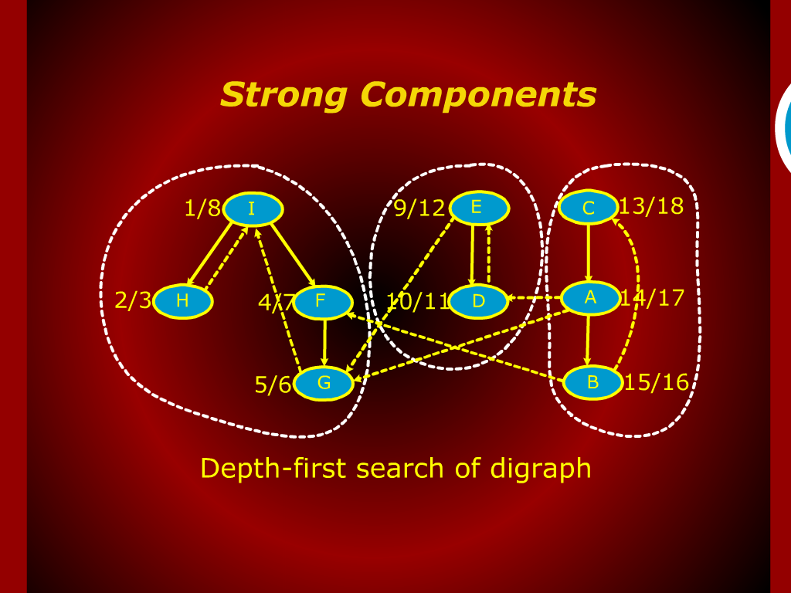
Strong Components

Slide 14
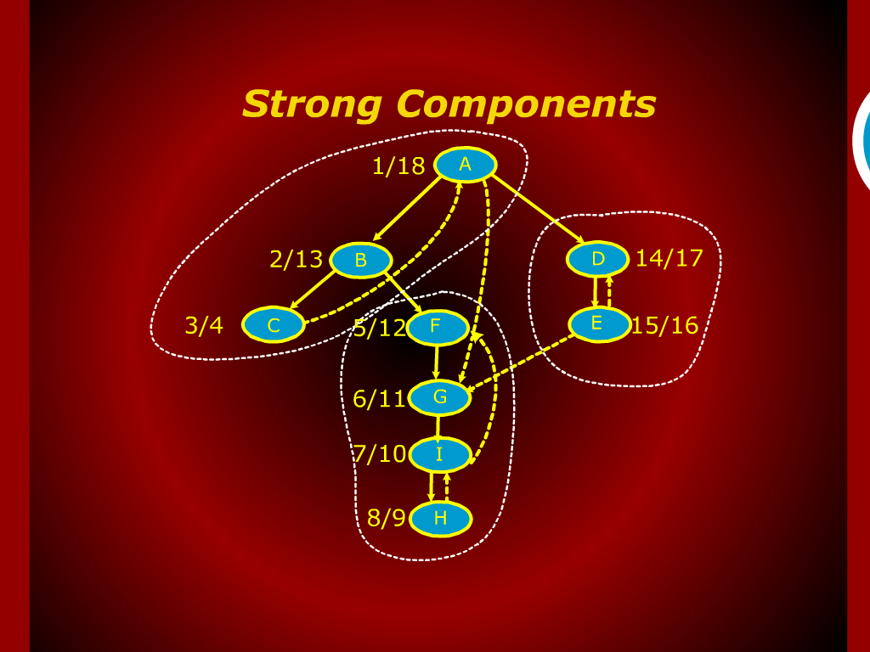
Strong Components

Slide 15
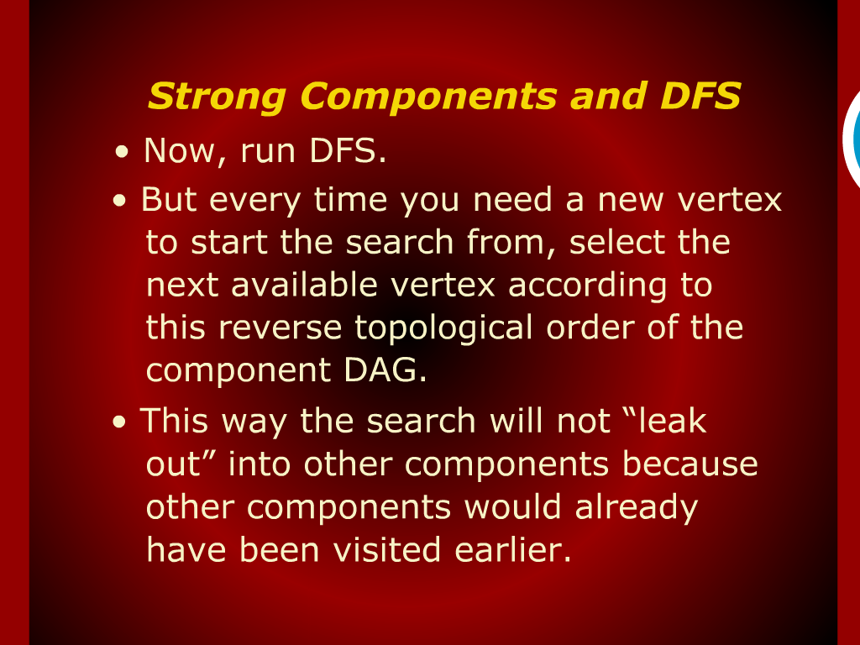
Strong Components and DFS

Slide 16
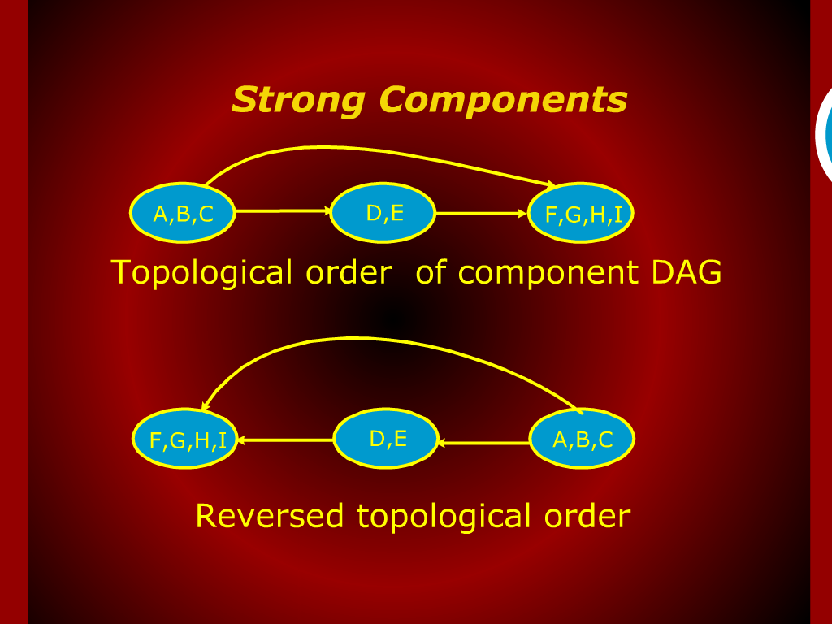
Strong Components

Slide 17
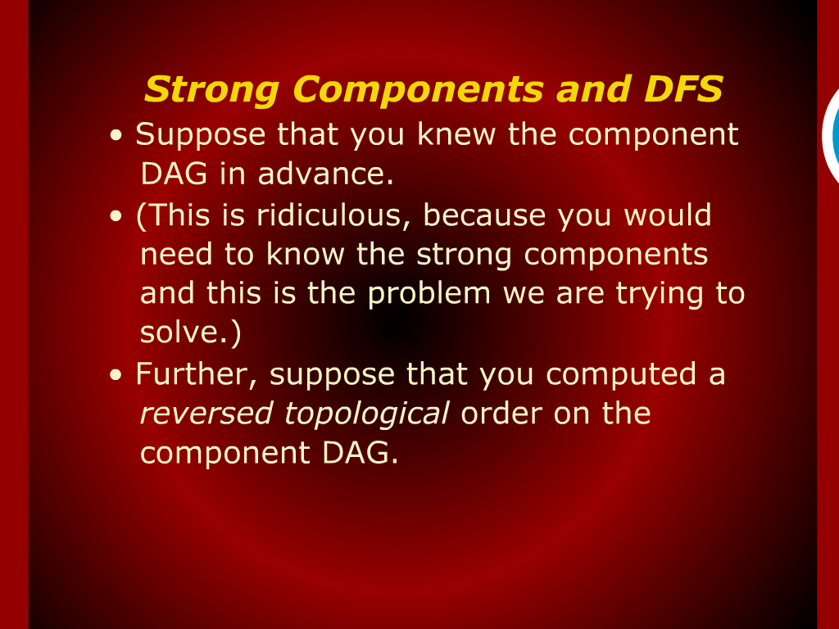
Strong Components and DFS

