Slide 1
Algorithms
Lecture # 34
Dr.Sohail Aslam

Slide 2
Strong Components

Slide 3
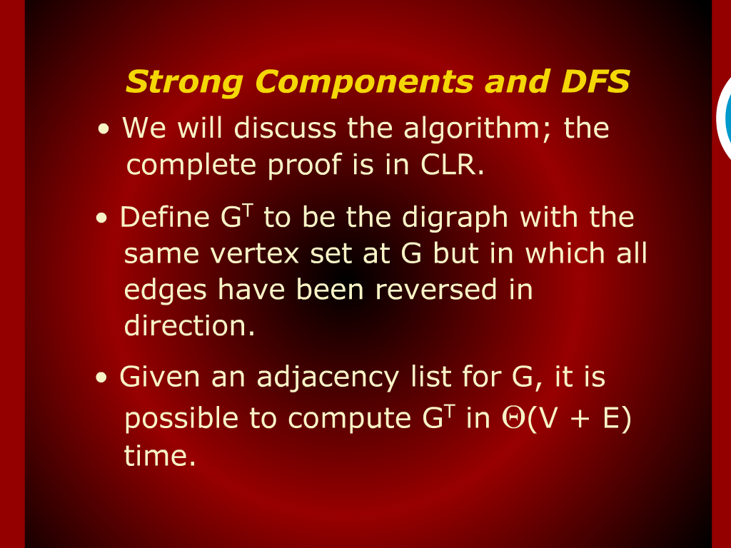

Slide 4
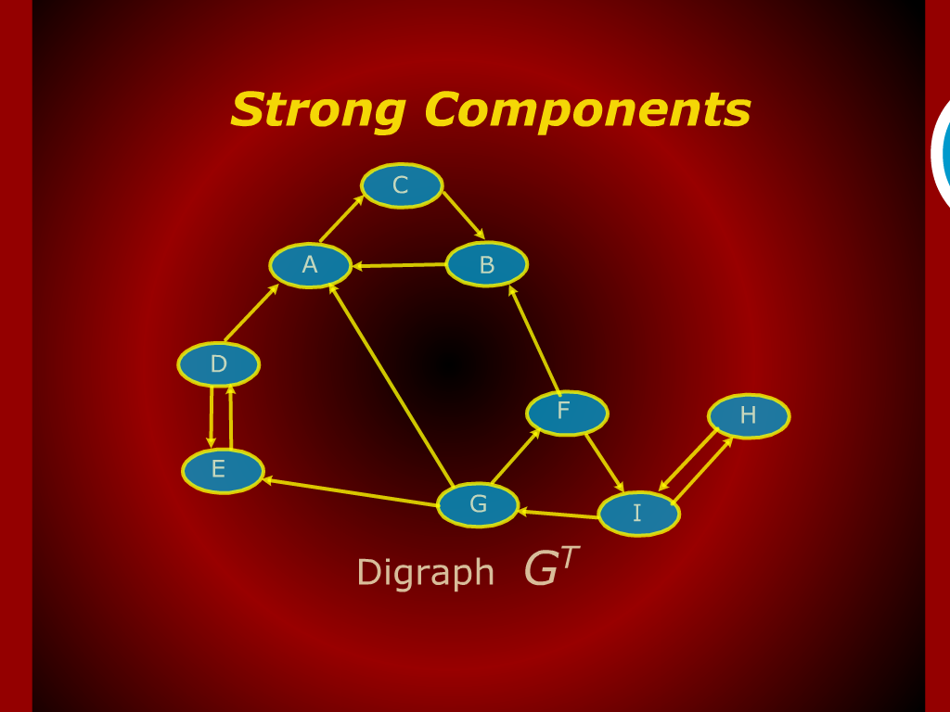
Strong Components

Slide 5
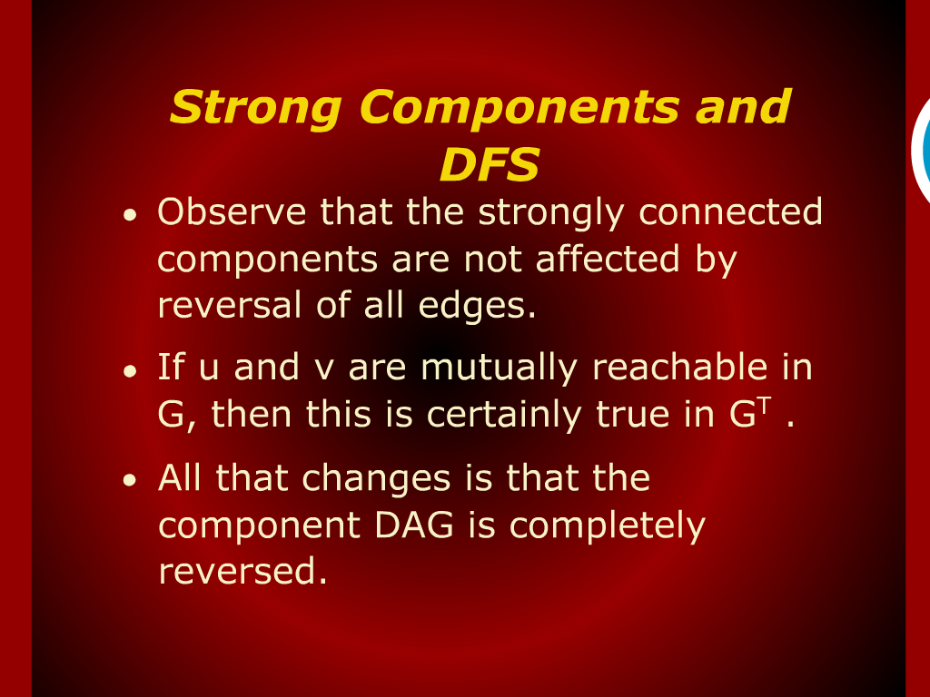
Strong Components and DFS

Slide 6
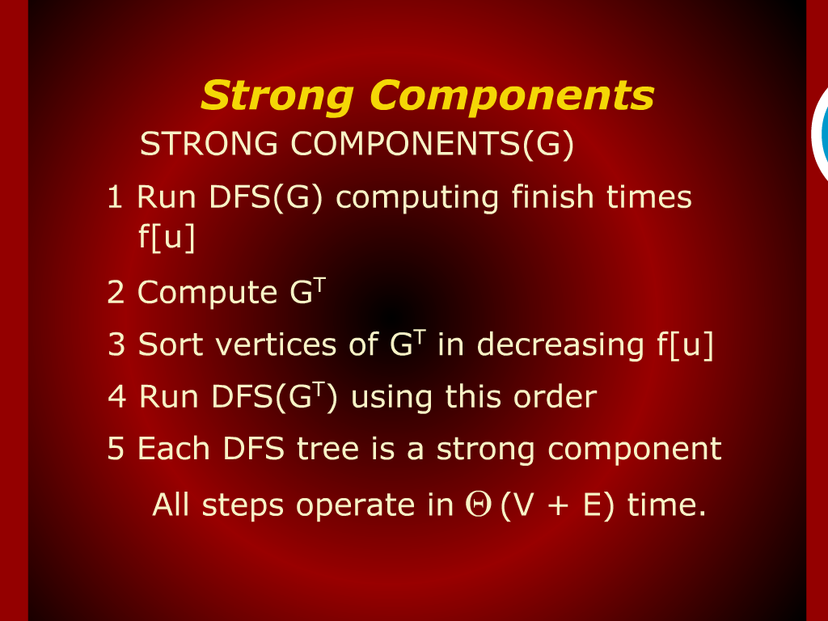
Strong Components

Slide 7
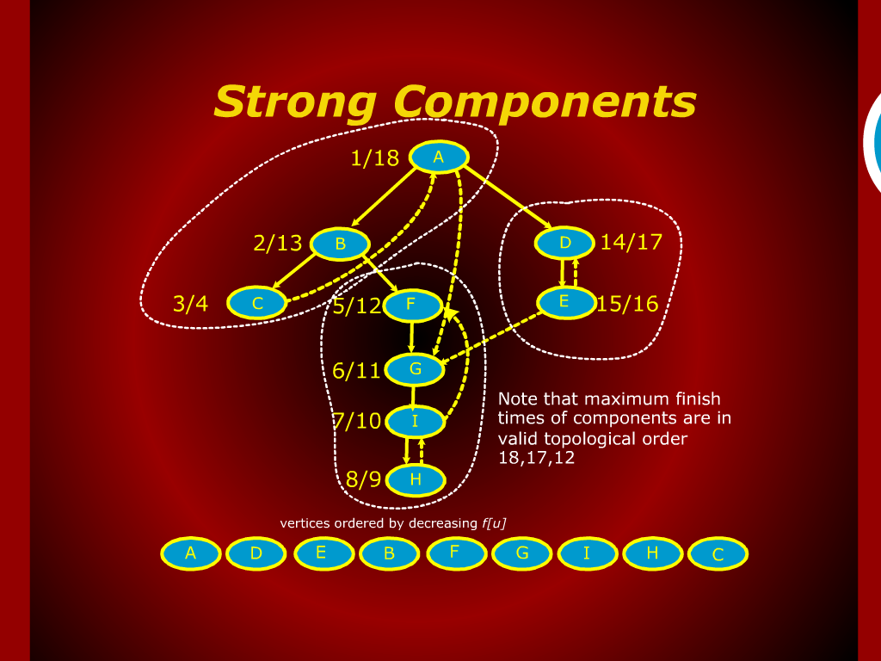
Strong Components

Slide 8
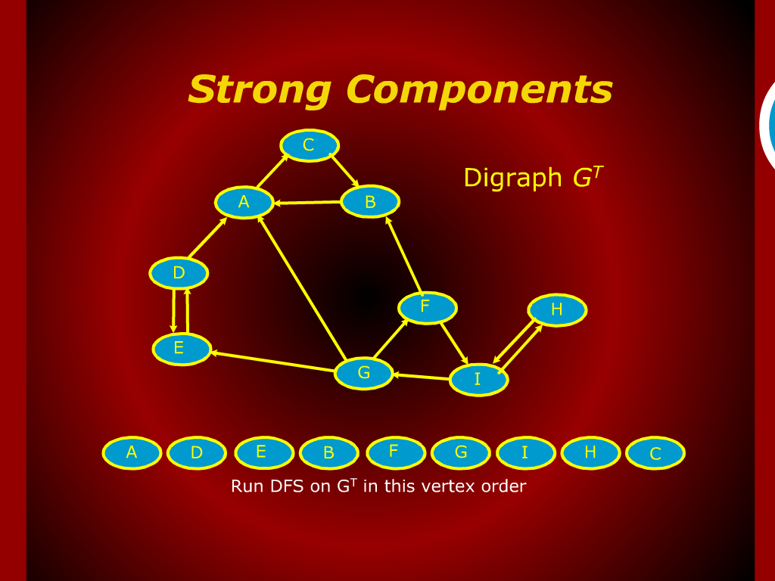
Strong Components

Slide 9
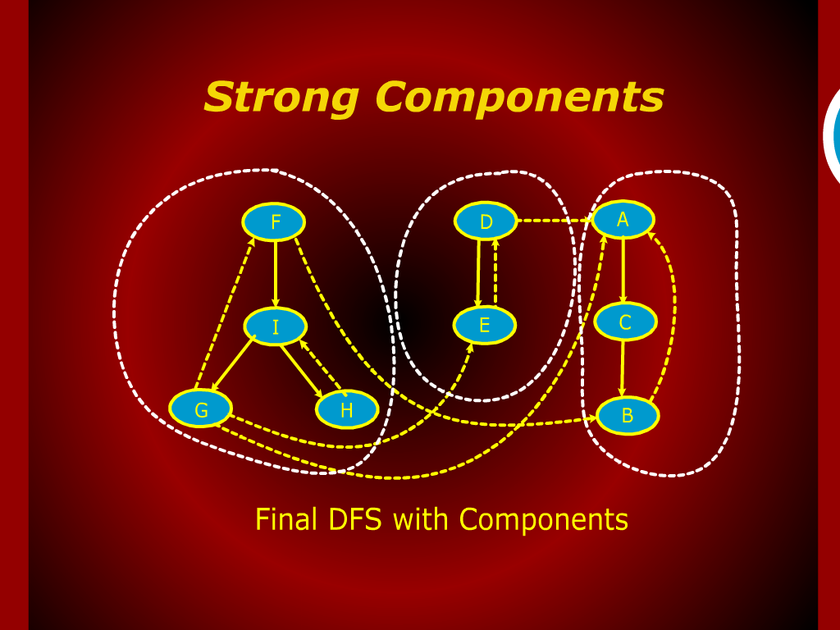
Strong Components

Slide 10
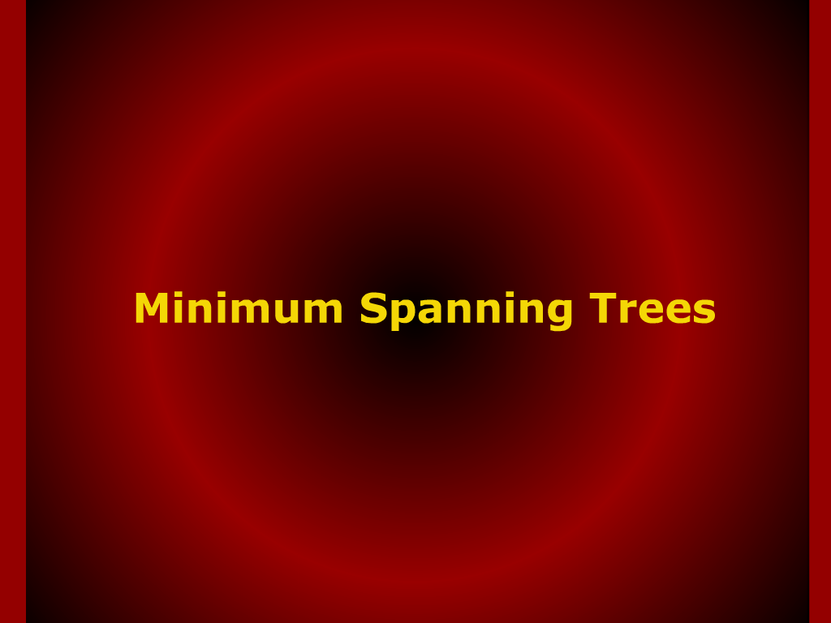
Minimum Spanning Trees

Slide 11
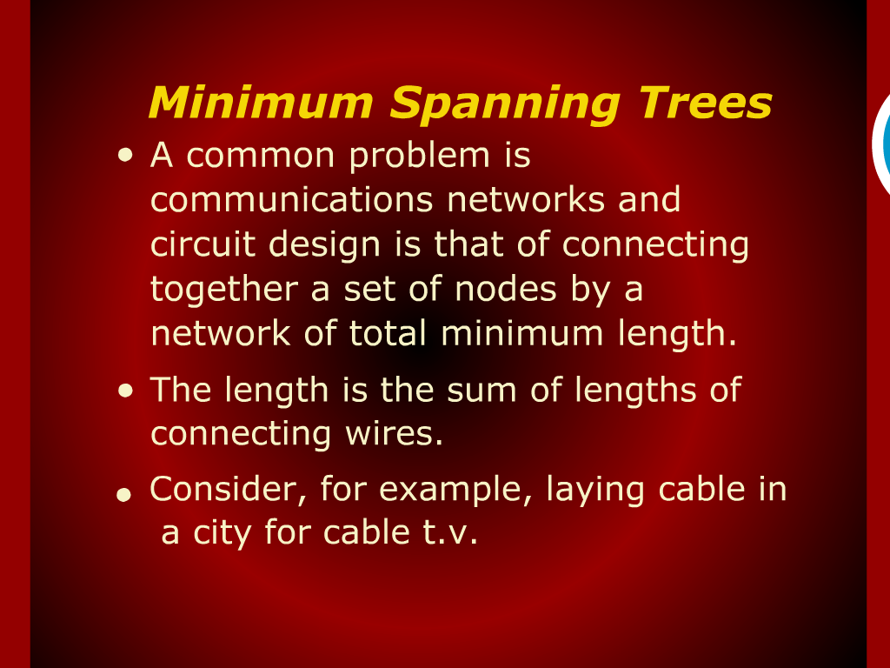
Minimum Spanning Trees

Slide 12
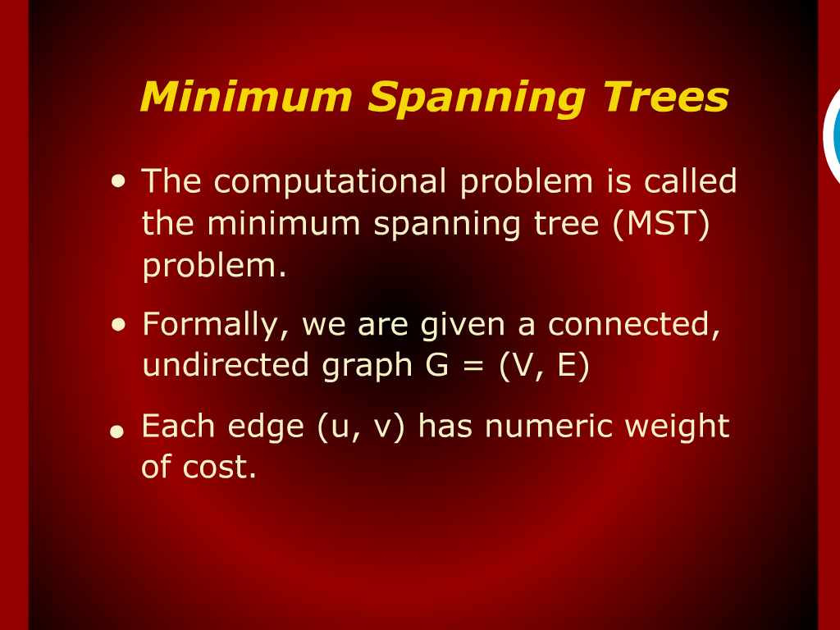
Minimum Spanning Trees

Slide 13
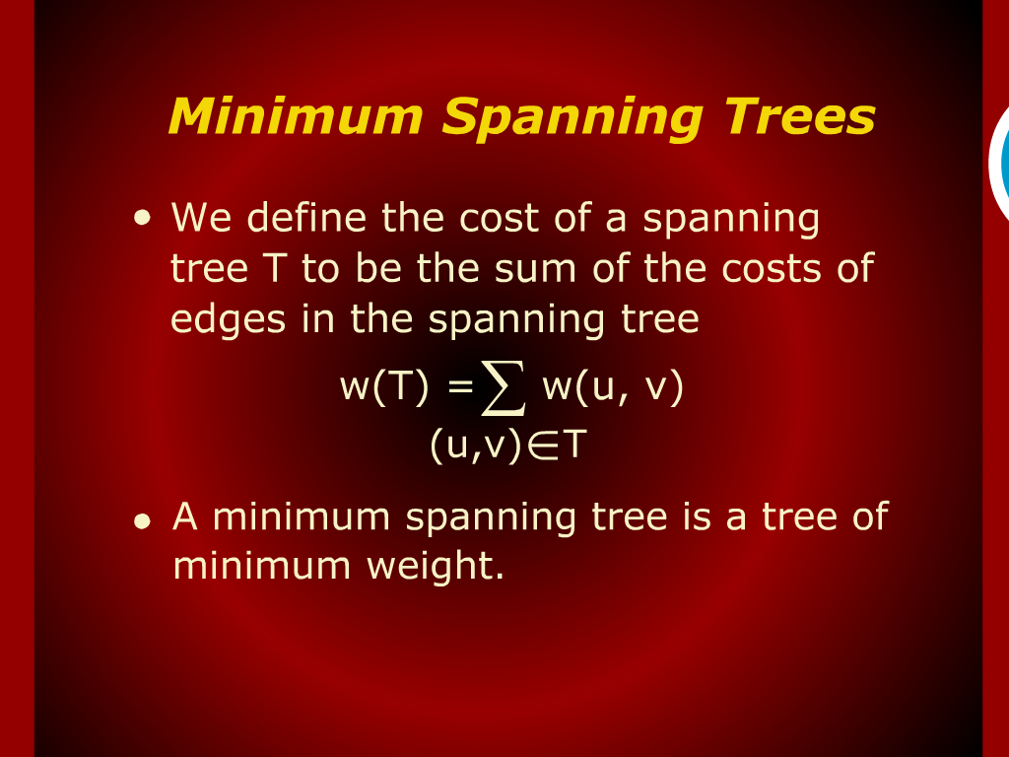
Minimum Spanning Trees

Slide 14
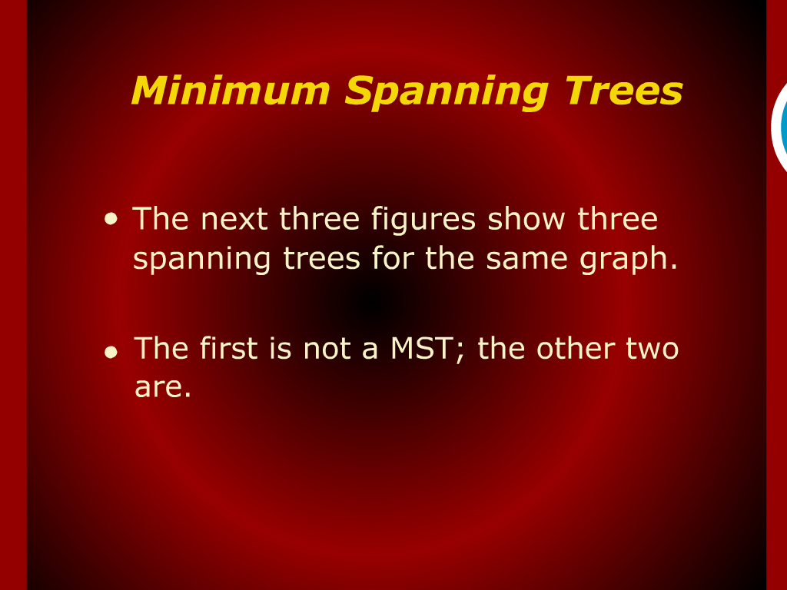
Minimum Spanning Trees

Slide 15
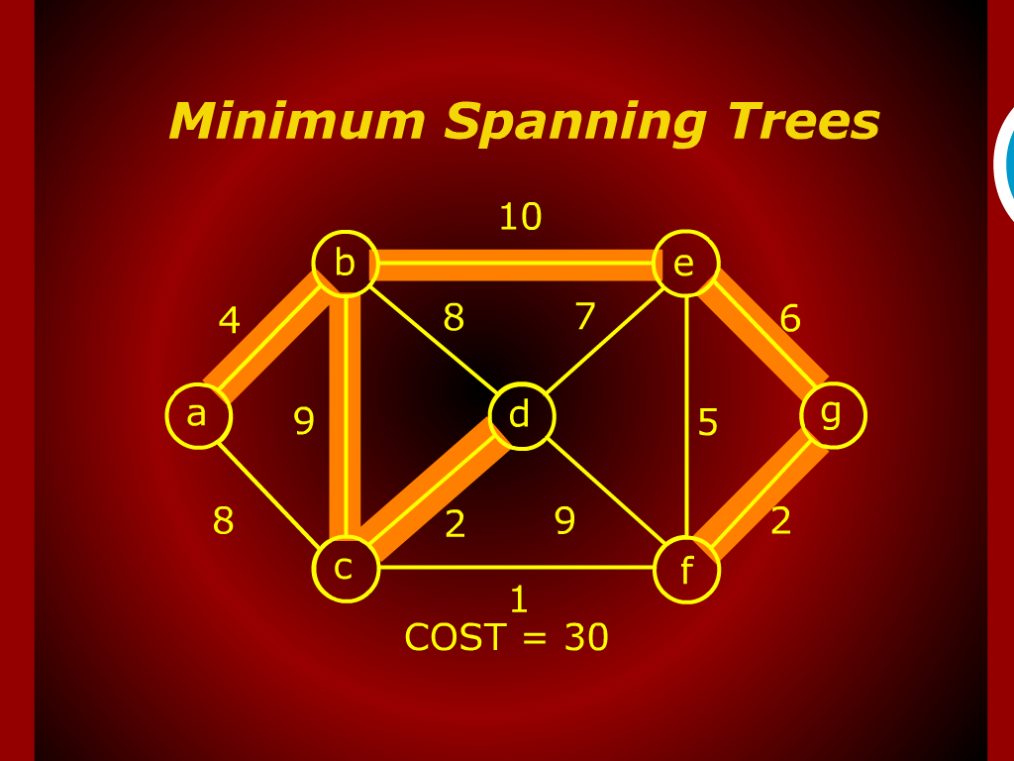
Minimum Spanning Trees

Slide 16
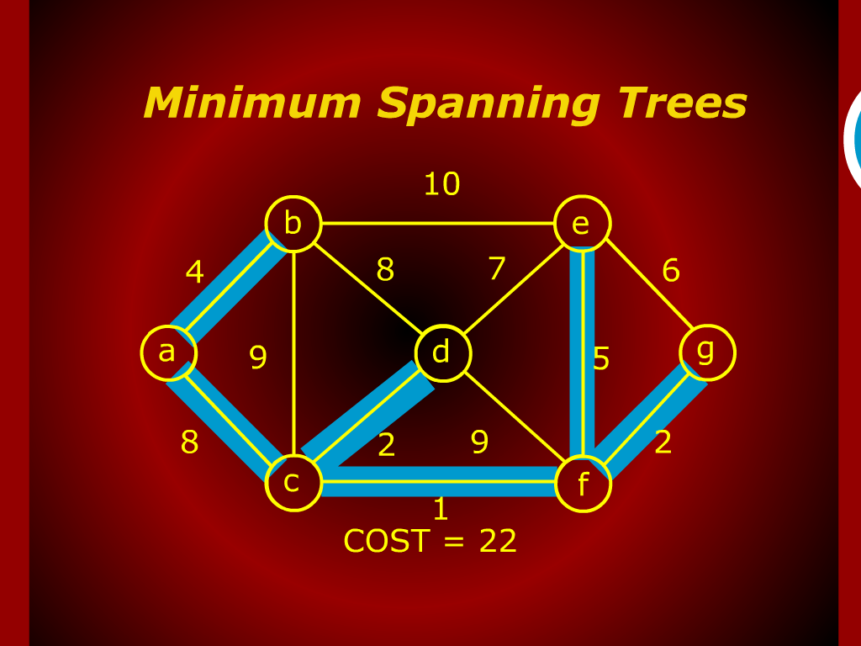
Minimum Spanning Trees

Slide 17
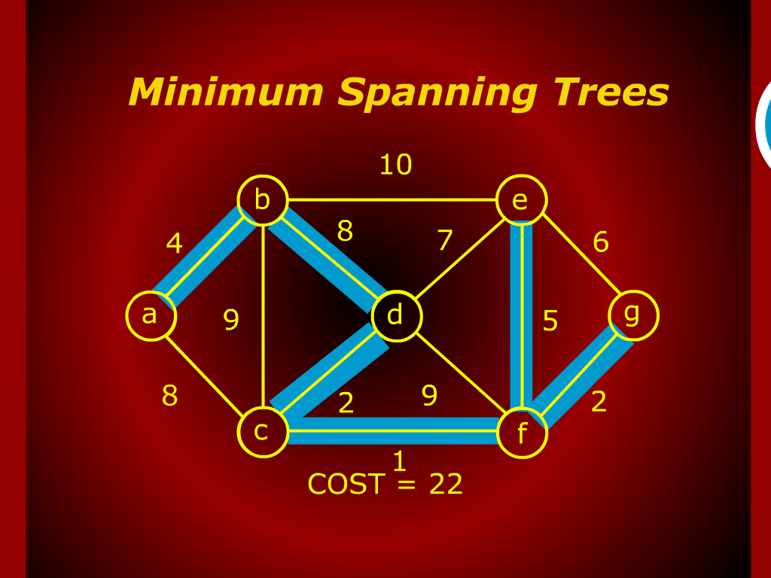
Minimum Spanning Trees

Slide 18
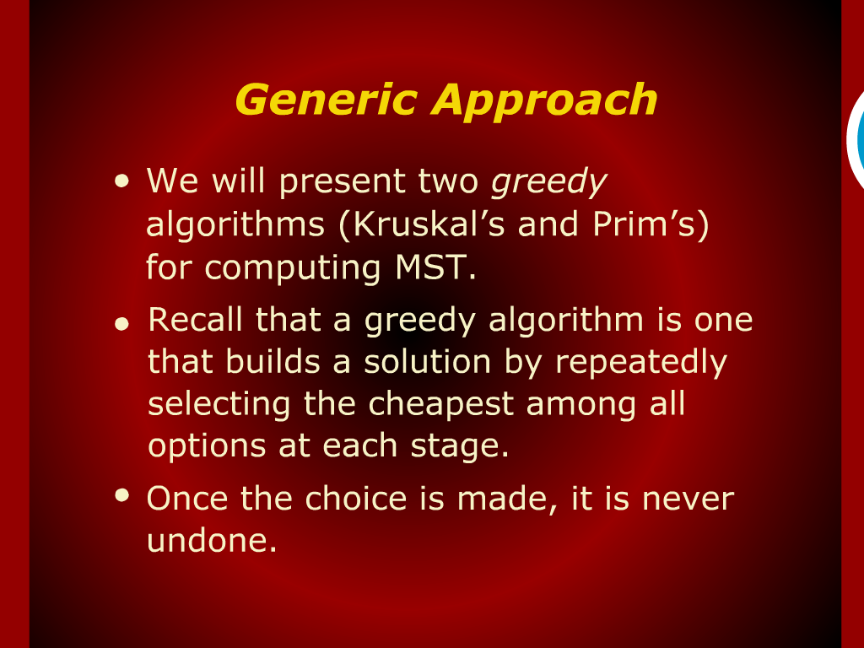
Generic Approach

Slide 19
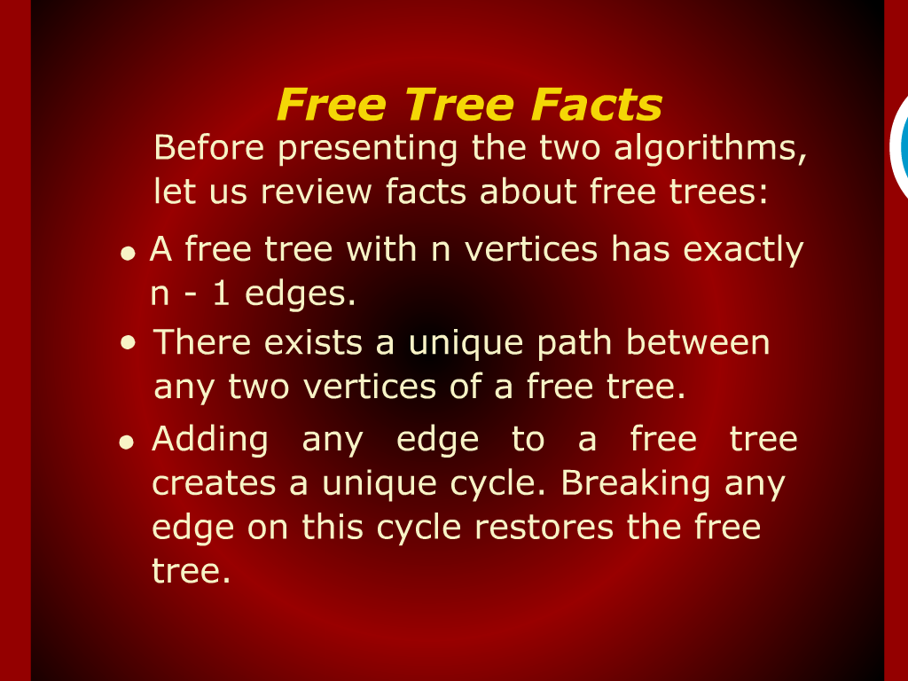
Free Tree Facts

