Slide 1
Algorithms
Lecture # 35
Dr. Sohail Aslam

Slide 2
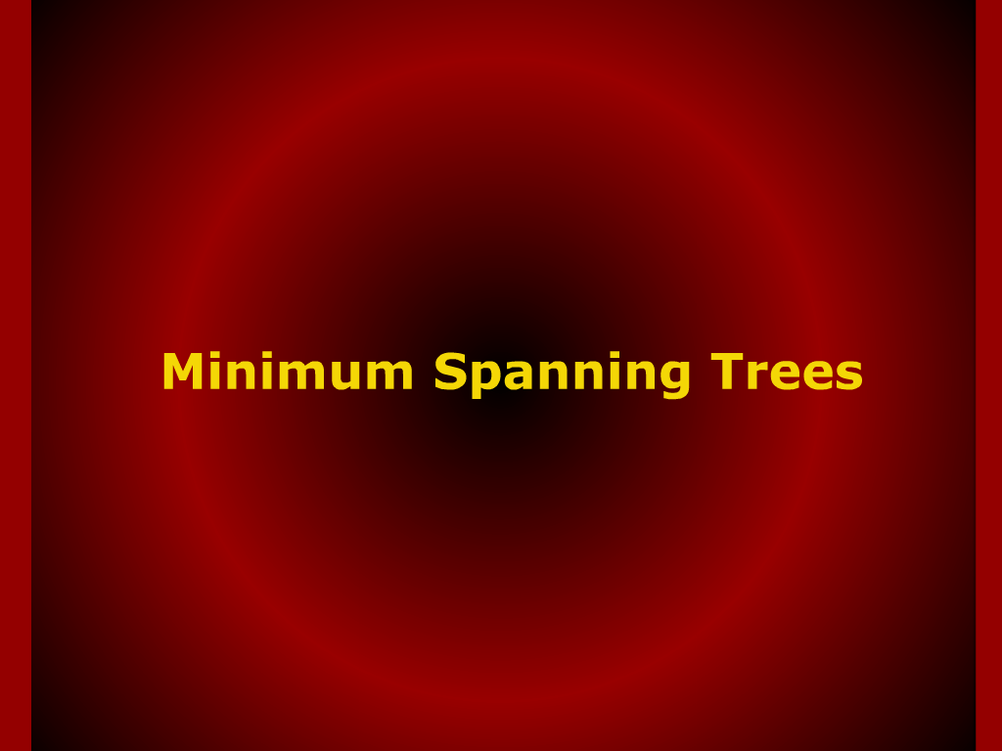
Minimum Spanning Trees

Slide 3
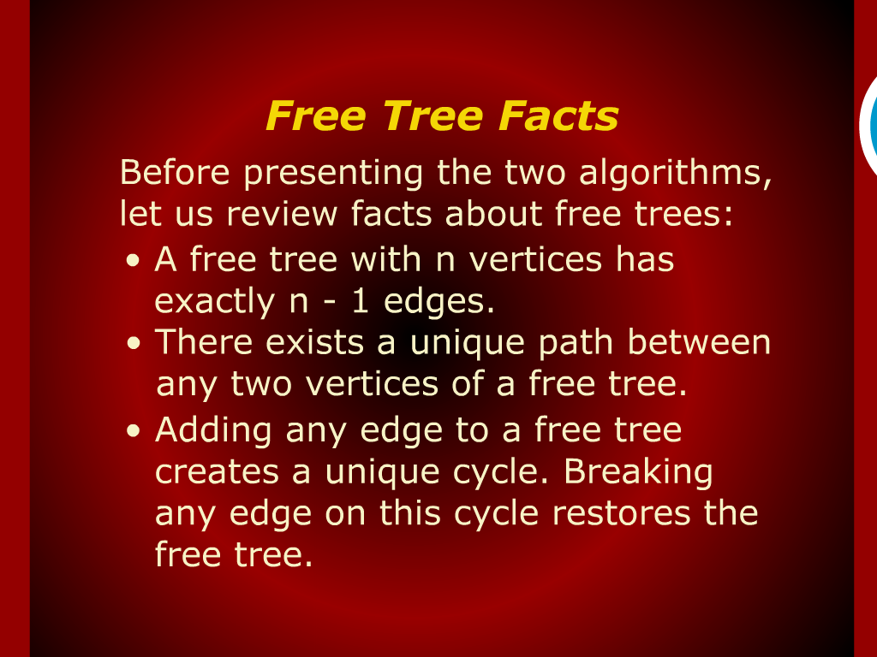
Free Tree Facts

Slide 4
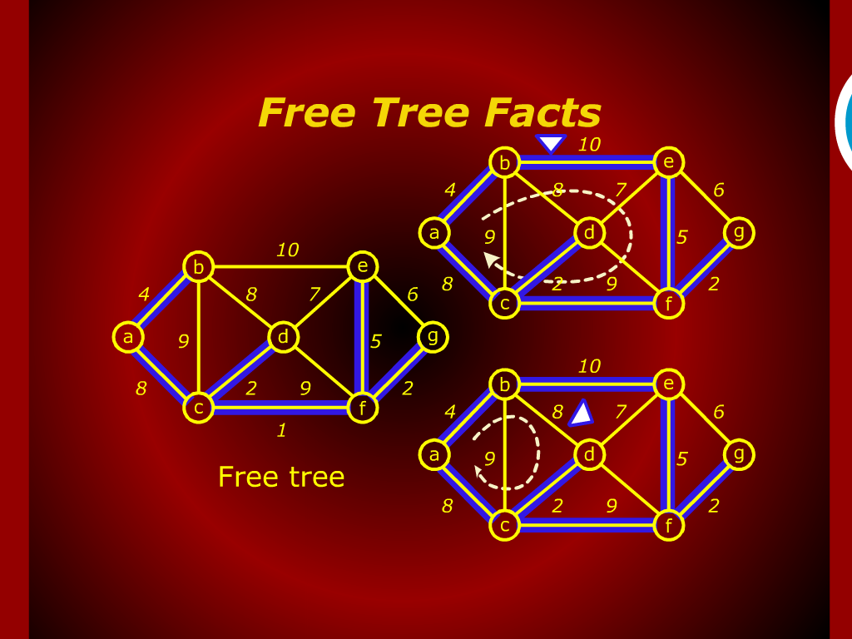
Free Tree Facts

Slide 5
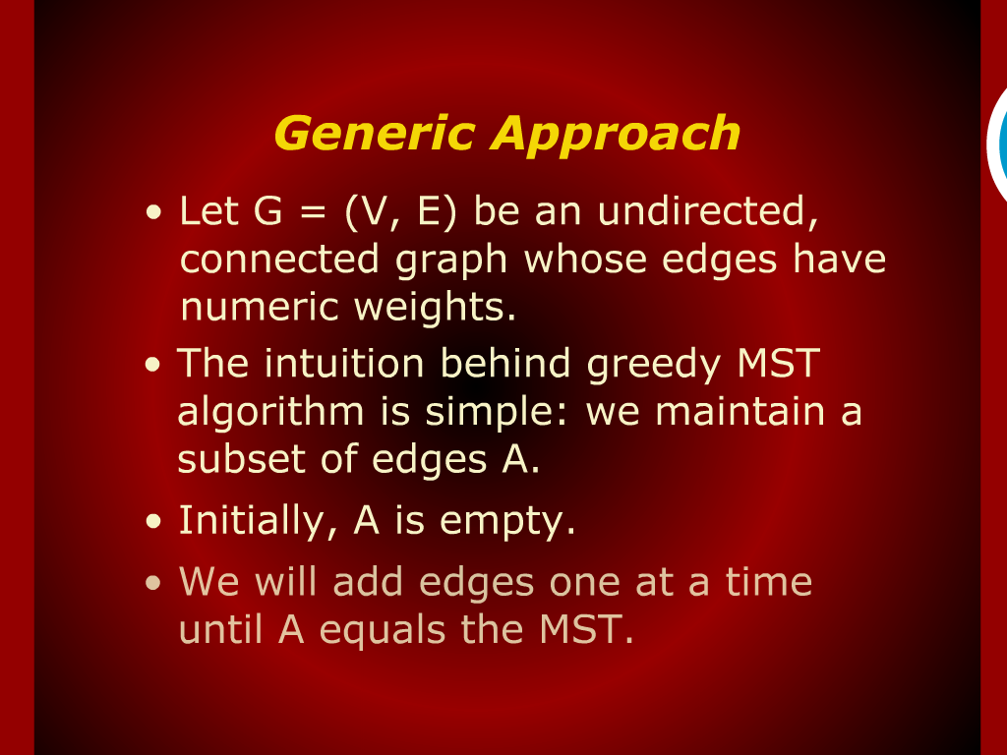
Generic Approach

Slide 6
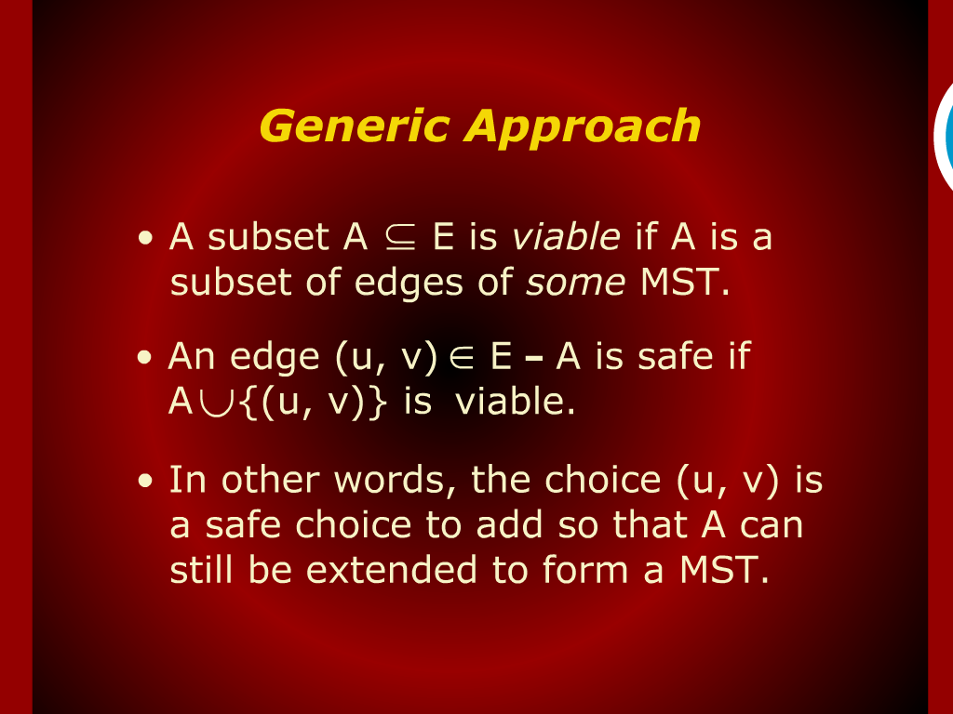
Generic Approach

Slide 7
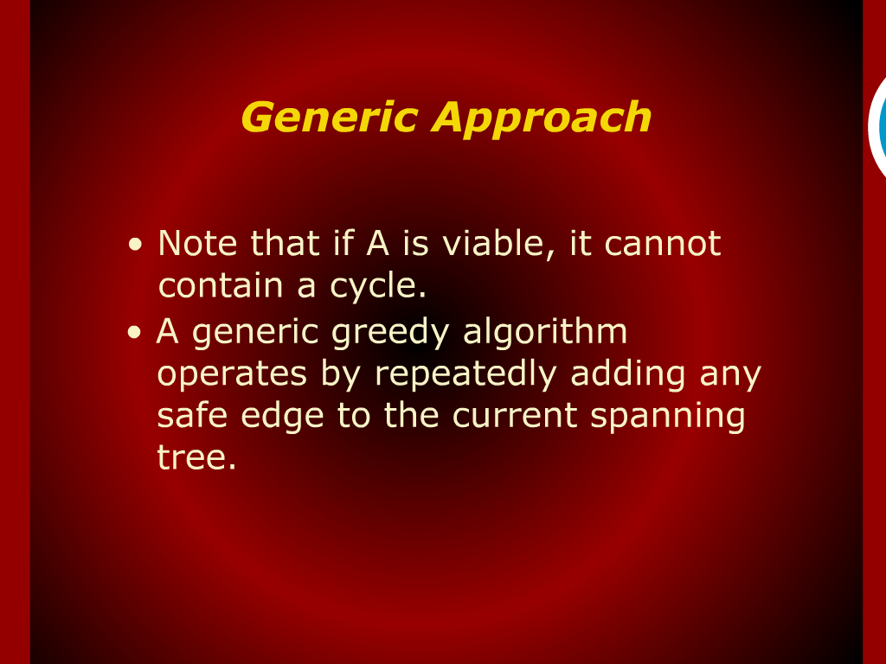
Generic Approach

Slide 8
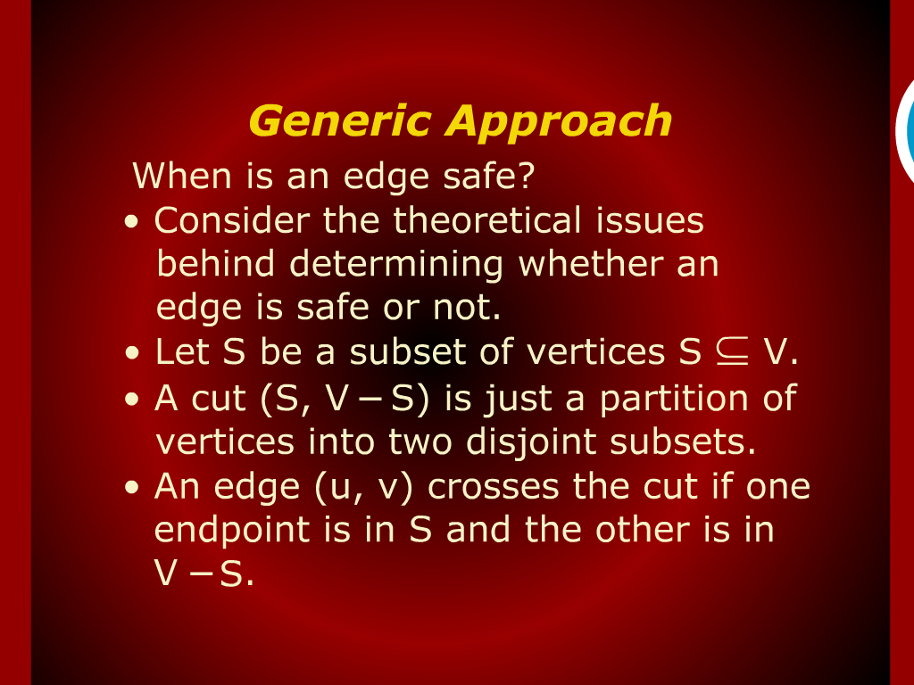
Generic Approach

Slide 9
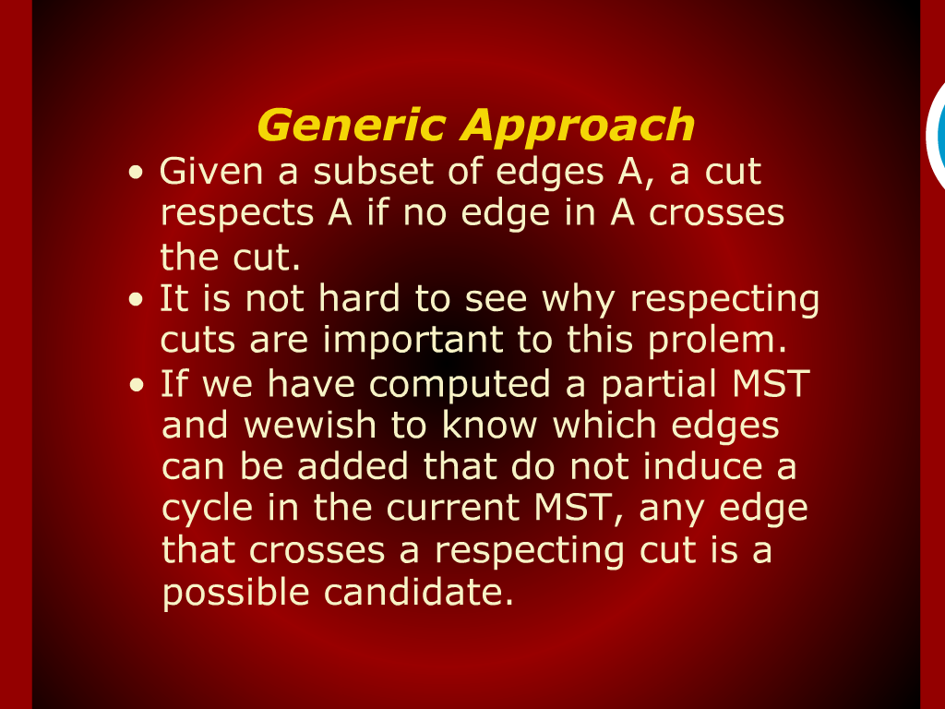
Generic Approach

Slide 10
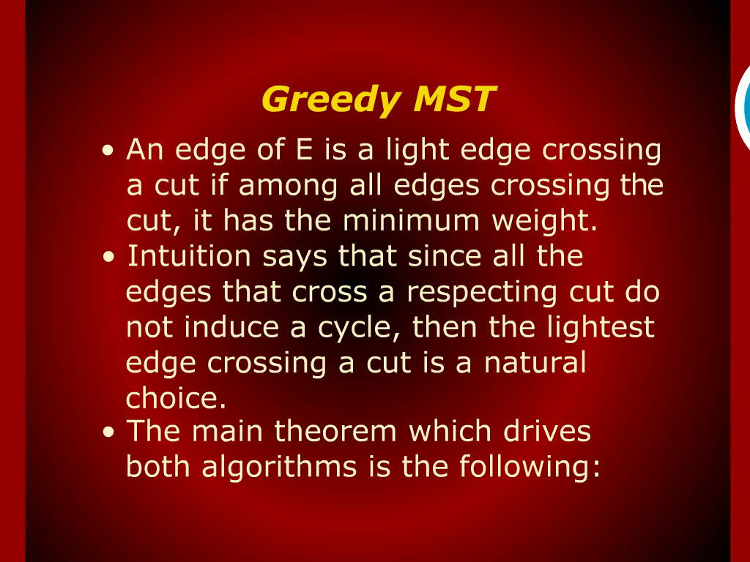
Greedy MST Proof

Slide 11
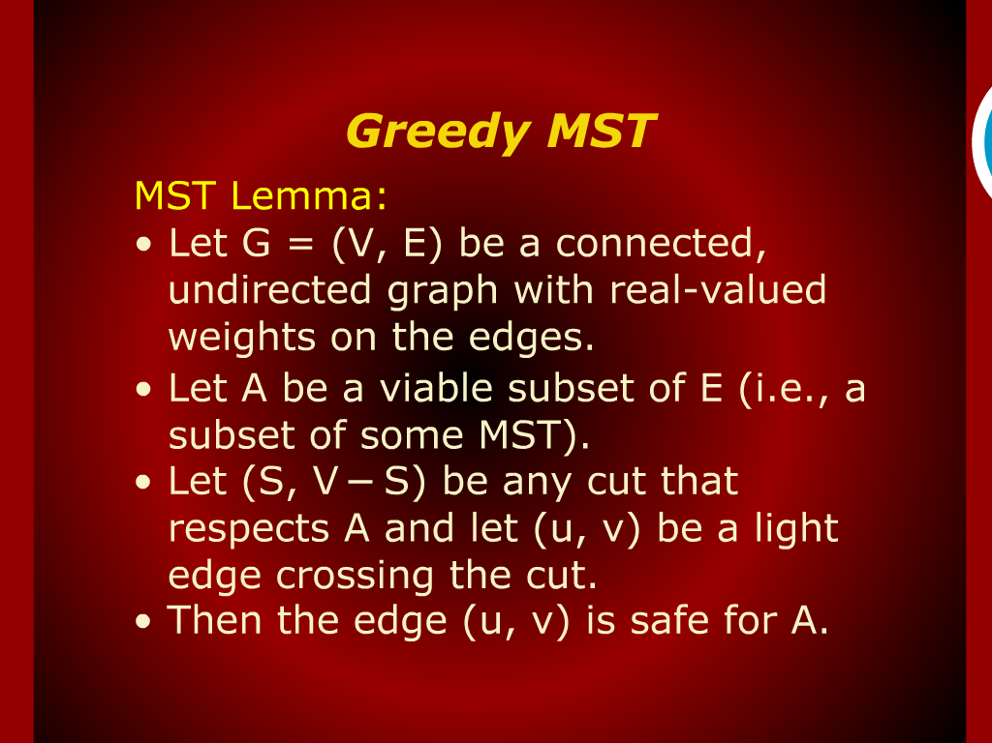
Greedy MST Proof

Slide 12
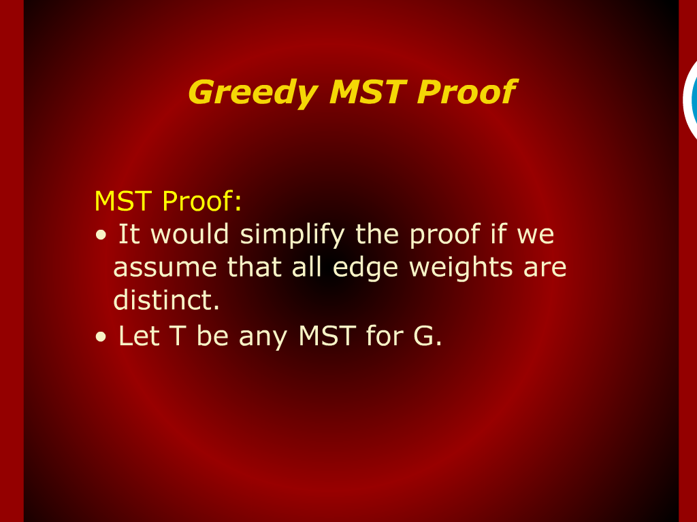
Greedy MST Proof

Slide 13
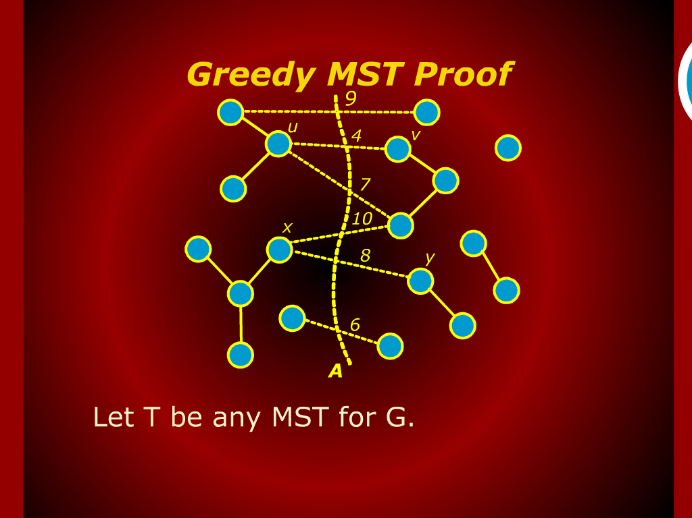
Greedy MST Proof

Slide 14
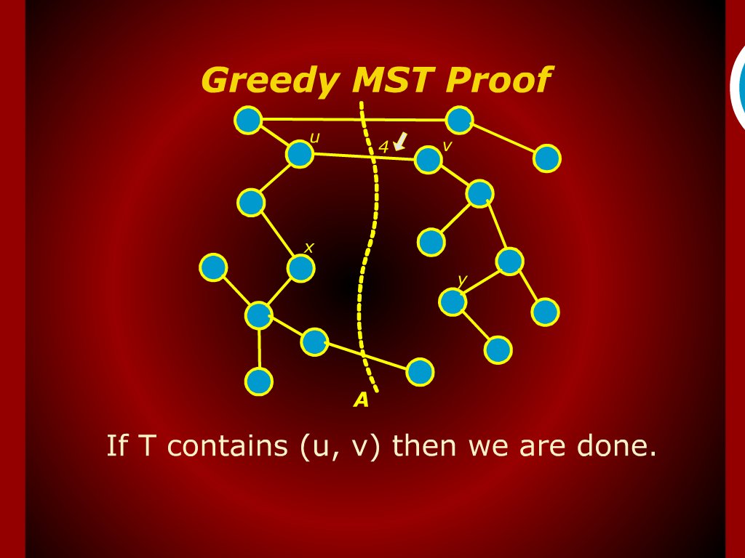
Greedy MST Proof

Slide 15
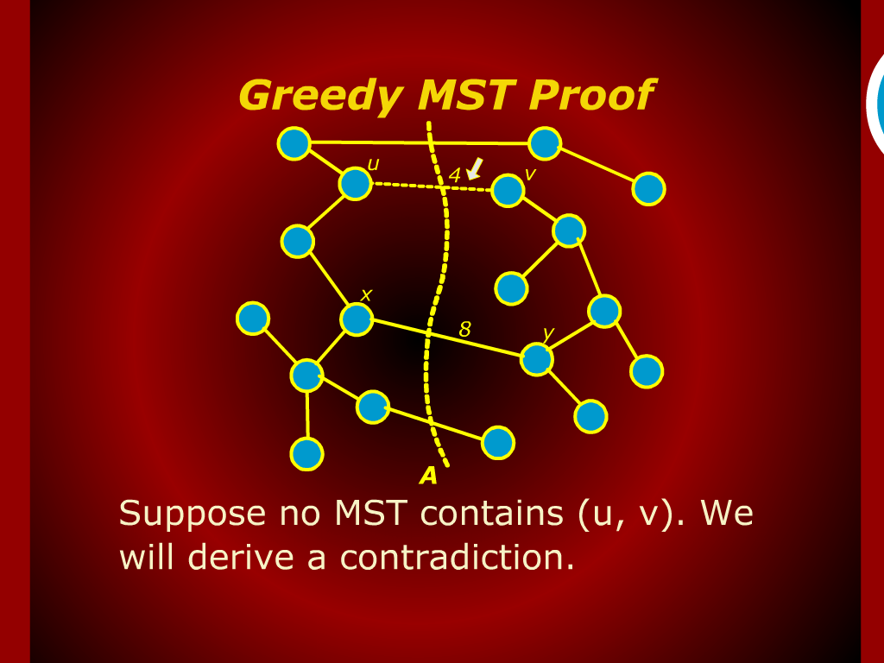
Greedy MST Proof

Slide 16
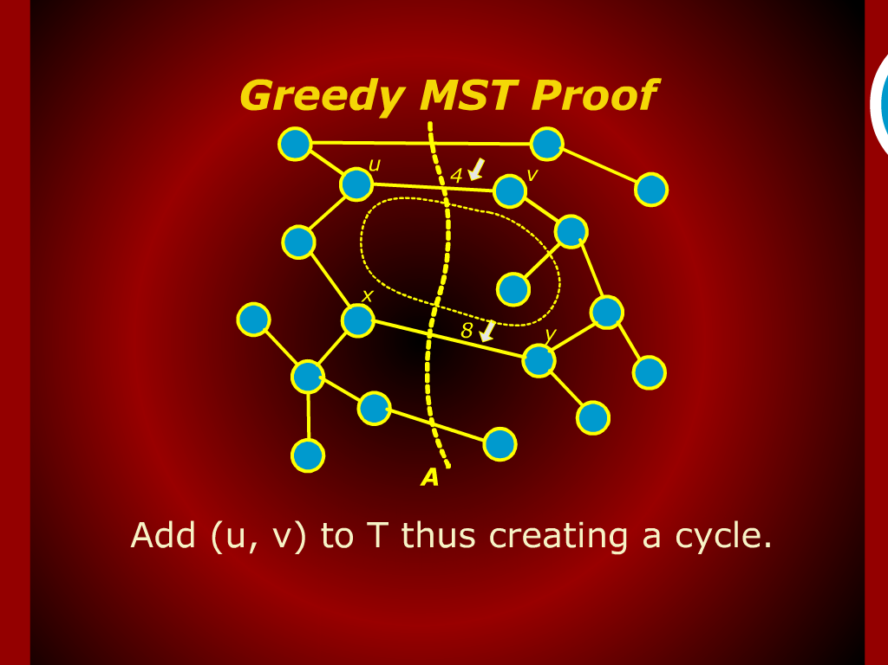
Greedy MST Proof

Slide 17
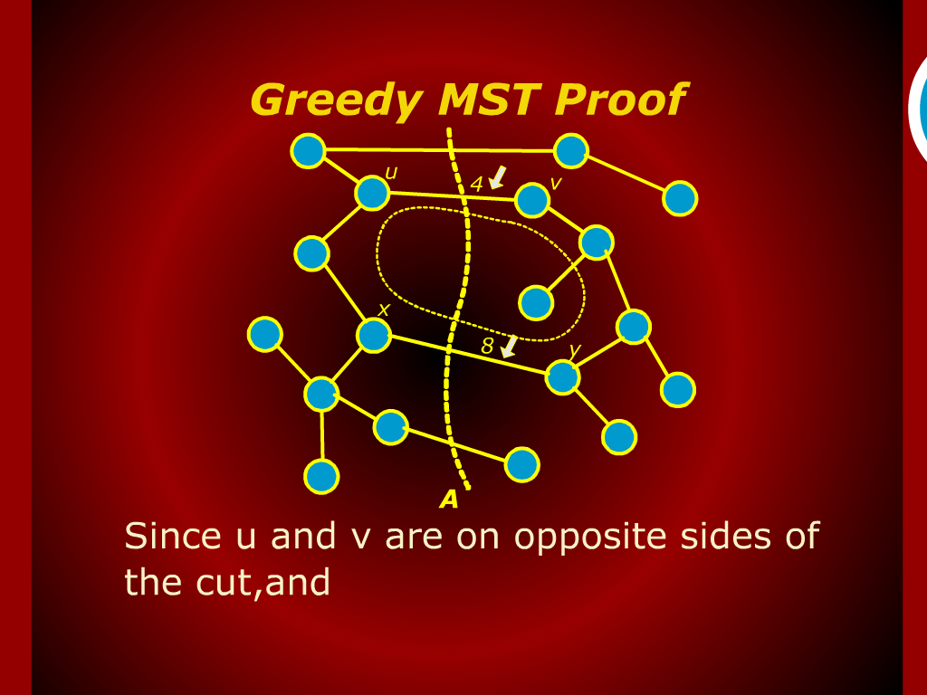
Greedy MST Proof

Slide 18
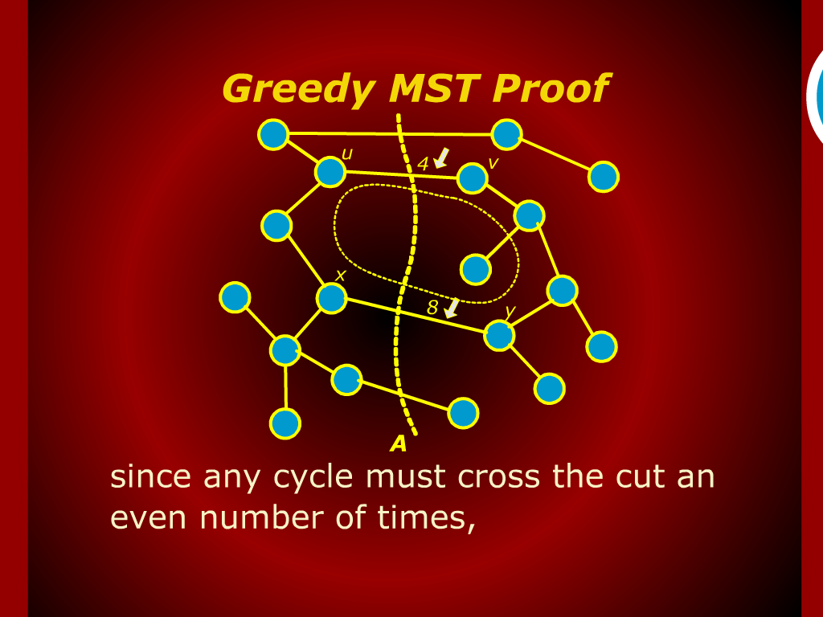
Greedy MST Proof

Slide 19
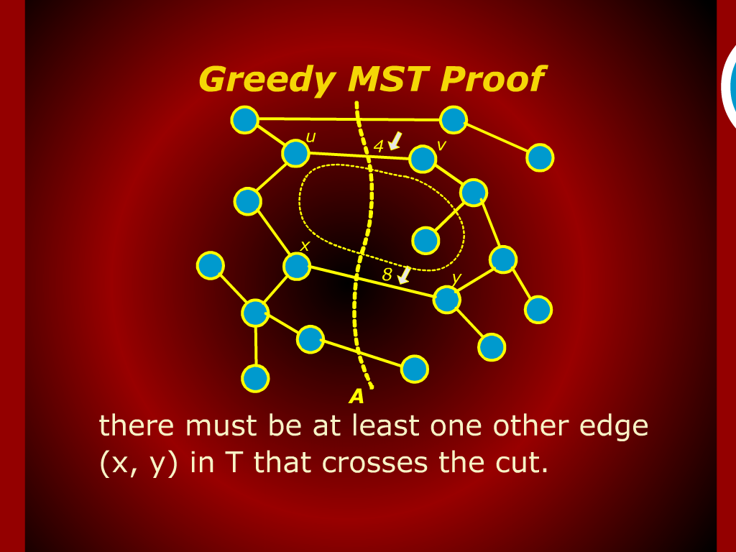
Greedy MST Proof

Slide 20
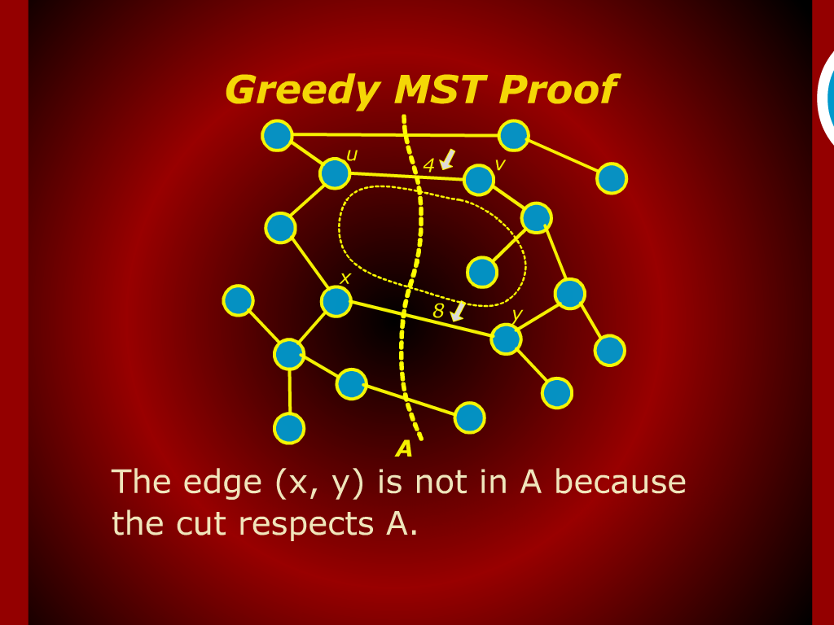
Greedy MST Proof

Slide 21
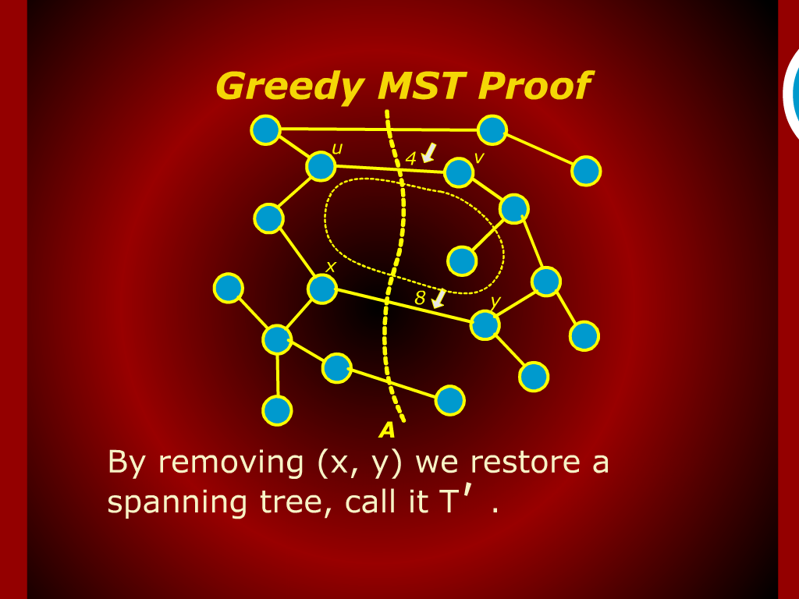
Greedy MST Proof

Slide 22

Greedy MST Proof

Slide 23
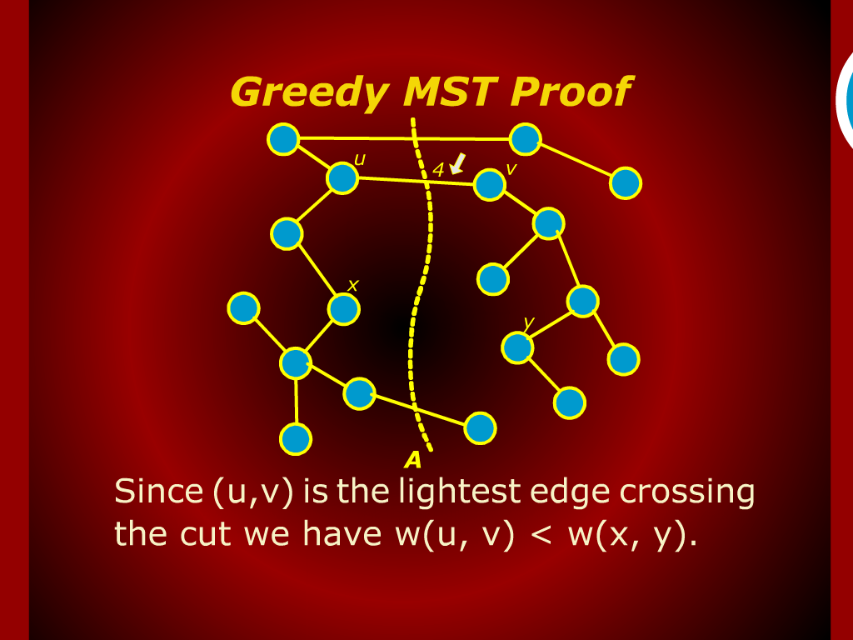
Greedy MST Proof

Slide 24
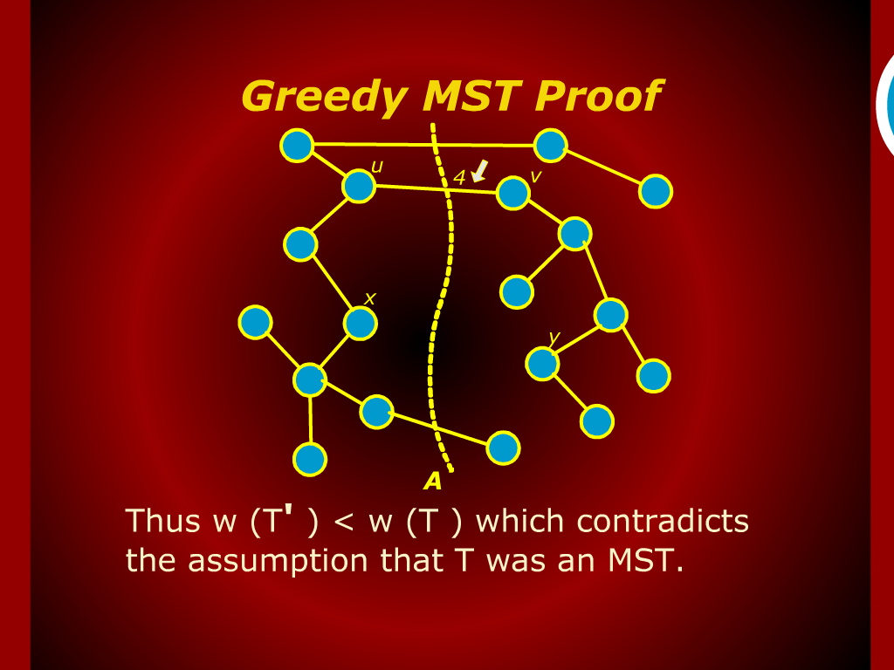
Greedy MST Proof

Slide 25
Random Access Machine

