Slide 1
Algorithms
Lecture # 36
Dr. Sohail Aslam

Slide 2
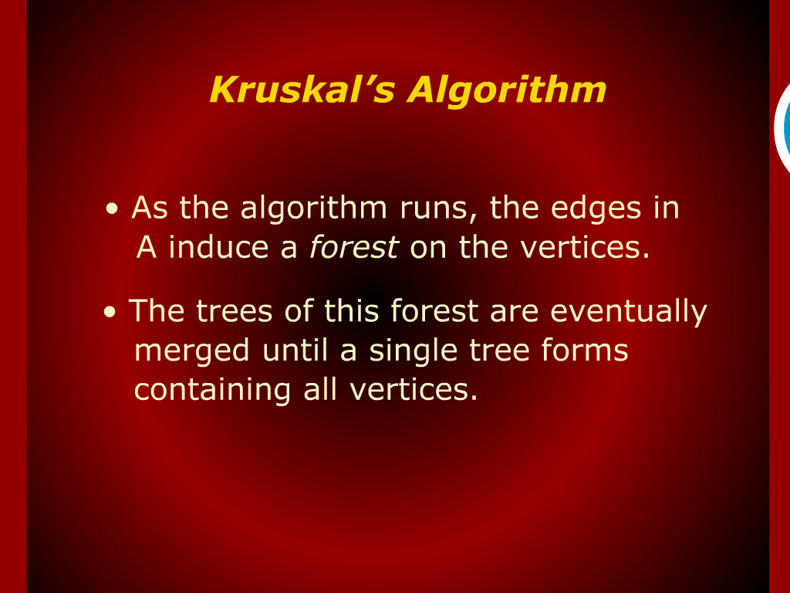
Kruskal’s Algorithm

Slide 3
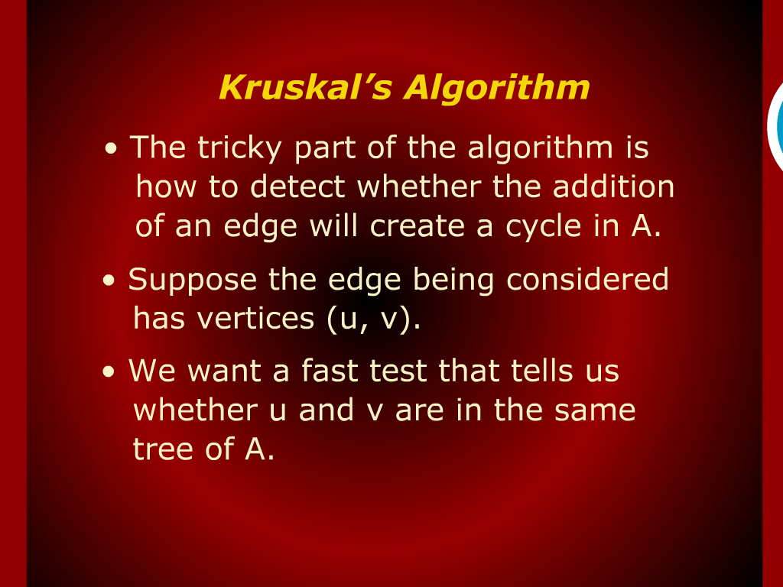
Kruskal’s Algorithm

Slide 4
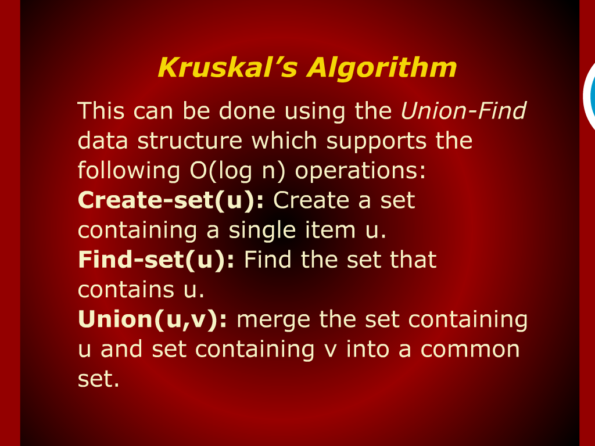
Kruskal’s Algorithm

Slide 5
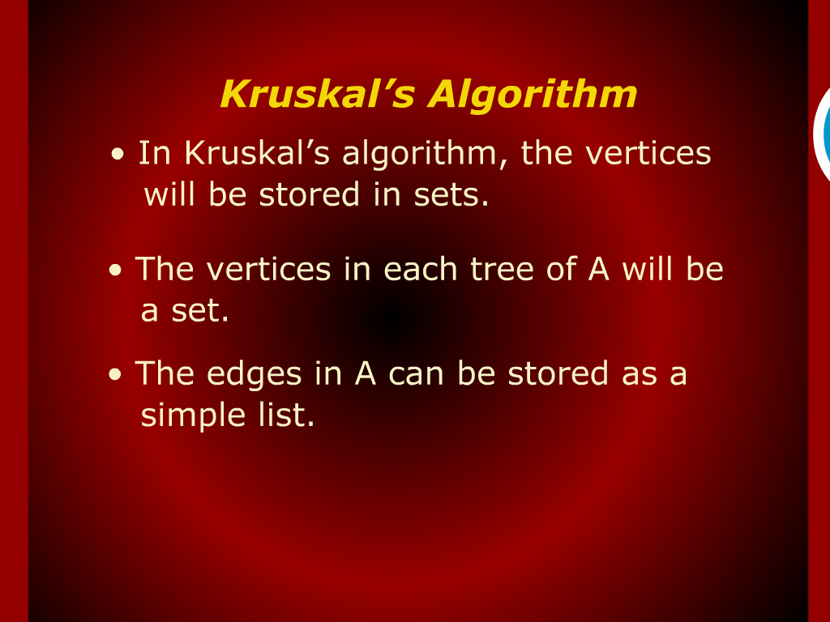
Kruskal’s Algorithm

Slide 6
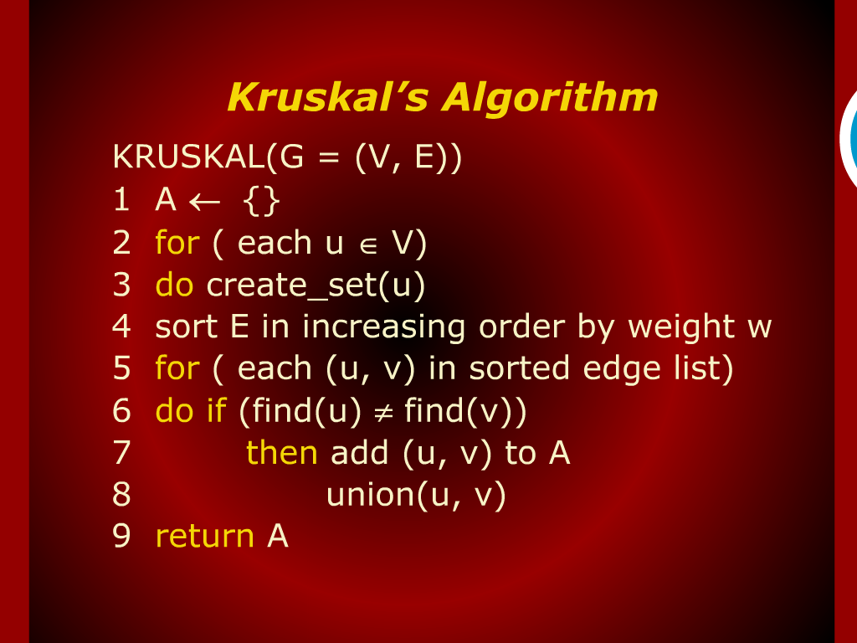
Kruskal’s Algorithm

Slide 7
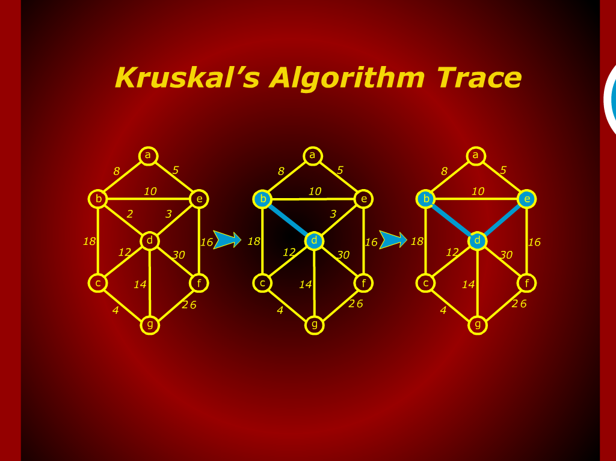
Kruskal’s Algorithm Trace

Slide 8
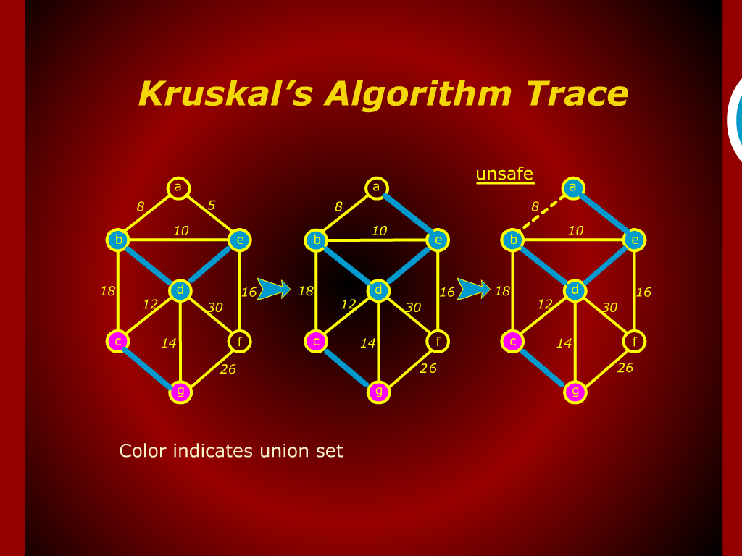
Kruskal’s Algorithm Trace

Slide 9
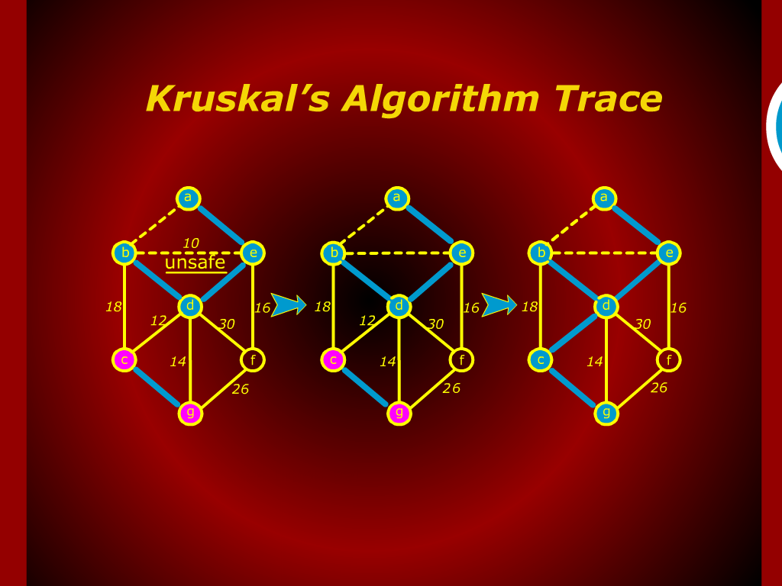
Kruskal’s Algorithm Trace

Slide 10
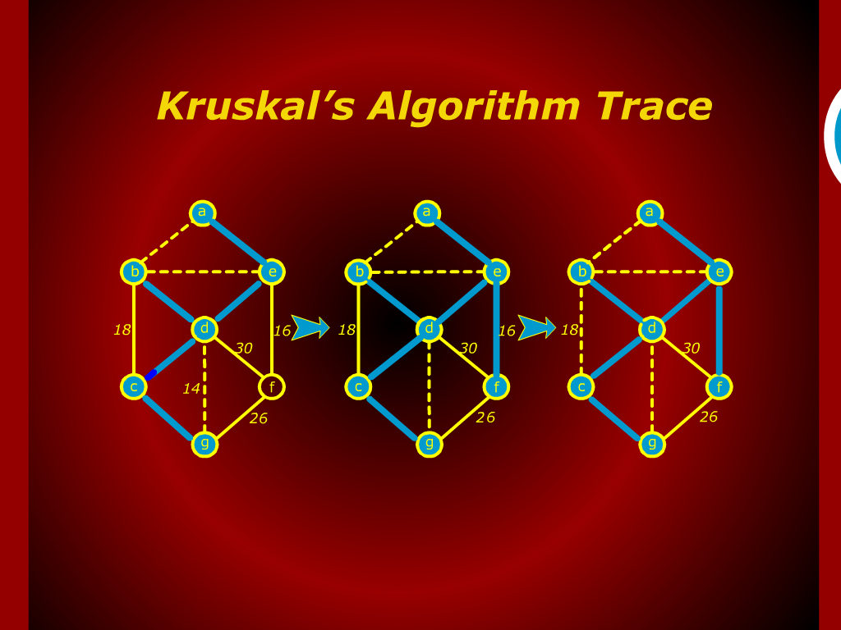
Kruskal’s Algorithm Trace

Slide 11
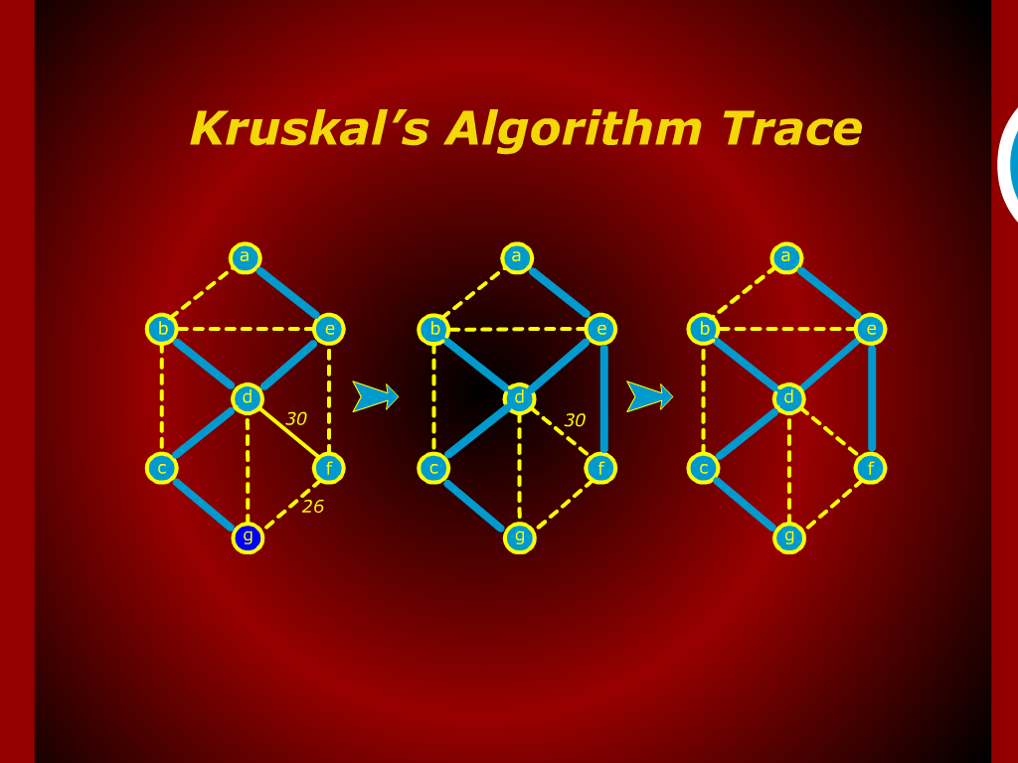
Kruskal’s Algorithm Trace

Slide 12
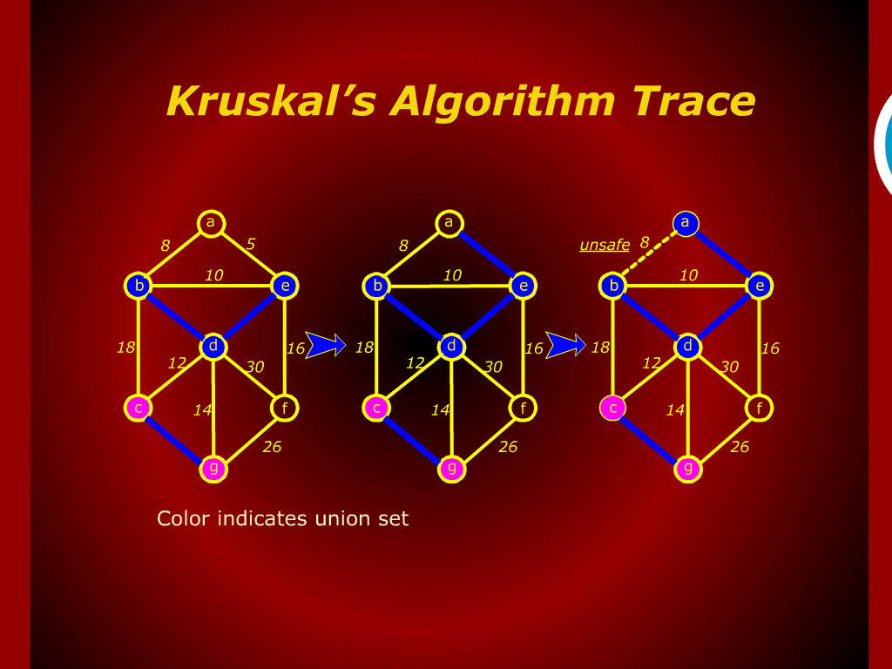
Kruskal’s Algorithm Trace

Slide 13
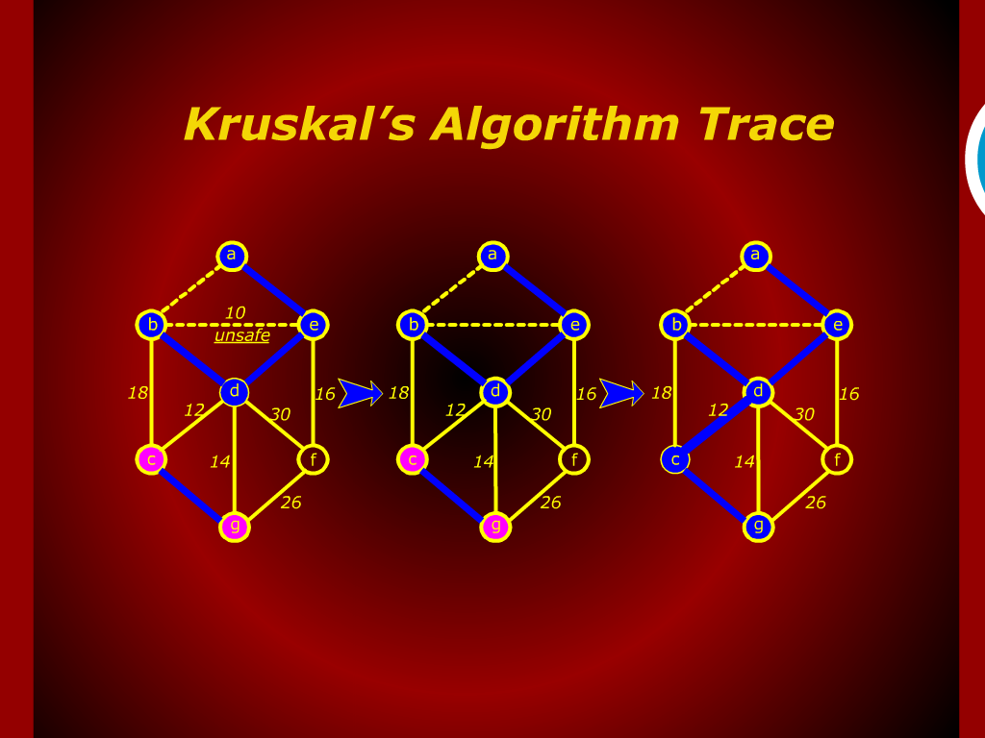
Kruskal’s Algorithm Trace

Slide 14
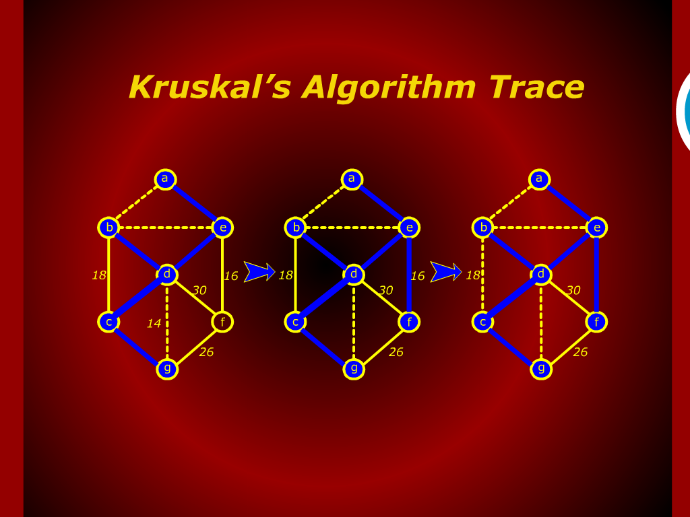
Kruskal’s Algorithm Trace

Slide 15
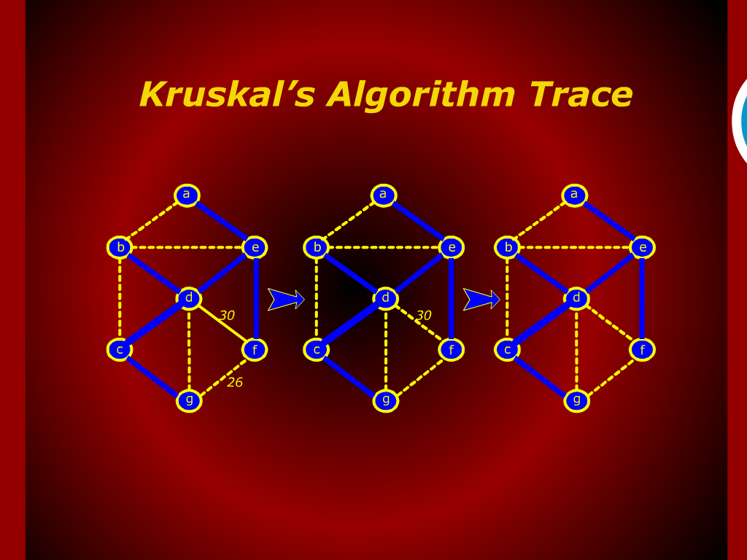
Kruskal’s Algorithm Trace

Slide 16
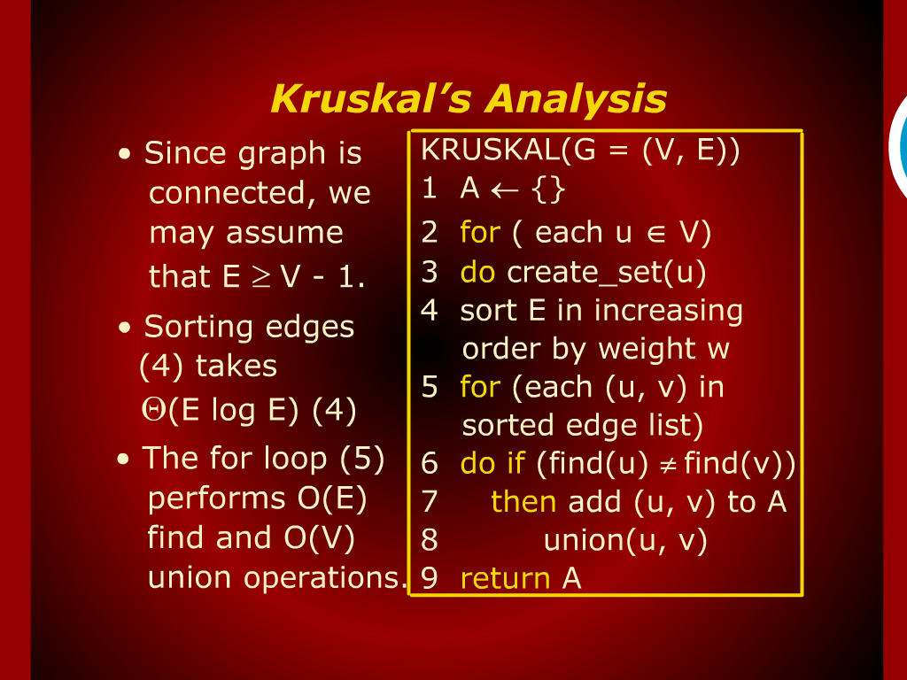
Kruskal’s Analysis

Slide 17
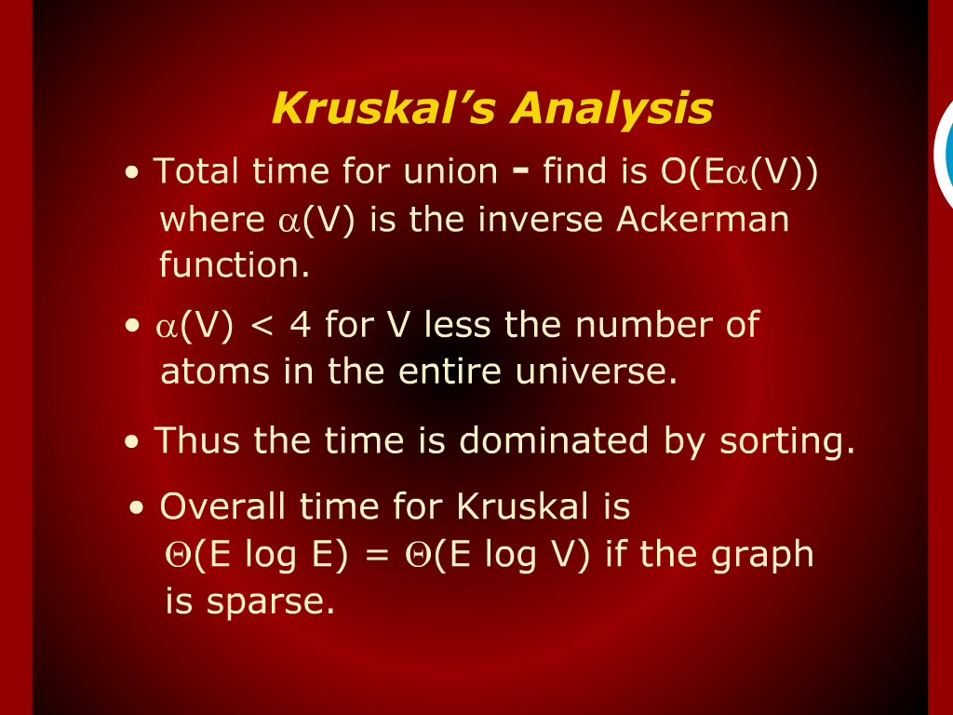
Kruskal’s Analysis

Slide 18
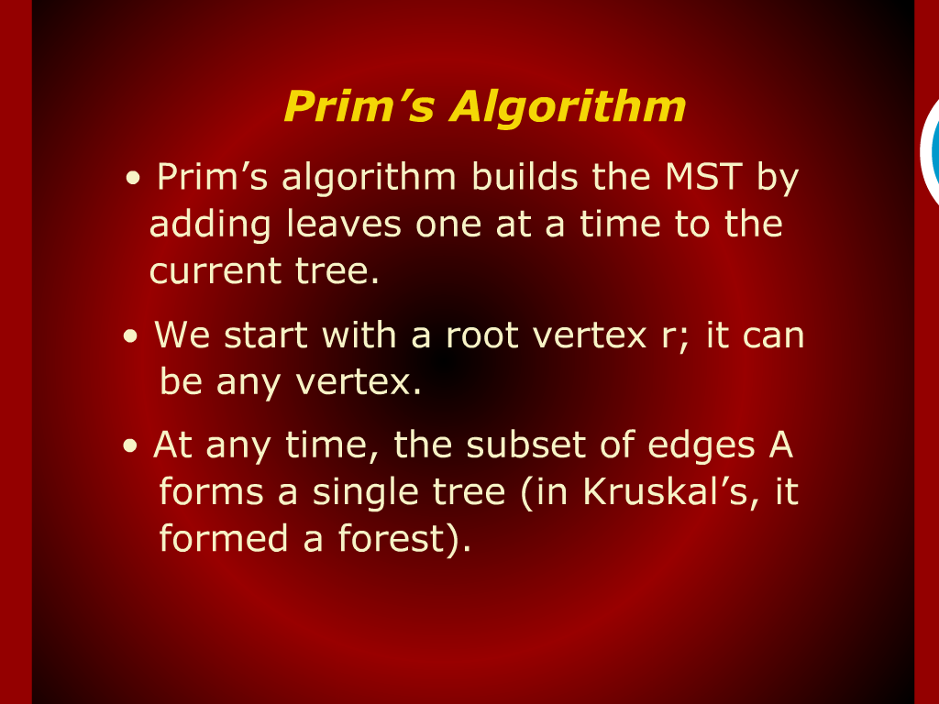
Prim’s Algorithm

Slide 19
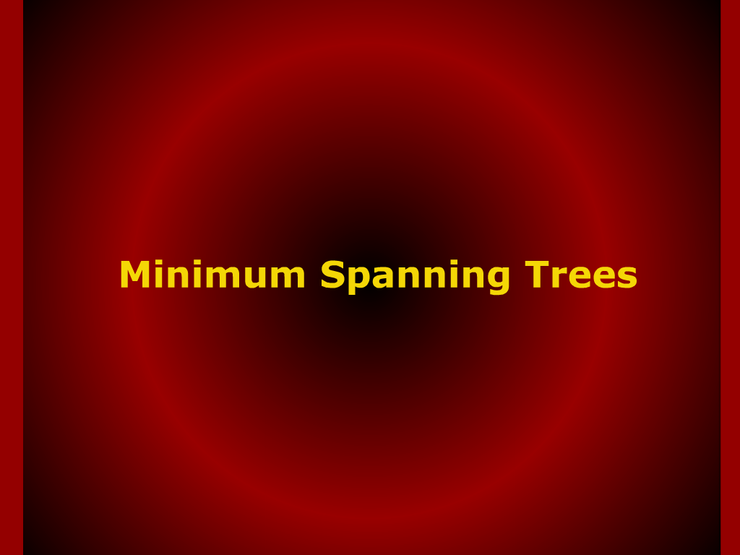
Minimum Spanning Trees

Slide 20
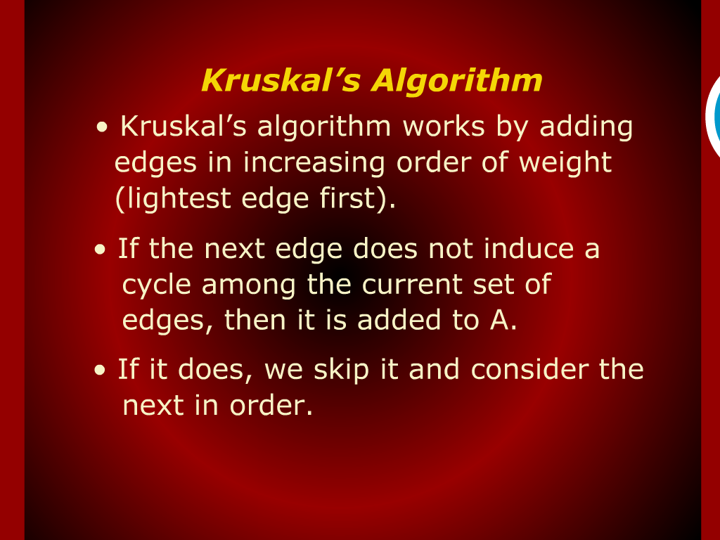
Kruskal’s Algorithm

Slide 21
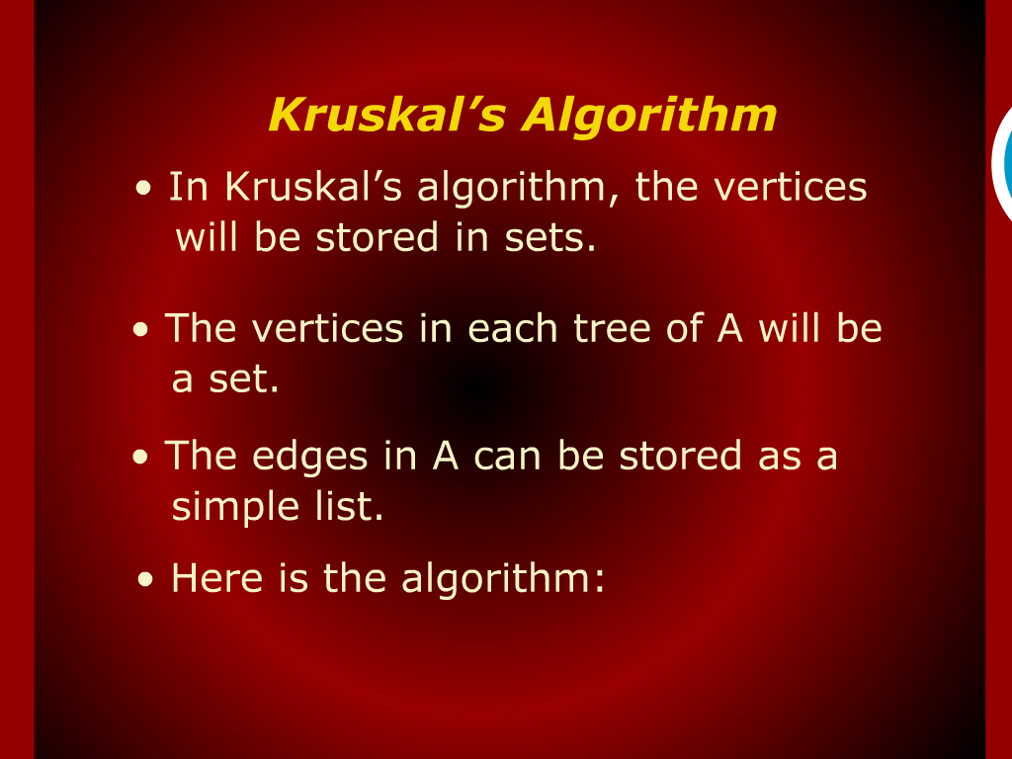
Kruskal’s Algorithm

