Slide 1
Algorithms
Lecture #37
Dr. Sohail Aslam

Slide 2
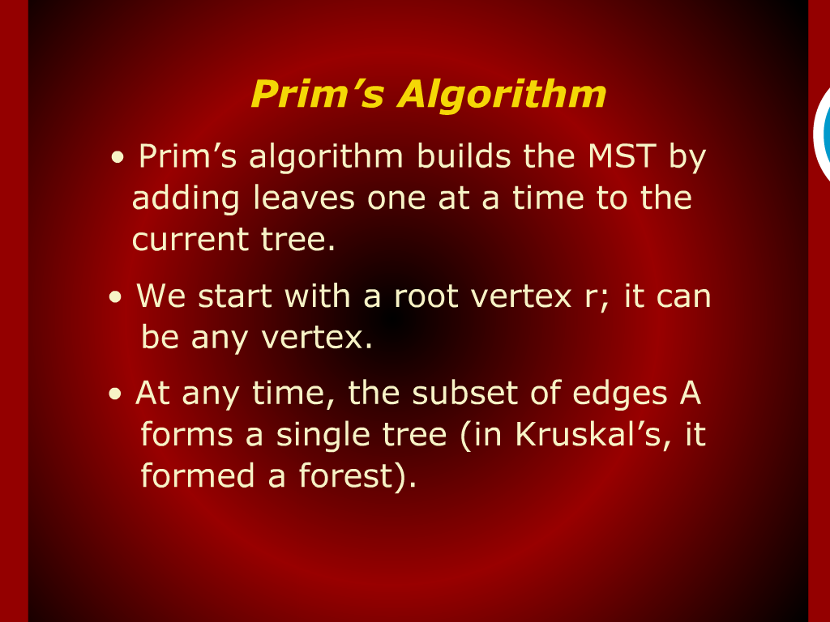
Prim’s Algorithm

Slide 3
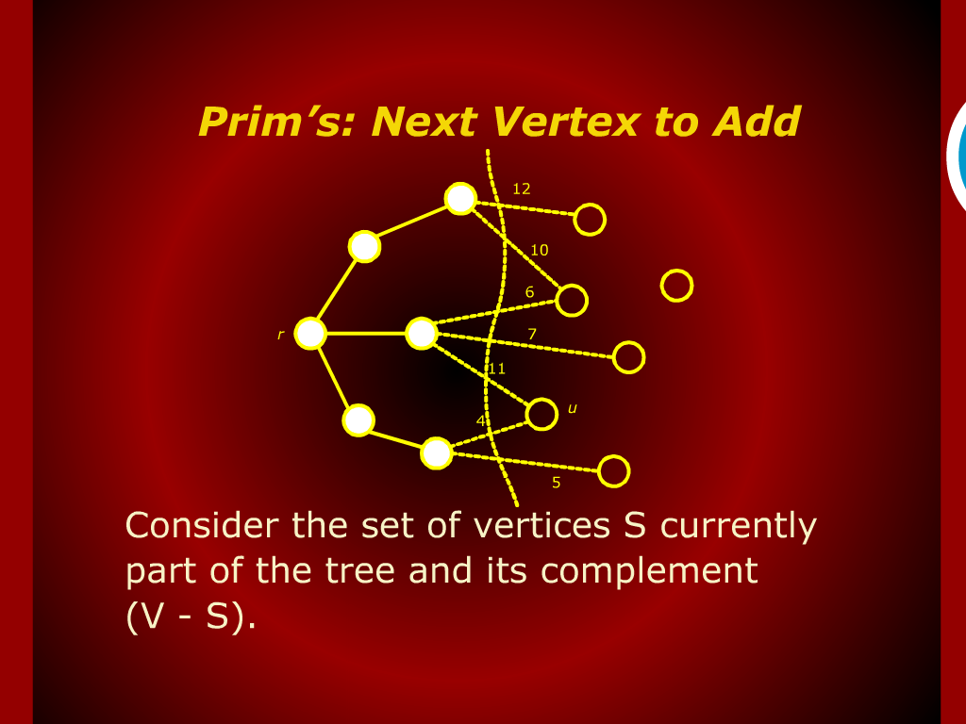
Prime’s Next Vertex to Add

Slide 4
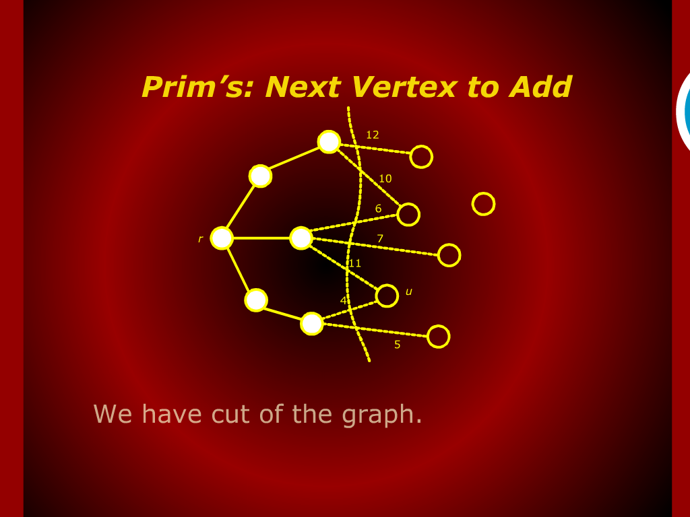
Prime’s Next Vertex to Add

Slide 5
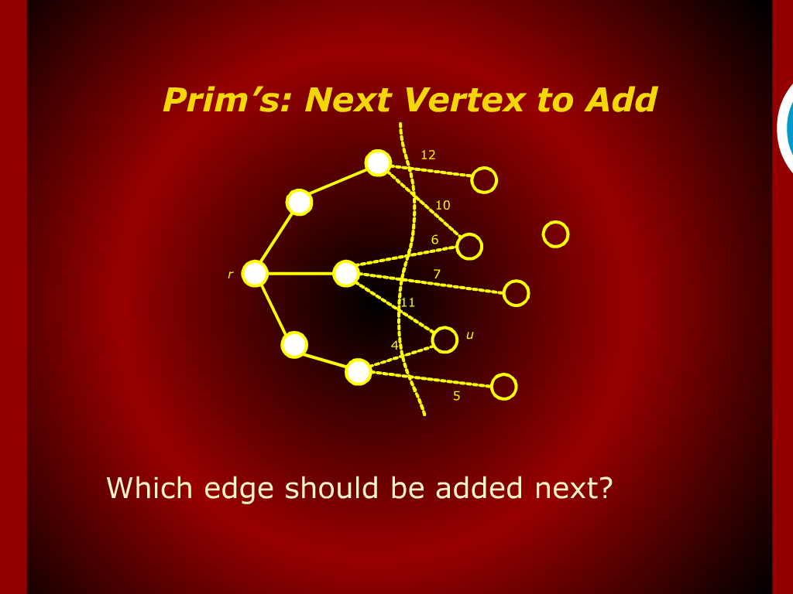
Prime’s Next Vertex to Add

Slide 6
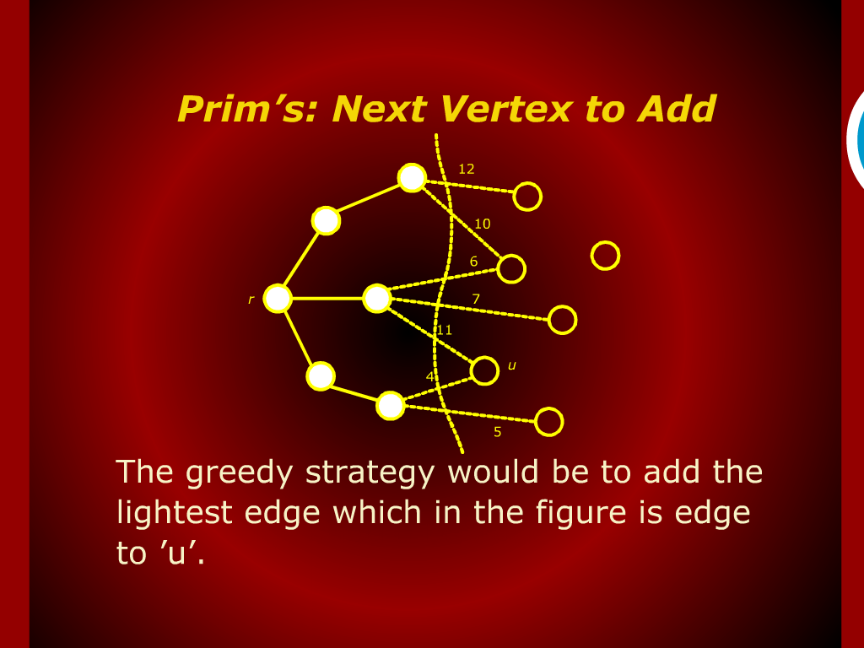
Prime’s Next Vertex to Add

Slide 7
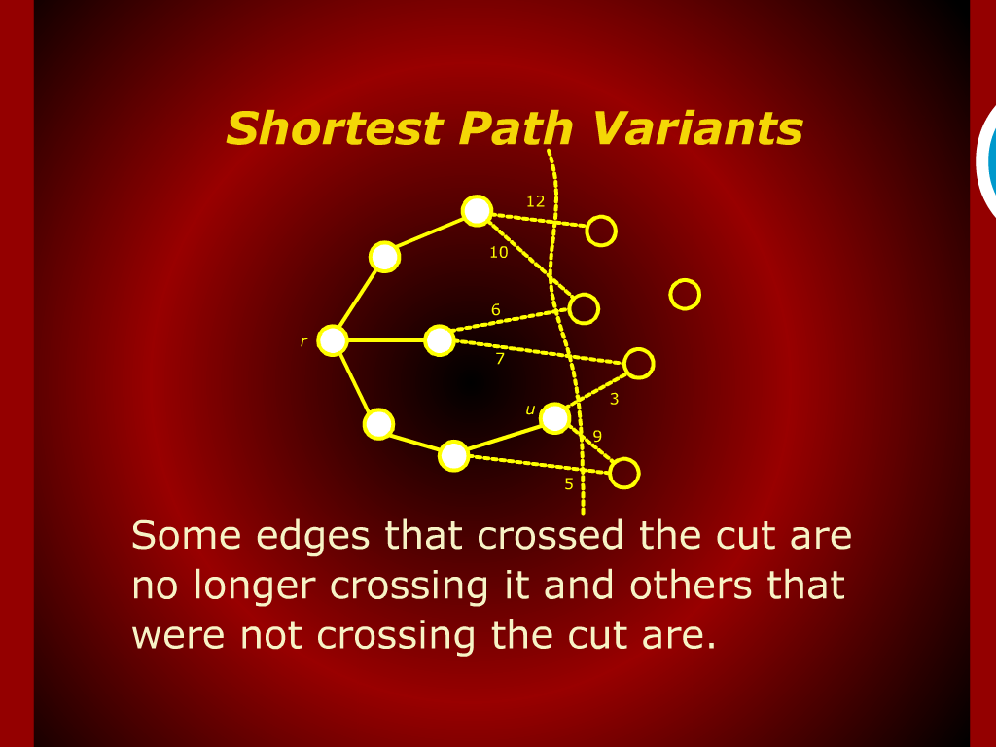
Shortest Path Variants

Slide 8
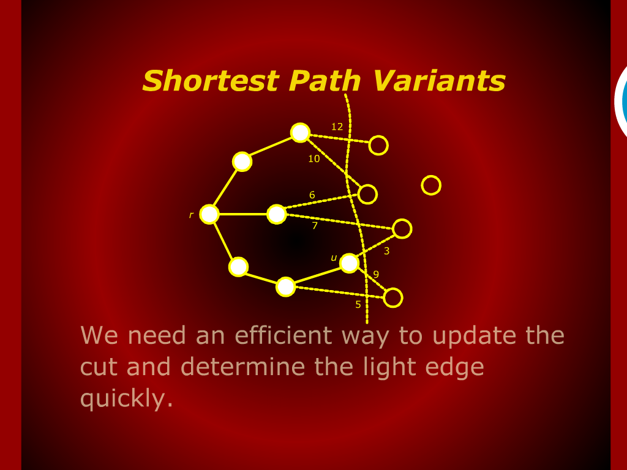
Shortest Path Variants

Slide 9
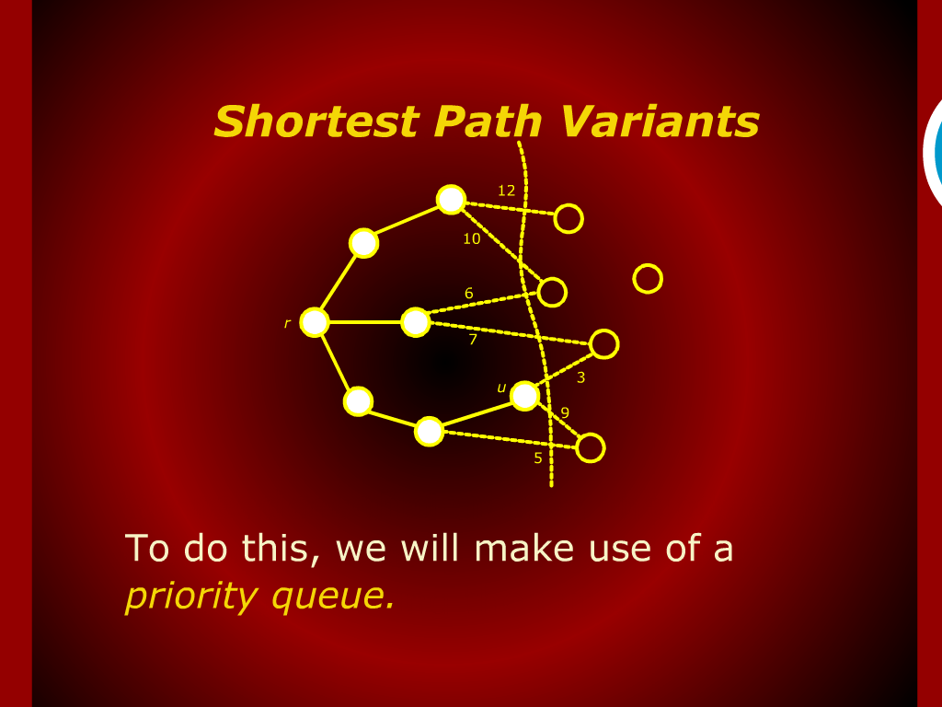
Shortest Path Variants

Slide 10
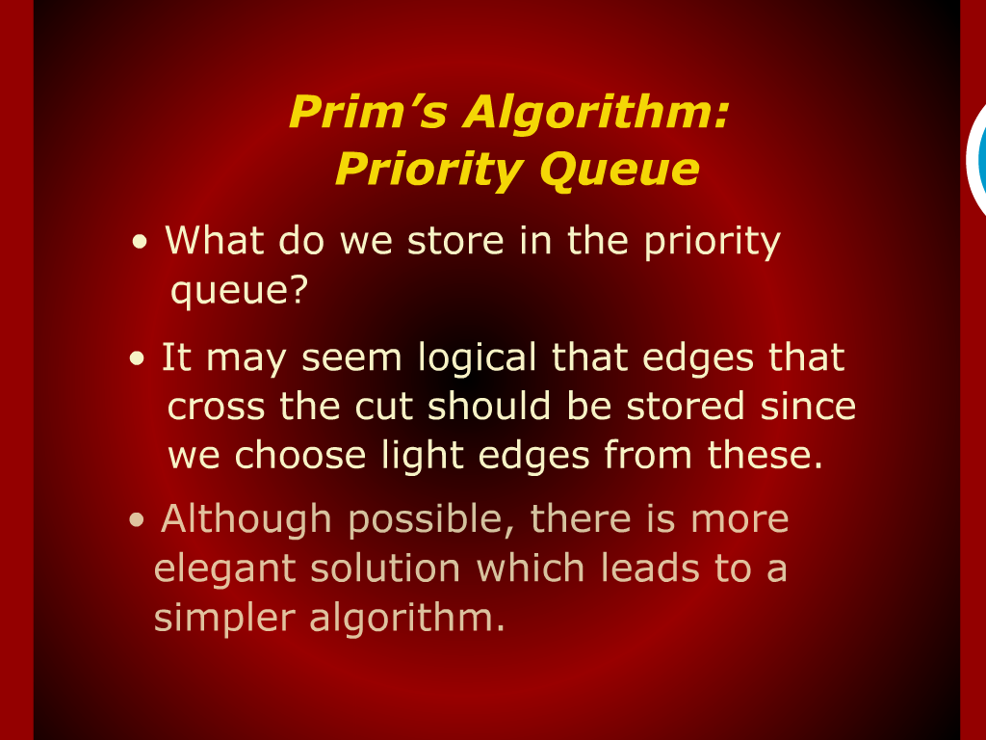
Prim’s Algorithm: Priority Queue

Slide 11
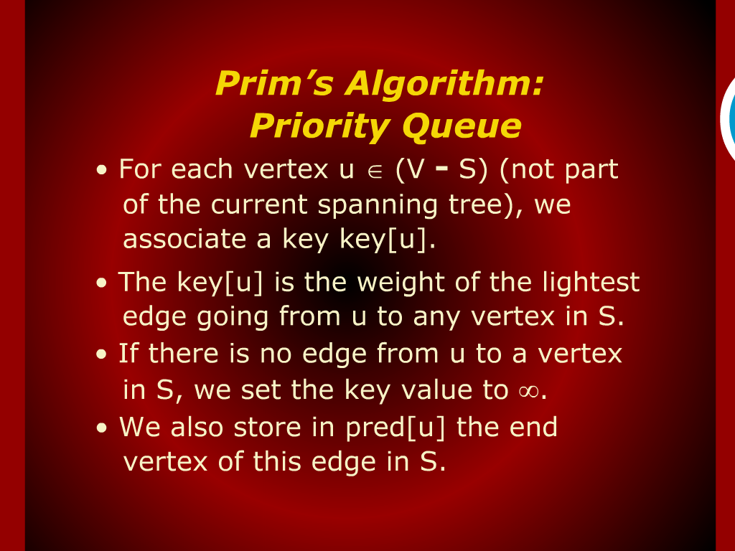
Prim’s Algorithm: Priority Queue

Slide 12
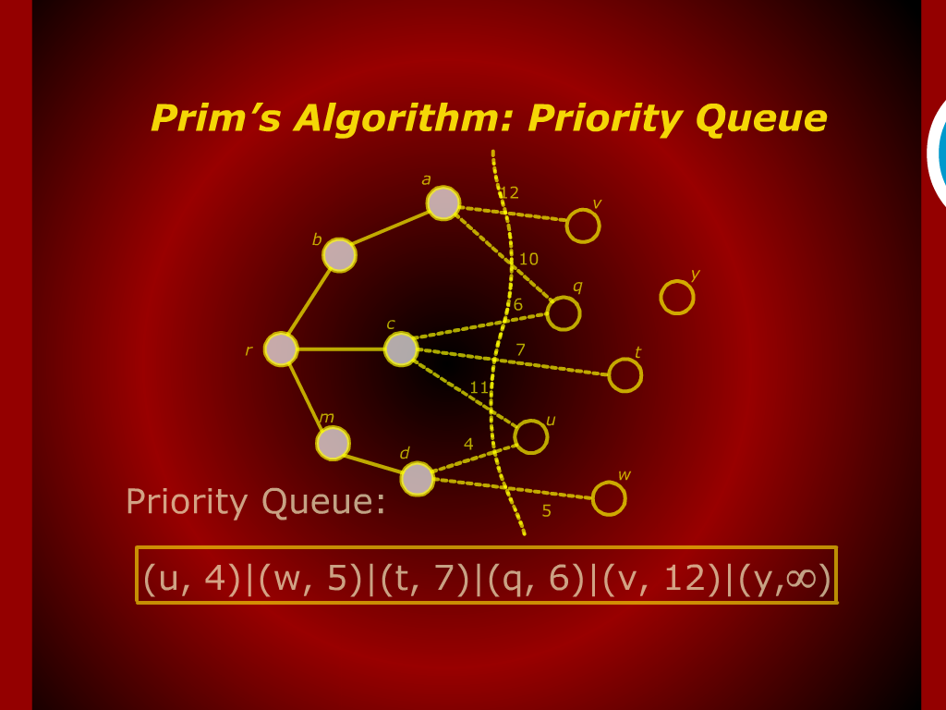
Prim’s Algorithm: Priority Queue

Slide 13
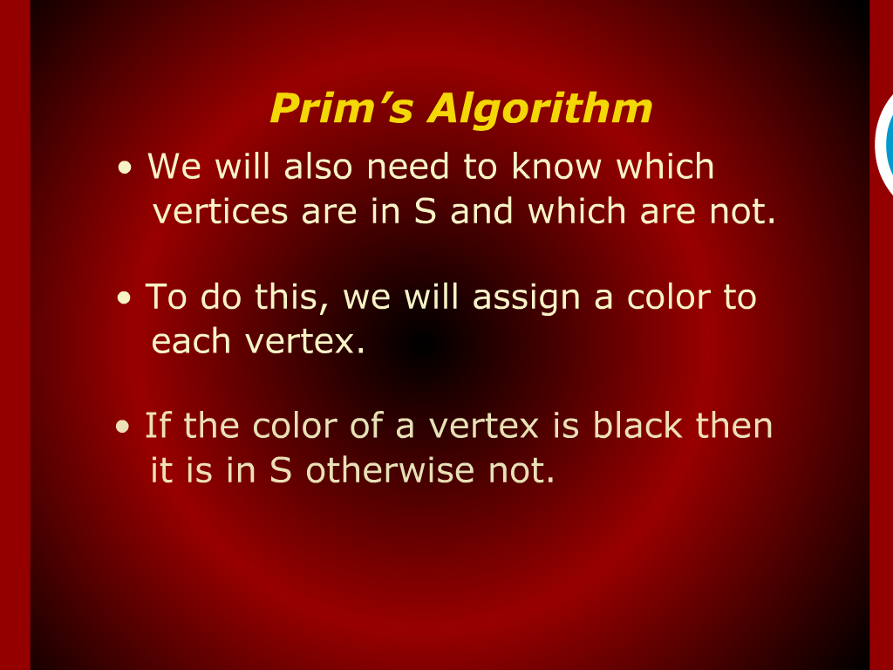
Prim’s Algorithm

Slide 14
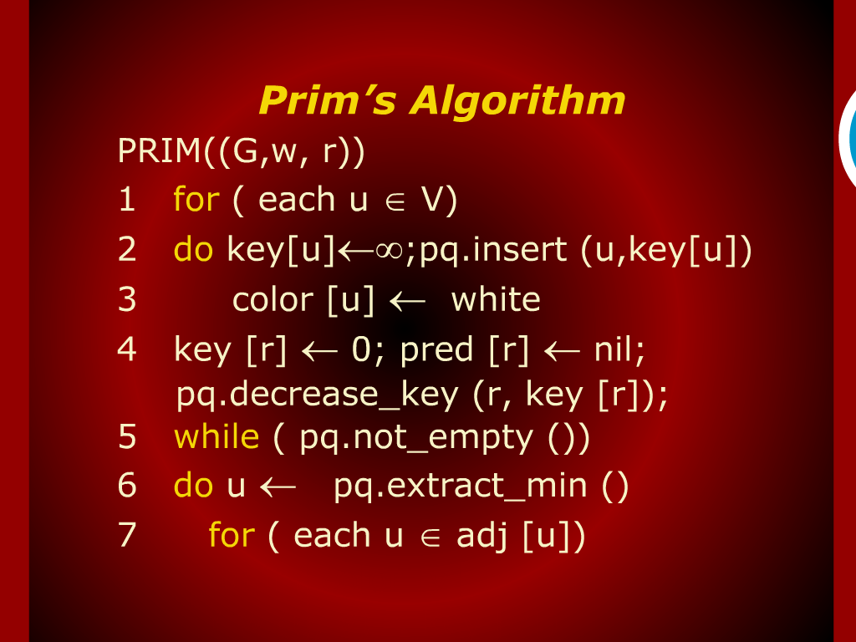
Prim’s Algorithm

Slide 15
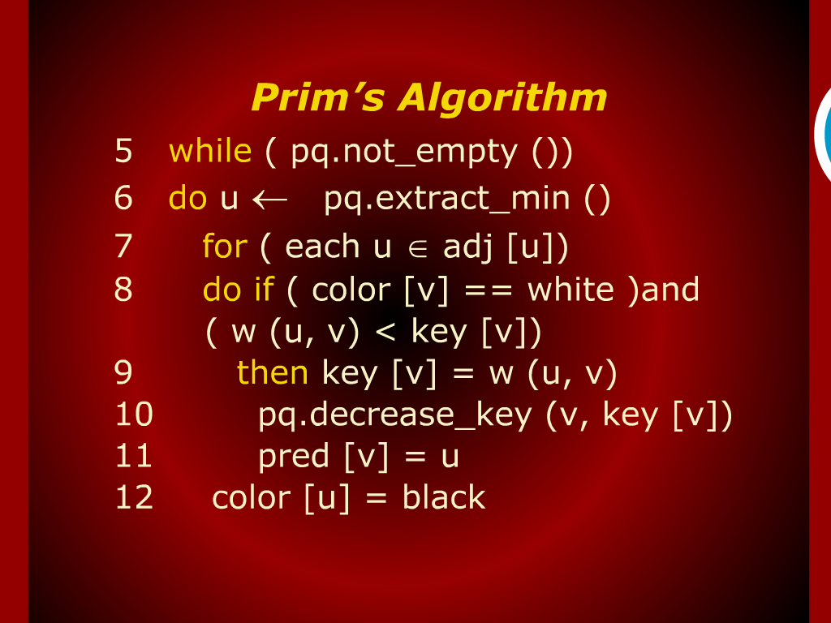
Prim’s Algorithm

Slide 16
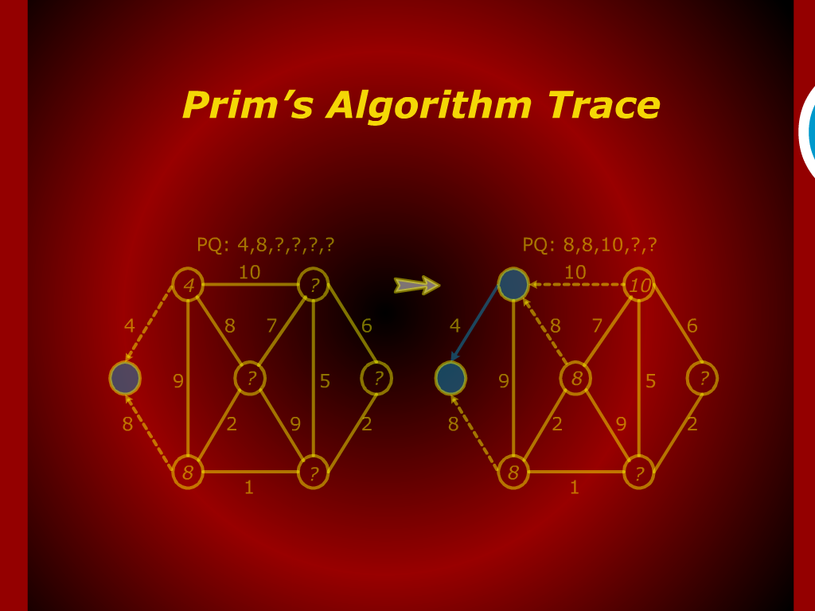
Prim’s Algorithm Trace

Slide 17
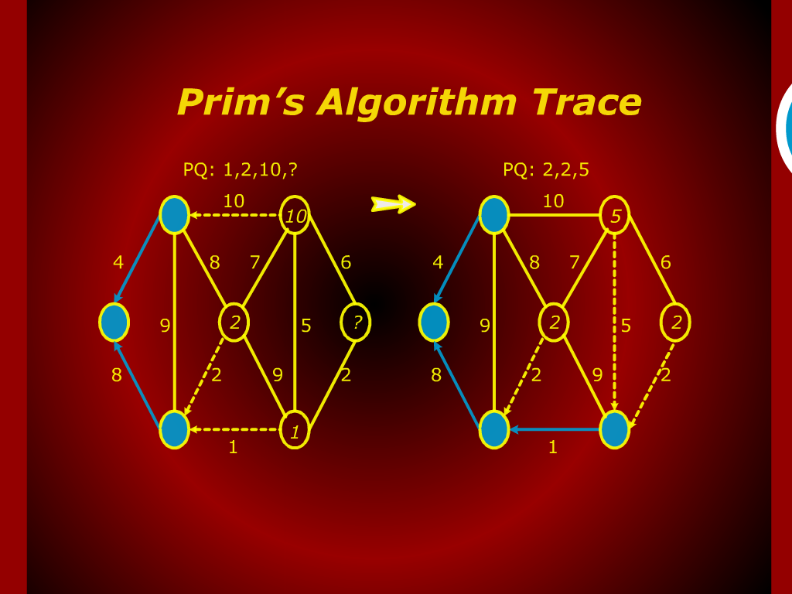
Prim’s Algorithm Trace

Slide 18
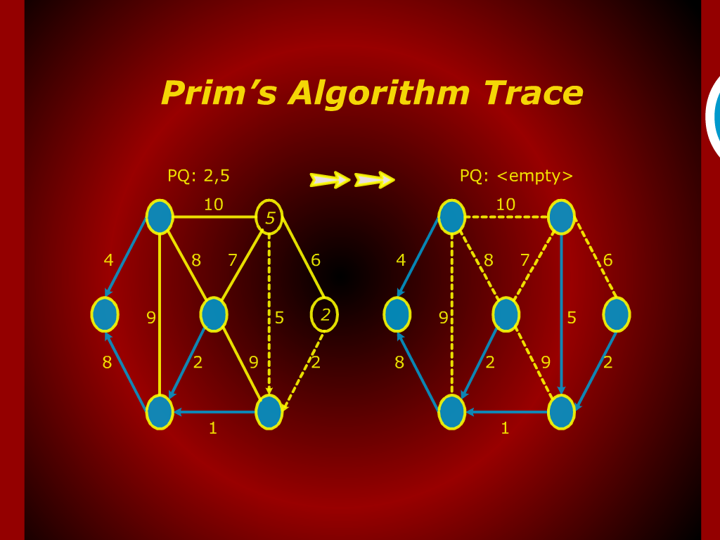
Prim’s Algorithm Trace

Slide 19
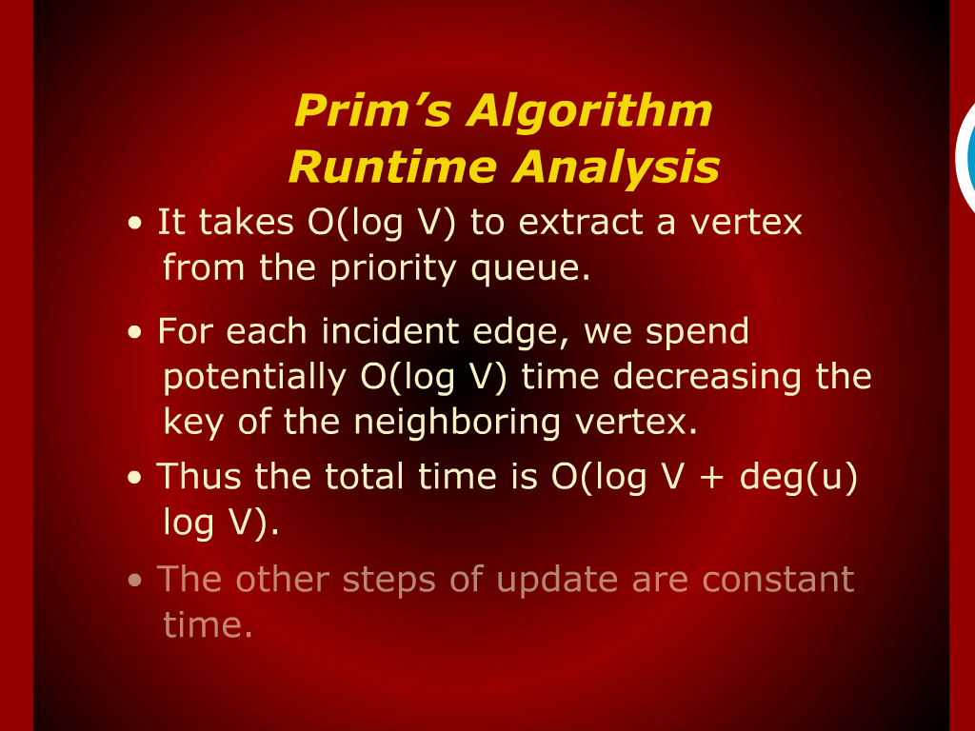
Prim’s Algorithm Run Time Analysis

Slide 20
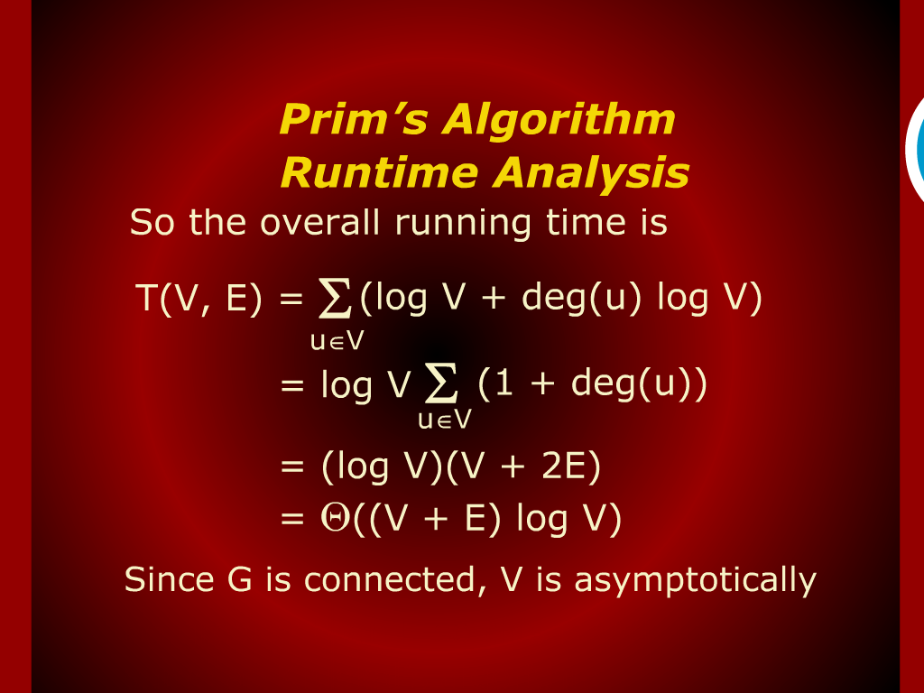
Prim’s Algorithm Run Time Analysis

Slide 21
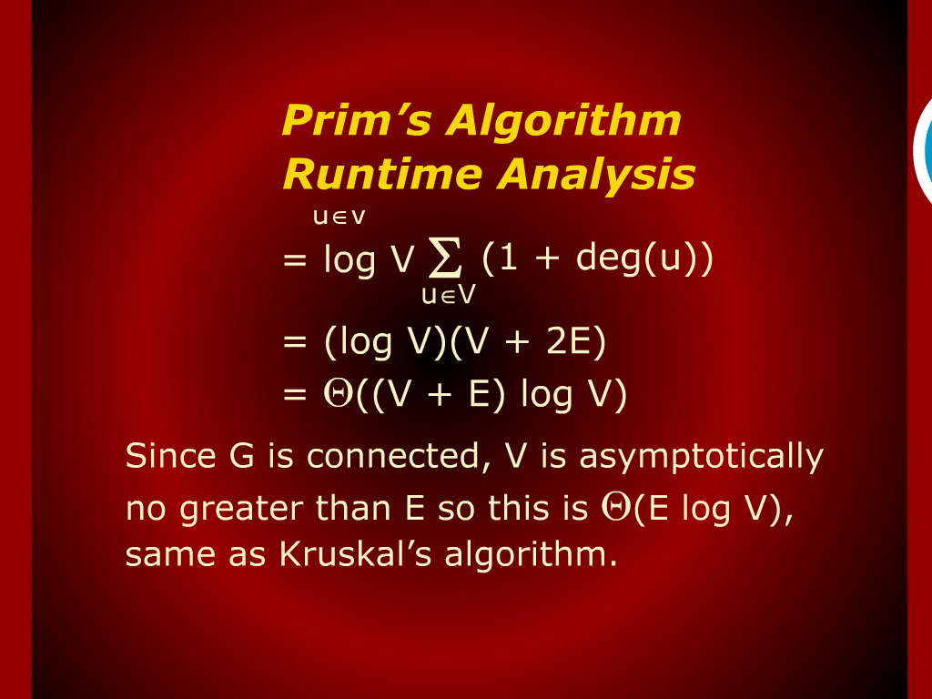
Prim’s Algorithm Run Time Analysis

Slide 22

Shortest Path

Slide 23
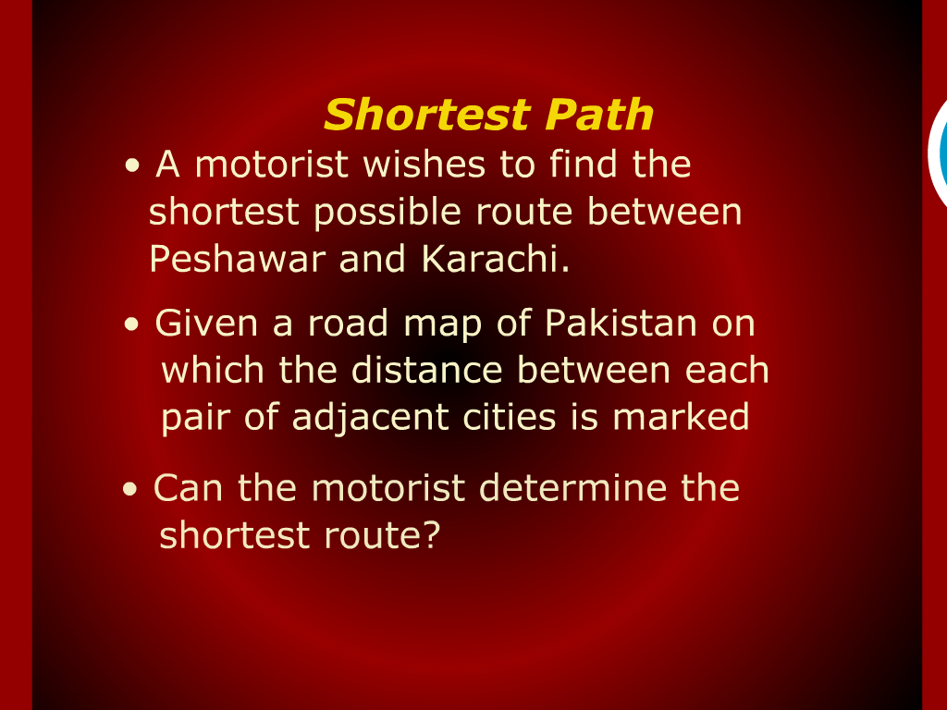
Shortest Path

Slide 24
Prim’s Algorithm

