Slide 1
Algorithms
Lecture #38
Dr. Sohail Aslam

Slide 2
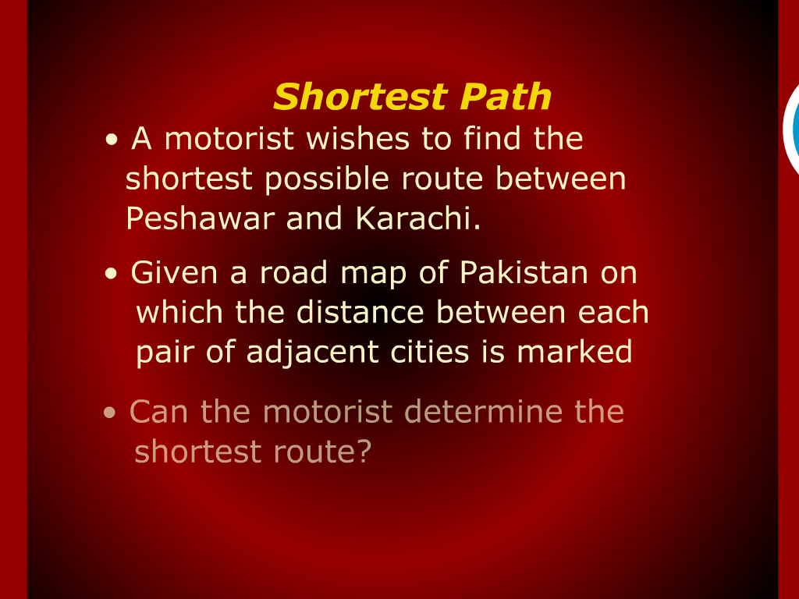
Shortest Path

Slide 3
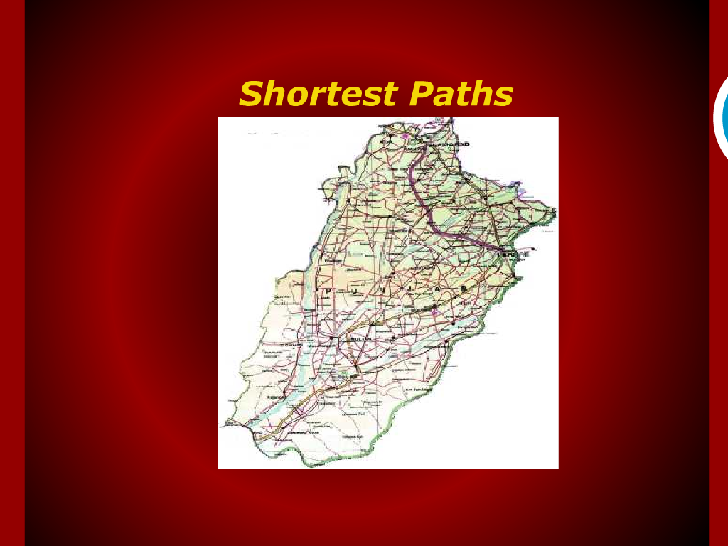
Shortest Path

Slide 4
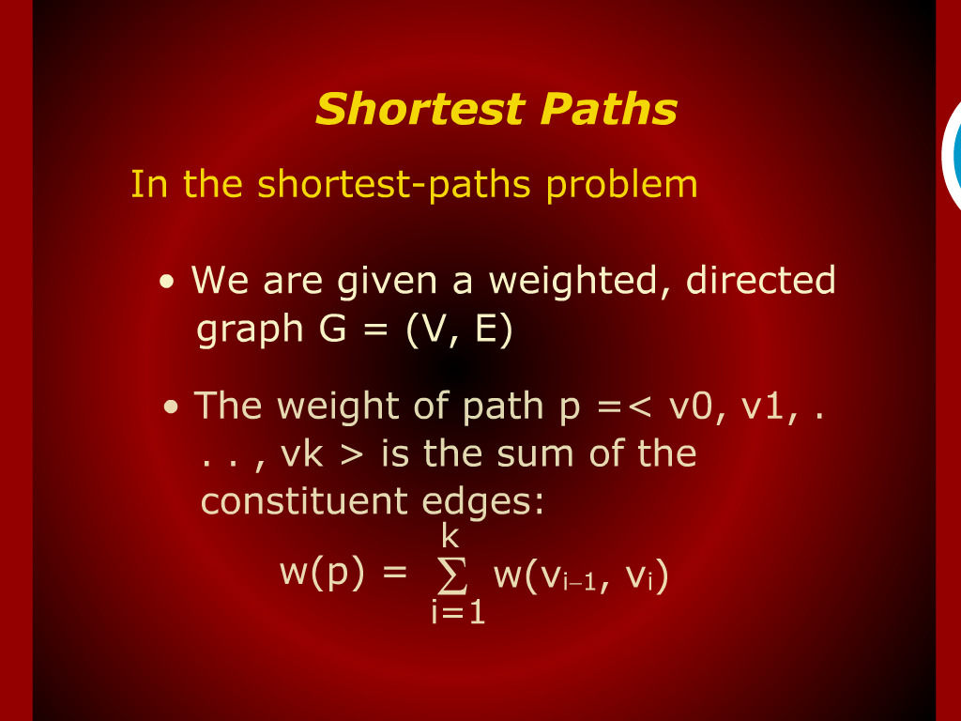
Shortest Path

Slide 5
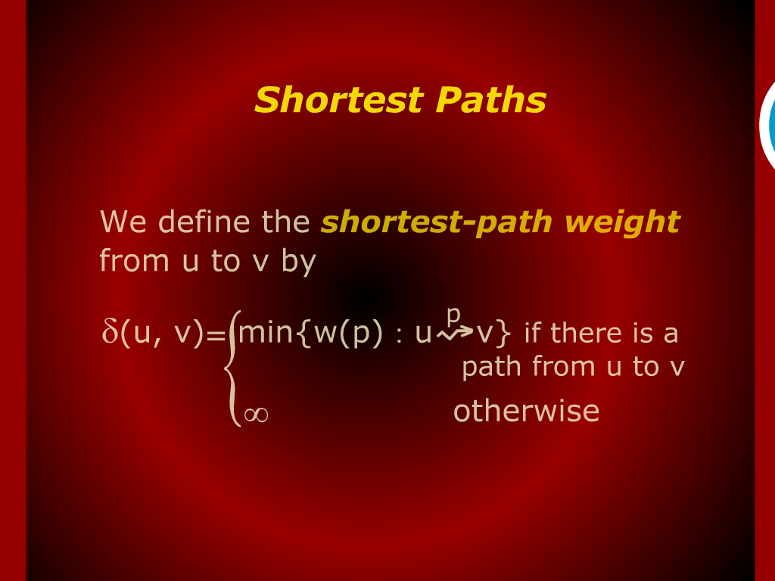
Shortest Path

Slide 6
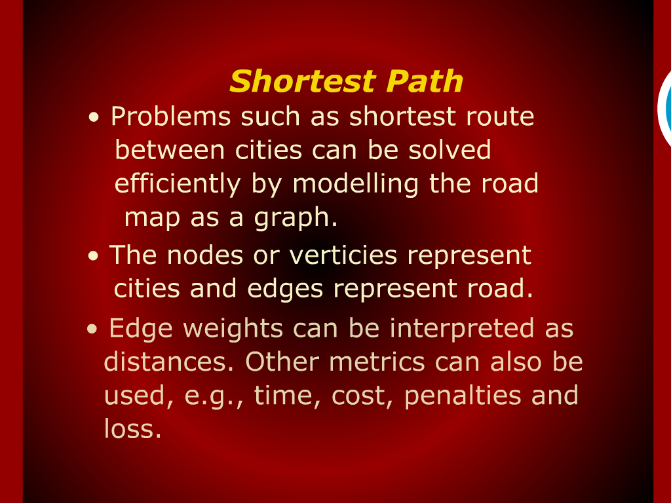
Shortest Path

Slide 7
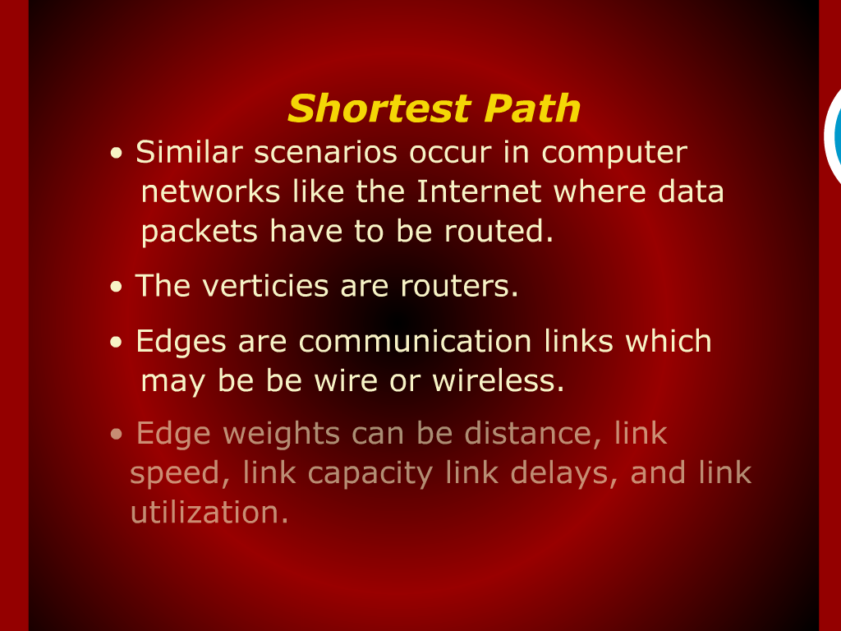
Shortest Path

Slide 8
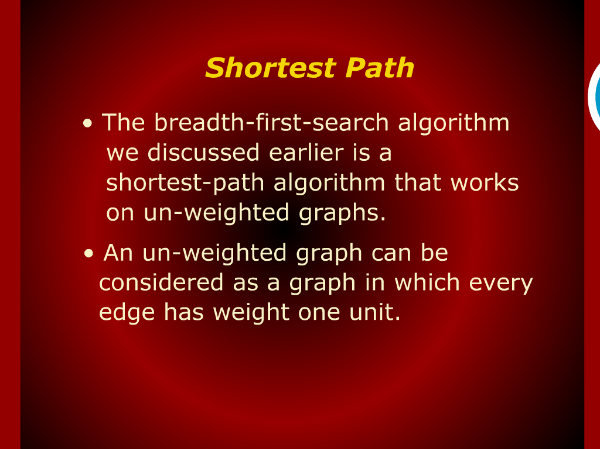
Shortest Path

Slide 9
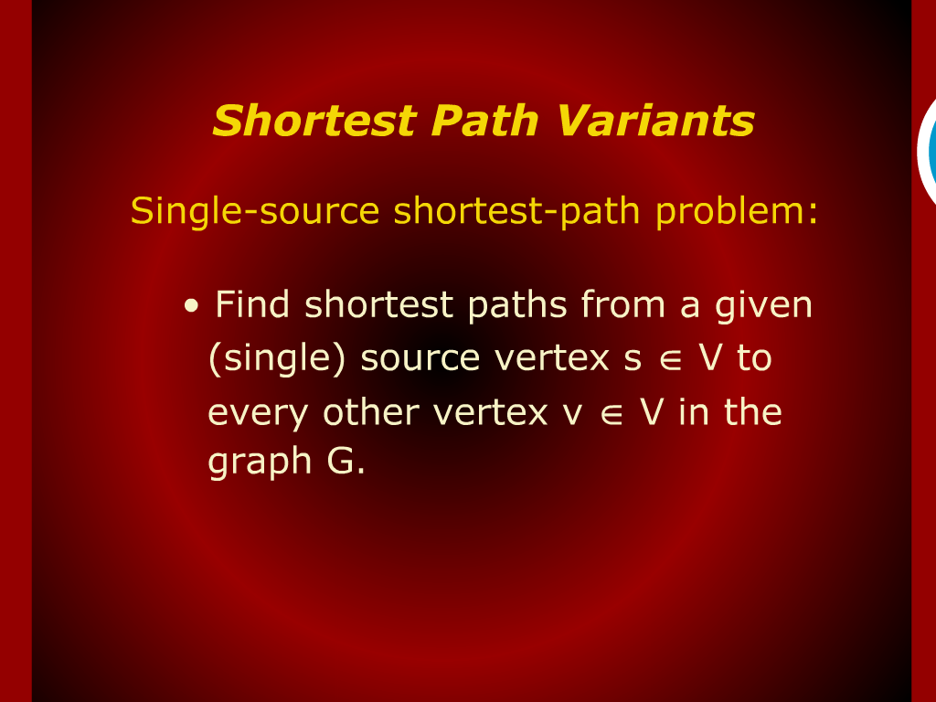
Shortest Path

Slide 10
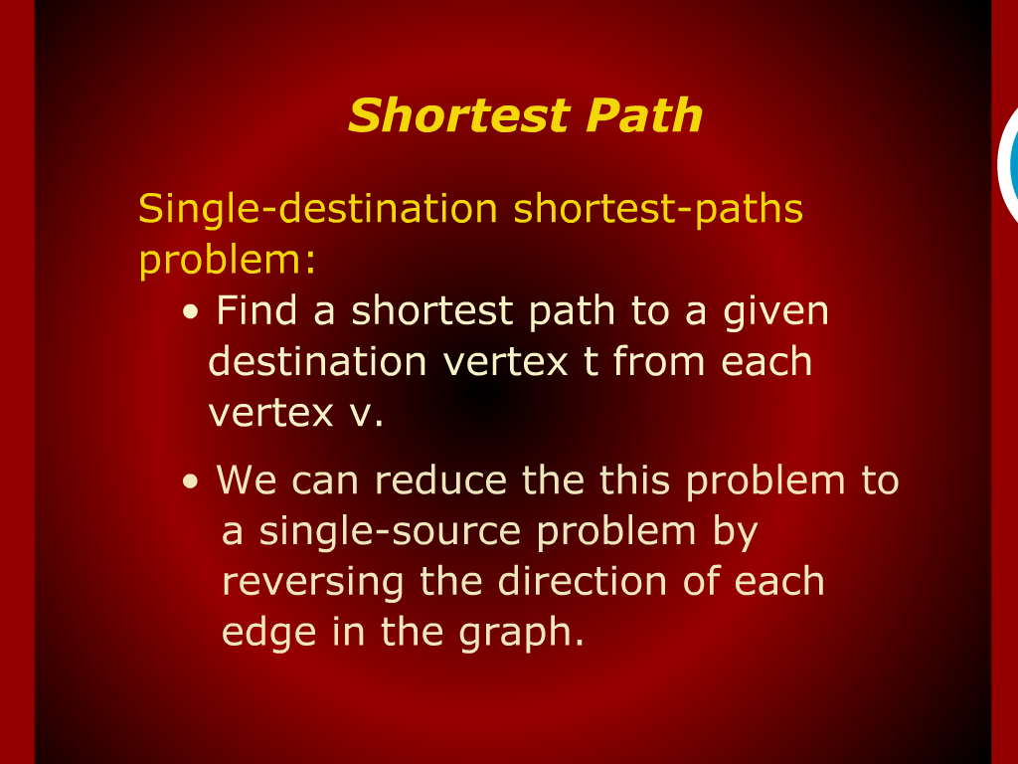
Shortest Path

Slide 11
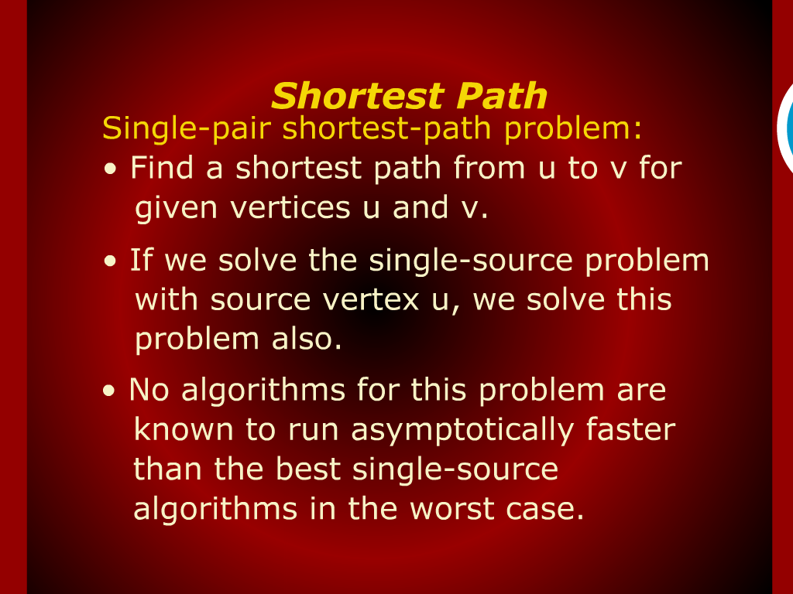
Shortest Path

Slide 12
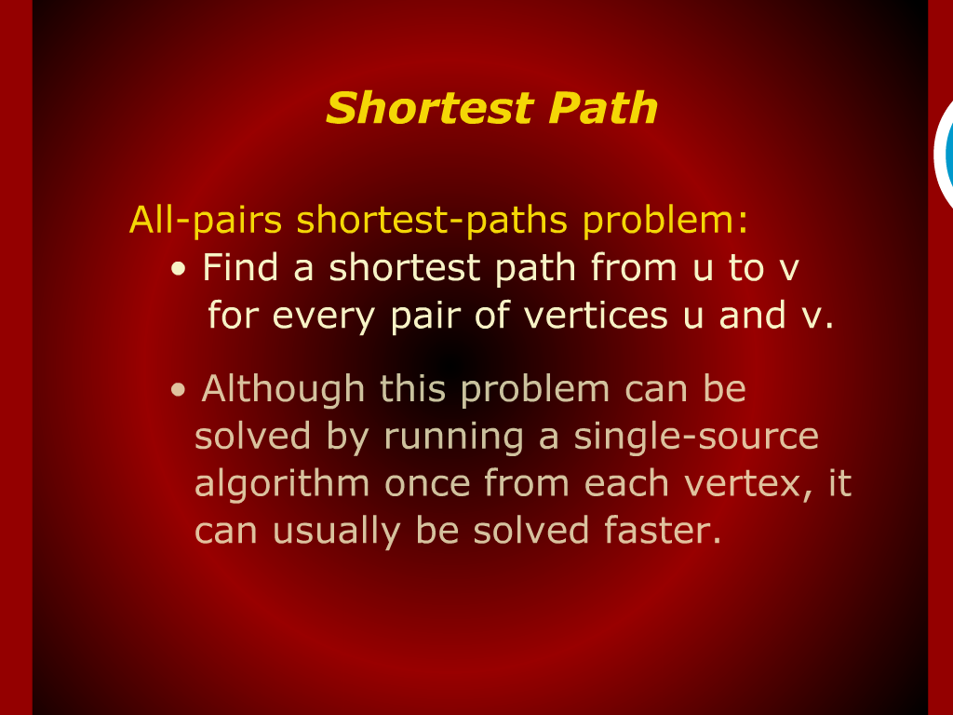
Shortest Path

Slide 13
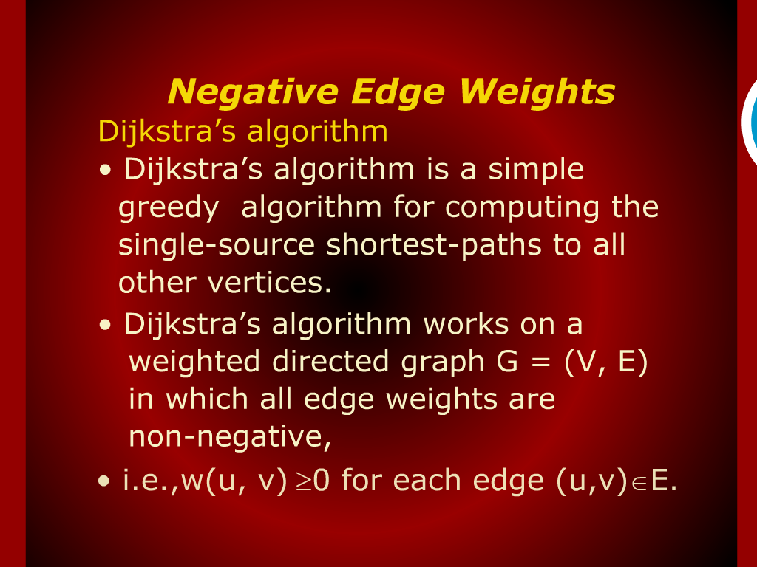
Negative Edge Weights

Slide 14
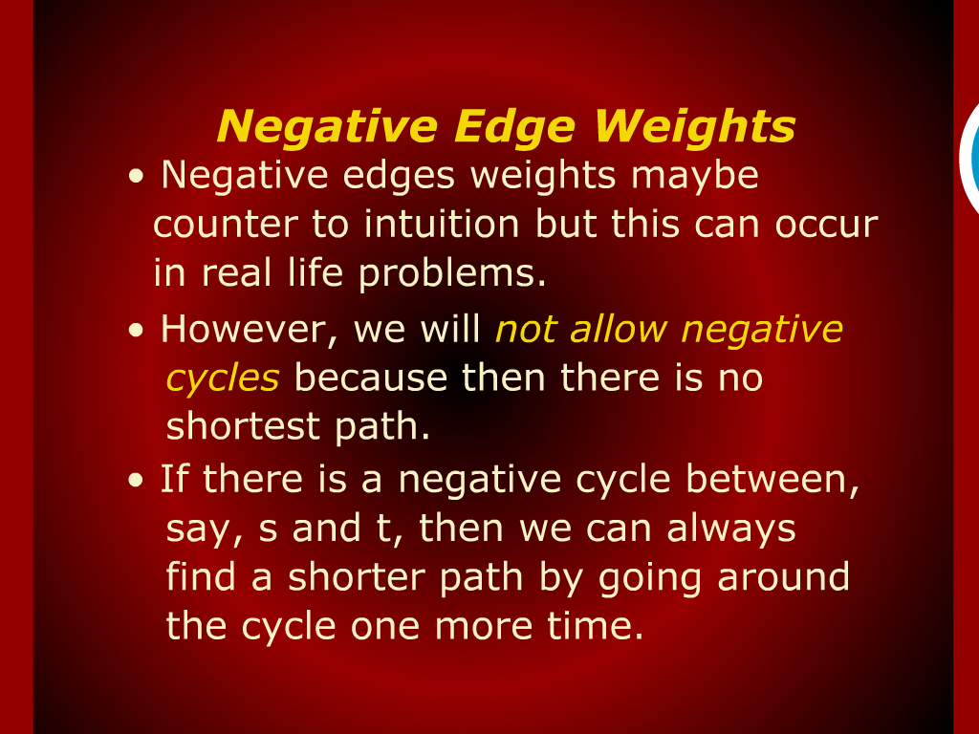
Negative Edge Weights

Slide 15
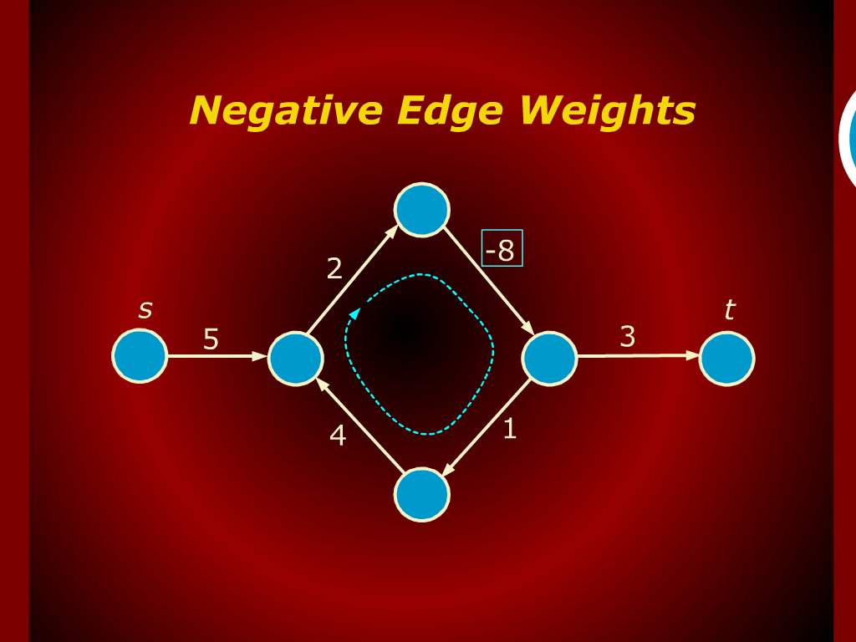
Negative Edge Weights

Slide 16
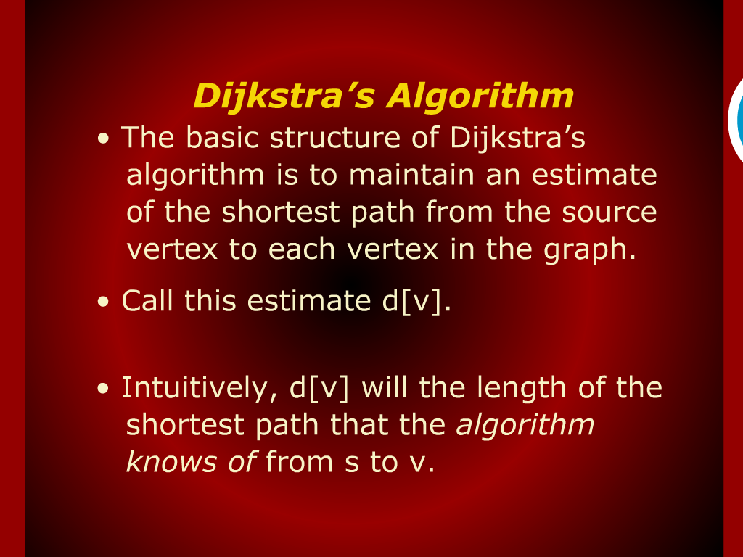
Dijkstra’s Algorithms

Slide 17
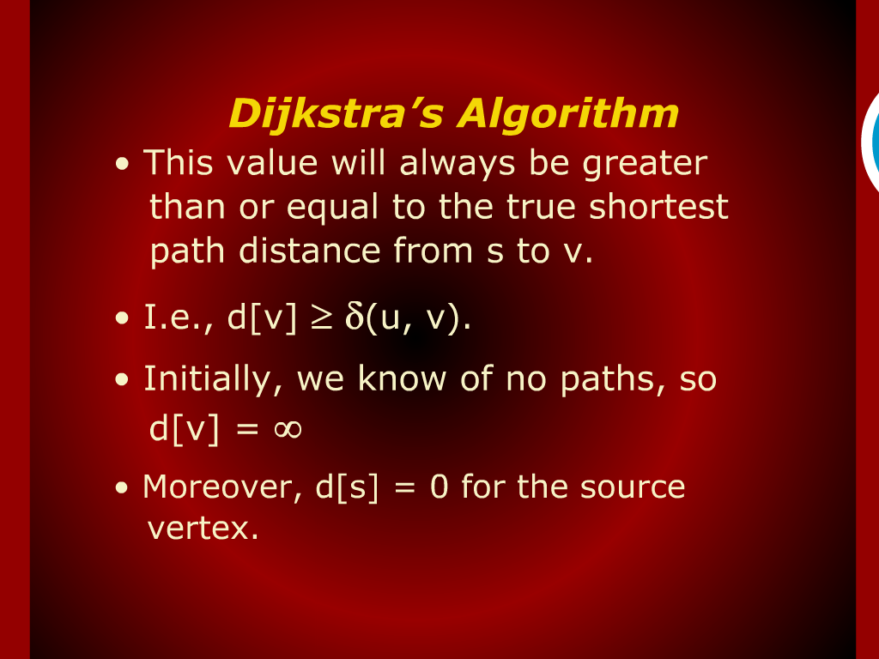
Dijkstra’s Algorithms

Slide 18
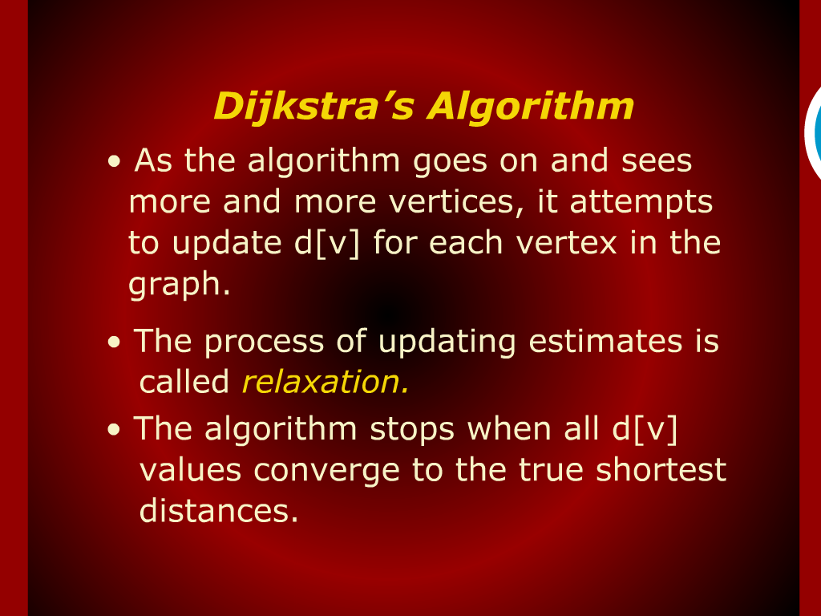
Dijkstra’s Algorithms

Slide 19
Shortest Path

