Slide 1
Algorithms
Lecture #40
Dr.Sohail Aslam

Slide 2
Difkstra’s Algorithm
Dijkstra’s Algorithm

Slide 3
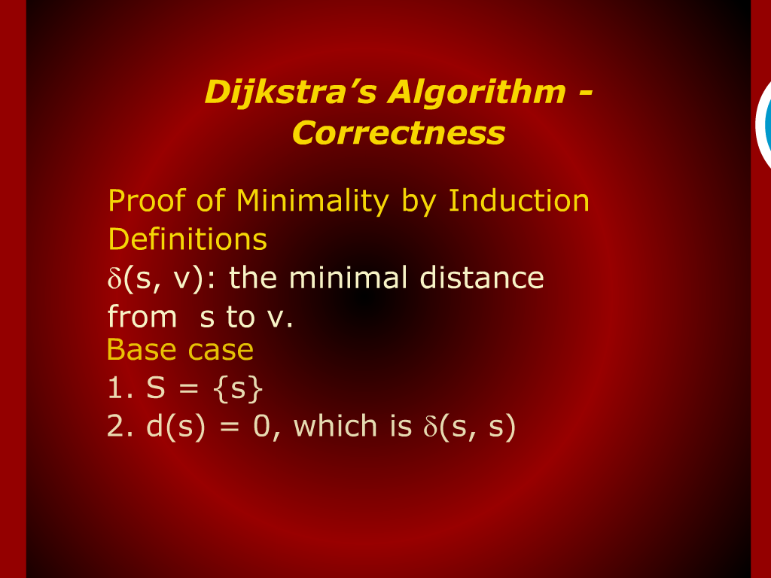
Dijkstra’s Algorithm - Correctness

Slide 4
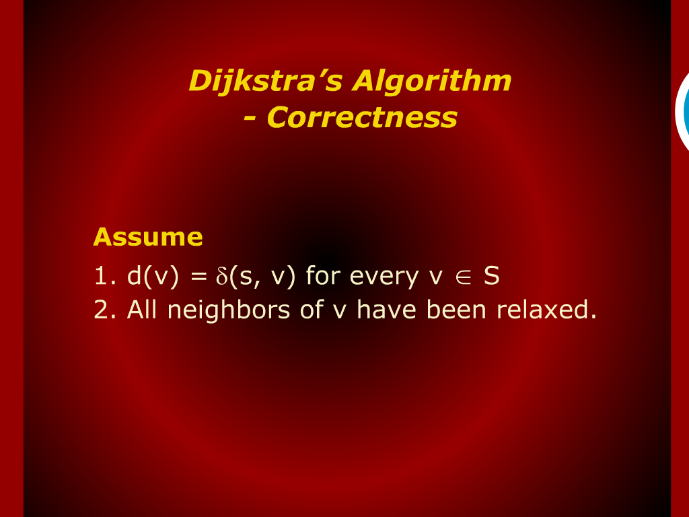
Dijkstra’s Algorithm - Correctness

Slide 5
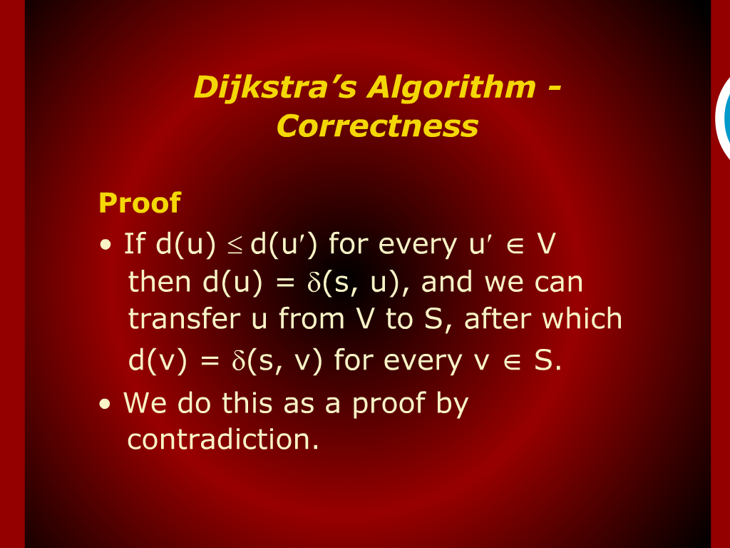
Dijkstra’s Algorithm - Correctness

Slide 6
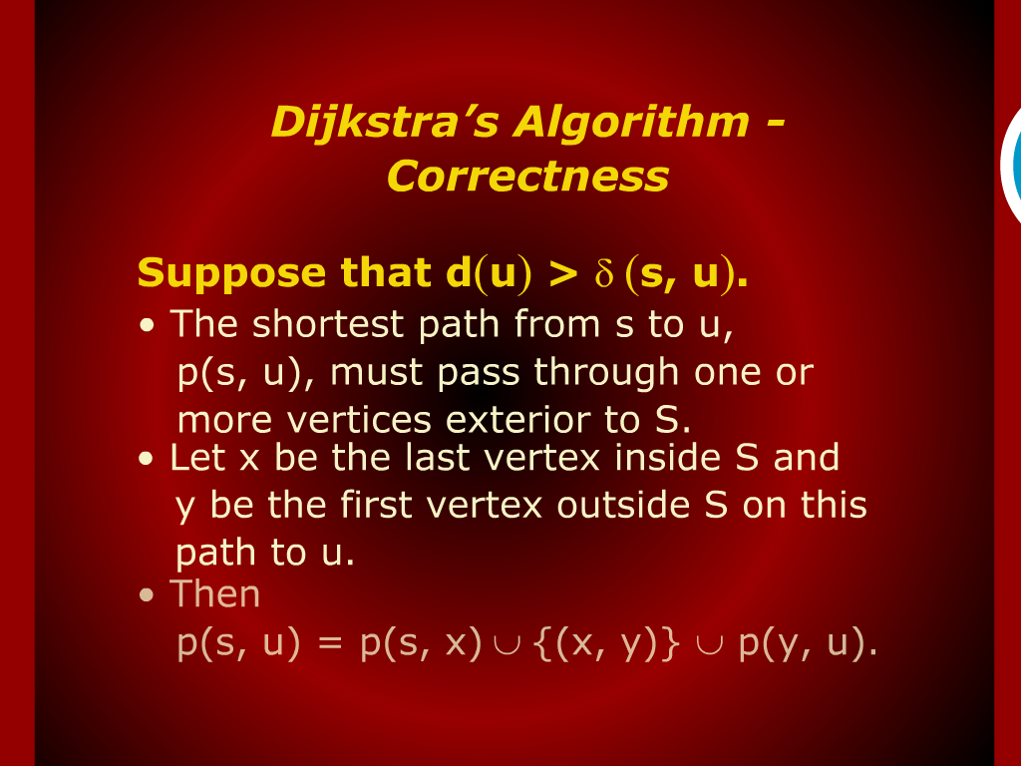
Dijkstra’s Algorithm - Correctness

Slide 7
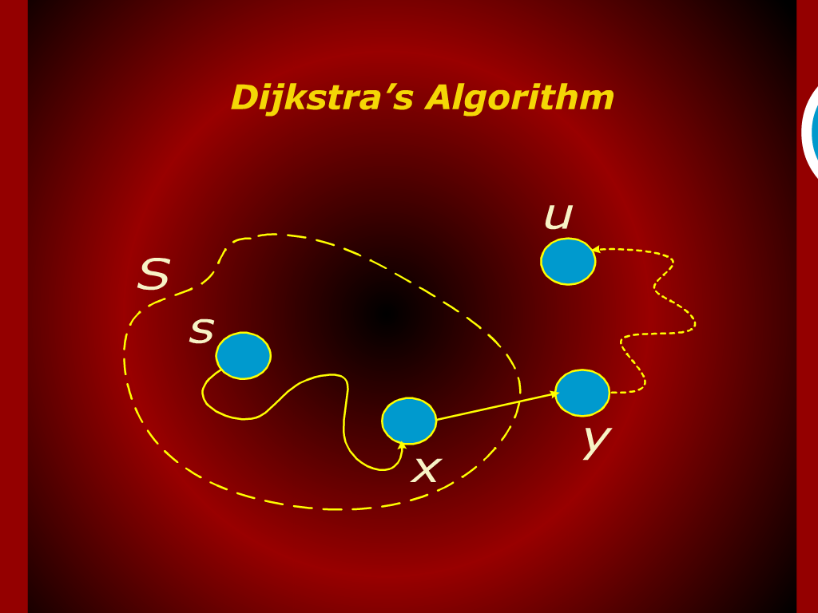
Dijkstra’s Algorith

Slide 8
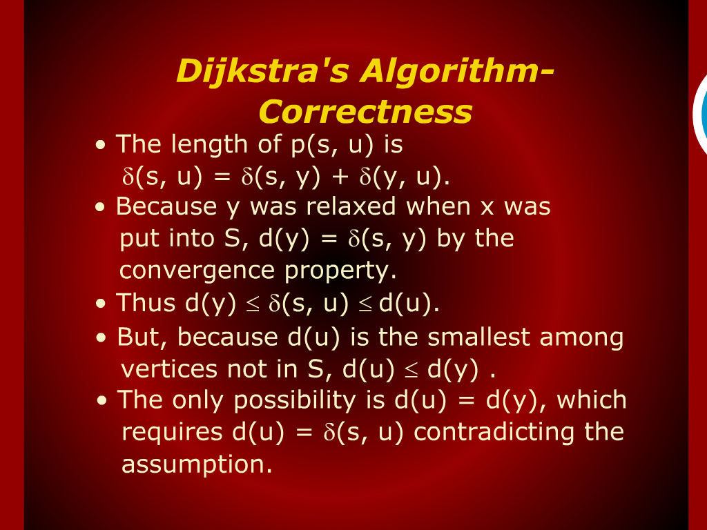
Dijkstra’s Algorithm - Correctness

Slide 9
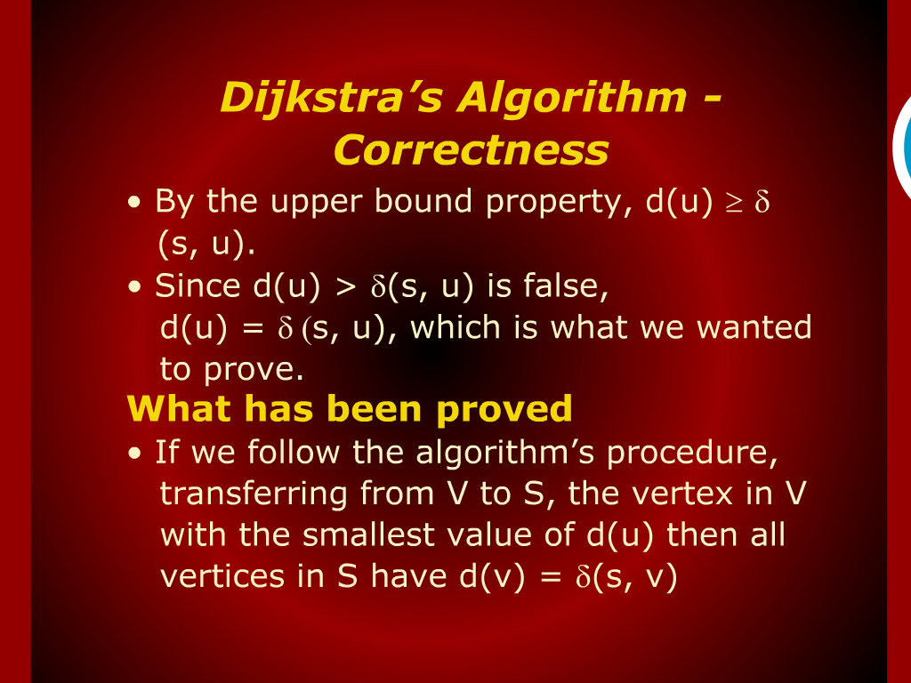
Dijkstra’s Algorithm - Correctness

Slide 10
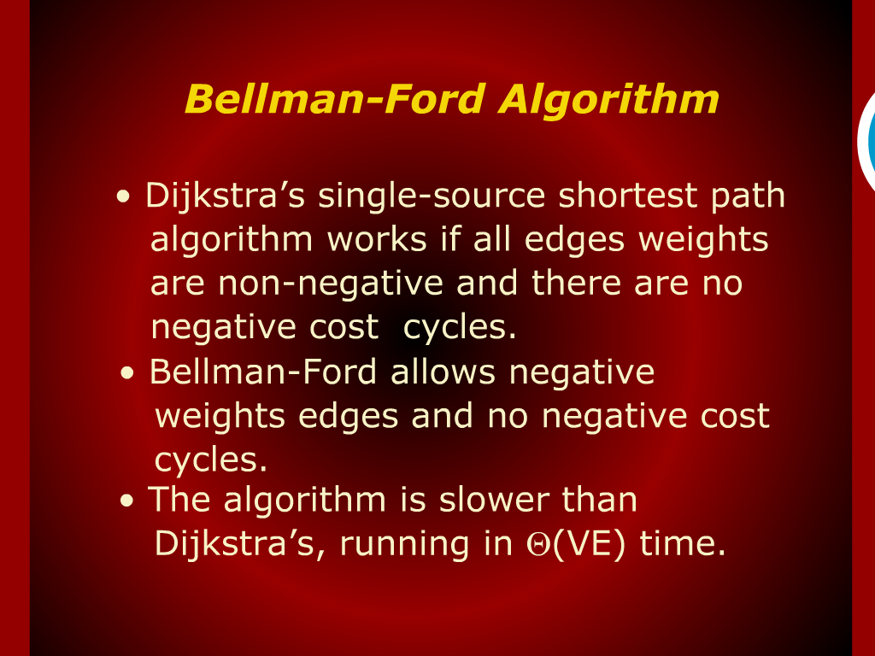
Bellman-Ford Algorithm

Slide 11
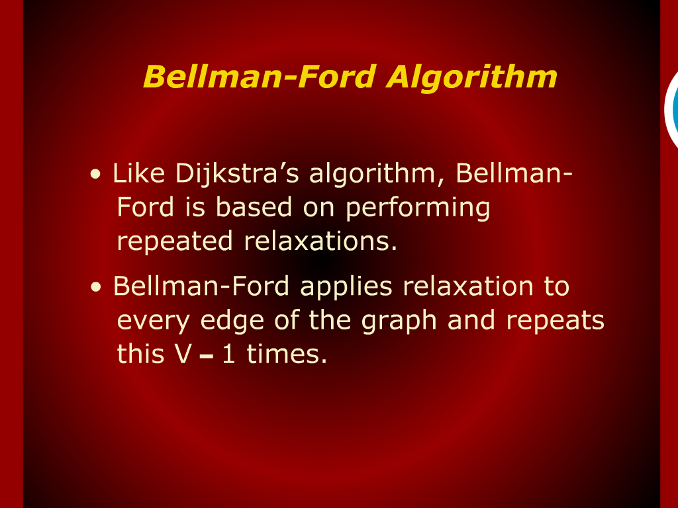
Bellman-Ford Algorithm

Slide 12
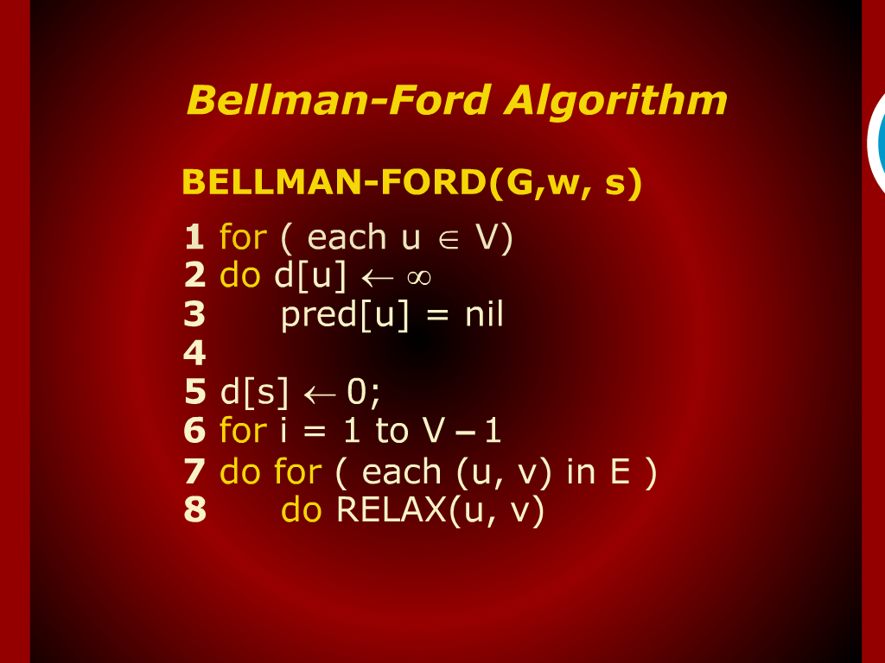
Bellman-Ford Algorithm

Slide 13
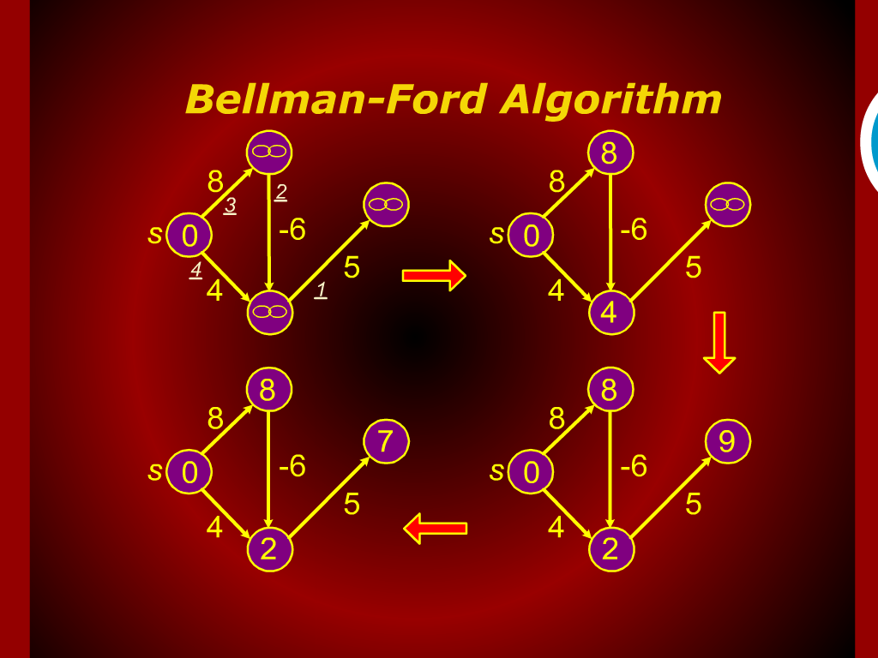
Bellman-Ford Algorithm

Slide 14
Bellman-Ford Algorithm

