Slide 1
Algorithms
Lecture #41
Dr.Sohail Aslam

Slide 2
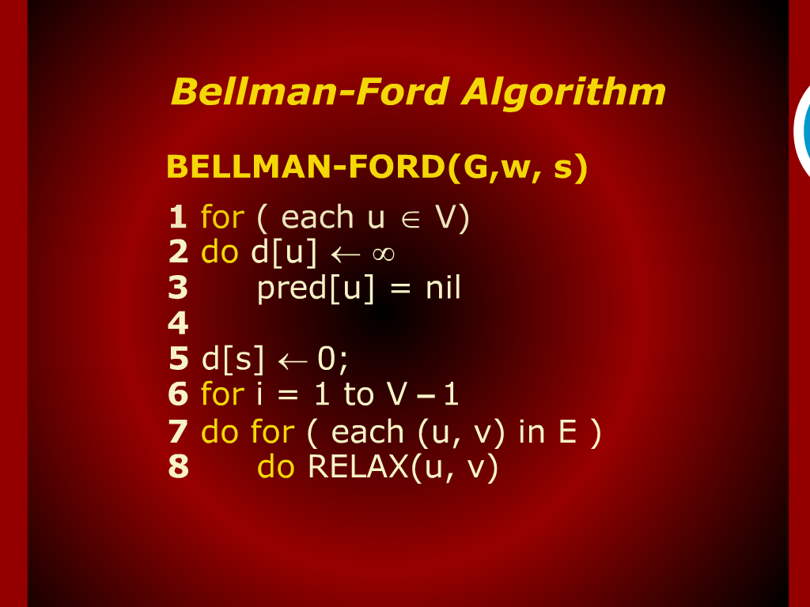
Bellman-Ford Algorithm

Slide 3
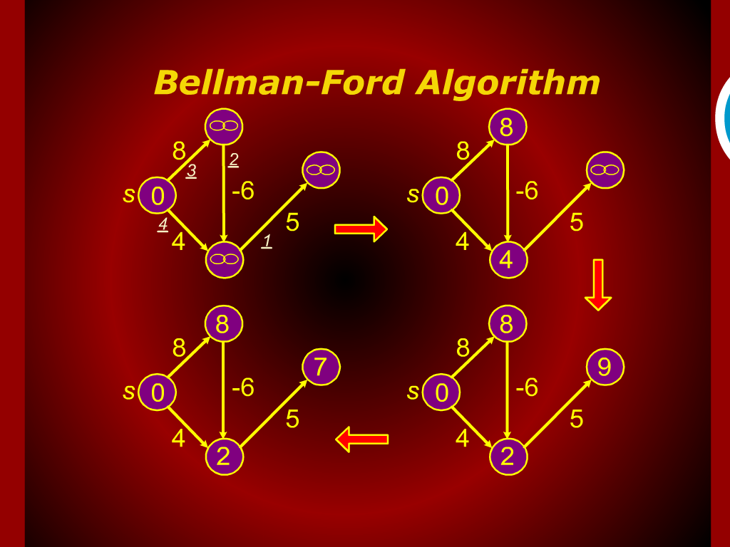
Bellman-Ford Algorithm

Slide 4
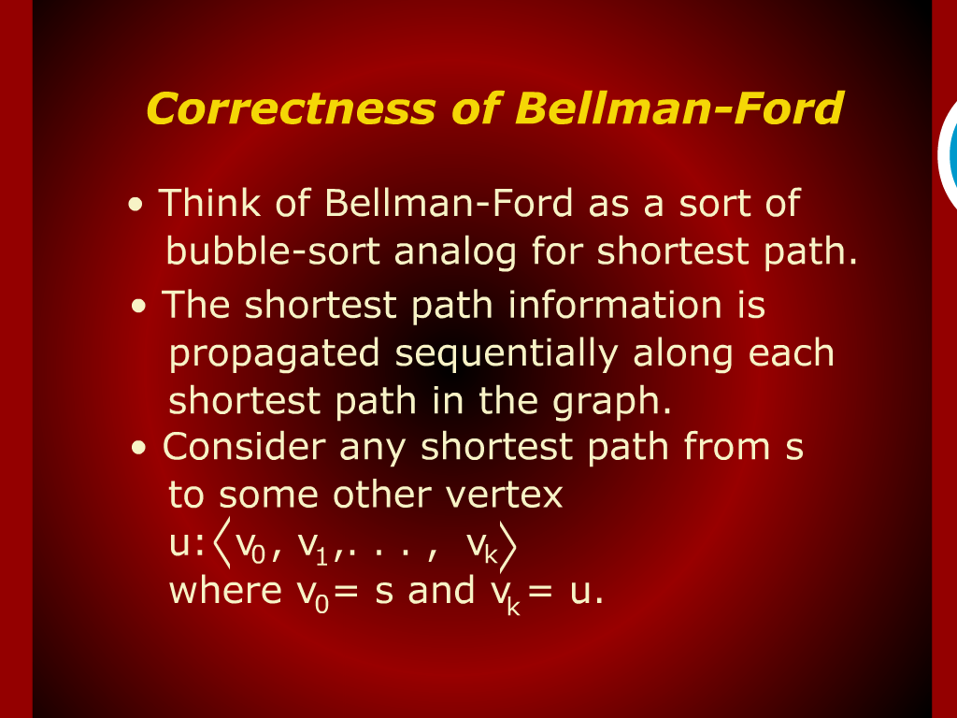
Correctness of Bellman-Ford

Slide 5
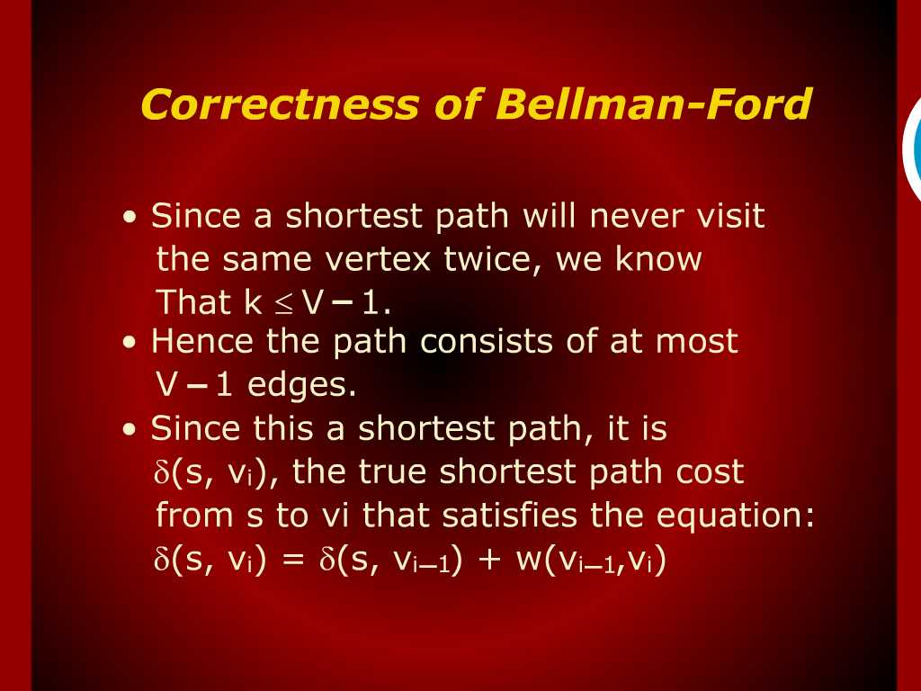
Correctness of Bellman-Ford

Slide 6
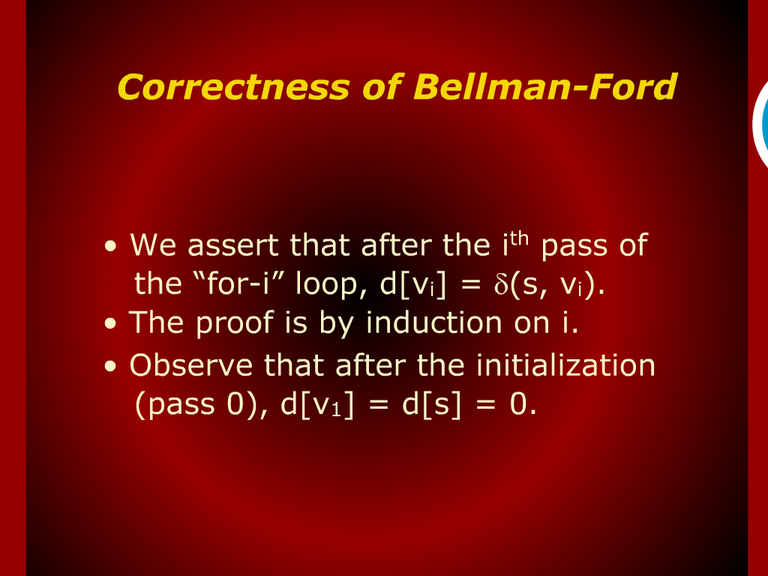
Correctness of Bellman-Ford

Slide 7
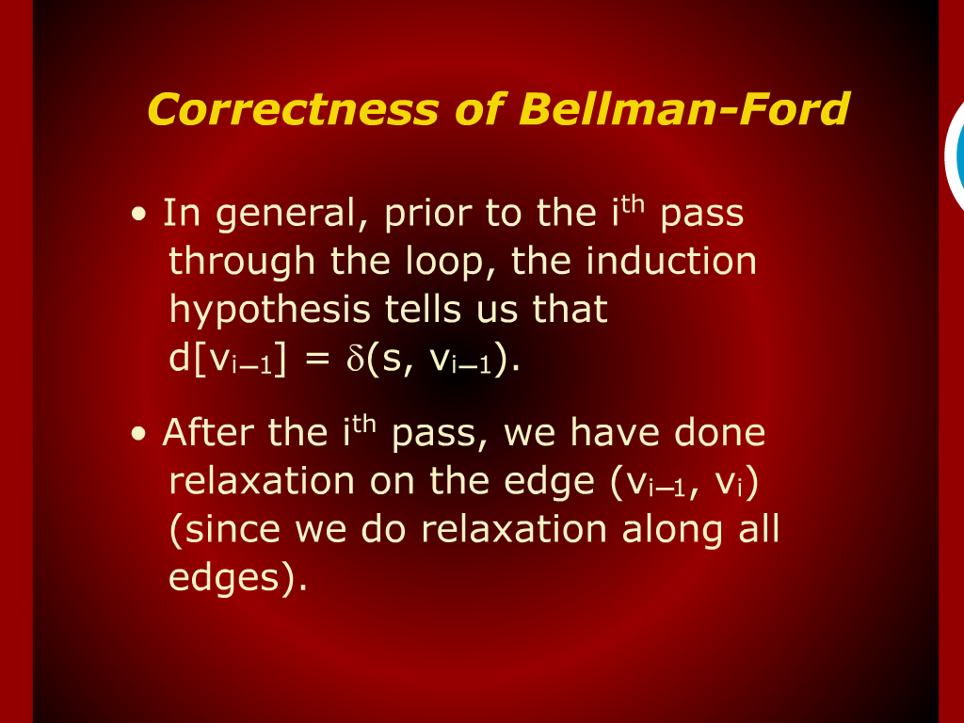
Correctness of Bellman-Ford

Slide 8
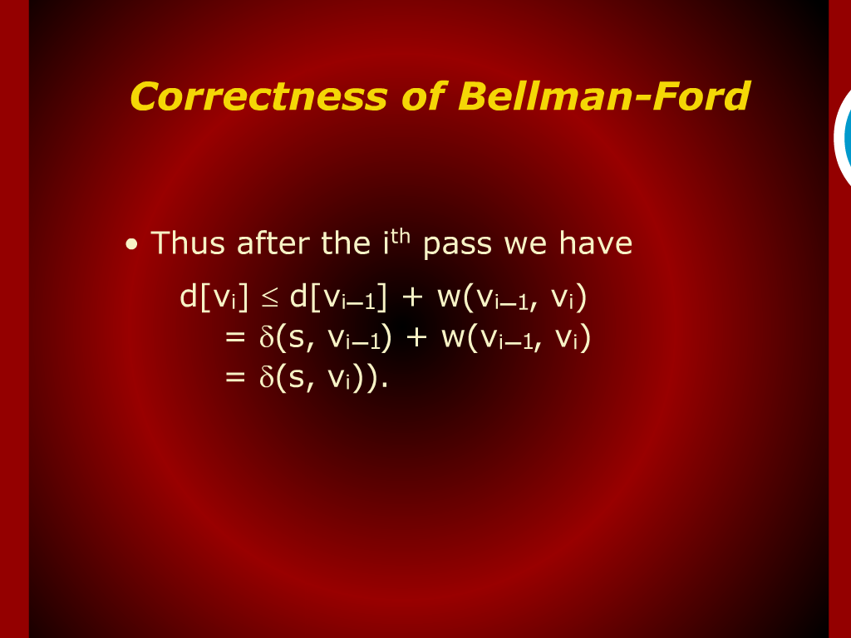
Correctness of Bellman-Ford

Slide 9
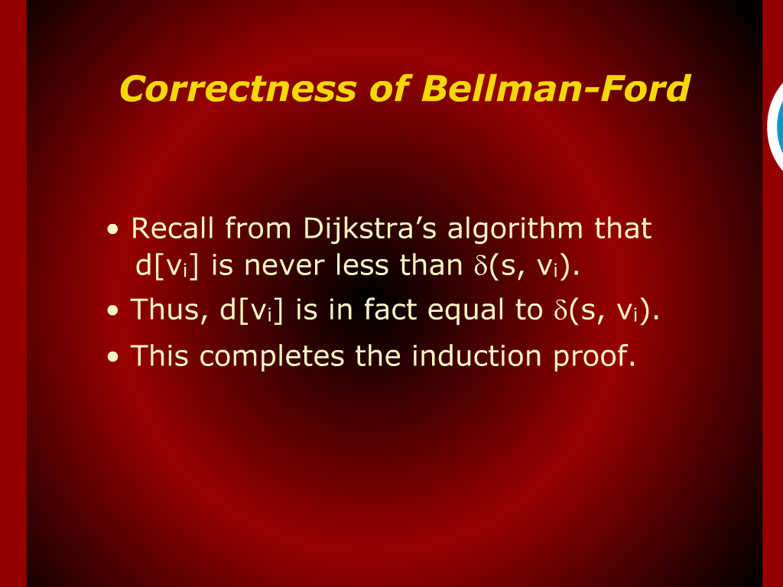
Correctness of Bellman-Ford

Slide 10
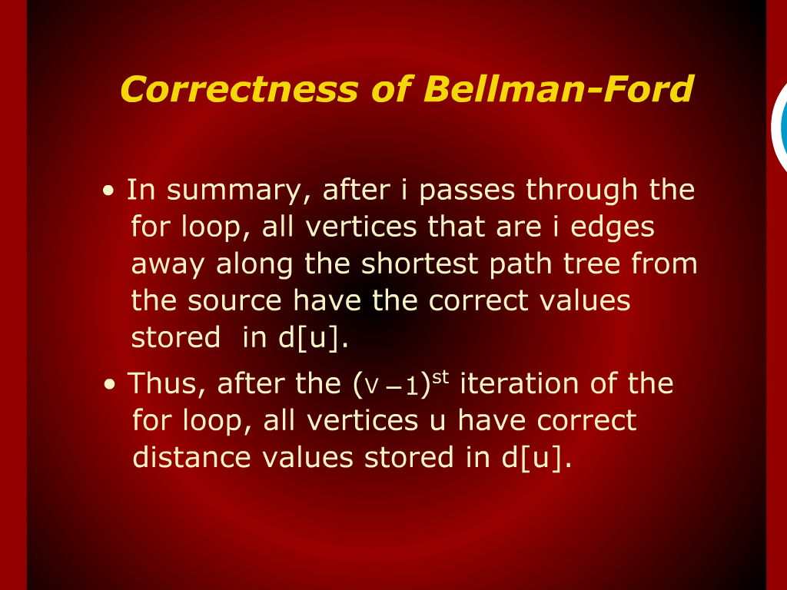
Correctness of Bellman-Ford

Slide 11
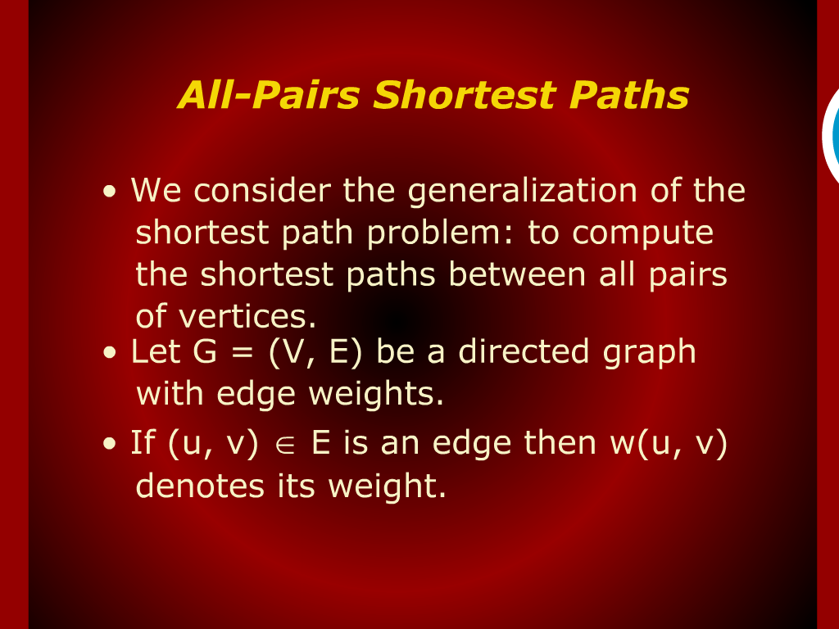
All-Pairs Shortest Paths

Slide 12
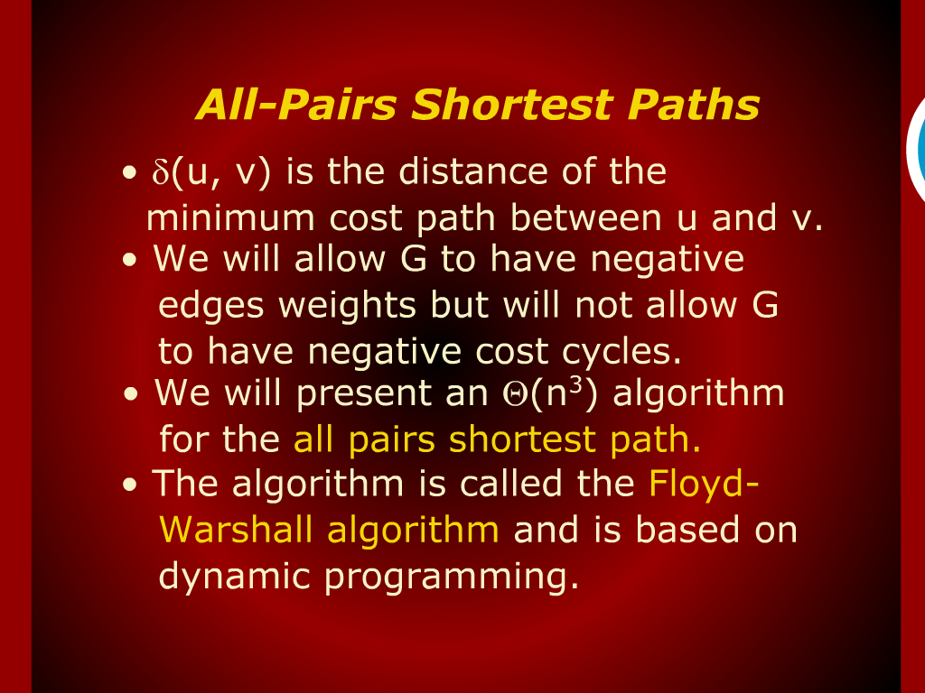
All-Pairs Shortest Paths

Slide 13
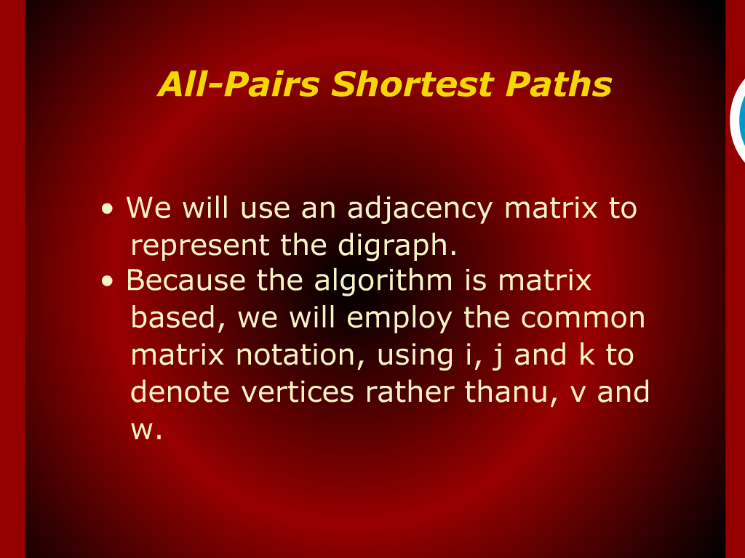
All-Pairs Shortest Paths

Slide 14
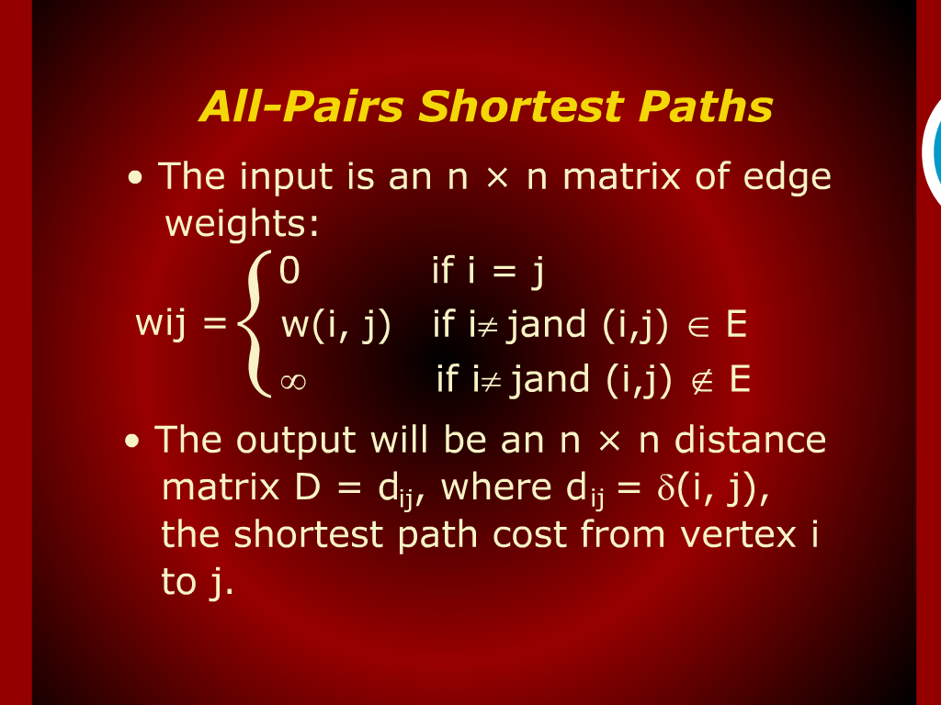
All-Pairs Shortest Paths

Slide 15
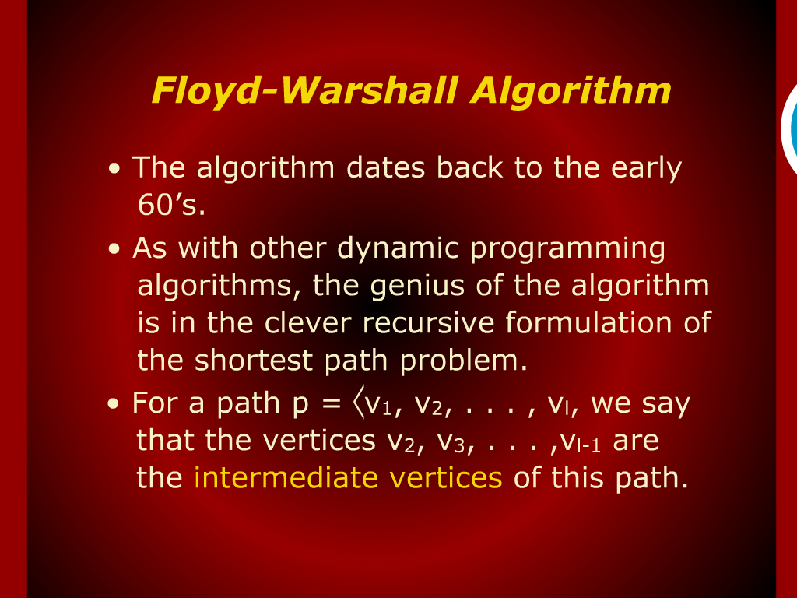
Floyd-Warshall Algorithm

Slide 16
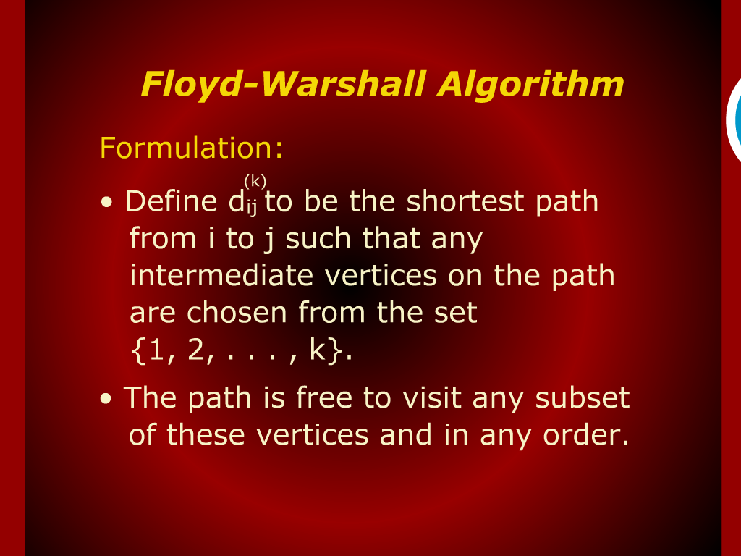
Floyd-Warshall Algorithm

Slide 17
Floyd-Warshall Algorithm
Floyd-Warshall Algorithm

Slide 18
Bellman-Ford Algorithm
Bellman-Ford Algorithm

