Slide 1
Algorithms
Lecture #42
Dr. Sohail Aslam

Slide 2
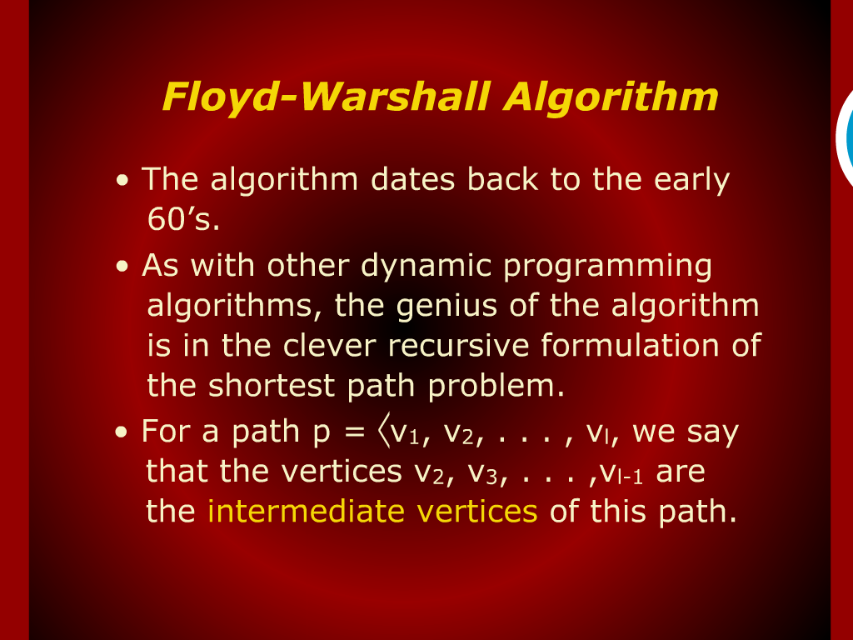
Floyd-Warshall Algorithm

Slide 3
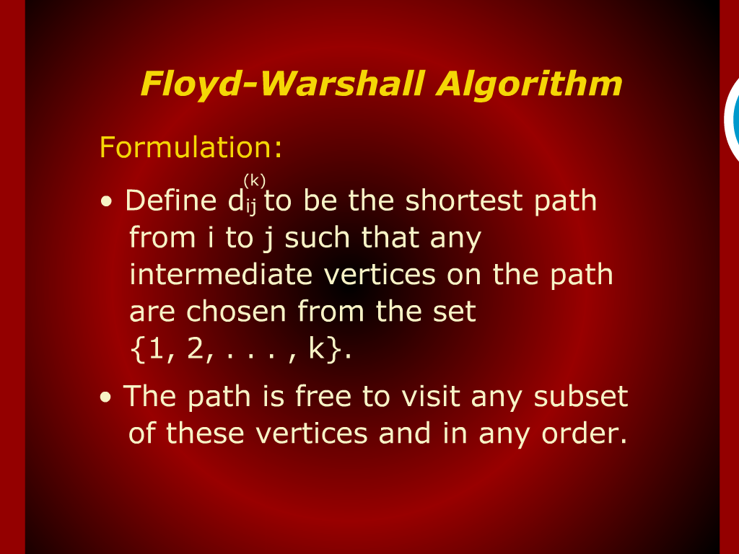
Floyd-Warshall Algorithm

Slide 4
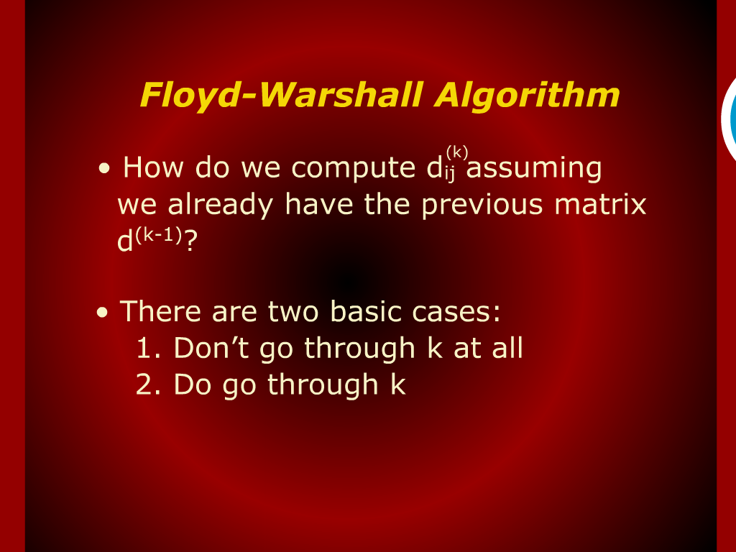
Floyd-Warshall Algorithm

Slide 5
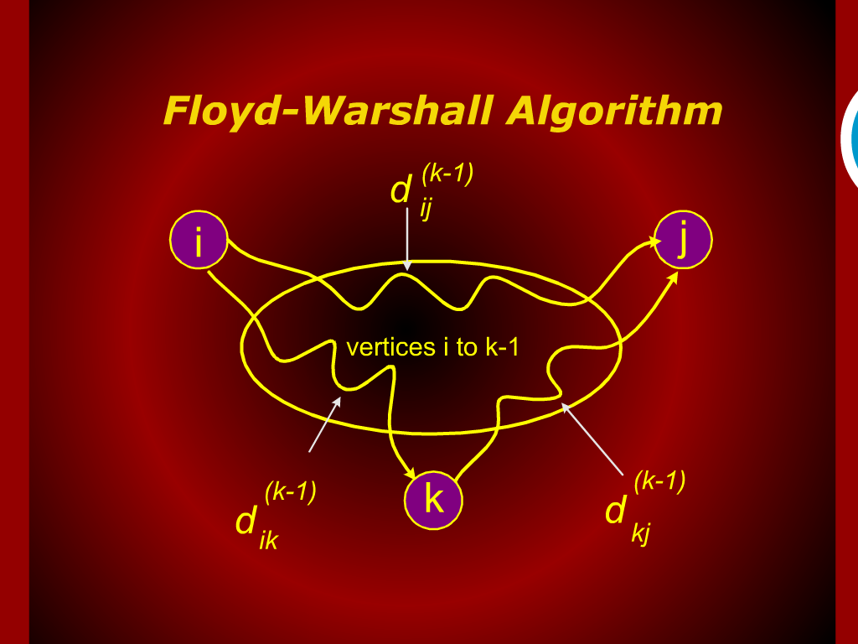
Floyd-Warshall Algorithm

Slide 6
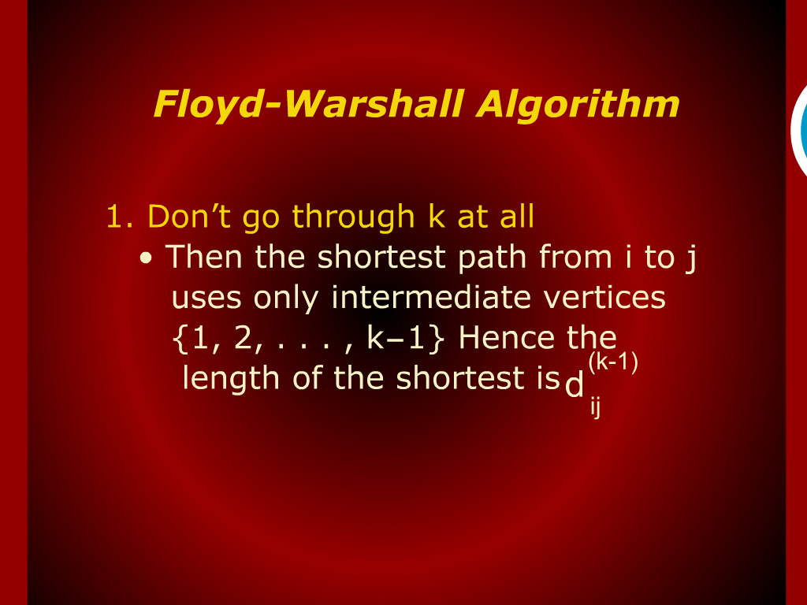
Floyd-Warshall Algorithm

Slide 7
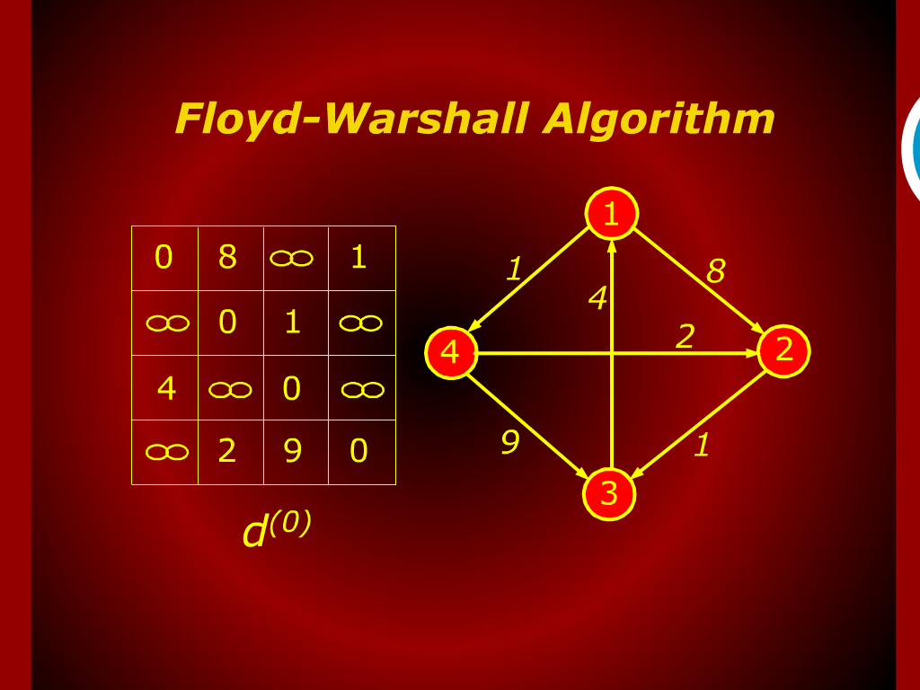
Floyd-Warshall Algorithm

Slide 8
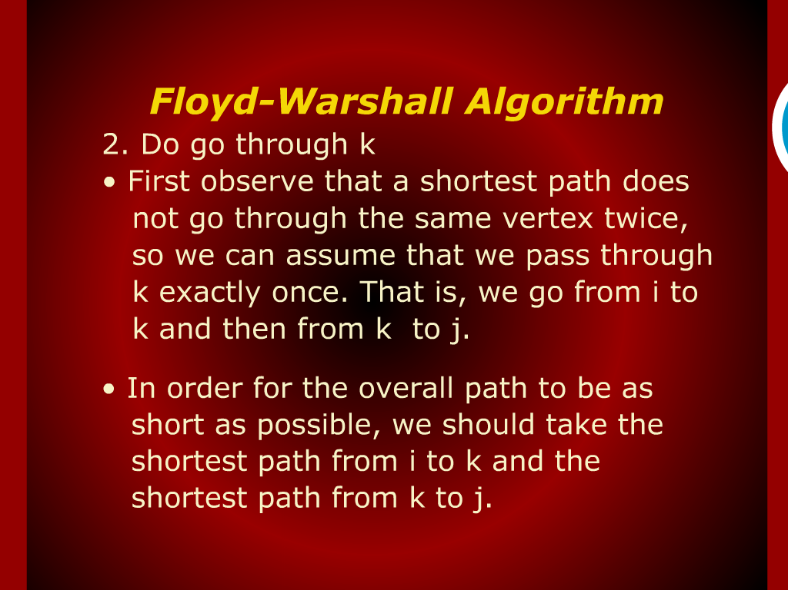
Floyd-Warshall Algorithm

Slide 9
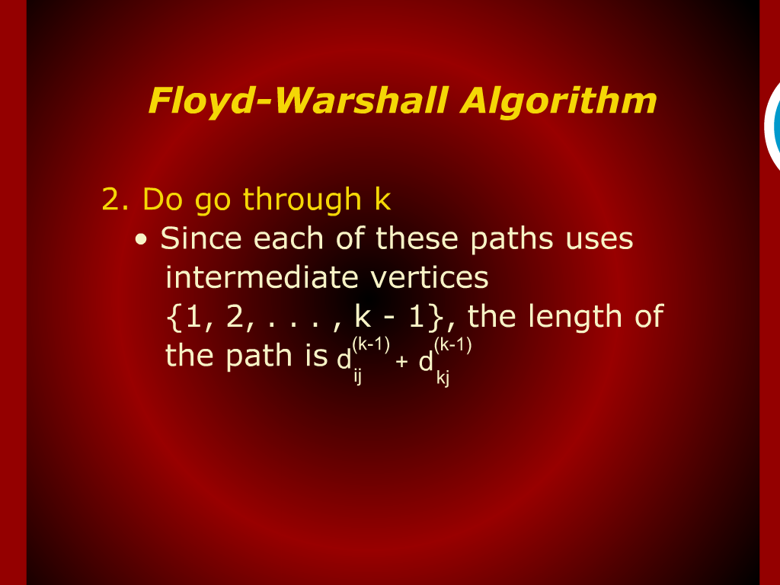
Floyd-Warshall Algorithm

Slide 10
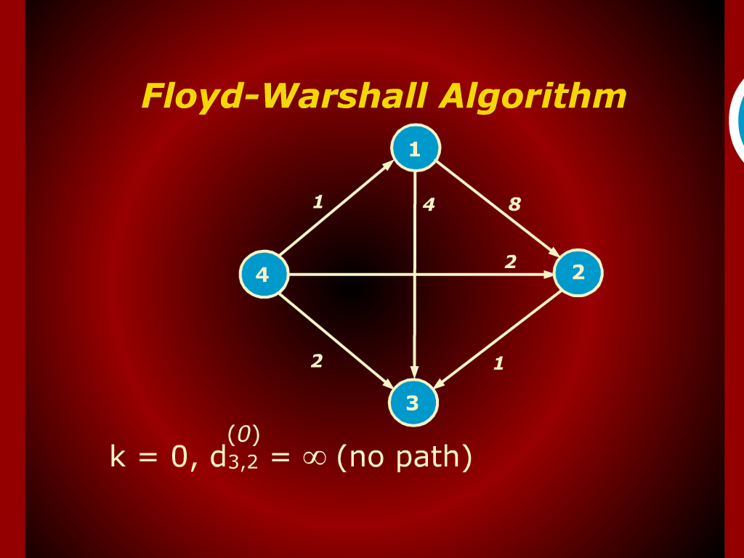
Floyd-Warshall Algorithm

Slide 11
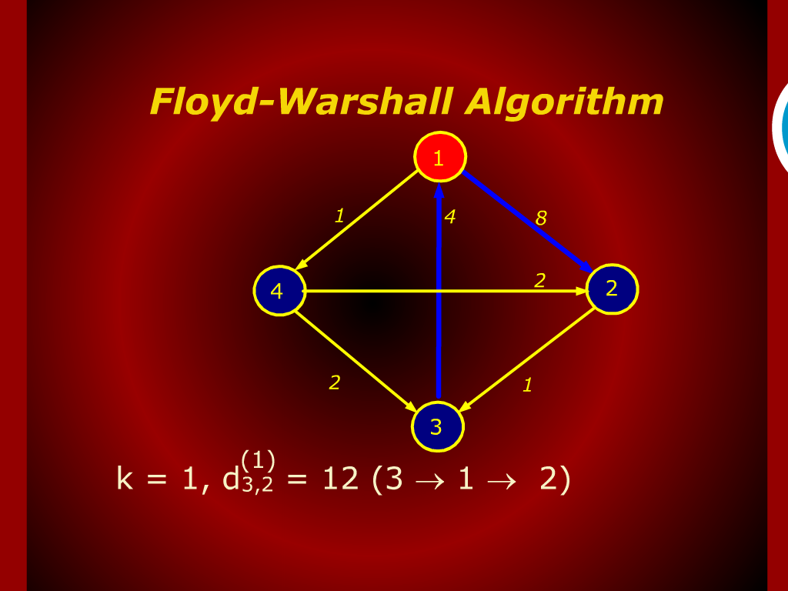
Floyd-Warshall Algorithm

Slide 12
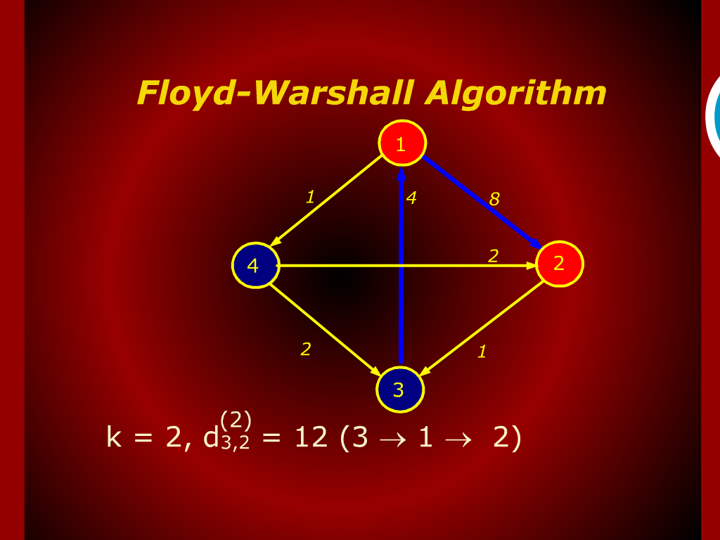
Floyd-Warshall Algorithm

Slide 13
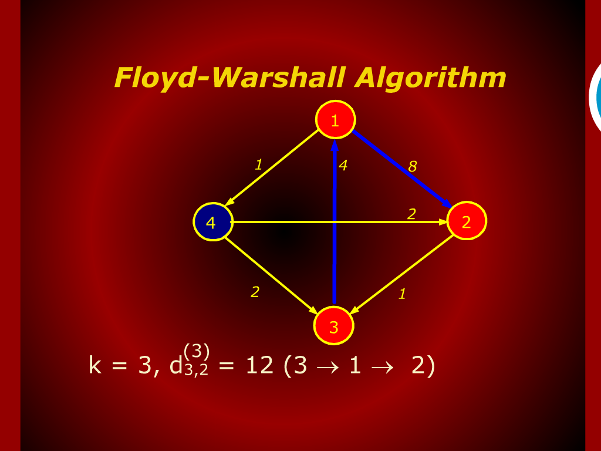
Floyd-Warshall Algorithm

Slide 14
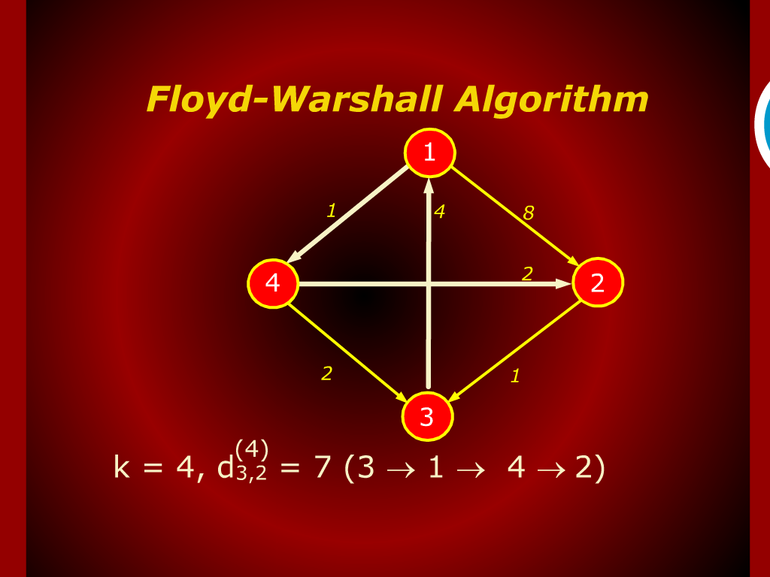
Floyd-Warshall Algorithm

Slide 15
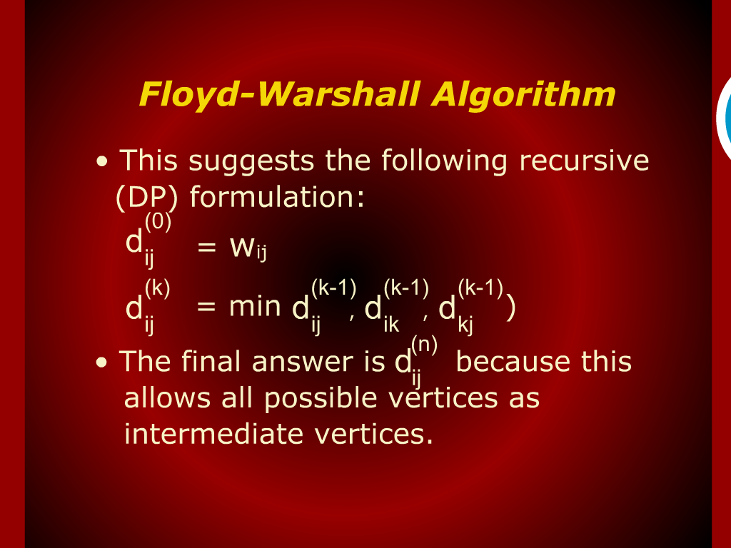
Floyd-Warshall Algorithm

Slide 16
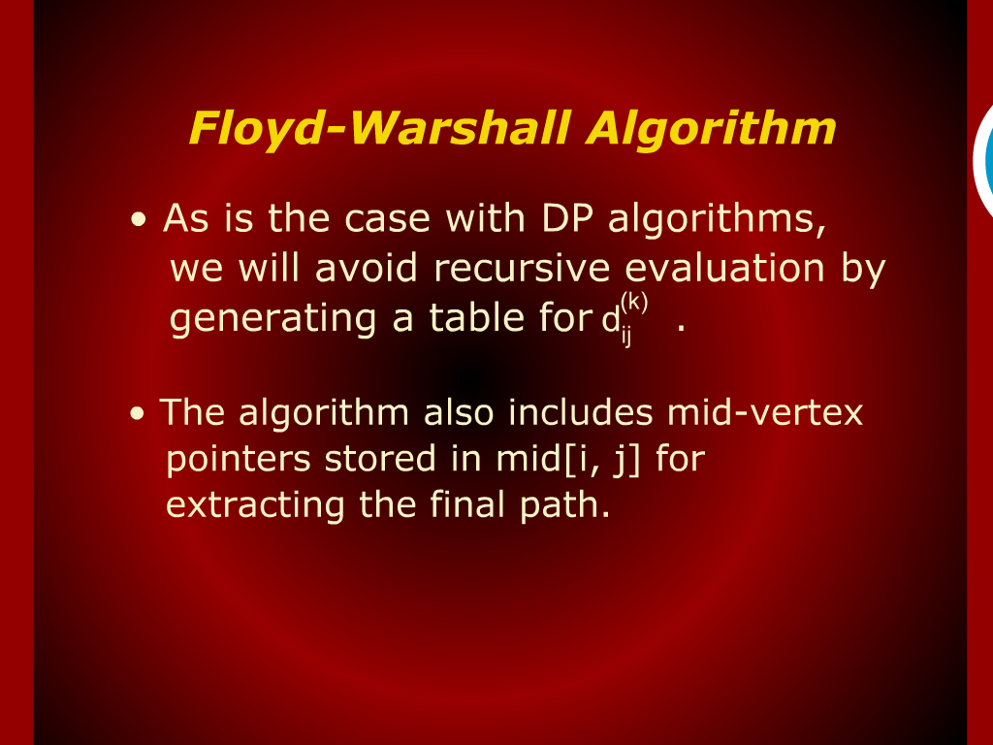
Floyd-Warshall Algorithm

Slide 17
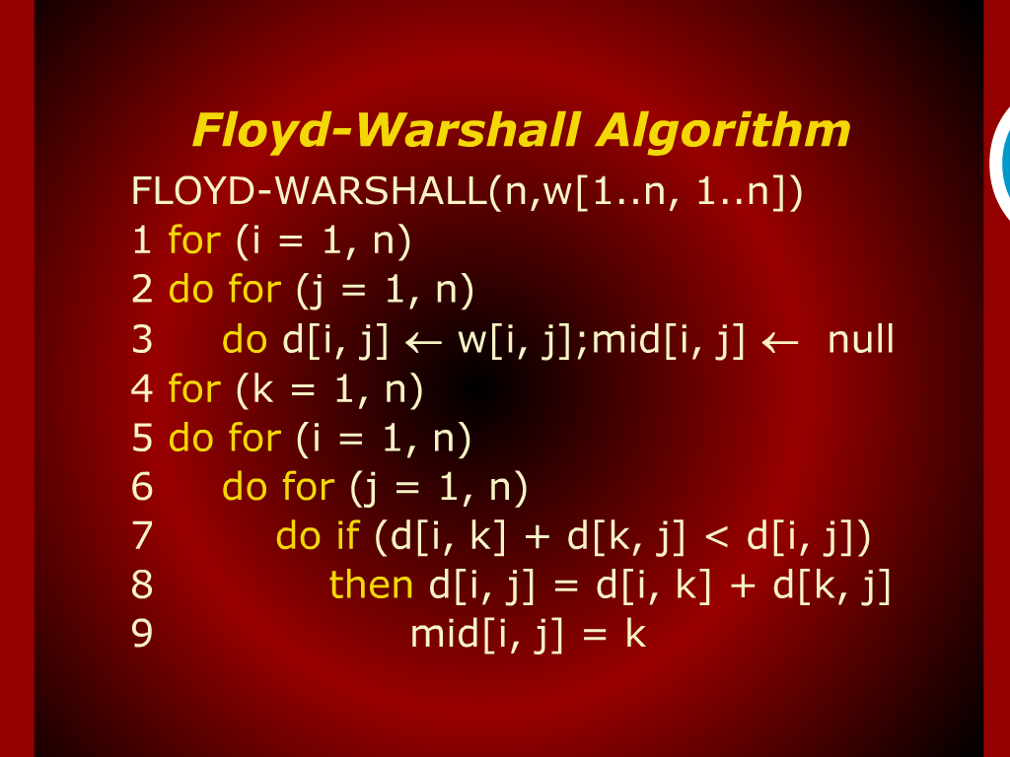
Floyd-Warshall Algorithm

Slide 18
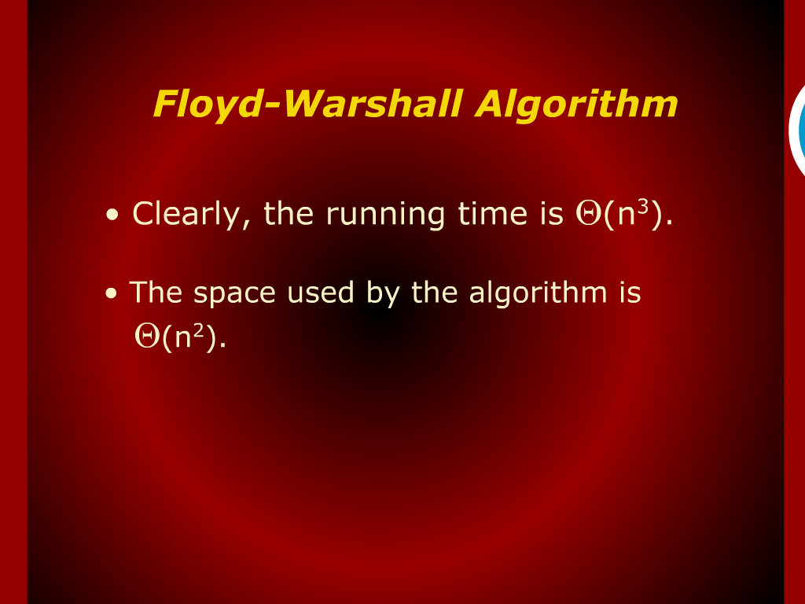
Floyd-Warshall Algorithm

Slide 19
Floyd-Warshall Algorithm

Slide 20
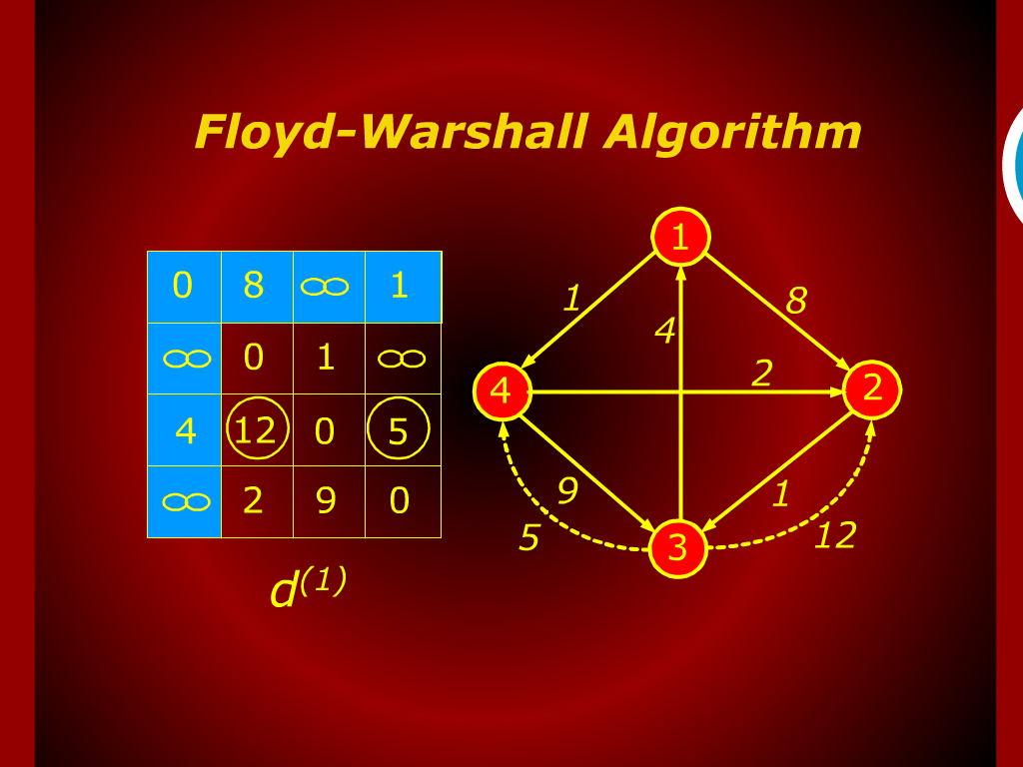
Floyd-Warshall Algorithm

Slide 21
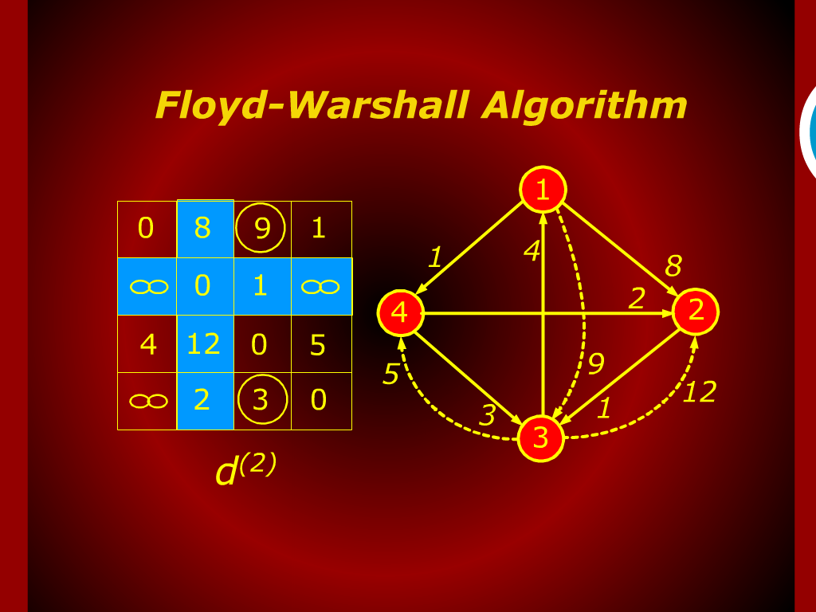
Floyd-Warshall Algorithm

Slide 22
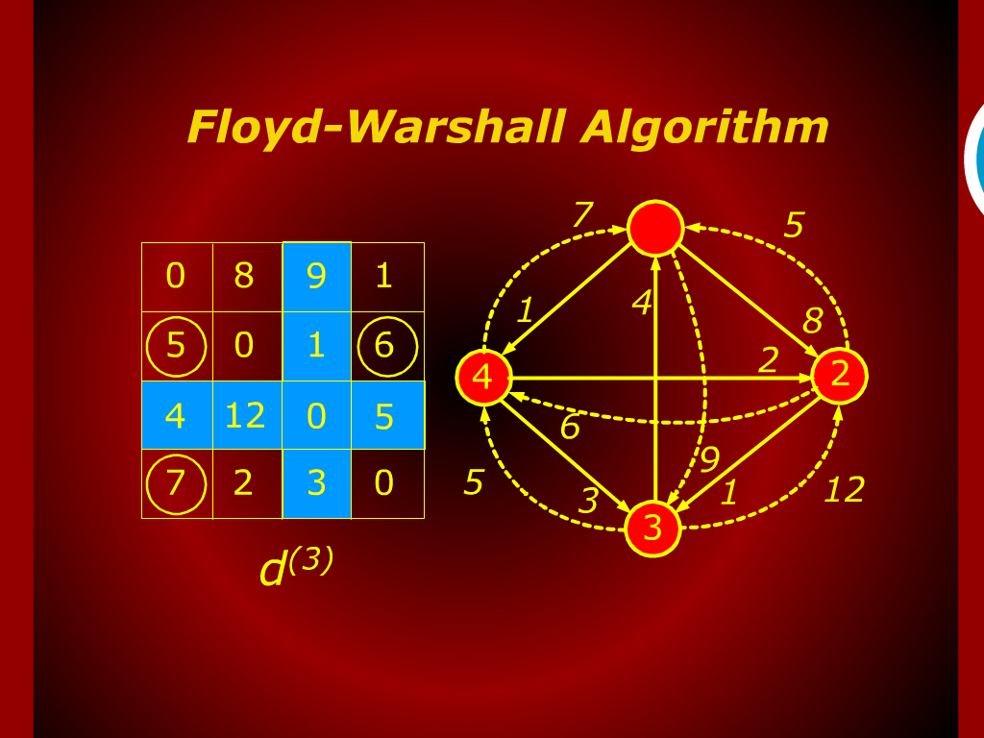
Floyd-Warshall Algorithm

Slide 23
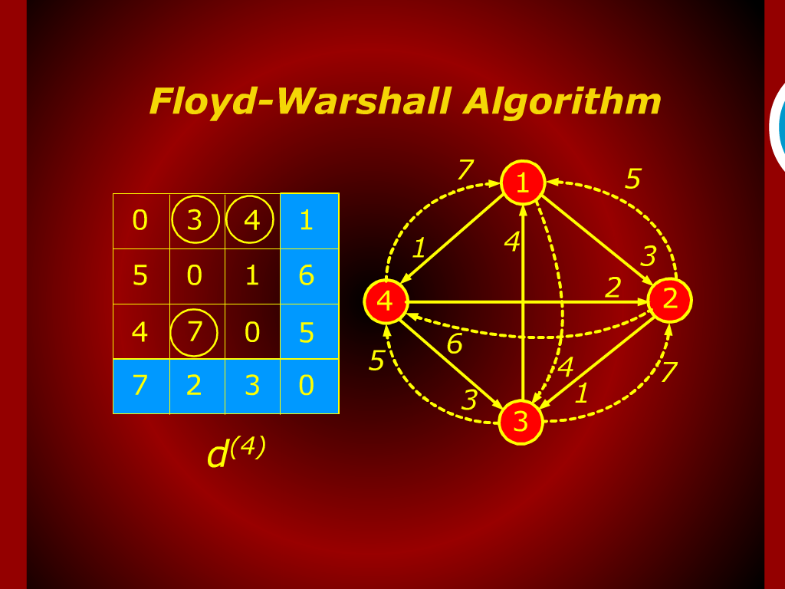
Floyd-Warshall Algorithm

Slide 24
Criteria for analyzing Algorithms

Slide 25
Model of Computation

