Slide 1
Algorithms
Lecture #43
Dr.Sohail Aslam

Slide 2
Complexity Theory

Slide 3
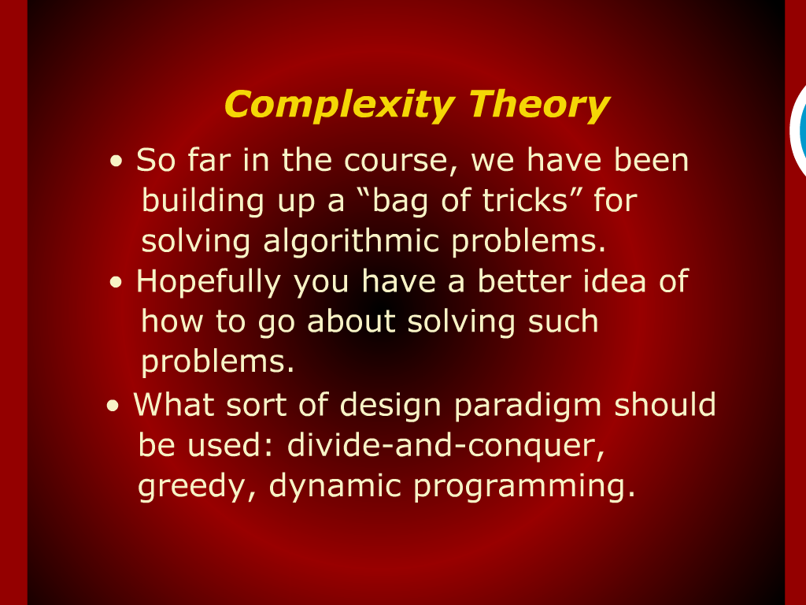
Complexity Theory

Slide 4
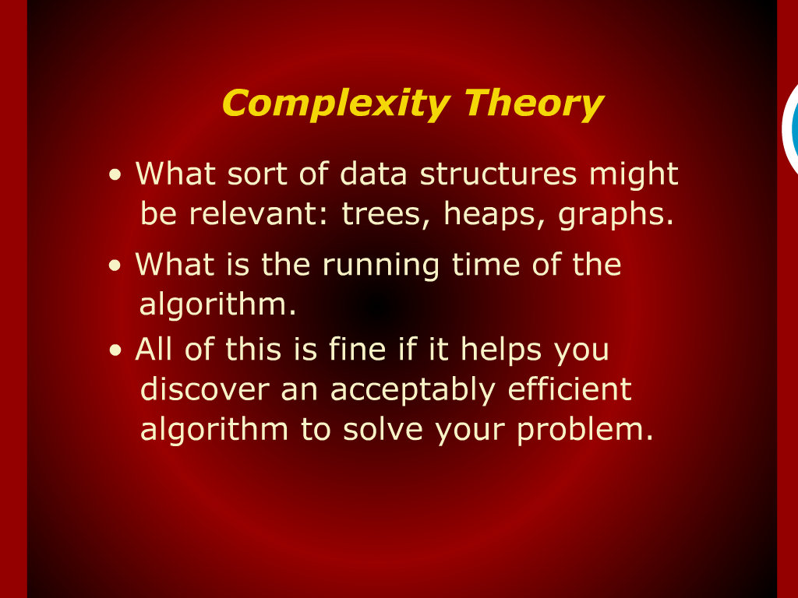
Complexity Theory

Slide 5
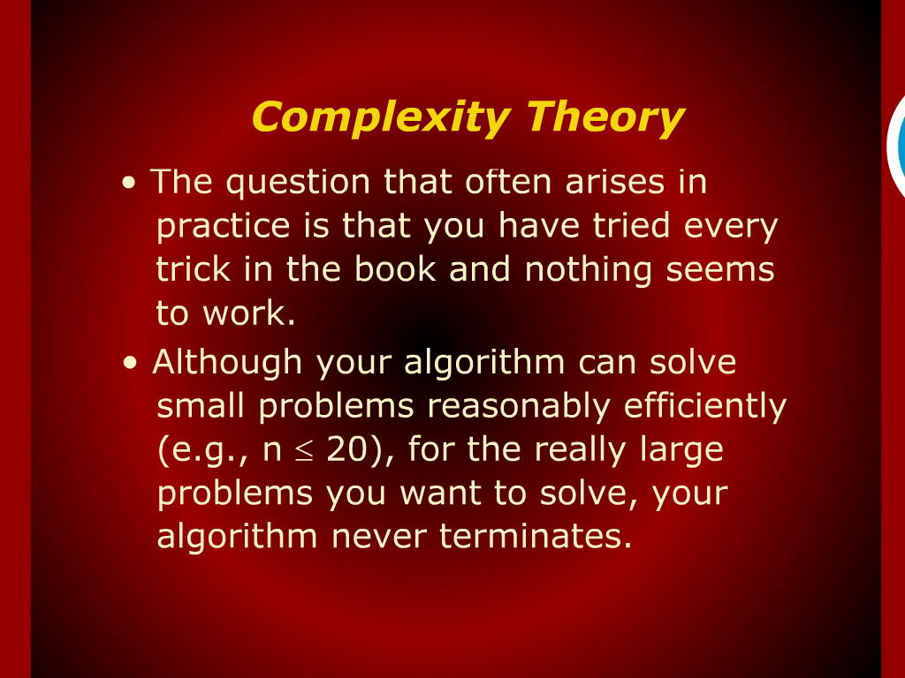
Complexity Theory

Slide 6
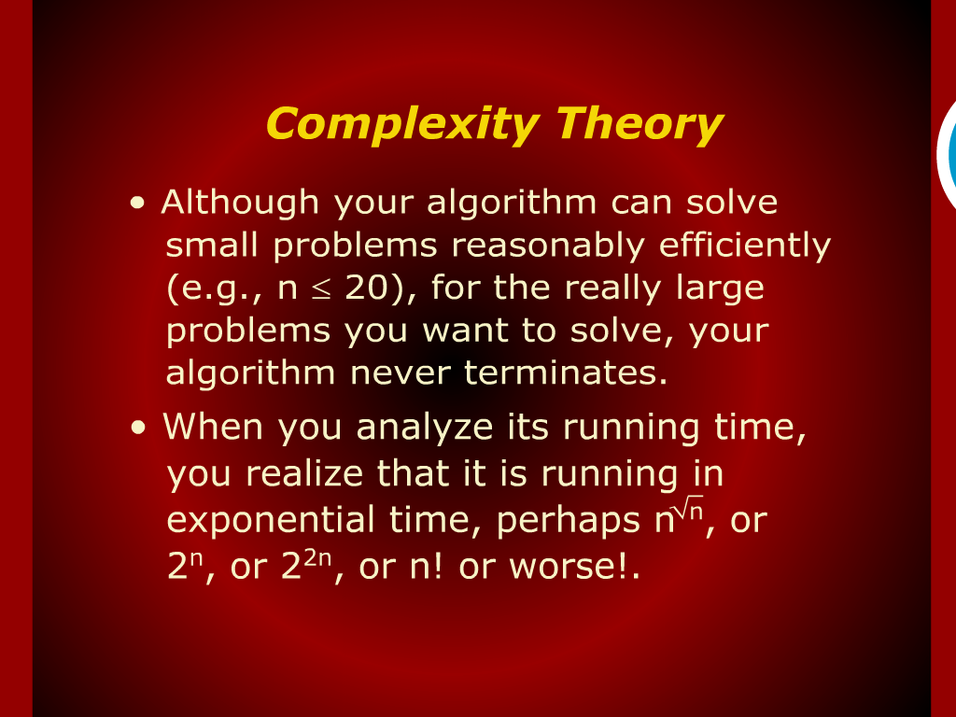
Complexity Theory

Slide 7
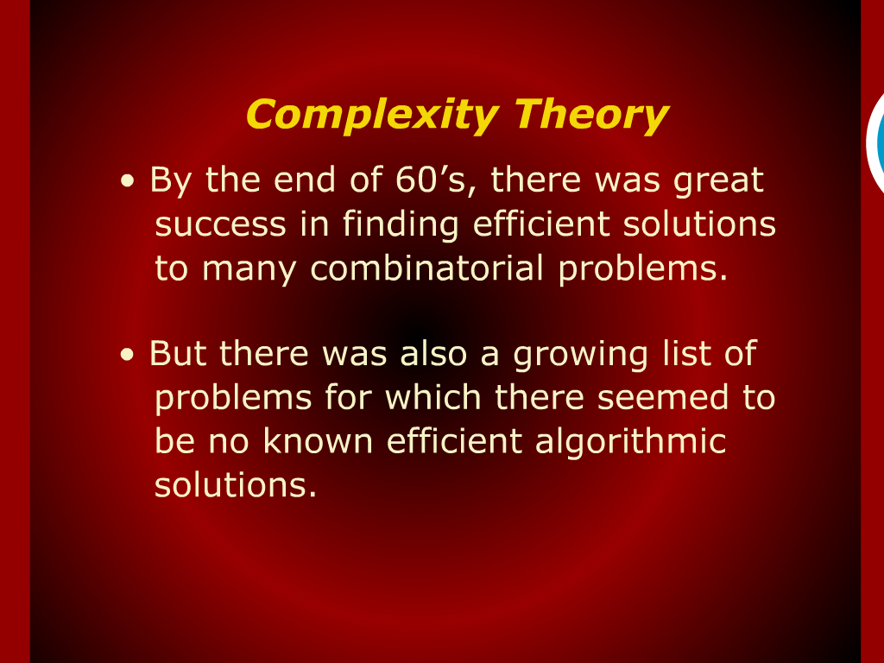
Complexity Theory

Slide 8
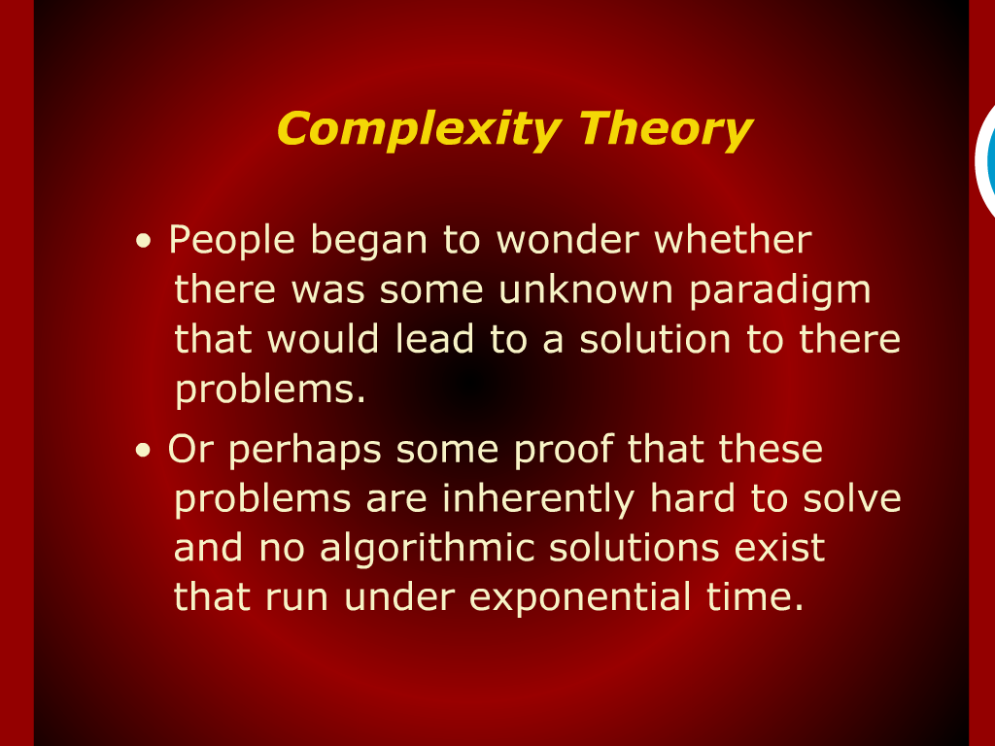
Complexity Theory

Slide 9
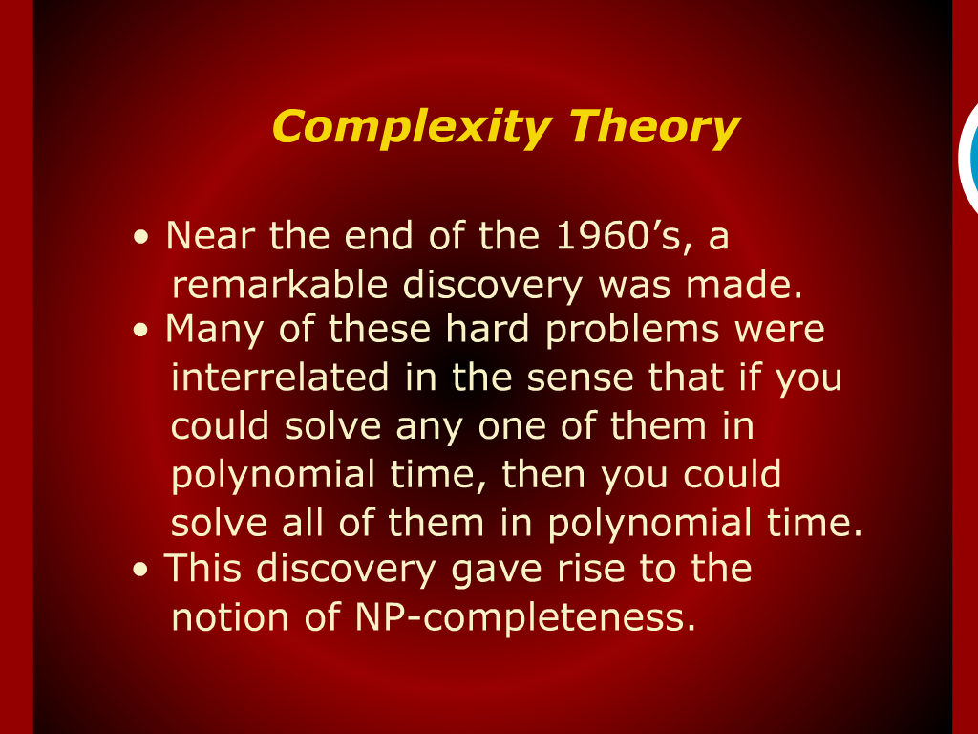
Complexity Theory

Slide 10
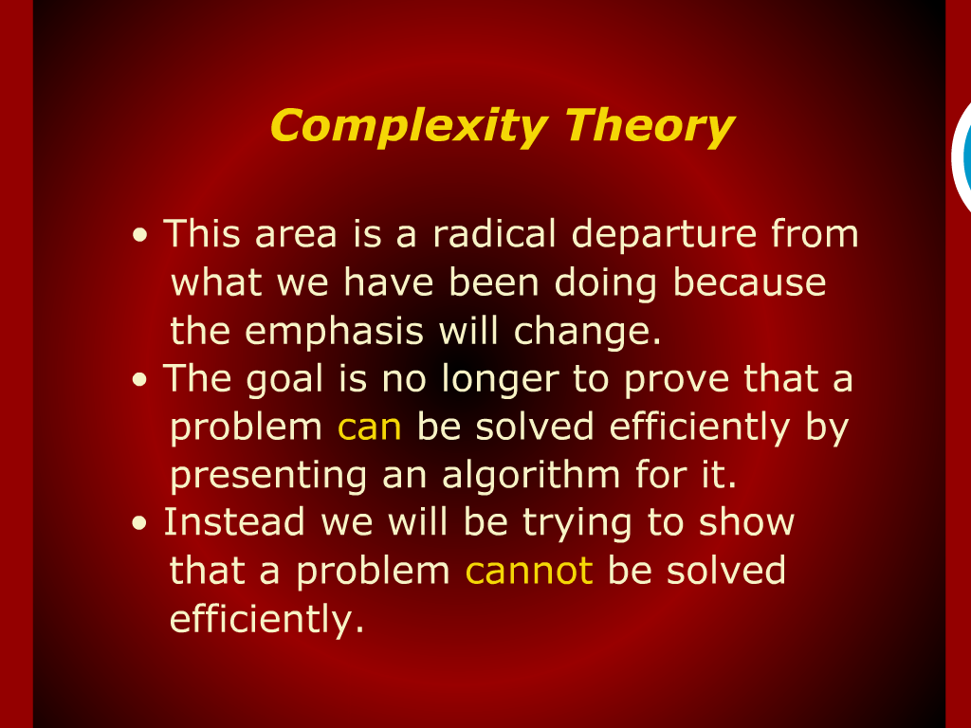
Complexity Theory

Slide 11
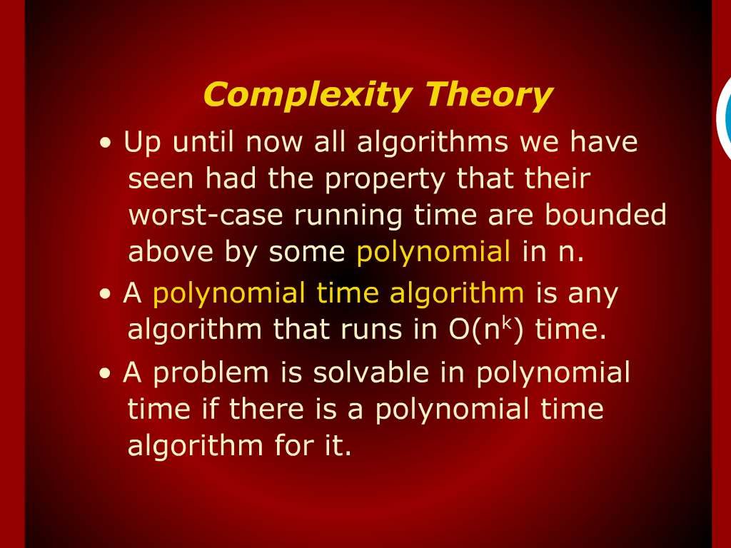
Complexity Theory

Slide 12
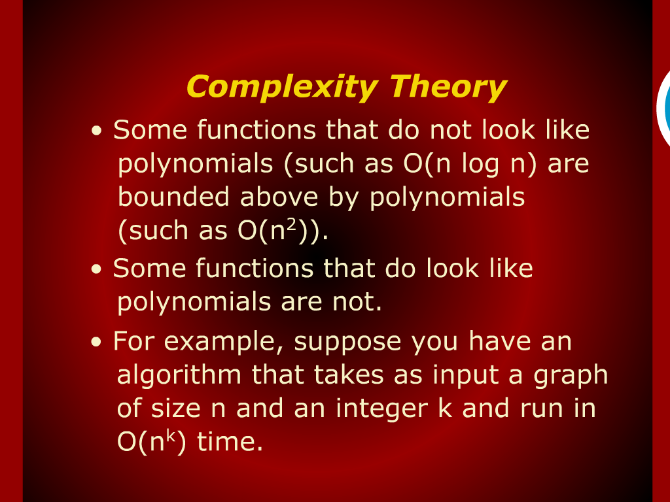
Complexity Theory

Slide 13
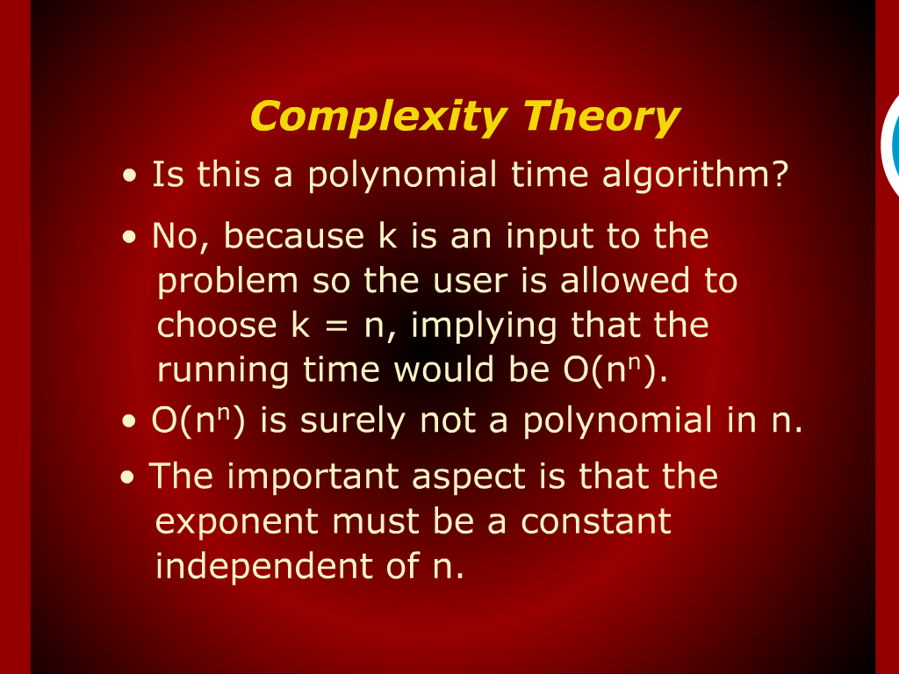
Complexity Theory

Slide 14
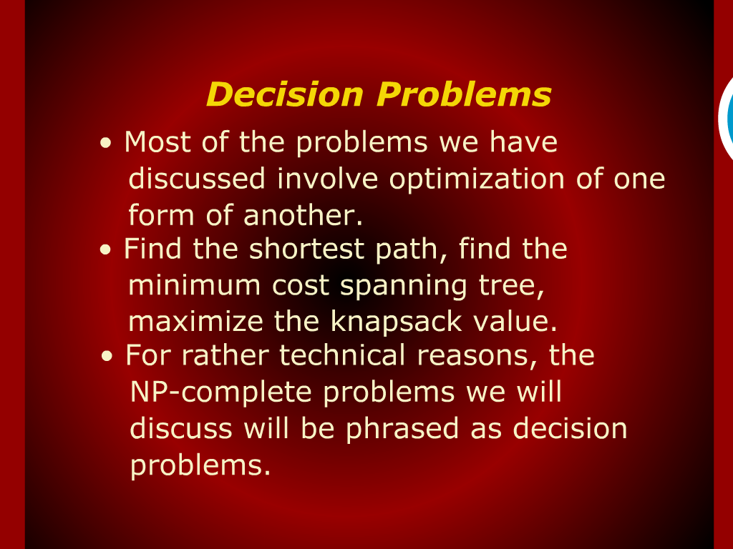
Decision Problems

Slide 15
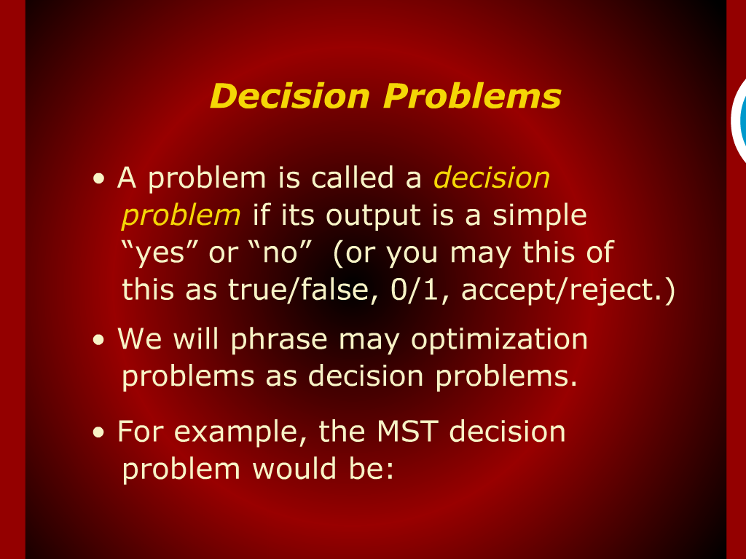
Decision Problems

Slide 16
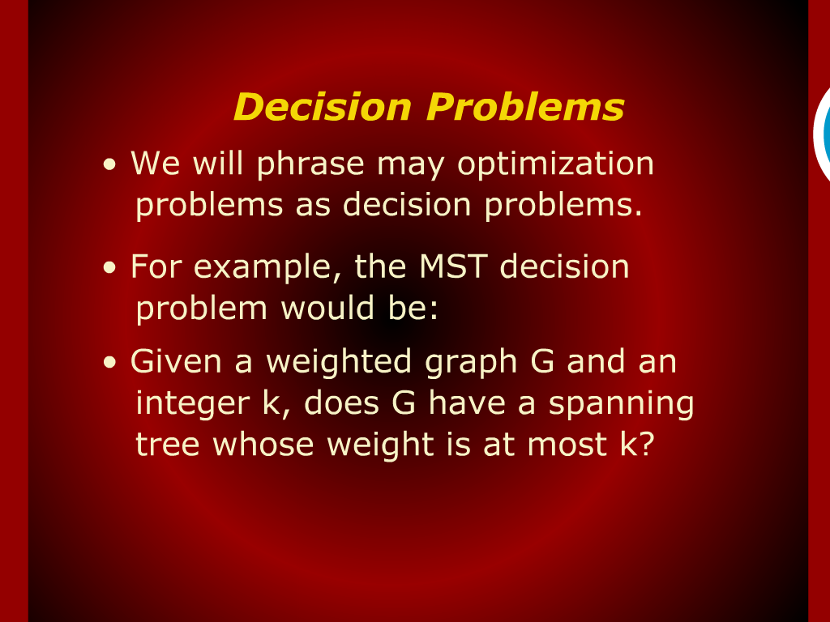
Decision Problems

Slide 17
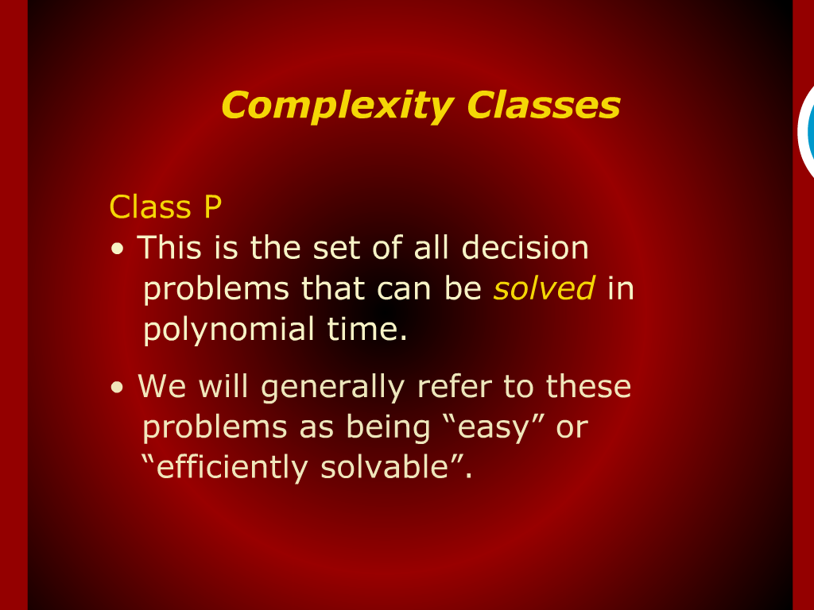
Complexity Classes

Slide 18
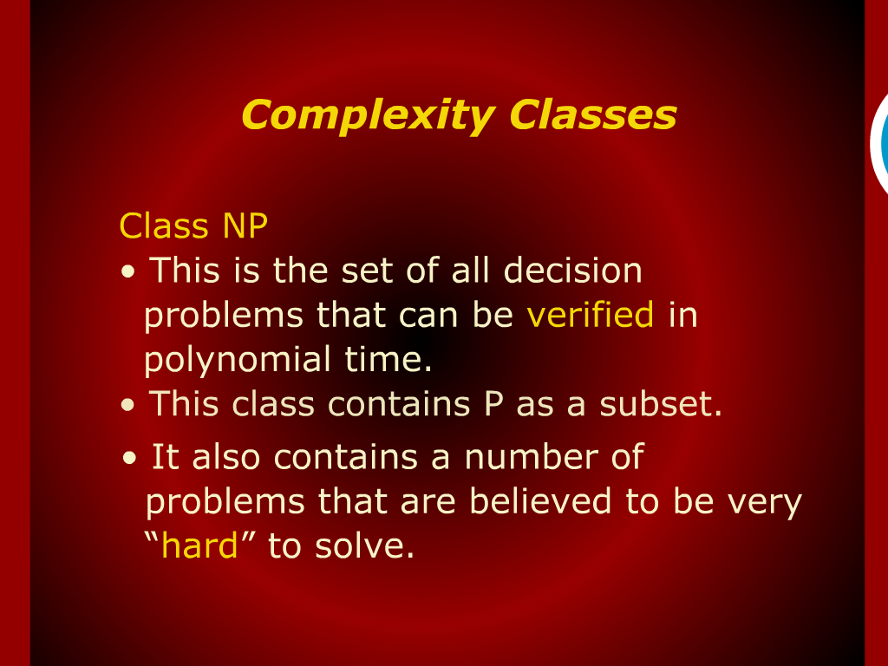
Complexity Classes

Slide 19
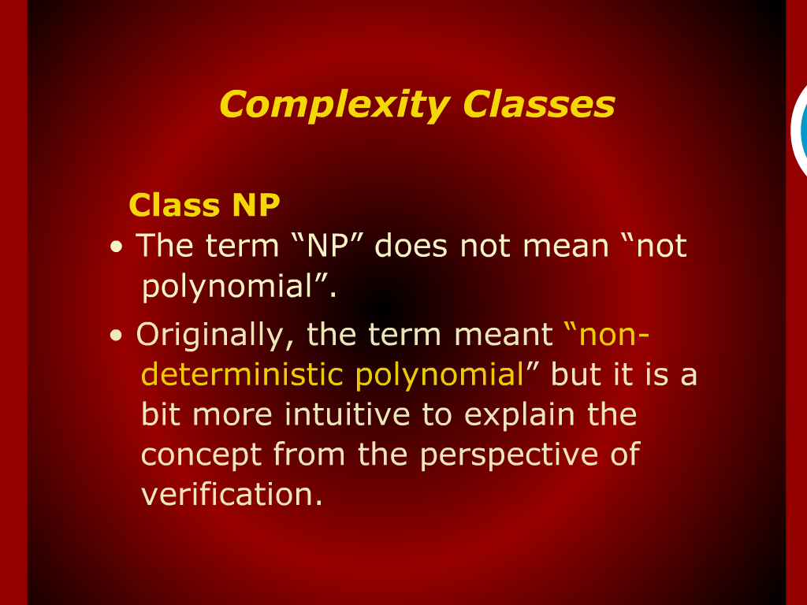
Complexity Classes

Slide 20
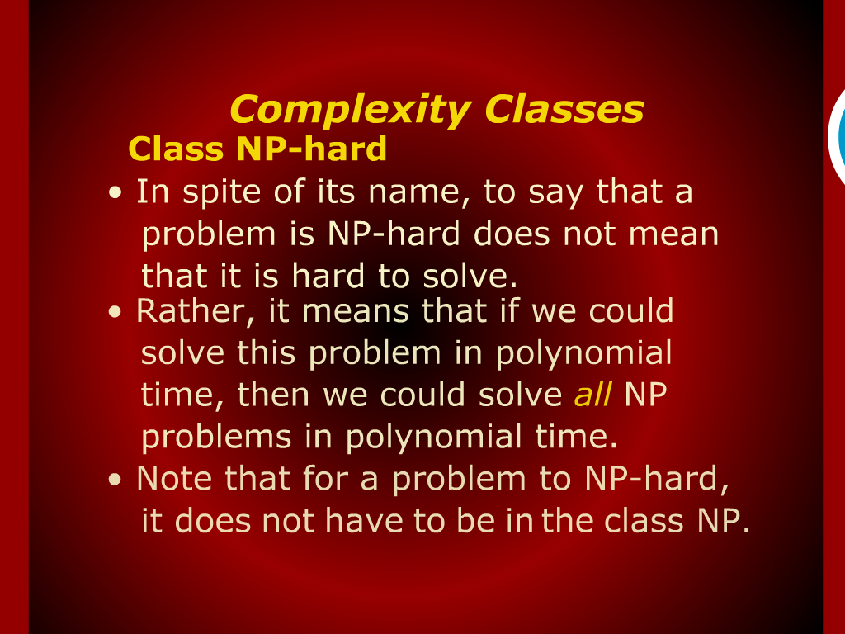
Complexity Classes

Slide 21
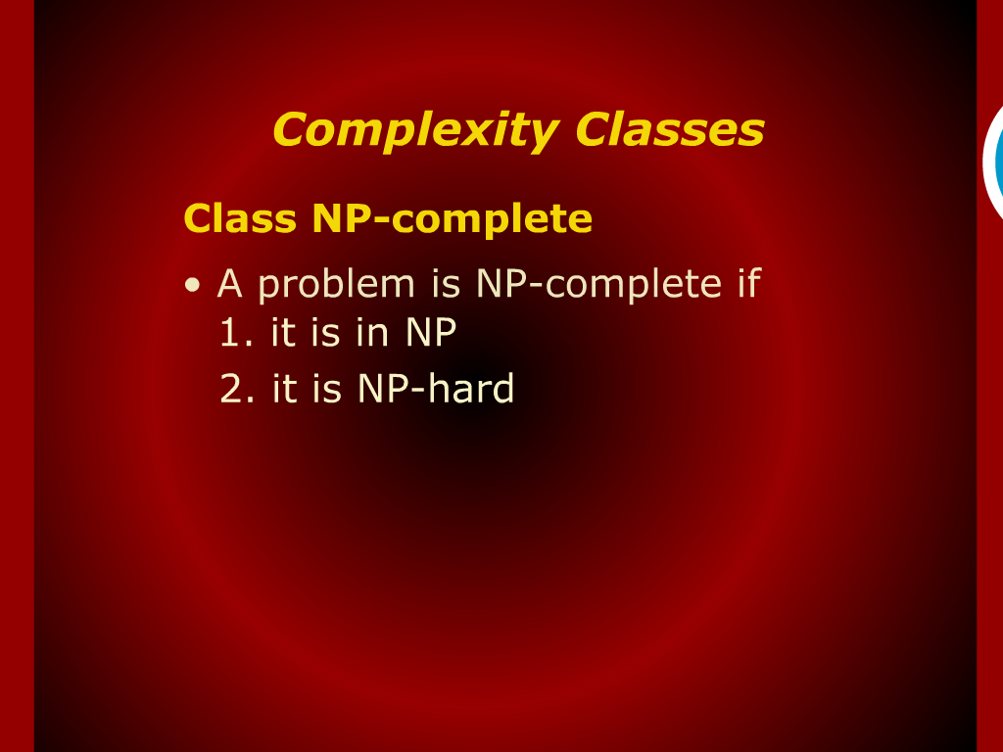
Complexity Classes

Slide 22
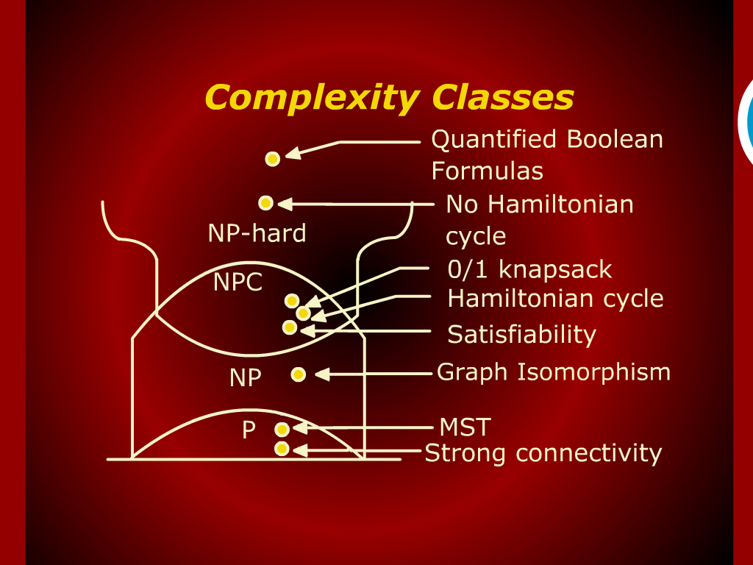
Complexity Classes

Slide 23
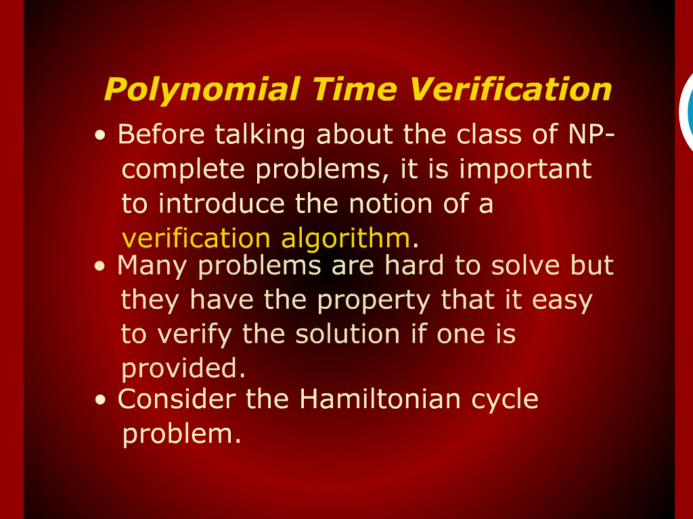
Polynomial Time Verification

Slide 24
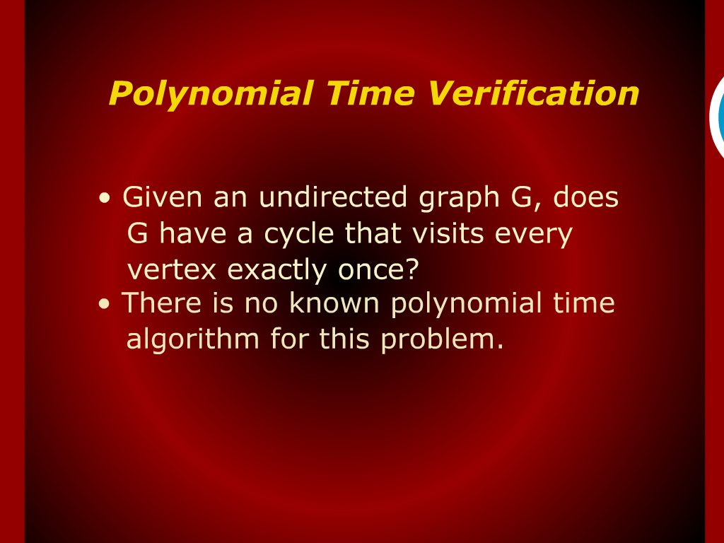
Polynomial Time Verification

Slide 25
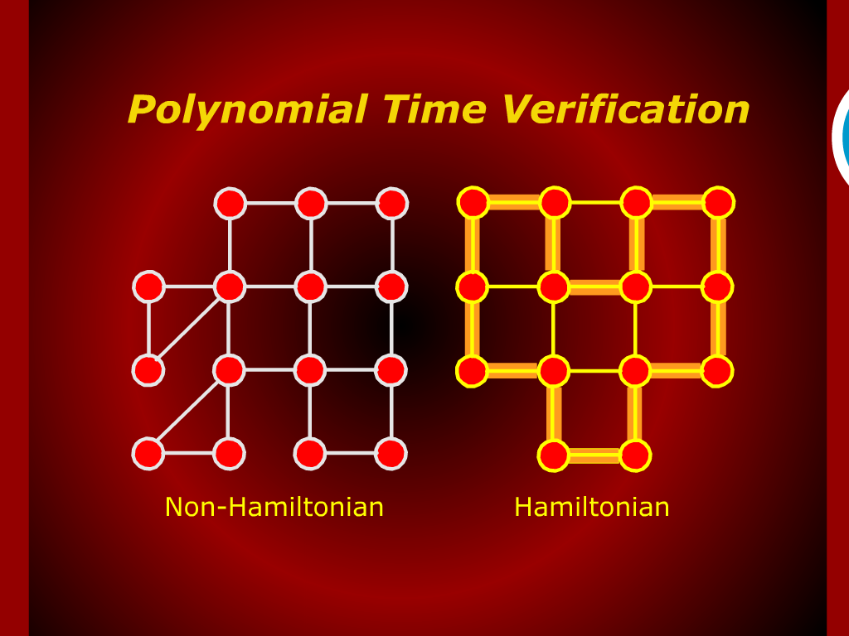
Polynomial Time Verification

Slide 26
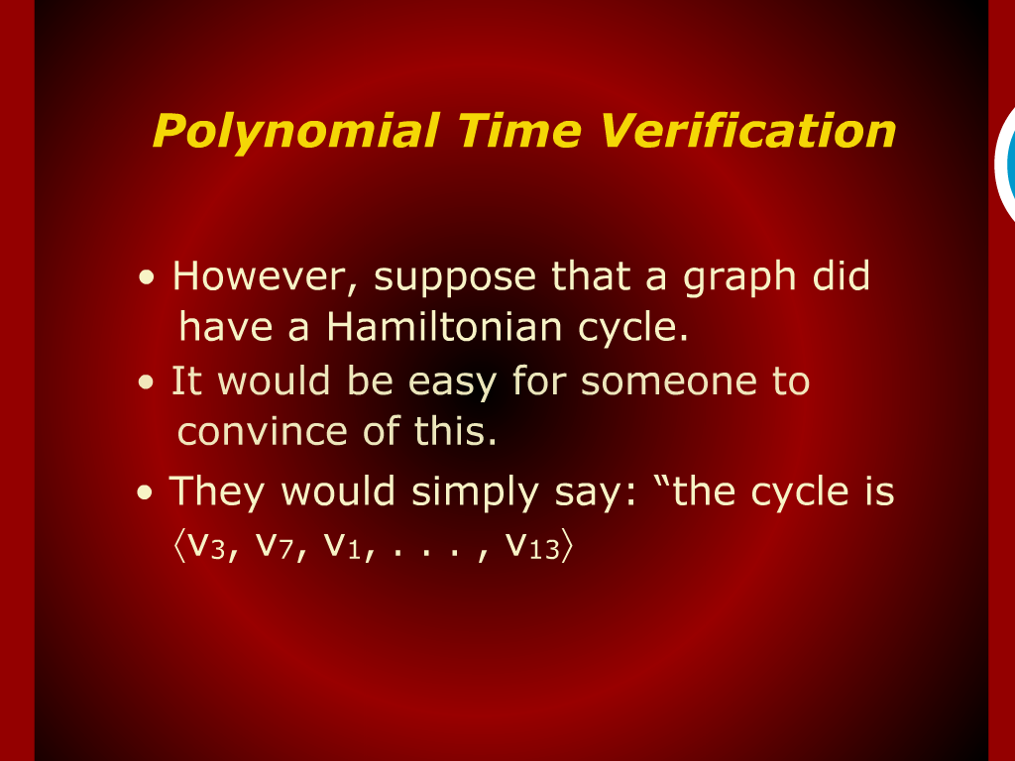
Polynomial Time Verification

Slide 27
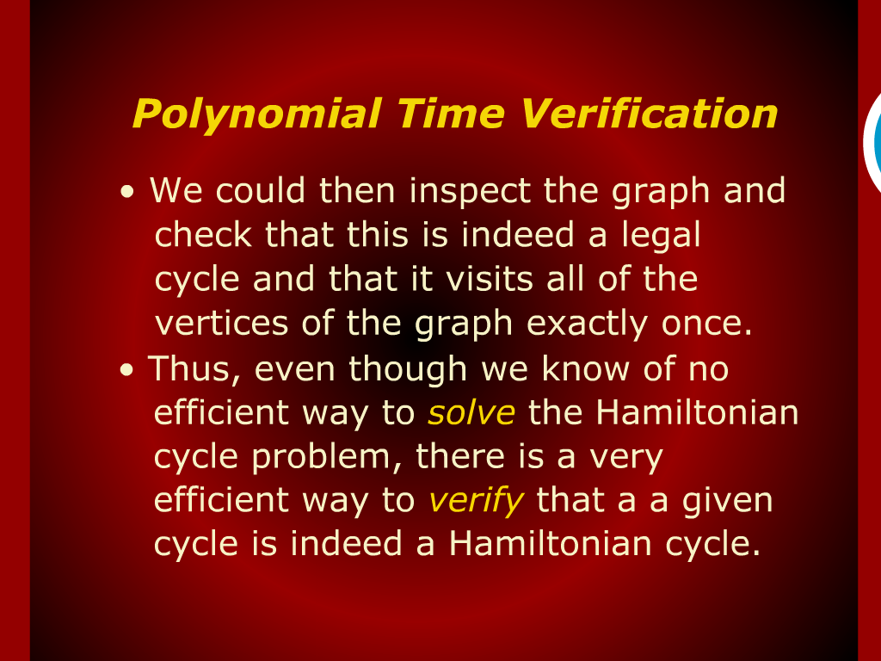
Polynomial Time Verification

Slide 28
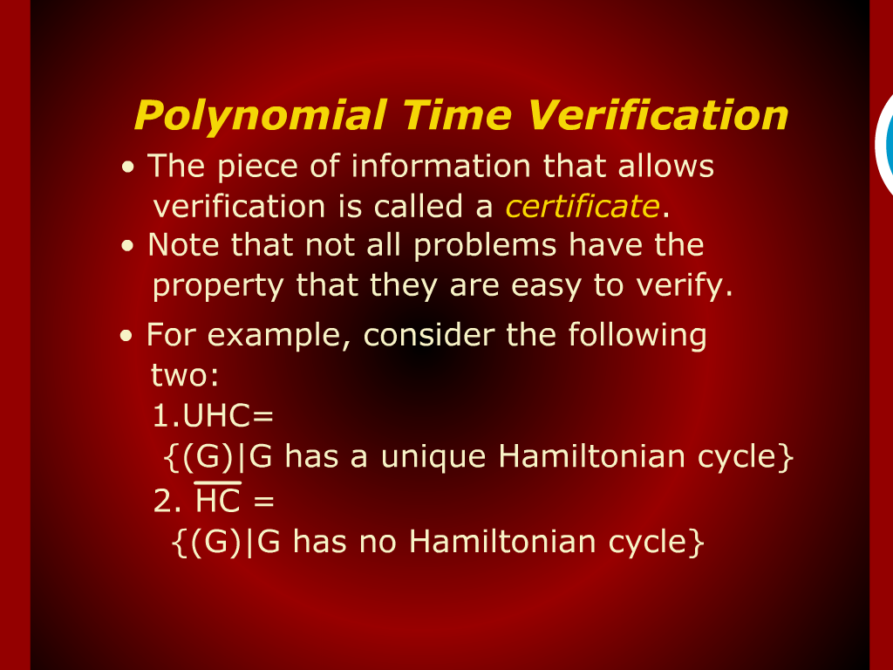
Polynomial Time Verification

Slide 29
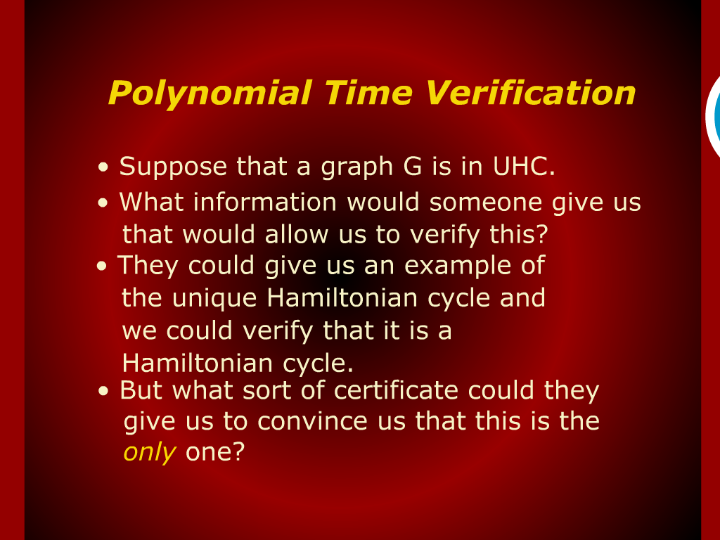
Polynomial Time Verification

Slide 30
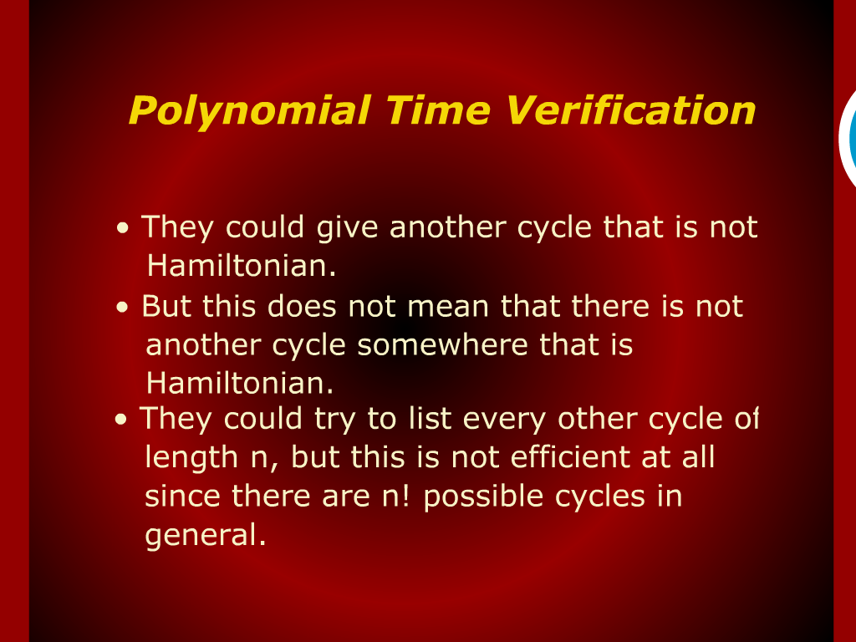
Polynomial Time Verification

Slide 31
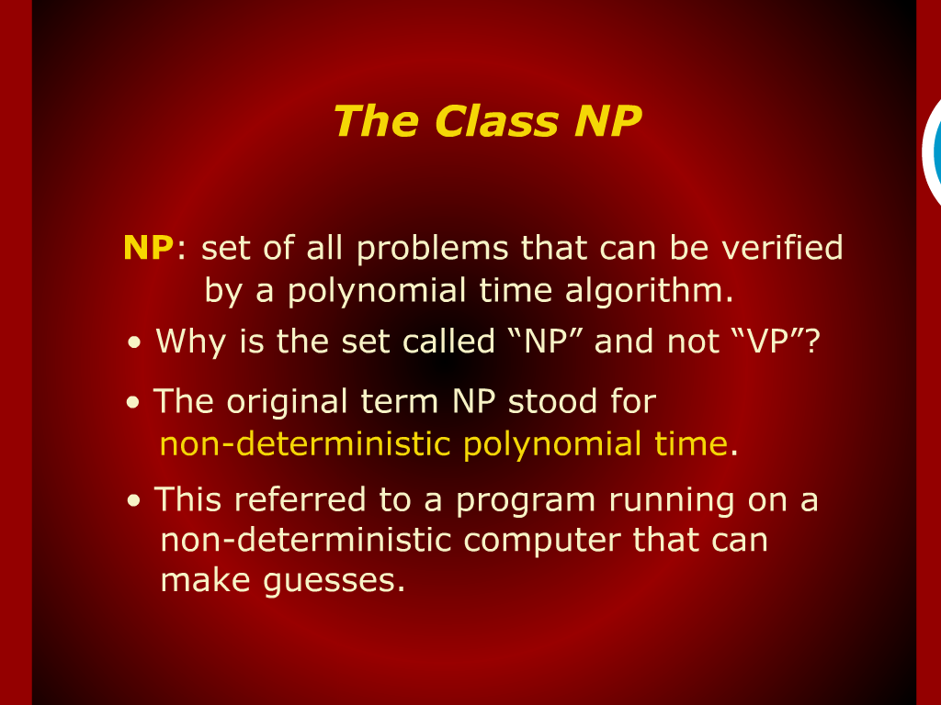
The Class NP

Slide 32
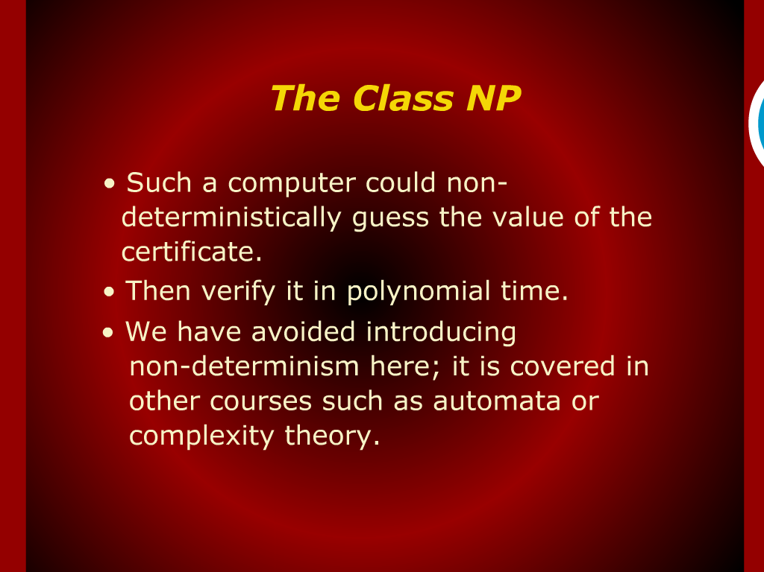
The Class NP

Slide 33
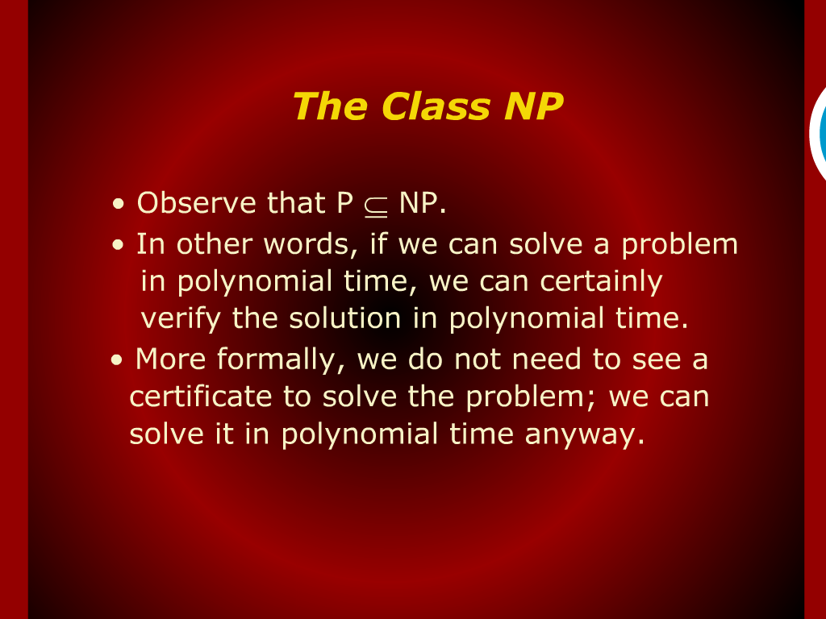
The Class NP

Slide 34
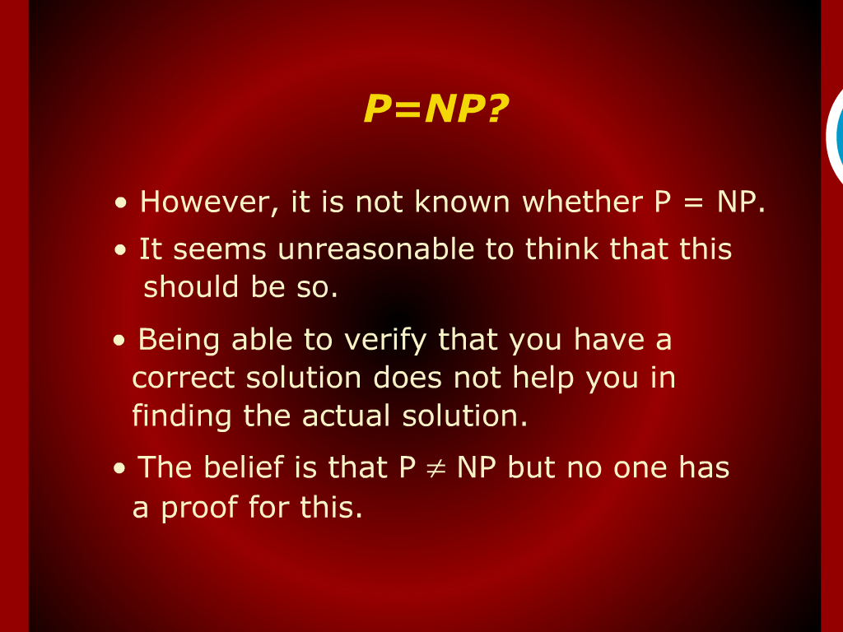
P=NP?

Slide 35
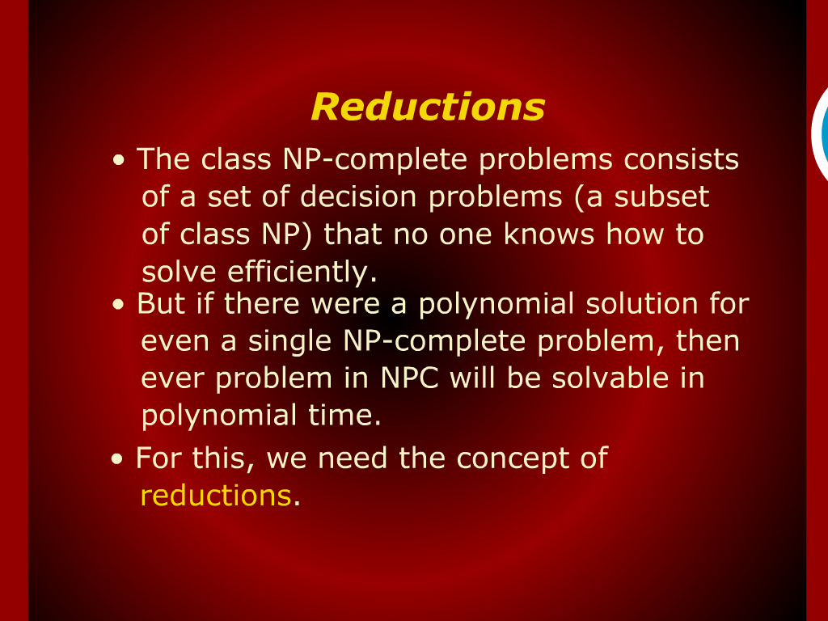
Reductions

