Slide 1
Algorithms
Lecture #44
Dr.Sohail Aslam

Slide 2
Reductions

Slide 3
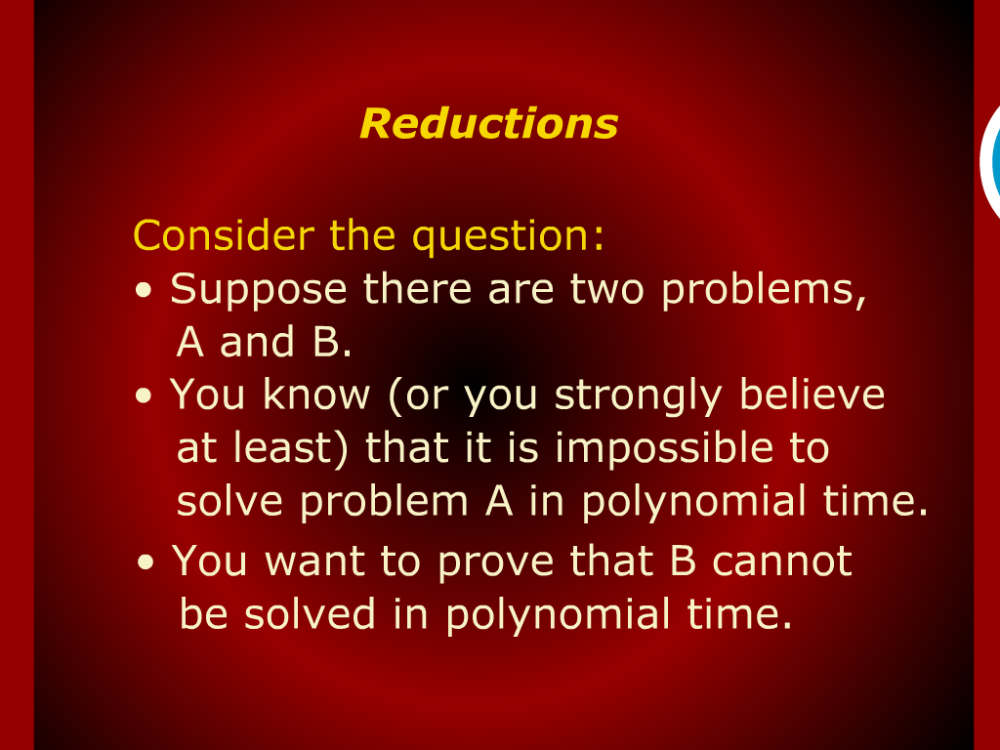
Reductions

Slide 4
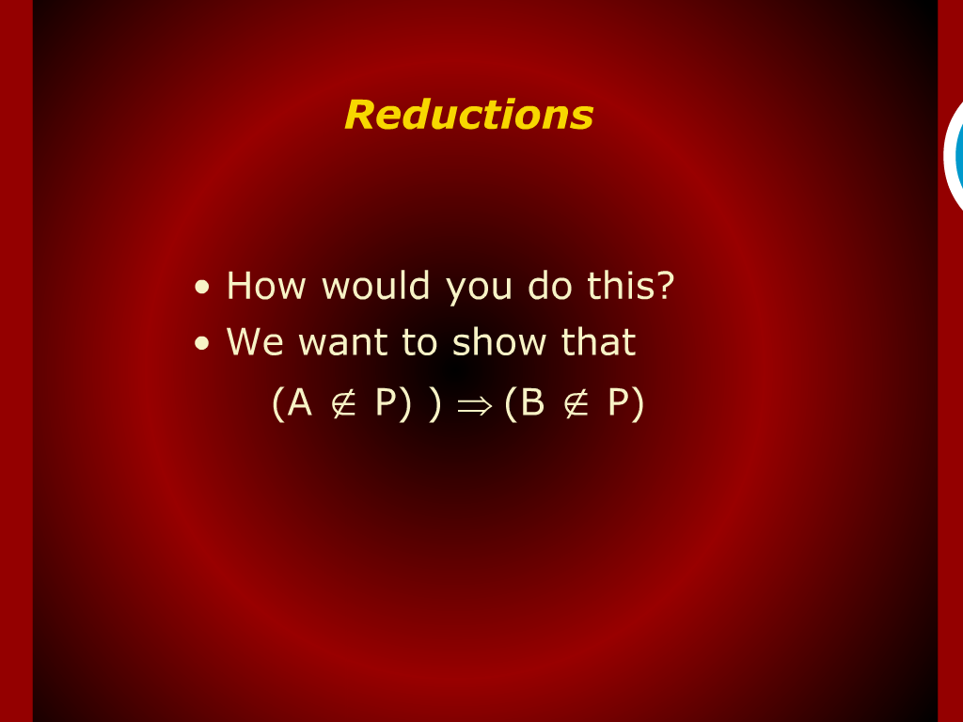
Reductions

Slide 5
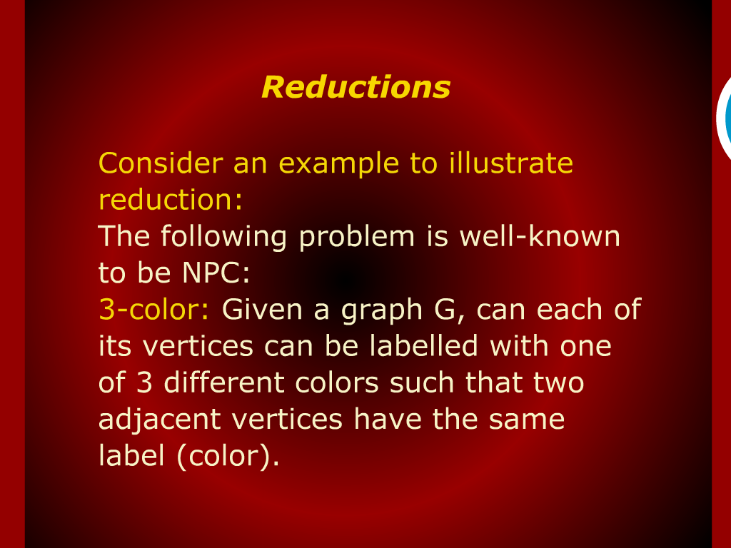
Reductions

Slide 6
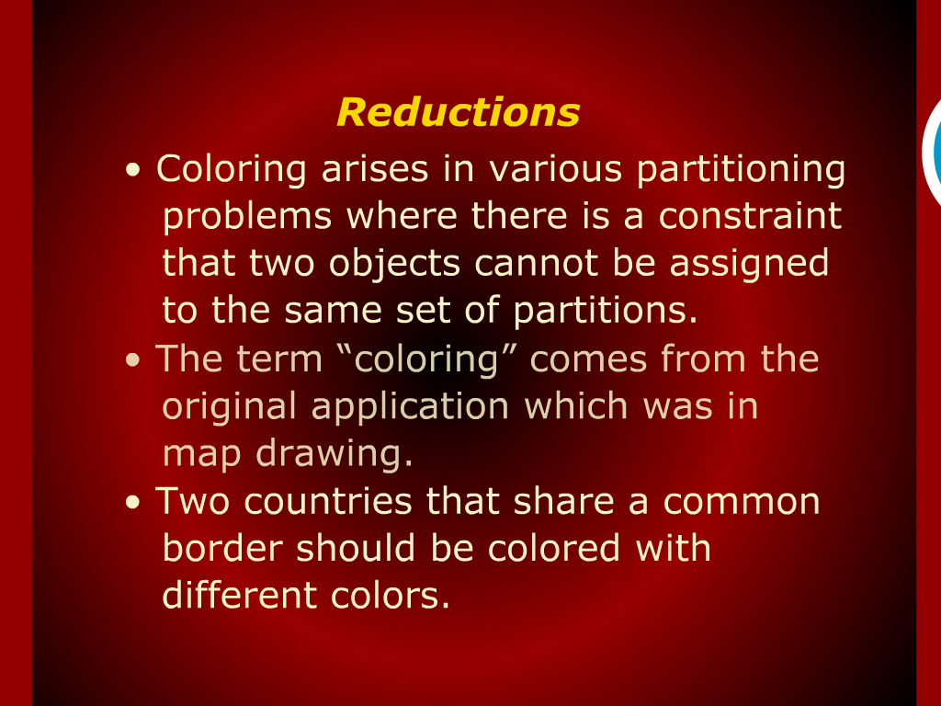
Reductions

Slide 7
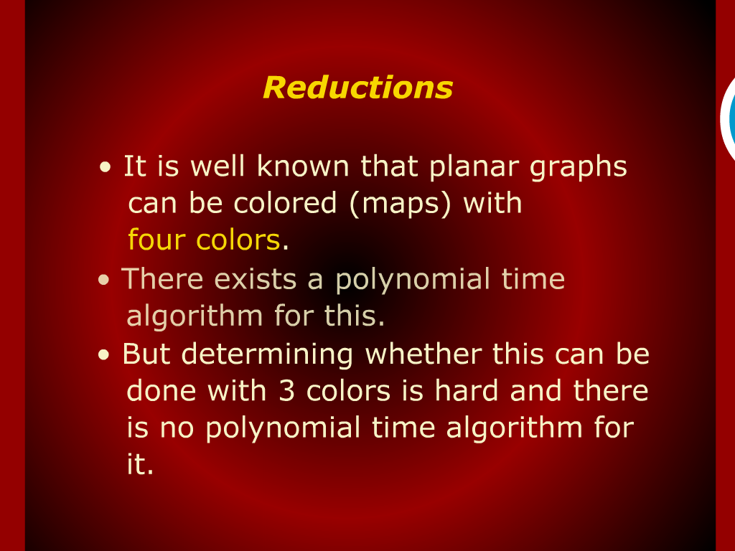
Reductions

Slide 8
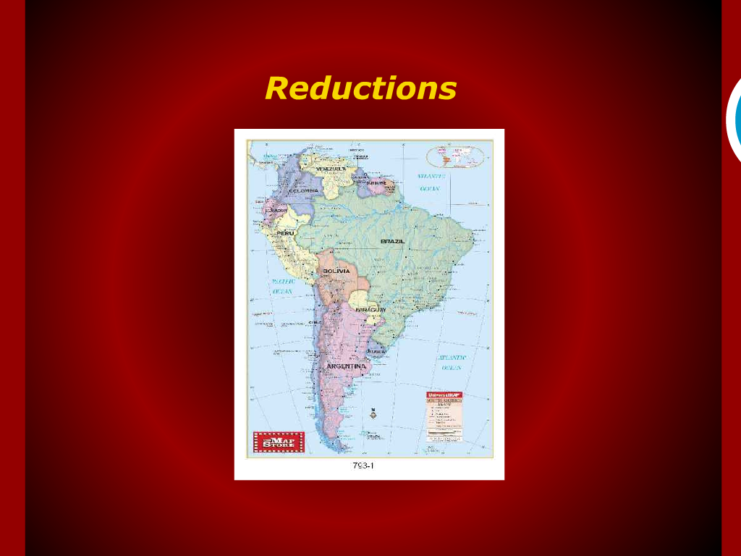
Reductions

Slide 9
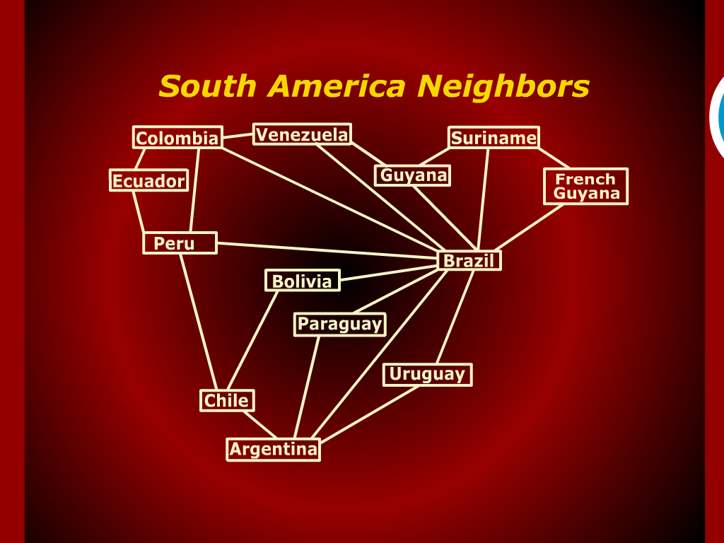
South America Neighbors

Slide 10
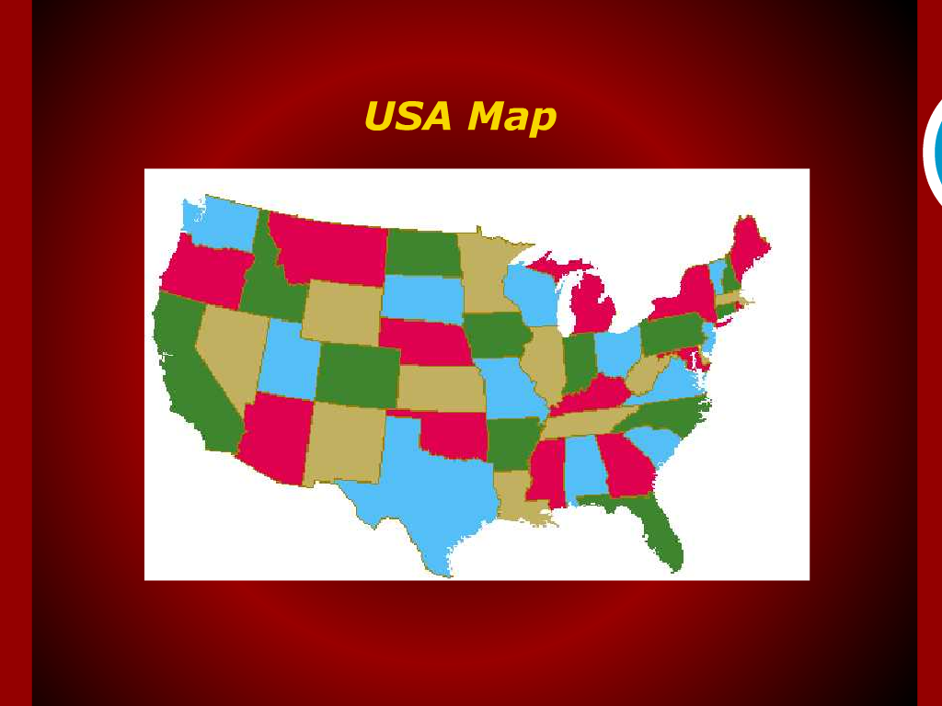
USA Map

Slide 11
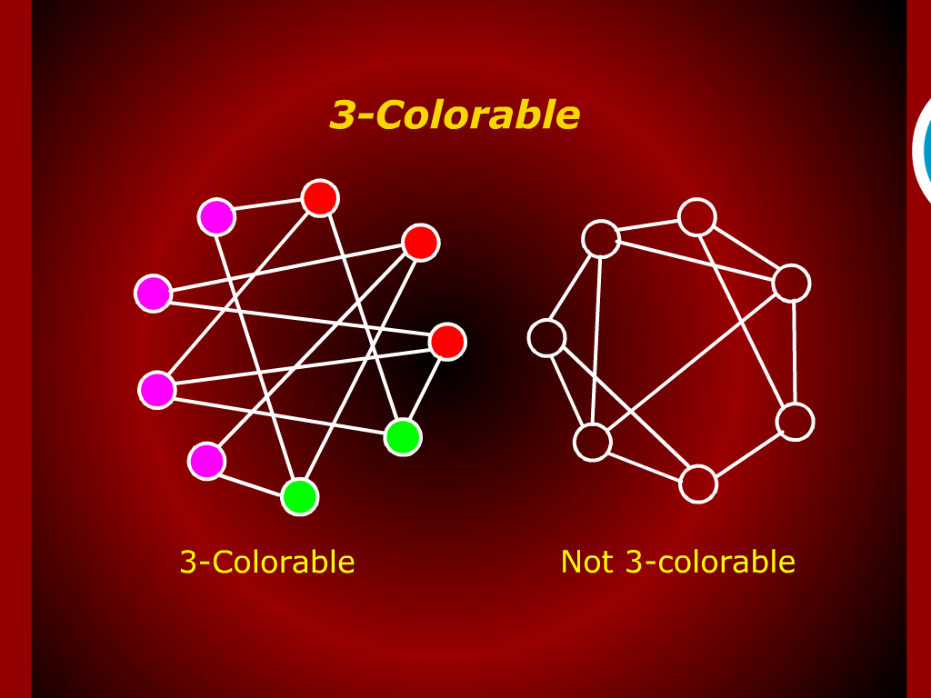
3-Colorable

Slide 12
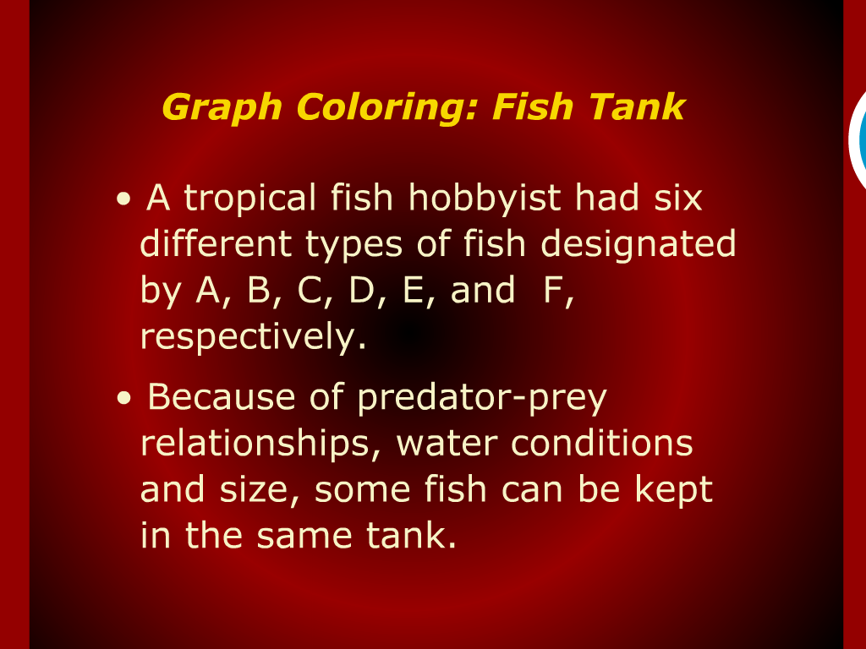
Graph Coloring: Fish Tank

Slide 13
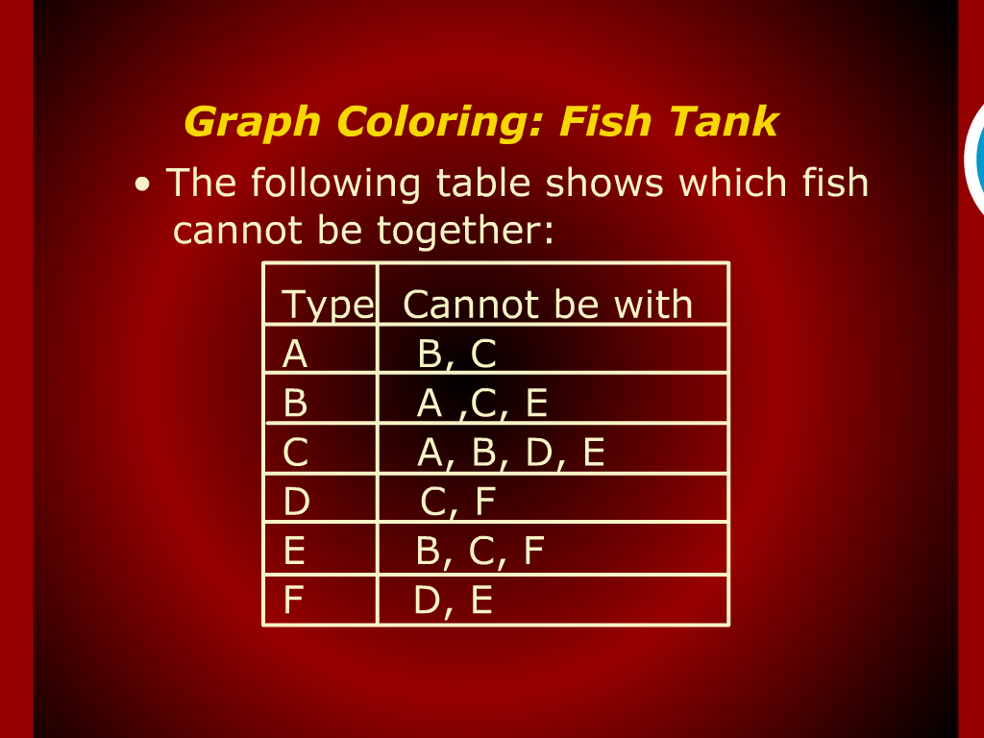
Graph Coloring: Fish Tank

Slide 14
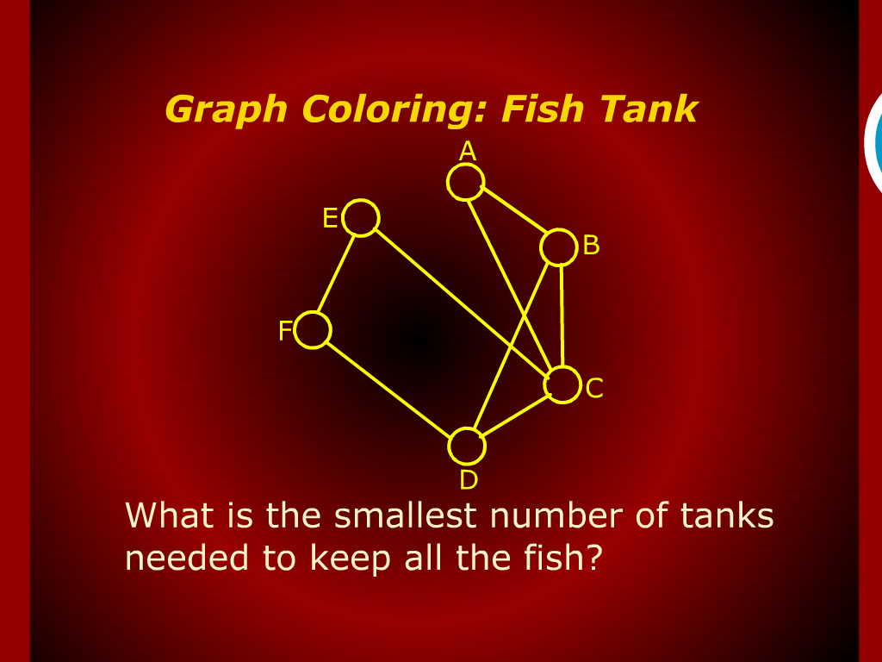
Graph Coloring: Fish Tank

Slide 15
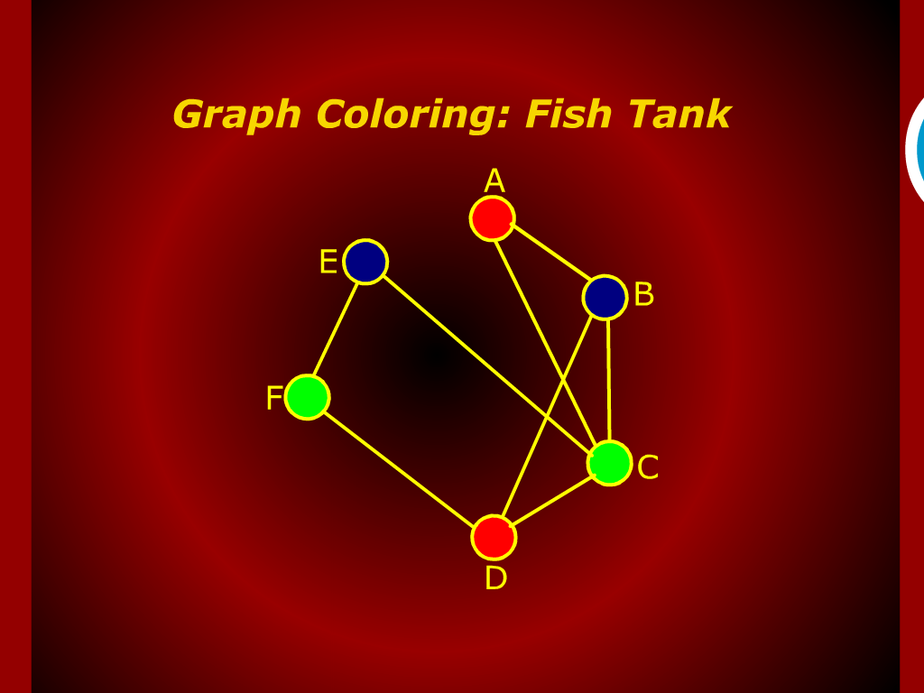
Graph Coloring: Fish Tank

Slide 16
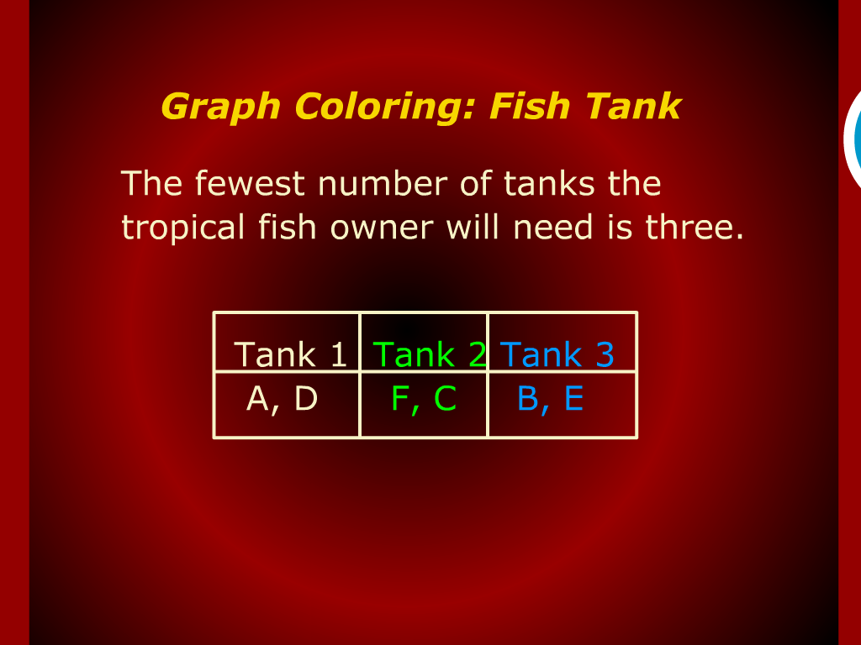
Graph Coloring: Fish Tank

Slide 17
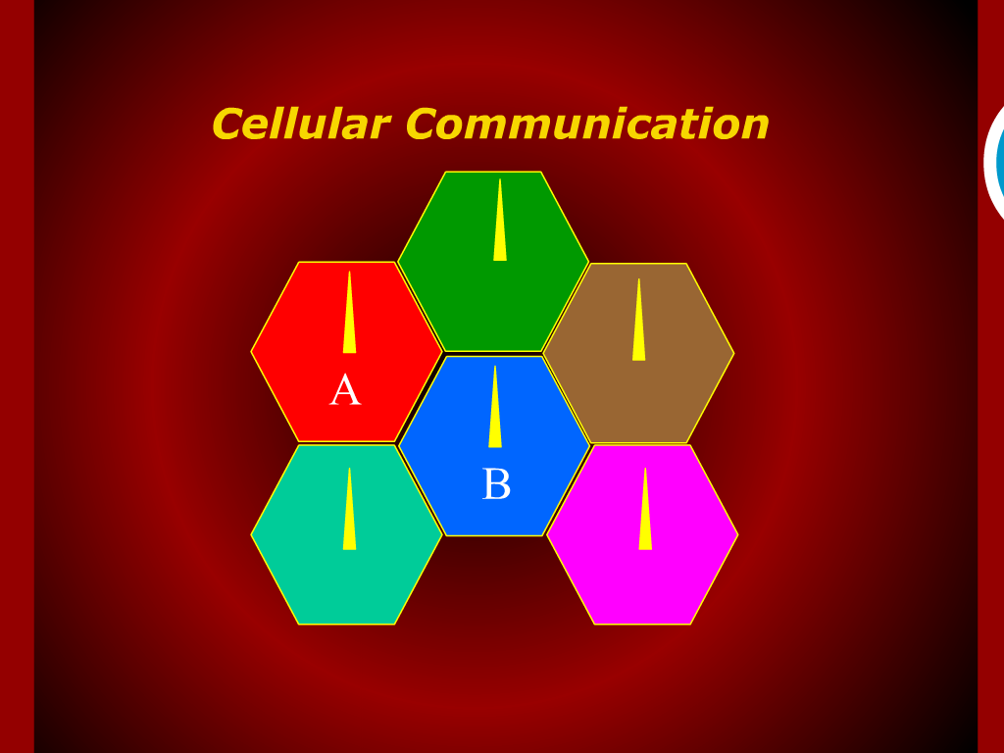
Cellular Communication

Slide 18
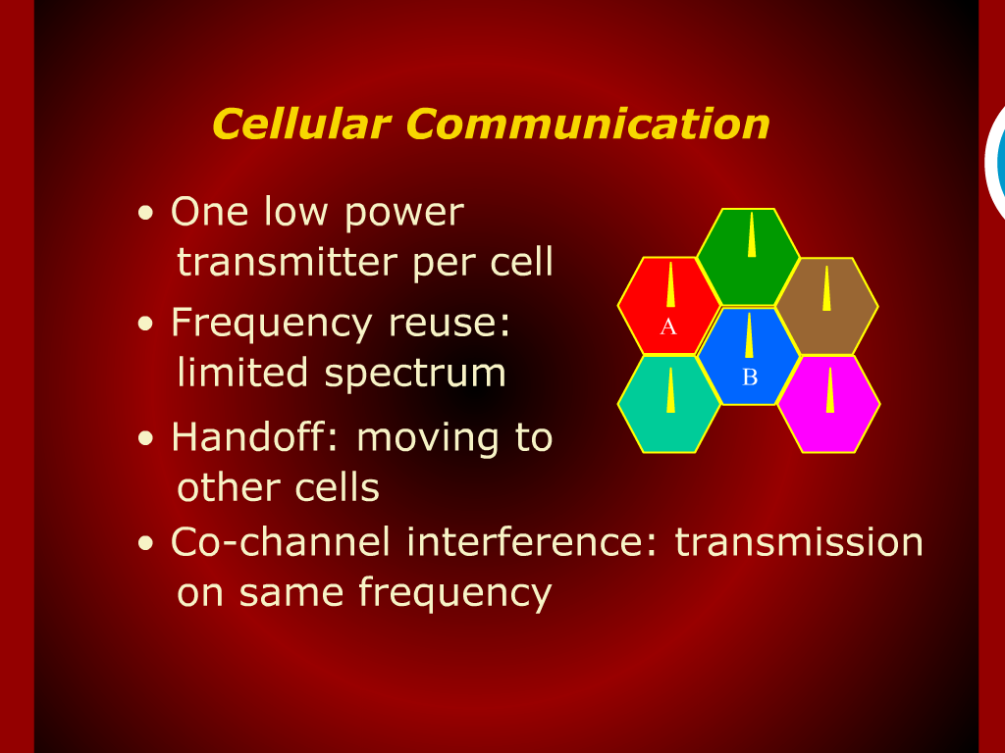
Cellular Communication

Slide 19
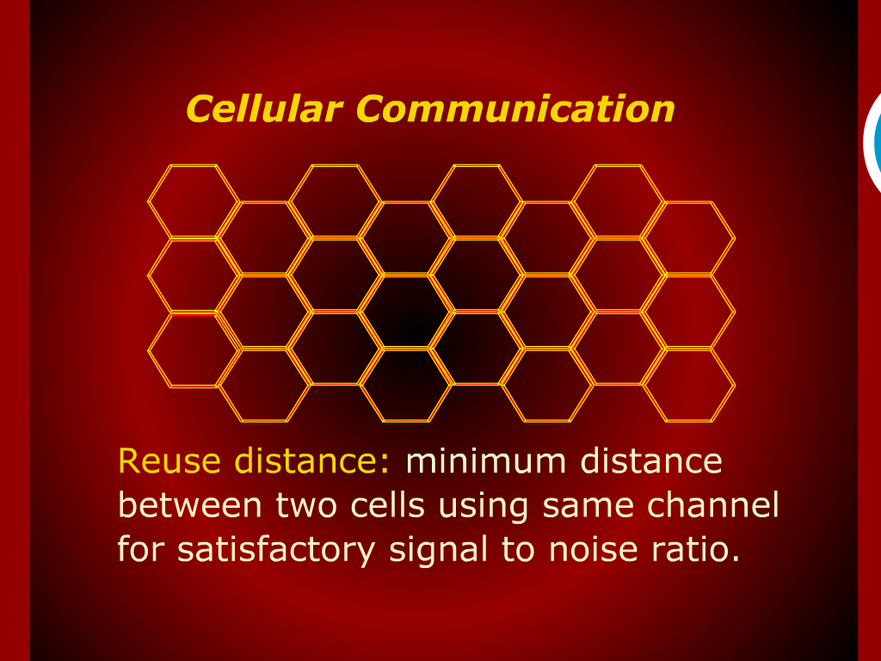
Cellular Communication

Slide 20
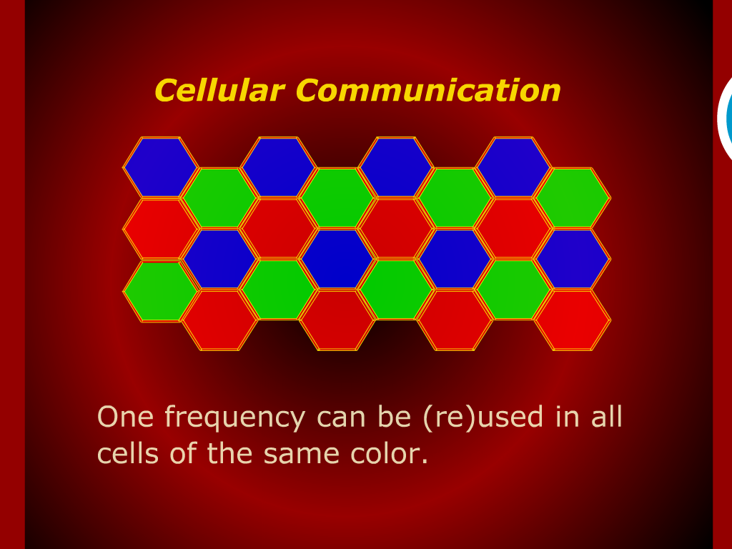
Cellular Communication

Slide 21
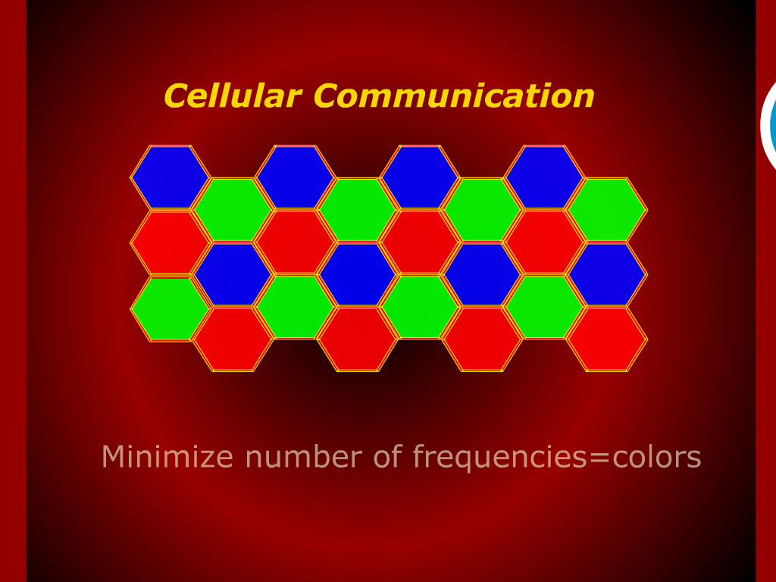
Cellular Communication

Slide 22
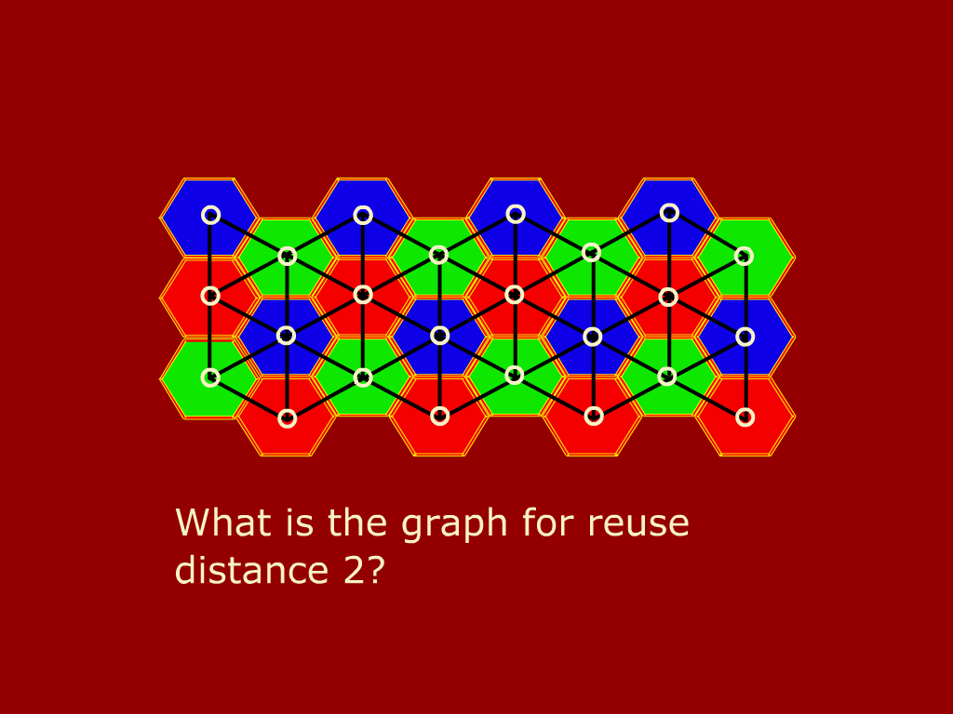
Cellular Communication

Slide 23
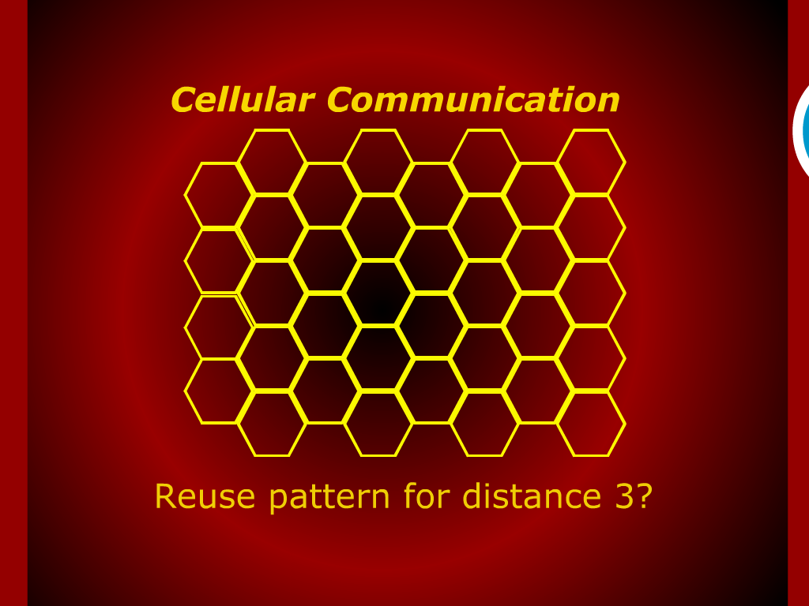
Cellular Communication

Slide 24
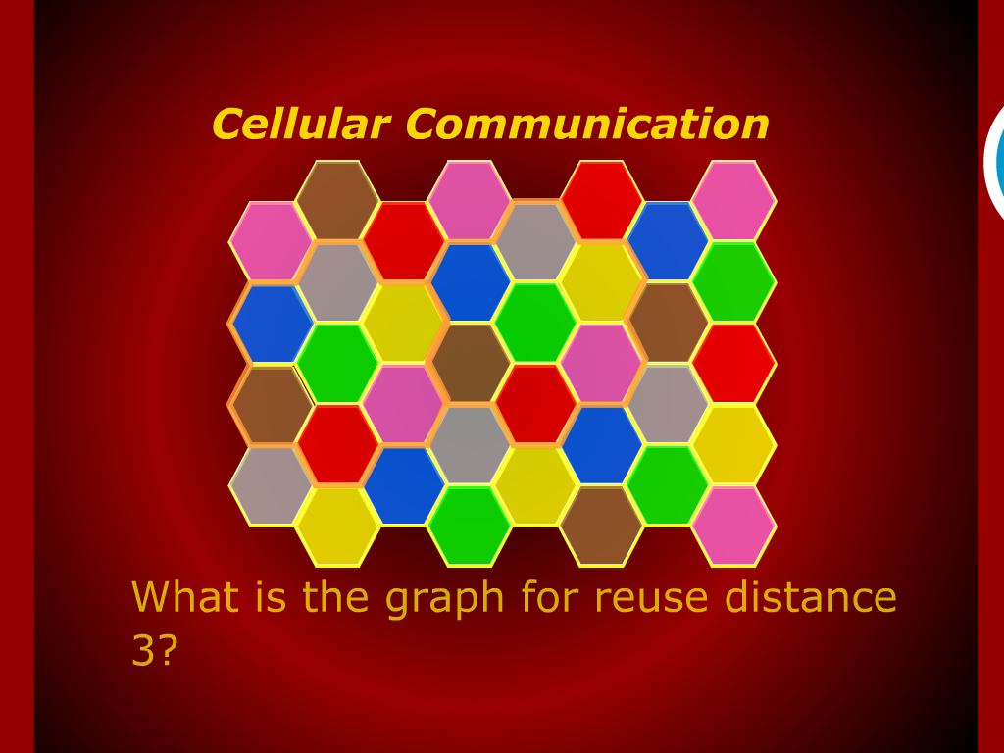
Cellular Communication

Slide 25
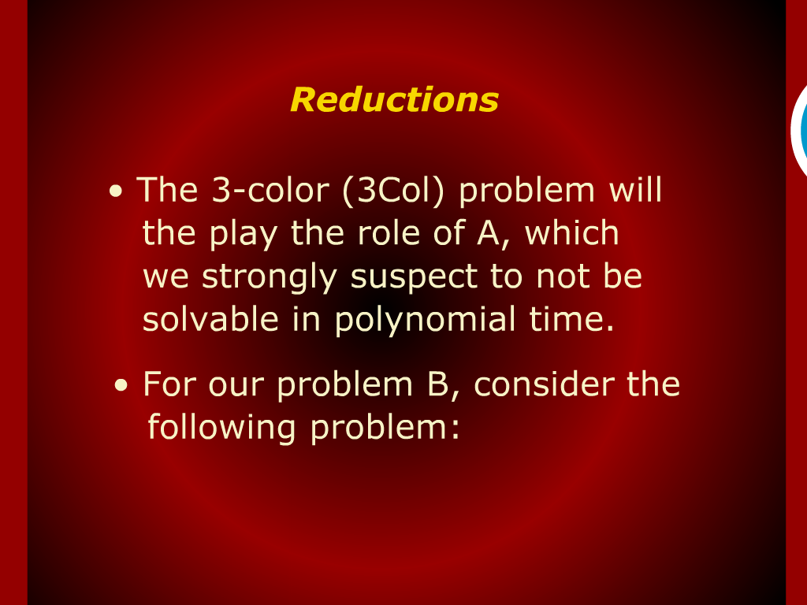
Reductions

