Slide 1
Algorithms
Lecture #45
Dr.Sohail Aslam

Slide 2
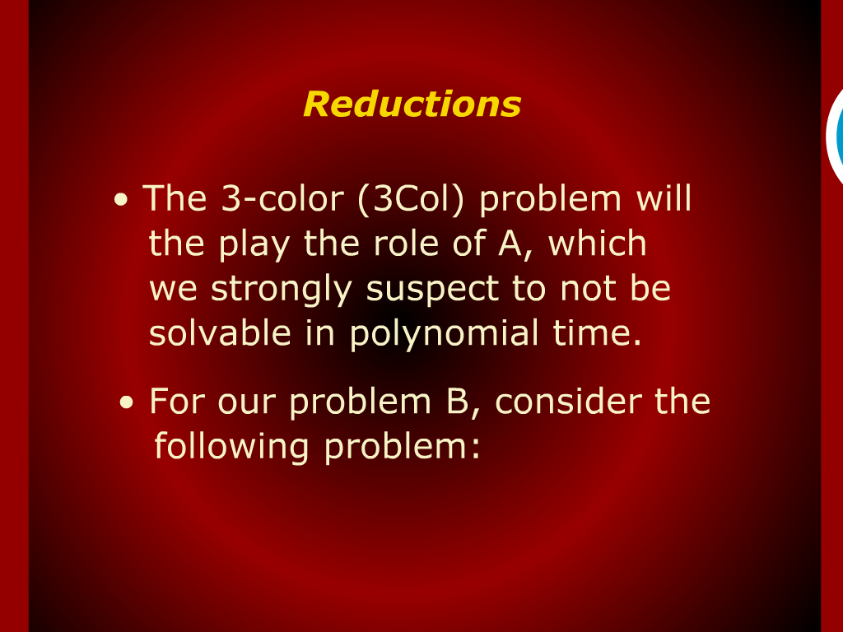
Reductions

Slide 3
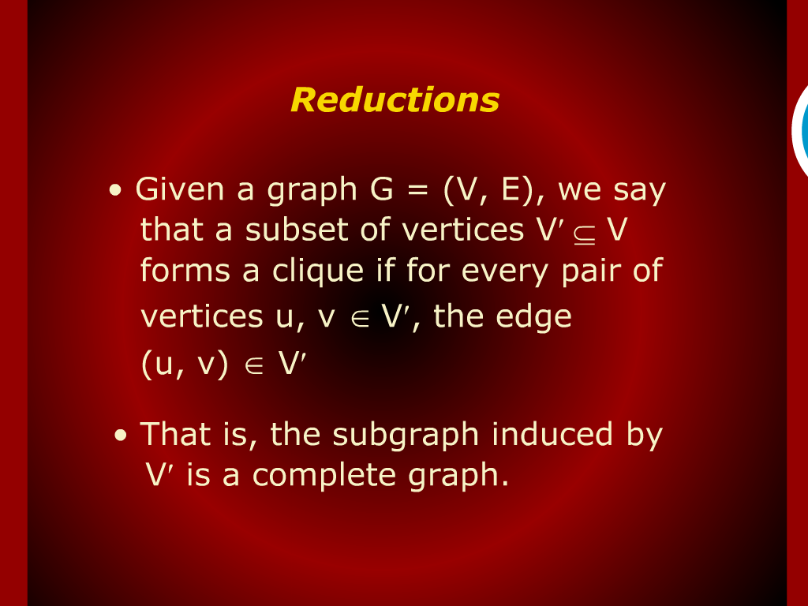
Reductions

Slide 4
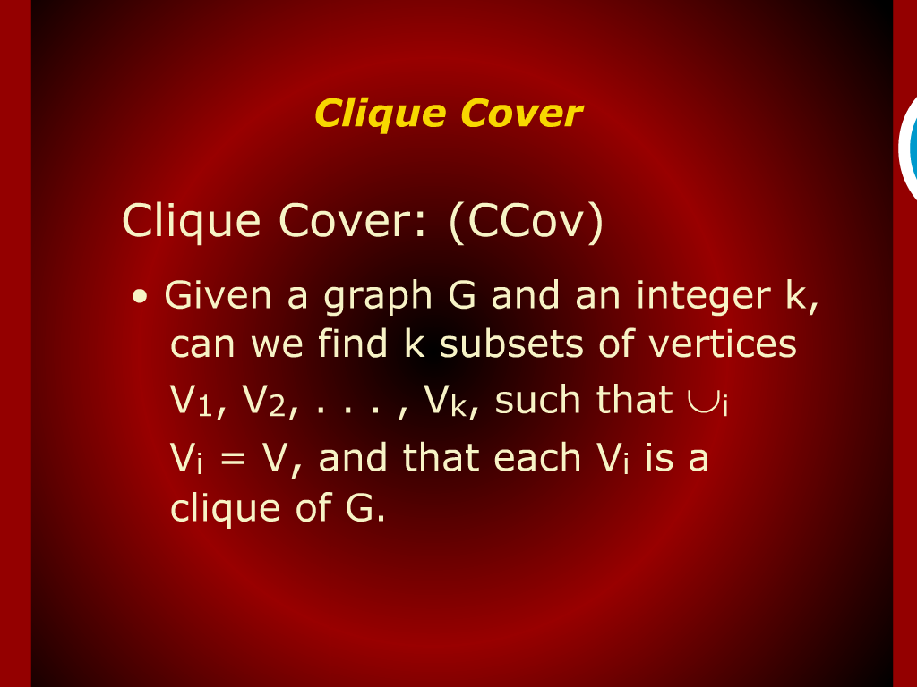
Clique Cover

Slide 5
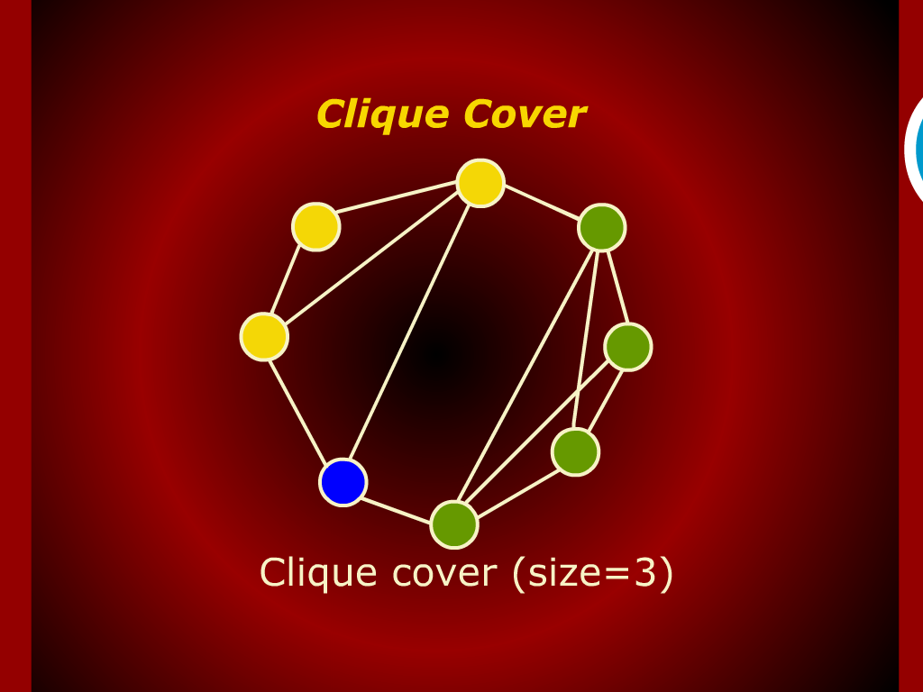
Clique Cover

Slide 6
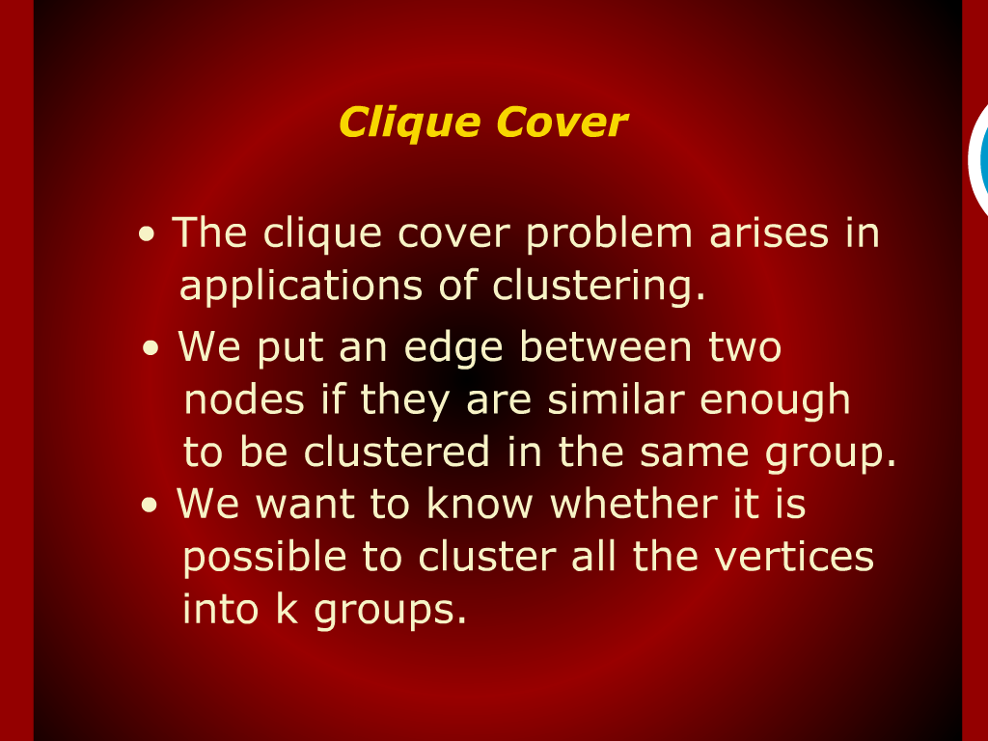
Clique Cover

Slide 7
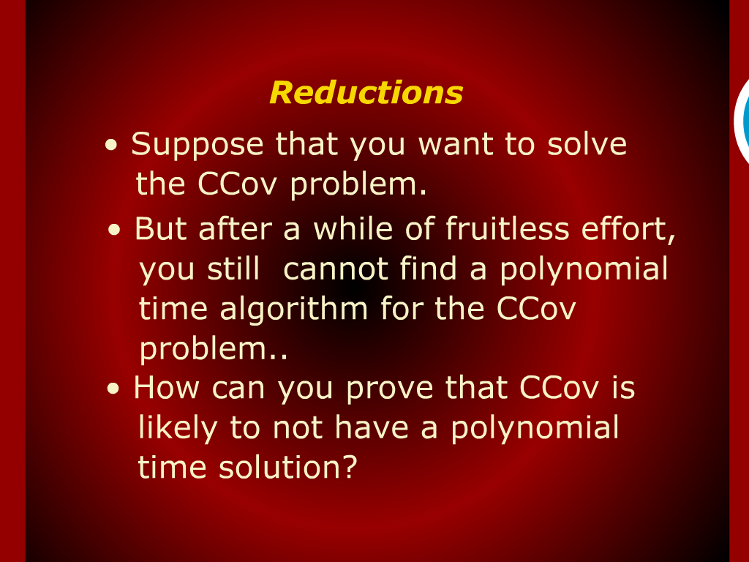
Reductions

Slide 8
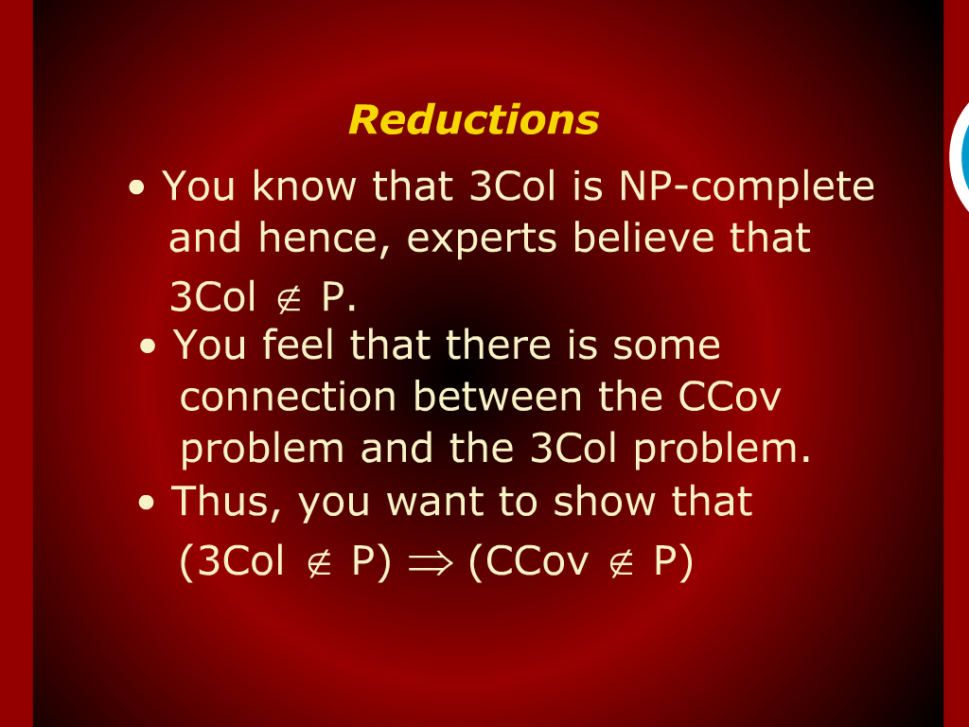
Reductions

Slide 9
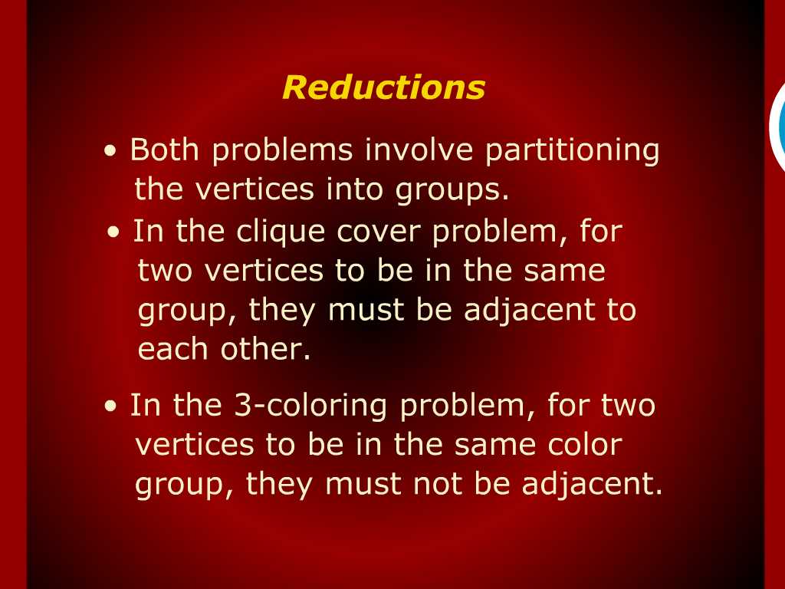
Reductions

Slide 10
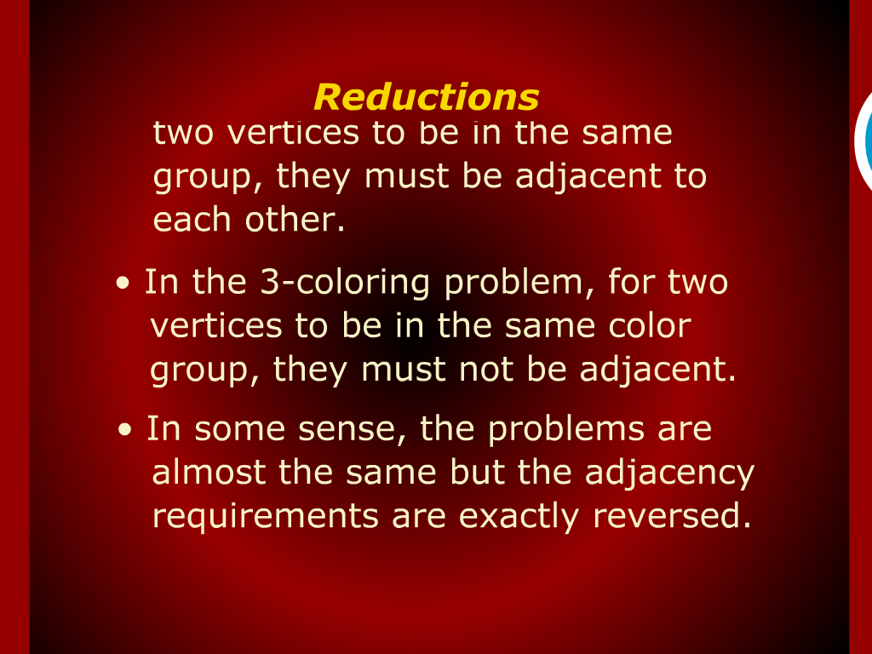
Reductions

Slide 11
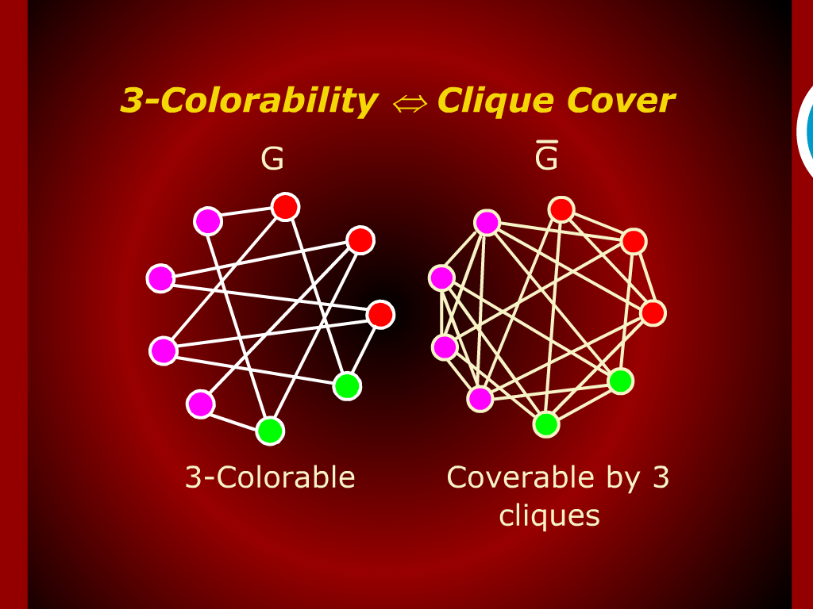
3-Colorability <=> Clique Cover

Slide 12
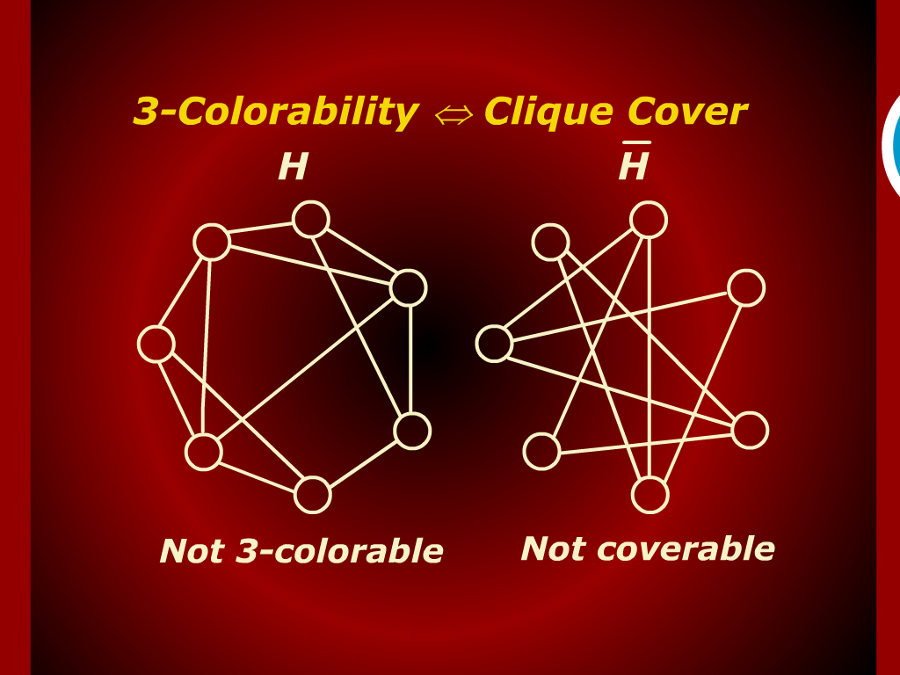
3-Colorability <=> Clique Cover

Slide 13
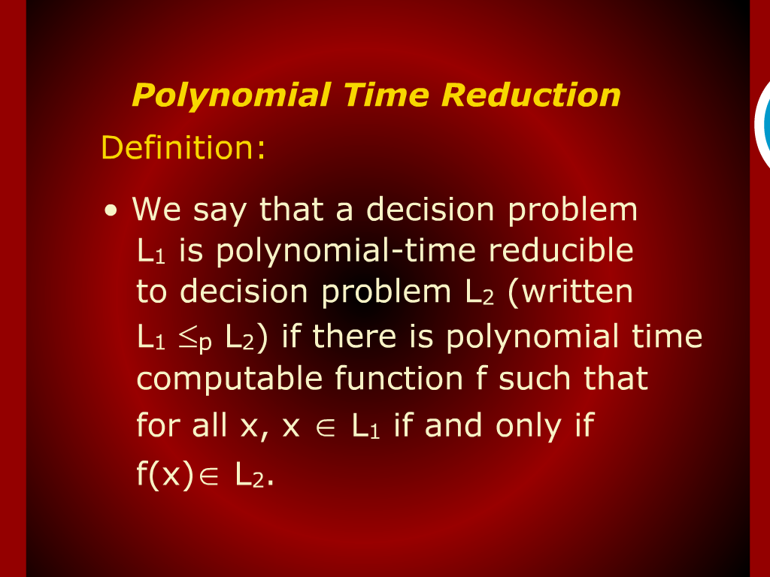
Polynomial Time Reduction

Slide 14
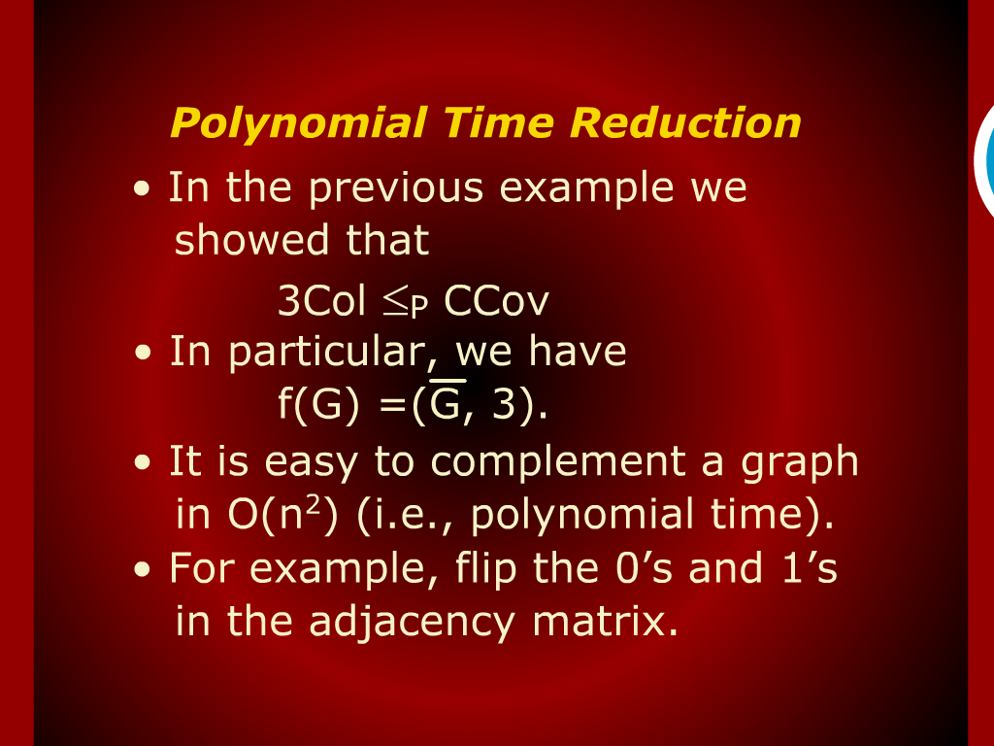
Polynomial Time Reduction

Slide 15
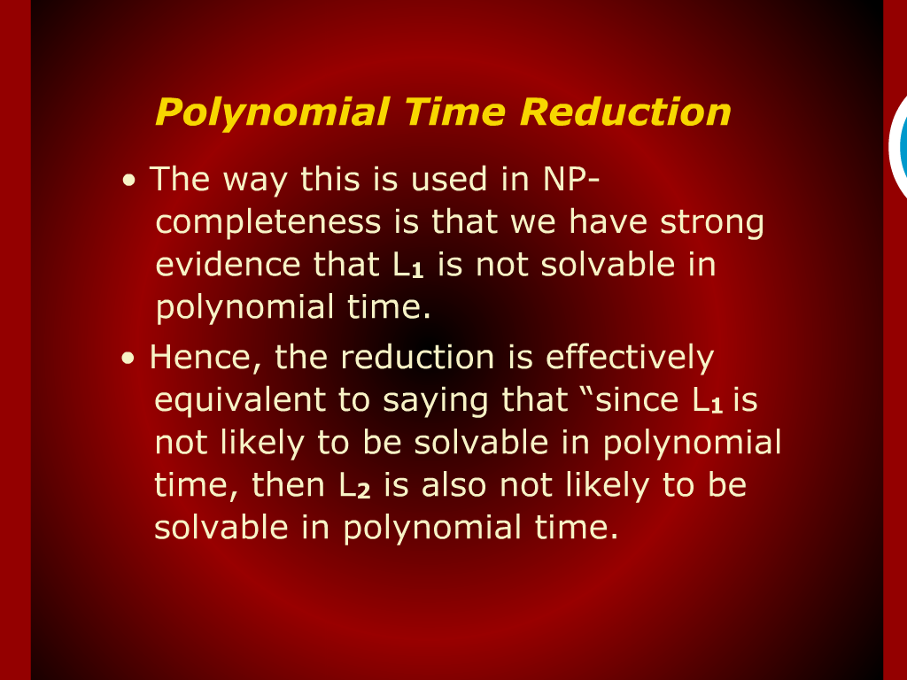
Polynomial Time Reduction

Slide 16
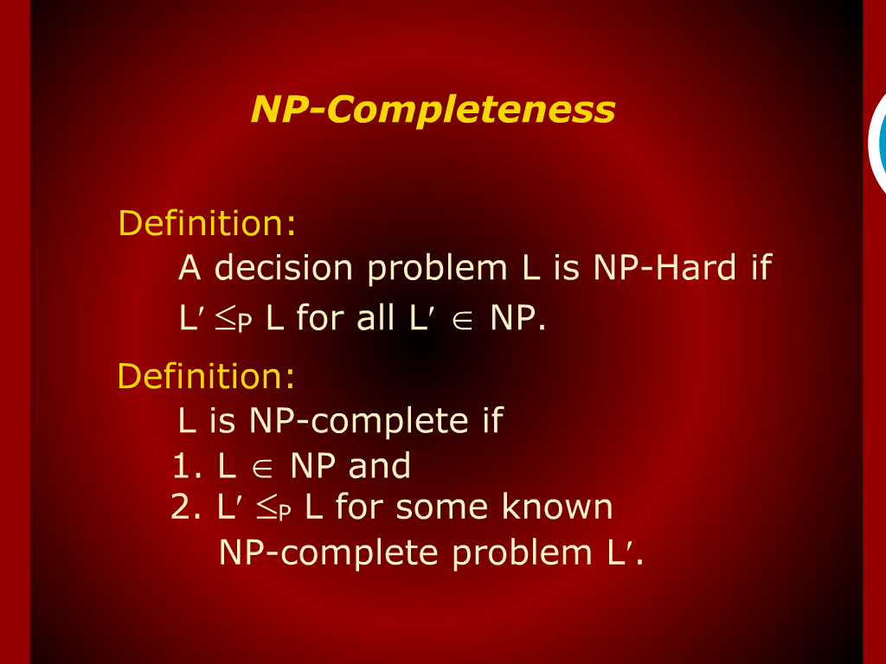
NP-Completeness

Slide 17
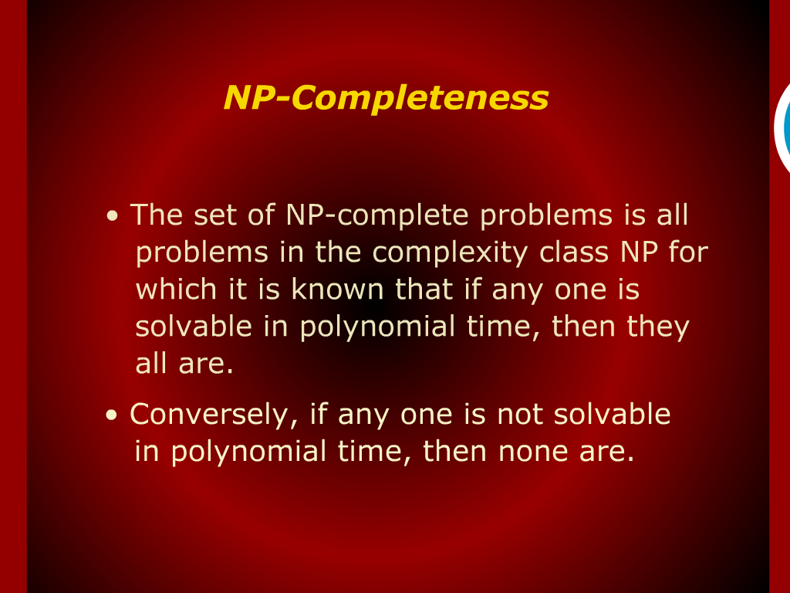
NP-Completeness

Slide 18
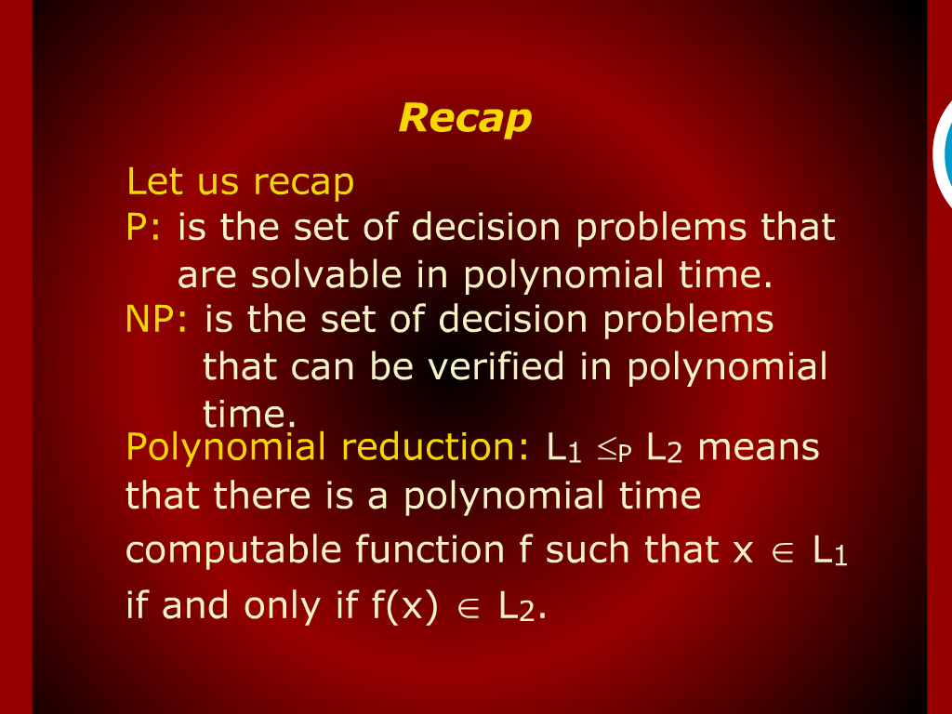
Recap

Slide 19
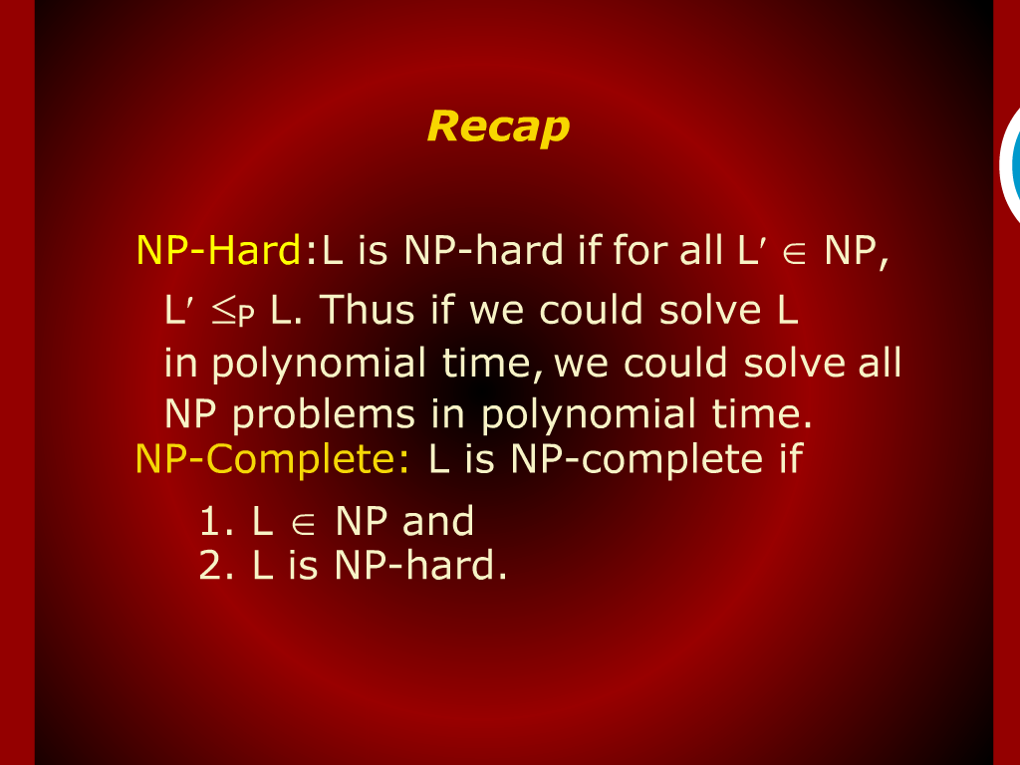
Recap

Slide 20
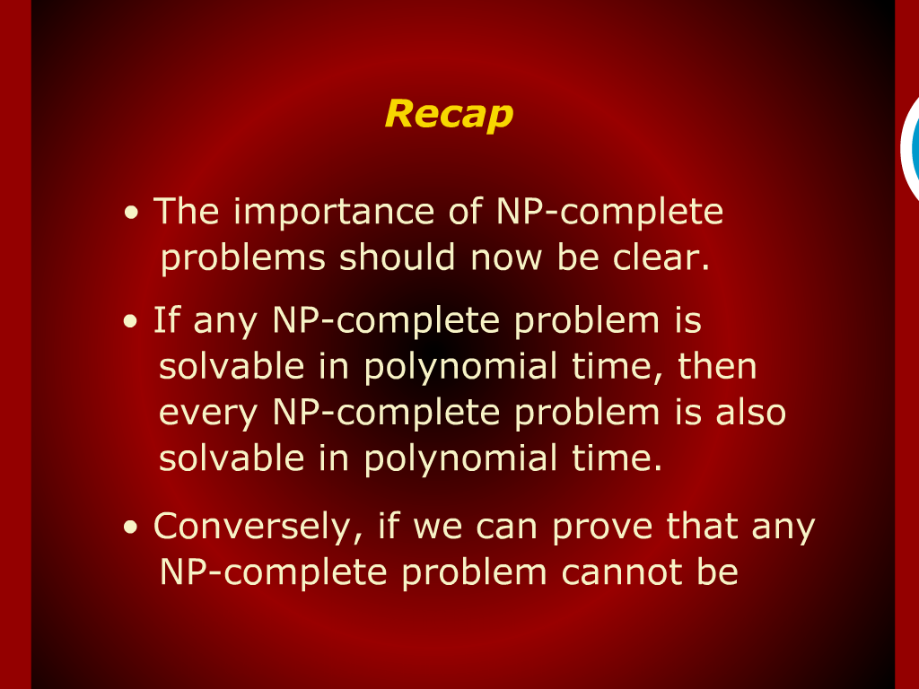
Recap

Slide 21
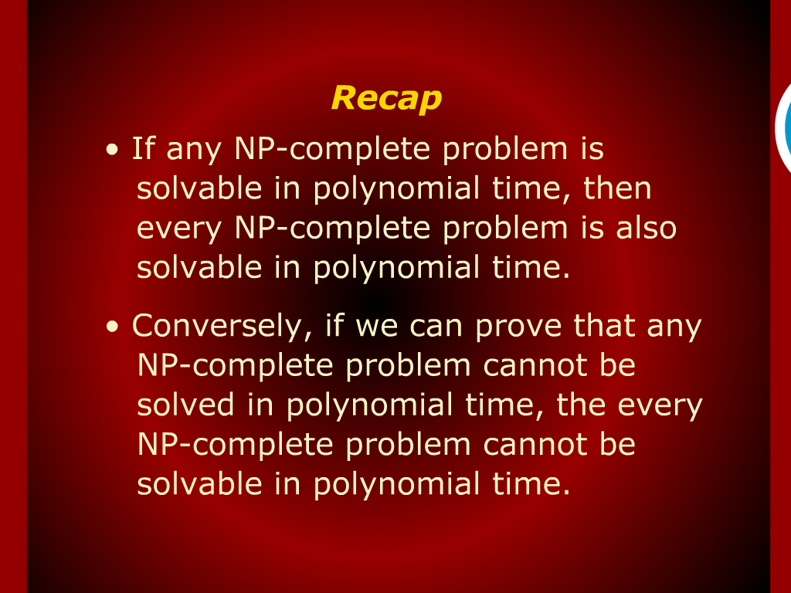
Recap

Slide 22
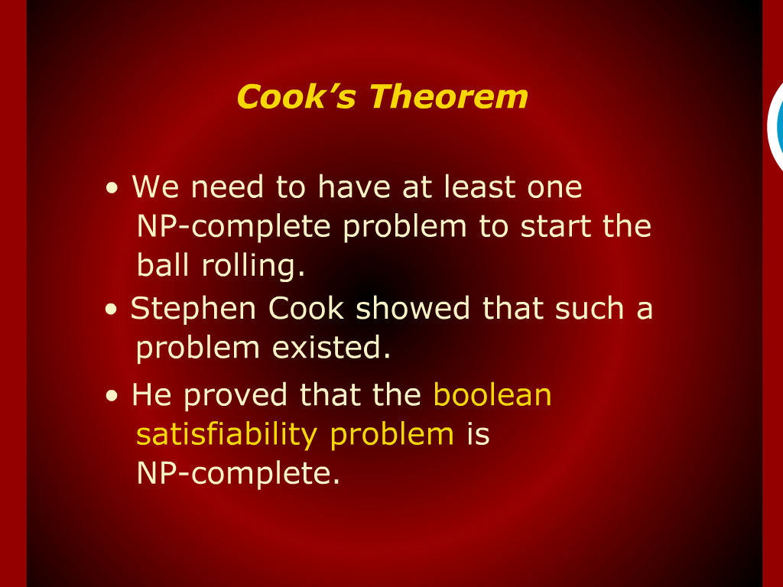
cook’s Theorem

Slide 23
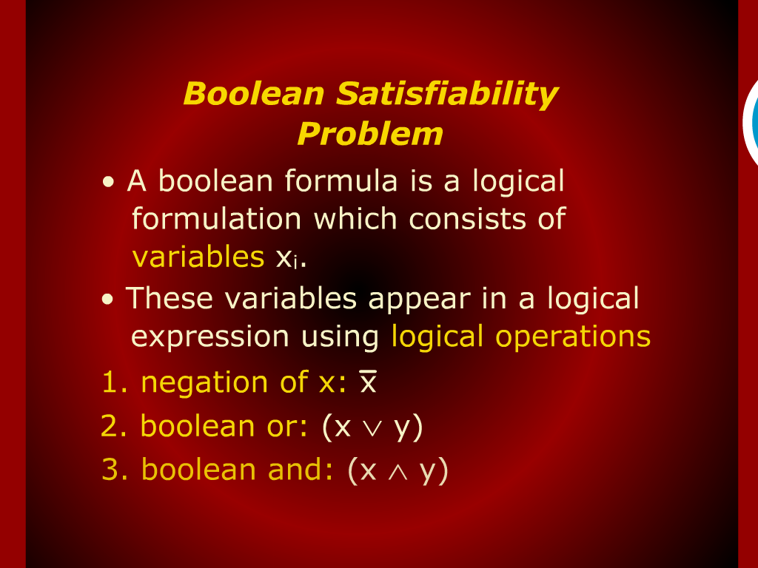
Boolean Satisfiability Problem

Slide 24
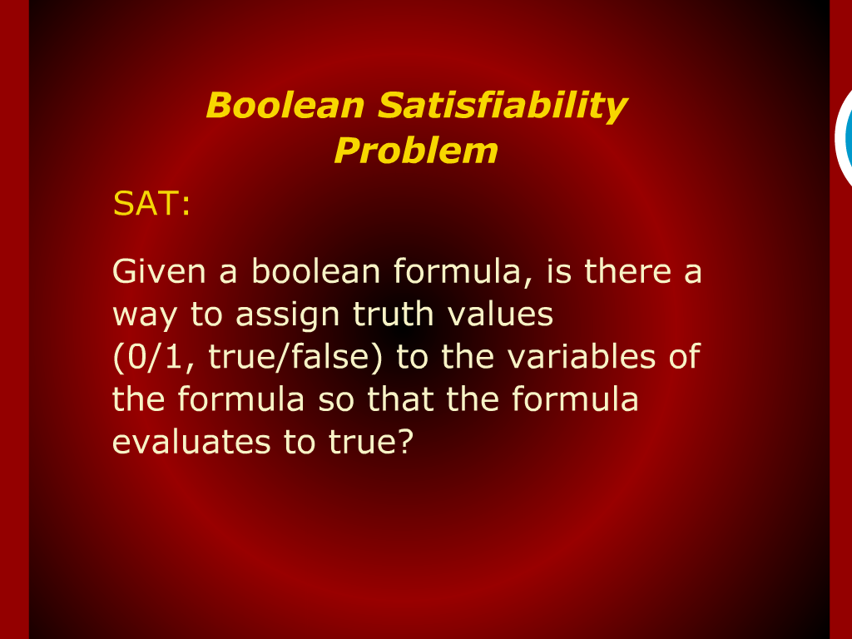
Boolean Satisfiability Problem

Slide 25
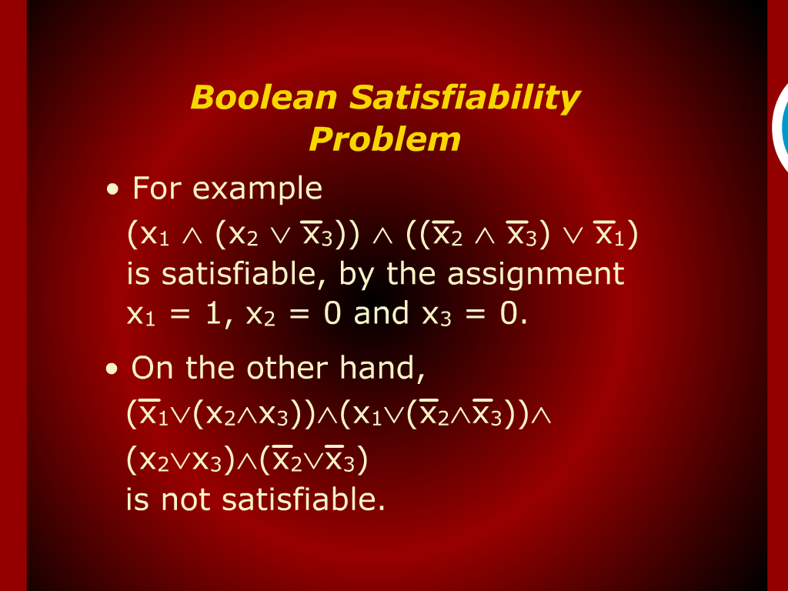
Boolean Satisfiability Problem

Slide 26
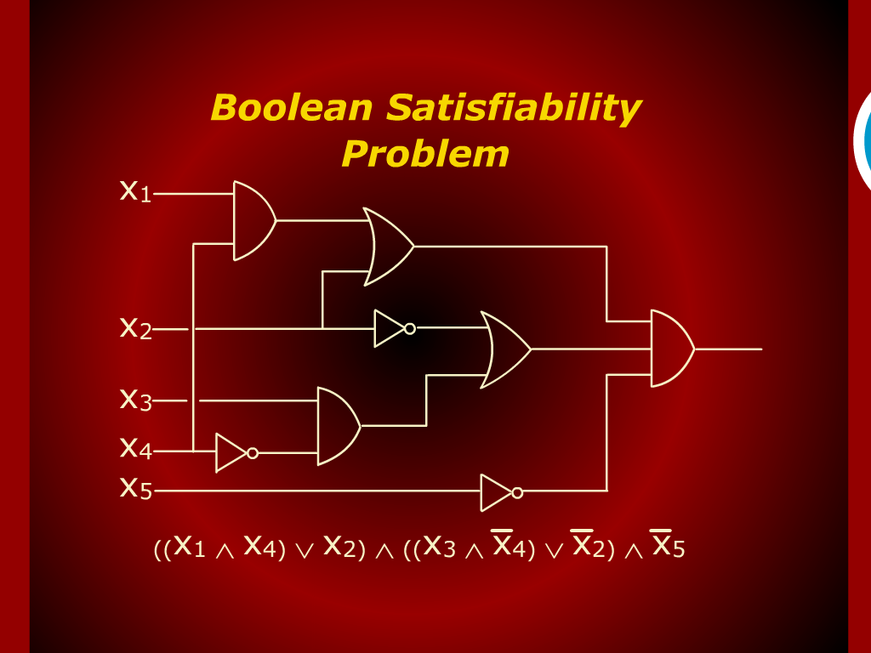
Boolean Satisfiability Problem

Slide 27
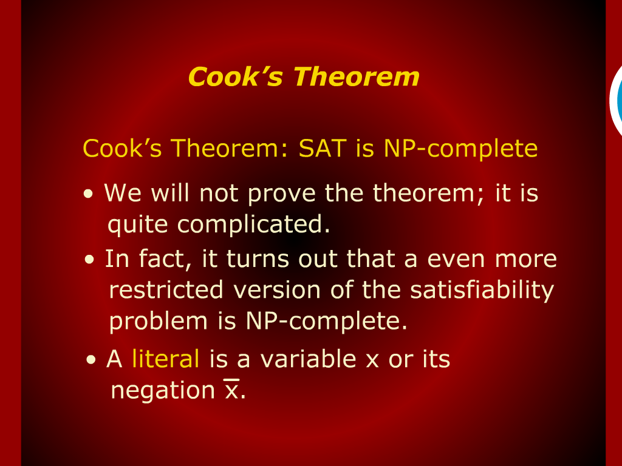
cook’s Theorem

Slide 28
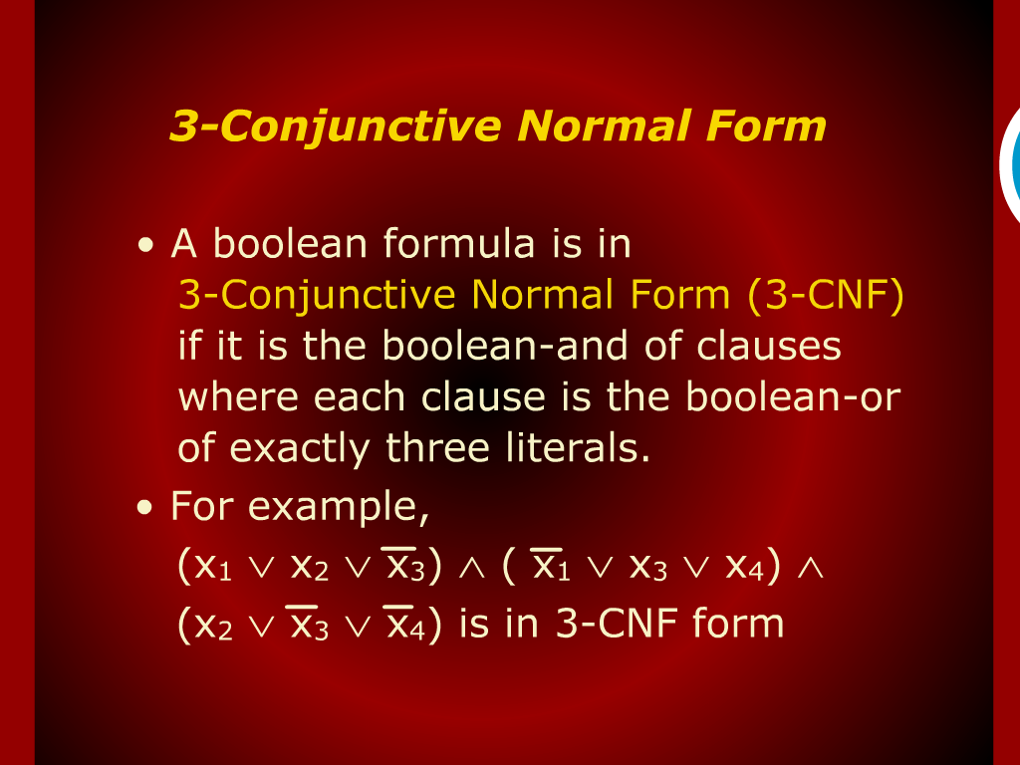
3-Conjuctive Normal Form

Slide 29
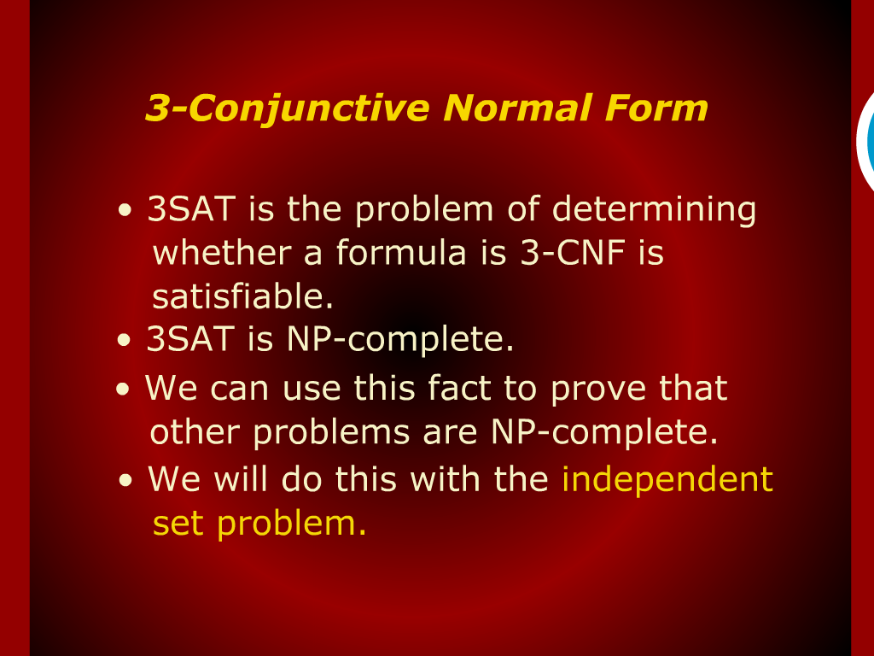
3-Conjuctive Normal Form

Slide 30
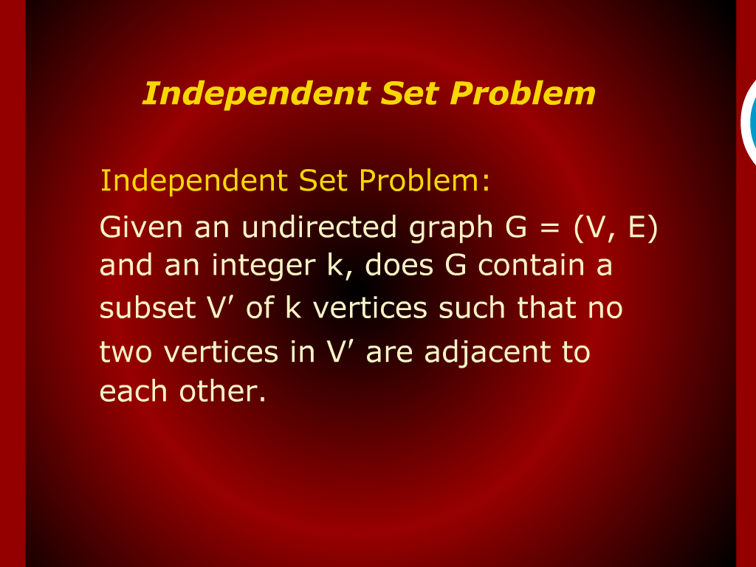
Independent Set Problem

Slide 31
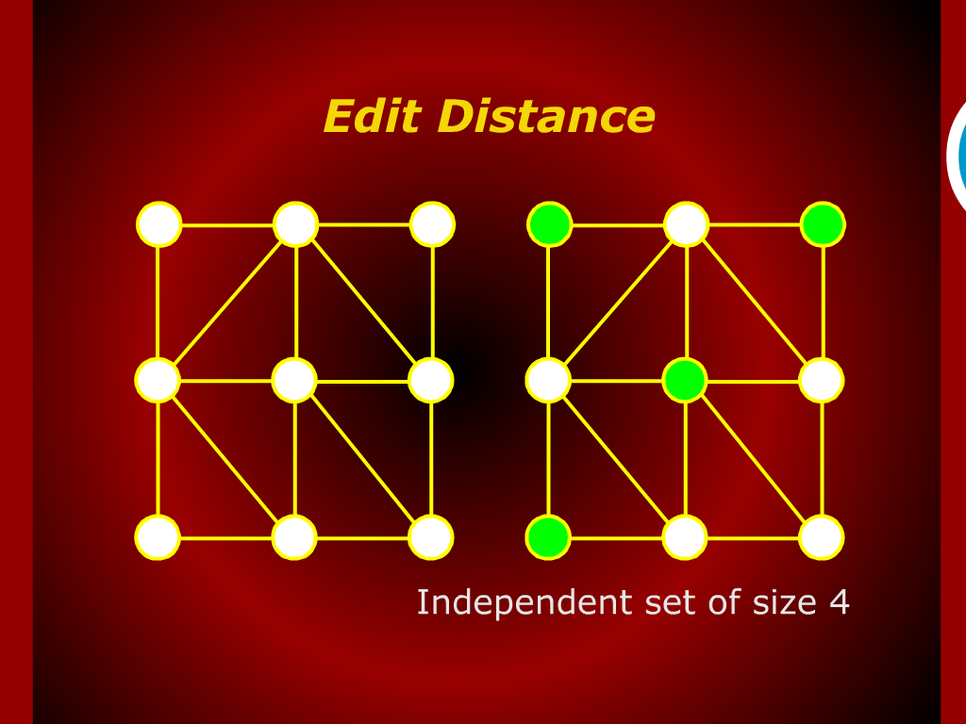
Edit Distance

Slide 32
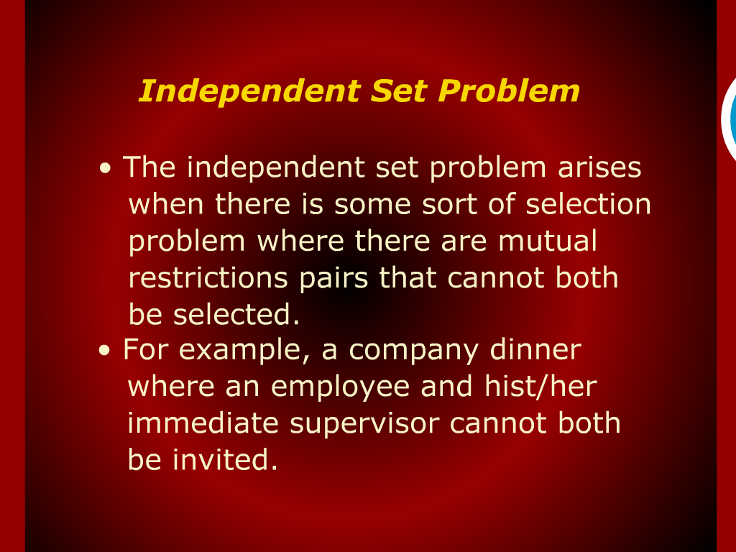
Independent Set Problem

Slide 33
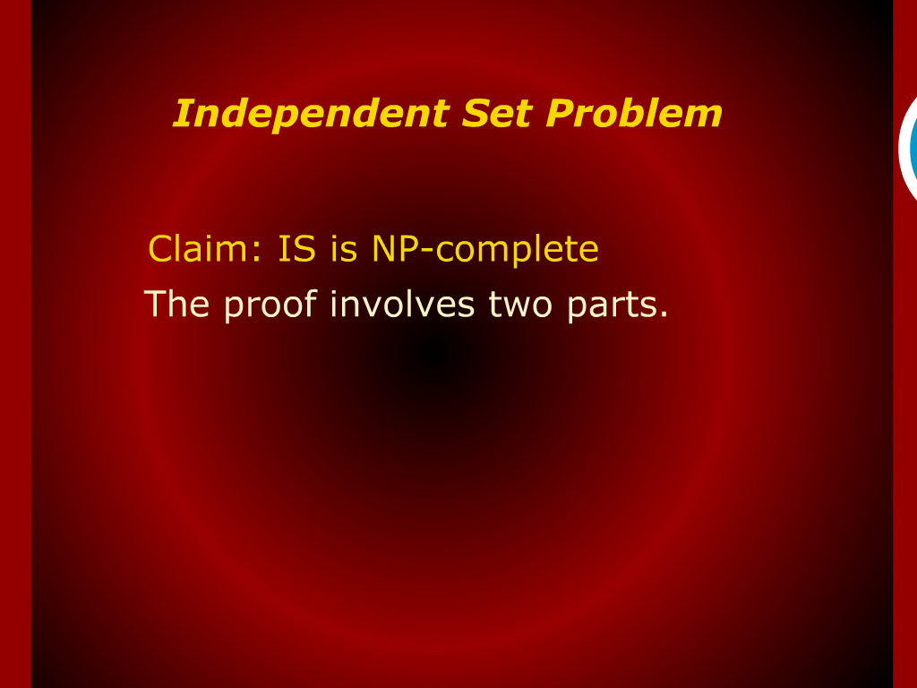
Independent Set Problem

Slide 34
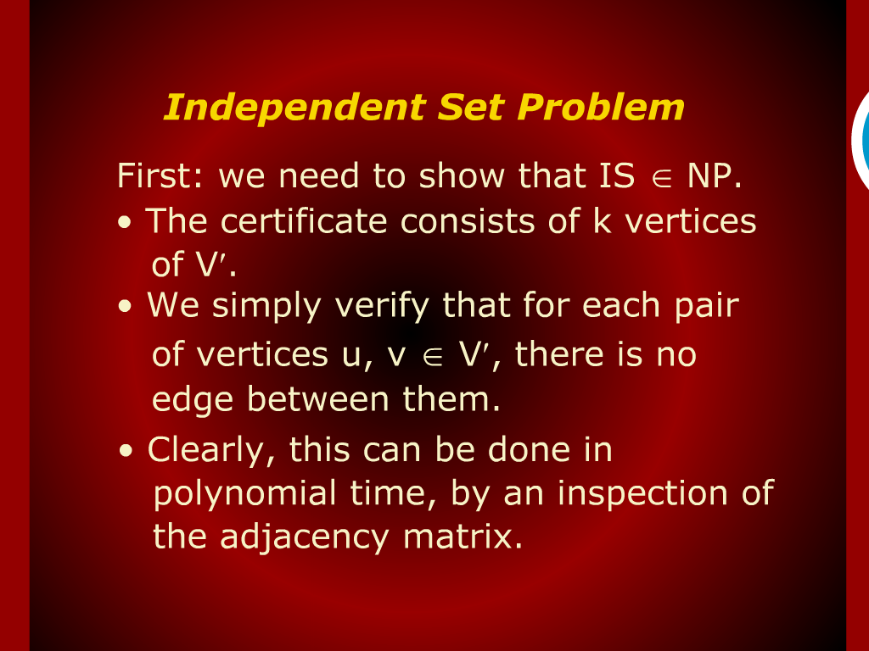
Independent Set Problem

Slide 35
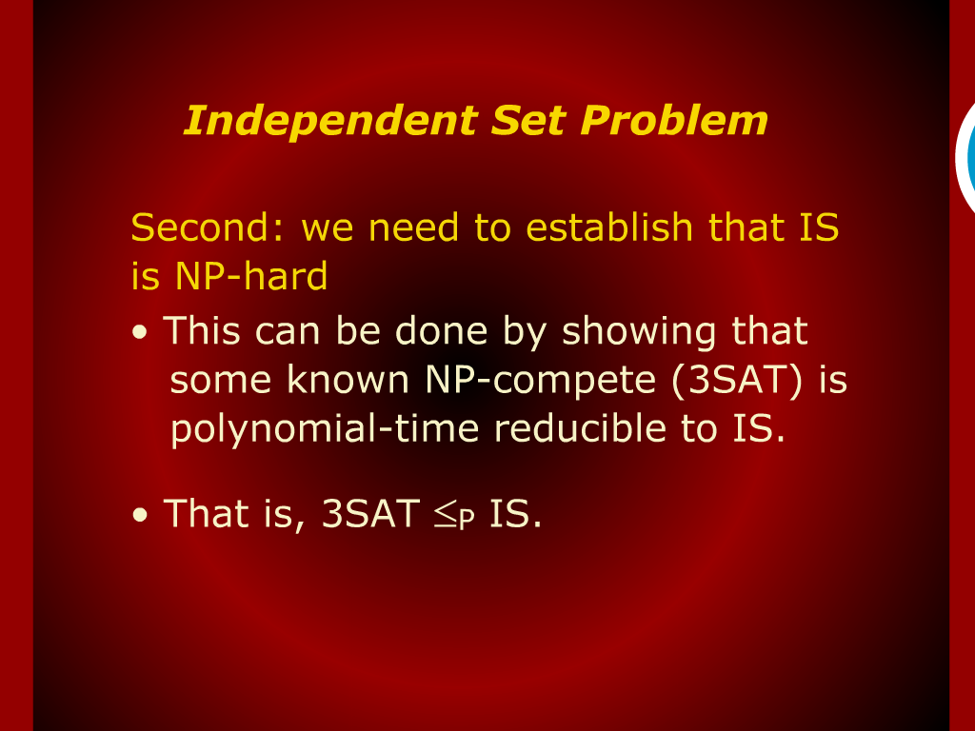
Independent Set Problem

Slide 36
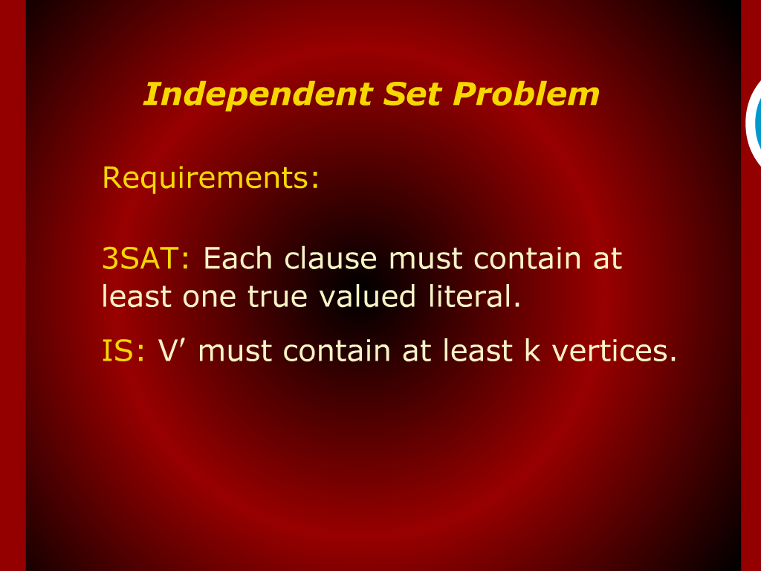
Independent Set Problem

Slide 37
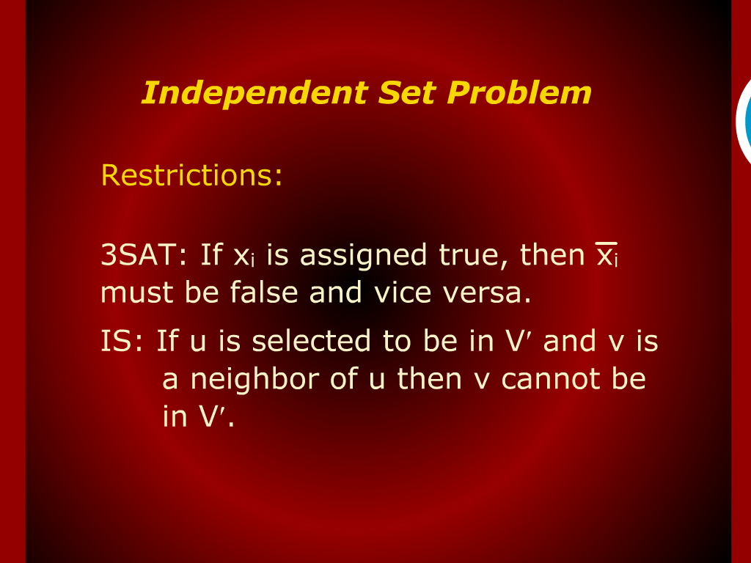
Independent Set Problem

Slide 38
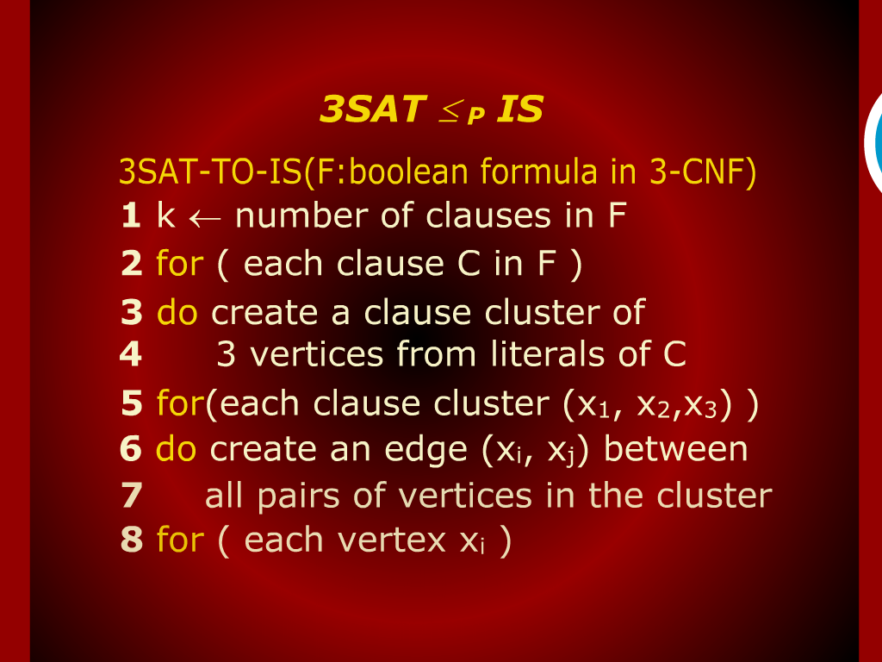
3SAT

Slide 39
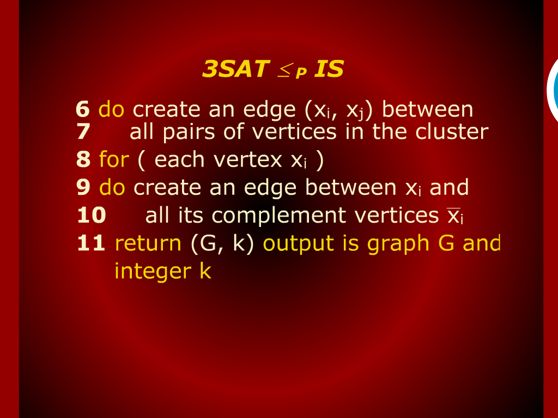
3SAT

Slide 40
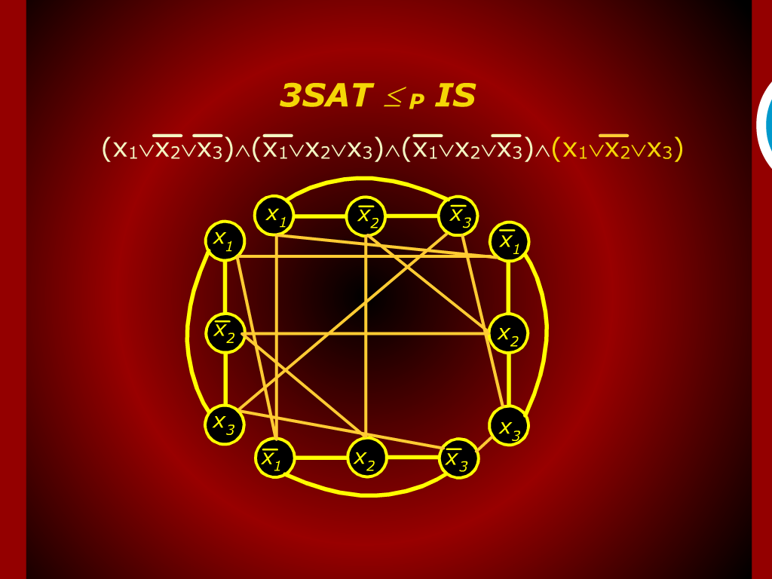
3SAT

Slide 41
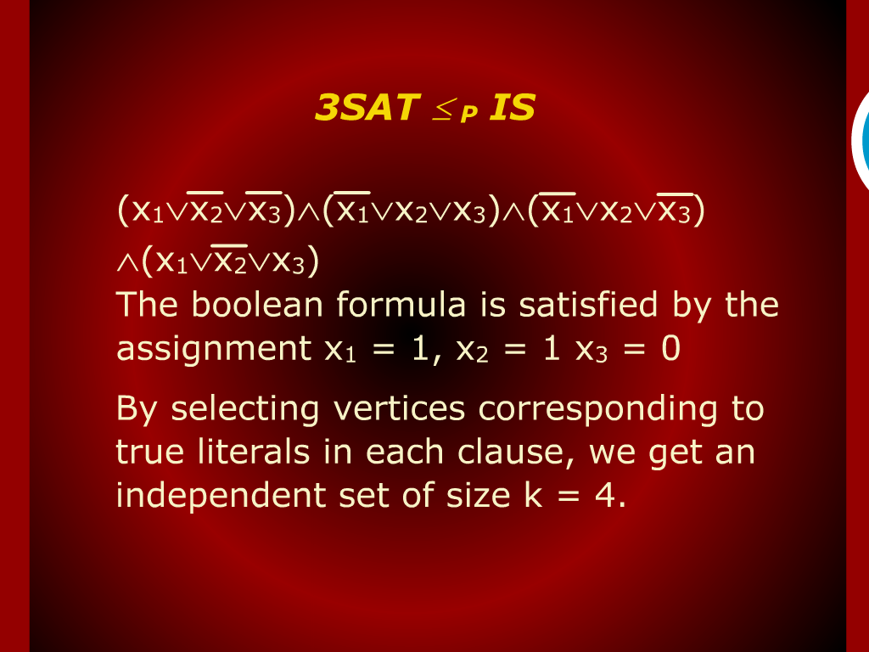
3SAT

Slide 42
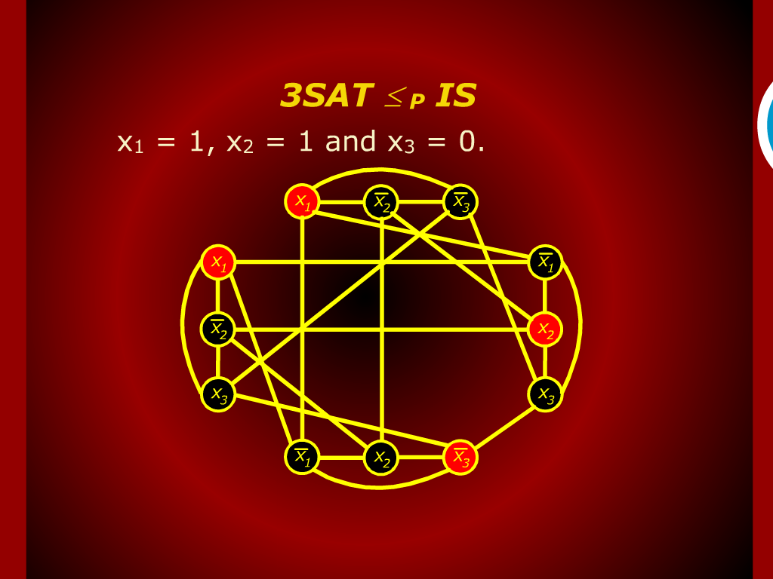
3SAT

Slide 43
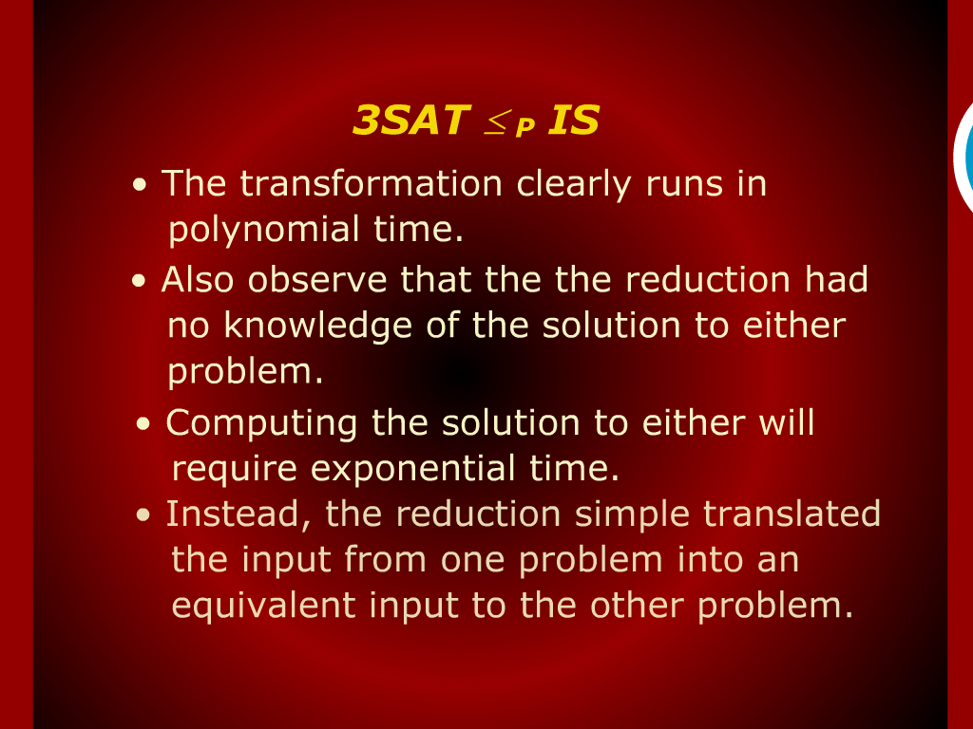
3SAT

Slide 44
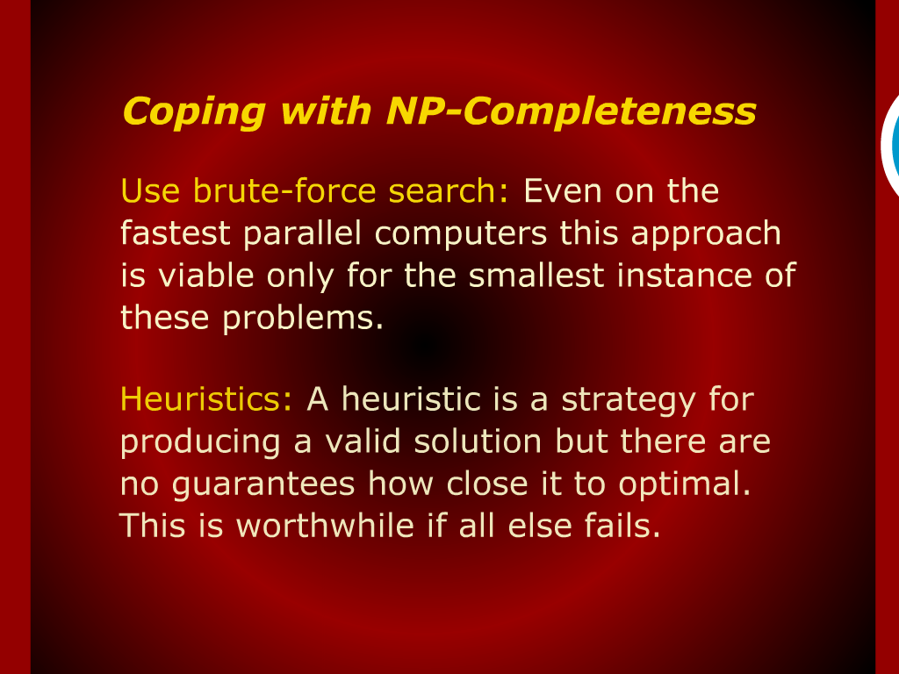
Coping with NP-Completeness

Slide 45
Graph Coloring

Slide 46
Boolean Satisflability problem

