Slide 1

Boolean vs Fuzzy
Strictly 0 or 1 output
Output varies between 0 and 1
Notes:
1) 12:24 Make the lines thicker

Slide 2
Boolean v/s Fuzzy
height
height
1.0
Tall (1.0)
1.0
Quite Tall (0.8)
Degree of
tallness
Degree of
tallness
0.0
Not Tall (0.0)
0.0
Not Very Tall (0.2)
Notes:
2) 13:33 Highlight the left side
3) 15:52 ~ 17:30 highlight the right side

Slide 3
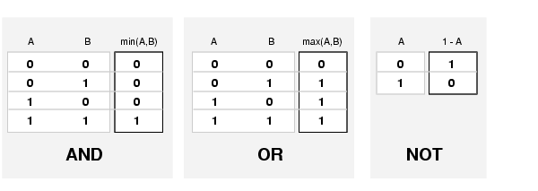
Logical Operators for Fuzzy
Notes:
4) 28:30 ~ 30:37 Highlight AND box
5) 30:38 ~ 31:28 Highlight OR box
6) 31:29 ~ 31:40 Highlight NOT box
7) ~ for sometime don’t highlight any of the boxes

Slide 4
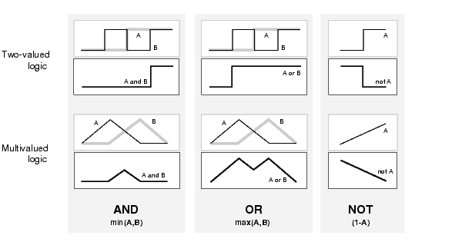
Logical Operators
Notes:
8) 33:10 ~ 38:33 Don’t highlight any box

Slide 5
Tall and Short
Membership value
[0-1]
Height
[0-7feet]
Tall
Short
Tall AND Short
(Medium)
Tall OR Short
(Extremes)
Notes:
9) 39:41
45:50 Highlight Medium Figure
49:00 ~ 50:00 Highlight Extremes Figure
Make the lines more bold

