Slide 1

Fuzzy System Structure
Fuzzy Inference Engine
Working Memory
Knowledge base (Rules and fuzzy sets)
Notes:
1) 31:04 ~ 32:04

Slide 2
Linguistic Variables
Linguistic Variables | Typical Values
Temperature | Hot, cold
Height | Short, medium, tall
Speed | Slow, fast
Notes:
2) 32:48 ~ 34:00
Maybe change the table first row’s text color to any suitable color of your choice
No animation within the table rows required

Slide 3
Terminology
Ahmad is young
  We are saying that the implied linguistic variable age has the linguistic value young
  In fuzzy expert systems we use linguistic variables in fuzzy rules
Notes:
2-b) ~ 34:00 ~ 35:25
No animation within the text required

Slide 4
Fuzzy Set Representation
Fuzzy set of tall people may be represented as follows:
Tall = (0/5, 0.25/5.5, 0.7/6, 1/6.5, 1/7)
  Numerator: membership value
  Denominator: actual value of the variable
Notes:
3) ~ 35:25 ~ 38:20
No animation required within the text

Slide 5
Fuzzy Rules
If x is A then y is B
premise or
antecedent
conclusion or
consequent
If hotel service is good then tip is average
If Speed is slow Then make the acceleration high
If Temperature is low AND Pressure is medium Then make the speed very slow
Notes:
4) 41:17 continues with the next two slides

Slide 6
Fuzzy Rules…
Antecedents can have multiple parts
  If wind is mild and racquets are good then playing badminton is fun
  In this case all parts of the antecedent are resolved simultaneously and resolved to a single number using logical operators
Notes:
4-b)

Slide 7
Fuzzy Rules…
The consequent can have multiple parts as well
  if temperature is cold then hot water valve is open and cold water valve is shut
All consequents are affected equally by the result of the antecedent
Notes:
4-c) from last slides to ~ 44:50

Slide 8
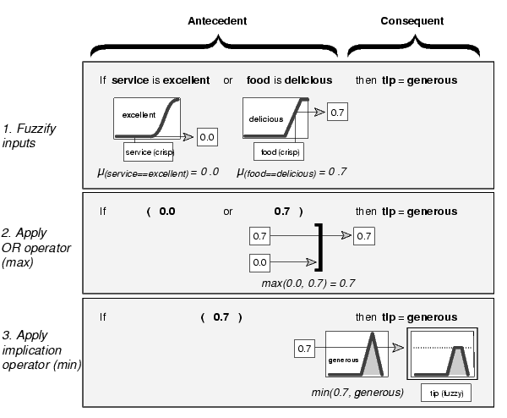
Notes:
5) ~ 44:50
~ 48:48 Highlight 1. Fuzzify inputs and the entire rectangular box in front of it
~ 53:00 Highlight 2. Apply OR operator (max) and the entire rectangular box in front of it
~ 53:20 Highlight 3. Apply implication operator and the entire rectangular box in front of it. (Remove (min) from diagram)

Slide 9
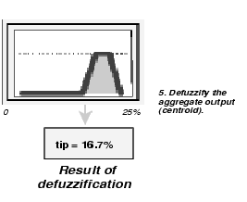
Defuzzify
Notes:
5-b) 53:59 ~ 54:30
Make the diagram more neat.

