Slide 1

Course Outline
Introduction
Expert Systems
Advanced
Topics
Problem
Solving
Uncertainty
Conclusion
Genetic
Learning
Algorithms
Knowledge
Representation
Planning
& Reasoning
Notes:
Get rid of the green oval

Slide 2
The AI Cycle
LEARNING
PERCEPTION
KNOWLEDGE
REPRESENTATION (KR)
REASONING
WITH UNCERTAINTY
PLANNING
EXECUTION

Slide 3
Systems that THINK Like Humans
“[The automation of] activities that we associate with human thinking, activities such as decision making, problem solving, learning …” (Bellman, 1978)

Slide 4
Systems that ACT Like Humans
“The study of how to make computers do things at which, at the moment, people are better” (Rich and Knight, 1991)

Slide 5
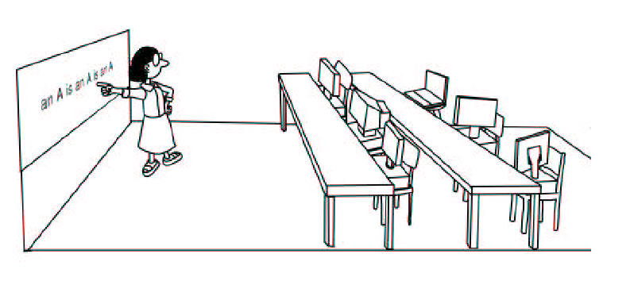
Machine Learning?
Notes:
You have to make the picture yourself. Copyright problems otherwise ☺

Slide 6
Behind the Picture
What is Machine Learning
History of Machine Learning
Applications of Machine Learning
Overview of Learning Strategies
Problem Solving using Learning Paradigm

Slide 7
Multidisciplinary Aspects of Machine Learning
Statistics
Pattern Recognition
Visualization
Robotics
Control

Slide 8
What is Learning?
Learning denotes changes in the system that are adaptive in the sense that they enable the system to do the same task or tasks drawn from the same population more effectively the next time (Simon, 1983).
A computer program learns if it improves its performance at some task through experience (Mitchell, 1997).

Slide 9
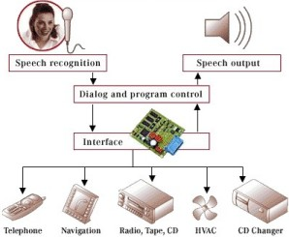
Intelligent Cars
Notes:
Kindly redo the picture, make sure there are no spelling mistakes

