Slide 1
Conjunctive vs Disjuncvtive
BP
BP
H
0
0
1
H
1
1
1
N
0
0
1
N
0
0
1
L
0
0
1
L
0
0
1
L
N
H
T
L
N
H
T
Conjuntive Rule (ANDing)
h = < T=H AND BP = ? >
Disjuntive Rule (ORing)
h = < T=H AND BP = ?
OR
T=? AND BP = H >

Slide 2
Decision Trees
Decision tree gives us disjunctions of conjunctions (OR’s of AND’s), that is, they have the form:
  (A AND B) OR (C AND D)
In tree representation:
A
C
B
D

Slide 3
Decision Trees
A decision tree is a tree where:
  each non-leaf node has associated with it an attribute (feature)
  each leaf node has associated with it a classification (+ or -)
  each arc has associated with it one of the possible values of the attribute at the node from which the arc is directed
T
Low
High
Normal
BP
+
BP
Low
High
Low
High
-
+
-
+

Slide 4
ID3 Algorithm
An algorithm for constructing decision tree
First step of ID3 is to find the root node
  It uses a special GAIN function for that
  Attribute having the max gain is chosen
The rest of the attributes are evaluated for the next slots

Slide 5
Entropy
Entropy(S) = - p₊log₂ p₊ - p₋log₂ p₋
S is the sample space, or Data set D
p₊ is the proportion of positive examples in S
p₋ is the proportion of negative examples in S

Slide 6
Entropy
Suppose S is a collection of:
  14 examples of some Boolean concept
  9 positive examples
  5 negative examples
Entropy(S) = - (9/14)log₂ (9/14) - (5/14)log₂ (5/14)
Entropy(S) = 0.940

Slide 7
Entropy
Order in the data:
  If all the members are of the same class in S
    if all the members are positive
    p₊=1 and p₋ = 0 and so:
      Entropy(S) = - 1log₂ 1 - 0log₂ 0
      = - 1 (0) - 0 [log₂ 1 = 0, also 0log₂ 0 = 0]
      = 0

Slide 8
Entropy
Disorder in the data:
  If all the members of S are equally distributed, half are + and half -
    p₊= 0.5 and p₋ = 0.5 and so:
      Entropy(S) = - 0.5log₂ 0.5 – 0.5log₂ 0.5
      = - 0.5 (-1) – 0.5 (-1) [log₂ 0.5 = -1]
      = 0.5 + 0.5
      = 1

Slide 9
Information Gain
Given entropy as a measure of the order in a collection of training examples
We now define a measure of the effectiveness of an attribute in classifying the training data
Information gain, is simply the expected reduction in entropy caused by partitioning the examples according to this attribute

Slide 10
ID3
D
Temp.
BP
Allergy
SICK
d₁
High
High
No
YES
d₂
Normal
Normal
Yes
YES
d₃
Low
Normal
Yes
NO
d₄
Normal
Normal
Yes
NO
d₅
Low
High
No
NO
For simplicity:
Temperature = A, High = a₁, Normal = a₂, Low = a₃
BP = B, High = b₁, Normal = b₂
Allergy = E, Yes = e₁, No = e₂
D
A
B
E
C
d₁
a₁
b₁
e₂
YES
d₂
a₂
b₂
e₁
YES
d₃
a₃
b₂
e₁
NO
d₄
a₂
b₂
e₁
NO
d₅
a₃
b₁
e₂
NO

Slide 11
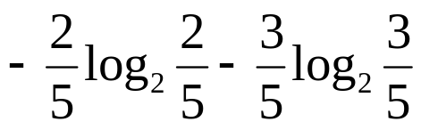
ID3
First step is to calculate the entropy of the entire set S. We know:
E(S) = - p₊log₂ p₊ - p₋log₂ p₋
=
= 0.97

Slide 12
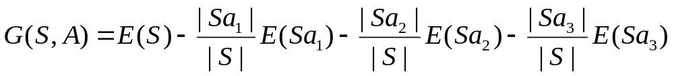
ID3
where G(S,A) is the gain for A, |Sa₁| is the number of times attribute A takes the value a₁. E(Sa₁) is the entropy of a₁, which will be calculated by observing the proportion of total population of a₁ and the number of times the C is YES or NO within these observation containing a₁ for the value of attribute A
S
A
B
E
C
d₁
a₁
b₁
e₂
YES
d₂
a₂
b₂
e₁
YES
d₃
a₃
b₂
e₁
NO
d₄
a₂
b₂
e₁
NO
d₅
a₃
b₁
e₂
NO
|S| = 5 |Sa₁| = 1 |Sa₂| = 2 |Sa₃| = 2

Slide 13
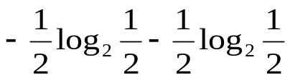
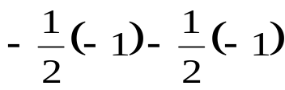
ID3
S
A
B
E
C
d₁
a₁
b₁
e₂
YES
d₂
a₂
b₂
e₁
YES
d₃
a₃
b₂
e₁
NO
d₄
a₂
b₂
e₁
NO
d₅
a₃
b₁
e₂
NO
|S| = 5 |Sa₁| = 1 |Sa₂| = 2 |Sa₃| = 2
Entropy = - p+log2 p+ - p-log2 p-
E(Sa₁) = -1log₂1 - 0log₂0 = 0
E(Sa₂) =
=
= 1
E(Sa₃) = -0log₂0 - 1log₂1 = 0

Slide 14
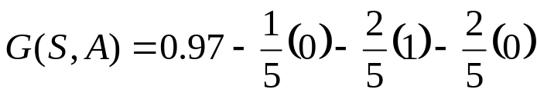
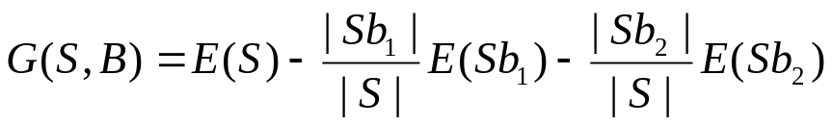
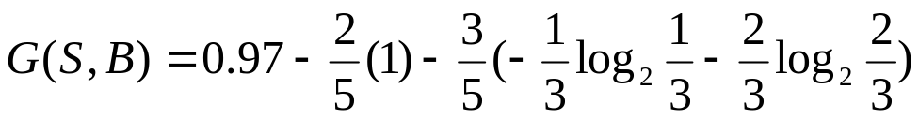
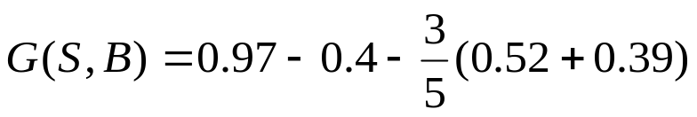
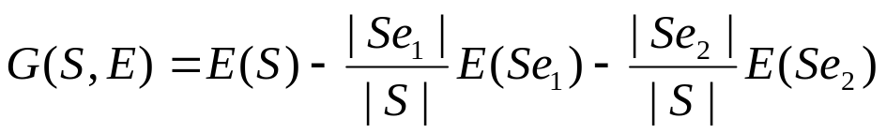
ID3
= 0.57
Similarly for B, now since there are only two values observable for the attribute B:
= 0.02
Similarly for E:
= 0.02

Slide 15
ID3
A
a₁
a₂
a₃
YES
S’ = [d₂, d₄]
NO
S
A
B
E
C
d₁
a₁
b₁
e₂
YES
d₂
a₂
b₂
e₁
YES
d₃
a₃
b₂
e₁
NO
d₄
a₂
b₂
e₂
NO
d₅
a₃
b₁
e₂
NO
S’
A
B
E
C
d₂
a₂
b₂
e₁
YES
d₄
a₂
b₂
e₂
NO

Slide 16
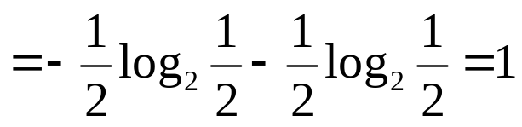
ID3
S’
A
B
E
C
d₂
a₂
b₂
e₁
YES
d₄
a₂
b₂
e₂
NO
E(S’) = - p₊log₂ p₊ - p₋log₂ p₋

Slide 17
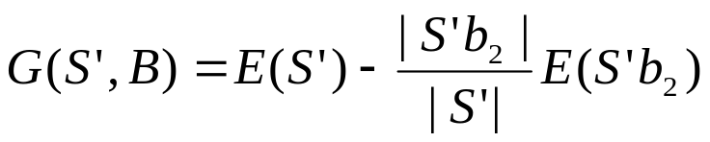
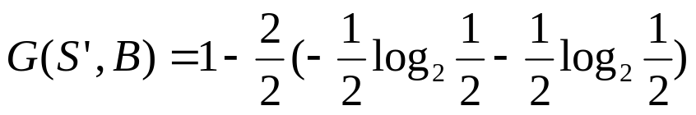
ID3
S’
A
B
E
C
d₂
a₂
b₂
e₁
YES
d₄
a₂
b₂
e₂
NO
|S’| = 2 |S’b₂| = 2
= 1 - 1 = 0

Slide 18
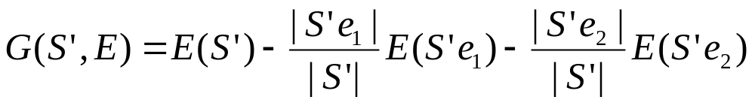
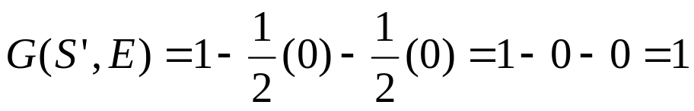
ID3
S’
A
B
E
C
d₂
a₂
b₂
e₁
YES
d₄
a₂
b₂
e₂
NO
Similarly for E:
|S’| = 2
|S’e₁| = 1 [since there is only one observation of e₁ which outputs a YES]
E(S’e₁) = -1log₂1 - 0log₂0 = 0 [since log 1 = 0]
|S’e₂| = 1 [since there is only one observation of e₂ which outputs a NO]
E(S’e₂) = -0log₂0 - 1log₂1 = 0 [since log 1 = 0]
Hence:

Slide 19
ID3
A
a₁
a₂
a₃
YES
E
NO
e₁
e₂
YES
NO
S
A
B
E
C
d₁
a₁
b₁
e₂
YES
d₂
a₂
b₂
e₁
YES
d₃
a₃
b₂
e₁
NO
d₄
a₂
b₂
e₁
NO
d₅
a₃
b₁
e₂
NO

Slide 20
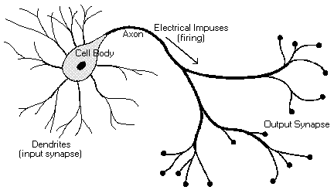
Biological Neuron
Cell body
Dendrites
Axon
Impulses
Synapses
Notes:
Please redo the picture, make sure the spellings are correct

Slide 21
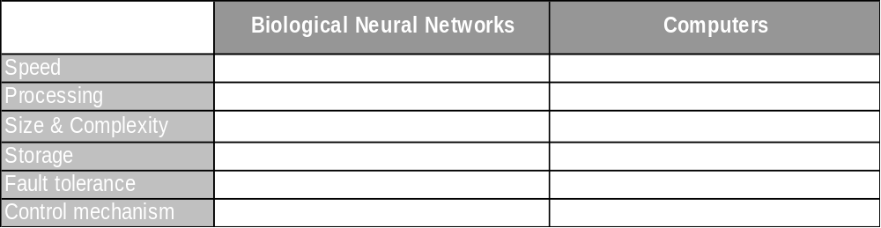
Performance Comparison

Slide 22
Single Perceptron / Neuron
Inputs
Weights
Bias
Outputs
Threshold function
Input₁
weight₁
Input₂
Threshold Function
Output
weight₂
Bias
IF (Input₁ x weight₁) + (Input₂ x weight₂) + (Bias) satisfies Threshold value
Then Output = 1
Else Output = 0

Slide 23
Single Perceptron is a a straight Line
x
a
y
Threshold Function
Output
b
c
ax + by + c = 0

Slide 24
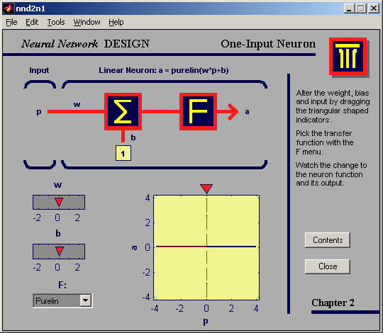
Response of changing Bias
Notes:
For this and the next few slides, please copy and paste these pictures as they are. Don’t change them, as they are the snapshots of a software.

Slide 25

Response of changing Bias

Slide 26
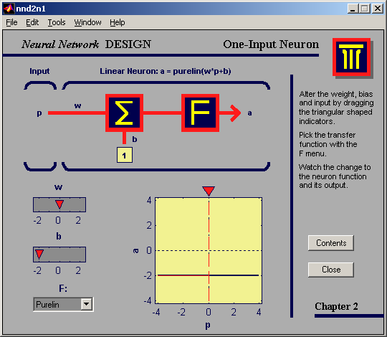
Response of changing Bias

Slide 27
Response of changing Weights

Slide 28
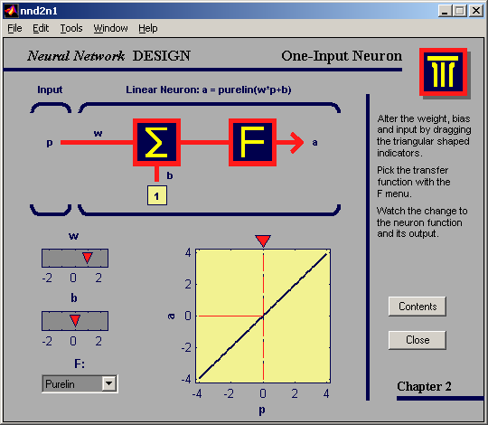
Response of changing Weights

Slide 29
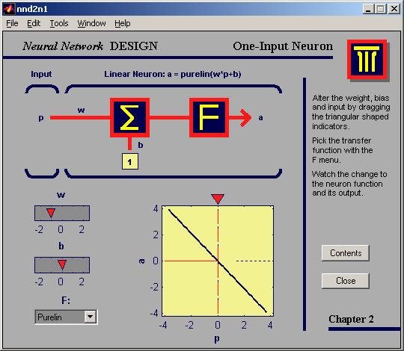
Response of changing Weights

Slide 30
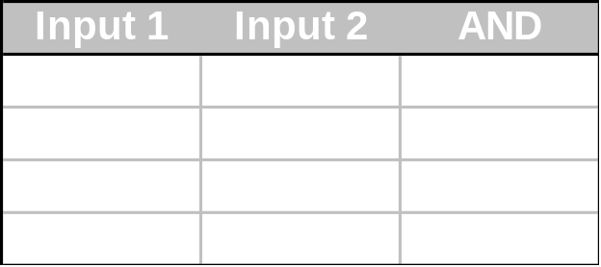
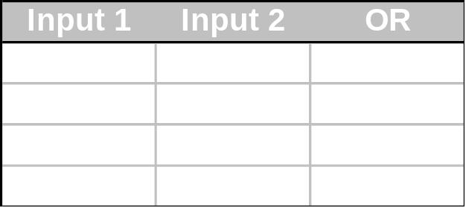
Linearly separable problems
(1,0)
(1,1)
Input 2
(0,0)
Input 1
(0,1)
Notes:
Please see the animation required, and replicate it as it is

Slide 31
Linearly separable problems
Linearly Separable
Linearly Non Separable /
Non linear decision region
Notes:
Please see the animation required, and replicate it as it is

Slide 32
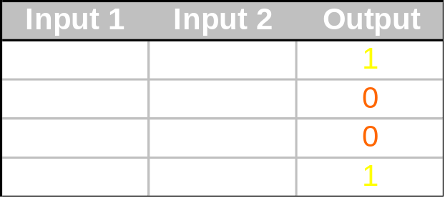
XOR problem
(1,0)
(1,1)
Input 2
(0,0)
Input 1
(0,1)
Can you draw one line which separates the ones from zeros?

Slide 33
Multiple Layer Perceptrons
We need two lines:
(1,0)
(1,1)
Input 2
(0,0)
Input 1
(0,1)

