Slide 1

Entropy
Entropy(S) = - p₊log₂ p₊ - p₋log₂ p₋
S is the sample space, or Data set D
p₊ is the proportion of positive examples in S
p₋ is the proportion of negative examples in S

Slide 2
Entropy
Suppose S is a collection of:
  14 examples of some Boolean concept
  9 positive examples
  5 negative examples
Entropy(S) = - (9/14)log₂ (9/14) - (5/14)log₂ (5/14)
Entropy(S) = 0.940

Slide 3
Entropy
Order in the data:
  If all the members are of the same class in S
    if all the members are positive
    p₊=1 and p₋ = 0 and so:
      Entropy(S) = - 1log₂ 1 - 0log₂ 0
      = - 1 (0) - 0 [log₂ 1 = 0, also 0log₂ 0 = 0]
      = 0

Slide 4
Entropy
Disorder in the data:
  If all the members of S are equally distributed, half are + and half -
    p₊= 0.5 and p₋ = 0.5 and so:
      Entropy(S) = - 0.5log₂ 0.5 – 0.5log₂ 0.5
      = - 0.5 (-1) – 0.5 (-1) [log₂ 0.5 = -1]
      = 0.5 + 0.5
      = 1

Slide 5
Information Gain
Given entropy as a measure of the order in a collection of training examples
We now define a measure of the effectiveness of an attribute in classifying the training data
Information gain, is simply the expected reduction in entropy caused by partitioning the examples according to this attribute

Slide 6
ID3
D
Temp.
BP
Allergy
SICK
d₁
High
High
No
YES
d₂
Normal
Normal
Yes
YES
d₃
Low
Normal
Yes
NO
d₄
Normal
Normal
Yes
NO
d₅
Low
High
No
NO
For simplicity:
Temperature = A, High = a₁, Normal = a₂, Low = a₃
BP = B, High = b₁, Normal = b₂
Allergy = E, Yes = e₁, No = e₂
D
A
B
E
C
d₁
a₁
b₁
e₂
YES
d₂
a₂
b₂
e₁
YES
d₃
a₃
b₂
e₁
NO
d₄
a₂
b₂
e₁
NO
d₅
a₃
b₁
e₂
NO

Slide 7
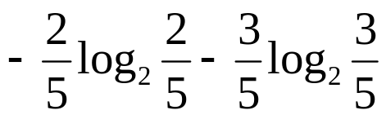
ID3
First step is to calculate the entropy of the entire set S. We know:
E(S) = - p₊log₂ p₊ - p₋log₂ p₋
=
= 0.97

Slide 8
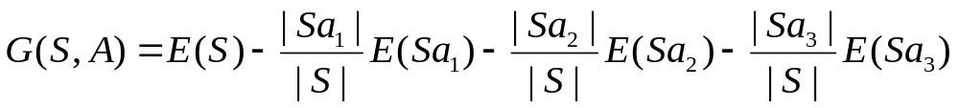
ID3
where G(S,A) is the gain for A, |Sa₁| is the number of times attribute A takes the value a₁. E(Sa₁) is the entropy of a₁, which will be calculated by observing the proportion of total population of a₁ and the number of times the C is YES or NO within these observation containing a₁ for the value of attribute A
S
A
B
E
C
d₁
a₁
b₁
e₂
YES
d₂
a₂
b₂
e₁
YES
d₃
a₃
b₂
e₁
NO
d₄
a₂
b₂
e₁
NO
d₅
a₃
b₁
e₂
NO
|S| = 5 |Sa₁| = 1 |Sa₂| = 2 |Sa₃| = 2

Slide 9
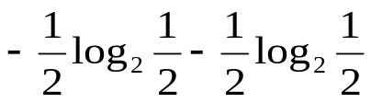
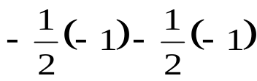
ID3
S
A
B
E
C
d₁
a₁
b₁
e₂
YES
d₂
a₂
b₂
e₁
YES
d₃
a₃
b₂
e₁
NO
d₄
a₂
b₂
e₁
NO
d₅
a₃
b₁
e₂
NO
|S| = 5 |Sa₁| = 1 |Sa₂| = 2 |Sa₃| = 2
Entropy = - p+log2 p+ - p-log2 p-
E(Sa₁) = -1log₂1 - 0log₂0 = 0
E(Sa₂) =
=
= 1
E(Sa₃) = -0log₂0 - 1log₂1 = 0

Slide 10
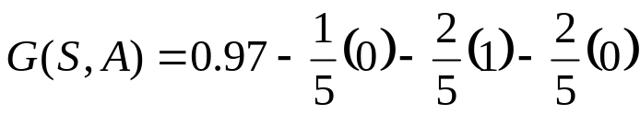
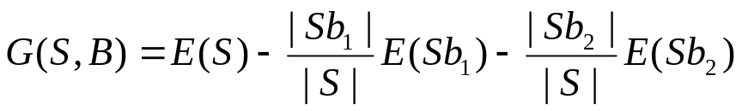
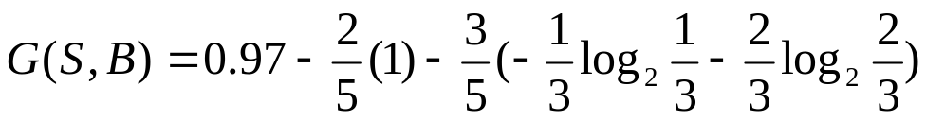
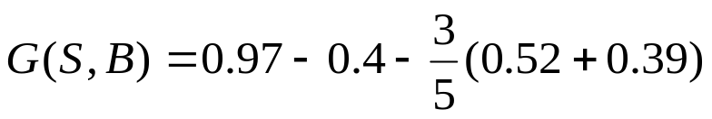
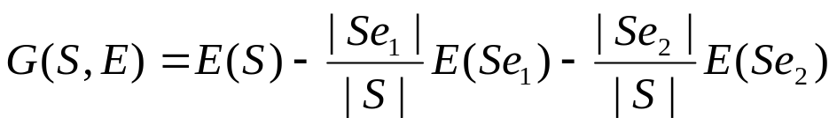
ID3
= 0.57
Similarly for B, now since there are only two values observable for the attribute B:
= 0.02
Similarly for E:
= 0.02

Slide 11
ID3
A
a₁
a₂
a₃
YES
S’ = [d₂, d₄]
NO
S
A
B
E
C
d₁
a₁
b₁
e₂
YES
d₂
a₂
b₂
e₁
YES
d₃
a₃
b₂
e₁
NO
d₄
a₂
b₂
e₂
NO
d₅
a₃
b₁
e₂
NO
S’
A
B
E
C
d₂
a₂
b₂
e₁
YES
d₄
a₂
b₂
e₂
NO

Slide 12
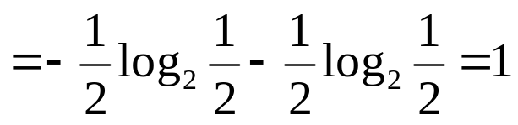
ID3
S’
A
B
E
C
d₂
a₂
b₂
e₁
YES
d₄
a₂
b₂
e₂
NO
E(S’) = - p₊log₂ p₊ - p₋log₂ p₋

Slide 13
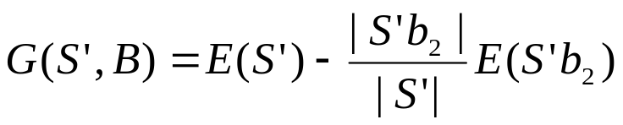
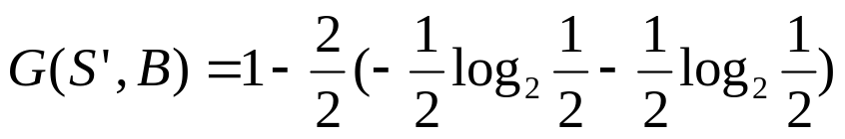
ID3
S’
A
B
E
C
d₂
a₂
b₂
e₁
YES
d₄
a₂
b₂
e₂
NO
|S’| = 2 |S’b₂| = 2
= 1 - 1 = 0

Slide 14
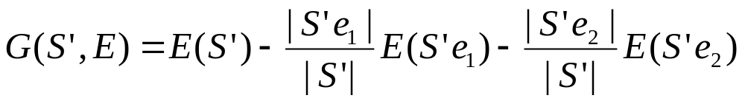
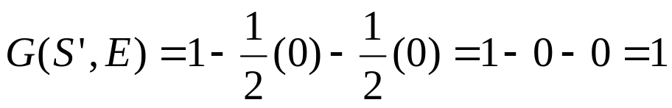
ID3
S’
A
B
E
C
d₂
a₂
b₂
e₁
YES
d₄
a₂
b₂
e₂
NO
Similarly for E:
|S’| = 2
|S’e₁| = 1 [since there is only one observation of e₁ which outputs a YES]
E(S’e₁) = -1log₂1 - 0log₂0 = 0 [since log 1 = 0]
|S’e₂| = 1 [since there is only one observation of e₂ which outputs a NO]
E(S’e₂) = -0log₂0 - 1log₂1 = 0 [since log 1 = 0]
Hence:

Slide 15
ID3
A
a₁
a₂
a₃
YES
E
NO
e₁
e₂
YES
NO
S
A
B
E
C
d₁
a₁
b₁
e₂
YES
d₂
a₂
b₂
e₁
YES
d₃
a₃
b₂
e₁
NO
d₄
a₂
b₂
e₁
NO
d₅
a₃
b₁
e₂
NO

