Slide 1

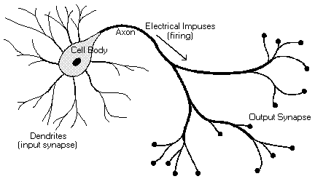
Biological Neuron
Cell body
Dendrites
Axon
Impulses
Synapses
Notes:
Please redo the picture, make sure the spellings are correct

Slide 2
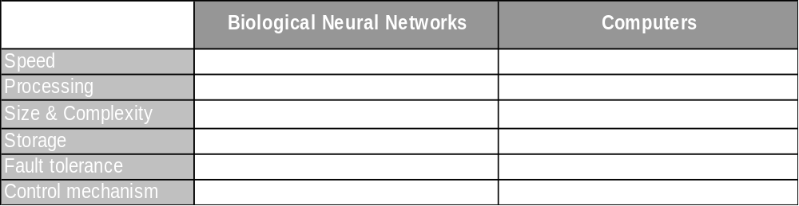
Performance Comparison

Slide 3
Single Perceptron / Neuron
Inputs
Weights
Bias
Outputs
Threshold function
Input₁
weight₁
Input₂
Threshold Function
Output
weight₂
Bias
IF (Input₁ x weight₁) + (Input₂ x weight₂) + (Bias) satisfies Threshold value
Then Output = 1
Else Output = 0

Slide 4
Single Perceptron is a a straight Line
x
a
y
Threshold Function
Output
b
c
ax + by + c = 0

Slide 5
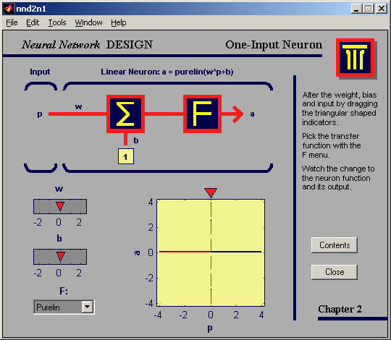
Response of changing Bias
Notes:
For this and the next few slides, please copy and paste these pictures as they are. Don’t change them, as they are the snapshots of a software.

Slide 6

Response of changing Bias

Slide 7
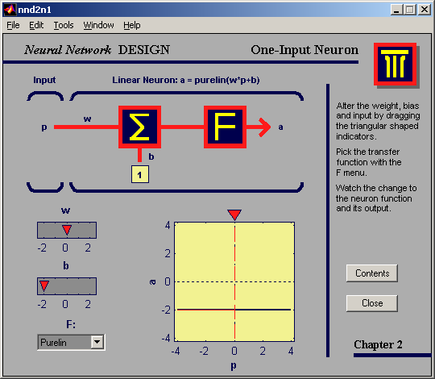
Response of changing Bias

Slide 8
Response of changing Weights

Slide 9
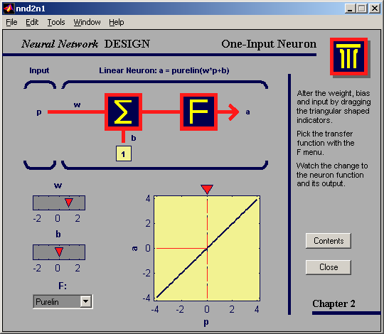
Response of changing Weights

Slide 10
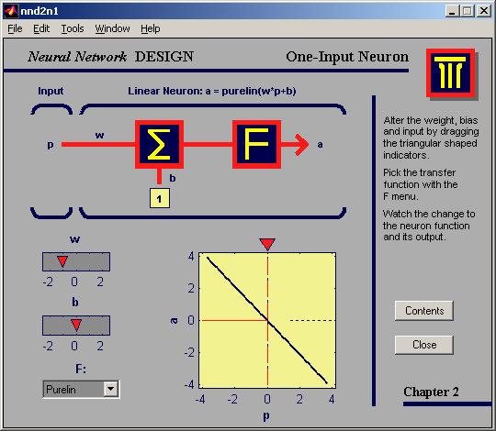
Response of changing Weights

Slide 11
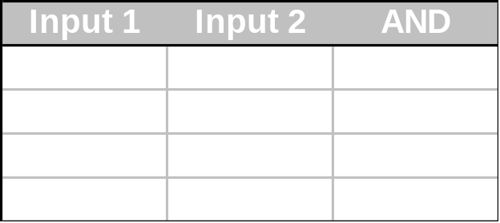
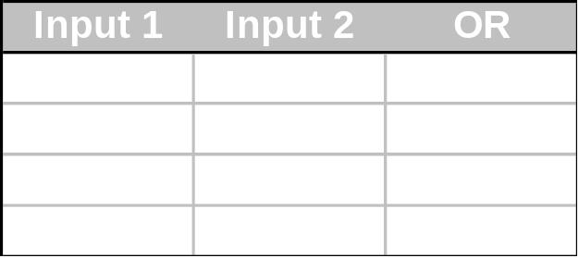
Linearly separable problems
(1,0)
(1,1)
Input 2
(0,0)
Input 1
(0,1)
Notes:
Please see the animation required, and replicate it as it is

Slide 12
Linearly separable problems
Linearly Separable
Linearly Non Separable /
Non linear decision region
Notes:
Please see the animation required, and replicate it as it is

Slide 13
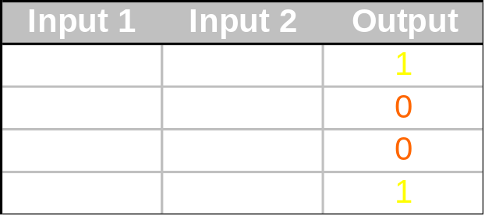
XOR problem
(1,0)
(1,1)
Input 2
(0,0)
Input 1
(0,1)
Can you draw one line which separates the ones from zeros?

Slide 14
Multiple Layer Perceptrons
We need two lines:
(1,0)
(1,1)
Input 2
(0,0)
Input 1
(0,1)

