Slide 1

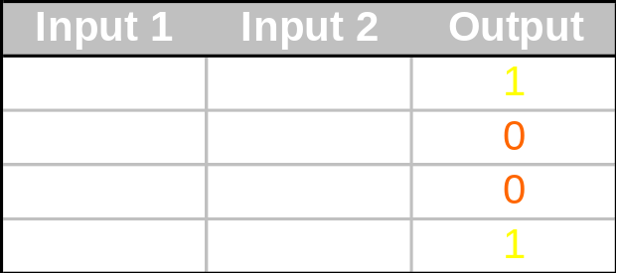
XOR problem
(1,0)
(1,1)
Input 2
(0,0)
Input 1
(0,1)
Can you draw one line which separates the ones from zeros?

Slide 2
Multiple Layer Perceptrons
We need two lines:
(1,0)
(1,1)
Input 2
(0,0)
Input 1
(0,1)

Slide 3
Multiple Layer Perceptrons
Input 1
Input 2
1
Input
Layer
Hidden
Layer
Output
Layer

Slide 4
Artificial Neural Networks
A neural network is a massively parallel distributed computing system that has a natural propensity for storing experiential knowledge and making it available for use. It resembles the brain in two respects:
  Knowledge is acquired by the network through a learning process (called training)
  Interneuron connection strengths known as synaptic weights are used to store the knowledge
  Knowledge is implicit and distributed

Slide 5
Classes of ANN
Number of layers
  Single layer network
  Multilayer networks
Direction of information (signal) flow
  Feed-forward
  Recurrent (feed-back)
Connectivity
  Fully connected
  Partially connected
Learning methodology
  Supervised
  Unsupervised

Slide 6
Single vs Multiple Layers
Single Layer
Only one input and
One output layer
Two Layers
One input ,
One hidden and
One output layer

Slide 7
Feed forward vs Reccurrent
Feed forward
Recurrent Network

Slide 8
Fully Connected vs Partially Connected
Fully connected
Partially connected

Slide 9
Training Cycle
Activation
function
Weighted Sum
of input
Similarity measure
Input
Weight
updation
Notes:
Kindly make the arrows more circular

