Slide 1

Course Outline
Introduction
Expert Systems
Advanced
Topics
Problem
Solving
Uncertainty
Conclusion
Genetic
Learning
Algorithms
Knowledge
Representation
Planning
& Reasoning
Notes:
Please make sure that the green semi circle is deleted and only Planning circle is made yellow.

Slide 2
Make Up Cont.
Partial Ordering is required
START
START
START
LEFT
GLOVE
RIGHT
GLOVE
LEFT
GLOVE
RIGHT
GLOVE
RIGHT
GLOVE
LEFT
GLOVE
FINISH
FINISH
FINISH
TOTAL ORDERING
PARTIAL ORDERING
Notes:
Now this isn’t searching

Slide 3
Problem Solving V/S Planning?
State was completely specified
Operator was a formula to convert a state into another
Goal is just a black-box test that could be applied on any STATE not the ACTIONs that might lead to GOAL
Solution is unbroken sequence of actions from the initial state to the goal or solution state
Search space Vs. Plan space

Slide 4
POP
(initial_state, goal, operators) returns plan
Begin
  Initialize plan with initial_state linked to goal
  Loop until plan becomes complete solution
    Find an action a which satisfies an unachieved pre-condition
    Insert a in plan linked with the preconditioned action
    Reorder actions to resolve all threats

Slide 5
Predicates
Conditions
  at(x)
  has (x)
  sells (s, g)
  path (s, d)
Actions
  buy (x)
  go (x)
  start ()
  finish ()

Slide 6
Initial State
  at(home) ^ sells (hws, drill) ^ sells (sm, banana) ^ sells (sm, milk) ^ path (home, sm) ^ path (sm, hws) ^ path (home, hws)
Goal
  at (home) ^ has (banana) ^ has (milk) ^ has (drill)

Slide 7
Operators
  Go (x)
    Preconditions: at(y) ^ path(y,x)
    Postconditions: at(x) ^ ~at(y)
  Buy (x)
    Preconditions: at(s) ^ sells (s, x)
    Postconditions: has(x)

Slide 8
  Start
    Preconditions: nil
    Postconditions: at(home) ^ sells (hws, drill) ^ sells (sm, banana) ^ sells (sm, milk) ^ path (home, sm) ^ path (sm, hws) ^ path (home, hws)
  Finish
    Preconditions: at (home) ^ has (banana) ^ has (milk) ^ has (drill)
    Postconditions: nil

Slide 9
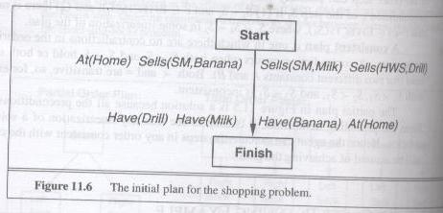
Notes:
This and the next three are the figures taken from the book. Please redo them. Make sure there are no spelling mistakes.

Slide 10
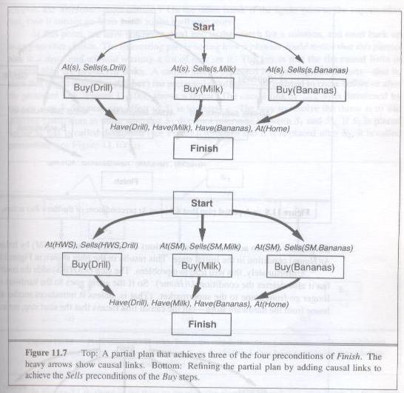

Slide 11
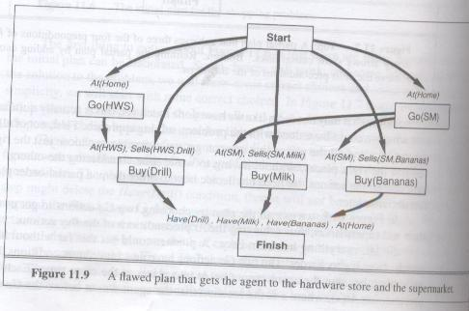

Slide 12
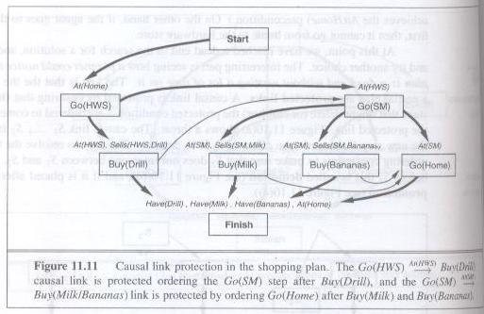
Notes:
The last words of the text at the end are:
Line1: At(HWS) Buy(Drill)
Line2: At(SM)
Line3: Buy(Banana)

