Slide 1

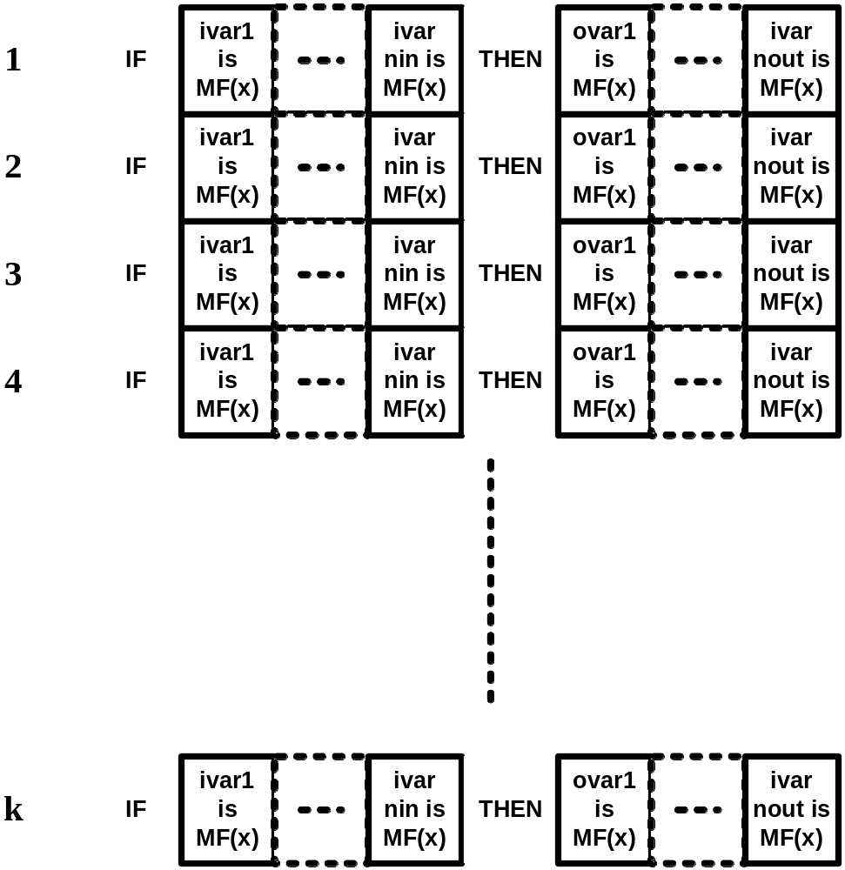
Encoding Rules
IF Taste is Worse AND Quantity is Sleak
THEN Tip is Little
IF Taste is Average AND Quantity is Abundant
THEN Tip is Average
IF Taste is Delicious AND Quantity is Medium
THEN Tip is High
IF Taste is Delicious AND Quantity is Abundant
THEN Tip is High

Slide 2
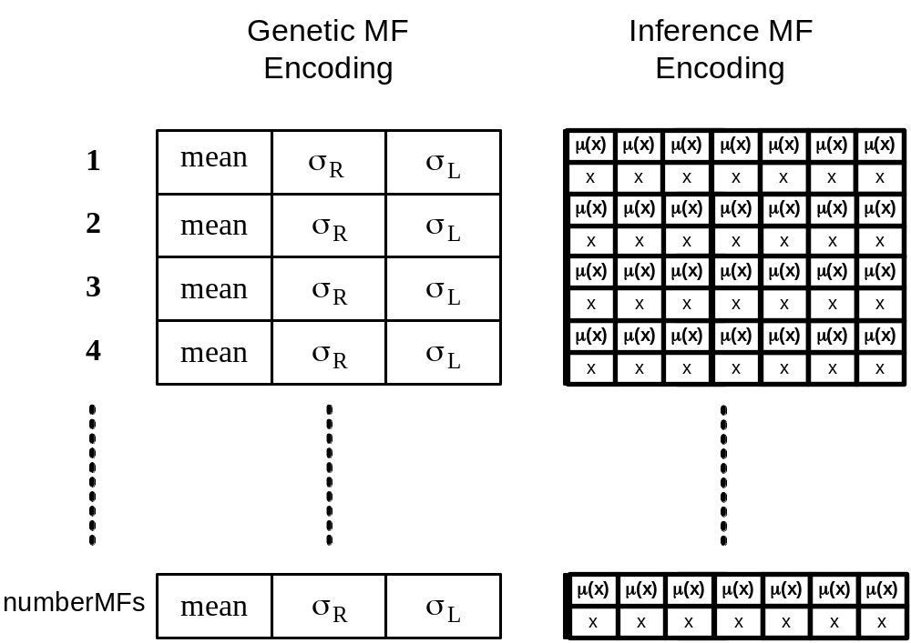
Encoding – Membership functions
μ(x)
1.0
0.5
-3σ_{R}
-2σ_{R}
-1σ_{R}
1σ_{L}
2σ_{L}
0
3σ_{L}

Slide 3
Objective Function (OF)
Objective function is the MSE (mean squared error) on supervisory data of the given Fuzzy System individual

Slide 4
Genetic Operators
Applied on genetic MF encoding of membership functions
Types
  Crossover
  Mutation
  Set similar
  Set zero
  Set unity

Slide 5
Genetic Operators – Mutation (random)
parent
child
mean
σ_{R}
σ_{L}
mean
σ_{R}
σ_{L}
mutation cell

Slide 6
Genetic Operators - Crossover
parent A
parent B
{
mean
σ_{R}
σ_{L}
{
mean
σ_{R}
σ_{L}
cutoff
child 1
child 2

Slide 7
Neuro Fuzzy
Rule
Implication
MF
Rule
Composition
W_{1,1}
Defuzzification
Input 1
W_{1,2}
W_{1,3}
Input 2
Output 1
Input
Layer
Hidden
Layer
Output
Layer

Slide 8
