Slide 1
Algorithms
Lecture # 01
Syed Hamed Raza

Slide 2
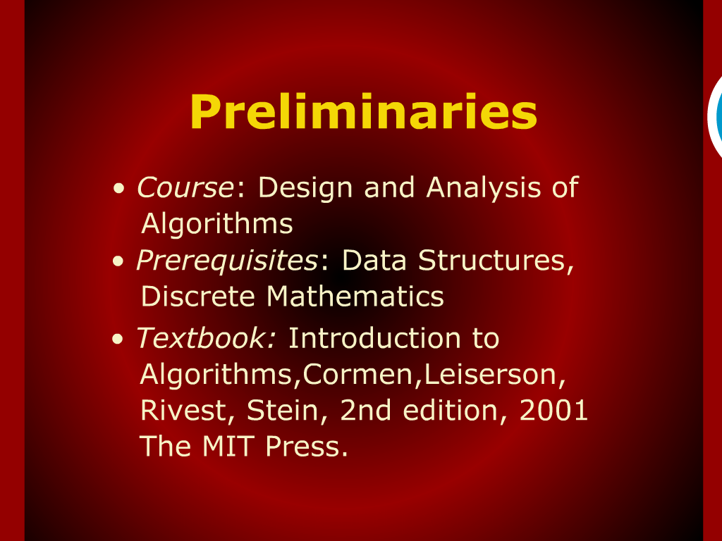
Preliminaries

Slide 3
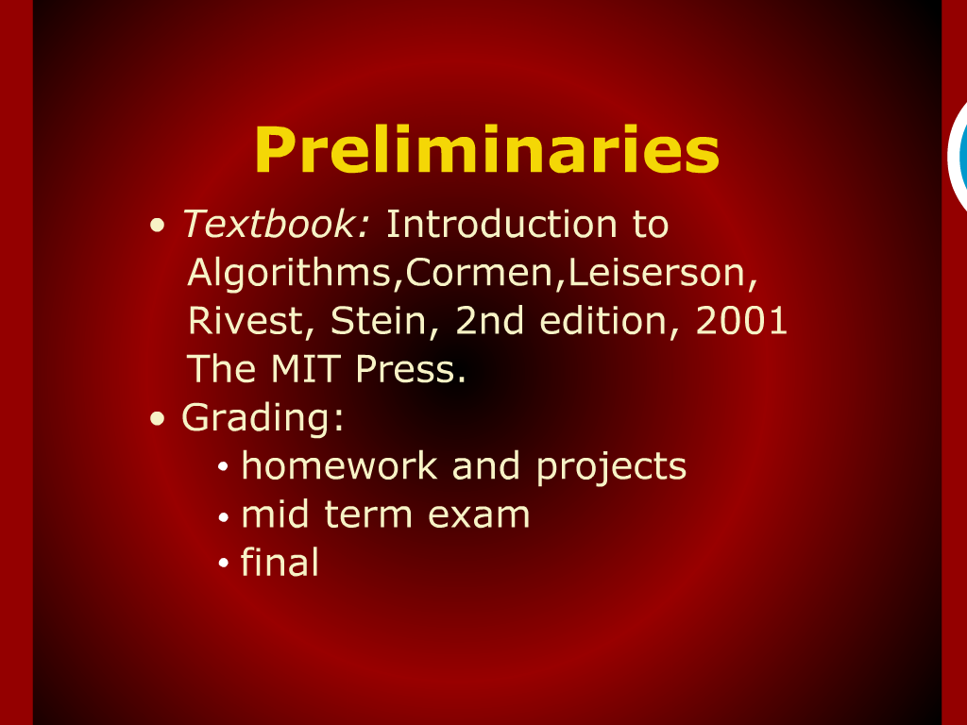
Preliminaries

Slide 4
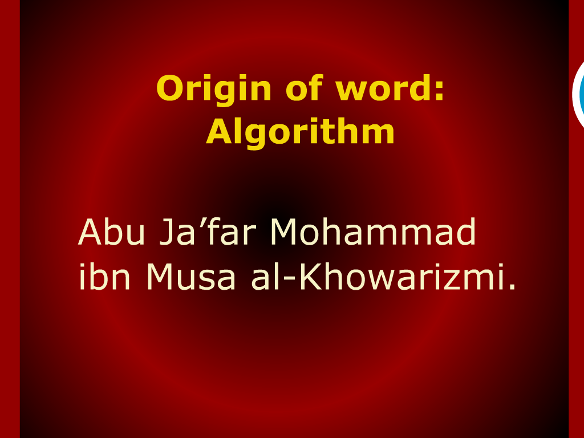
Origin of Word: ALGORITHM

Slide 5
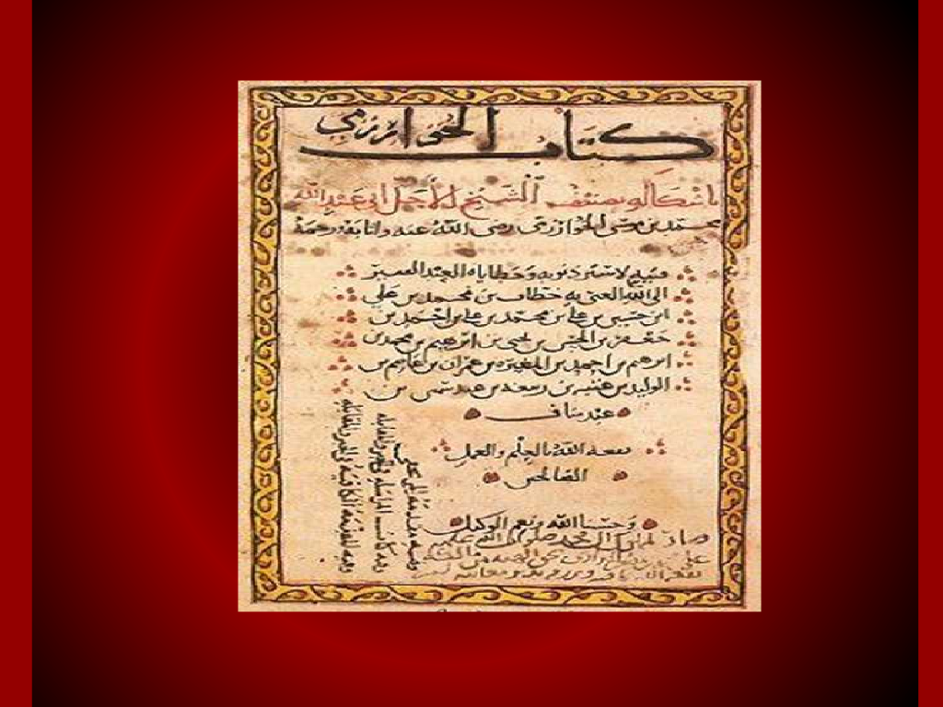
Origin of Word: ALGORITHM

Slide 6

Origin of Word: ALGORITHM

Slide 7
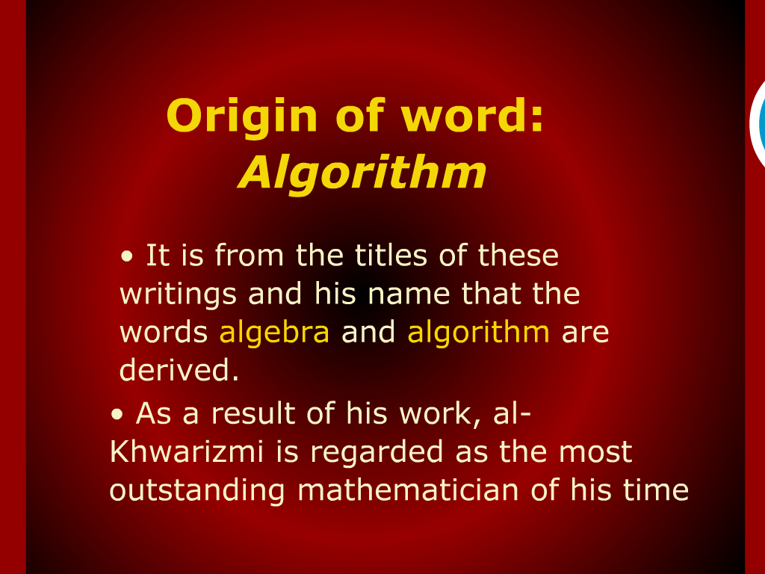
Origin of Word: ALGORITHM

Slide 8
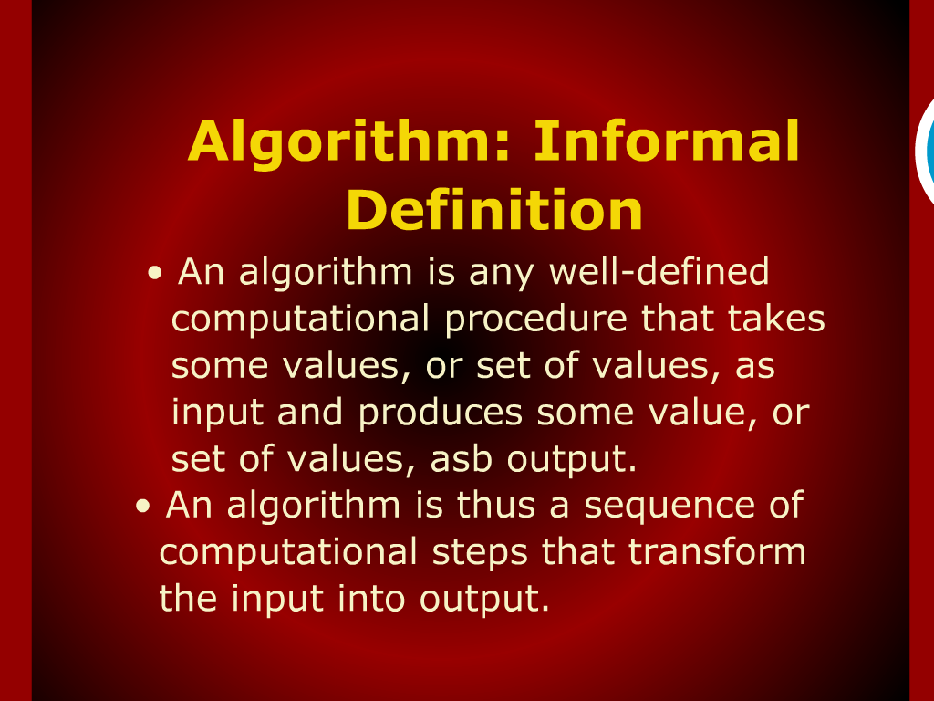
ALGORITHM informal definition

Slide 9
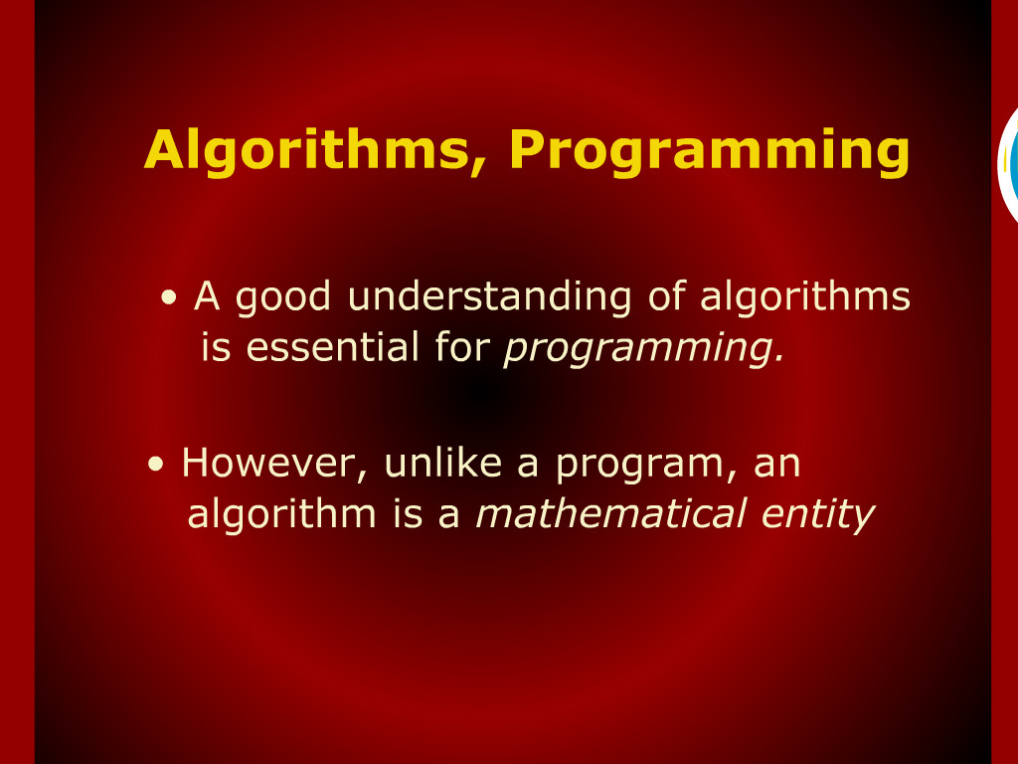
ALGORITHM, programming

Slide 10
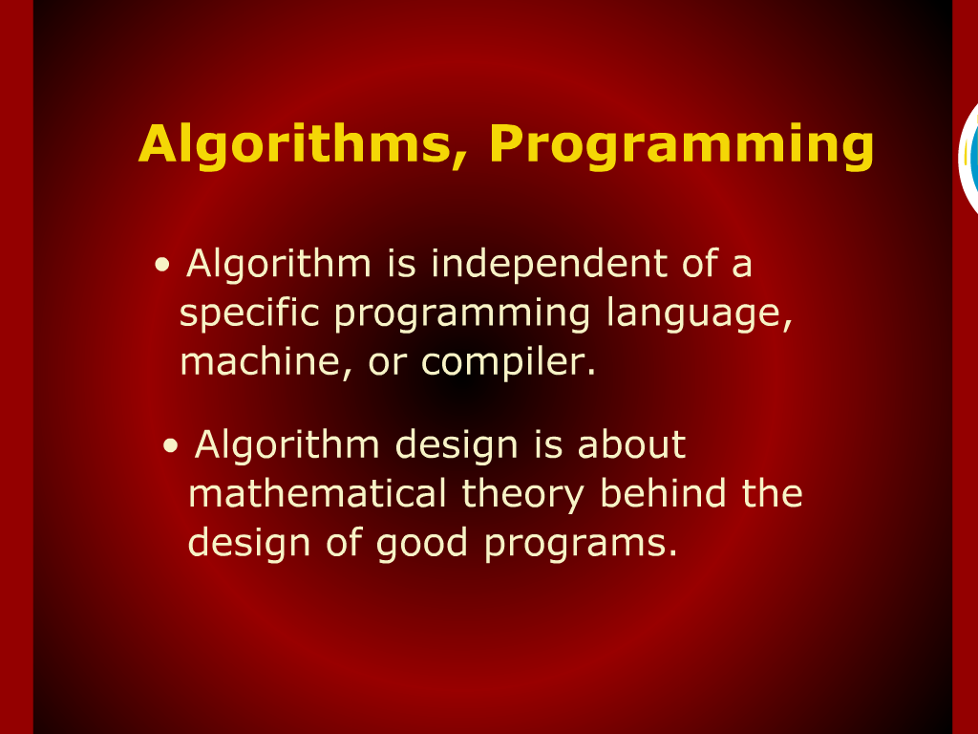
ALGORITHM, programming

Slide 11
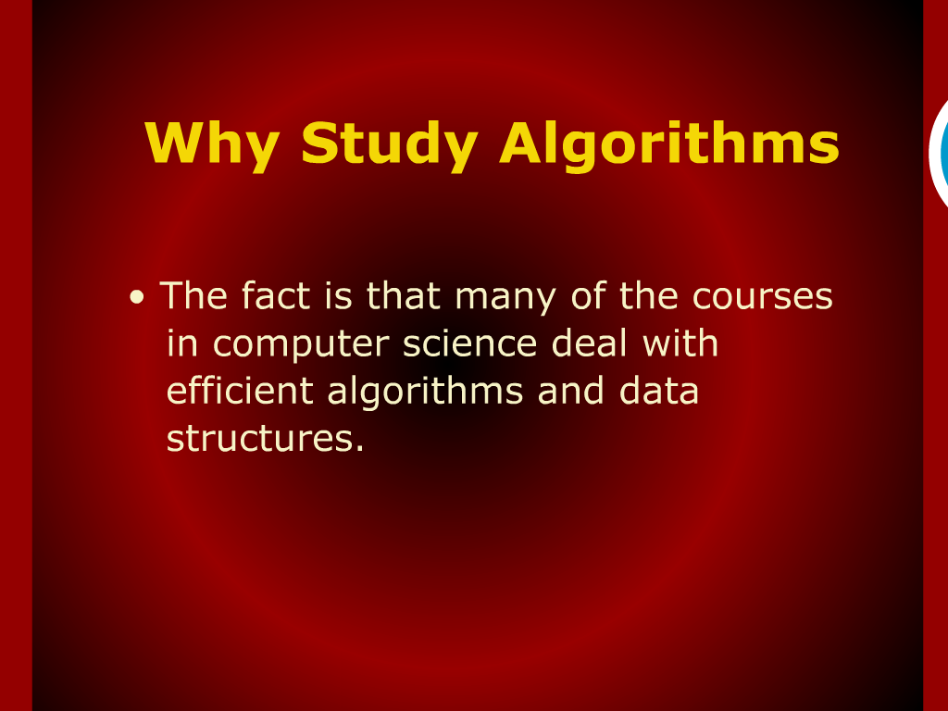
Why Study?

Slide 12
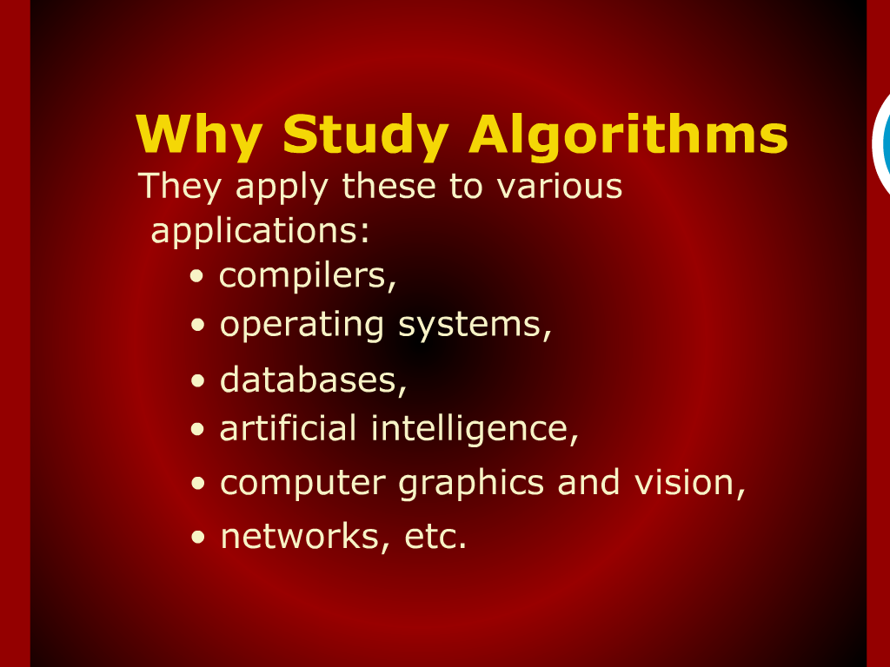
Why Study?

Slide 13
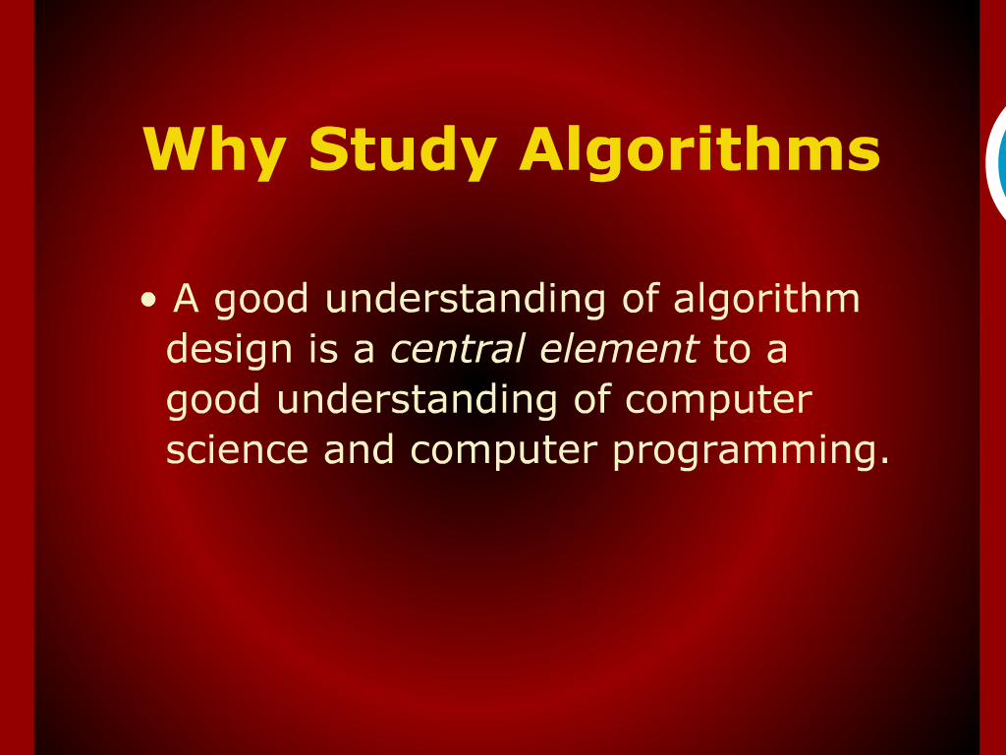
Why Study?

Slide 14
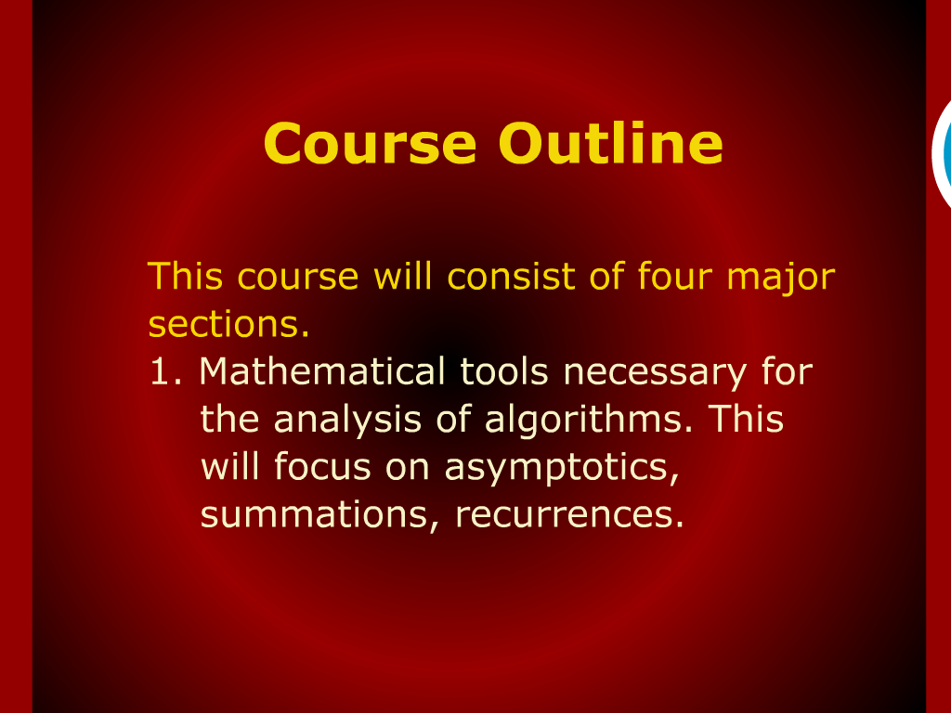
Course outline

Slide 15
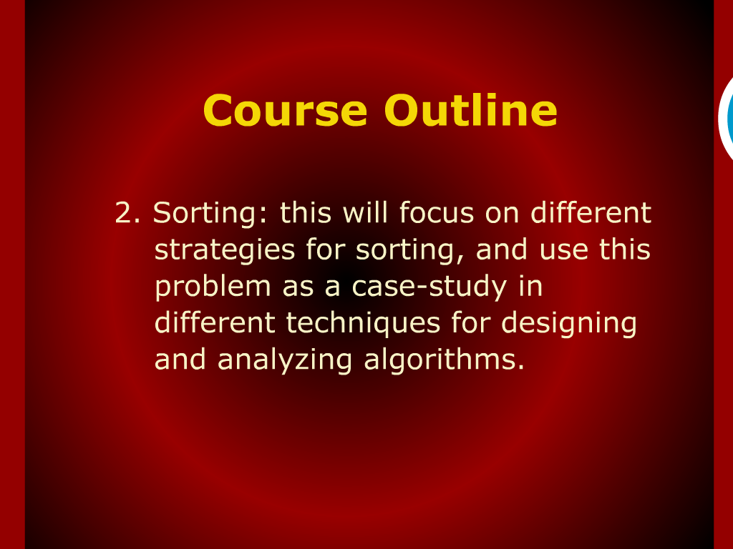
Course outline

Slide 16
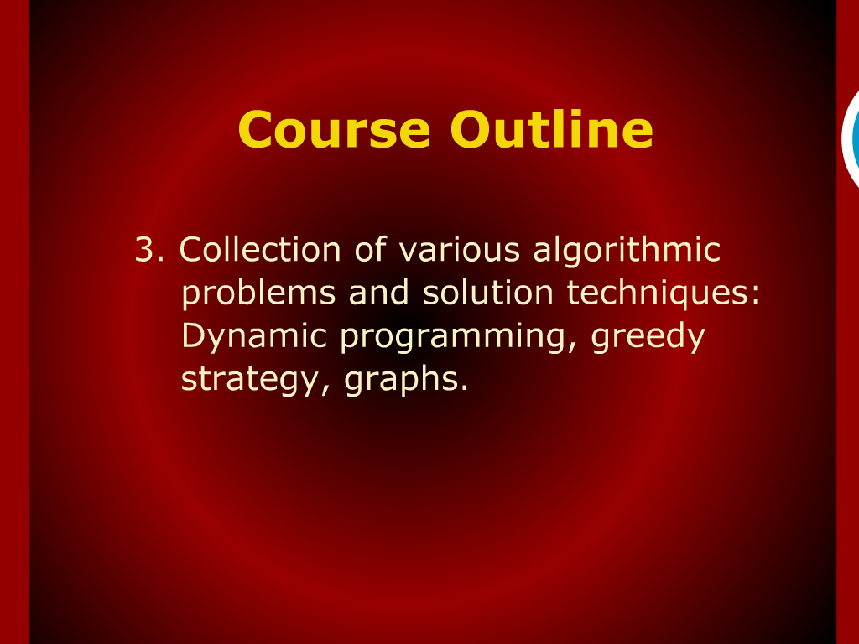
Course outline

Slide 17
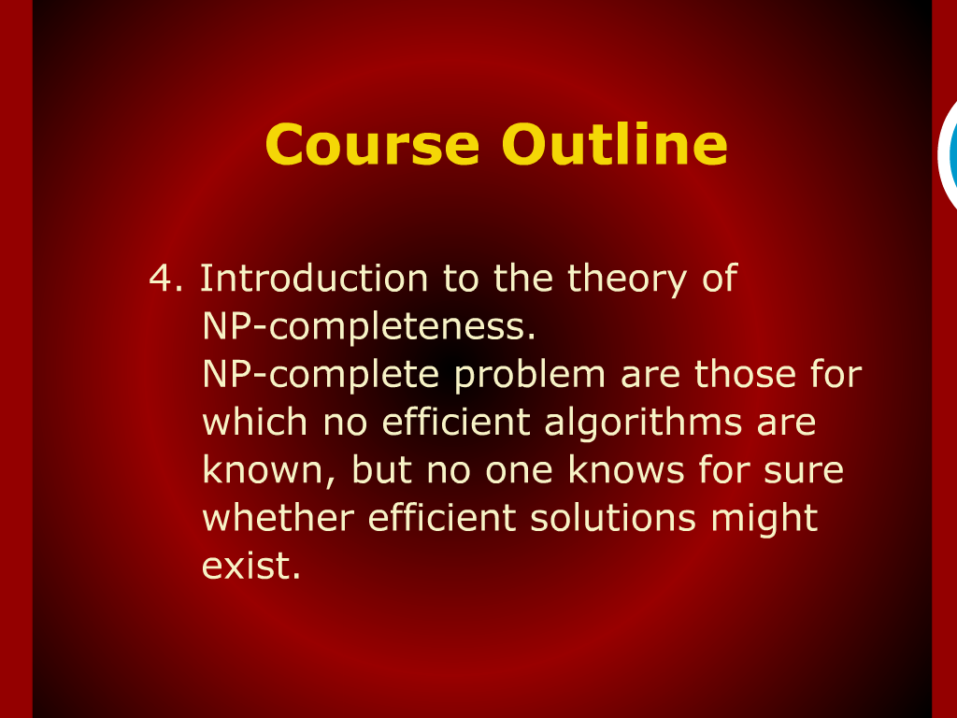
Course outline

Slide 18
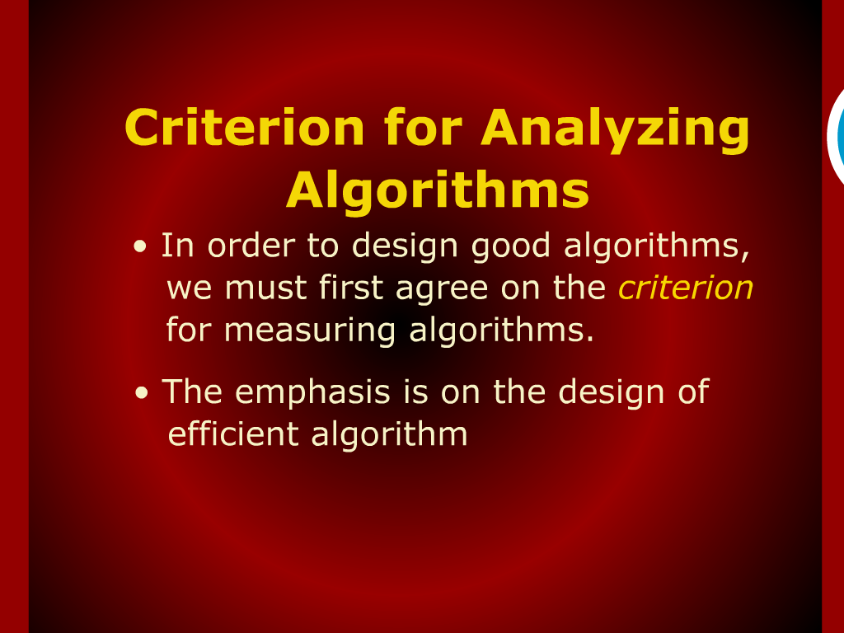
Criteria for analyzing Algorithms

Slide 19
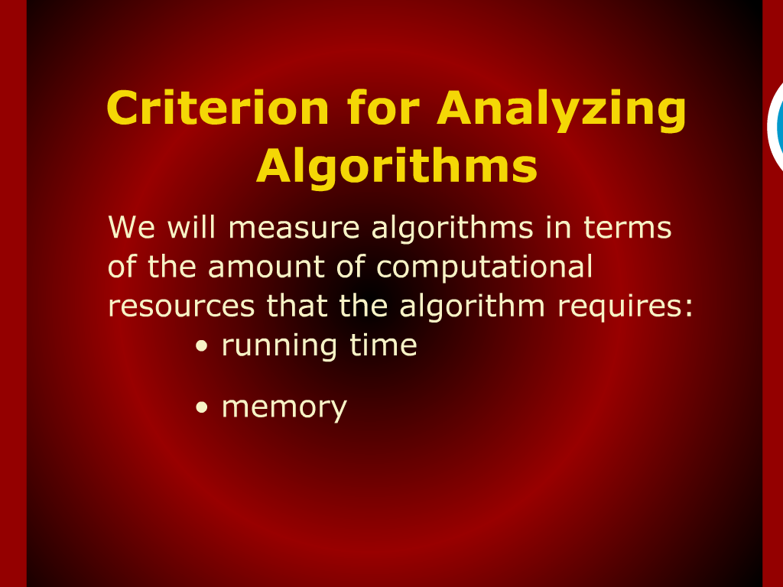
Criteria for analyzing Algorithms

Slide 20
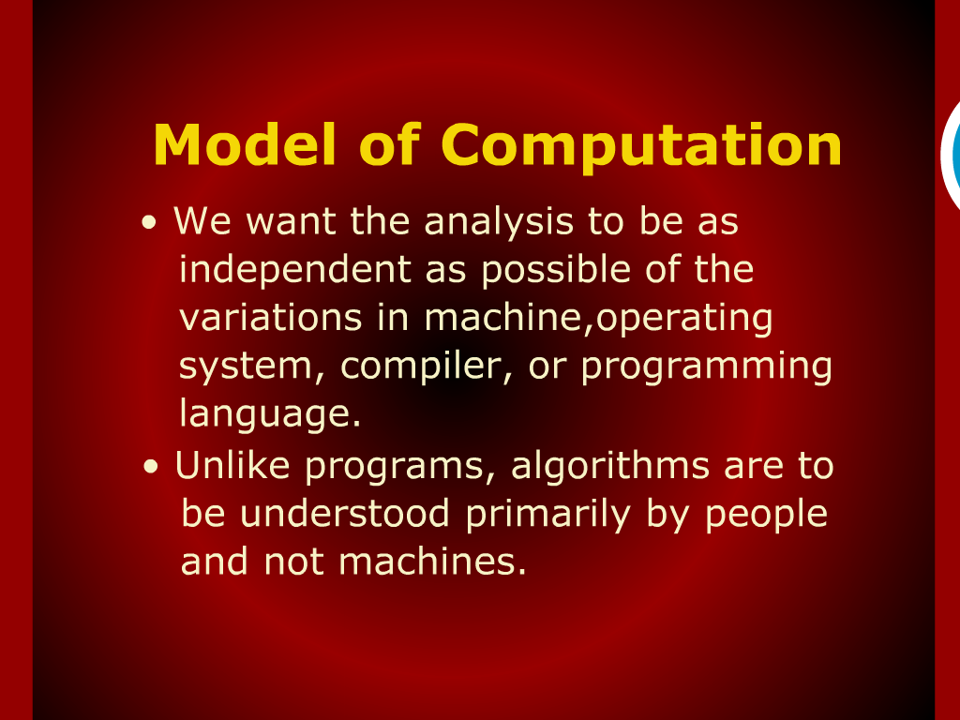
Model of Computation

Slide 21
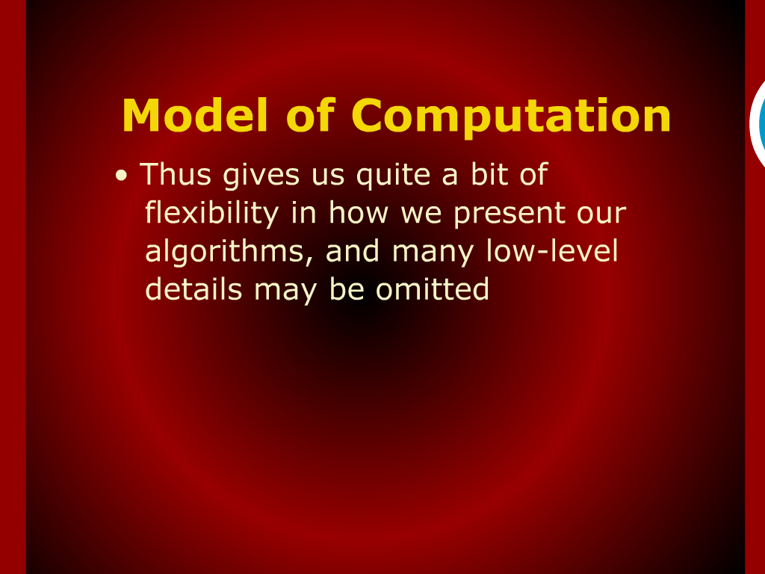
Model of Computation

Slide 22
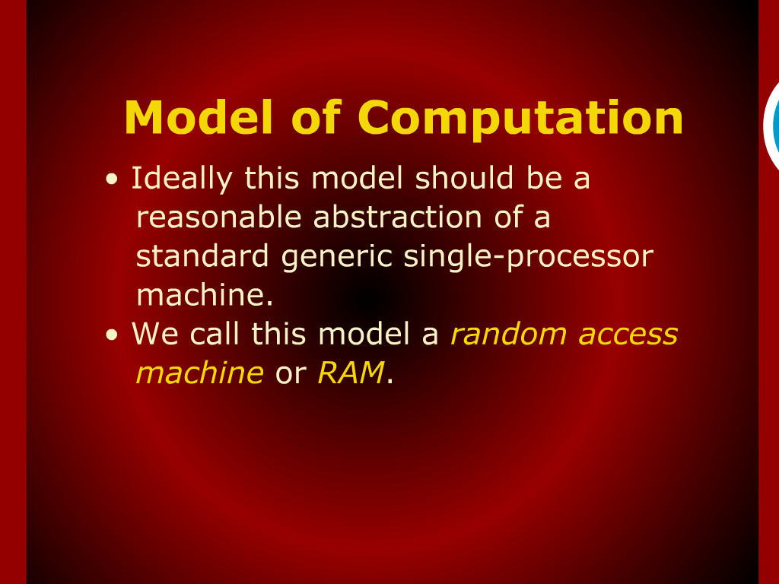
Model of Computation

Slide 23
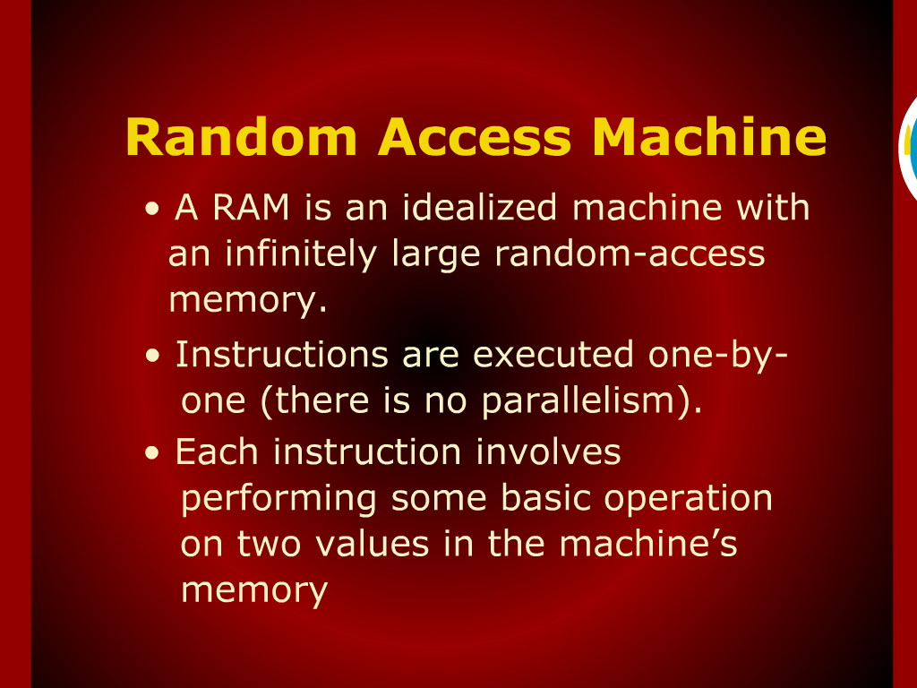
Random Access Machine

Slide 24
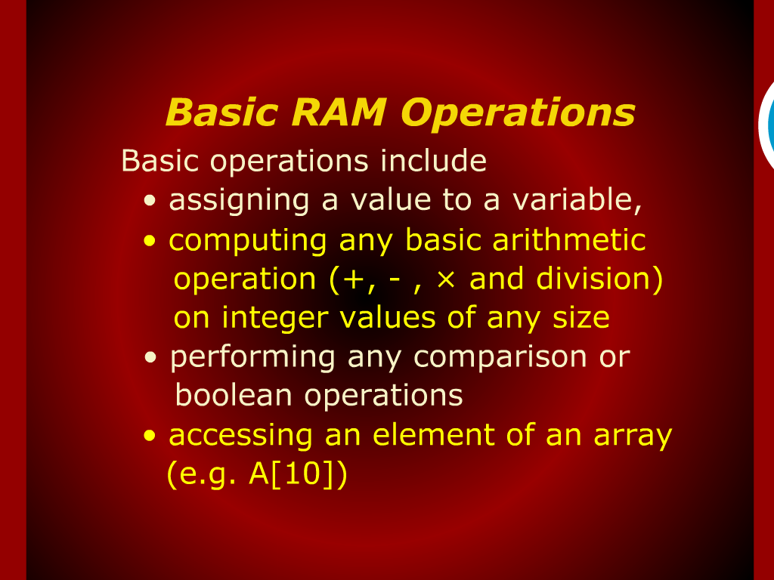
Basic RAM Operations

Slide 25
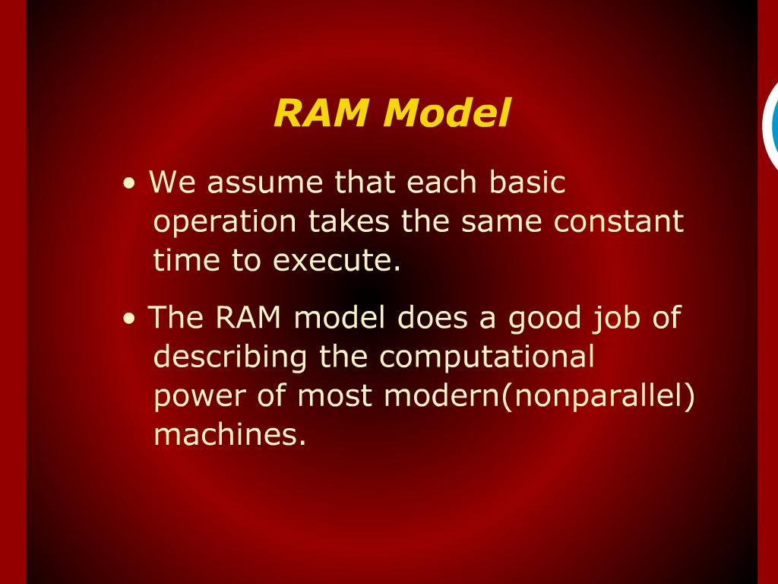
RAM Model

Slide 26
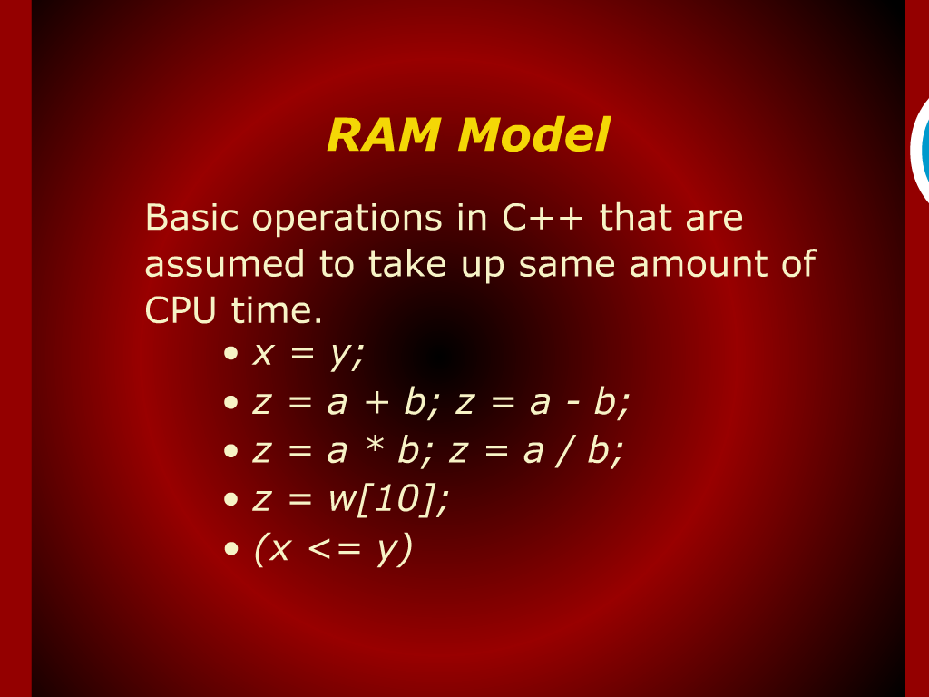
RAM Model

Slide 27
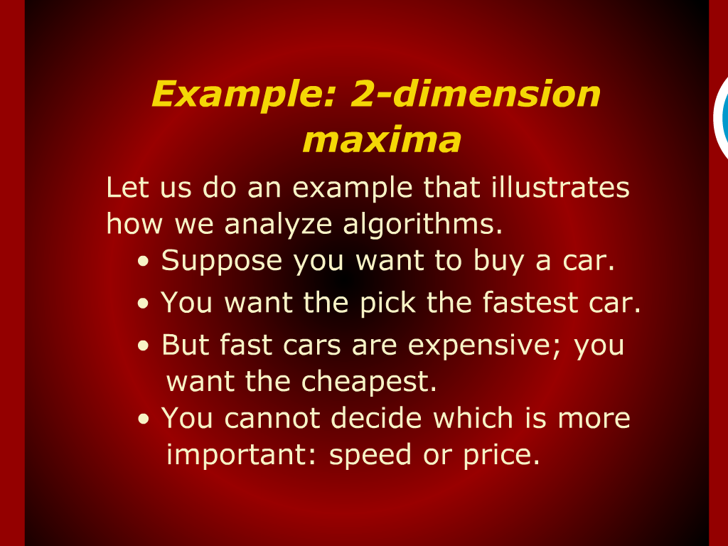
Example: 2-dimension maxima

Slide 28
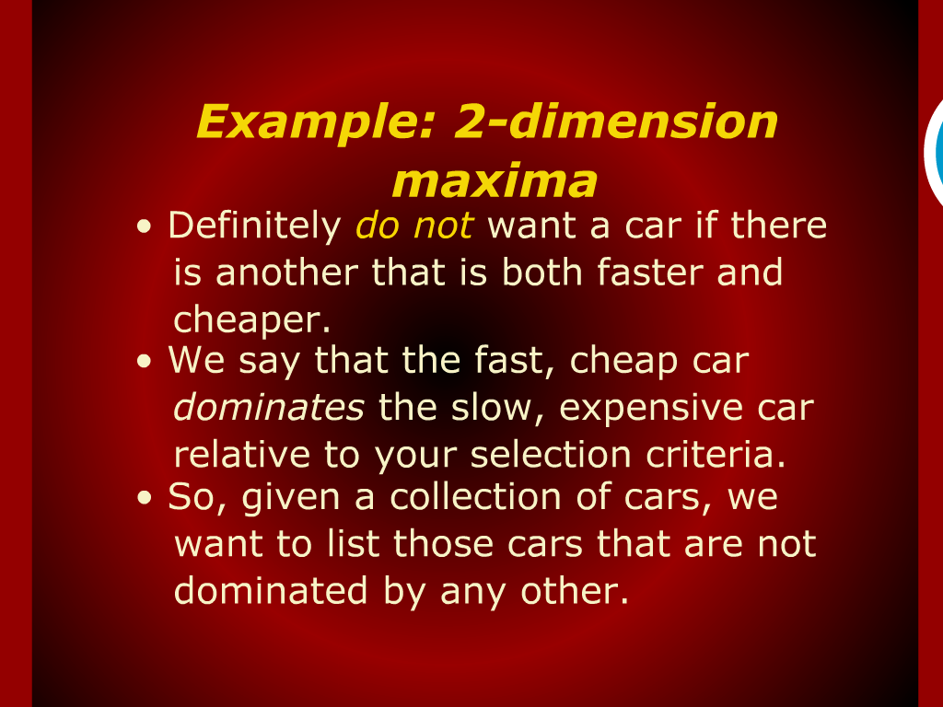
Example: 2-dimension maxima

Slide 29
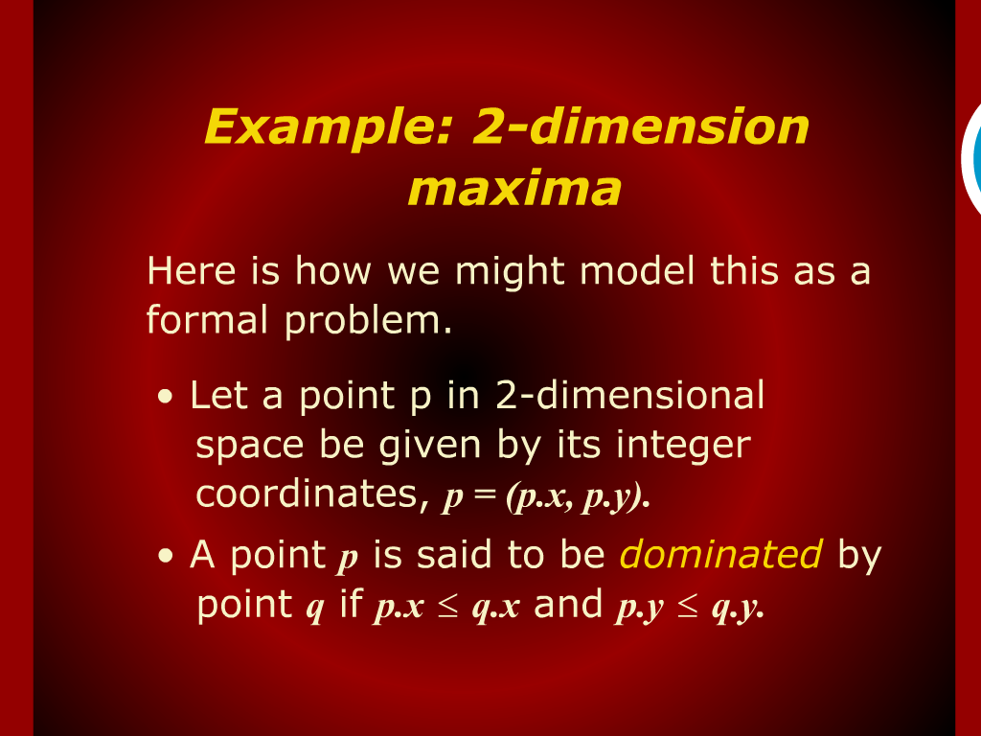
Example: 2-dimension maxima

Slide 30
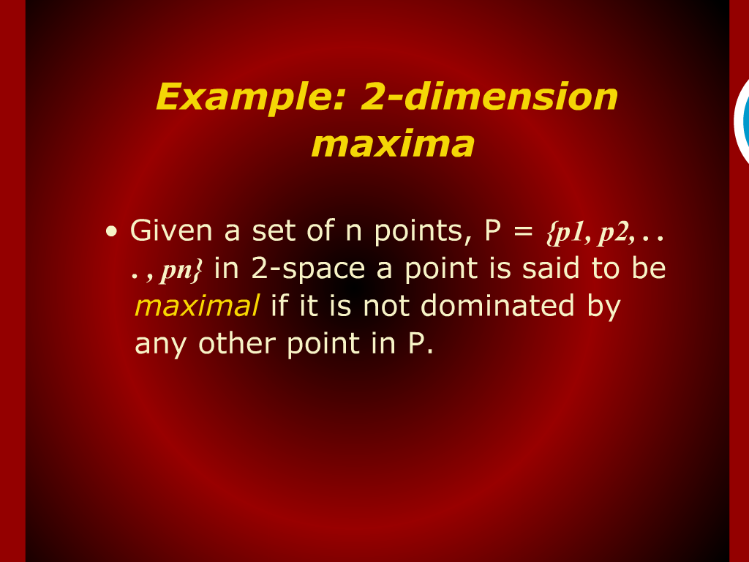
Example: 2-dimension maxima

Slide 31
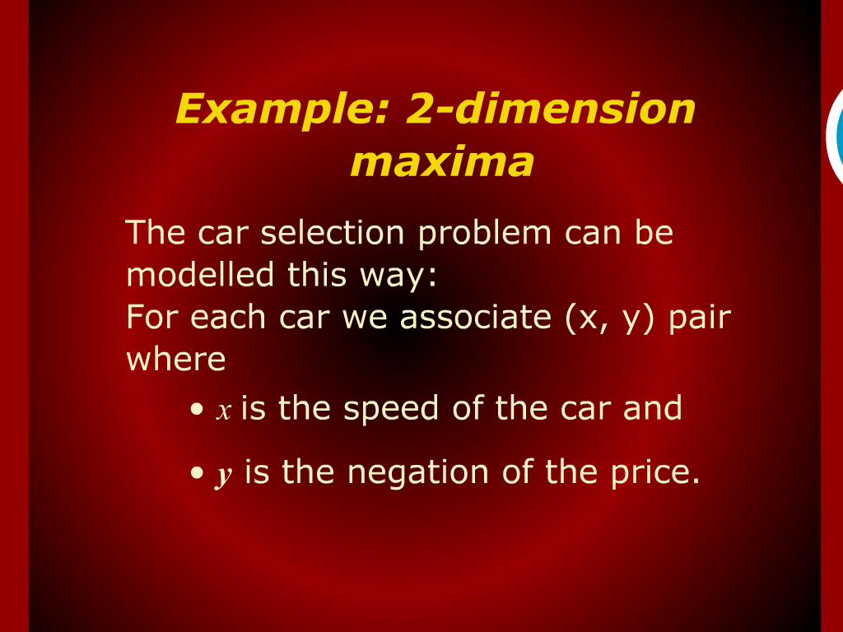
Example: 2-dimension maxima

Slide 32
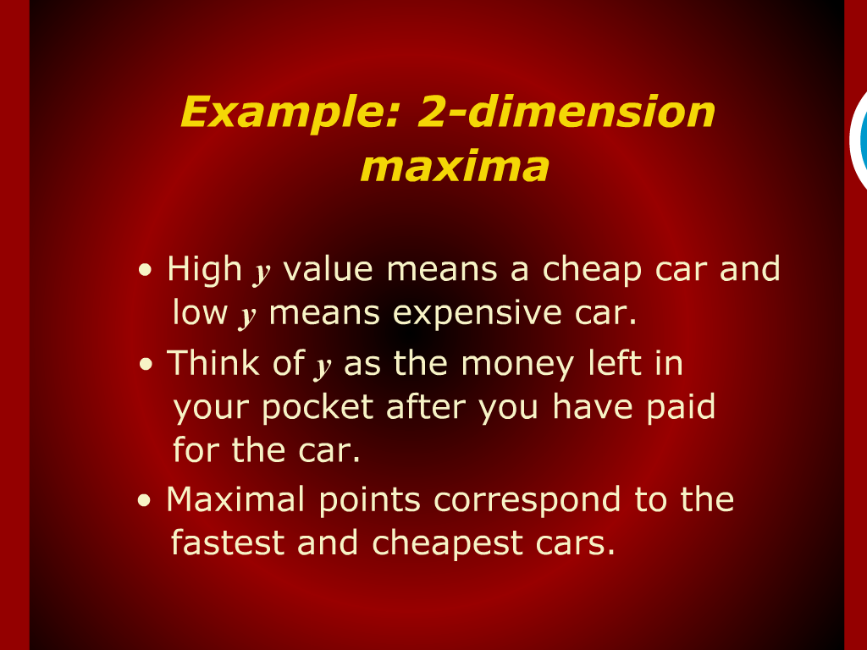
Example: 2-dimension maxima

Slide 33
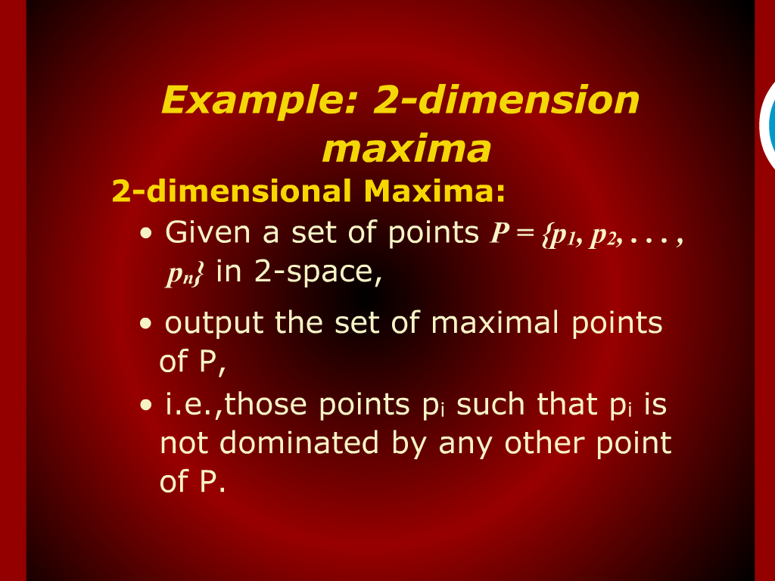
Example: 2-dimension maxima

Slide 34
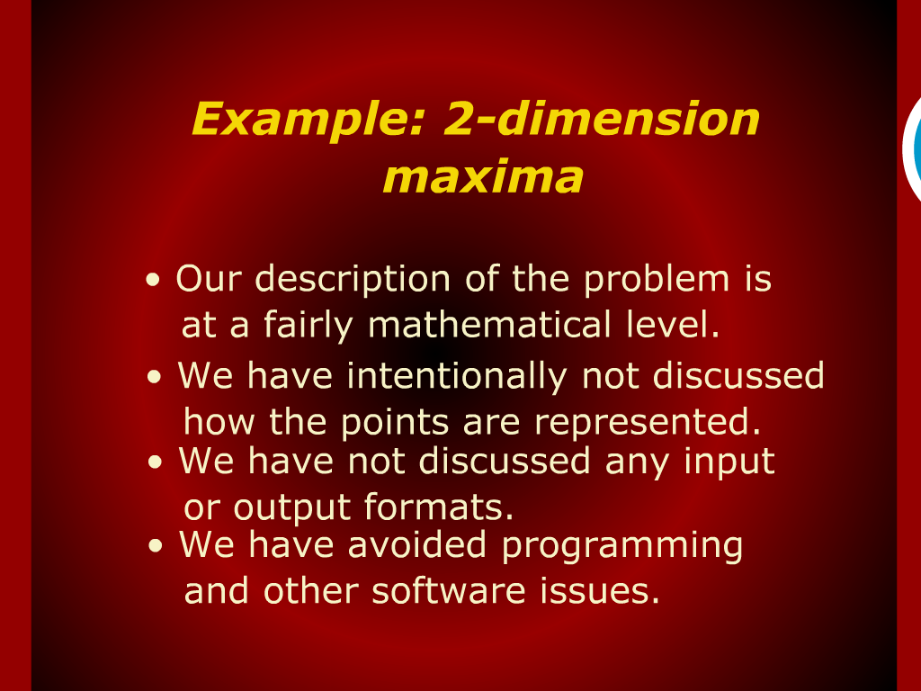
Example: 2-dimension maxima

Slide 35
Example: 2-dimension maxima

Slide 36
Example: 2-dimension maxima

Slide 37
Example: 2-dimension maxima

Slide 38

Example: 2-dimension maxima

Slide 39
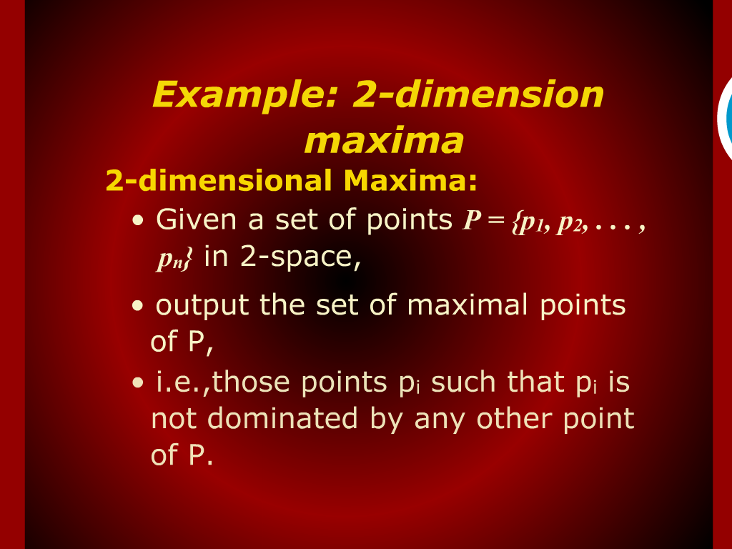
Example: 2-dimension maxima

Slide 40

Example: 2-dimension maxima

