Slide 1
pletR
AIMMS User Support

Slide 2
pletR architecture
pletR Client
plet database
pletR app
AIMMS app with service of interest
Browser Window
pletR Architecture.

Slide 3
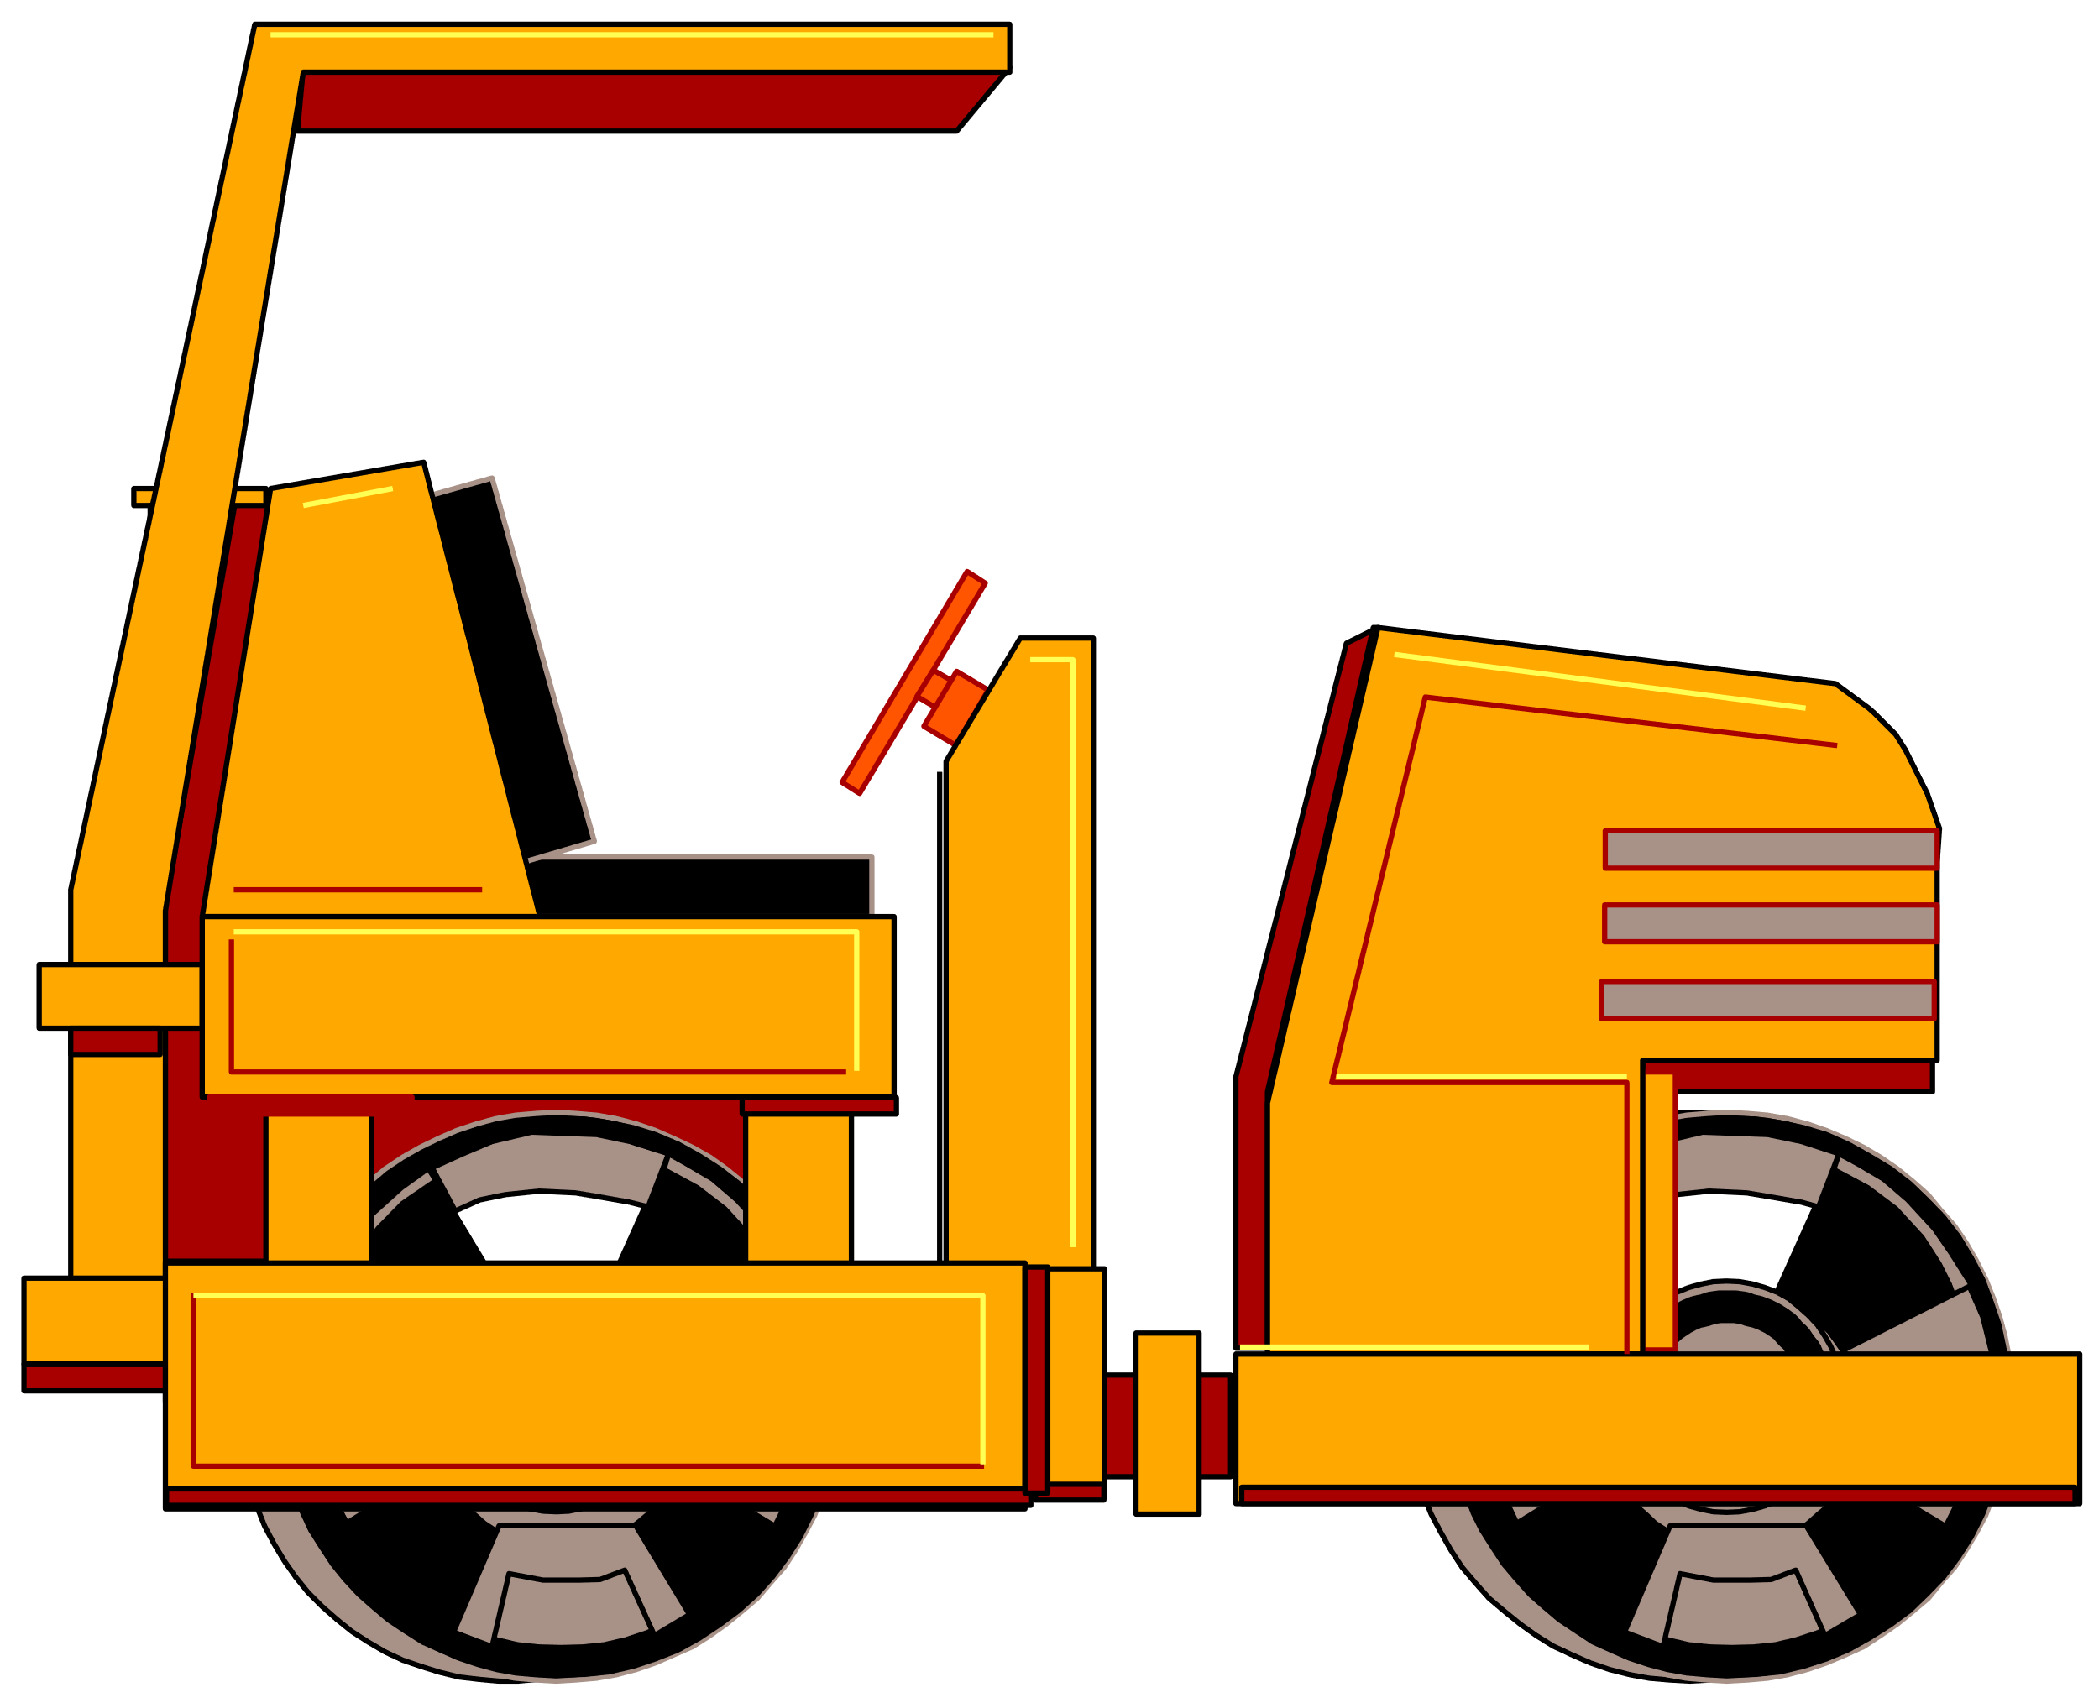
Road Roller Icon from Cactus Cowboy

Slide 4
Agenda Slide
Font is Arial
Size is 18
Item 3

Slide 5
Capital on Initial Letter
Next item is bold
Capital on the first initial
Item 3

Slide 6
No More than 3 Types of Font per Page
Regular text is Arial
Code reference is Courier New as what AIMMS editor uses
To be discussed – Editor color
axll::ReadTable(
IdentifierReference : UnitTransCost,
RowHeaderRange : "A31:A36",
ColumnHeaderRange : "B30:AE30",
DataRange : "B31:AE36",
ModeForUnknownElements : 1);

Slide 7
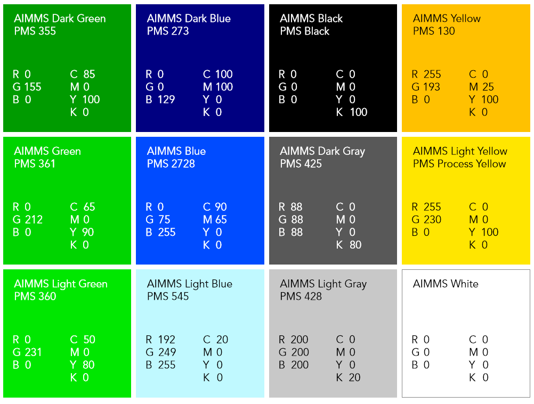
AIMMS Color Palette
AIMMS Dark Green is primary

Slide 8
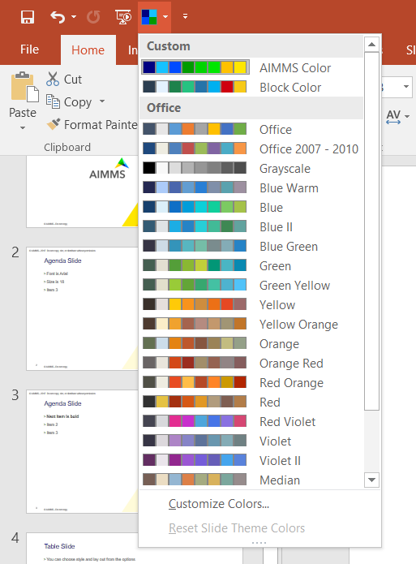
Colors
Make sure “AIMMS Color” is selected from top left
Then the colors are available to choose

Slide 9

Color Blocks and Shapes
No gradient in shape fill
GUI CONSTRUCTION
MODEL BUILDING
SOLVERS
WebUI
WinUI
External DLLs
SDK
ODBC
Databases
Model Explorer
Drag and Drop
Wizards
Inline Help
Excel
CSV
CPLEX
CONOPT
CBC
IPOPT
CPO
SNOPT
MINOS
KNITRO
MOSEK
BARON
PATH
AOA

Slide 10
Available Imagery
https://aimmsopt.sharepoint.com/MarCom/Shared%20Documents/Forms/AllItems.aspx?id=%2FMarCom%2FShared%20Documents%2FNew%20Brand%20Materials%2FNew%20images
https://pixabay.com/

