Slide 1
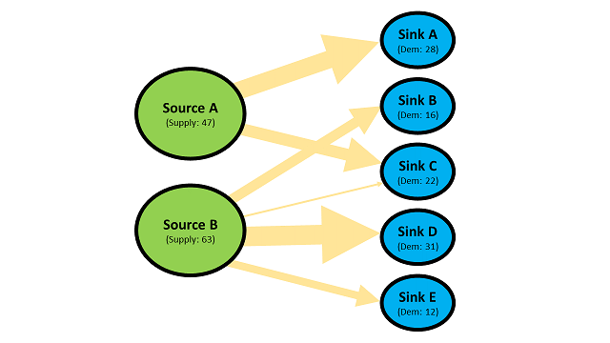
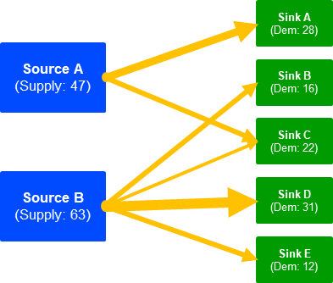
Sink A
(Dem: 28)
Source A (Supply: 47)
Sink B
(Dem: 16)
Sink C
(Dem: 22)
Source B (Supply: 63)
Sink D
(Dem: 31)
Sink E
(Dem: 12)

