Slide 1
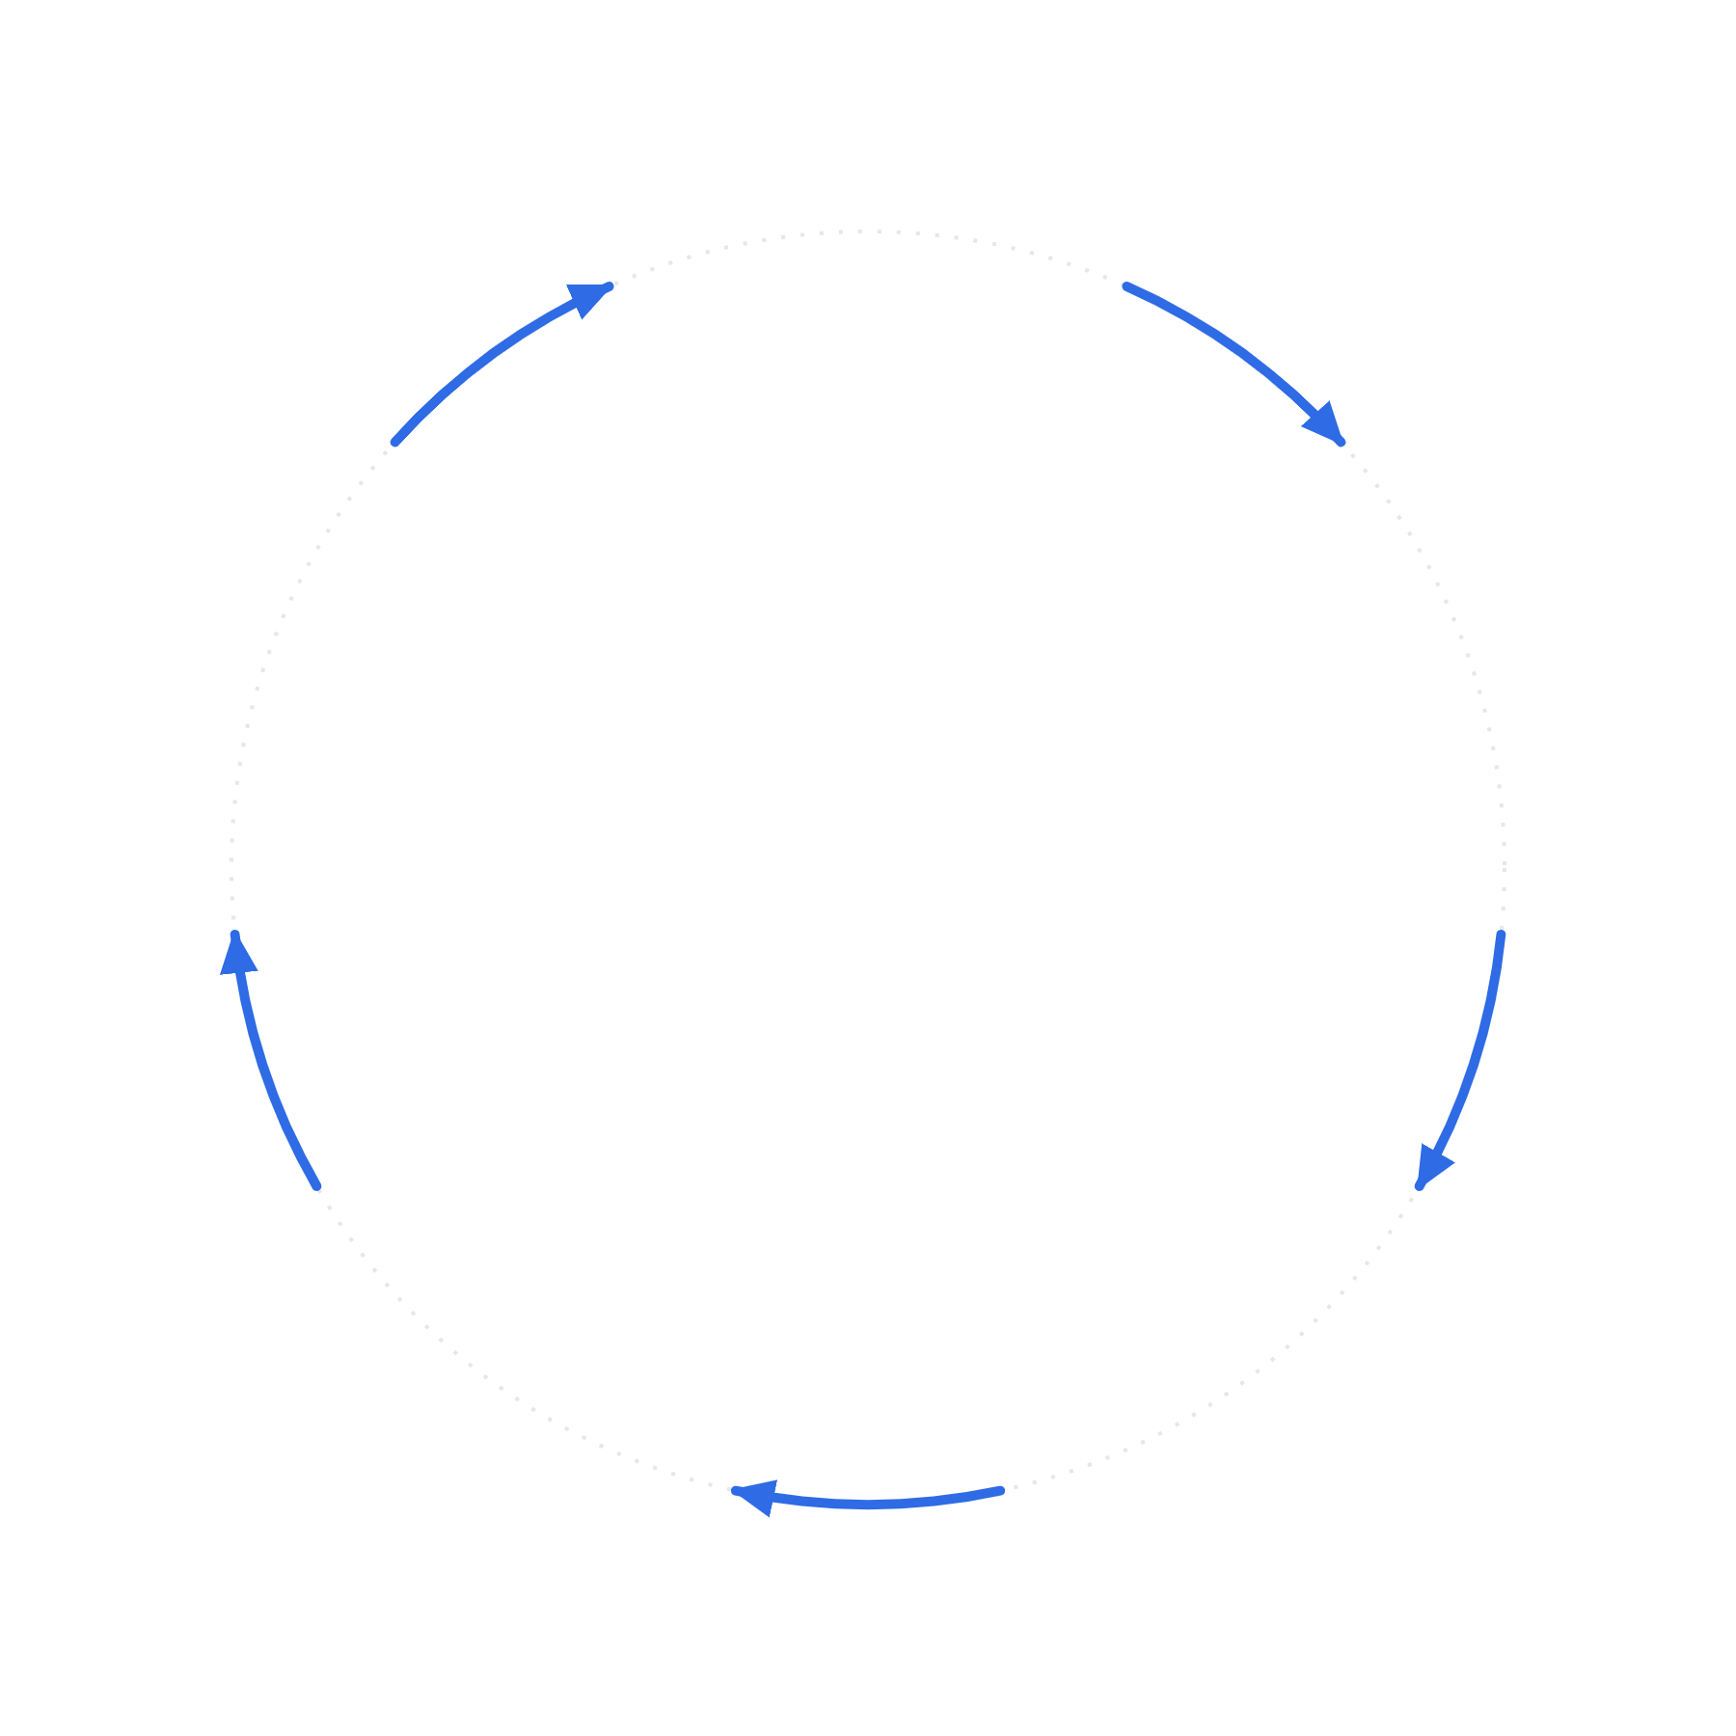
1
SELECT
Select file corresponding to iterator
5
ADVANCE
2
LOAD
Increase iterator
Load input data from selected file
LOOP
One pass per input file
4
STORE
3
SOLVE
Store output results
Solve math program

