Slide 1
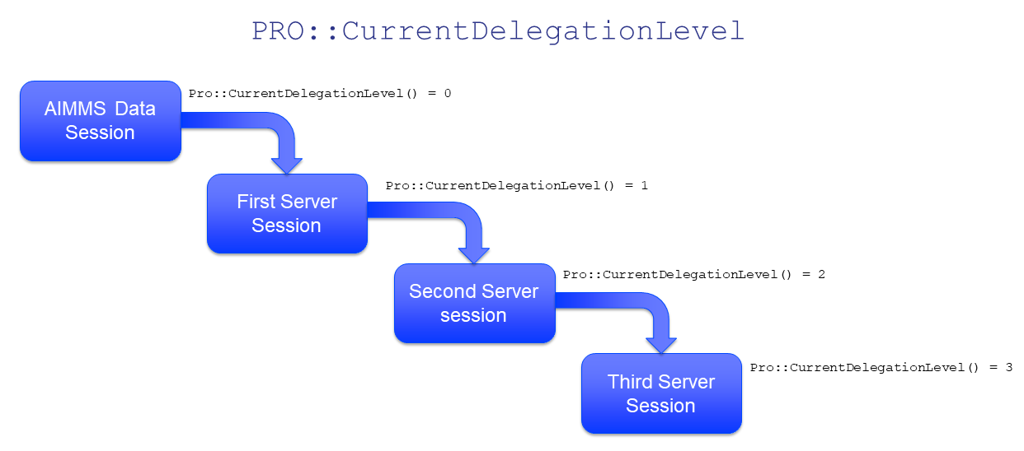

Slide 2
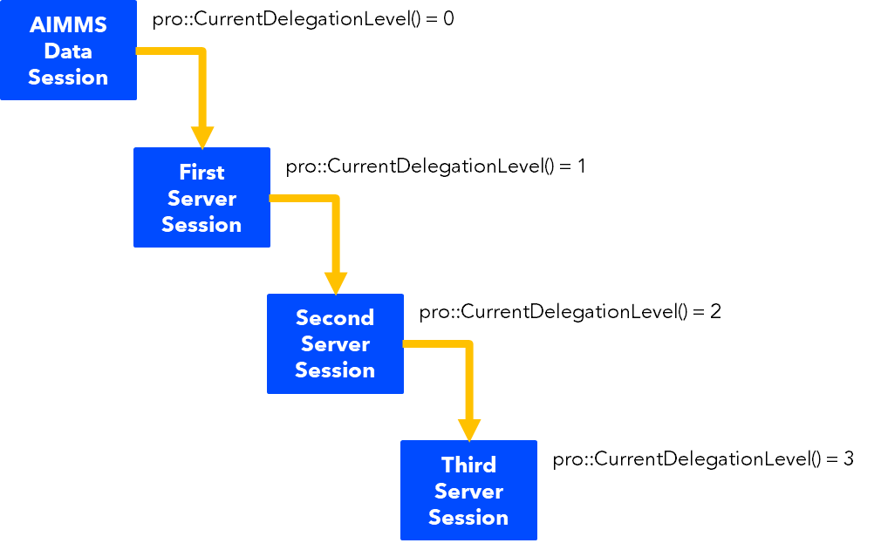
AIMMS Data Session
pro::CurrentDelegationLevel() = 0
First Server Session
pro::CurrentDelegationLevel() = 1
Second Server Session
pro::CurrentDelegationLevel() = 2
Third Server Session
pro::CurrentDelegationLevel() = 3

