Slide 1
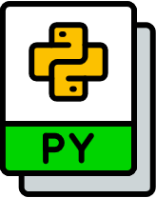
Python Interpreter
Virtual Environment
Virtual Environment

