Slide 1
Operating Systems Concepts (CS-351)
Week 1

Slide 2
Course Information
Course: CS-351 (3 credits)
Time and place:
Course Website: Titanium
Instructor: Mikhail I. Gofman
Email: mgofman@fullerton.edu
Phone: (657) 278-7304 (office)
Office: CS-548
Office Hours: TR 4:00 pm – 5:00 pm, 7:00 pm - 8:00 pm, F 7:00 pm – 9:00 pm, and by appointment
Section | Days | Times | Place
01 | T R | 1:00 pm – 2:15 pm | CS 104 – Teaching Lab
02 | T R | 2:30 pm – 3:45 pm | CS 101 - Self Instruction Lab

Slide 3
Prerequisites
Prior to taking this course, you must either:
Complete all of the following courses (strictly enforced):
CPSC-254: UNIX and Open Source Systems
CPSC 301/EPP (corequisite): Programming Lab Practicum
Or, have the permission of the CS department.
Failure to meet the prerequisites may result in you being dropped administratively.
Notes:
Source: http://www.fullerton.edu/ecs/cs/cscoursedescription.htm

Slide 4
Course Objectives
To learn about the design and implementation of modern operating systems (OSs):
Operating Systems. What are they? What do they do?
Classical components of modern operating systems:
Processes
Threads
CPU schedulers
Memory managers
File systems
I/O systems
Interposes communications mechanisms
State-of-the-art and the future:
Virtual machines
Cloud computing
Mobile Computing

Slide 5
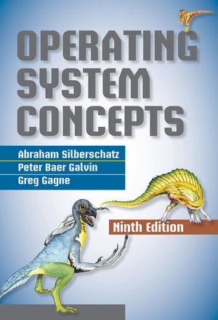
Texts
Silberschatz, Galvin, Gagne, Operating System Concepts, 9th edition, ISBN: ISBN 978-1-118-06333-0.
Not required, but highly recommended.
All additional materials shall be posted on Titanium.

Slide 6
Evaluation
Course grade breakdown:
Assignments: 30% (around 4 Assignments)
In-class/take-home quizzes: 20% (may drop 1 lowest)
Attendance and participation: 5%
Midterm: 20%
Final Exam: 25%
The course grade shall be curved over the entire class, and (strictly) assigned according to the following range:
B: ≥ 82%
B-: ≥ 80%
C+: ≥ 78%
C: ≥ 72%
C-: ≥ 70%
D+: ≥ 68%
D: ≥ 62%
D-: ≥ 60%
A+: ≥ 95
A-: ≥ 90
A: ≥ 93%
B+: ≥ 88%

Slide 7
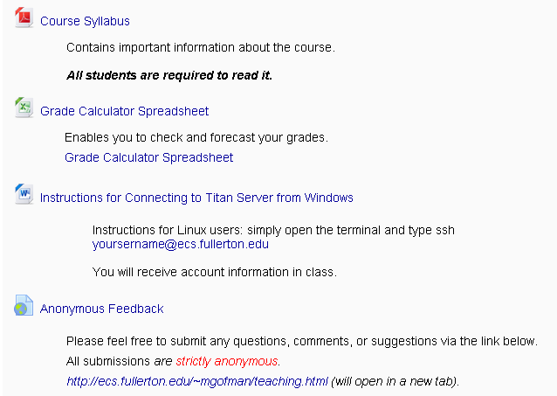
Grade Calculator Spreadsheet
Grade calculator spreadsheet has been posted on Titanium.
Just replace the sample grades and weights with your own.
Useful for forecasting your average.
Does not consider the curve.

Slide 8
Assignments
Written assignments: may be done by groups of 2 students (unless otherwise specified)
Programming assignments:
To be done individually
Must use Linux OS.
Must use C or C++
Familiarity with basic C and Unix is assumed.
Exceptions to these rules shall be announced.
All completed assignments must be submitted via Titanium.
Late assignments shall be penalized 10%.
No assignment shall be accepted after 24 hours from the deadline.

Slide 9
Quizzes
In-Class quizzes:
Closed book.
Test your understanding of the material presented in class.
Missed quizzes shall earn a grade of 0 (unless you can provide written documentation of a legitimate excuse e.g., doctor’s note).
Take-home quizzes:
Require critical thinking (and creativity!).
Late submissions shall be penalized 10%.
No quiz shall be accepted after 24 hours from the deadline.

Slide 10
Exams
All exams are comprehensive and closed book.
Midterm (Tentative):
Sections 1 and 2: 10/27/2016 (In class).
There will be no make ups (unless accompanied by written evidence of a valid excuse).
Final Exam (In-class):
Section 1: 12/13/2016 (12:00 pm - 1:50 pm)
6
Section 2: 12/15/2016 (2:30 pm - 4:20 pm)
Check with the Final Exam Schedule posted online.
Missed exams shall be dealt with according to University policies on incompletes and withdrawals.

Slide 11
Attendance and Participation
The attendance is mandatory and shall be taken at beginning of every class.
You may miss 1 class without incurring attendance penalties.
Participate in class discussions (don’t be afraid!).
Ask questions!

Slide 12
Extra Credit
Some assignments, exams, and quizzes may include bonus sections.
No other forms of extra credit shall be granted.

Slide 13
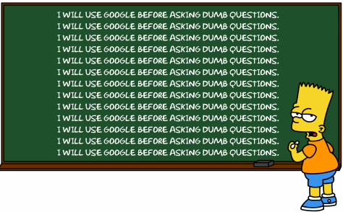
Asking Questions
Never be afraid to ask:
In class or after class.
During office hours.
Make Google your friend (can’t beat the availability and response time!)

Slide 14
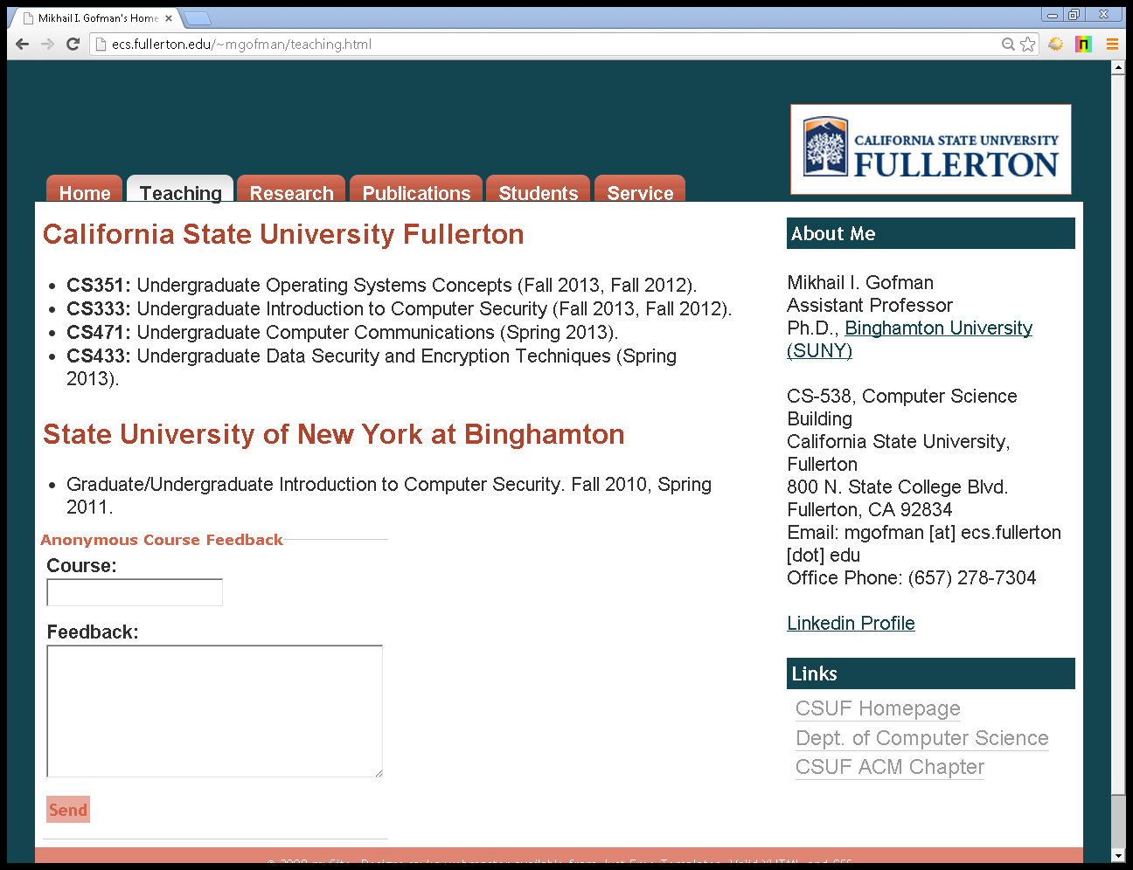
Anonymous Feedback
Please feel free to anonymously submit comments and questions at http://ecs.fullerton.edu/~mgofman/teaching.html.

Slide 15
Class Cancellation Policy
All class cancellations shall be announced by email.
Instructor does not arrive within the first 15 minutes of class = class is canceled.

Slide 16
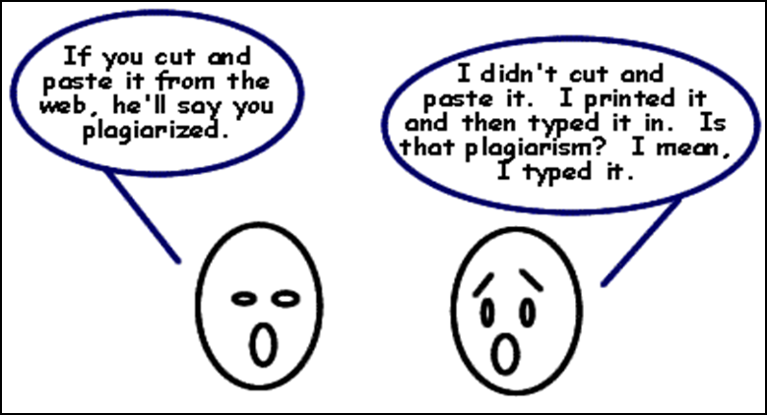
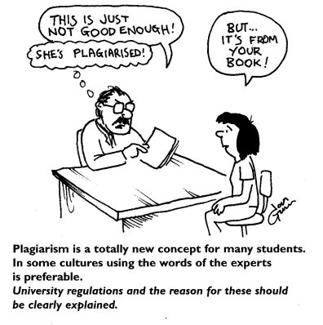
Academic Honesty

Slide 17

Academic Honesty
Incidents of cheating shall be treated with utmost seriousness.
You may discuss the problems with other students, however, you must write your own solutions.
Discussing solutions to the problem is NOT acceptable.
Copying an assignment from another student or allowing another student to copy your work may lead to an automatic F for this course.
If you have any questions about whether an act of collaboration may be treated as academic dishonesty, please consult the instructor before you collaborate.
Moss shall be used to detect plagiarism in programming assignments.

Slide 18
Emergency Policy
Please familiarize yourself with the actions to take in case of an emergency.
The information can be found at http://prepare.fullerton.edu/

Slide 19
Disabled Student Services
Information for students with disabilities can be found at: http://www.fullerton.edu/DSS/

Slide 20
Course Syllabus
You are required to read the syllabus!
A copy of the syllabus is available on Titanium.
If something is not clear, ask the instructor.

Slide 21
Introduction to Operating Systems
Silberschatz Chapter 1

Slide 22
Agenda
Operating Systems, what are they? What do they do?
Computer organization fundamentals
Operating System Functions
Process Management
Memory Management
Storage Management
I/O Management
Protection and Security
Distributed Systems
Special Purpose Operating Systems
Computing Models

Slide 23
What is an Operating System?
A program that:
Runs at all times (a.k.a. a resident monitor, a.k.a. kernel)
Manages computer’s hardware resources.
Provides basis for application programs.
Acts as an intermediary between user and hardware.
No completely adequate definition.
Why do we need operating systems?
Increase the usability of computers.
Simplify problem solving.

Slide 24
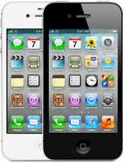
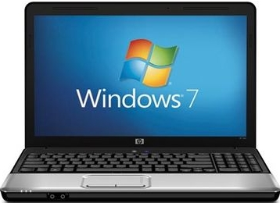
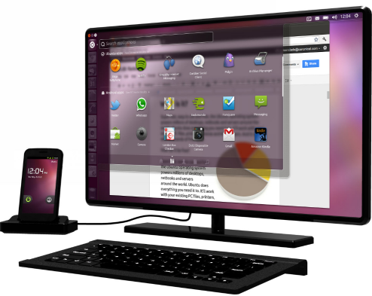
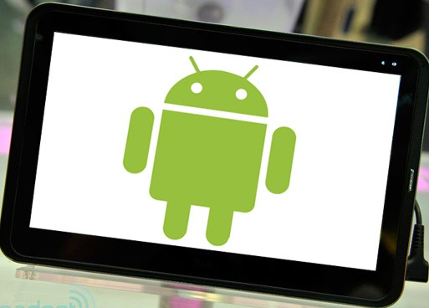
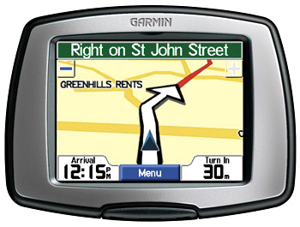
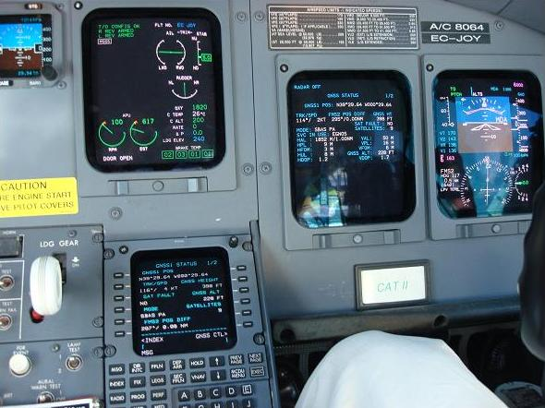
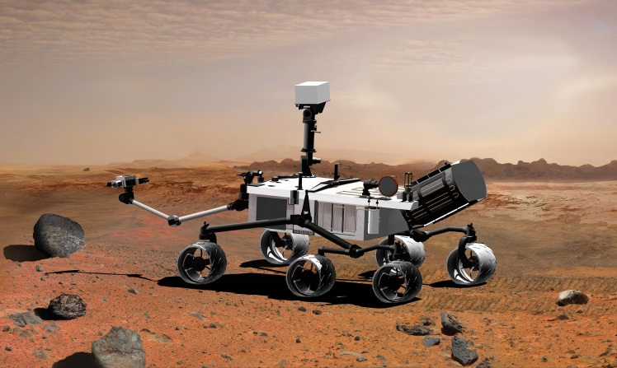
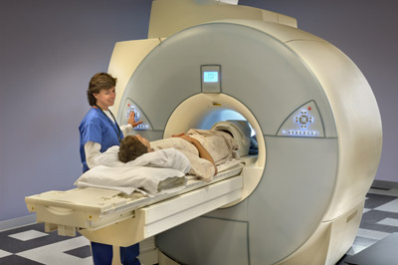
The Diversity of Operating Systems

Slide 25








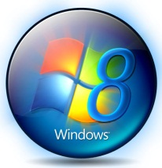
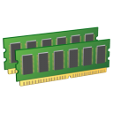



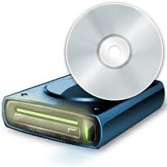
OS’s Place in the Overall System
Components of a computer system: application programs, operating system, and computer hardware.
User
1
User
2
User
3
…
User
n
Application 1
Application 2
Application 3
Application n
System and application programs
Operating System
Hardware (CPU, memory I/O devices)

Slide 26
What does an operating system do?
Overall: provides the means for proper use of system resources e.g., hardware, software, and data.
Similar to a government, OS serves no useful function when by itself. It only provides an environment in which user programs can do useful work.

Slide 27
What does an operating system do?
Users and computers perceive the OS differently.
User perspective of OS: OS is something that makes computers easier to use and simplifies problem solving.
Varies according to how users interact with the system:
Example: Most users interact with an OS using a keyboard, monitor, and mouse and a GUI.
Such systems are designed for ease of use and performance; strive to maximize productivity (or play).
Example: Multiple users connect to a mainframe computer using a terminals:
Such systems are designed to maximize resource utilization and fair sharing of resources among users.

Slide 28
What does an operating system do?
System Perspective:
Resource allocator: allocates and manages hardware resources e.g. CPU time, memory space, disk space, and I/O.
Control program: manages the execution of user programs.

Slide 29
Process Management
Process: a unit of work on the system
Program vs. Process:
Program: is a set of instructions (a passive entity).
Process: a program in execution (an active entity).
Processes require resources to run:
CPU time
Memory
Files
I/O devices

Slide 30
Process Management (1)
Operating system must:
Act an intermediary between the process and the rest of the system.
Allocate resources when the process starts, manage them while it runs, and reclaim them when the process terminates.
Multiplex resources among multiple processes.
Provide means for suspending/resuming a process.
Provide means for process synchronization.
Provide means for inter-process communications.

Slide 31
Process Management (2)
OS acts as an intermediary between a process and the rest of the system:
Processes are restricted from accessing hardware directly.
If process needs to access hardware (e.g., open a file on the disk), the process must request OS to perform the access on the process’s behalf.
Shifts the burden of dealing with hardware peculiarities from the application developers to the OS.
Allows OS to enforce order e.g., deny invalid/unauthorized accesses.

Slide 32
Process Management (3)
OS exposes a set of system calls: functions which processes can invoke to request services from the operating system such as:
Read file from the disk
Send data over the network
Send message to another process

Slide 33
Process Management (4)
Example: Some Linux system calls:
sys_open(): open a file
sys_close(): closes the file
sys_read(): reads from file
sys_write(): writes to file
Linux system calls are defined in part of the operating system called the system call table: http://docs.cs.up.ac.za/programming/asm/derick_tut/syscalls.html

Slide 34
Process Management (5)
A typical computer supports two modes of execution (i.e., dual-mode operation): user mode and system mode:
User mode (i.e., unprivileged mode): when a process is executing.
Allows the process to execute only unprivileged instructions e.g., addition, subtraction, logical operations, etc.
CPU restricts execution of privileged instructions (e.g., instructions for directly accessing hardware, managing OS timers, etc).
System mode (i.e., privileged mode): when the OS is executing.
CPU allows execution of privileged instructions.

Slide 35
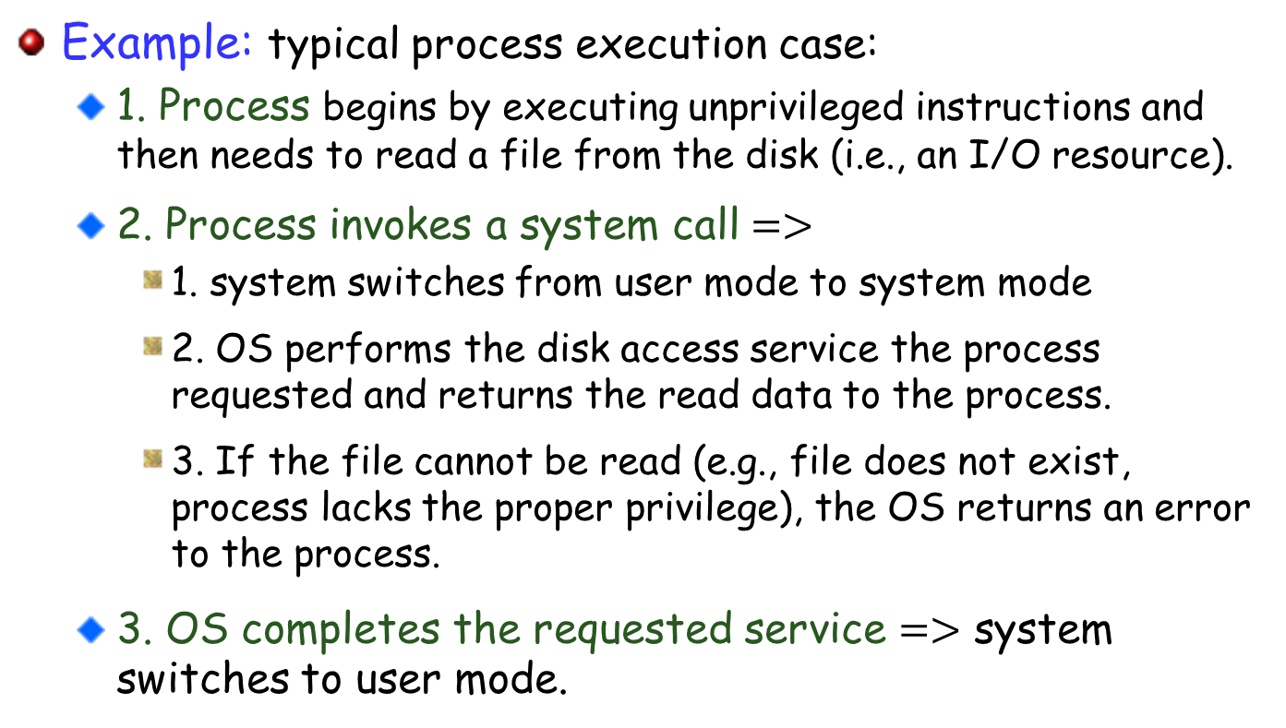
Process Management (6)
Example: typical process execution case:
1. Process begins by executing unprivileged instructions and then needs to read a file from the disk (i.e., an I/O resource).
2. Process invokes a system call $=>$
1. system switches from user mode to system mode
2. OS performs the disk access service the process requested and returns the read data to the process.
3. If the file cannot be read (e.g., file does not exist, process lacks the proper privilege), the OS returns an error to the process.
3. OS completes the requested service $=>$ system switches to user mode.

Slide 36
Process Management (7)
Why two modes?
To protect OS from the errant programs/users.
To protect errant users/programs from each other.
Example:
1. Process is executing (i.e., the system is in user mode)
2. Process invokes an instruction to update an OS timer—a privileged instruction!
3. The CPU sees an attempt to invoke a privileged instruction in the user mode, and prevents it.

Slide 37
Process Management (7)
To know what mode the system is currently in, CPU maintains a mode bit
Set to 0 when in system mode.
Set to 1 when in user mode.
Before executing a privileged instruction, the CPU verifies that mode bit == 0.

Slide 38
Memory Management
Main memory:
A large array of bytes or words where each byte or word has its own address.
The only large storage directly accessible by the CPU.
For improved resource utilization, several programs are usually kept in memory:
Introduces the need for memory management.
Memory Management:
Keep track of what parts of memory are being used by what processes.
Decide which processes (or parts of) to move into and out of memory.
Allocate and deallocate memory as needed.

Slide 39
Storage Management (1)
For convenience, the information on the storage device is abstracted into units called files.
File: collection of related information defined by its creator.
Operating system file management services:
Creating and deleting files.
Creating and deleting directories (i.e., collections of files).
Mapping files to memory on the storage device.
File Backup.
Mass-storage (e.g., disk) management:
Managing free space.
Storage allocation.
Disk scheduling (i.e., managing multiple operations that read/write to/from the disk).

Slide 40
Storage Management (2)
Caching: temporarily store data/instructions in faster storage (i.e., cache) and access them from there.
Must ensure data consistency along all levels of the hierarchy.
Hardware Registers
Speed
Price
Cache Memory
Main Memory
Magnetic Disk

Slide 41
I/O Management (1)
Purpose: hide the peculiarities of specific devices from the user.
Example: the Unix I/O subsystem provides:
Functionality to manage data buffering, caching, and spooling.
A general device driver interface.
Drivers for specific hardware devices (which know how to control the specific device).

Slide 42
I/O Management (2)
Example: How Unix/Linux I/O subsystem provides uniform interface for wide range of devices:
This code works on many different devices:
// Linux abstracts devices as files; application developers can
// read/write data to/from devices just like reading/writing files.
// Open the device (just like opening a file!)
int fd = open(“/dev/somedevice”);
// Write 10 integers to the device
for(int iCount=0; iCount < 10; ++iCount){
fprintf(fd, “%d\n”, iCount);
}
close(fd)
// Example from: http://www.cs.columbia.edu/~krj/os/lectures/L24-IO.pdf

Slide 43
Protection and Security
Protection: controls the access of users and processes to the system resources (e.g., memory, files, etc).
Internal to the OS
Example: process A attempts to (illegally) write to the memory of process B. The operating system detects the violation and terminates process A.
Security: defending the OS against external threats.
Example: malware (e.g., viruses, worms, etc).
Protection vs. Security: definitions vary

Slide 44
Computing Environments: Distributed Systems
A collection of physically separate, networked systems that share resources.
Advantages of resource sharing: increases computation speed, functionality, data availability, and reliability.
Distributed systems can be interconnected via:
Local-Area Network (LAN): connects systems within a single floor room or building, or
Wide-Area Network (WAN): connects buildings, cities, or countries.

Slide 45
Computing Environments: Mobile Computing
Computing on handheld smartphones and tablet computers.
Sacrifice screen size, memory capacity, CPU power, in favor of portability:
This will change as mobile devices grow more powerful.
Allows for applications impractical on traditional systems (e.g. laptops, desktops, etc).
Navigation
Augmented reality
Many others!
Dominant OSs:
iOS: designed for Apple’s iPhone and iPad platforms.
Android: runs on all sorts of devices.

Slide 46
Real-Time Embedded Systems
Embedded Systems: systems dedicated to specific tasks e.g. controlling car engines, robotic arms, etc.
Usually have little to no user interface.
One of the most prevalent types of computers.
Real-Time Systems: systems where tasks must complete within the defined timing constraints.
Example: the robotic arm must stop moving before it smashes into a car it was building (not after!).
Embedded systems usually run real-time operating systems.

Slide 47
Multimedia Systems
Systems specialized to deliver media content (i.e. a mix of text, video, sound, etc).
Some media must be delivered within certain timing constraints.

Slide 48



Computing Models: Virtual Machines (1)
Virtual Machines (VMs): a software that can run its own operating system and applications just like a real physical system.
VM1
VM2
VM3
Applications
Applications
Applications
OS
OS
OS
Virtual Hardware
Virtual Hardware
Virtual Hardware
Virtualization Software (Bare-Metal Hypervisor)
Hardware (CPU, memory I/O devices)

Slide 49
Computing Models: Virtual Machines (2)
Virtual Machines (VMs): a software that can run its own operating system and applications just like a real physical system.
VM1
VM2
VM3
Applications
Applications
Applications
OS
OS
OS
Virtual Hardware
Virtual Hardware
Virtual Hardware
Virtualization Software (Hosted Hypervisor)
Operating System
Hardware (CPU, memory I/O devices)

Slide 50
Computing Models: Cloud Computing (1)
Delivers services over the network.
Three types of cloud computing services:
Infrastructure-as-a-Service (IaaS): provides hardware resources e.g., storage, CPU, and networking services.
Platform-as-a-Service (PaaS): provides hardware and platform ready for applications (e.g., a database server).
Software-as-a-Service (SaaS): provides software applications over the network.
Helps reduce operating costs.
Helps to improve resource utilization (by combining computing resources).
Makes it easier to tackle large scale computing problems.

Slide 51
Computing Models: Cloud Computing (2)
Types of clouds:
Public: available to anybody willing to pay for the services.
Example: Amazon’s Elastic Cloud (EC2)
Example: Google’s App Engine
Private: a cloud run by a company for its own use.
Example: IBM SmartCloud Foundation
Hybrid: a combination of public and private.

Slide 52
Next Class
Processes

