Slide 1
Processes I (CS-351)
Week 2
Notes:
Hi everyone. My name is Mikhail I. Gofman. It’s Great to be here.
I will be presenting our work titled Preserving confidentiality in Virtual Machine Checkpointing and Role Based Access Control

Slide 2
Last Lecture
What are operating systems? What do they do?
Outline of Operating System Structure and Services:
Process Management
Memory Management
Storage Management
I/O Management
Protection and Security
Types of Operating Systems

Slide 3
Agenda
What is a process?
Process Scheduling
Parents and Children

Slide 4
Processes
Process: a unit of work on the system.
Recall: Program vs. Process:
Program: is a set of instructions (a passive entity).
Process: a program in execution (an active entity).
Processes need resources: CPU, memory, files, and I/O devices.
Application vs. Process: an application may consist of multiple processes e.g., Google Chrome.

Slide 5
Process Memory
max
Stack
Stack: stores function parameters, local variables, and return address.
Heap: contains dynamic memory allocated during process runtime.
Data: contains global variables.
Text: stores the program instructions (i.e., the executable).
Heap
Data
Text (i.e. binary)
0

Slide 6
Process Memory: Example
int a = 1;
int f(int c) { int b = c+1; return b;}
int main()
{ int d = 2;
char* arr = new char[100];
for(int i = 0; i < 100; ++i)
arr[i] = ‘\0’;
f(d);
delete arr;
return 0;
}
max
Stack
Heap
Data
Text (i.e. binary)
0

Slide 7
Process Memory: Example
int a = 1;
int f(int c) { int b = c+1; return b;}
int main()
{ int d = 2;
char* arr = new char[100];
for(int i = 0; i < 100; ++i)
arr[i] = ‘\0’;
f(d);
delete arr;
return 0;
}
Data
max
Stack
Heap
Data
Text (i.e. binary)
0

Slide 8
Process Memory: Example
int a = 1;
int f(int c) { int b = c+1; return b;}
int main()
{ int d = 2;
char* arr = new char[100];
for(int i = 0; i < 100; ++i)
arr[i] = ‘\0’;
f(d);
delete arr;
return 0;
}
max
Stack
Stack
Heap
Data
Text (i.e. binary)
0

Slide 9
Process Memory: Example
int a = 1;
int f(int c) { int b = c+1; return b;}
int main()
{ int d = 2;
char* arr = new char[100];
for(int i = 0; i < 100; ++i)
arr[i] = ‘\0’;
f(d);
delete arr;
return 0;
}
max
Stack
Heap
Heap
Data
Text (i.e. binary)
0

Slide 10
Process Memory: Example
int a = 1;
int f(int c) { int b = c+1; return b;}
int main()
{ int d = 2;
char* arr = new char[100];
for(int i = 0; i < 100; ++i)
arr[i] = ‘\0’;
f(d);
delete arr;
return 0;
}
max
Stack
Heap
Data
Text (i.e. binary)
0
Text (i.e., executable instructions)

Slide 11
Process States
Terminated
Creation Complete
New
Execution Interrupted
Running
Execution Complete
Ready
The event we were waiting for has happened (e.g. I/O completed)
Assigned to CPU
Need to wait for an event (e.g. I/O to complete)
Waiting
The states of a process:
New: Process being created.
Running: Instructions are being executed.
Waiting: process is waiting for some event (e.g., I/O completion).
Ready: process waiting to be assigned to a processor.
Terminated: the process has finished execution.

Slide 12
Process States in Linux
Can learn process state using the ps utility:
Example: ps –aux
Interpreting the output of ps:
R the process is running or runnable (on run queue).
D uninterruptible sleep (usually I/O)
S interruptible sleep (waiting for an event to complete)
Z defunct/zombie, terminated but not reaped by its parent (discussed later).
T stopped, either by a job control signal or because it is being traced
T
Process is paused using e.g. using Ctr+Z
Process is woken up e.g. using fg cmd.
I/O operation completes
D
R
Z
Process terminates
I/O operation
The event completes
Process must wait for an event to complete.
S

Slide 13
Process Control Block
To represent each process, the OS uses a Process Control Block (PCB):
PCB Components:
Process State: the state of the process e.g. Running.
Process ID: a unique ID associated with the process e.g. 123.
Program Counter: the address of the next instruction to be executed.
CPU Registers: the current values of the accumulators, stack pointers, etc.
CPU-Scheduling Information: e.g. priority and other info. needed for assigning the process to the CPU.
Process State
Process ID
Program Counter
Registers
Scheduling Info.
Memory Limits
Open Files
…

Slide 14
Process Control Block
PCB Components (Contd):
Memory Management Information: info. about memory belonging to the process.
Accounting Information: e.g. how long the process was running etc.
I/O Status Information: list of I/O devices used by the process, list of open files, etc.
Example: in Linux OS, PCB is represented using struct task_struct which contains:
struct mm_struct mm – which stores memory information.
struct files_struct *files – list of open files
and much more.
Process State
Process ID
Program Counter
Registers
Scheduling Info.
Memory Limits
Open Files
…

Slide 15
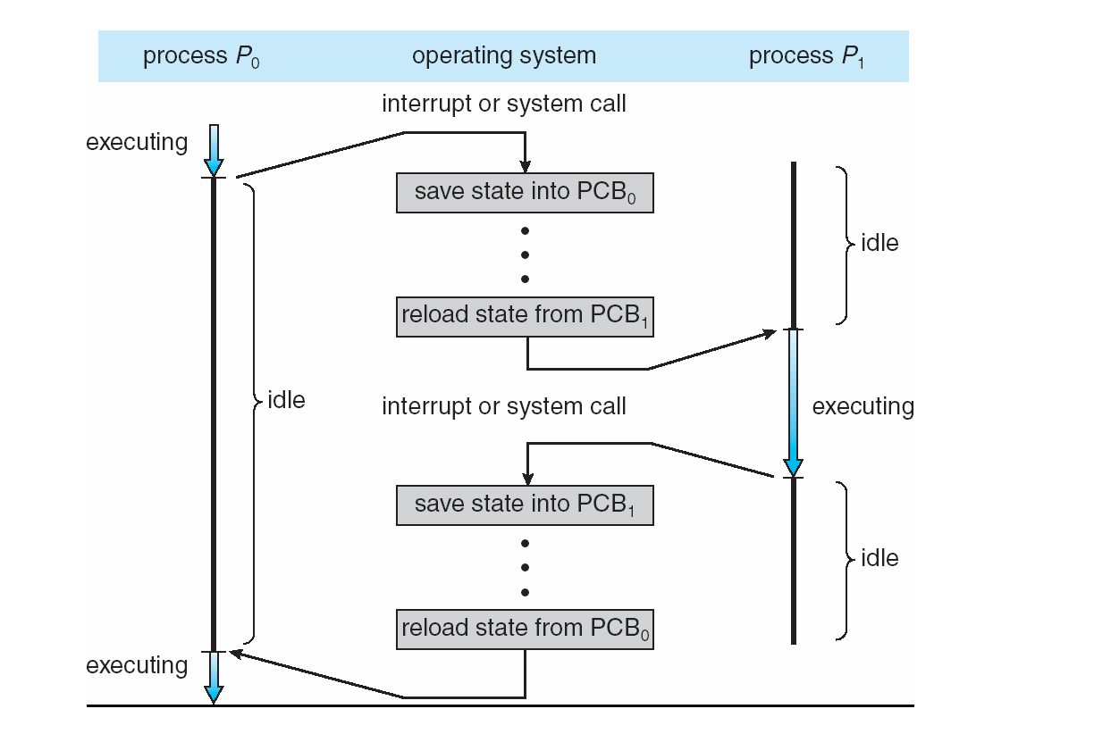
Process Control Block: Usage

Slide 16
Process Scheduling: The Queuing Mechanism
Objective of multiprogramming (i.e., supporting multiple processes): have some process running at all times, to increase CPU utilization.
Solution: use a process scheduler: decides which available processes get the CPU.
Process scheduler implementation consists of:
Job queue: contains all processes on the system.
Ready queue: contains processes that are in the main memory and are ready to execute.
Device queue (1 per device): contains all processes waiting to use a particular device.

Slide 17
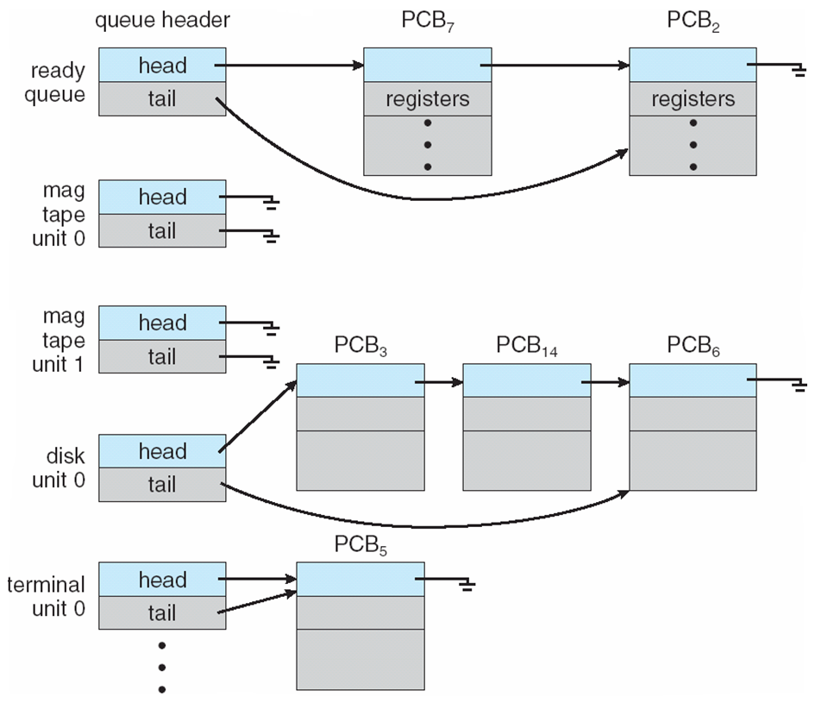
Process Scheduling: The Queuing Mechanism
Example of queues:

Slide 18
Process Scheduling: The Queuing Mechanism in Action
1. New process is placed on a ready queue.
2. The process is dispatched i.e., selected for execution.
3. During execution:
Process may be queued on the device queue due to an I/O request.
Process can create a new subprocess and wait for its termination.
Process can be interrupted and removed from the CPU.
Process time slice (i.e. time allotted for its CPU use) expires:
Process is placed removed from the CPU, and
Placed on the the ready queue until scheduled to run for another time slice.

Slide 19
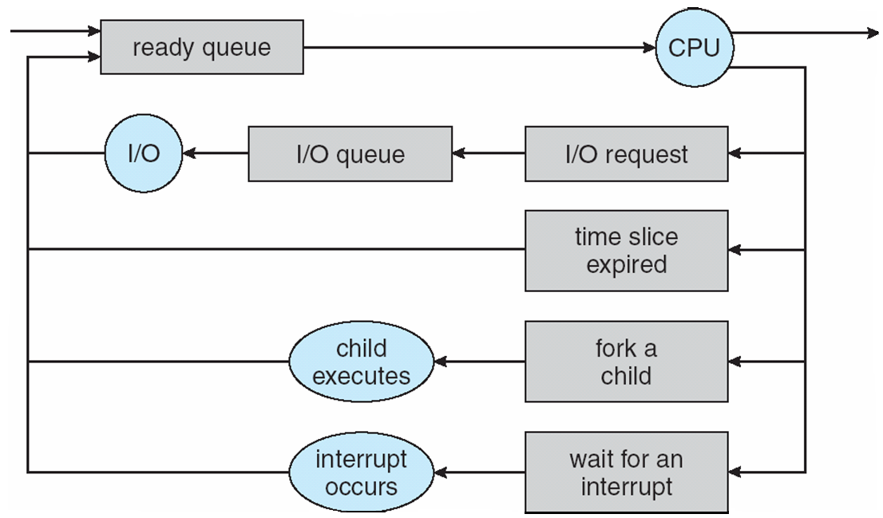
Process Scheduling: The Queuing Mechanism in Action
Boxes = queues
Circles = actions

Slide 20
Process Scheduling: Schedulers
Assigning processes to queues and selecting processes for execution, is the job of a process scheduler.
Types of schedulers:
Short-term
Long-term
Middle-term

Slide 21
Process Scheduling: Schedulers: Short-term
Short-term scheduler: decides which process in memory gets the CPU.
Invoked very frequently (often at least once every 100 msecs)
Has to be efficient.

Slide 22
Process Scheduling: Schedulers: Long-term
Question: What if we have more processes than can fit into memory?
Answer: no problem! Spool (i.e. temporarily store) some processes on a mass storage device (e.g., hard drive).
Long-term scheduler: selects spooled processes to load from the mass storage device into main memory.
Executes less frequently than a short-term scheduler.

Slide 23
Process Scheduling: Schedulers: Long-term
Key idea: maximize resource utilization by selecting a mix of CPU bound and I/O bound processes:
I/O bound processes: processes that spend more time doing I/O operations than CPU computations.
CPU bound processes: processes that spend more time doing CPU computations than I/O operations.
Why is mixing important?
If all selected processes are I/O-bound, then ready queue will always be empty i.e., nothing to execute on the CPU!
If all selected processes are CPU-bound, the device queues will be empty i.e., the devices go unused.
Not present on all systems: e.g., Windows and Unix.

Slide 24
Process Scheduling: Schedulers
Medium-term scheduler:
Removes some processes from memory in order to improve the process mix.
Later, the removed processes can be brought back into memory.
The job of the medium-term scheduler is a.k.a. swapping.

Slide 25
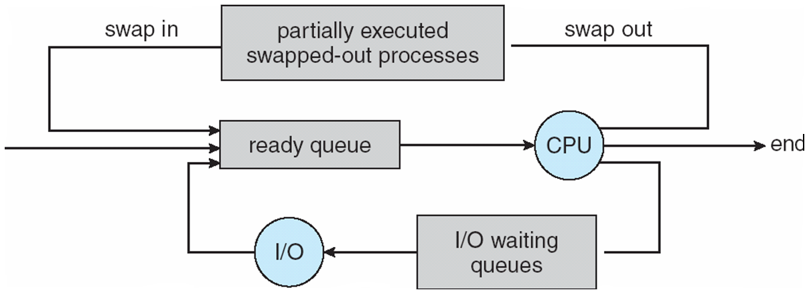
Process Scheduling: Schedulers
Medium-term scheduler in action:

Slide 26
Process Scheduling: Context Switching
Context switch: switching CPU between processes:
1. Save CPU state of the currently executing process into a PCB.
2. Select another process.
3. Use the saved PCB of the selected process to initialize the CPU.
4. Let the selected process resume execution.
Context switch time is pure overhead!

Slide 27
Operations on Processes
A process may create new processes by issuing a process creating system call i.e., asking the OS to create another process.
Parent process: the creator process.
Child process: the process created by the parent process.
Child processes can create their own child processes.
Process tree: a model of parent-child relationships.

Slide 28
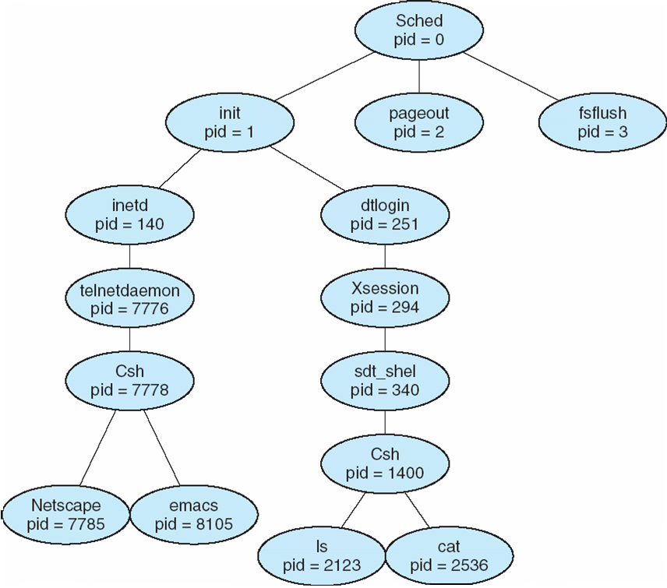
Operations on Processes: Process Tree Example
Process tree of Solaris processes.

Slide 29
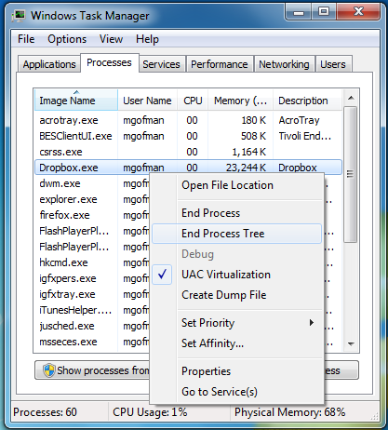
Operations on Processes: Process Tree Example
Windows: “End Process Tree” terminates the selected process and all its descendants.

Slide 30
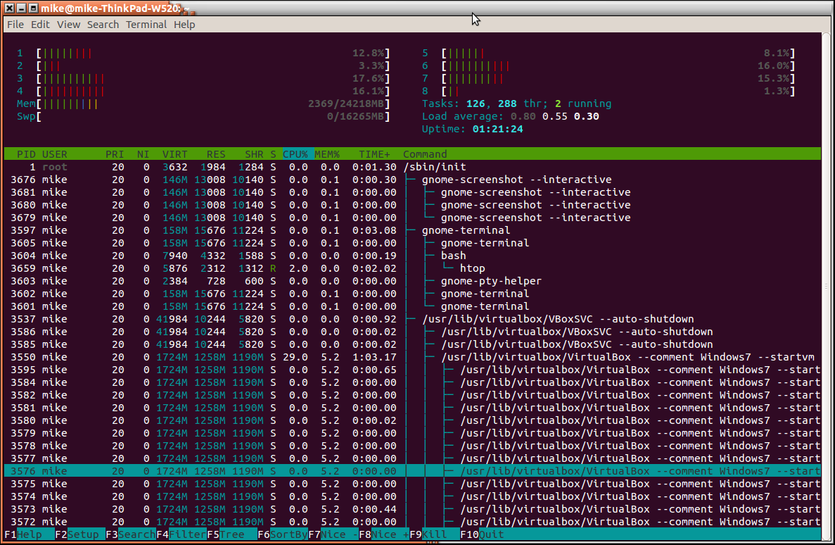
Operations on Processes: Process Tree Example
Linux: process displayed using the “htop” program.

Slide 31
Operations on Processes: Parent-Child Relations
After creating a child process a parent process may:
continue executing, or
wait for the child process to terminate.
The child process can either:
be a duplicate of the parent process (i.e. has the same program and data), or
it may be running a new program.

Slide 32
Next Lecture
More on process creation.
Inter-process communications.

