Slide 1
Processes II (CS-351)
Week 2
Notes:
Hi everyone. My name is Mikhail I. Gofman. It’s Great to be here.
I will be presenting our work titled Preserving confidentiality in Virtual Machine Checkpointing and Role Based Access Control

Slide 2
Operations on Processes: Process Creation in Unix/Linux: fork()
fork() system call is issued by a parent process to create a child process.
Child process is a clone of a parent process.
Both parent and child continue execution at the instruction immediately after fork():
In the child fork() returns 0
In the parent fork returns process id (pid) of the child.
fork() returns -1 on failure.

Slide 3
Operations on Processes: Process Creation in Unix/Linux: fork()
The child process inherits:
The set of files opened by the parent process.
Other resources…

Slide 4
Operations on Processes: Process Creation in Unix/Linux: exec()/wait()/exit()
exec(…): replaces the program of the caller process with a new program.
wait(…): waits until the child terminates.
exit(int exitcode): terminates the caller process with the specified exit code.

Slide 5
Operations on Processes: Process Creation in Unix/Linux: exec() variants
int execl(const char *path, const char *arg, ...);
int execlp(const char *file, const char *arg, ...);
int execle(const char *path, const char *arg,..., char * const envp[]);
int execv(const char *path, char *const argv[]);
int execvp(const char *file, char *const argv[]);
int execvpe(const char *file, char *const argv[], char *const envp[]);
Example: execlp(const char *file, const char *arg, ...);
file: the path of the executable image
arg0…argn: command line arguments to pass to the process.
All return -1 on failure

Slide 6
Operations on Processes: Process Creation in Unix/Linux: wait() variants
pid_t wait(int *status);
pid_t waitpid(pid_t pid, int *status, int options);
int waitid(idtype_t idtype, id_t id, siginfo_t *infop, int options);
wait() and waitpid() return the process id of the child.
waitid() return 0 on success and -1 on faliure.

Slide 7
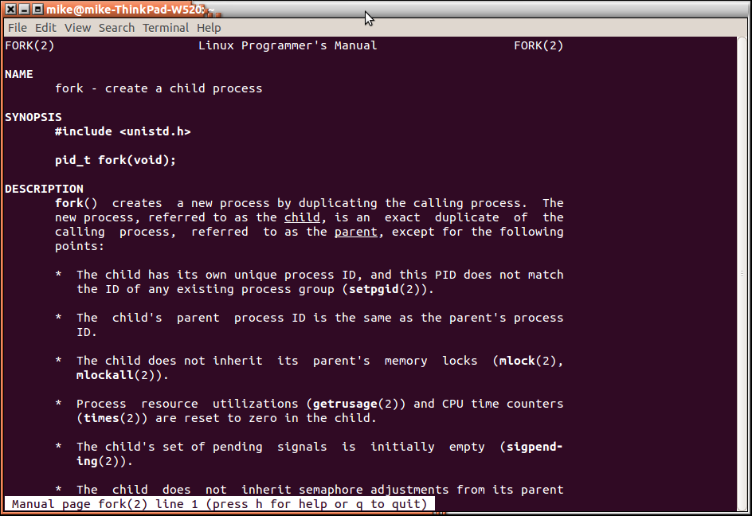
Operations on Processes: Process Creation in Unix/Linux: Manual Pages (man pages)
For more technical details (or usage) of fork(), exec(), and wait() please see the man pages:
Google: man fork, or
In Linux terminal: e.g. man fork

Slide 8
Operations on Processes: Process Creation in Unix/Linux: Putting it all Together
Start with a parent process
//Parent process
int main()
{
pid_t pid;
/* fork another process */
pid = fork();
if (pid < 0) { /* error occurred */
fprintf(stderr, "Fork Failed");
exit(-1);
}
else if (pid == 0) { /* child process */
execlp("/bin/ls", "ls", NULL);
}
else { /* parent process */
/* parent will wait for the child to complete */
wait (NULL);
printf ("Child Complete");
exit(0);
}
}

Slide 9
Operations on Processes: Process Creation in Unix/Linux: Putting it all Together
Parent process issues a fork() system call.
//Parent process
int main()
{
pid_t pid;
/* fork another process */
pid = fork();
if (pid < 0) { /* error occurred */
fprintf(stderr, "Fork Failed");
exit(-1);
}
else if (pid == 0) { /* child process */
execlp("/bin/ls", "ls", NULL);
}
else { /* parent process */
/* parent will wait for the child to complete */
wait (NULL);
printf ("Child Complete");
exit(0);
}
}

Slide 10
Operations on Processes: Process Creation in Unix/Linux: Putting it all Together
fork() clones the parent process. Both parent and child continue by executing the next instruction after fork().
//Parent process
int main()
{
pid_t pid;
/* fork another process */
pid = fork();
if (pid < 0) { /* error occurred */
fprintf(stderr, "Fork Failed");
exit(-1);
}
else if (pid == 0) { /* child process */
execlp("/bin/ls", "ls", NULL);
}
else { /* parent process */
/* parent will wait for the child to complete */
wait (NULL);
printf ("Child Complete");
exit(0);
}
}
//Child process
int main()
{
pid_t pid;
/* fork another process */
pid = fork();
if (pid < 0) { /* error occurred */
fprintf(stderr, "Fork Failed");
exit(-1);
}
else if (pid == 0) { /* child process */
execlp("/bin/ls", "ls", NULL);
}
else { /* parent process */
/* parent will wait for the child to complete */
wait (NULL);
printf ("Child Complete");
exit(0);
}
}

Slide 11
Operations on Processes: Process Creation in Unix/Linux: Putting it all Together
In parent, fork() returns process id of the child.
In child, fork() returns 0.
//Parent process
int main()
{
pid_t pid;
/* fork another process */
pid = fork();
if (pid < 0) { /* error occurred */
fprintf(stderr, "Fork Failed");
exit(-1);
}
else if (pid == 0) { /* child process */
execlp("/bin/ls", "ls", NULL);
}
else { /* parent process */
/* parent will wait for the child to complete */
wait (NULL);
printf ("Child Complete");
exit(0);
}
}
//Child process
int main()
{
pid_t pid;
/* fork another process */
pid = fork();
if (pid < 0) { /* error occurred */
fprintf(stderr, "Fork Failed");
exit(-1);
}
else if (pid == 0) { /* child process */
execlp("/bin/ls", "ls", NULL);
}
else { /* parent process */
/* parent will wait for the child to complete */
wait (NULL);
printf ("Child Complete");
exit(0);
}
}

Slide 12
Operations on Processes: Process Creation in Unix/Linux: Putting it all Together
Parent issues a wait() syscall to wait until the child terminates.
Child issues a execlp() syscall to replace its executable image with that of ls command
//Parent process
int main()
{
pid_t pid;
/* fork another process */
pid = fork();
if (pid < 0) { /* error occurred */
fprintf(stderr, "Fork Failed");
exit(-1);
}
else if (pid == 0) { /* child process */
execlp("/bin/ls", "ls", NULL);
}
else { /* parent process */
/* parent will wait for the child to complete */
wait (NULL);
printf ("Child Complete");
exit(0);
}
}
//Child process
int main()
{
pid_t pid;
/* fork another process */
pid = fork();
if (pid < 0) { /* error occurred */
fprintf(stderr, "Fork Failed");
exit(-1);
}
else if (pid == 0) { /* child process */
execlp("/bin/ls", "ls", NULL);
}
else { /* parent process */
/* parent will wait for the child to complete */
wait (NULL);
printf ("Child Complete");
exit(0);
}
}

Slide 13
Operations on Processes: Process Creation in Unix/Linux: Putting it all Together
Parent waits (in wait()) for the child process to terminate.
ls command executes starting from the first instruction; original child code is destroyed.
//Parent process
int main()
{
pid_t pid;
/* fork another process */
pid = fork();
if (pid < 0) { /* error occurred */
fprintf(stderr, "Fork Failed");
exit(-1);
}
else if (pid == 0) { /* child process */
execlp("/bin/ls", "ls", NULL);
}
else { /* parent process */
/* parent will wait for the child to complete */
wait (NULL);
printf ("Child Complete");
exit(0);
}
}
//Child process
ls command code

Slide 14
Operations on Processes: Process Creation in Unix/Linux: Putting it all Together
wait() returns, and parent process executes the next instruction
ls command finishes execution and terminates
//Parent process
int main()
{
pid_t pid;
/* fork another process */
pid = fork();
if (pid < 0) { /* error occurred */
fprintf(stderr, "Fork Failed");
exit(-1);
}
else if (pid == 0) { /* child process */
execlp("/bin/ls", "ls", NULL);
}
else { /* parent process */
/* parent will wait for the child to complete */
wait (NULL);
printf ("Child Complete");
exit(0);
}
}
//Child process
ls command code

Slide 15
Operations on Processes: Process Creation in Unix/Linux: Putting it all Together
Parent process issues an exit() syscall in order to self-terminate.
//Parent process
int main()
{
pid_t pid;
/* fork another process */
pid = fork();
if (pid < 0) { /* error occurred */
fprintf(stderr, "Fork Failed");
exit(-1);
}
else if (pid == 0) { /* child process */
execlp("/bin/ls", "ls", NULL);
}
else { /* parent process */
/* parent will wait for the child to complete */
wait (NULL);
printf ("Child Complete");
exit(0);
}
}

Slide 16
Operations on Processes: Process Creation in Unix/Linux: Putting it all Together
Parent process terminates.
//Parent process
int main()
{
pid_t pid;
/* fork another process */
pid = fork();
if (pid < 0) { /* error occurred */
fprintf(stderr, "Fork Failed");
exit(-1);
}
else if (pid == 0) { /* child process */
execlp("/bin/ls", "ls", NULL);
}
else { /* parent process */
/* parent will wait for the child to complete */
wait (NULL);
printf ("Child Complete");
exit(0);
}
}

Slide 17
Operations on Processes: Process Creation in Unix/Linux: Summary of fork()/exec()/wait()
Process creation system call sequence.
wait()
Parent issues
Parent resumes
fork()
Child’s termination causes parent’s wait() call to unblock
Child issues
exec()
Child terminates
exit()

Slide 18
Operations on Processes: Process Creation in Unix/Linux: Summary of fork()/exec()/wait()
If a parent forks a child, but does not issue a wait() after the child terminates, the terminated child becomes a zombie process.
Zombie process: a terminated process whose PCB was not deallocated i.e. PCB contains child’s exit code e.g. the code returned by int main().
The child will remain a zombie until the parent calls wait().
Child’s exit code may be useful to the parent e.g. to see whether the child has exited with an error.

Slide 19
Operations on Processes: Process Creation in Unix/Linux: Summary of fork()/exec()/wait()
What if the parent process terminates instead of calling wait() on the child?
The child becomes an orphan process.
init process becomes the new parent of the orphaned children.
init periodically calls wait() to collect the return statuses of orphans.

Slide 20
Orphans and Zombies (Demo)
Zombies:
Compile and run zombie.cpp
Observe the behavior with ps
Orphans:
Compile and run orphan.cpp
Run htop
Let the parent exit
Observe the changes in htop

Slide 21
Interprocess Communications
A process can either be:
Independent: i.e. cannot affect or be affected by other processes.
Cooperating: process that can affect or be affected by other processes:
Example: if the process shares memory with other processes.
Advantages of process cooperation:
Information sharing: e.g. exchanging data.
Computation speedup: e.g. break a task into subtasks and execute them concurrently on multiple processors.
Modularity: divide system functions into separate processes.
Convenience: working on many tasks at the same time e.g. editing, printing, etc.

Slide 22
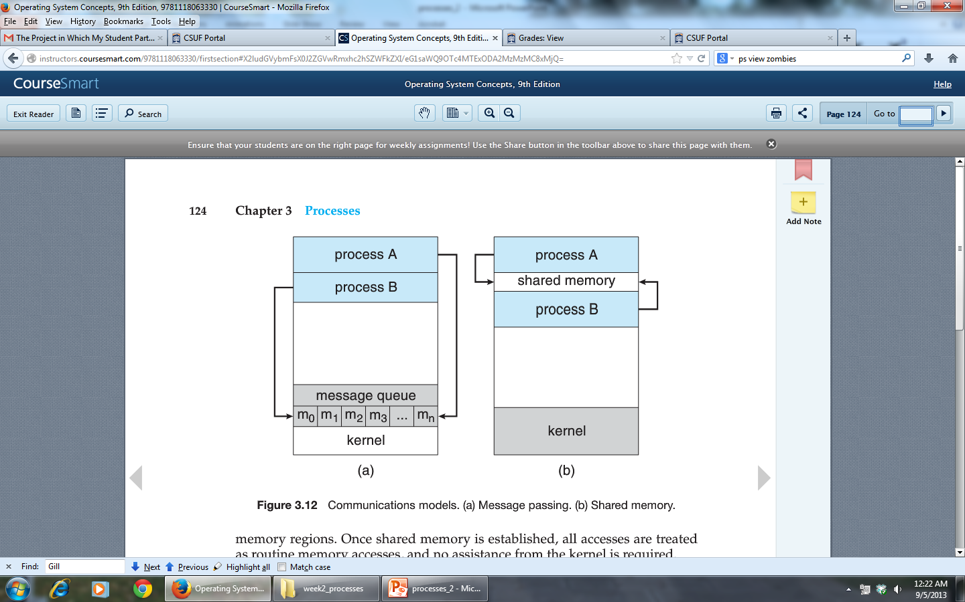
Interprocess Communications
Cooperating processes need a mechanism to exchange information i.e. interprocess communications (IPC).
Fundamental IPC models:
Shared memory: cooperating processes exchange information by reading/writing data from/to a region of shared memory.
Message passing: cooperating processes exchange messages.
Shared memory
Message Passing

Slide 23
Interprocess Communications: Shared Memory vs. Message Passing
Shared memory:
Faster than message passing: only requires intervention from the OS to establish a shared memory region.
Good for large transfers of information.
Disadvantage: requires process synchronization to ensure that e.g. no two processes write the same memory location at the same time.
Message passing:
No need for synchronization.
Good for small information transfers.
Easier to implement than shared memory.
Disadvantage: usually requires OS intervention on every message transfer:
Can be slower than shared memory.

Slide 24
Interprocess Communications: Shared Memory: Producer Consumer Problem
Producer consumer problem: producer process produces information that is consumed by the consumer process
Example: webserver process produces HTML that is consumed by the web browser.
Solution: use shared memory!
Approach 1: unbounded buffer
Approach 2: bounded buffer

Slide 25
Interprocess Communications: Shared Memory: Producer Consumer Problem
Unbounded buffer: no practical limits on the size of the shared buffer i.e. the size of shared memory.
The producer may produce items indefinitely.
Consumer waits until items are available.

Slide 26
Interprocess Communications: Shared Memory: Producer Consumer Problem
Bounded buffer: assumes a fixed size shared buffer.
Producer must wait if the buffer is full.
Consumer must wait if the buffer is empty.

Slide 27
Interprocess Communications: Shared Memory: Producer Consumer Problem
Bounded buffer implementation (a wrap-around buffer):
Store the following variables in shared memory:
#define BUFFER_SIZE 10
typedef struct {
. . .
} item;
item buffer[BUFFER_SIZE];
int in = 0; //First empty position in “buffer”
int out = 0; //First full position in “buffer”
//The buffer is empty when in == out
//The buffer is full when ((in+1) % BUFFER_SIZE) == out.

Slide 28
Interprocess Communications: Shared Memory: Producer Consumer Problem
Bounded buffer implementation (a wrap-around buffer):
Producer code:
while (true)
{
/* do nothing -- no free buffers */
while ((in + 1) % BUFFER_SIZE == out);
//Produce an item
…..
//Save the produced item
buffer[in] = item;
//Compute the next free index
in = (in + 1) % BUFFER_SIZE;
}

Slide 29
Interprocess Communications: Shared Memory: Producer Consumer Problem
Bounded buffer implementation (a wrap-around buffer):
Consumer code:
while (true)
{
//No items to consume
while (in == out);
// Consume an item
item = buffer[out];
//Compute the index of the next item to consume
out = (out + 1) % BUFFER SIZE;
return item;
}

Slide 30
Interprocess Communications: Shared Memory: Producer Consumer Problem
Bounded buffer implementation (a wrap-around buffer):
Problem: what if producer and consumer try to access the same buffer slot concurrently?
Solution: process synchronization (later in the course).

Slide 31
Interprocess Communications: Message Passing
Message passing functions:
send(message): sends the message
receive(message): receives the message
Messages can be either fixed-sized or variable-sized:
Fixed-sized: easier to implement, but imposes limitations.
Variable-sized: harder to implement, but is more flexible.
Two processes exchange messages through an established link which can be implemented in many ways:
Direct or indirect communication.
Synchronous or asynchronous communication.
Automatic or explicit buffering.

Slide 32
Interprocess Communications: Message Passing: Direct Communication
A process must explicitly name the sender or the receiver.
Symmetrical direct communication: both communicating processes must explicitly name the sender or the receiver:
send(P,message): send message “message” to process P.
receive(Q,message): receive a message from process Q.
A link is established automatically between all pairs of processes.
Each link is exactly between two processes.
Between each pair of processes there is only one link.

Slide 33
Interprocess Communications: Message Passing: Direct Communication
A process must explicitly name the sender or the receiver.
Asymmetrical direct communication: similar to symmetrical, but only the sender must explicitly name the receiver.
send(P,message): send message to process P.
receive(id,message): receive the message from any process and save the sender’s id in id.

Slide 34
Interprocess Communications: Message Passing: Direct Communication
Problem: if the process changes the identifier, we must change the identifier in all places that use it.
Example: the receiver process saves all messages. If sender changes its identifier, receiver must change it in all saved messages.

Slide 35
Interprocess Communications: Message Passing: Indirect Communication
Indirect communication: processes use mailboxes to send/receive messages:
send(A,message): send message to mailbox A.
receive(A,message): receive a message from mailbox A.
There is a link between two processes only if they share a mailbox.
A link may be associated with more than two processes.
Each pair of communicating processes must share a mailbox.

Slide 36
Interprocess Communications: Message Passing: Indirect Communication
Problem: processes P₁, P₂, and P₃ share mailbox A:
Process P₁ places a message into A
Both P₂ and P₃ execute receive. Who should get the message?
Solutions:
Restrict one link to at most two processes.
Allow only one process at a time to execute receive.
Select the receiver arbitrarily and notify the sender of the receiver’s id.

Slide 37
Interprocess Communications: Message Passing: Synchronization
How can we implement send() and receive()?
Blocking send: sender blocks until the receiver gets the message.
Nonblocking send: the sender sends the message and resumes operation.
Blocking receive: the receiver blocks until the message is available.
Nonblocking receive: the receiver retrieves either a valid message or a null.

Slide 38
Interprocess Communications: Message Passing: Synchronization
When both send() and receive() are implemented as blocking, we say that there is a rendezvous between the sender and the receiver:
The receiver blocks until the message is available.
The sender blocks until the receiver gets the message.

Slide 39
Interprocess Communications: Message Passing: Synchronization: Buffering
Messages exchanged between processes must be placed in a temporary queue.
Question: how do we implement such queue?
Implementing a queue:
Zero capacity (no buffering): the queue has a maximum length of zero; the sender must block until the message is received.
Bounded capacity: the queue has a finite capacity. When the capacity is exceeded the sender blocks.
Unbounded capacity: any number of messages can be placed in the queue; the sender never blocks.

Slide 40
Interprocess Communications: IPC examples: System V Shared Memory
Process allocates a shared memory region using shmget() (i.e. SHared MEmory GET) system call:
segment_id = shmget(key, size, S_IRUSR | S_IWUSR)
segment_id:
On success, unique identifier of the shared memory segment, or
-1 in case of error.
key: a key associated with the shared memory segment.
size: how much memory to allocate?
S_IRUSR | S_IWUSR flags: the memory is both readable and writable.
Other possible flags:
IPC_CREAT: create a memory segment with key key if the segment does not exist.
IPC_EXCL: exit with an error if IPC_CREAT flag is specified but the segment with key key already exists.

Slide 41
Interprocess Communications: IPC examples: System V Shared Memory
Accessing a shared memory region:
shared_memory = (char*)shmat(segment_id, NULL,0);
segment_id: the segment id to attach to local memory.
shared_memory: a pointer to the beginning of the shared memory segment.

Slide 42
Interprocess Communications: IPC examples: System V Shared Memory
Example: Processes P₁ and P₂ wish to communicate using shared memory. Assume that we want P₁ to be responsible for allocating the shared memory segment.
P₁:
Step 1: Create a shared memory region by invoking shmget() with key parameter of 123 and flag IPC_CREAT.
OS sees there is no shared memory region with key 123 and sees IPC_CREAT flag, so it allocates a new memory segment with key 123.
Step 2: Attach the allocated region by invoking shmat() with segment id returned by shmget() (in prev. step) as a parameter.
Step 3: Access shared memory through the pointer returned by shmat().
P₂: follows the same steps as process 1, except:
In step 1, no new memory region will be allocated; shmget() will return the segment ID of the region previously allocated by process 1 (OS knows that process 1 means that region, because process 2 invokes shmget() with the same key as process 1).

Slide 43
Interprocess Communications: IPC examples: System V Shared Memory
Problem: how can we ensure that both communicating processes know the key of the shared memory segment?
Solution: Both processes call ftok() function with the same arguments:
key_t key = ftok("/bin/ls", 'b');
Generates a key based on the random path e.g. “/bin/ls” and a random character e.g. ‘b’.
Given the same path and character, will always generate the same key.

Slide 44
Interprocess Communications: IPC examples: System V Shared Memory
Writing to shared memory:
sprintf(shared_memory, “Hello world”);
Detaching shared memory:
shmdt(shared_memory);
Deallocating shared memory segment:
shmctl(segment_id, IPC_RMID,…);

Slide 45
Interprocess Communications: IPC examples: System V Message Queues
1. Sender: Set up a message queue
a. key_t key = ftok("/bin/ls", 'b');
Generate a unique key based on the random path e.g. “/bin/ls” and a random character e.g. ‘b’.
Given the same path and character, will always generate the same key.
b. int msqid = msgget(key, 0666 | IPC_CREAT);
Create a message queue with key key.
If the queue does not exist, then create it (IPC_CREAT flag).
0666 specifies permissions to access the queue.
Returns the id of the created queue.

Slide 46
Interprocess Communications: IPC examples: System V Message Queues
Sender: initialize the message:
Message structure:
/* Message Buffer */
struct msgBuff
{
/* All message buffers must start with this long.
* It's used by the receiver for message selection
* Later slides.
*/
long mtype;
/* The actual data we want to send */
char data[100];
};
/* Create a message. mtype must be a positive value */
msgBuff msg; //Declare the message
msg.mtype = 2; //Set mtype
strncpy(msg.data, “Hello World”, 12); // Set the payload

Slide 47
Interprocess Communications: IPC examples: System V Message Queues
Sender: place the message into the queue:
msgsnd(msqid, &msg, sizeof(msgBuff) - sizeof(long), 0);
msqid: the id of the message queue into which to place a message.
msg: the message to send
sizeof(msgBuff) - sizeof(long): the size of the payload (i.e. total message size – the size of mtype)
0: miscellaneous flags (can leave as 0).

Slide 48
Interprocess Communications: IPC examples: System V Message Queues
Receiver: connect to the queue previously set up by the sender.
a. key_t key = ftok("/bin/ls", 'b');
Identical to the sender.
b. int msqid = msgget(key, 0666);
Get the id of the message queue associated with key key.
DO NOT create the queue if it does not exist.

Slide 49
Interprocess Communications: IPC examples: System V Message Queues
Receiver: prepare the message buffer:
msgBuff msg; (msgBuff is the same struct type in the sender)
Receiver: retrieve the message from the queue:
msgrcv(msqid, &msg, sizeof(msgBuff) - sizeof(long), 2, 0):
msqid: the id of the queue from which to retrieve the message.
msg: the buffer where to store the received message.
sizeof(msgBuff) - sizeof(long): the size of payload (i.e. total message size – the size of mtype).
2: the mtype of the message to retrieve. Must match the mtype in the message specified by the sender.
0: miscellaneous flags (can leave as 0).

Slide 50
Interprocess Communications: IPC examples: System V Message Queues
Deallocating a message queue:
msgctl(msqid, IPC_RMID, NULL);
msqid: the message queue id.
IPC_RMID: flag indicating that we would like to deallocate a message queue.
NULL: last argument can always be set to NULL when removing message queues.

Slide 51
Interprocess Communications: IPC examples: Mach
Mach: an OS developed at Carnegie Mellon.
All communications are based on message passing:
Even system calls are messages.
Each task gets two mailboxes at creation: Kernel and Notify
Three system calls used for message transfer:
msg_send()
msg_receive()
msg_rpc()
Mailboxes needed for communication, are created using port_allocate().

Slide 52
Interprocess Communications: IPC examples: Windows XP
Messages are passed via local procedure call (LPC) facility.
Uses ports to establish and maintain connections between processes.
Two types of ports:
Connection ports: visible to all processes; used to set up communication ports.
Communication ports: used for actual communications.

Slide 53
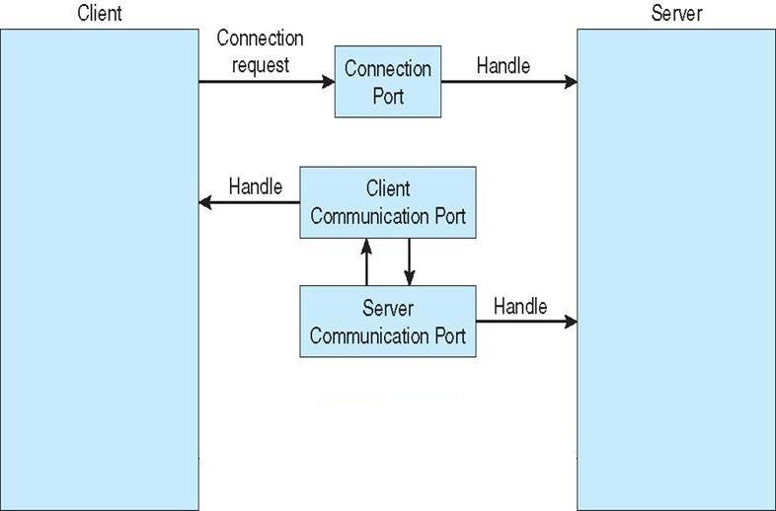
Interprocess Communications: IPC examples: Windows XP
The mechanism works as follows:
The client opens a handle (i.e. interface) to the server’s (published) connection port object.
The client sends a connection request.
The server creates two private communications ports and returns the handle to one of them to the client.
The client and server use the corresponding port handles to send messages.

Slide 54
Interprocess Communications: IPC examples: Pipes
Pipe: acts as a channel between two processes.
Ordinary pipes: enable a straightforward, 1-way, producer-consumer communications.
Used by processes to exchange streams of unstructured data.
A typical pipe comprises a front-end and a rear-end:
Producer: writes to the front-end of the pipe.
Consumer: reads the written information from the rear-end of the pipe.
Bi-directional communications require two pipes.

Slide 55
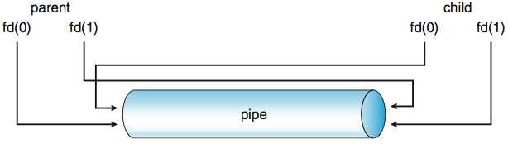
Interprocess Communications: IPC examples: Pipes
Example: in Unix ordinary pipes are used for communications between parents and children.
pipe(fd) system call (where int fd[2]) creates a pipe where:
fd[0] is the read end
fd[1] is the write end
A parent creates a pipe and forks a child.
The child inherits the pipe because pipes are treated as files (recall: child inherits the state of files of the parent)
Example: if the file is opened in the parent at time of forking, then same file will also be opened in the newly created child).
Parent and child should close the unused ends of the pipe.

Slide 56
Interprocess Communications: IPC examples: Pipes
In Unix data can be read from/written to the pipe, using read()/write() system calls.
Example: (next slide)

Slide 57
Interprocess Communications: IPC examples: Pipes
#include <sys/types.h>
#include <stdio.h>
#include <string.h>
#include <unistd.h>
#define BUFFER_SIZE 25
#define READ_END 0
#define WRITE_END 1
int main( void )
{
char write_msg[BUFFER_SIZE] = “Greetings”;
char read_msg[BUFFER_SIZE];
int fd[2];
pid_t pid;
/*create pipe */
if (pipe(fd) == -1) {
fprintf(stderr, "Pipe failed.\n");
return 1;
}
/* fork a child process */
pid = fork();
if (pid < 0) { /* error occurred */
fprintf(stderr, "Fork Failed\n");
return 1;
}
else if (pid > 0) { /* parent process */
close (fd[READ_END]);
write(fd[WRITE_END], write_msg, strlen(write_msg)+1);
close (fd[WRITE_END]);
wait(NULL); //Wait for the child
}
else { /* child process */
close (fd[WRITE_END]);
read(fd[READ_END], read_msg, BUFFER_SIZE);
printf("Read from pipe: %s \n", read_msg);
close (fd[READ_END]);
}
return 0;
}

Slide 58
Interprocess Communications: IPC examples: Pipes
Named pipes (or FIFOs in Unix):
Support bi-directional relay of data (one direction at a time).
Persist after the processes that use them have terminated (unlike ordinary pipes).
Must be explicitly removed.
Can be used for IPC between unrelated processes (and more than one).
We can create a FIFO in Unix shell using the mkfifo command:
Example:
Create a FIFO: mkfifo myfifo
Write a string to the FIFO: echo “Hello” > myfifo
Read a string from the FIFO: cat myfifo.

Slide 59
Interprocess Communications: IPC examples: Pipes
Named pipes can also be created programmatically using mkfifo() system call.
Example: mkfifo(“myfifo”, S_IWUSR | S_IRUSR)
Will create a FIFO called “myfifo”.
The FIFO will be readable and writable by the user (i.e. the second parameter).
The FIFO can be read or written using fread(), fgets(), fstream, and other standard means of reading/writing files.

Slide 60
Interprocess Communications: IPC examples: Sockets
Socket: an endpoint of communication.
Pair of processes can communicate over the network using a pair of sockets.
A socket is identified by concatenating an IP address of the system and a port number on the system.
The mechanism works as follows:
A server listens on the port to which the client connects.
The server accepts the client’s connection.
The server sets up a pair of sockets used for communications.
Sockets provide means for low-level communications: unstructured byte stream.
Reading/writing sockets is similar to pipes.

Slide 61
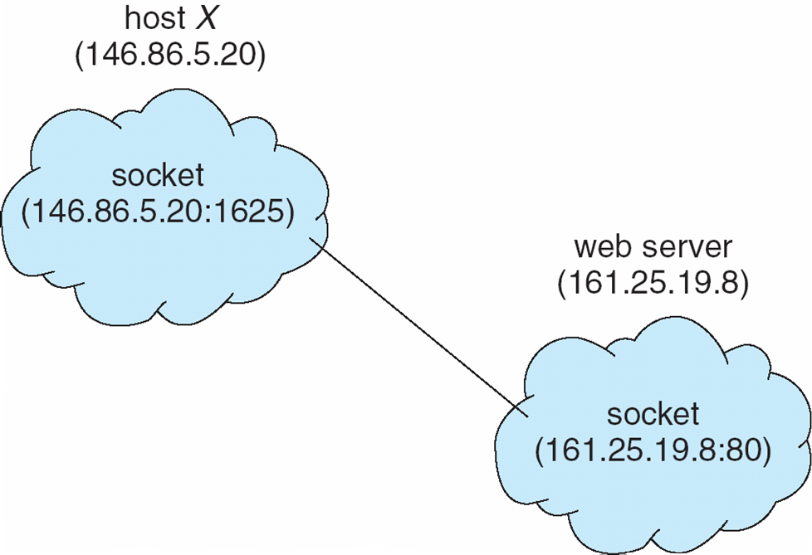
Interprocess Communications: IPC examples: Sockets Example

