Slide 1
REACT + NODE JS
=>Supakorn Emchananon
(P’ Pond)

Slide 2
WHAT WE KNOW TODAY
REACT
REST API
NODEJS
Can write react as hook style and know how to crud any data via api
Understood of rest api concept
Know how to use node js as a backend service.

Slide 3

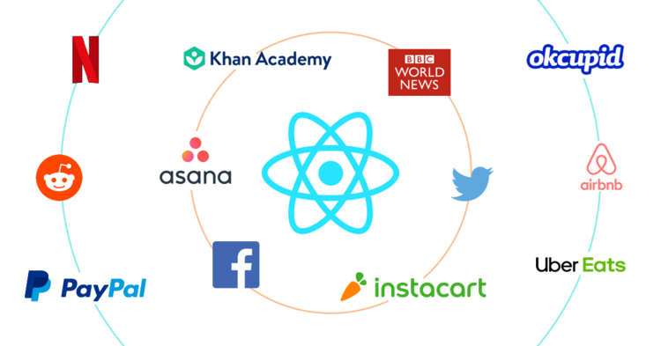
WHAT’S REACT
A JavaScript library for building user interfaces
=> Declarative
=> Component-Based

Slide 4
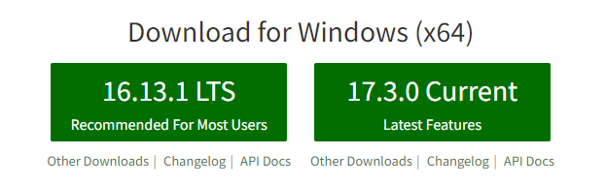
01
INSTALL NODEJS
https://nodejs.org/en/

Slide 5
02
RUN NPM COMMAND
npm install -g create-react-app
npx create-react-app bank-queue

Slide 6

03
Launch!!
npm start

Slide 7
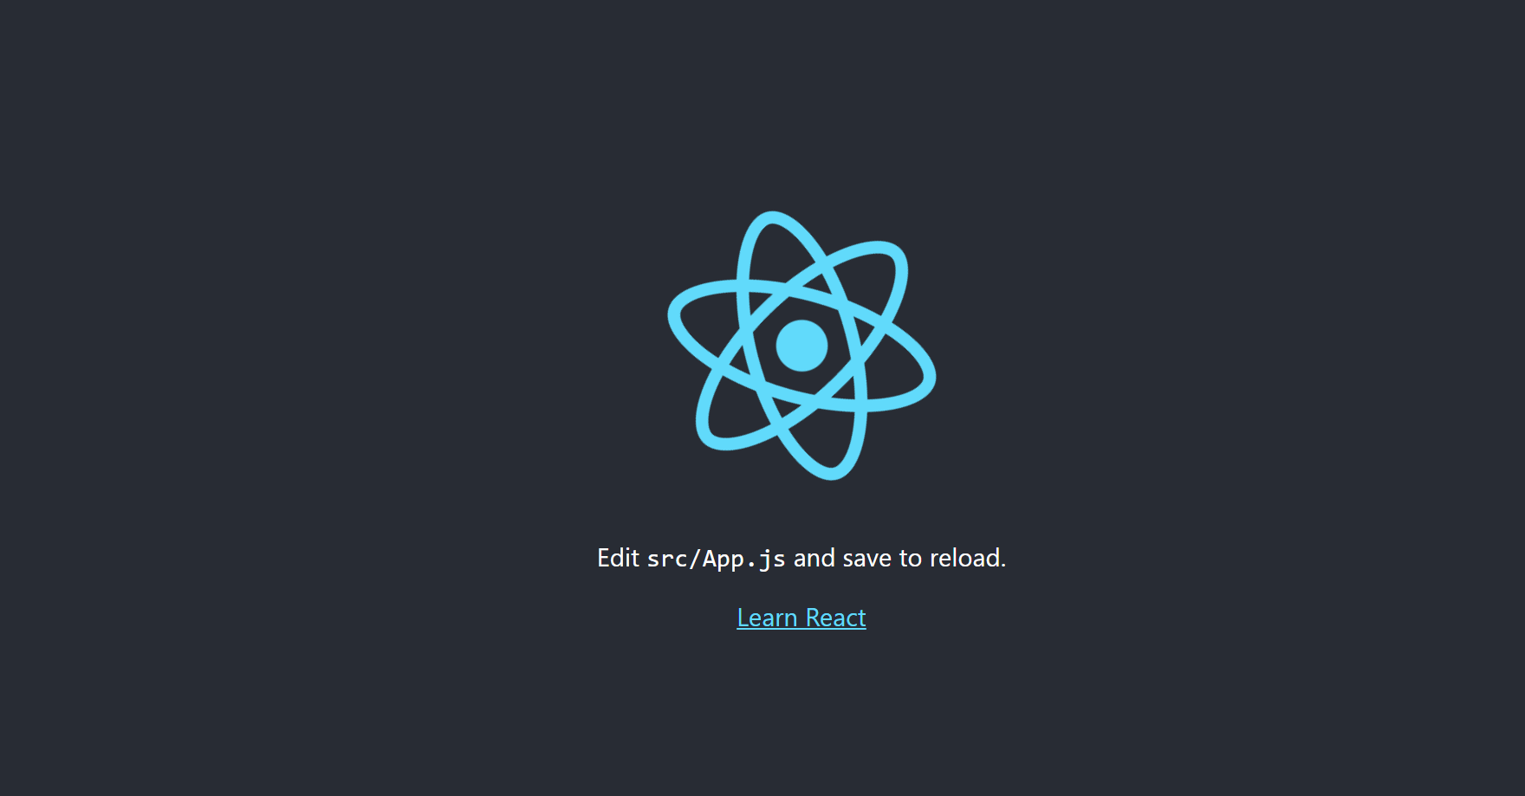
http://localhost:3000/

Slide 8
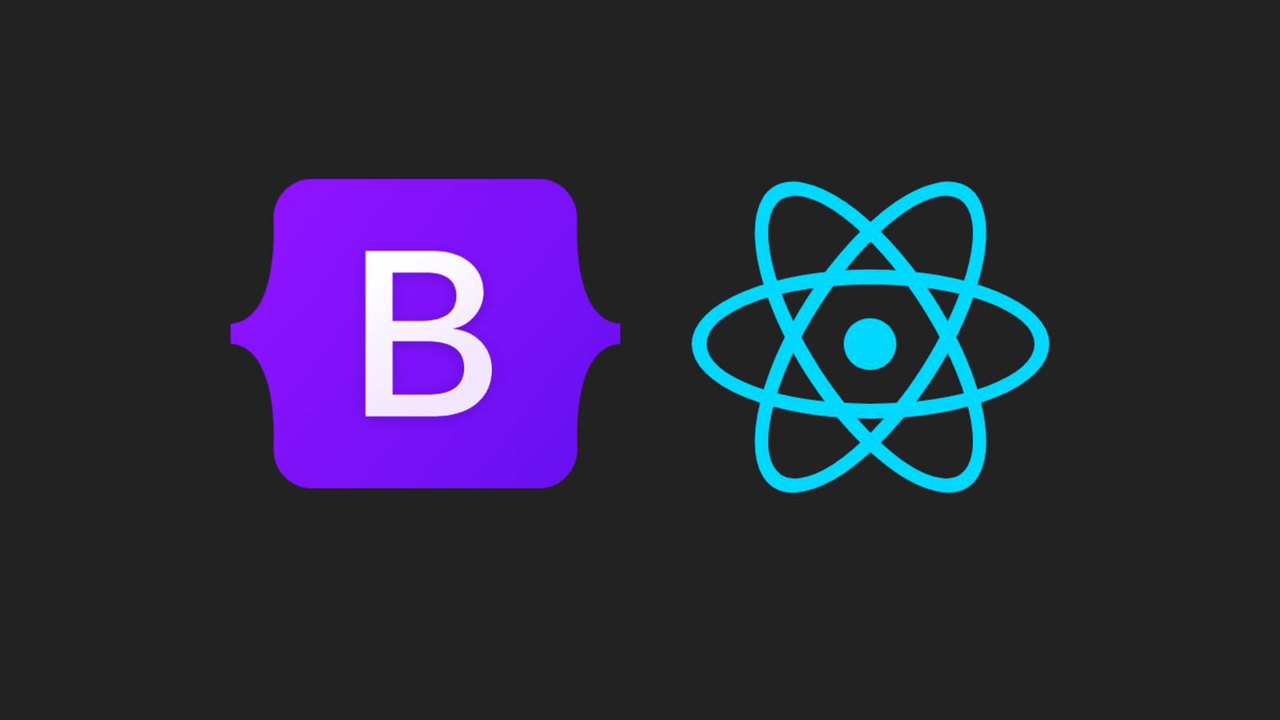
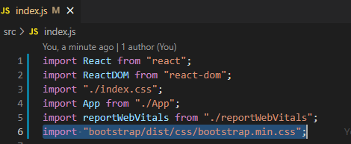
ADD BOOTRAP 5
npm install bootstrap
Edit src/index.js

Slide 9
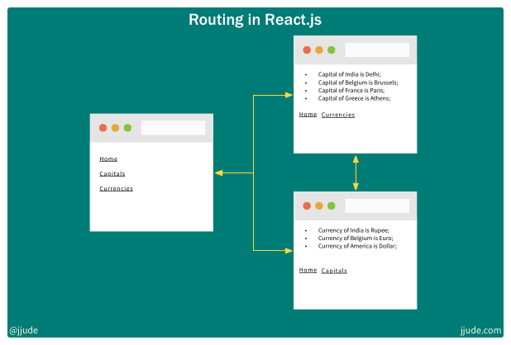
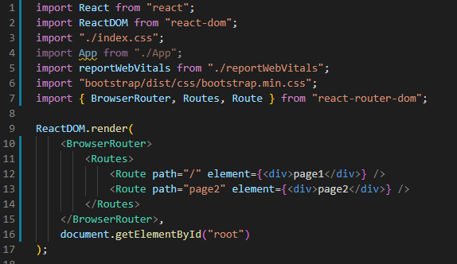
ADD ROUTER
npm install react-router-dom@6
Edit src/index.js

Slide 10
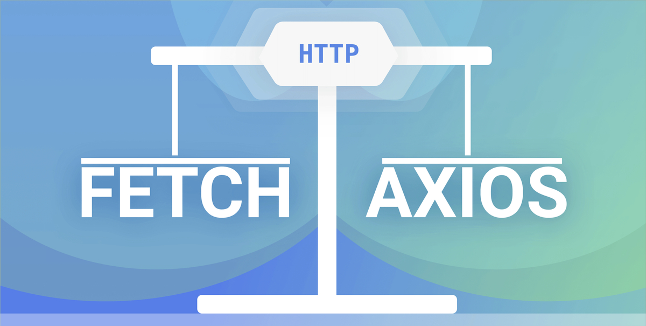
ADD AXIOS
Axios is a Javascript library used to make HTTP requests from node.js or XMLHttpRequests from the browser that also supports the ES6 Promise API
npm install axios

Slide 11
REST API CONCEPT
Frontend
Backend
API
Payload JSON
Response JSON

Slide 12
HTTP REQUEST METHOD
GET => Get data
/queues => display queues
/queues/:id => filter and display
POST => Store data
/queue => store queue
PUT => Update data
/queue/:id => filter then update
DELTE => Delete data
/queue/:id => filter then delete

Slide 13

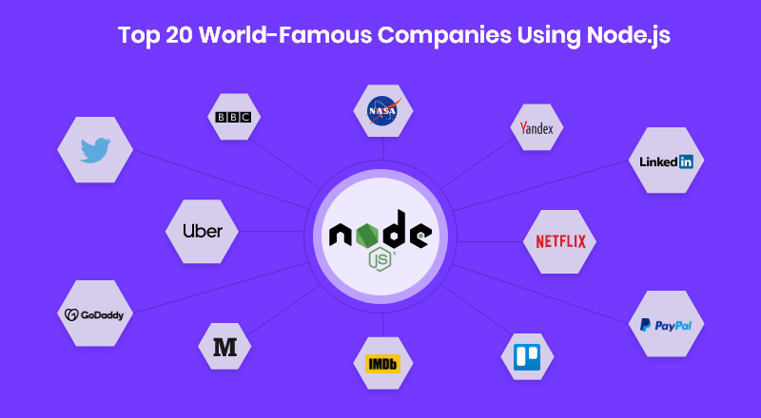
WHAT’S NODE JS
Node.js® is a JavaScript runtime built on Chrome's V8 JavaScript engine.

Slide 14
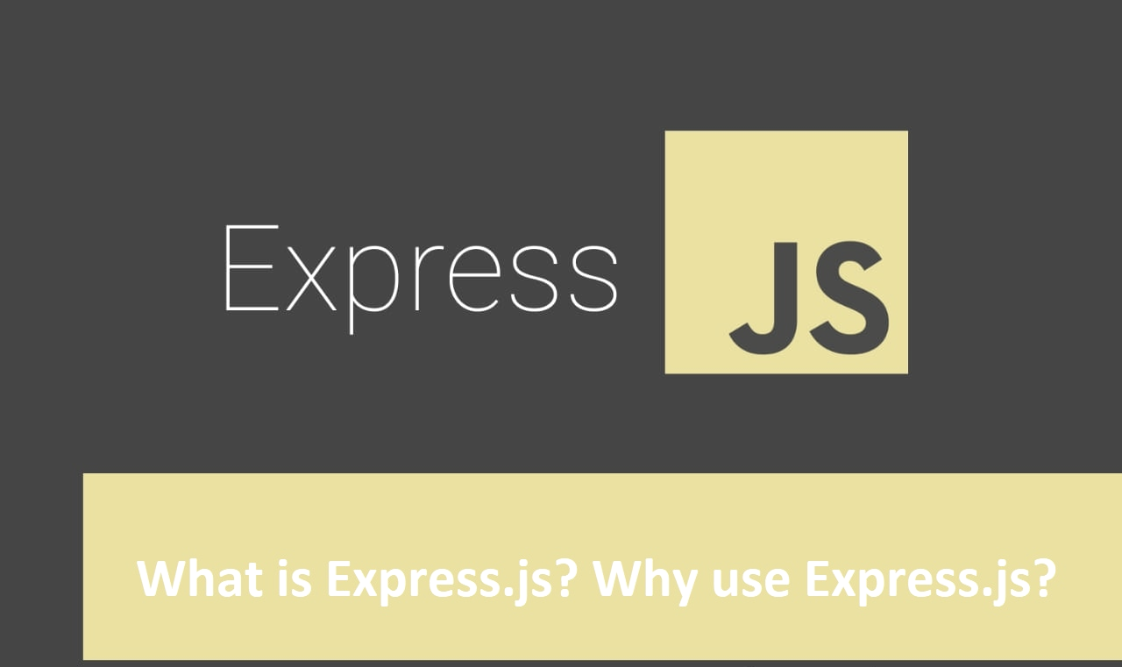
EXPRESS JS
minimalist web framework for Node.js

Slide 15
STEP TO INSTALL EXPRESS JS
npm install -g express-generator
npm install -g nodemon
express
npm install
nodemon start

Slide 16
Bank Q
c1
c2
c3
q5
q4
q3
q1
q2

Slide 17
EXERCISE

Slide 18
THANKS!
Do you have any questions?
Fb: Supakorn Emchananon
Tel: 0961827473

