Slide 1
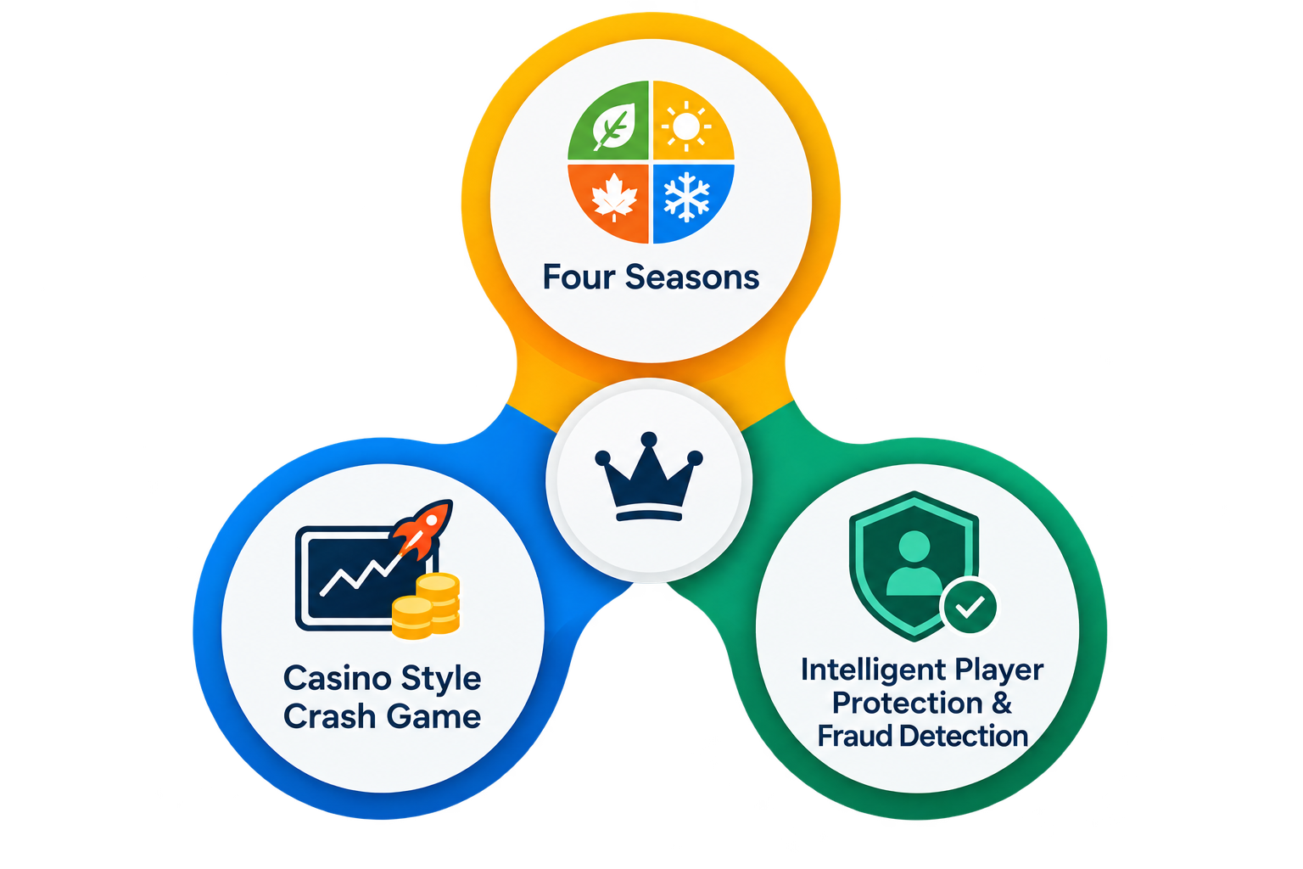
Four Winds
By: Don’t join my team
A SEASONAL CRASH GAME WHERE THE WORLD TELLS PLAYERS DETERMINE YOUR RISK BY THE SEASONS.

Slide 2

Four seasons create four kinds of tension
The world tells players what they are signing up for.
Season | Risk | Instant crash | Ceiling
Spring | Low risk | 0% | Up to 10x
Summer | Medium risk | 10% | Up to 50x
Autumn | High risk | 20% | Up to 200x
Winter | Extreme risk | 35% | Up to 1000x
Seasons rotate every 4–9 seconds; each flight stays locked to the season it started in.

Slide 3
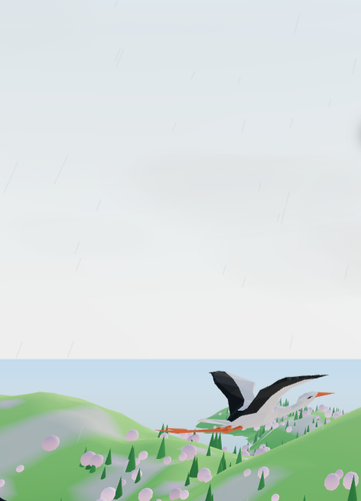
THE PLAYER MOMENT
The demo takes flight
Place your bet, watch the multiplier increase in real time and cash out before the bird reaches the ground.
Season-specific hazards make the outcome legible and memorable.
The scene is 3D with a 2D fallback, plus reduced motion, sound controls and English/French UI.

Slide 4


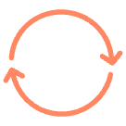

TRUSTED ENGINE
The server decides; the client only draws
Server owns state
Outcome derives
Retries stay safe
States stay simple
Balance, clock, round state, and crash point.
HMAC-SHA256 uses the hidden seed and round ID.
Bet and cash-out retries are ineffective.
FLYING → CASHED, CRASHED, or LANDED.
The client renders a result it never gets to choose.
The crash point is never streamed before settlement.

Slide 5
PLAYER-VERIFIABLE FAIRNESS
Fairness is something players can check
Commit first. Reveal later. Verify in the browser.
01
02
03
Before the flight
After settlement
Verify round
The client gets generated with SHA-256(seed) as a commitment not in the same environment.
The server reveals the seed.
Recomputes the commitment and crash point in the browser.
97%
3%
Confidence
Edge, regardless of season

Slide 6








PROTECTION BY DESIGN
Protection is part of the product
Loss budget
Plain signals
Friction
Human review
A player can set a loss budget if they want; wagers beyond the remaining budget are refused.
Risk levels explain chasing losses, fast play, long sessions, and large wagers.
Reality checks, loss-streak notices, and a 30-second cool-off add friction before harm compounds.
Fraud flags never block a player automatically; a person decides.

Slide 7
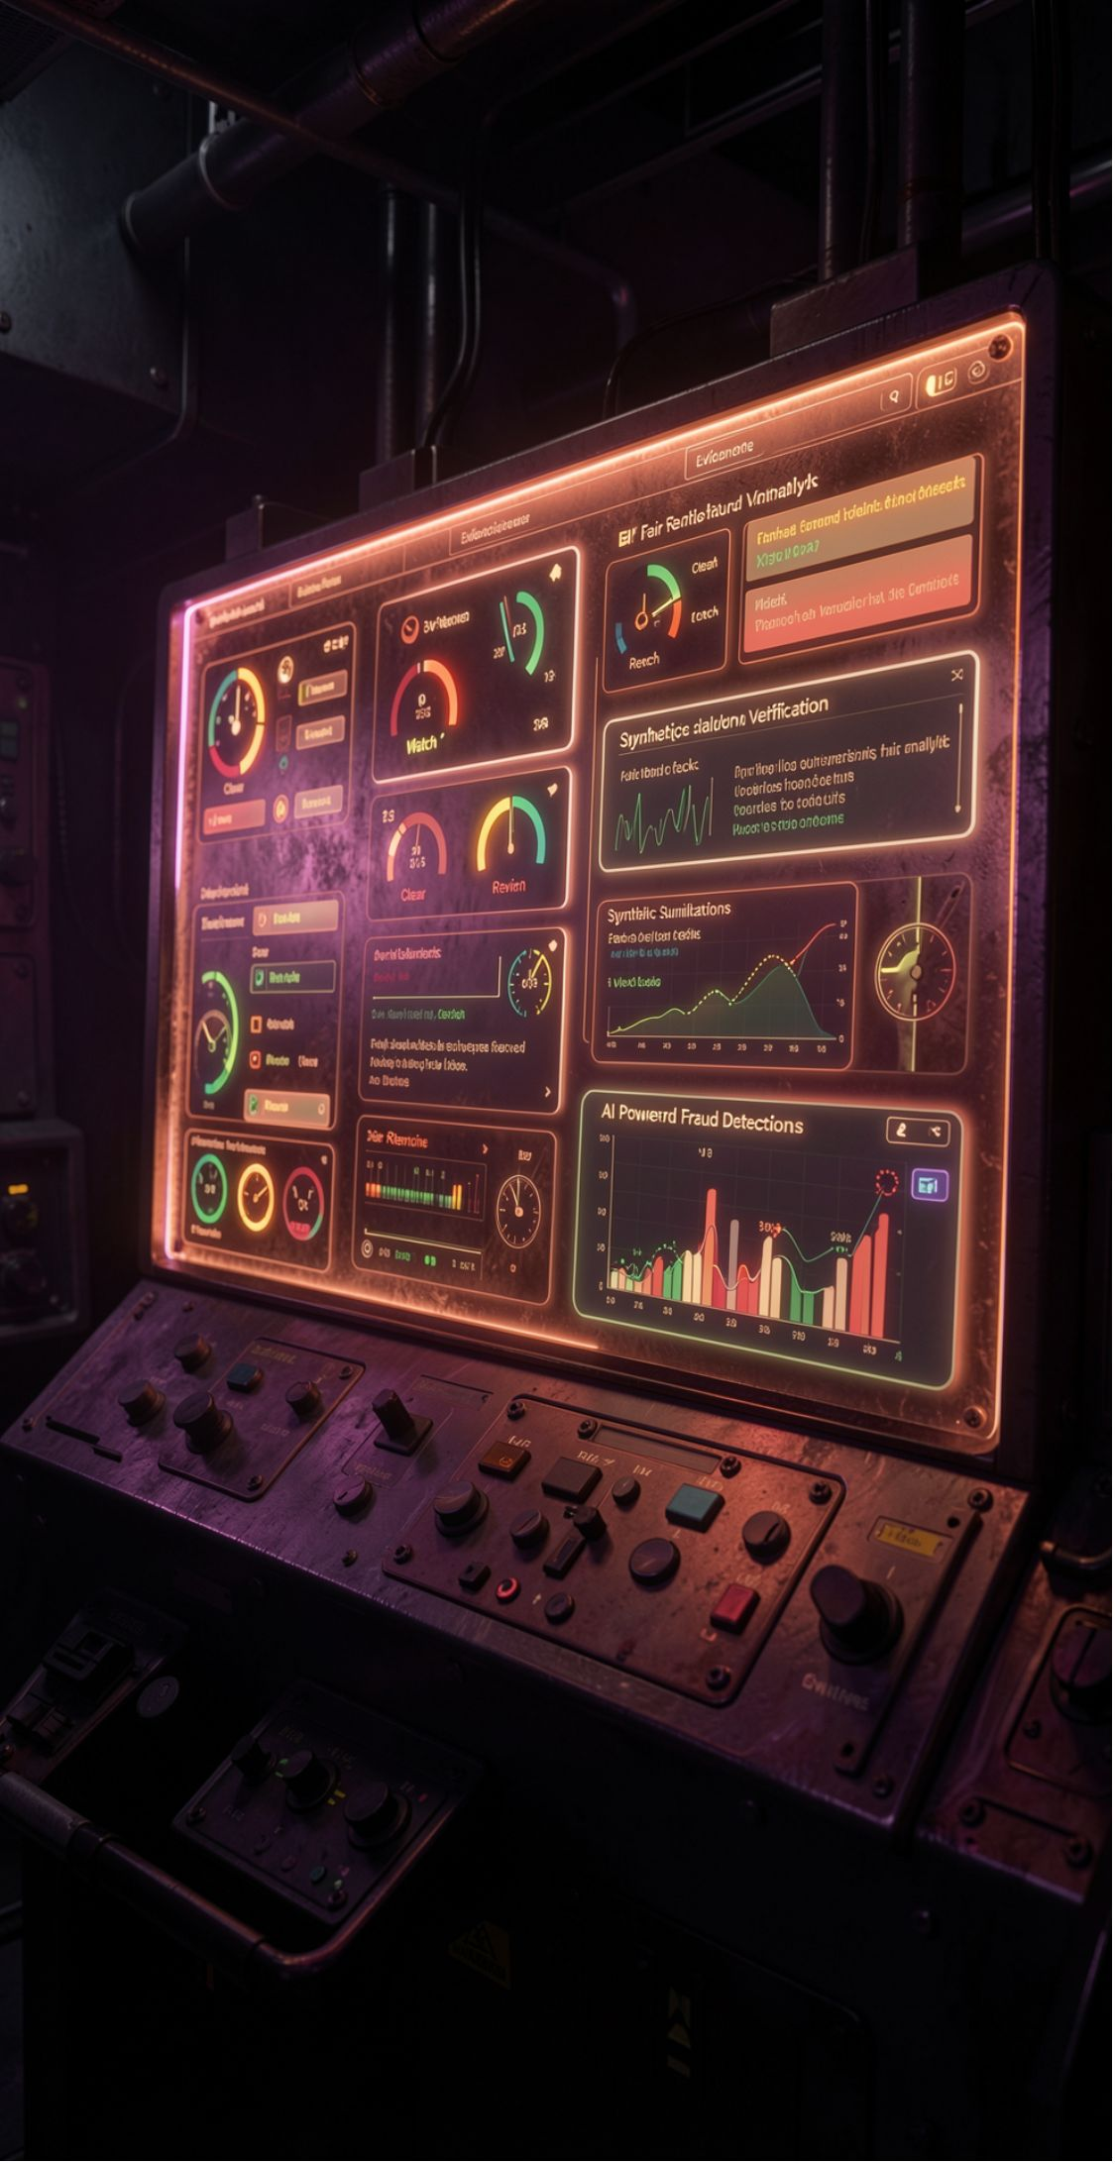



THE JUDGEABLE DEMO
Sentinel makes the demo judgable
Live status
Fair-return check
Clear, Watch, or Review with an evidence meter and plain-language reasoning.
Tests whether fixed-target wins exceed the odds, then checks return against the 97% fair return.
Safe simulation
Prototype proof
Judges can run a synthetic cheater simulation: the meter climbs toward REVIEW in about 8 seconds without touching the real balance.
Built with Node.js, includes an AI agent for fraud detection.

