Slide 1





PEDAGOGICAL CONCEPTS
Kenya - workshop
AI Research Foundations
Notes:
Combined session, two parts: Part 1 Pedagogical Concepts (30 min) + Part 2 AI vs RI Activities (30 min). Week 1 splits the parts around lunch: close Part 1 on the recap slide, reopen after lunch with the Part 2 title slide. Week 2 runs them back-to-back.

Slide 2



Slide 3
Learning Objective
DEFINITION A clear, specific statement describing what a learner is expected to be able to do by the end of a lesson, course, or activity : always starting with an action verb.
Examples:
By the end of this lesson, students will be able to understand tokenization and compare different tokenization methods.
By the end of this course, students will be able to explain how the BPE algorithm builds a vocabulary step by step.

Slide 4
Three Domains of Bloom's Taxonomy
COGNITIVE
AFFECTIVE
PSYCHOMOTOR
How learners process knowledge
How learners engage with values, attitudes and ethics
How learners develop physical skills through practice and hands-on experience
IN SCOPE TODAY
IN SCOPE TODAY
out of scope
IN SCOPE TODAY

Slide 5
The Cognitive Domain
DEFINITION Describes how learners develop knowledge and skills, from remembering facts to creating original work.
Create
design, generate, invent
Evaluate
judge, critique, defend
Analyze
compare, distinguish, examine
Apply
execute, implement, use
Understand
explain, summarize, classify
Remember
recall, list, name

Slide 6

Cognitive Domain
REMEMBER · L1
UNDERSTAND · L2
The ability to remember and recall previously learned facts, concepts, or skills.
The ability to explain information in your own words, demonstrating understanding of its meaning.
Example
Example
List the five steps of the BPE algorithm used to create subword tokens from text data.
Explain why word-level tokenization struggles with unknown words.
List
Recall
Name
Explain
Summarize
Describe

Slide 7
Cognitive Domain
APPLY · L3
ANALYZE · L4
The ability to apply knowledge in new situations by using what you know to solve problems.
The ability to break complex information into parts and examine how those parts connect and relate to each other.
Example
Example
Apply the first three steps of the BPE algorithm to a small corpus.
Distinguish between the OOV problem in word-level tokenization and the long sequence problem in character-level tokenization.
Implement
Use
Solve
Compare
Distinguish
Examine

Slide 8
Cognitive Domain
EVALUATE · L5
CREATE · L6
The ability to make informed judgments using criteria and standards to assess the quality or validity of something.
The highest level of thinking, involving combining elements to create something new, such as a product, plan, or idea.
Example
Example
Evaluate whether removing emojis from review data is a good preprocessing choice for a sentiment analysis task.
Design a 2D embedding map for ten words from your own language community.
Judge
Assess
Argue
Design
Build
Plan

Slide 9
The Affective Domain
DEFINITION The affective domain is about how learners develop values and ethics, from receiving information to internalizing it as part of their behaviour.
Higher-order →
Internalize
embody, act consistently
Organize
integrate, prioritize
Value
advocate, commit
Respond
react, comply
Receive
attend, observe

Slide 10
Affective Domain
RECEIVE · L1
RESPOND · L2
Students become aware of an attitude, behaviour, or value and show willingness to pay attention to it.
Students respond to a value or attitude and demonstrate active participation.
Example
Example
Listen to a community member describe how they use an AI tool in daily life.
Discuss how a community is affected when an AI model does not understand their language.
Attend
Observe
Notice
Discuss
Contribute
Share

Slide 11
Affective Domain
VALUE · L3
ORGANIZE · L4
Students recognise and demonstrate a value through their involvement or commitment, showing that they care about it.
Students determine priorities and resolve conflicts between different values, developing a personal value system.
Example
Example
Advocate for community members having a say in how their language and culture are represented in AI.
Prioritize local languages over convenience when choosing training data for an African AI project.
Advocate
Commit
Justify
Prioritize
Integrate
Balance

Slide 12
Affective Domain
INTERNALIZE · L5
Students act consistently with their internalized beliefs, making the value a natural part of their behaviour.
Example
Embody the habit of asking who is affected by your AI tool before asking how well it performs.
Embody
Maintain
Influence

Slide 13
Online vs. Classroom Learning Objectives
ONLINE COURSES
CLASSROOM SESSIONS
Remember (L1)
Analyze (L4)
List the types of tokenization: sentence-level, word-level, character-level, and subword tokenization.
Compare how two tokenizers split a word and identify which one better preserves its meaning.
Notes:
Talk-through, not a handout (~3 min): read the two filled rows aloud, then ask the room to propose the missing Understand/Apply and Evaluate/Create entries verbally. Do not distribute paper.

Slide 14

AI vs RI (Responsible Innovation) Activities
Kenya - Workshop
AI Research Foundations
Notes:
Part 2 opener. If delivering after the lunch split, re-anchor quickly with the two-ladders recap on the next slide before moving into the toolkit.

Slide 15
Two domains, two ladders
COGNITIVE
AFFECTIVE
Remember
Retrieve
Receive
Listen / attend
Understand
Explain
Respond
React / participate
Apply
Execute a procedure
Value
Demonstrate commitment to something
Analyze
Tune hyperparameters; compare training curves
Organize
Integrate different values
Evaluate
Judge competing design choices
Internalize
Integrate values into professional practice
Create
Design an MLP architecture

Slide 16


Toolkit activities: AI & RI
AI
RI
Technical skills
Responsible innovation
Machine-learning foundations
Embeddings and neural networks
Mini-hackathons and end-to-end labs
Formats: Short - Medium - Long
Long activities come with lab notebooks
Ethics and responsibility in AI
Societal impact and fairness
Reflection and structured discussion
Formats: Short - Medium
Facilitation guides
Notes:
Make the link explicit here (it returns as takeaway 02): longer formats climb Bloom — Short activities sit around Understand/Apply, Medium around Analyze/Evaluate, Long (with notebooks) reach Create.

Slide 17
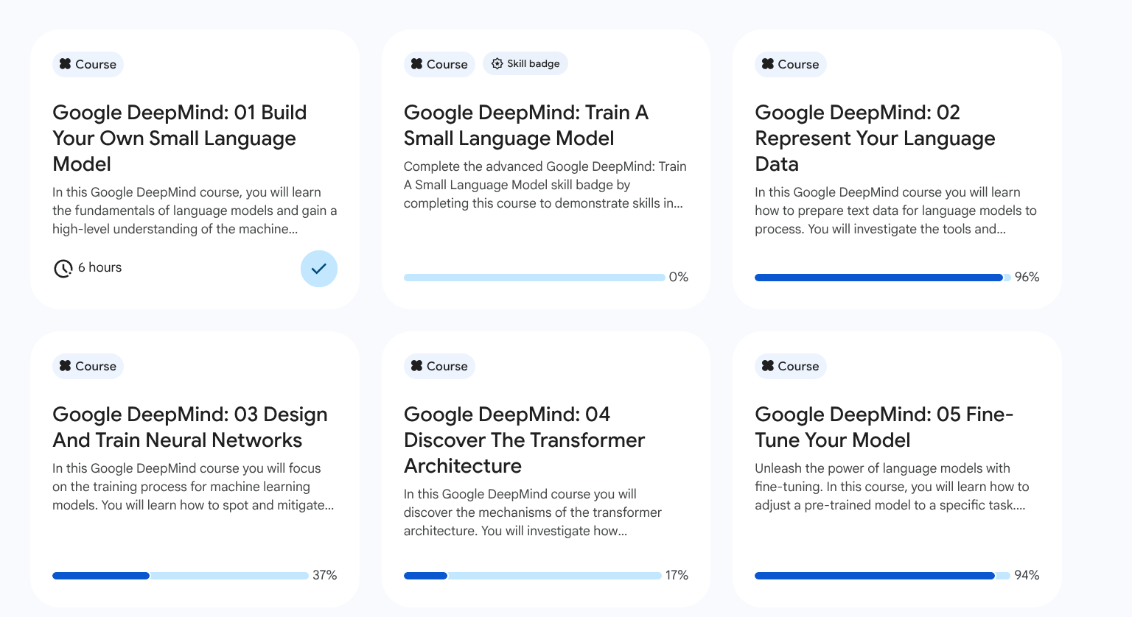
The AI Research Foundations Curriculum
Notes:
Gloss if asked: the Conversational Framework is Diana Laurillard's (UCL) taxonomy of learning-activity types (acquisition, discussion, practice, production...). One sentence only — Bloom is today's focus. GCSB = Google Cloud Skills Boost, where students do the online Spotlight activities.

Slide 18

UCL Extend: the toolkit's home : extend.ucl.ac.uk
Notes:
TRANSFER: insert after the slide titled 'The Toolkit on UCL Extend' (local deck #20, the site-tree slide). First of three screenshot slides from this pack; keep them in pack order, between the tree slide and the 'One home for everything: UCL Extend' counts slide.
1 min. The live course page, captured 2026-08-16: UCL and AIMS, with support from Google.org, hosted by the UCL Centre for Engineering Education. The tree on the previous slide is this single course page, live with all ten sessions. Access for participants: enrolment details are shared during the workshop; never show an enrolment key on screen.

Slide 19
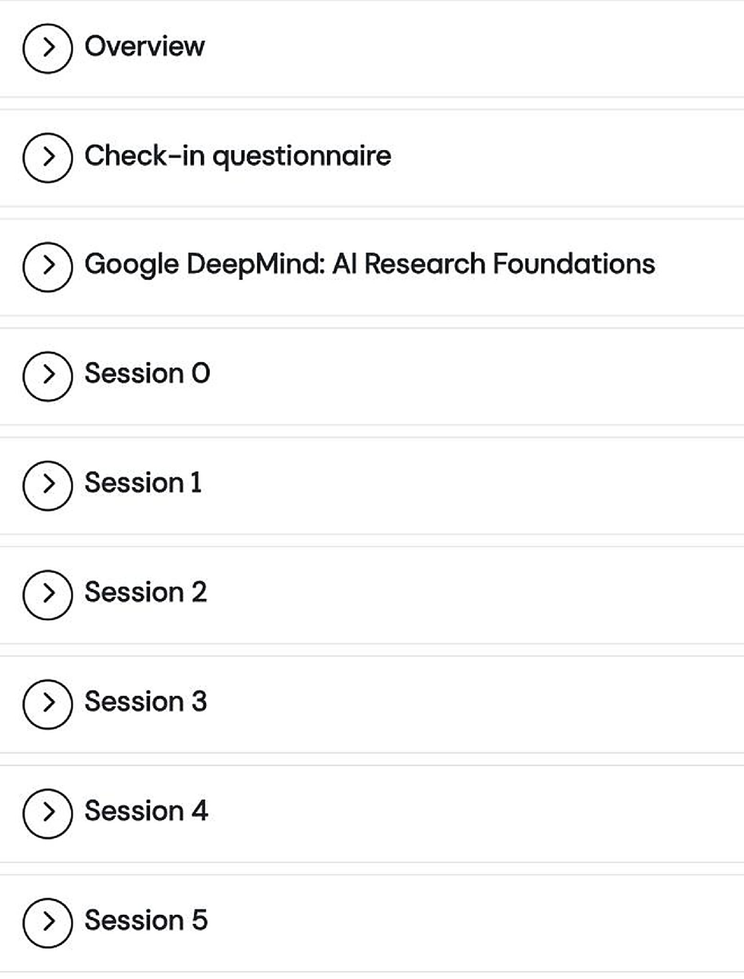
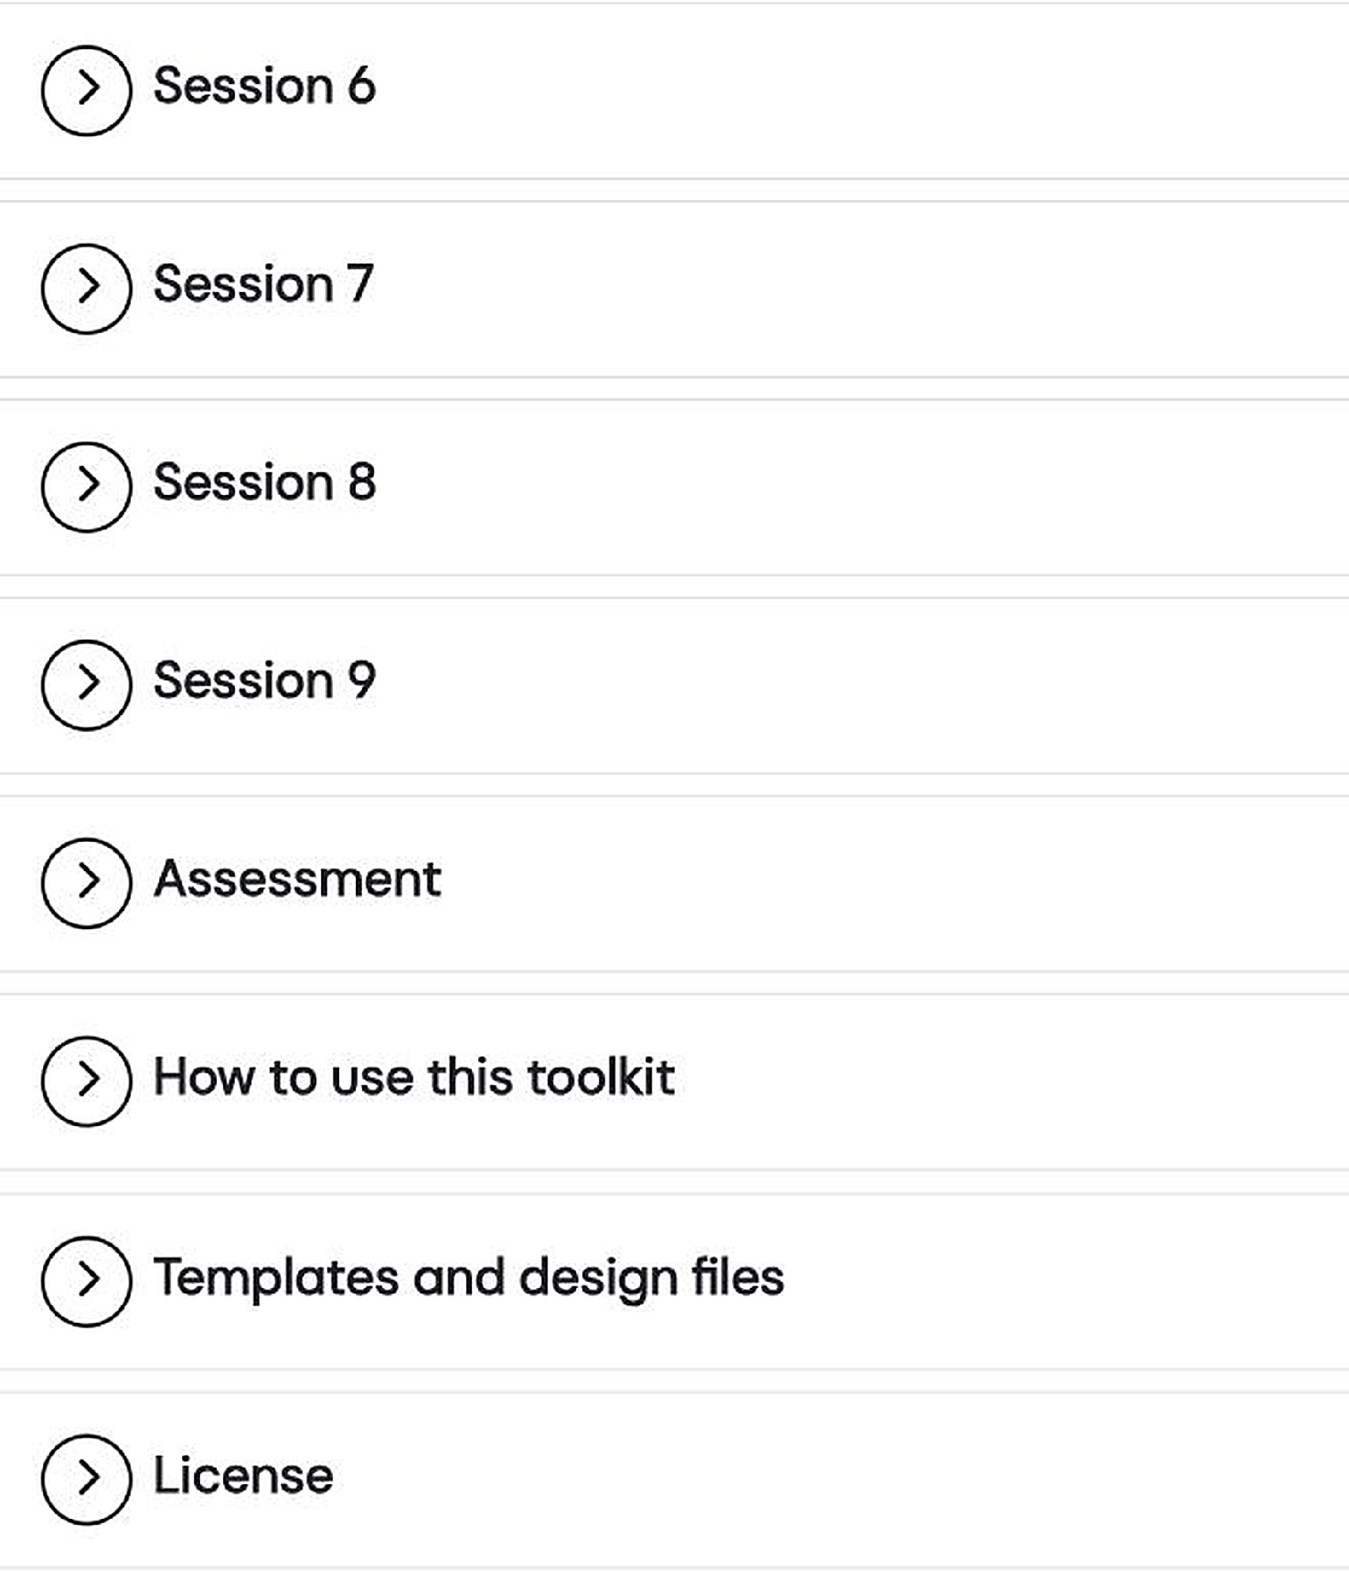
Ten sessions, one page each
Notes:
TRANSFER: insert directly after 'UCL Extend: the toolkit's home' from this pack.
1 min. The whole toolkit is one course page: a section per session (Session 0 to Session 9), plus the Google DeepMind course links, Assessment, How to use this toolkit, Templates and design files, and License. Each section expands in place. Captured 2026-08-16 with all ten sessions live (the site held only Session 5 until UCL's end-of-July upload).

Slide 20
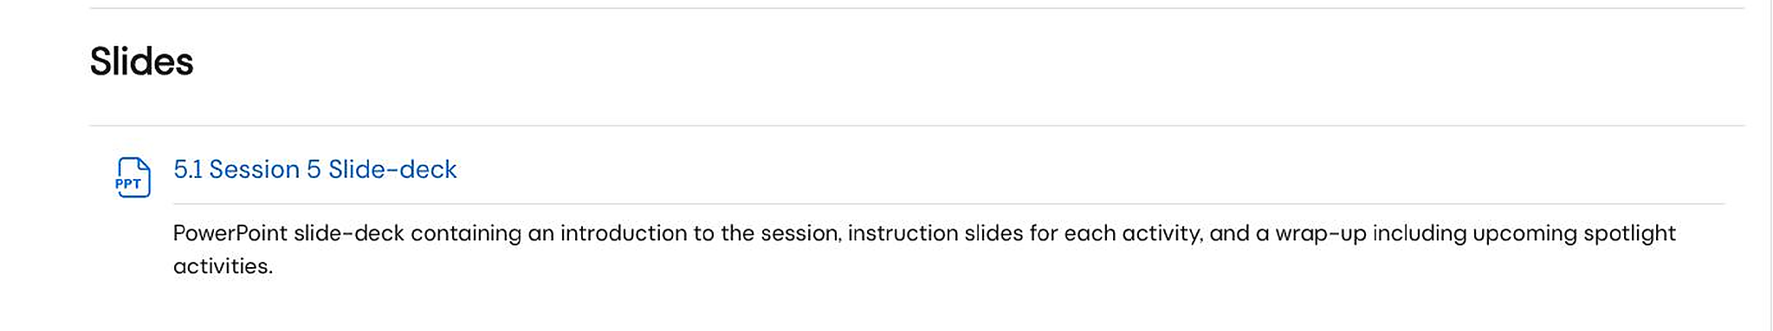
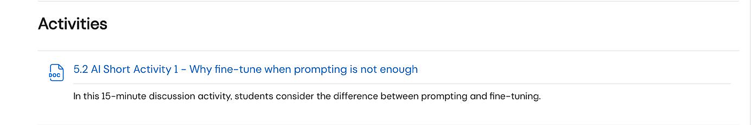
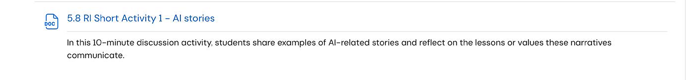
Inside a session page Session 5 shown
RI activities 5.8 to 5.11, further down the same Activities list
Every session page: intro and aims, spotlight pre-learning, slide-deck, ten AI and RI activity files, lab notebooks, learning designs.

Slide 21



One home for everything : UCL Extend
Slides
Learning Activities
Notebooks
10 decks
10 session pages
21 files
One ready-to-present lecturer deck for every session, 0 through 9.
AI and Responsible Innovation activities for each session, in Short, Medium and Long formats, wrapped in handbook-style guidance.
Jupyter labs for the AI Long activities : in Student and Teacher versions plus real datasets.

Slide 22

Get the toolkit in five steps
1
Open the UCL Extend store (scan the code) and choose SELECT (FREE)
2
Create your account: choose “I am a new customer”, email in lower case
3
Follow the “Click here” link under Access Details on the order confirmation page
4
Open the toolkit from your UCL Extend dashboard
extendstore.ucl.ac.uk
Lecturer Toolkit, free
5
Complete the check-in questionnaire: REQUIRED, 3 to 5 minutes; it unlocks the materials

Slide 23

What each step looks like: 1 to 3

Slide 24

What each step looks like: 4 and 5

Slide 25
Course 2 - Represent Your Language Data
AI Activities
RI Activities
Lab: Implement a BPE Tokenizer
Iteratively merge subword tokens on a small corpus to see how modern tokenizers learn.
Whose voice is missing?
Reflect on the exclusion introduced by dataset selection when training LLMs.

Slide 26
Classify an Activity, AI? RI? Which level?
Example 1
Example 2
“Train a convolutional neural network to classify maize leaf images as healthy, blighted, or rust-infected using a labelled dataset of 5,000 photographs from Kenyan smallholder farms”
“If your model misdiagnoses a smallholder farmer's only crop, who bears the cost?”
AI
Apply
RI
Respond

Slide 27
AI Activity or RI Activity?
Which level in Bloom’s Taxonomy?
Notes:
TODO before delivery: this QR code is still the PILOT Mentimeter. Build the Nigeria Mentimeter from the 10-question 'Quizz' bank (classify: AI or RI + Bloom level) in the AI vs RI activities Drive folder, then replace this QR. Timing: cap the live run at ~5 questions (~5 min) — the full bank of 10 does not fit the 30-min half.

Slide 28
Question 1 · AI or RI? Which level?
“Implement a BPE tokenizer from scratch and test it on isiZulu text.”
A. AI Activity / Apply
B. RI Activity / Apply
C. AI Activity / Respond
D. AI Activity / Create
Notes:
Give the room about 45 seconds; vote A/B/C/D by show of hands. Correct answer (revealed in green on the next slide): A = AI Activity / Apply.

Slide 29
Question 1 · Answer
“Implement a BPE tokenizer from scratch and test it on isiZulu text.”
A. ✓ AI Activity / Apply
B. RI Activity / Apply
C. AI Activity / Respond
D. AI Activity / Create
Notes:
Correct: A = AI Activity / Apply. A coding task executing a known, specified procedure (the BPE algorithm). RI/Apply: wrong type (pure tech, no stakeholders) and an impossible pairing (Apply is cognitive). AI/Respond: impossible pairing (Respond is affective). AI/Create: level too high; implementing a given algorithm is applying a procedure, not designing a new scheme.

Slide 30
Question 2 · AI or RI? Which level?
“Discuss who owns the data when companies scrape African language websites. Use the Fair Trade analogy to propose a governance model.”
A. AI Activity / Value
B. RI Activity / Respond
C. RI Activity / Value
D. AI Activity / Analyze
Notes:
Give the room about 45 seconds; vote A/B/C/D by show of hands. Correct answer (revealed in green on the next slide): B = RI Activity / Respond.

Slide 31
Question 2 · Answer
“Discuss who owns the data when companies scrape African language websites. Use the Fair Trade analogy to propose a governance model.”
A. AI Activity / Value
B. ✓ RI Activity / Respond
C. RI Activity / Value
D. AI Activity / Analyze
Notes:
Correct: B = RI Activity / Respond. Participants engage with a provided framing (the Fair Trade analogy) in a structured discussion: that is Responding. AI/Value: wrong type and impossible pairing (Value is affective). RI/Value: level too high; the discussion is scaffolded by a given analogy, no own position is demanded yet. AI/Analyze: wrong type; no model, code or measurement is touched.

Slide 32
Question 3 · AI or RI? Which level?
“Compare models trained for 10, 400, and 1000 epochs. Identify overfitting and underfitting in the loss curves.”
A. AI Activity / Apply
B. AI Activity / Analyze
C. RI Activity / Value
D. AI Activity / Value
Notes:
Give the room about 45 seconds; vote A/B/C/D by show of hands. Correct answer (revealed in green on the next slide): B = AI Activity / Analyze.

Slide 33
Question 3 · Answer
“Compare models trained for 10, 400, and 1000 epochs. Identify overfitting and underfitting in the loss curves.”
A. AI Activity / Apply
B. ✓ AI Activity / Analyze
C. RI Activity / Value
D. AI Activity / Value
Notes:
Correct: B = AI Activity / Analyze. Differentiating and diagnosing patterns across cases is textbook Analyze. AI/Apply: level too low, nothing is executed; the work is comparison and diagnosis. RI/Value: wrong type; purely technical, no human-impact dimension. AI/Value: impossible pairing (Value is affective).

Slide 34
Question 4 · AI or RI? Which level?
“Estimate the FLOPs needed to fine-tune an SLM. Experiment with bfloat16 to reduce compute cost.”
A. AI Activity / Apply
B. RI Activity / Respond
C. AI Activity / Understand
D. AI Activity / Organize
Notes:
Give the room about 45 seconds; vote A/B/C/D by show of hands. Correct answer (revealed in green on the next slide): A = AI Activity / Apply.

Slide 35
Question 4 · Answer
“Estimate the FLOPs needed to fine-tune an SLM. Experiment with bfloat16 to reduce compute cost.”
A. ✓ AI Activity / Apply
B. RI Activity / Respond
C. AI Activity / Understand
D. AI Activity / Organize
Notes:
Correct: A = AI Activity / Apply. Carrying out estimation procedures and running an experiment: Apply. RI/Respond: wrong type; a compute-budget exercise with no stakeholder reflection. AI/Understand: level too low; participants calculate and experiment, not just explain. AI/Organize: impossible pairing (Organize is affective).

Slide 36
Question 5 · AI or RI? Which level?
“Read Adebara et al. (2025). Identify three communities missing from a popular NLP benchmark and propose how to include them.”
A. AI Activity / Analyze
B. RI Activity / Respond
C. RI Activity / Organize
D. AI Activity / Organize
Notes:
Give the room about 45 seconds; vote A/B/C/D by show of hands. Correct answer (revealed in green on the next slide): C = RI Activity / Organize.

Slide 37
Question 5 · Answer
“Read Adebara et al. (2025). Identify three communities missing from a popular NLP benchmark and propose how to include them.”
A. AI Activity / Analyze
B. RI Activity / Respond
C. ✓ RI Activity / Organize
D. AI Activity / Organize
Notes:
Correct: C = RI Activity / Organize. Turning a representation gap into a concrete inclusion proposal means prioritising and integrating values into a plan of action: Organization. AI/Analyze: wrong type; the gap is about communities and representation, not model mechanics. RI/Respond: level too low; a structured proposal is demanded. AI/Organize: impossible pairing and wrong type.

Slide 38
Question 6 · AI or RI? Which level?
“A Nairobi hospital wants to deploy an AI diagnostic tool trained for 1000 epochs with no validation set. Role-play a meeting between the developer, a nurse, and a patient advocate.”
A. AI Activity / Analyze
B. AI Activity / Value
C. RI Activity / Respond
D. RI Activity / Value
Notes:
Give the room about 45 seconds; vote A/B/C/D by show of hands. Correct answer (revealed in green on the next slide): D = RI Activity / Value.

Slide 39
Question 6 · Answer
“A Nairobi hospital wants to deploy an AI diagnostic tool trained for 1000 epochs with no validation set. Role-play a meeting between the developer, a nurse, and a patient advocate.”
A. AI Activity / Analyze
B. AI Activity / Value
C. RI Activity / Respond
D. ✓ RI Activity / Value
Notes:
Correct: D = RI Activity / Value. Each role must adopt and defend a position about what matters (patient safety, duty of care, accountability): committing to worth is Valuing. AI/Analyze: tempting because the premise contains a technical flaw (no validation set), but the task is the human-impact negotiation. AI/Value: impossible pairing. RI/Respond: level too low; participants advocate and defend value positions in role.

Slide 40
Question 7 · AI or RI? Which level?
“Design an MLP architecture for sentiment analysis on Twi product reviews. Justify your hidden layers and activation functions.”
A. AI Activity / Apply
B. AI Activity / Create
C. RI Activity / Analyze
D. AI Activity / Organize
Notes:
Give the room about 45 seconds; vote A/B/C/D by show of hands. Correct answer (revealed in green on the next slide): B = AI Activity / Create.

Slide 41
Question 7 · Answer
“Design an MLP architecture for sentiment analysis on Twi product reviews. Justify your hidden layers and activation functions.”
A. AI Activity / Apply
B. ✓ AI Activity / Create
C. RI Activity / Analyze
D. AI Activity / Organize
Notes:
Correct: B = AI Activity / Create. Producing and justifying a new design for a new task is Create. AI/Apply: level too low; no given recipe is executed, the architecture is the participant's own construction. RI/Analyze: wrong type (design is technical) and impossible pairing (Analyze is cognitive). AI/Organize: impossible pairing (Organize is affective).

Slide 42
Three takeaways
01
02
03
Two domains, both essential.
Longer activities, higher levels.
Protect the pairing.
AI : Technical
RI : Ethical
Cognitive : AI
Affective : RI
AI + RI

Slide 43
Questions?
Slides + the annotated quiz reach Drive & Discord today.
This afternoon: the Course 3 lab — you train what we just built.
Notes:
Close the loop: recap the six takeaways in one breath, remind them slides + quiz are shared, bridge to the afternoon lab. Take questions as they come — do not batch them here.

