Slide 1





LECTURE IT BACK
Kenya - workshop
AI Research Foundations

Slide 2

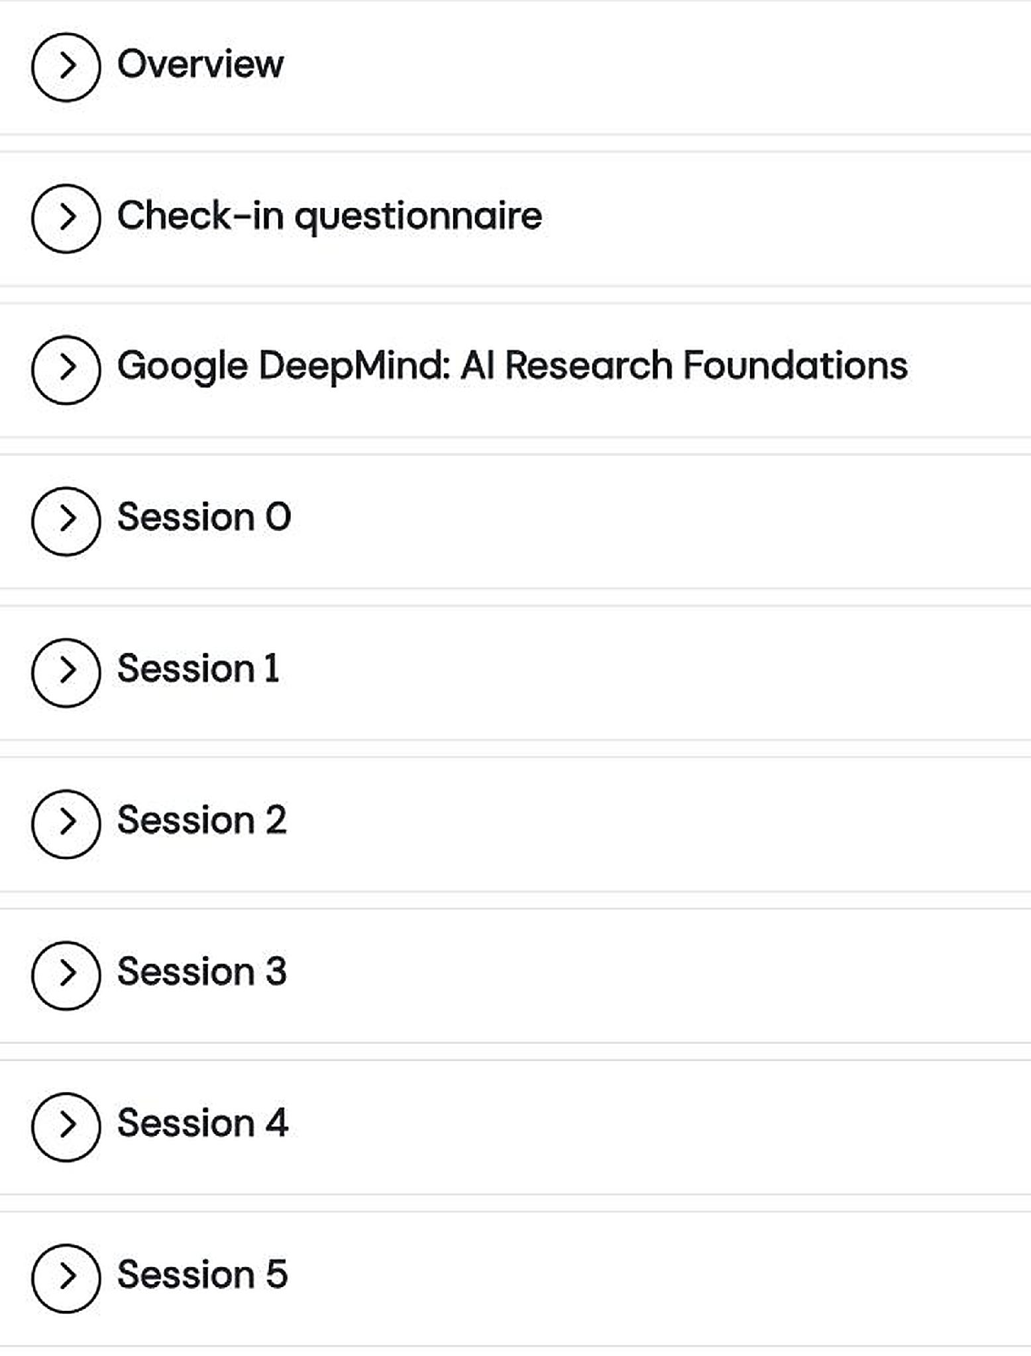
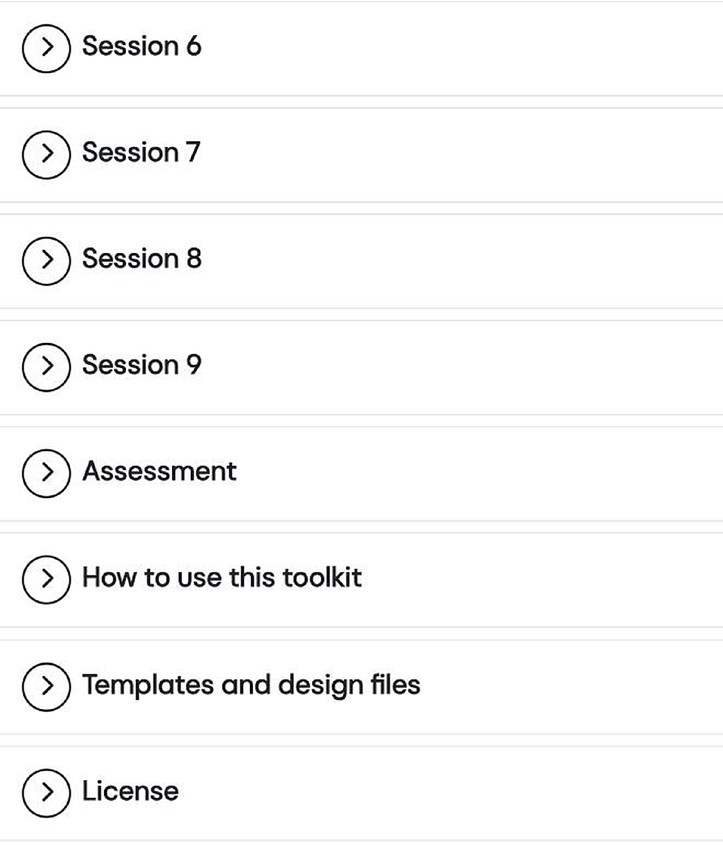
Ten sessions
Notes:
TRANSFER: insert directly after 'UCL Extend: the toolkit's home' from this pack.
1 min. The whole toolkit is one course page: a section per session (Session 0 to Session 9), plus the Google DeepMind course links, Assessment, How to use this toolkit, Templates and design files, and License. Each section expands in place. Captured 2026-08-16 with all ten sessions live (the site held only Session 5 until UCL's end-of-July upload).

Slide 3
How it works!
Plan
Eight groups
Each group will be assigned one AI activity or one RI Activity from the toolkit
Each group prepares how you'll run them.
💡 Remarks:
If the activities require handouts, they are provided with the activities.
Need paper, markers, or anything else? Just ask us 🙌

Slide 4
Agenda :
Thursday 15 Oct (16:00 - 17 : 00)
Friday 16 Oct (16:00 - 17 : 00)

Slide 5
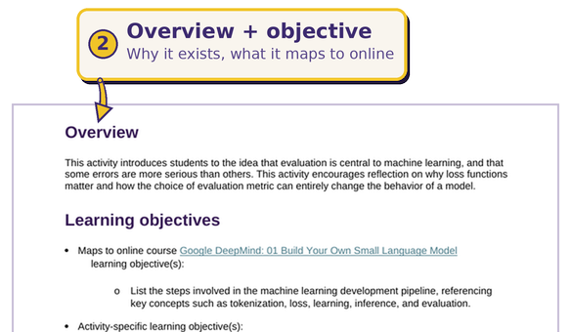
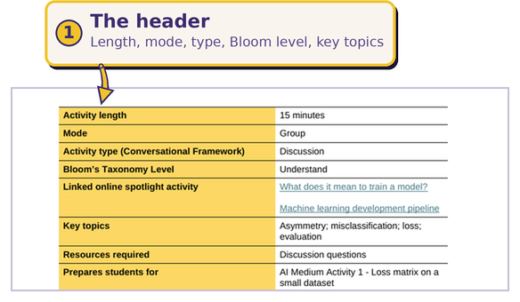
Structure of an activity

Slide 6
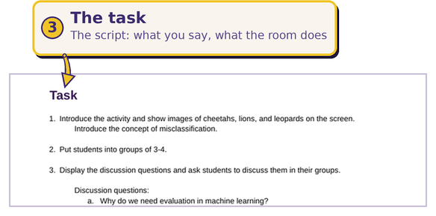
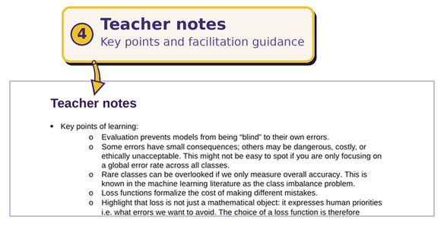
Structure of an activity

Slide 7
In your delivery slot
Run
Feedback
≈ Respect the timing
≈ 5 minutes
Deliver it as you would to your class: open the idea, run the task, manage the time, debrief the answers.
Peers and facilitators respond: what landed, what to tighten (timing, clarity, participation, debrief).

Slide 8
Materials?
Deadline : Thursday - 10 a.m
Where? #lecture-it-back-kenya-cohort-1

Slide 9
AFRICA AI UPSKILLING PROGRAMME - AI RESEARCH FOUNDATIONS WORKSHOP
Lecture it Back · Group Assignments
Group 1 GROUP OF 4
Thu 15 Oct · 16:00 to 16:20 · Room A
Group 5 GROUP OF 4
Thu 15 Oct · 16:20 to 17:00 · Room A
1.4 Loss matrix on a small dataset
AI · 20 MIN
0.9 Responsible, not responsible, uncertain
RI · 40 MIN
Dr. Leah Mutanu
Dr. Edward Ombui
Dr. Henry Muchiri
Dr. Fidelis Kilonzo
Anthony Karugu
Hillary Kavagi
Bonsa Guyo
Stanley K. Kimaita
Group 2 GROUP OF 4
Thu 15 Oct · 16:00 to 16:20 · Room B
Group 6 GROUP OF 4
Thu 15 Oct · 16:20 to 17:00 · Room B
2.4 Why tokenization matters
AI · 20 MIN
0.10 Context, perspective and LLMs
RI · 40 MIN
Prof. Jimmy Macharia
Dr. Joseph Onderi Orero
Dr. Mary Njeri Ngaruiya
Dr. Eric Araka
Ernest Andugo
Hilda Manegene
Serena Cheres
Moses Mataara
Group 3 TRIO
Fri 16 Oct · 16:00 to 16:20 · Room A
Group 7 GROUP OF 4
Fri 16 Oct · 16:20 to 16:35 · Room A
3.4 Where did the model go wrong?
AI · 20 MIN
1.8 Can versus should with LLMs
RI · 15 MIN
Prof. Calvin Omolo
Dr. Kennedy Kilel
Dr. Vincent Mbandu
Joel Mutevu
Michelle Chebet
Daniel Simiyu
Mary Wairimu Ndirangu
Group 4 TRIO
Fri 16 Oct · 16:00 to 16:20 · Room B
Group 8 GROUP OF 4
Fri 16 Oct · 16:20 to 17:05 · Room B
4.5 Deconstructing a transformer block
AI · 20 MIN
1.10 The Ubuntu lens: individual and collective values
RI · 45 MIN
Dr. Collins Oduor Ondiek
Dr. Rogers Ochenge
Aicha Zindamoyen
Victor Kemboi
Joy Dorcas Bisieri
Paul Kweyu
Susan Gitau

Slide 10
Questions? 🤔

