Slide 1





LECTURE IT BACK
Nigeria · Aug 2026
AI Research Foundations
Notes:
Planning session: Tuesday 14:30-15:00 (both weeks). Deliveries: Thursday and Friday 16:00-17:00, three groups per day: 20 minutes per group total (~15 run + ~5 feedback). Briefing is ~10 min of the 30; the rest is group planning time. Group count (6) assumes one group per activity; adjust to cohort size. Slot math to confirm with Maharavo (tracker owner).

Slide 2

How it works
Plan
Deliver
Today · 30 minutes
Thursday & Friday · 16:00
Form six groups, claim one activity from the Lecture it Back folder, read the pack, and plan how you'll run it.
Your group runs its activity for the room; we are your students. About 15 minutes to run it, then feedback.
Notes:
Emphasise: this is facilitation practice for the material they will teach at their own institutions. Three groups deliver Thursday, three Friday.

Slide 3
Today's 30 minutes
Form groups
1
Six groups, one activity per group: mix institutions so feedback crosses campuses.
Claim an activity
2
Three AI and three RI activities are in the folder: first come, first served, and every activity must be taken.
Read the pack
3
Each pack is the UCL activity brief: overview, learning objectives, timings, the task, and teacher notes (3.4 also ships a worksheet).
Plan the delivery
4
Assign roles (who opens, who runs the task, who debriefs) and trim the activity to fit your slot.
Notes:
Keep this moving: briefing ~10 min, groups formed and activities claimed in the next ~5, leaving ~15 minutes of real planning time.

Slide 4
The Lecturer Toolkit: how it's built
One home, ten sessions
1
Session 0 through 9, each a self-contained page on UCL Extend, hosted in one place.
Two activity types per session
2
AI activities (cognitive, technical) and RI activities (affective, reflective), each in Short, Medium or Long formats.
Everything ships ready to run
3
A slide deck for every session; AI Long activities also come with Student and Teacher notebooks.
Built from a standard brief
4
Every activity, AI or RI, follows the same brief format, so once you can read one, you can read them all.
Notes:
This is the toolkit they'll be pulling their activity from - the point is fluency with the STRUCTURE, not memorising all ten sessions. Bridges into the next slide (the brief format itself).

Slide 5
Anatomy of an activity brief
The header
1
Length, mode, activity type, and Bloom level: a 10-second scan of what it is and how long it runs.
Overview and learning objective
2
Why this activity exists, and what it maps back to in the online course.
The task
3
The actual script: what you say, what the room does, step by step.
Teacher notes
4
Key learning points, a closing message, and facilitation prompts for when discussion needs steering.
Notes:
These four fields are on every brief regardless of activity or format. Next slide shows them filled in for one real example (1.4).

Slide 6
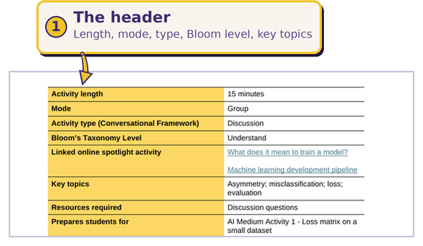
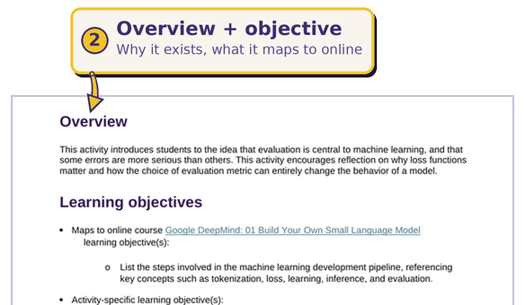
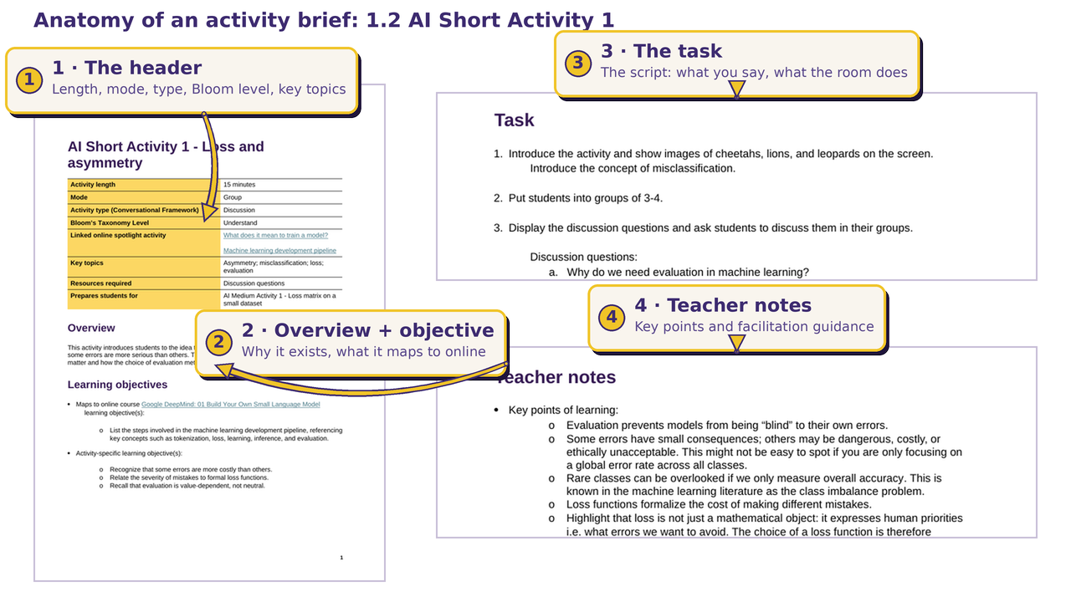
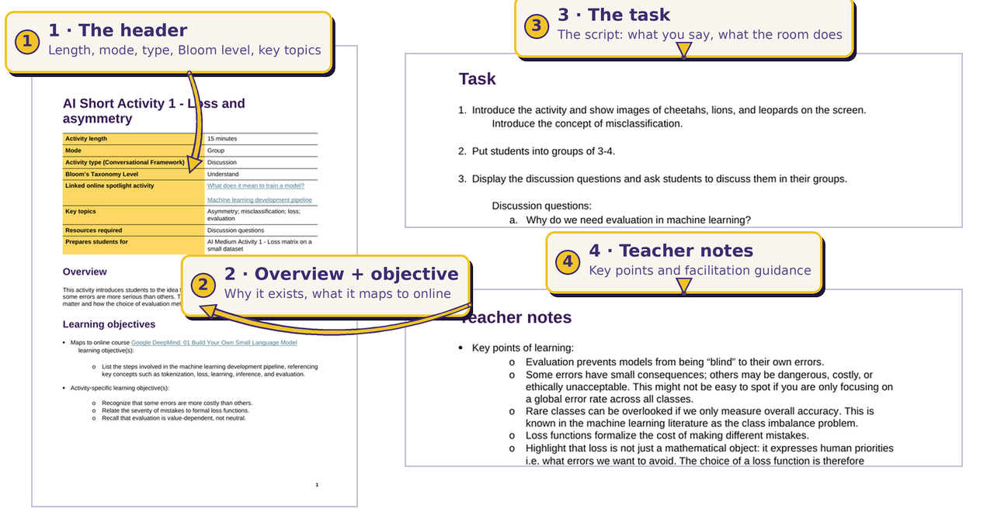
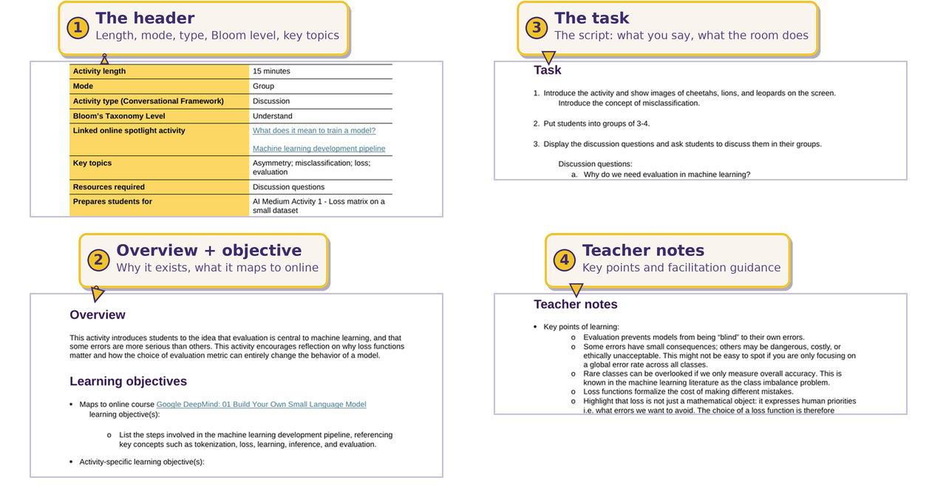
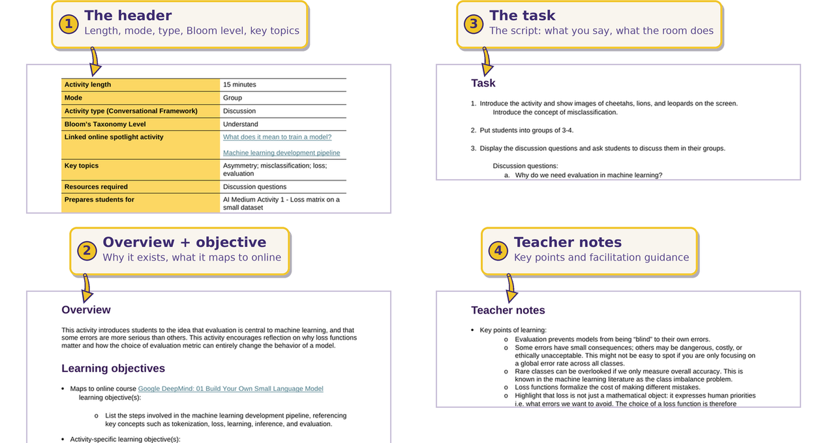
The same four pieces, on a real brief
Notes:
Point at this briefly, don't read it line by line: 'this is a real brief, the same four pieces we just named, marked up.' 1.2 is the Session 1 activity that sets up 1.4 (our worked example next).

Slide 7
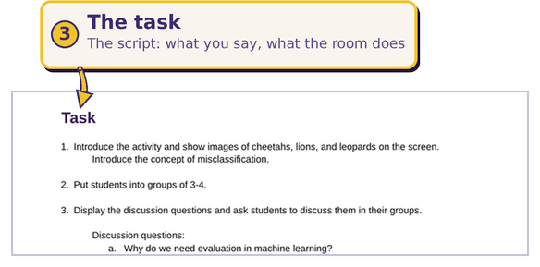
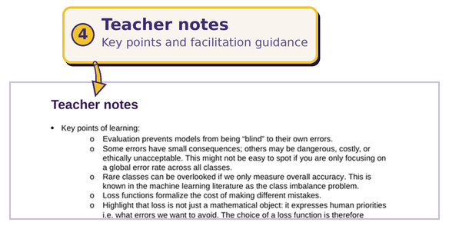
The same four pieces, on a real brief

Slide 8
1.4 · Loss matrix on a small dataset
AI ACTIVITY
WORKED EXAMPLE
What you'll run
Where it's from
Score a 20-row animal dataset (leopard / lion / cheetah) against a predictor's outputs: compute overall and per-class error, build the 3×3 confusion matrix, and surface why a model can look accurate overall yet fail the rare class.
Session 1 · UCL Lecturer Toolkit
Course 1 · Build Your Own Small Language Model
AI Medium · ~20 min · Bloom: Apply
Materials: dataset worksheet (print it) + board
Notes:
Facilitation skill on show: silent individual maths kept on track, then a reveal steered so the rare-class insight lands. One pre-fix in the source deck: S1 slide 24 says 'Cats only' where it means 'Leopards only'.

Slide 9
Where the material lives
UCL Extend hosts ten sessions; today's six activities come from Sessions 1, 2 and 3.
0
1
2
3
4
5
6
7
8
9
extend.ucl.ac.uk → Session → Activities → AI/RI → Format
Session 1
└── AI · Medium → 1.4 Loss matrix on a small dataset
Session 2
├── AI · Medium → 2.4 Why tokenization matters
├── RI · Short → 2.9 What is “data coloniality”?
└── RI · Medium → 2.11 Data ownership debate
Session 3
├── AI · Medium → 3.4 Where did the model go wrong? (+ worksheet)
└── RI · Short → 3.8 Risk resulting from AI
Your group's activity is one of these six: the walkthrough you just saw uses 1.4 as the model.
Notes:
CONFIRM BEFORE DELIVERY: this assumes Sessions 1-3 are live on UCL Extend by workshop day. As of the pedagogy-deck research, only Session 5 was uploaded (draft, key-gated) - the rest were tied to UCL's 31 Jul submission. If Sessions 1-3 aren't live yet, fall back to sharing the Drive copies directly and say so verbally, but don't put that fallback on the slide itself.

Slide 10
In your delivery slot
Run
Feedback
≈ 15 minutes
≈ 5 minutes
Deliver it as you would to your class: open the idea, run the task, manage the time, debrief the answers.
Peers and facilitators respond: what landed, what to tighten (timing, clarity, participation, debrief).
Notes:
Feedback frame: two things that worked, one thing to tighten. Facilitators go last so peer voices come first.

Slide 11
Three rules
01
02
03
Run it, don't read it.
Timebox like a pro.
Debrief is the lesson.
You are facilitating an activity, not presenting slides. Get the room doing the task quickly.
Announce timings, cut group work on time, and keep a protected buffer for the share-out.
Collect answers, name the misconception, and connect back to the course concept before you close.
Notes:
Close the briefing here, then release groups to plan. Remind them the folder stays open all week.

