Slide 1





Challenge Lab Walkthrough
Build Your Own Small
Language Model
Nigeria · Aug 2026
AI Research Foundations
Notes:
Facilitator debrief, 30 min (Wed 16:00, both Nigeria weeks + Ghana). Participants already completed GSP531 before this session (virtual onboarding). New slides 4-5 recap the access path from the reference video; slide 16 adds two notebook gotchas found in QA that the original deck never mentioned. Menu Master says 40 min; the schedule only allocates 30, confirm with whoever owns the agenda.

Slide 2





Why each solution works, not just how
Explain the reasoning
Place each task in the arc
Pre-empt the wrong turns
Articulate why a solution is correct.
Connect all four tasks to the path from raw text to a trainable language model.
Name the common incorrect approaches so you can rescue a stuck student fast.
By the end of this session
You can map the lab's four tasks back to specific concepts from the online course content, and walk any student through the reasoning behind each checkpoint

Slide 3





How “Check my progress” actually grades you
Every test cell ends with a logger.info(...) call. The grader does not read your code or your outputs; it queries Google Cloud Logging for those log lines in the lab's project.
›
›
›
Test cell runs
logger.info(...)
Cloud Logging
Grader queries
code executes in Colab
emits a tracked value
entry lands in the project
“Check my progress”
Why this is the most useful thing you can know
Correct code + wrong environment = a red checkmark.
If the runtime, the account, or a stale library stops the cell from logging, the grader sees nothing, so the checkpoint stays red even when the student's logic is flawless. The first question for any stuck student is never “show me your code.” It is: did the cell actually run, and did it log?

Slide 4




Before this session: getting into the lab
Enrol, then start
Budget 90 minutes
Incognito and the student account
Start from the Train A Small Language Model course, not from the path.
The card says 1 hour. The running lab shows 1h 29m left.
Open Google Cloud console prompts you to use private browsing.
WHAT | Enrol in the course, then click Start challenge.
WHAT | Set aside a full, uninterrupted 90 minutes.
WHAT | Copy the username, password and project ID first.
WHY IT MATTERS | No enrolment means no skill badge.
WHY IT MATTERS | A lab cannot be paused once you click Start.
WHY IT MATTERS | Signing in with a personal Gmail can create real charges.
Notes:
Sources: lab manual GSP531 read live on 2026-08-07 (manual last updated 2026-05-04); reference recording 2026-07-09.
Enrolment: the manual opens with "To earn the skill badge, you must be enrolled in the challenge lab course. Please ensure you are enrolled before you begin this lab." The lab is reachable straight from the path, which is the trap: a student can score 100 and still get no badge. Route them through the course Google DeepMind: Train A Small Language Model, then Start challenge.
Timer: the card advertises 1 hour. On our run the lab page read 1h 29m left once started. Tell students to budget 90 minutes and to expect no pause button.
Naming: the course is Build Your Own Small Language Model; the lab is Train a Small Language Model (Challenge Lab), GSP531, 5 credits. Students confuse the two.

Slide 5




The main steps
Task 1: Import and load data
Task 2: Character tokenizer
Task 3: N-gram text generator
Task 4: Dataset preparation

Slide 6



PART ONE
Task 1
Import and load the data
The lab's own Task 1 is Import the notebook, define helper functions, and load data. There is no code to write here, and no Check my progress button.
1 IMPORT
2 TOKEN
3 N-GRAM
4 DATA

Slide 7
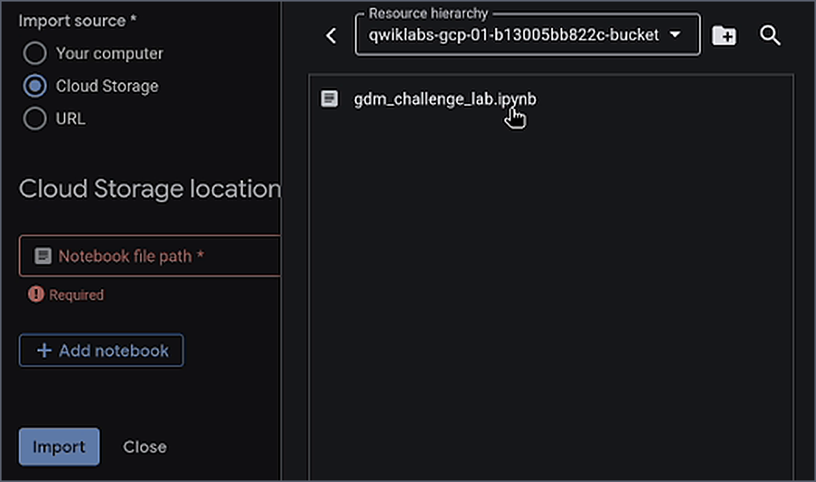

Getting the notebook open
1 Agent Platform → Notebooks → Colab Enterprise → My notebooks
2 Set the Region shown on the lab page (us-west4 on our run)
3 Import source: Cloud Storage, not Your computer
4 Pick gdm_challenge_lab.ipynb from the project bucket
Notes:
Frames: reference recording 2026-07-09, source timeline 161.3 s and 175.3 s. Steps verified against the live lab manual read 2026-08-07.
The nav is four levels deep and the Notebooks level is easy to miss. The manual says only "Select the region" and redacts the file path until the lab starts, so students must read both off their own lab page. On our run it was us-west4 (Las Vegas) and <project-id>-bucket/gdm_challenge_lab.ipynb.
The default Import source is Your computer. A student who does not switch it to Cloud Storage has nothing to import and often assumes the lab is broken.

Slide 8
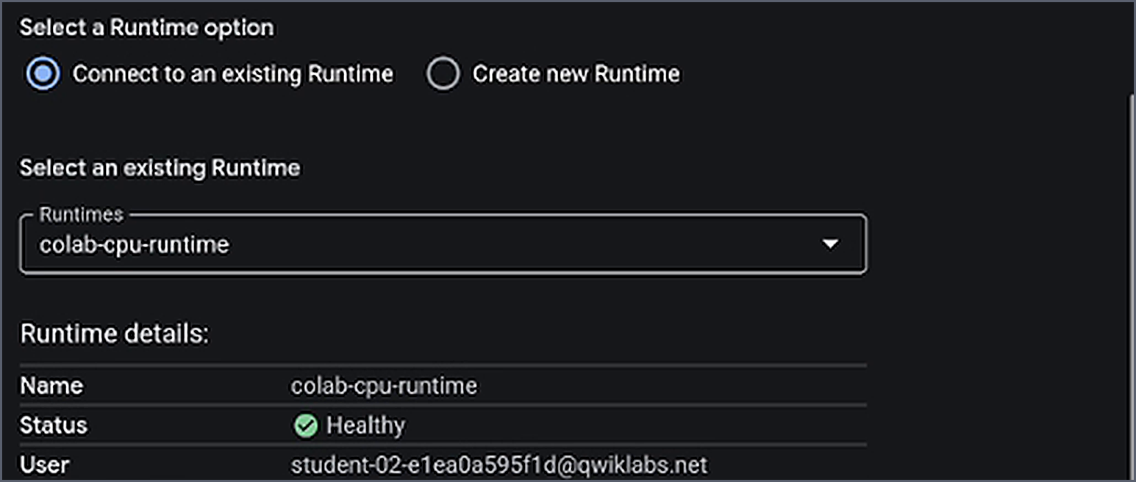
Connect to the runtime that is already there
1 In the notebook, open Additional connection options, top right
2 Choose Connect to a runtime
3 Connect to an existing runtime, then colab-cpu-runtime
4 Never Create new Runtime. The status bar confirms which one you got.
Notes:
Frame: reference recording 2026-07-09, source timeline 217.4 s. Wording verified against the live lab manual read 2026-08-07.
The manual's exact route: click the Additional connection options expander arrow at the top right of the notebook, select Connect to a runtime, then in the Connect to Agent Platform runtime dialog select Connect to an existing runtime and pick colab-cpu-runtime.
Create new Runtime sits directly beside the right answer and succeeds. That is what makes it dangerous: the notebook runs, the student sees output, and nothing reaches the grader. The one-glance diagnostic is the status bar at the bottom right of the notebook.

Slide 9
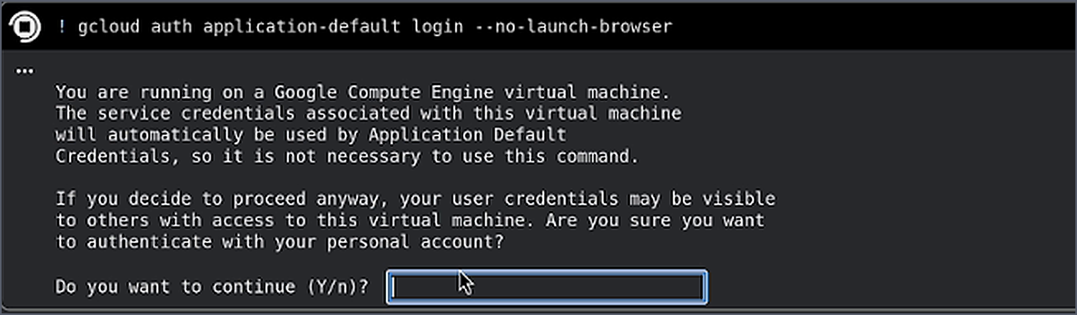
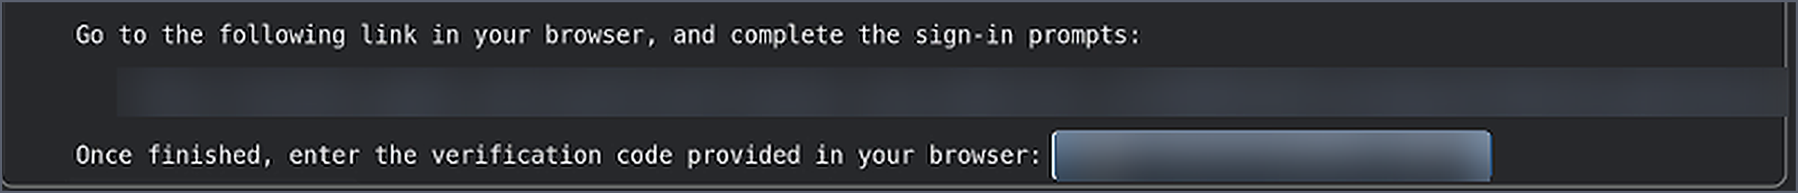
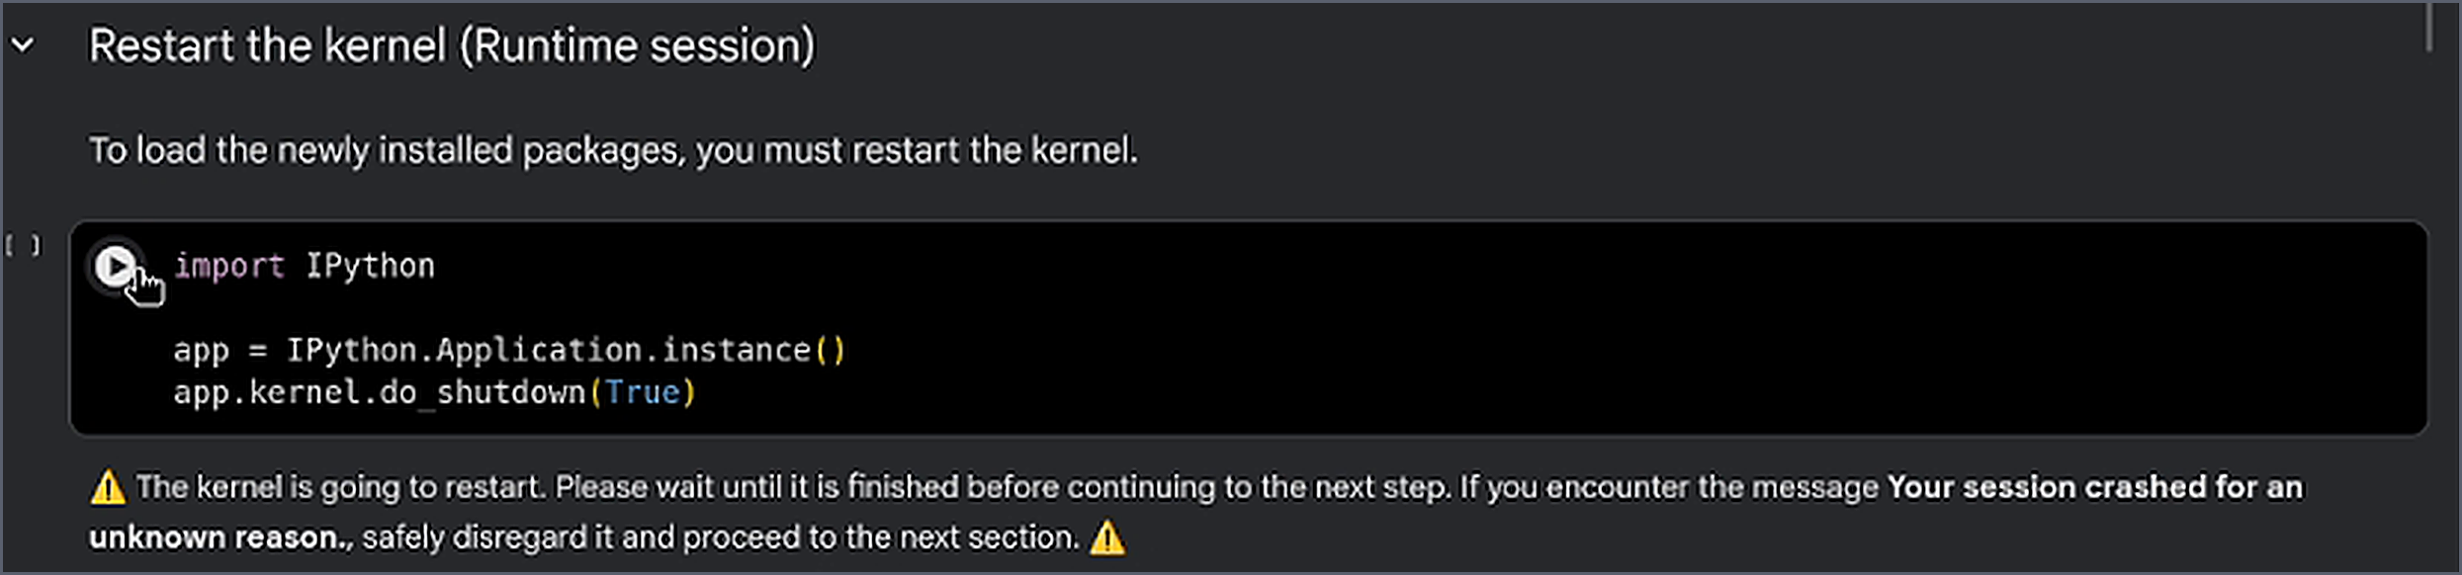
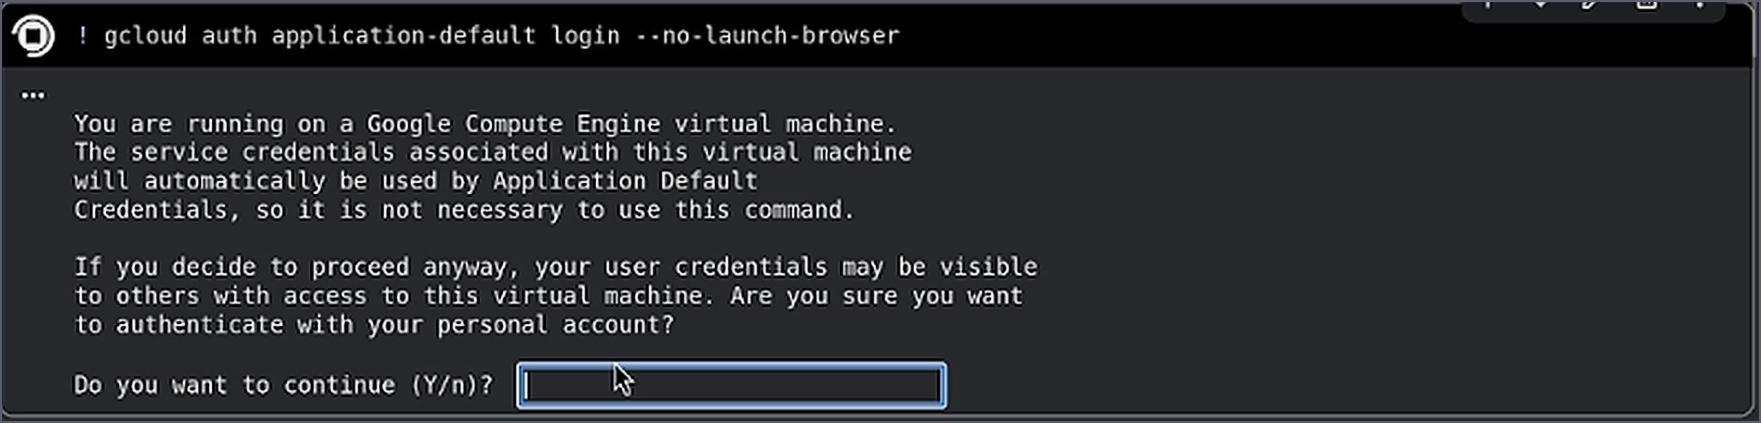
The prompt waits, then the kernel restarts
1 The first cell is interactive. It stops at Do you want to continue (Y/n)?
2 Type Y, open the printed link, sign in as the student again
3 Paste the verification code back into the cell
4 The next cell kills the kernel. Your session crashed is expected.
Notes:
Frames: reference recording 2026-07-09, source timeline 289.4 s, 315.4 s and 346.4 s. The sign-in link and the verification code are blurred in the image files themselves, not covered on the slide.
gcloud auth application-default login --no-launch-browser is interactive. It prints a Google Compute Engine warning, then waits at Do you want to continue (Y/n)?. A student who runs the cell and walks away comes back to a cell still showing [*] and concludes the lab has hung.
This is the student's third sign-in: the Cloud console, then Colab Enterprise, then this one. Every one of them has to be the student account.
The restart is deliberate: the notebook shuts down its own kernel to load the packages it just installed, and the notebook itself tells you to disregard the crash banner. Historical note: an earlier version of this deck claimed the notebook shipped a broken protobuf pin. It never did. The install cell reads %pip install --upgrade protobuf, as the frame above shows.

Slide 10

Nothing here throws an error: that's the problem
Task 1 has no Check my progress button. All three of these first surface as a failed Task 2 check.
Wrong runtime
Wrong account
Auth never finished
Created a new Runtime instead of connecting to the provisioned one.
A personal Google account signed in at one of the three sign-in points.
The gcloud cell is still waiting at Do you want to continue (Y/n)?
DIAGNOSE
Ask: what does the status bar say?
DIAGNOSE
Ask: which account is in the avatar?
DIAGNOSE
Ask: is that first cell still showing [*]?
FIX
Reconnect via Additional connection options, top right.
FIX
Sign out, redo all three as the student.
FIX
Answer Y, then paste the verification code.
Notes:
All three fail silently: the cell runs, the code is right, nothing reaches Cloud Logging, and the checkpoint stays red. Three sign-in points, all of which must be the student account: the Cloud console, a second 'Choose an account to continue to Colab Enterprise' prompt, and the gcloud link inside the auth cell.
Retired: the protobuf pin. Earlier decks told facilitators the install cell shipped %pip install --force-reinstall protobuf==3.20.0 and had to be edited by hand. The 2026-07-09 recording of a live run shows the cell already reads %pip install --upgrade protobuf, unrun, straight after import, so there is nothing to fix and that slide has been removed. If it ever comes back, the tell is at the first cell after the kernel restart: import keras raises ImportError: cannot import name 'runtime_version' from 'google.protobuf'. Recovery is %pip install --upgrade protobuf in a new cell, then restart the kernel again. Full history: labs-testing/challenge-lab-qa-2026-07.md.

Slide 11

PART TWO
Task 2
Character Tokenizer
Two methods to complete. Both are one line. The lesson is restraint: the standard library already does the hard part.
1 IMPORT
2 TOKEN
3 N-GRAM
4 DATA

Slide 12


Trust the standard library
Python's str is Unicode-aware, and the bidirectional + diacritic characters were already stripped during preprocessing. So the order is already correct, no special handling needed.
def character_tokenize(self, text):
tokens = list(text)
return tokens
def join_text(self, tokens):
text = "".join(tokens)
return text
list(text) keeps logical order
Index 0 is the first character read (the right-most glyph). Visual RTL ≠ index order.
“join” means concatenate
Joining with "" rebuilds the exact text. The empty separator is the whole point.
What the grader checks: it logs the token count of the first line (len(first_line_tokens)). A character tokenizer returns one token per character; a whitespace split returns far fewer, so the logged count is wrong and the checkpoint fails with no exception to point at.

Slide 13
PART THREE
Task 3
N-gram Text Generator
The students write the generation loop on top of Cymbal Chat's pre-built model. This is where the deepest misunderstandings live, and where greedy “bugs” are actually the lesson.
1 IMPORT
2 TOKEN
3 N-GRAM
4 DATA

Slide 14



Three moves, repeated n_tokens times
Built on the model's three pre-written functions. With n = 4, the context is the last 3 characters, and it must be a joined string, because that is exactly how the model keys its contexts.
1 · Build the context
2 · Query the model
3 · Branch on sampling
Take the last n-1 tokens and "".join them into a string key: the model is indexed by string contexts, not tuples.
ngram_model[context] returns a { next_token: probability } distribution for that context.
greedy → argmax of the probabilities. random → sample weighted by them. Append, then repeat.
What the grader checks: it logs the word count of the generated text.

Slide 15
PART FOUR
Task 4
Dataset Preparation
Two functions turn raw stories into training tensors. The grader checks segment counts and array shapes, and most failures are one tiny wiring mistake away from correct.
1 IMPORT
2 TOKEN
3 N-GRAM
4 DATA

Slide 16
Slide a window, keep an overlap
Worked example: max_length = 3, n_overlap = 1
[17, 40, 30, 41, 29, 2, 33, 40, 35, 20]
→ step = 3 - 1 = 2
[17,40,30] [30,41,29] [29,2,33]
[33,40,35] [35,20] ← last is shorter
What the grader checks: - It logs the length of the sequence (len(sequence)).
- It logs the shape of the input and the targets.

Slide 17
Two more gotchas to watch for
Task 3, unseen-context crash
Task 4, overlap direction
A sampled context was never seen during training.
The docstring's overlap spec is inverted.
DIAGNOSE | Ask: did generation stop with a KeyError?
DIAGNOSE | Ask: does it match the worked example, not the docstring?
FIX | Guard the lookup: skip generation if context not in ngram_model.
FIX | Last n_overlap tokens of segment i = first n_overlap of segment i+1.
Notes:
Sourced from labs-testing/challenge-lab-qa-2026-07.md bugs #3 and #4 - both live in the notebook itself (reported upstream via the AIMS -> UCL/DeepMind channel), but facilitators should recognise them if a student hits either.

Slide 18
Four grader checks, and the task that has none
TASK | WHAT THE STUDENT WRITES | WHAT THE GRADER READS FROM THE LOG
1 · Import and load | Nothing, runs as shipped | No check here; its failures surface at the Task 2 check
2 · Tokenizer | list(text) / "".join(tokens) | Token count of the first line
3 · N-gram | The generation loop | Word count of the generated text
4a · Segment | Sliding-window with overlap | Aggregate length across all subsequences
4b · Sequences | encode → segment → extend | Shapes of the inputs and targets arrays

Slide 19

The goal: be able to decode it, not just do it!
Explain the reasoning behind each solution, not reproduce it.
Name the failure mode for each task and the fix to offer.
Leave with shared, student-facing guidance for your cohort.

