Slide 1


Modelling and Data Centre Requirements: CEDA
ESGF UV-CDAT Conference 09-11 December 2014
Philip Kershaw, Centre for Environmental Data Archival, RAL Space, STFC

Slide 2
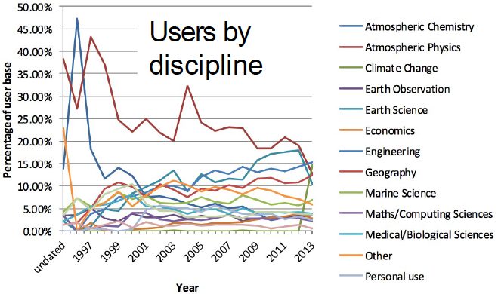
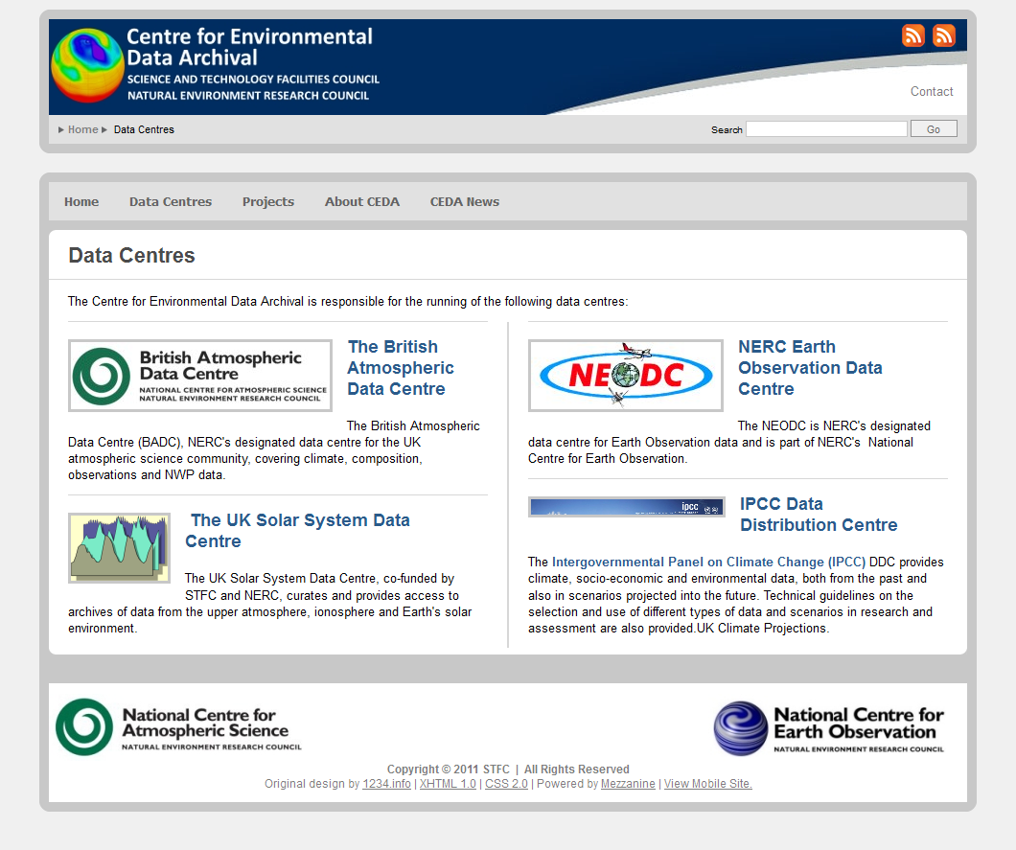
Centre for Environmental Data Archival
CEDA Archive snapshot – variety + complexity challenge
3.0 PB of allocated archive
2.3 PB used in 2,176 “filesets” totalling 152M files
Our CMIP5 is 1.2 PB in 1,174 “filesets” totalling 3.2M files
http://www.ceda.ac.uk

Slide 3
CEDA’s Engagement with ESGF
Overarching requirement comes through NERC (UK Natural Environment Research Council):
to maximise the UK's contributions to the CMIP cycle and
Exploit the data for the user communities
Supplementary requirements related to CEDA's stakeholders and associated services.
International collaboration has been a key to meeting these objectives:
engaging with shared software development effort was more likely to result in systems fit for purpose and
build a community upon which to create common tools and services.
The current operation and support burden with ESGF together with other commitments is placing a big strain

Slide 4
Consistency, conformance to standards, performance of services within ESGF
Issues around the ingest pipeline and consistency of metadata
“It takes two days to write a script to handle tens to hundreds of parallel wget threads, and six months to deal with all the failure modes associated with mis-configured information”
There are many opportunities in the process for de-synchronisation
Need a single source of authority for information
Uptime and reliability of services
We’re interconnected and reliant on one another
But lack of reliability and responsiveness to issues of any one service affects people’s perception of the whole of the federation and of individual partners
There are key services which have a high profile and larger impact
It needs a practical re-assessment e.g. Should we be in the business of running IdPs?

Slide 5
Governance
Need clarity about the scope of governance in each of the contexts:
Projects and data
The operational system
The software
What drives requirements
The science
User communities
The data centres: the system is not sustainable if it cannot be integrated into the data management infrastructures of the institutions that are operating it.

Slide 6
Operations and Support
Need to create a virtuous circle of experience from operations feeding back into software development drivers
Complexity increases exponentially with number of deployments. This is a Federation
Do something simple and do it well
Establish processes and decision gates
Process for a new project joining the federation
Should it join at all? – What does it gain for project and for the existing communities using ESGF?
Process for releases and patching – does the severity of a security alert warrant major disruption?
Process for publishing … other processes …
Clearly delineate between project specific and federation-wide scope
Resourcing - People and skills, funding
Metrics for level of service – SLA, uptime
If a given provider can’t meet perhaps they shouldn’t be doing it or perhaps we’re doing the wrong things

Slide 7
Future Priorities for our Engagement
CEDA needs to serve a number of projects and communities over above ESGF
We can’t continue to run parallel systems
Need to integrate component by component as required and support for interfaces
Need to resolve governance and,
Operations and support
How can these be resourced?
Simplifying what we run could be more effective
Publishing is a high priority for CEDA to contribute to and improve
both from a point of view of software
best practice for consistency and good version control

