Slide 1
NCAR Data Center Requirements: Reducing Barriers to Community Data Use
2014 ESGF/UV-CDAT F2F
Eric Nienhouse (NSF/NCAR)
Notes:
I am the Product Owner for several NCAR science gateways. My role in these efforts is to represent our end users and other stakeholders and to engage with them to ensure that we're providing the right products for our user community.
This talk is coming from an ESGF customer perspective.

Slide 2
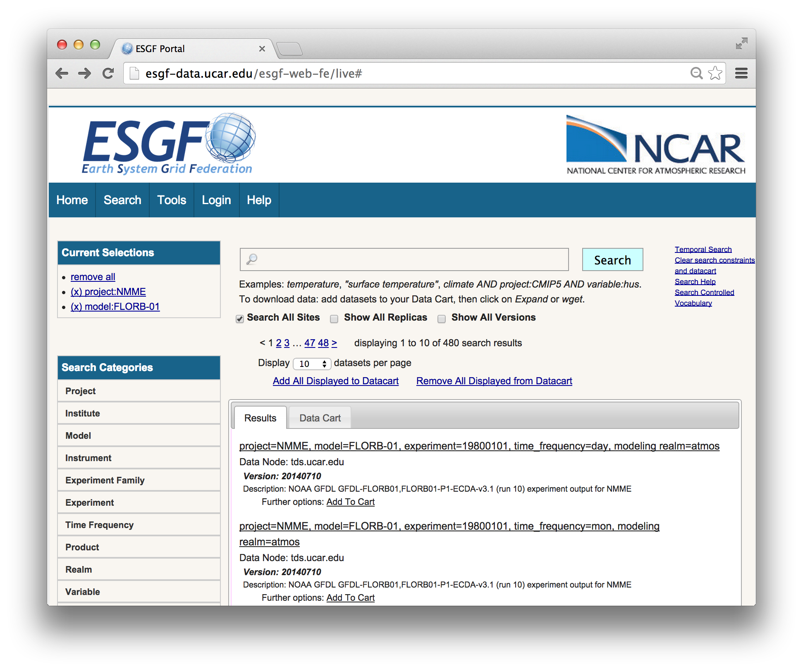
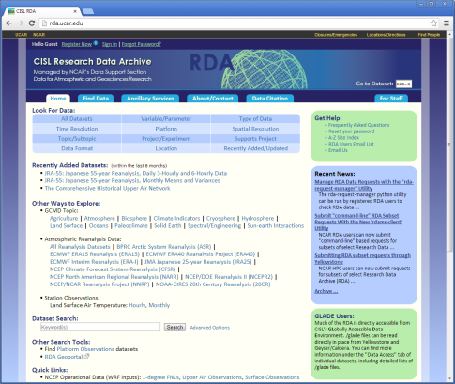
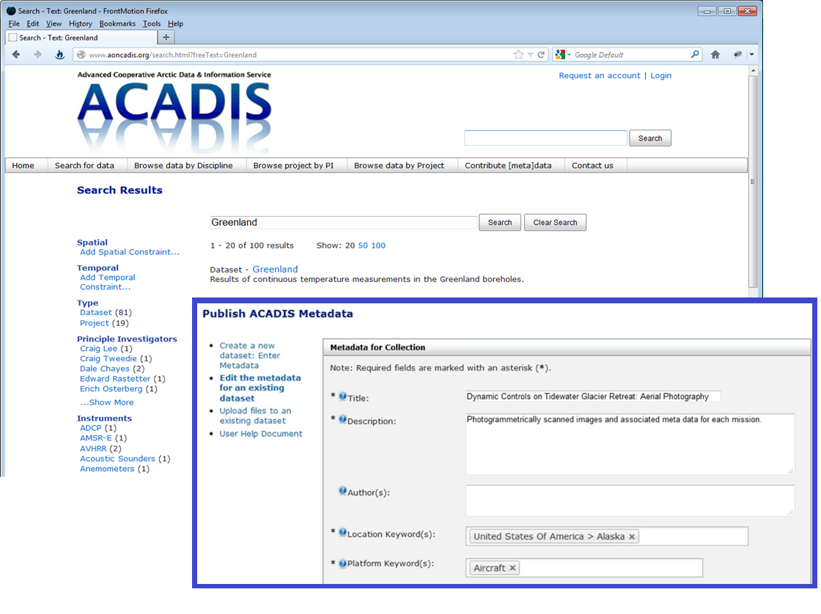
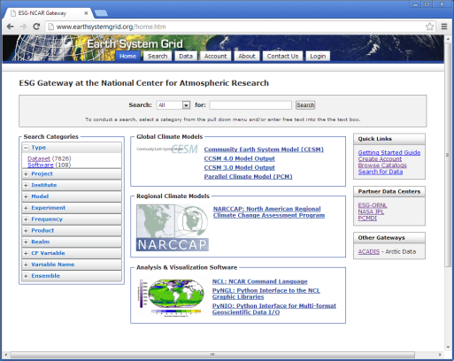
Sample of NCAR Data Archives
We build data archives and curate data for diverse communities.
20K annual users, 300 data providers, 20K collections, 5PB, 2.5PB yearly downloads.
ACADIS
Advanced Collaborative Arctic Data Information Service
NSF Arctic projects
Self publishing tools
Many disciplines
Long term preservation
ESGF & ESG-NCAR
Climate Data at NCAR
Climate models (CESM)
RCMs (NARCCAP)
Large data volume
Heavily accessed
RDA
Research Data Archive
Reanalysis + obs products
Subset and re-format svcs
ECMWF, ICOADS, JRA-55
Actively curated
Notes:
Starting with some background and perspective.
NCAR CISL data archives (note NCAR has other archives, MLSO, EOL, etc.)
On the left is ACADIS which serves a community of arctic researchers which are primarily small projects with modest if any resources for data management.
Middle is ESG-NCAR, which primarily addresses the needs of large, organized science, or the “so called Big Head” of science which typically has good funding and sound management for data handling.
On the right is the RDA which is an actively curated, heterogeneous collection of reference datasets that support scientific studies in climate, weather, Earth System modeling, and increasingly, other related sciences.

Slide 3
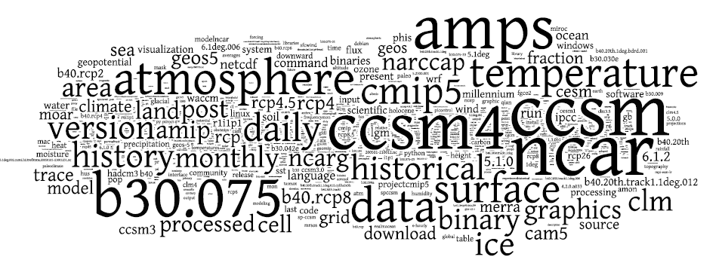
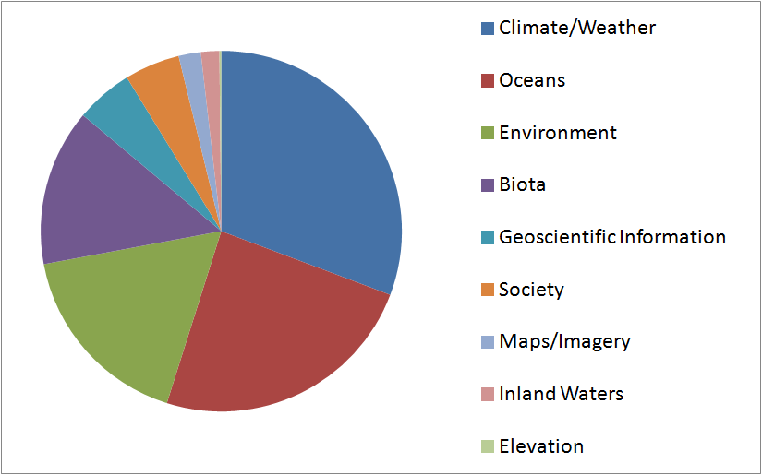
Community Use and Access
Data products are growing in popularity among non traditional disciplines
Over 2300 download users monthly
Diverse and growing user base
5X download volume by 2017
Data reduction increasingly utilized
Seeking more ways to access data
Notes:
Downloads, CMIP5, search wordle, note need for metrics aggregation.
Federation with GCMD, TR Web of Knowledge, WMO-WIS via OAI-PMH.
Show expected Growth (5X = 0.5PB/month from ESG & ESGF) and need for sub-setting, server side solutions.
-Sub-setting services have proven to be very popular with the RDA user community, typically reducing required download volumes by at least an order of magnitude.
CMIP5 use/growth (TDS access)
Add variable popularity (for CMIP5)?
Show CMIP5 data…

Slide 4
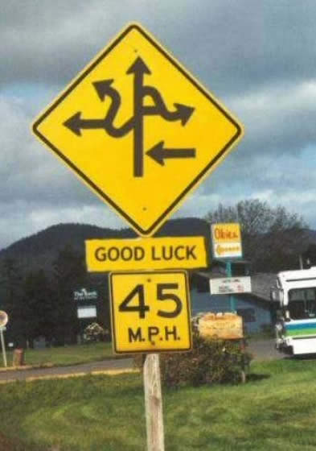
Removing Barriers to Scientific Data Use
Common Problems:
Finding and preparing data for use is expensive.
Search, download, evaluate, repeat is slow.
Scientifically related data is hard to find.
Data evaluation tools are lacking in workflows.
Human experts cannot scale to meet needs.
Notes:
These are problem many of us a data managers and data systems engineers are well acquainted with.
Further there have been recent publications raising these concerns, especially as new communities including citizen scientists are increasingly seeking climate related data.
For example, a recent article in IEEE Earthzine by Ruud and Edwards calls out these very issues.
I believe, we’ve been a bit distracted from these data use issues as we’ve worked on the challenges of processing, moving and managing these large data collections.

Slide 5
Removing Barriers to Scientific Data Use
Imparting knowledge to inform data consumers is a growing need.
Knowledge
Analysis
Published
Data
Notes:
A big challenge of “Big Data” is providing ways for data consumers to efficiently obtain the data needed to impart scientific knowledge and ultimately generate scientific wisdom.
In a simple sense, data publishing is an early step in the process leading to data evaluation, analysis which ultimately leads to scientific knowledge, action and ultimately wisdom.

Slide 6
Challenges of Obtaining Data for Analysis
Big data challenges include increasing efficiency of obtaining data and information
Evaluate
Discover
Published
Data
Analysis
Access
Discovery is improving
Metadata federation
Search engines
Schema.org
Evaluation & access is challenging
Download often required
Little guidance in workflow
Human experts fill in gaps
Notes:
A big challenge of “Big Data” is providing ways for data consumers to efficiently obtain the data needed to impart scientific knowledge and ultimately generate scientific wisdom.
As a community of data managers and distributors, we’ve made good improvements on discovery.
Data evaluation for suitability and access is still a great challenge.
Workflows provide little guidance to users.
Current improvements include projects like NCAR’s Climate Data Guide and EU CHARMe Project

Slide 7
Data Production Efficiency and Quality
Model output changed to reduce significant post processing workload
CCSM/CESM 2000 – 2012
CESM 2014/2015
model
model
time 1
header
field 1
field 2
...
field n
time 2
header
field 1
field 2
...
field n
time m
header
field 1
field 2
...
field n
field 1
header | time 1 | time 2 | ... | time m
...
field 2
header | time 1 | time 2 | ... | time m
field n
header | time 1 | time 2 | ... | time m
Synoptic Output
Significant post-processing
Multiple file storage forms
Single Field Time Series Output
Minimal post-processing
CMOR standardization simplified

Slide 8
What are the Major Concerns?
Open services, user experience driven with tools for enabling innovation
Efficient and automated data processing workflows
Data service (TDS) scaling to CMIP6 volumes
Information rich data access workflows
Security infrastructure with a greater usability focus
Analytics to understand use and guide improvements
Notes:
Add quote from earthzine article?

Slide 9
Ideas for Continued Improvement?
Begin to address Big Data challenges by reviewing and re-thinking
Open data for CMIP6?
(Lossy) compression for data products?
Wiki / expert content within access workflows?
Share automated workflow technology?
Governance with build, measure, learn focus?
Notes:
Is Open Data (ie. No login for access) an option? Can ESGF better support open/free data?
Some interesting work at NCAR, with a promising 80% reduction in file size w/ minimal (or no) workflow tool impact under way, note “Pepsi” challenge.
Can we improve the experience for expert and non-expect climate data consumers? Again, projects like CHARMe and Climate Data Guide are showing promise.
We all share come common pain points in the data production workflow, can we share more and leverage tools such as the Apache OODT?
Good strides have been made regarding governance, how can we best utilize these structures to swiftly advance the infrastructure?
Do we need a governance model around the data and metadata itself?
Add CESM Large Ensemble Link here…

Slide 10
Thank you! ejn@ucar.edu

Slide 11
Questions? ejn@ucar.edu

Slide 12
Blank Slide
Extra stuff follows

Slide 13
Quick Outline
Expanding access to climate and related data products
Introduction to NCAR systems and user communities
Publishing workflows & challenges
Barriers to data use
Requirements for the ESGF
Product and content governance
Notes:
NCAR Archives, communities, technologies, using ESGF
Publishing workflow changes (CESM model, post-processing storage, automated publication queue.)
Use and access barriers still a major issue for Climate Data
Requirements/ideas: Scaling TDS,
Prioritization and coordinating of development, release roadmap, documentation, content controls and review? (incentives for search)

Slide 14
Challenges in Workflow: Source to Analysis
Service quality is hindered by workflow inefficiencies and software feedback cycle
Data Preparation
Data Evaluation & Use
Software Feedback
Quality / Completeness
Frustrating / Time Consuming
Unclear Priorities
Notes:
Downloads, CMIP5, search wordle, note need for metrics aggregation.
Federation with GCMD, TR Web of Knowledge, WMO-WIS via OAI-PMH.
Show expected Growth and need for subsetting, server side solutions.
-Subsetting services have proven to be very popular with the RDA user community, typically reducing required download volumes by at least an order of magnitude.
CMIP5 use/growth (TDS access)
Add variable popularity (for CMIP5)?
Show CMIP5 data…

Slide 15
Key Focus Areas
Community experience and feedback highlights common issues
Data Production
(Automation)
Data Evaluation
(Usability)

Slide 16
How do we improve the path to analysis?
Open services, user experience driven with tools for enabling innovation
Open data helps (services, ease of access)
Connect information to data workflows (wikis, experts)
Focus on usability with user centered, iterative design
Increase access to information throughout access workflow
Enable services for data reduction and server side analysis
Enable third party innovation with open service access
Build in metrics to measure and guide improvements

Slide 17
Questions and Challenges
Where does the ESGF platform end and customization begin?
Tertiary or Cloud Storage?
Tape access is unsupported, is this a core capability of the ESGF?
Integration with storage APIs?
Search Facets?
Policy for sharing custom of project based search facets?
Site Customization?
Ease of upgrading customized node components (view/UI)

Slide 18
What the future holds
Collaboration, focus on data use and new communities of users
Recognition that significant barriers to use still exist.
Expand collaboration and technology sharing.
User centered design which includes emerging user classes.
Workflows supporting efficient path to analysis.
More access to expert information and guidance.

Slide 19
A Brief Word on Metrics…
Metrics enable cost minimization and efficient use of resources.
Funders require metrics and are a “must do”.
Metrics are critical to the “Build, Measure, Learn” loop.
Adding measurement to ESGF can yield faster, better development.
Notes:
Metrics are valuable.
Stakeholder input is still critical to guide priorities.
Metrics can help validate if feature/change was worth it.

Slide 20
Blind Evaluation of Lossy Data-Compression in LENS The objective of this project is to evaluate the impact of lossy data compression on climate data and determine whether or not it would impact science results. To this end, we are providing climate scientists direct experience with data that has undergone lossy compression via a blind experiment in the context of the CESM-CAM5 large ensemble community project (http://www2.cesm.ucar.edu/models/experiments/LENS).

Slide 21

NCAR Workflow 2000-2012
model
TB scale disk
time 1
header
field 1
field 2
...
field n
time 2
header
field 1
field 2
...
field n
time m
header
field 1
field 2
...
field n
...
post-processing/analysis
field 1
header | time 1 | time 2 | ... | time m
field 2
header | time 1 | time 2 | ... | time m
TB scale disk
field n
header | time 1 | time 2 | ... | time m
tape archive
tape archive
publish
publish
data access / ESGF

Slide 22
NCAR Workflow 2014/2015
model
analysis
field 1
header | time 1 | time 2 | ... | time m
field 1
header | time 1 | time 2 | ... | time m
field 2
header | time 1 | time 2 | ... | time m
field 2
header | time 1 | time 2 | ... | time m
field n
header | time 1 | time 2 | ... | time m
field n
header | time 1 | time 2 | ... | time m
10s PB disk
tape archive
publish
data access / ESGF

