Slide 1
Friction..
Search
This data comes from Dynamind.
Friction for class 8
Friction – Objective Type Questions
Friction – theory
Friction – difficult questions
Friction – Q&A, Videos
Friction for class 9
From Dynamind
+
1
More..
From searching groups with related topic.
Related Groups
Friction Experts
Friction Demystified
Friction Examples
JOIN
2
JOIN
More..
JOIN
Class X-XII
Newton’s Laws
JEE2017
My Groups
(All)
3
More..
Akshay
Sudha T
IR Sudha
Related Mentors
4
More..

Slide 2
On click on “More..”, then open the group Window
On click of line item, Open the Chat Box
3
Class X-XII
Newton’s Laws
JEE2017
Group 1
Gorup2

Slide 3
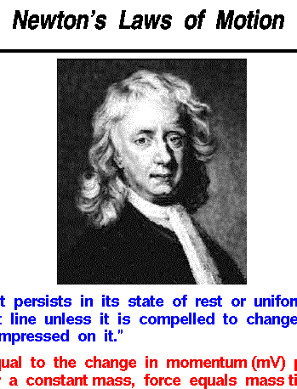
1
On click on “More..”, open the search window related to topic
On click on Link, open the related document/ video
Friction for class 8
Friction for class 9
Friction – Objective Type Questions
Friction – theory
Friction – difficult questions
Friction – Q&A, Videos
Friction for class 8
Friction for class 9
Friction – Objective Type Questions
Friction – theory
Friction – difficult questions
Friction – Q&A, Videos
Friction for class 8
Friction for class 9
Friction – Objective Type Questions
Friction – theory
Friction – difficult questions
Friction – Q&A, Videos

Slide 4
2
On click on “More..”, open the group window related to topic
On click on “JOIN.”, open the chat window if it is OPEN GROUP
Friction Experts
Friction Demystified
Friction Examples
Friction Experts
Friction Demystified
Friction Examples
Friction Experts
Friction Demystified
Friction Examples
Friction Experts
Friction Demystified
Friction Examples
Friction Experts
Friction Demystified
Friction Examples
JOIN
JOIN
JOIN
JOIN
JOIN
JOIN
JOIN
JOIN
JOIN
JOIN
JOIN
JOIN
JOIN

Slide 5
4
On click on “More..”, open the mentor list related to topic
On click mentor name, get into one-on-one chat
Akshay
Sudha T
IR Sudha
Akshay
Sudha T
IR Sudha
Akshay
Sudha T
IR Sudha
Akshay
Sudha T
IR Sudha
Akshay
Sudha T
IR Sudha
Akshay
Sudha T
IR Sudha

Slide 6
Functionality for Next Release
Show ‘Join Group’ option for new users.
Add Userd_ID1 as Chat_GroupAdmin in Chat_Group table while creating new groups
ChatGroup_users table – mark all GroupAdmins as ‘Y’ in Chat_GroupAdmin field
Add ‘Want to be a Mentor’ hyperlink at the time of registration.
On ‘click’ take him to ‘Mentor Detail’ page. Mark IsMentor=‘Y’ in UserDetails table

Slide 7
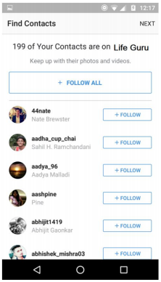
Screen to Follow Contacts
Screen to Invite Contacts

Slide 8
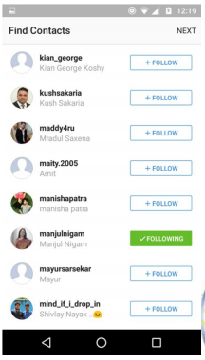

Slide 9
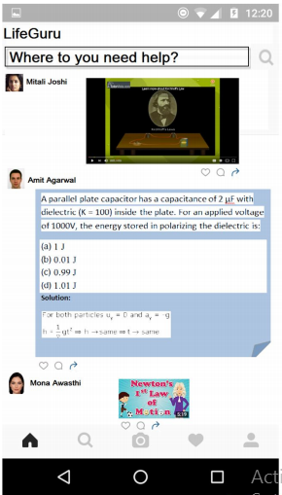
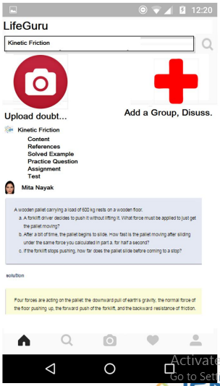
Landing Screen for the New Mentee

Slide 10
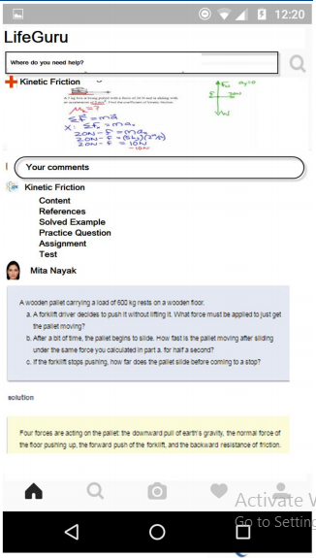
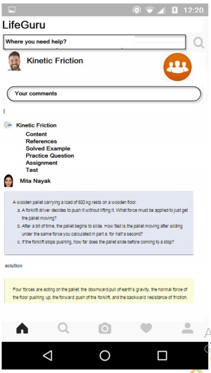
New Mentee -Upload Doubt , Create Group

Slide 11

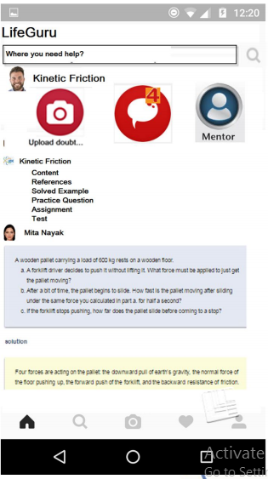





Repeat Mentee Landing Screen
Where do you need help?
Upload
Kinetic Friction
Content
Reference
Solved Examples
Practice Questions
Assignments
Tests
Chat Groups
Mentors
Invite
Posts in the group
Search links from Dyanmind

Slide 12
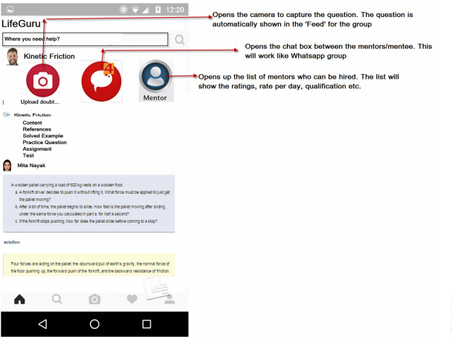
Repeat Mentee Landing Screen

Slide 13
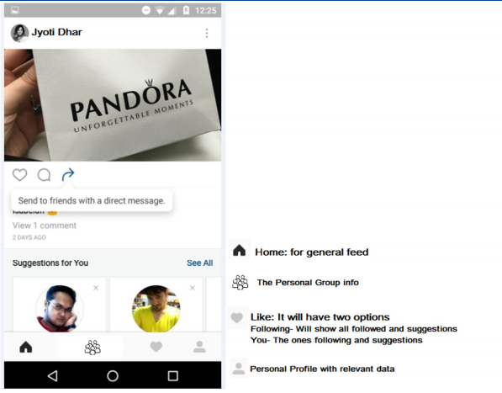
Mentee Bottom Menu

Slide 14
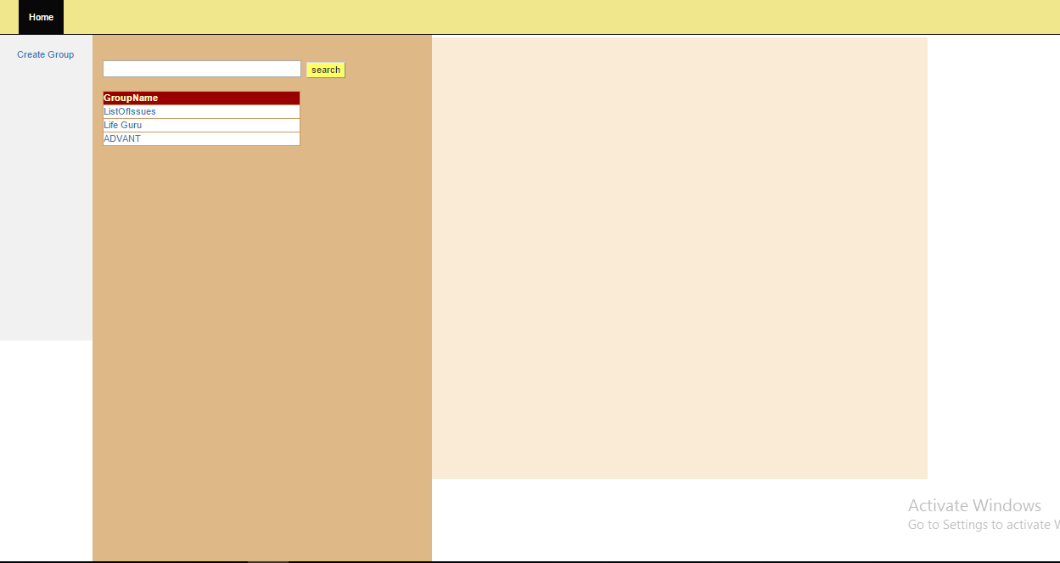

Slide 15
Home
Groups
Mentors
Invite
Profile
Empty Palette ( to be used for ads)

Slide 16
Home Screen
Home
Groups
Mentors
Invite
Profile
Mentors
Empty Palette ( to be used for ads)
Search
Kinetic Friction
Content
Reference
Solved Examples
Practice Questions
Assignments
Tests
Mentor1 , Bangalore
Mentor 2, Pune
Your Groups
Mentor3, Mumbai
Mentor4, Delhi

Slide 17
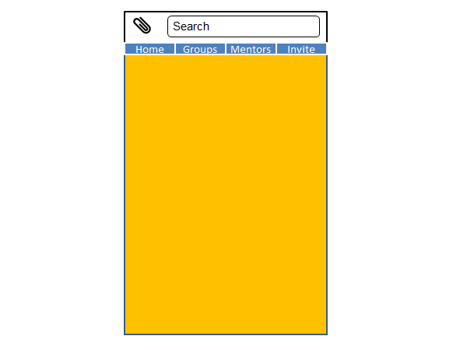
What do you want to share?
Search
Screen
Previous Posts
Publish
Previous Search..
Home Screen
Some Posts, Feed

