Slide 1
vehicles_analysis
File created on: 4/6/26 9:28:45 PM PDT

Slide 2
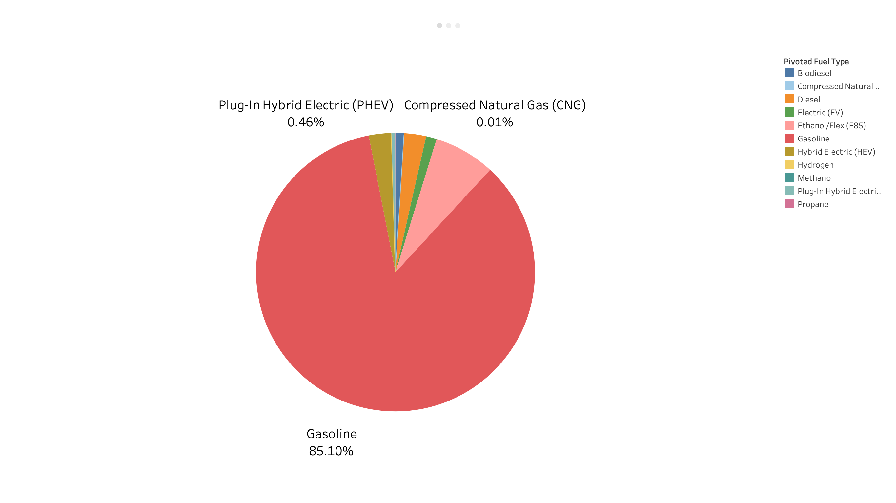

Slide 3
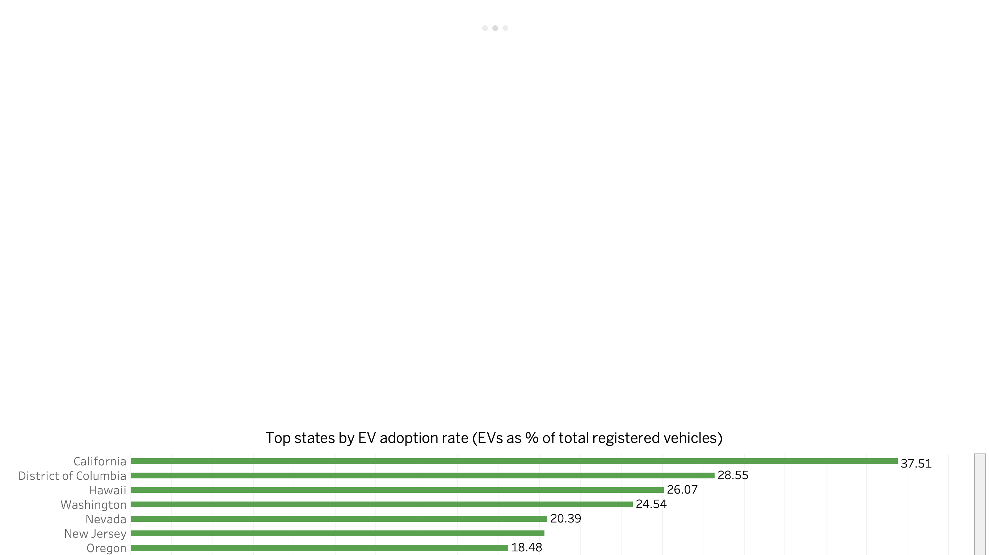

Slide 4


